Slide 1
Double Pendulum: Lagrangian Dynamics & Simulation
Equations of Motion, Python Code, and Visualization

Slide 2
Double Pendulums – Real & Simulated
https://youtu.be/DVr7KnpDAOc
https://www.youtube.com/shorts/hPmiSrw-x3M
https://www.youtube.com/watch?v=H_trgmAk5kY
Added by Sam Siewert with YouTube Google search

Slide 3
System Overview
• A double pendulum consists of two masses connected by rods, swinging in a plane.
• Key variables:
θ₁, θ₂: angles from vertical
l₁, l₂: lengths of rods
m₁, m₂: masses of the bobs
g: gravitational acceleration
• Highly sensitive to initial conditions → chaotic dynamics

Slide 4
Lagrangian Mechanics
L = T - V
Kinetic Energy (T):
T = ½(m₁ + m₂)l₁²θ̇₁² + ½m₂l₂²θ̇₂² + m₂l₁l₂θ̇₁θ̇₂cos(θ₁ - θ₂)
Potential Energy (V):
V = -(m₁ + m₂)gl₁cos(θ₁) - m₂gl₂cos(θ₂)
Apply Euler-Lagrange to derive 2 coupled nonlinear ODEs

Slide 5
Coupled Differential Equations
(m₁ + m₂)l₁θ̈₁ + m₂l₂θ̈₂cos(θ₁ − θ₂) + m₂l₂θ̇₂²sin(θ₁ − θ₂) + (m₁ + m₂)g sin(θ₁) = 0
l₂θ̈₂ + l₁θ̈₁cos(θ₁ − θ₂) − l₁θ̇₁²sin(θ₁ − θ₂) + g sin(θ₂) = 0

Slide 6
Python Simulation Code
1. Use scipy.integrate.solve_ivp to solve coupled ODEs
2. Calculate x, y positions from θ₁, θ₂
3. Animate using matplotlib.animation
4. Save output as MP4 using ffmpeg

Slide 7
Simulation Output
• Animation shows chaotic motion of double pendulum
• Motion is highly sensitive to initial conditions
• Nonlinear dynamics demonstrated through visual simulation

Slide 8
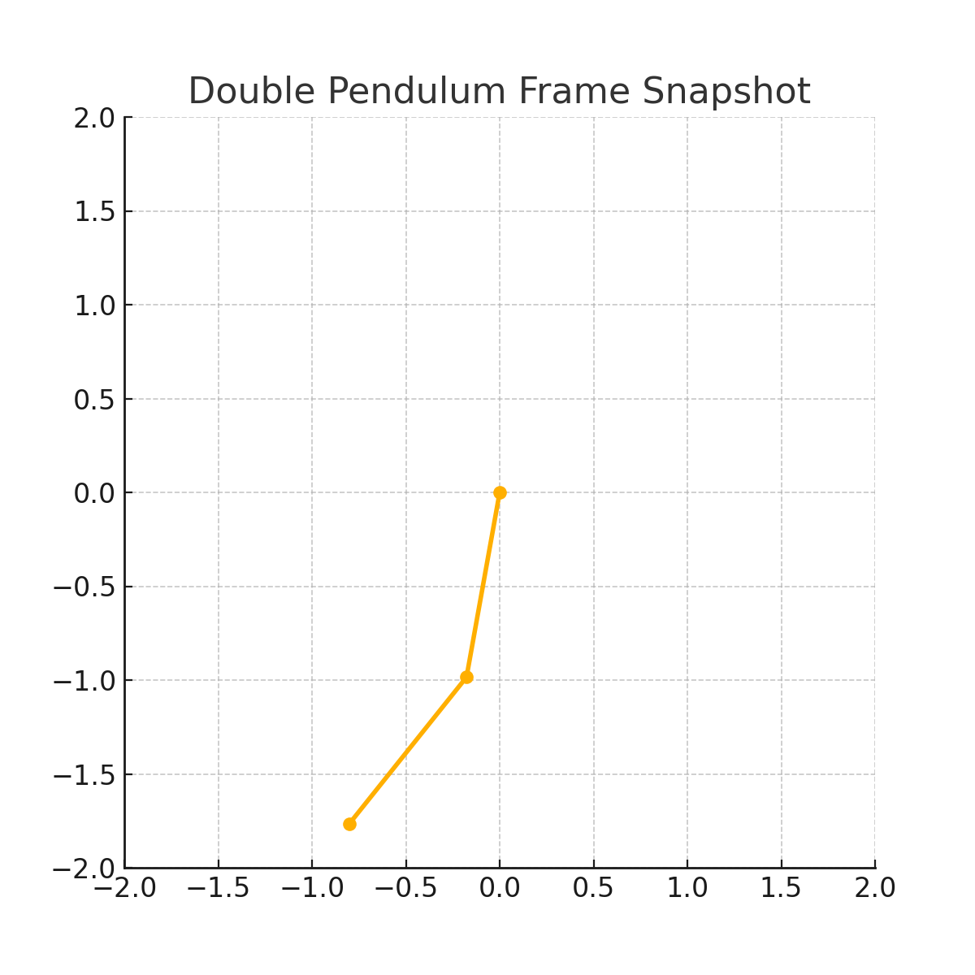
Simulation Frame Snapshot

Slide 9
Python Code: Double Pendulum (Excerpt)
from scipy.integrate import solve_ivp
def double_pendulum_derivs(t, y):
θ₁, ω₁, θ₂, ω₂ = y
Δ = θ₂ - θ₁
d1 = (m₁ + m₂) * l₁ - m₂ * l₁ * cos(Δ)**2
d2 = (l₂ / l₁) * d1
ω̇₁ = (m₂ * l₁ * ω₁² * sin(Δ) * cos(Δ) + ... ) / d1
ω̇₂ = (-m₂ * l₂ * ω₂² * sin(Δ) * cos(Δ) + ... ) / d2
return [ω₁, ω̇₁, ω₂, ω̇₂]

Slide 10
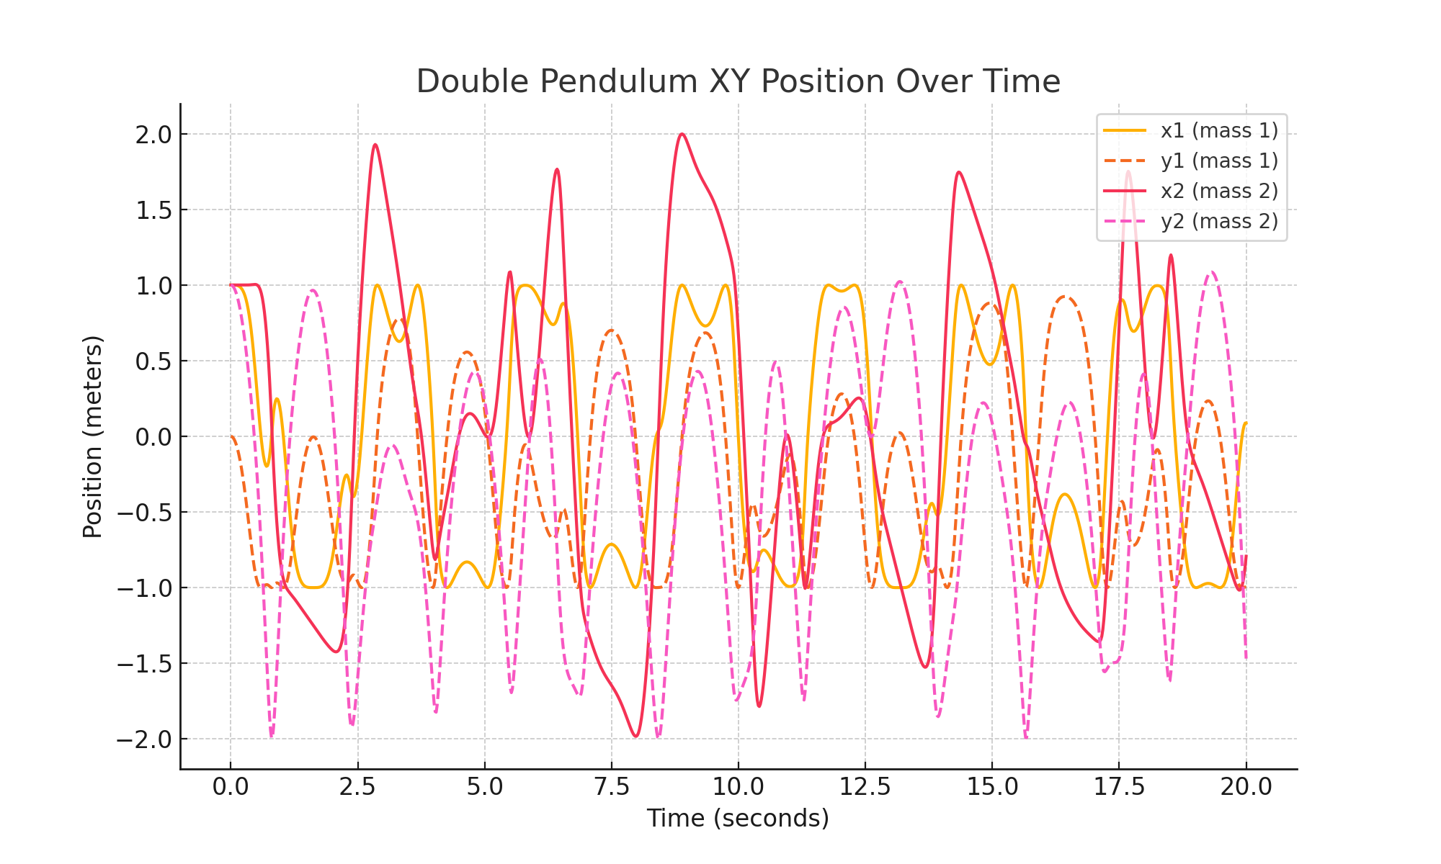
XY Position of Masses Over Time

