Slide 1
LAYERED SCENARIO MODEL
6
How the AV scenario
simulator works
independent scenario layers
→
And what the delivered 2-million-mile run actually tells us
1
joint scenario tuple at any instant
Delivered configuration: 2,000,000 miles at 50 mph
Results and mechanism walkthrough

Slide 2
LAYERED SCENARIO MODEL
02
It estimates unknown-scenario exposure—not vehicle safety risk
The simulator answers a coverage question:
What it does
“How often, and for how long, does a modeled scenario enter an unknown state?”
• samples categorical scenario elements
• evolves each layer over time
• tracks contiguous unknown episodes
• reports exposure, duration, and rate
What it does not do
DRIVE
SPEED
OUTPUT
2M mi
50 mph
Episodes
No physical dynamics, perception errors, collision model, or calibrated real-world risk estimate.
40,000 simulated hours
constant conversion from time to miles
starts, durations, overlaps and rates
Sources: README.md; DOCUMENTATION.md; config.yaml

Slide 3
LAYERED SCENARIO MODEL
03
Six independent layers form every scenario tuple
Each layer has its own dwell-time distribution and transition probabilities. The joint scenario changes whenever any layer changes.
Layer
Examples of what it represents
Mean dwell
Element unknowns?
street
route composition
300 s
No
temporal modifications
work zones / traffic management
600 s
Yes
ego maneuver
AV maneuver class
30 s
Yes
road-user maneuver
other road-user maneuver
45 s
Yes
environment
weather / lighting
1,800 s
No
triggering conditions
unexpected AV context
120 s
Yes
Independence is an intentional simplifying assumption: there are no conditional links between layers.
Source: config.yaml; simulator.py (LAYER_DEFINITIONS)

Slide 4
LAYERED SCENARIO MODEL
04
Each sampled layer gets a fixed probability model
The street layer is special: its 12 configured route-composition probabilities are used exactly, without a Dirichlet draw.
1
Choose count
Sample an element count from the layer’s configured range.
↓
2
Assign rarity
Use largest-remainder category counts, then shuffle labels across elements.
↓
3
Set weights
Common → very rare weights; solve the unknown weight for a 0.4% designed mass.
↓
4
Draw probabilities
One Dirichlet draw at concentration 20,000 creates the transition vector.
↓
5
Draw dwell times
Gamma(shape = μ²/var, scale = var/μ), clamped to ≥1 second.
Target unknown-element mass: 0.4%
Sources: config.yaml; simulator.py (build_layer, compute_unknown_weight)

Slide 5
LAYERED SCENARIO MODEL
05
The engine jumps directly to the next layer expiry
At any instant, every layer has a remaining dwell time. The loop advances by the minimum of those times, then updates only expired layers.
01
02
03
04
05
Current state
→
Find next event
→
Advance
→
Transition
→
Track
six current elements
+six remaining times
dt = min(remaining)
time += dt
miles += 50·dt / 3600
sample next element
and new Gamma duration
update episodes and
combination matches
Why it matters
The delivered 2M-mile run advances through 9,998,505 event steps in about 46 seconds—not 144 million one-second iterations.
Sources: simulator.py (ScenarioSimulator.run_resumable); results/summary.md

Slide 6
LAYERED SCENARIO MODEL
06
Episodes measure continuous unknown occupancy
This avoids inflating counts when a slow unknown condition persists while unrelated fast layers change around it.
Layer transition
Action
Meaning
known → unknown
open
A new element episode starts.
unknown → known
close
The current element episode ends.
unknown A → unknown B
close + open
A different unknown gets its own episode.
unknown A → unknown A
continue
A self-transition does not split the episode.
known → known
nothing
No element episode is active.
Key consequence: element episodes are per layer and may overlap; changes in other layers do not start or end them.
Source: simulator.py (episode_transition_action and event loop); README.md

Slide 7
LAYERED SCENARIO MODEL
07
Three distinct mechanisms are tracked at the same time
All episode types contribute to the “unknown time” union, but they answer different questions.
ELEMENT
PATTERN
HASH
Unknown element
Known interaction
Unknown tuple
A single layer occupies an element labelled “unknown.” Starts and ends follow the occupancy rules.
A configured conjunction across ≥2 layers, e.g. a particular street state + weather state. Survives unrelated changes.
A deterministic SHA-256 classifier flags ~0.5% of all-known six-layer tuples. Ends on any tuple change.
Element episode
+
Pattern episode
+
Hash episode
= union time in “an unknown scenario” (overlaps counted once)
Sources: README.md; simulator.py (CombinationRule and UnknownCombinationClassifier)

Slide 8
DELIVERED 2M-MILE RUN
08
84,296 unknown episodes came from three different mechanisms
The headline total blends element-level novelty with two synthetic combination mechanisms.
RATE
42,148 / 1M mi
Episode starts per million miles
UNION TIME
2.7408%
3,946,822 seconds of simulated time
COMPLETION
0 truncated
No episodes remained open at run end
Source: results/summary.md; results/stats.json

Slide 9
DELIVERED 2M-MILE RUN
09
Short dwell times drive more episode starts
All four unknown-capable layers target 0.4% unknown selection. Episode counts still differ sharply because their dwell times differ.
Element episodes by layer
EGO MANEUVER
21,018
Mean dwell: 30 s → most frequent opportunities to start an episode.
ROAD-USER MANEUVER
12,217
Mean dwell: 45 s → second highest turnover rate.
TEMPORAL MODIFICATIONS
977
Mean dwell: 600 s → far fewer transition opportunities.
Source: results/summary.md; results/stats.json

Slide 10
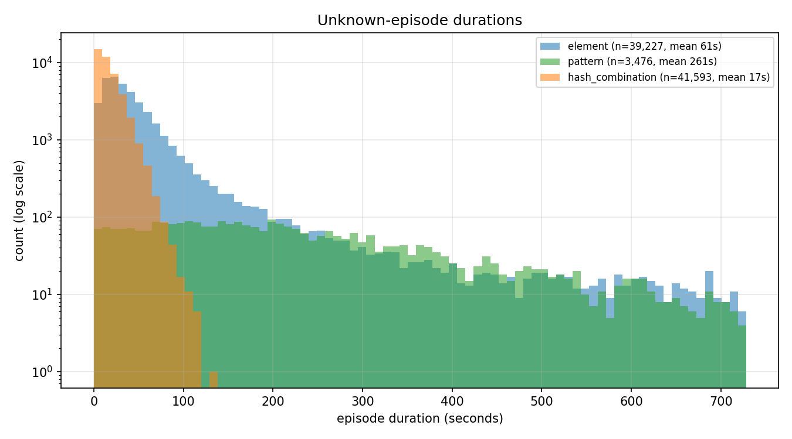
DELIVERED 2M-MILE RUN
10
Duration reveals what ends each kind of episode
Mean duration
ELEMENT
60.5 s
Ends when that layer leaves its unknown element.
PATTERN
261.0 s
Ends only when a referenced layer breaks the rule.
HASH COMBINATION
16.7 s
Ends on any genuine tuple change.
Sources: results/summary.md; results/plots/episode_durations.png

Slide 11
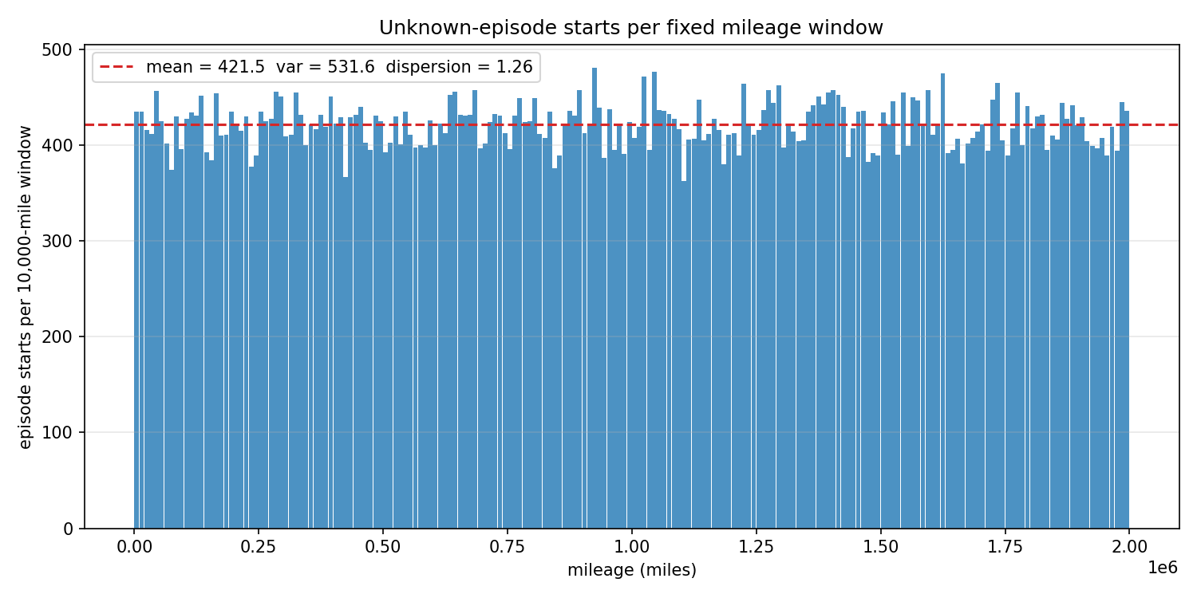
DELIVERED 2M-MILE RUN
11
Episode starts are steady at scale, but modestly more variable than Poisson
WINDOW MEAN
421.5
episode starts per 10,000 miles
(200 complete windows)
DISPERSION INDEX
1.261
variance / mean
1.0 would be ideal Poisson
Interpretation
Near-Poisson starts are consistent with independent rare transitions, but the process is not exactly Poisson.
Sources: results/summary.md; results/plots/window_counts.png; analytical_model.md

Slide 12
LAYERED SCENARIO MODEL
12
Use the simulator for coverage and sensitivity—not as a calibrated safety forecast
The delivered run is internally coherent: the conditional analytical model predicts 84,724 episodes; simulation produced 84,296 (within 0.5%).
What the results support
Critical interpretation caveat
• Sensitivity analysis of layer rates and dwell times
• Comparing coverage strategies
• Identifying which conditions drive exposure
• Testing episode definitions and overlap handling
The analytical report’s 1.639% “unknown-time union” is element-only. It is not directly comparable with the simulated 2.741% union once pattern and hash combinations are enabled.
Bottom line: the run quantifies exposure to the model’s definition of unknownness—not empirical AV danger or failure probability.
Sources: analytical_model.py; analytical_model.md; results/summary.md

