Slide 1
PROJECT EXPLAINER
Autonomous-Vehicle Scenario Simulator
A reproducible, event-driven model of layered driving scenarios and exact rare-combination episodes
Notes:
Open by framing the system as a joint-state simulator, not a conventional Poisson arrival generator.
[Sources]
- README.md
- DOCUMENTATION.md

Slide 2
Six concurrent layers form one evolving scenario
Parallel state
One active element per layer defines the current state.
Independent clocks
Each element holds for a sampled Gamma duration.
Joint classification
The full state is checked against exact rare-element rules.
2
Notes:
The model is best understood as six asynchronous renewal processes whose current values form one scenario.
[Sources]
- simulator.py:42-52
- simulator.py:1118-1164

Slide 3
The six layers describe complementary context
01 | Street — persistent road and lane context
02 | Temporal modifications — work zones and temporary traffic management
03 | Ego maneuver — the autonomous vehicle's current maneuver class
04 | Road-user maneuver — surrounding vehicle and road-user behavior
05 | Environmental conditions — weather, visibility, and ambient context
06 | Triggering conditions — unexpected conditions that can complete a rare scenario
3
Notes:
Emphasize that layers run simultaneously rather than as sequential processing stages.
[Sources]
- config.yaml:85-119
- simulator.py:42-52

Slide 4
Generated elements preserve the target class mix
CURRENT SEEDED CONFIGURATION
Largest-remainder allocation converts 70% common / 20% rare / 10% unknown targets into exact integer counts.
Layer | Total | Common | Rare | Unknown
Street | 12 | 9 | 2 | 1
Temporal modifications | 45 | 32 | 9 | 4
Ego maneuver | 20 | 14 | 4 | 2
Road-user maneuver | 22 | 16 | 4 | 2
Environmental conditions | 22 | 16 | 4 | 2
Triggering conditions | 83 | 58 | 17 | 8
All layers | 204 | 145 | 40 | 19
Configured target | 100% | 70% | 20% | 10%
4
Notes:
Counts shown are reproducible with the current element-count and rarity-assignment seeds.
[Sources]
- config.yaml:45-119
- simulator.py:549-557
- simulator.py:703-749

Slide 5
Selection mass is exact; time occupancy is not
TWO DIFFERENT PERCENTAGE CONTROLS
Element percentages set class counts. Selection percentages set total transition mass. A Dirichlet draw only redistributes probability within each class.
70%
20%
10%
common transition mass
rare transition mass
unknown transition mass
5
Notes:
Selection share is not occupancy share because rarity classes have different duration distributions.
[Sources]
- DOCUMENTATION.md:24-63
- simulator.py:718-735

Slide 6
Gamma clocks vary by element
Common
Longest band 1.50× layer mean
Rare
Middle band 0.75× layer mean
Unknown
Shortest band 0.25× layer mean
6
Notes:
The chart uses the street layer to make the configured non-overlapping mean bands concrete.
[Sources]
- config.yaml:67-79
- simulator.py:673-700

Slide 7
The engine jumps from one expiry to the next
Initialize
Select one element and sample one duration for all six layers.
Advance
Jump by the smallest remaining duration and derive mileage from elapsed time.
Replace + classify
Resample expired layers, then open, continue, or close the matching episode.
t = 0
next expiry
repeat
7
Notes:
No fixed time step is used. Multiple layers expiring together are handled at the same event time.
[Sources]
- simulator.py:1167-1252
- simulator.py:1284-1462

Slide 8
An unknown episode requires an exact rare set
EXAMPLE SELECTED C3 RULE
street_000 + temporal_001 + trigger_032
The remaining three layers must all be common.
Exact rare set
No additional rare element may be active.
Trigger required
Every C3–C6 rule includes a rare triggering condition.
Unknown disqualifies
Any unknown-rarity element prevents a match.
8
Notes:
The current configuration selects 40 C3, 30 C4, 20 C5, and 10 C6 rules without replacement.
[Sources]
- config.yaml:81-91
- simulator.py:974-1039
- simulator.py:1150-1164

Slide 9
“Unknown” means two different things
THE DISTINCTION PREVENTS MISREADING THE RESULTS
Unknown-rarity elements participate in ordinary selection and duration statistics. Only exact rare combinations create reportable episodes.
Unknown-rarity element
Unknown scenario episode
• One generated element class
• Has its own probability and Gamma law
• Does not open an episode
• One selected C3–C6 rare rule
• Starts when the full joint state matches
• Ends when that exact match breaks
9
Notes:
This is the most important semantic change in simulator version 6.
[Sources]
- README.md:44-57
- simulator.py:1045-1065
- simulator.py:1244-1251

Slide 10
Seeds and boundary rules make runs repeatable
DESIGNED FOR CONTROLLED EXPERIMENTS
Independent random streams isolate model decisions, while checkpointing preserves generator state for bit-identical resumed execution.
20,000 h
7
0 s
configured time horizon
independent RNG streams
intentional overshoot
10
Notes:
At 50 mph, 20,000 simulated hours correspond to one million derived miles.
[Sources]
- config.yaml:9-27
- simulator.py:1121-1148
- simulator.py:1358-1377
- run_simulation.py:682-717

Slide 11
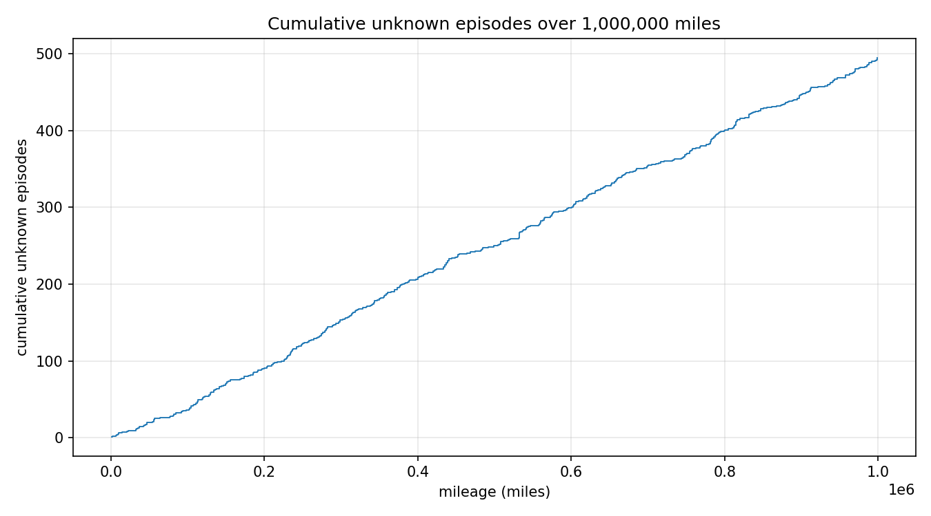
Outputs turn episodes into measurable evidence
The runner produces:
• episodes.csv — start, end, duration, inter-arrival
• windows.csv — starts per complete mileage window
• stats.json — rates, occupancy, composition, diagnostics
• summary.md and plots — review-ready evidence
Current seeded run: 495 episodes across 1,000,000 derived miles.
11
Notes:
The cumulative line is a realized output from the current seeded configuration, not a theoretical curve.
[Sources]
- run_simulation.py:30-63
- run_simulation.py:336-382
- version 6/stats.json
- version 6/plots/cumulative_episodes.png

Slide 12
CORE TAKEAWAY
A reproducible joint-state engine— not a Poisson clock
Six asynchronous layers
Element-specific Gamma sojourns
Exact C3–C6 episode rules
Notes:
Close by reinforcing the interpretation: Poisson-style statistics are outputs used for analysis, not the mechanism that drives the simulation.
[Sources]
- DOCUMENTATION.md
- simulator.py:1-18

