Slide 1
SCENARIO COVERAGE · SIMULATION STUDY · AUGUST 2026
Does the Occurrence of Unknown Scenarios
Follow a Poisson Distribution?
A layered-scenario simulator for autonomous-vehicle validation — project purpose, simulator design, and results
Samer Jameel · Xinhai Zhang
Scenario Coverage work stream
STREET
TEMPORAL
EGO MAN.
RU MAN.
ENVIRONMENT
TRIGGERING
street_009
temporal_030
ego_011
ru_010
environment_004
trigger_014
one simulated scenario state — the active rare set {ego_011, ru_010, trigger_014} matches a selected C3 rule and opens an unknown-scenario episode

Slide 2




OVERVIEW
What this presentation covers
01
02
Purpose & motivation
The simulator
Why the Poisson assumption matters for AV validation mileage and acceptance criteria — and why it can only be tested in simulation.
A six-layer scenario world: generated elements, three rarity classes, exact probability masses, per-element Gamma durations.
03
04
How a run works
Results & discussion
The event loop, the exact C3–C6 rare-combination mechanism, and a worked example of an episode's life cycle.
The 20,000-hour reference run, Poisson diagnostics, the verification battery, sensitivity studies — and what it all means.
Unknown-Scenario Poisson Verification · Layered Scenario Simulator v6
2

Slide 3

PURPOSE
Verify the Poisson assumption behind the AV safety case
Plus AI assumes that manifestations of functional insufficiencies (FIs) follow a Poisson distribution.
That single assumption underpins two safety-case calculations:
Validation mileage — how many miles are enough to demonstrate the residual FI rate is acceptably low.
Decomposition of acceptance criteria — splitting a vehicle-level target across scenario classes and subsystems.
The test at the heart of it
Count unknown-scenario occurrences k in fixed mileage windows, then compare Var(k) with Mean(k).
Var(k) ≫ Mean(k)
Overdispersion — risky: bursts of failures; needs more validation miles
Var(k) ≈ Mean(k)
Goal of this work
Verify the validity of this assumption — does the occurrence of unknown scenarios really follow a Poisson distribution?
Poisson-consistent — the assumption and the mileage math hold
Var(k) ≪ Mean(k)
Underdispersion — too conservative: mileage targets overshoot
Source: problem definition, “Poisson Assumption Verification” (Jameel & Zhang).
Unknown-Scenario Poisson Verification · Layered Scenario Simulator v6
3

Slide 4
PURPOSE
Testing it needs far more miles than any fleet can drive
FIs are triggered by scenarios. Autonomous driving is a chain of scenarios; an FI manifests when the vehicle meets a scenario it cannot handle — so scenario occurrence is what must be modeled.
Unknown scenarios are rare. In the simulated world: one episode every ≈2,000 miles. Real-world rates are far lower still.
Dispersion needs replication. Estimating Mean(k) and Var(k) takes hundreds of independent mileage windows — tens of millions of miles. “Can only be done in simulation.”
Poisson has a testable signature. If counts are Poisson, the miles between successive occurrences are exponential and windows are independent — both directly checkable on simulator output.
Miles between FIs — exponential if Poisson
✕
✕
✕
✕
✕
✕
✕
0
0.5
1
1.5
2
2.5
3
3.5
driven mileage (million miles)
✕ = unknown-scenario occurrence — gaps should be memoryless (exponential)
20,000 h
1M miles
simulated per run — in 11.7 s of wall-clock time
of driving history per run at 50 mph average
→ the simulator turns a fleet-scale question into minutes of compute
Unknown-Scenario Poisson Verification · Layered Scenario Simulator v6
4

Slide 5
BACKGROUND
A driving scene = six layers, one active element each
street
road geometry / section type
12 elements
Where can an unknown scenario come from?
Unknown element in a known layer
temporal_modifications
work zones, temporary traffic management
45 elements
a phenomenon the taxonomy has no entry for
ego_maneuver
ego vehicle maneuver classes
20 elements
Unknown layer
ru_maneuver
surrounding road-user maneuvers
22 elements
a whole dimension missing from the model
environmental_conditions
weather, visibility, light
22 elements
Unknown combination of known elements
MODELED IN V6
triggering_conditions
unexpected AV triggering conditions
83 elements
each element is known — their joint occurrence was never anticipated
Layer structure follows the PEGASUS-style layered scenario model used in TRATON. The scene at any instant is the cross product of the six active elements; driving is a chain of such scenes.
The simulator focuses on the third cause: it plants specific rare-element combinations as the “unknowns” and measures how often the driving process stumbles into them.
Unknown-Scenario Poisson Verification · Layered Scenario Simulator v6
5

Slide 6




THE SIMULATOR
An event-driven, fully reproducible six-layer world
config.yaml
→
Build the world
→
Event loop
→
Episodes
→
Outputs
class percentages, duration profiles, rule counts, 7 independent seeds
generate elements & rarities per layer; exact class masses; one Gamma law per element; select 100 C3–C6 rules
jump from layer expiry to layer expiry; resample expired layers; advance time & miles
open when the active rare set exactly matches a selected rule; close when the match breaks
episodes.csv, windows.csv, summary.md, stats.json, diagnostic plots
6
204
100
7
39
independent layers, each holding one active element
generated elements (this build): 145 common · 40 rare · 19 unknown
planted rare-combination rules: C3 40 · C4 30 · C5 20 · C6 10
seed streams — same config ⇒ bit-identical run (checkpoint-safe)
automated tests pass; config validation rejects invalid setups
Semi-Markov world: layers evolve independently; “unknown” rarity-class elements exist but never open episodes by themselves in v6 — only exact rare combinations do.
Unknown-Scenario Poisson Verification · Layered Scenario Simulator v6
6

Slide 7
THE SIMULATOR
Building the world: controlled rarity in every layer
layer
count range
built
common / rare / unknown
baseline mean
Across all six layers
street
12
12
9 / 2 / 1
300 s
145
common elements
71.1% of 204 — target 70%
temporal_modifications
40–45
45
32 / 9 / 4
600 s
ego_maneuver
20–24
20
14 / 4 / 2
30 s
40
rare elements
19.6% of 204 — target 20%
ru_maneuver
20–24
22
16 / 4 / 2
45 s
environmental_conditions
22
22
16 / 4 / 2
1,800 s
19
unknown elements
9.3% of 204 — target 10%
triggering_conditions
80–90
83
58 / 17 / 8
120 s
Element counts are drawn per layer from the configured range (seeded); IDs are stable: street_000, ego_003, trigger_042 …
Class counts use the largest-remainder method on the configured 70 / 20 / 10 split — integer counts, always ≥ 1 per class.
Note — unknown-class elements occur in ~10% of selections, but in v6 they never open episodes themselves; they only disqualify a rare-combination match while active.
Unknown-Scenario Poisson Verification · Layered Scenario Simulator v6
7

Slide 8

THE SIMULATOR
Who comes next: exact class masses, varied within class
Permanent transition vector per layer. When a sojourn expires, the next element is drawn from the layer's fixed probability vector — independent of all other layers (self-transitions allowed).
Class masses are pinned exactly. selection_class_percentages fixes common / rare / unknown total probability at 70% / 20% / 10% — by construction, not on average.
Variation inside a class. One Dirichlet(c·p) draw (c = 20,000) makes elements unequal; each class is then rescaled back to its exact mass — jitter changes only the within-class split.
Initial state uses the same exact class totals; every random source has its own seed stream.
Worked example — triggering_conditions
rare class mass (configured)
20.000%
rare elements in this layer
17
equal-split baseline per element
≈ 1.18%
after seeded Dirichlet jitter
≈ 1.05 – 1.31% each
class total after rescaling
exactly 20.000%
Verified in the run: every layer's realized transition mass is 10.0000% unknown / 20.0000% rare / 70.0000% common; empirical unknown selection share 10.02% vs 10% design target.
Unknown-Scenario Poisson Verification · Layered Scenario Simulator v6
8

Slide 9
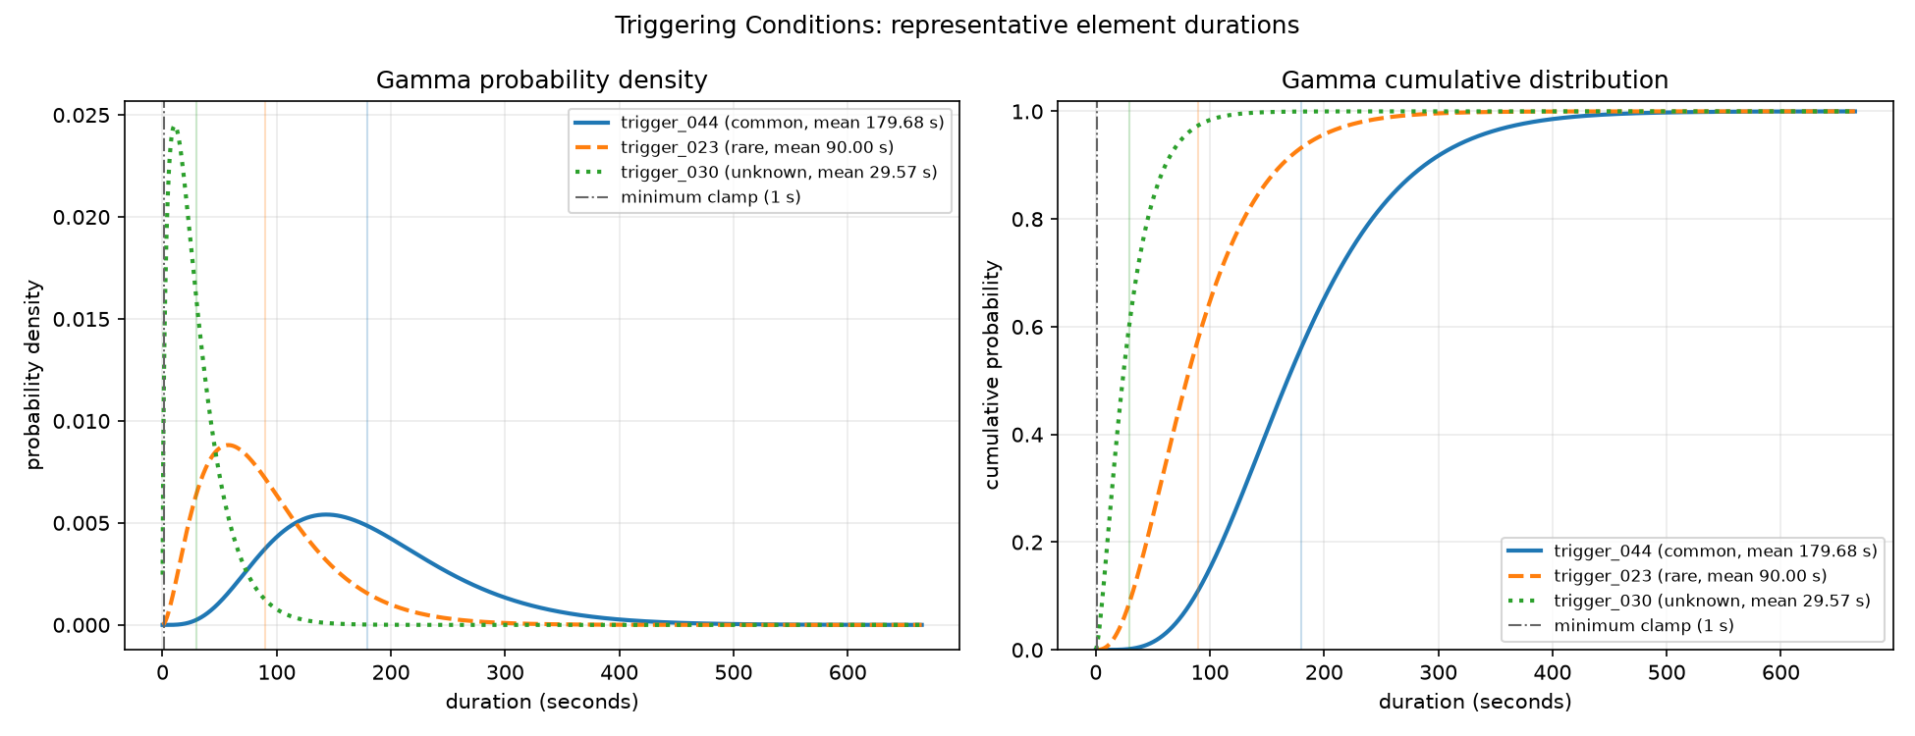
THE SIMULATOR
How long an element persists: one Gamma law per element
μᵢ = μ_layer × m_rarity × (1 + spread · uᵢ)
σᵢ = CV_rarity · μᵢ Gamma: shape = μᵢ²/σᵢ², scale = σᵢ²/μᵢ
uᵢ ∈ [−1, 1]: stable position of element i inside its class band · clamp ≥ 1 s
class
mean multiplier
CV
spread
common
1.50 ×
0.45
±10%
rare
0.75 ×
0.60
±10%
Simulator output — duration_distributions/triggering_conditions.png. Layer baseline 120 s → representative means: common 179.7 s, rare 90.0 s, unknown 29.6 s.
unknown
0.25 ×
0.80
±10%
Bands never overlap within a layer: every common mean > every rare mean > every unknown mean — unknown states are brief by design.
Gamma shape κ = 1/CV² ≈ 1.6–4.9, so sojourns are more regular than exponential.
Unknown-Scenario Poisson Verification · Layered Scenario Simulator v6
9

Slide 10
HOW A RUN WORKS
The event loop: jump from expiry to expiry, never tick seconds
six independent sojourn clocks
1
Find the next event
dt = min over layers of remaining sojourn time (clipped at the 20,000 h horizon)
street
temporal
2
Advance the world
t += dt; miles += 50 mph × dt / 3600 — mileage is derived, time is the clock
ego man.
3
Resample expired layers
draw the next element from the layer's vector; draw its own Gamma duration
ru man.
environment
4
Evaluate the rules
compare the new active rare set against the 100 planted combinations; open / continue / close an episode
triggering
one event: a layer expires → only that layer resamples; the other five clocks keep running
4,079,575 events cover 20,000 h (one event per ≈18 simulated seconds) — 11.7 s wall-clock.
common
rare
unknown
Unknown-Scenario Poisson Verification · Layered Scenario Simulator v6
10

Slide 11

HOW A RUN WORKS
Unknown scenarios = exact combinations of known rare elements
100 rules planted at build time — C3: 40, C4: 30, C5: 20, C6: 10 — sampled uniformly without replacement (ordinal unranking; no Cartesian blow-up).
Every rule spans distinct layers with one rare element per layer, and always includes a rare triggering condition.
Rule mass = product of its members' probabilities. C3 masses ≈ 0.001–0.006%; C5/C6 masses ≈ 10⁻⁸ — planted but effectively never met.
A self-transition that leaves the rare set unchanged continues the open episode — it does not close or re-open it.
Does the current state match a rule?
Active rare set = the rule's set, exactly
every rule element active; no extra rare element anywhere
No unknown-class element active
an unknown element in any layer disqualifies the match
All remaining layers are common
follows from the two conditions above
Why “exact” matching?
A rule matches only when the complete active rare set equals it. A C3 inside a richer rare state does not fire — no double counting, and every episode is attributable to exactly one rule.
Match → open (or continue) an episode
stays open while the match persists — self-transitions do not close it; closes on the first breaking change
Unknown-Scenario Poisson Verification · Layered Scenario Simulator v6
11

Slide 12
HOW A RUN WORKS
Worked example: the life of episode #1 (real run data)
Rule C3: ego_maneuver = ego_011 & ru_maneuver = ru_010 & triggering_conditions = trigger_014 · mass 0.0031% · 27 episodes in this run · common-layer chips illustrative
MILE 2,269.8 — EPISODE OPENS
STREET
TEMPORAL
EGO MAN.
RU MAN.
ENVIRONMENT
TRIGGERING
trigger_014 is drawn at a triggering-layer expiry → active rare set now equals the rule exactly → unknown-scenario episode opens.
common
common
ego_011
ru_010
common
trigger_014
WHILE THE MATCH PERSISTS
STREET
TEMPORAL
EGO MAN.
RU MAN.
ENVIRONMENT
TRIGGERING
Common layers may transition to other common elements; the rare set is unchanged → the same episode continues (no re-count).
common′
common
ego_011
ru_010
common
trigger_014
23.9 s / 0.33 mi LATER — EPISODE CLOSES
STREET
TEMPORAL
EGO MAN.
RU MAN.
ENVIRONMENT
TRIGGERING
trigger_014 expires and a common trigger replaces it → rare set no longer equals the rule → episode closes; start, end, duration written to episodes.csv.
common
common
ego_011
ru_010
common
trigger_083
No match if: an extra rare element is active (rare set ≠ rule) · any unknown-class element is active · only a subset of the rule is present
Unknown-Scenario Poisson Verification · Layered Scenario Simulator v6
12

Slide 13
HOW A RUN WORKS
Count episodes, not encounters — the change that made counts testable
Before (v1): per-tuple encounters
Since v2 (kept in v6): episodes
Every new element tuple seen during one unknown period was counted as a fresh “encounter”.
Fast layers churn while a slow unknown persists → bursts of counts from a single real condition.
Windows shared bursts → heavily clustered counts, nothing like Poisson.
One episode = one maximal continuous period during which the unknown condition persists.
Opens are rare, short, well-separated events — the natural analogue of “one FI manifestation.”
In v6: the period during which the active rare set stays equal to one rule.
D ≈ 12
D ≈ 1
→
D = Var / Mean of counts per 10,000-mile window
encounter counts — strongly clustered (early runs)
episode starts — near-Poisson dispersion
Unknown-Scenario Poisson Verification · Layered Scenario Simulator v6
13

Slide 14
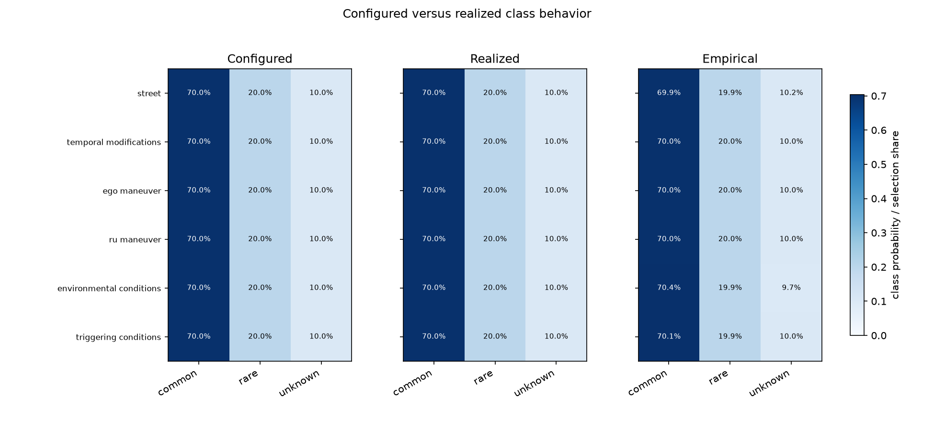
THE SIMULATOR
The simulator does exactly what the configuration says
Seven independent seed streams (element counts, rarity placement, Dirichlet, durations, initial state, transition sampling, rule selection) — the same config always reproduces the identical run.
Checkpoint / resume is bit-identical to an uninterrupted run — long horizons can be chunked safely.
39 automated tests pass, covering validation, exact-set matching, triggering-condition inclusion, unknown disqualification, exact time stop, and resume.
Realized behavior matches configured targets: class masses exact by construction; empirical unknown selection 10.02% vs 10%; per-layer realized mean sojourns within ≈4% of configured (e.g. street 381 s cfg → 366 s emp).
Simulator output — configured vs realized vs empirical class shares, per layer (plots/class_mass_verification.png)
Unknown-Scenario Poisson Verification · Layered Scenario Simulator v6
14

Slide 15
THEORY
Why Poisson is the expected answer — conditional on a built world
1 · ONE LAYER
2 · SIX LAYERS
3 · FINITE P
Thinned renewal → exponential
Superposition stays Poisson
The correction is invisible
Each transition opens an episode with small probability p; the wait between opens is a geometric sum of Gamma sojourns. Rényi (1956): as p → 0 the normalized gaps converge to Exp(1) — the opens form a Poisson process of rate p/μ.
Layers are independent by construction. Grigelionis: the union of independent near-Poisson streams converges to a Poisson process with the summed rate Λ = Σ (mₖ − sₖ)/μₖ. Disjoint windows become independent.
For a thinned renewal stream, dispersion → 1 − p(1 − 1/κ). At p ≈ 0.004 and Gamma κ ∈ [1.8, 4]: a 0.18–0.30% deviation — an order of magnitude below the sampling noise of any realistic window count.
Two boundaries of the claim. (1) It is conditional on one built world — across construction seeds, counts are mixed Poisson and genuinely overdispersed. (2) The proof thins transitions i.i.d.; v6's exact-combination matching depends on the joint cross-layer state — the results section measures what that does.
Full derivation: poisson_proof.md (renewal theory + Chen–Stein bound for the 1-dependent indicators).
Unknown-Scenario Poisson Verification · Layered Scenario Simulator v6
15

Slide 16
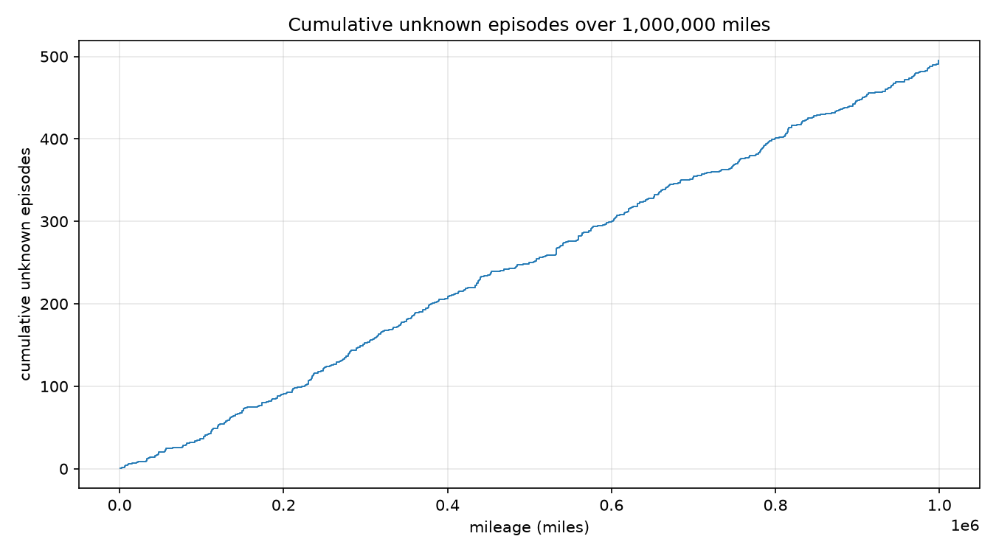
RESULTS
The v6 reference run: 20,000 hours, one million miles
495
0.0144%
20.9 s
C3: 481
unknown episodes in 1M miles — one every ≈2,020 mi (≈40 h)
of driving time inside an unknown scenario (10,362 s total)
mean episode duration · median 16.4 s · p90 42.6 s (≈0.29 mi)
episodes from C3 rules · C4: 14 · C5/C6: 0 (too rare to observe)
48 of the 100 planted rules fired at least once; the top rule produced 38 episodes (it contains slow street-layer elements).
All 495 episodes are rare-combination episodes — the only unknown mechanism in v6; none were truncated at the horizon.
Rates are properties of the configured world (design defaults, not field calibration). The object under test is the distributional shape of the counts, not the absolute rate.
Simulator output — cumulative episodes: steady, linear accumulation with no drift.
Unknown-Scenario Poisson Verification · Layered Scenario Simulator v6
16

Slide 17
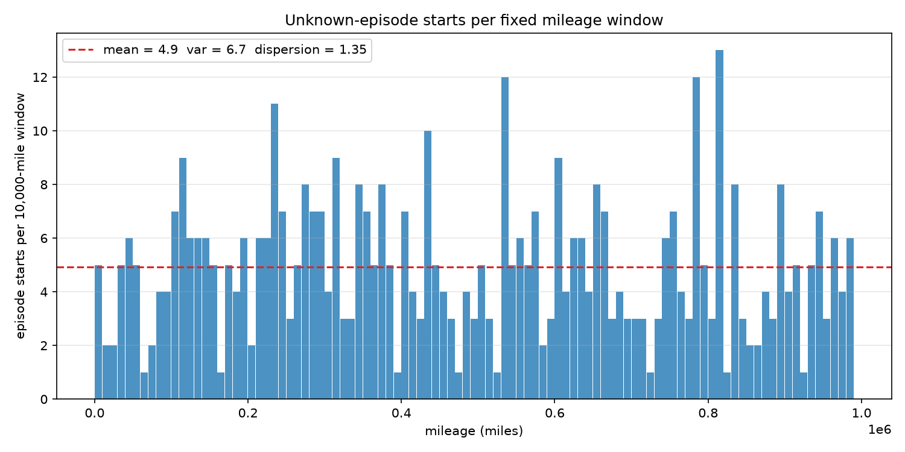
RESULTS
Window counts: the shape fits Poisson, the variance runs high
mean 4.93 · var 6.68
counts per 10,000-mile window
D = 1.355
dispersion index — ≈35% above the Poisson value of 1 (two-sided p ≈ 0.02: borderline)
GOF p = 0.82
χ² goodness of fit vs Poisson(4.93): the marginal shape is fully compatible
Simulator output — episode starts per 10,000-mile window across the run (99 complete windows).
A single run gives only 99 windows — under Poisson the dispersion estimate itself has sd ≈ 0.14, so 1.355 is a signal worth explaining, not yet a verdict.
Unknown-Scenario Poisson Verification · Layered Scenario Simulator v6
17

Slide 18
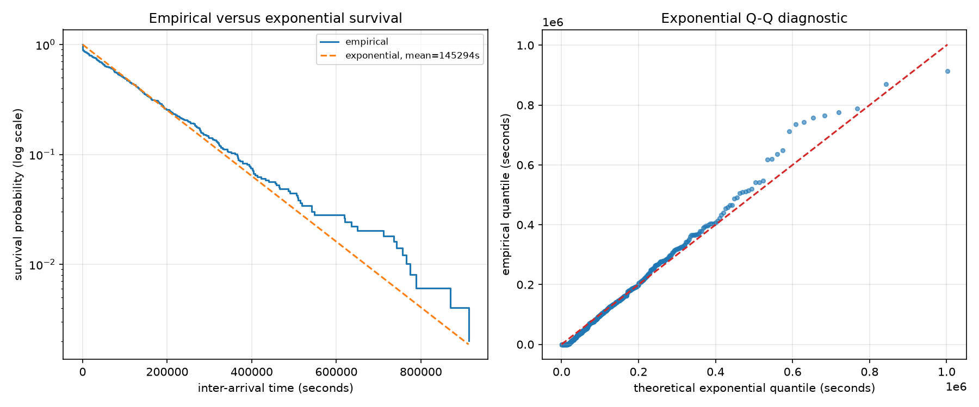
RESULTS
Inter-arrival gaps expose fine-scale clustering
KS p < 0.001
exponential fit rejected (KS = 0.112, n = 495); CV² of gaps = 1.20
37 gaps < 1 mile
vs ≈0.3 expected under exponential — a large excess of near-immediate re-arrivals
46 of 73
Simulator output — survival curve and Q–Q of the 495 inter-arrival times vs the fitted exponential.
gaps under 100 mi are the same rule re-opening moments after it closed
The mechanism. Slow layers hold rare elements in place for minutes (street ≈ 6 min, temporal ≈ 12 min, environment ≈ 37 min mean sojourns). A fast layer briefly breaks the match, then re-completes it — one persistent real-world condition is logged as several episodes in quick succession.
Gap analysis computed from the run's episodes.csv.
Unknown-Scenario Poisson Verification · Layered Scenario Simulator v6
18

Slide 19

RESULTS
Count distinct manifestations — and Poisson is restored
Treat re-opens of the same rule within 10 miles as one manifestation — the episode-level analogue of “the same FI condition, briefly interrupted.” This merges 45 of 495 starts (9%).
RAW EPISODE STARTS (495)
MERGED MANIFESTATIONS (450)
D = 1.355
KS p < 0.001
D = 1.084
KS p = 0.84
→
dispersion, p ≈ 0.02
exponential rejected
dispersion, p = 0.53
exponential fits
Reading: the entire measured deviation is re-opening bookkeeping, not genuine clustering of distinct unknown conditions. At the level that matters for the safety case — distinct manifestations — the v6 run is statistically indistinguishable from a Poisson process (dispersion p = 0.53, exponential-gap p = 0.84). The result is robust to the merge window: 10–100 mi all give the same answer.
Recomputed from episodes.csv / windows.csv of the v6 reference run (same tests as poisson_tests.py).
Unknown-Scenario Poisson Verification · Layered Scenario Simulator v6
19

Slide 20
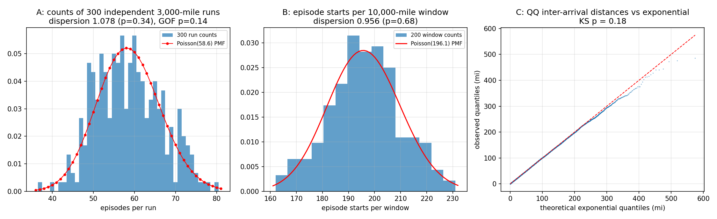
RESULTS
The formal verification battery: all tests pass
poisson_tests.py ran the decisive experiments on the element-route configuration (the mechanism the proof covers, ≈20× higher episode rate — much more statistical power):
A · Replication PASS
B · Windows PASS
C · Gaps PASS
300 independent runs × 3,000 mi over the same built world (only run-time seeds vary): mean 58.6, dispersion 1.078 (p = 0.34); χ² GOF vs Poisson: p = 0.14.
200 disjoint 10,000-mi windows of a 2M-mile run: dispersion 0.956 (p = 0.68) — no over- or under-dispersion.
39,227 inter-arrival distances vs exponential: KS = 0.0055, p = 0.18 — memoryless gaps ⇔ Poisson process.
poisson_proof.png — replication counts vs Poisson PMF · window counts vs Poisson PMF · Q–Q of gaps vs exponential
Unknown-Scenario Poisson Verification · Layered Scenario Simulator v6
20

Slide 21
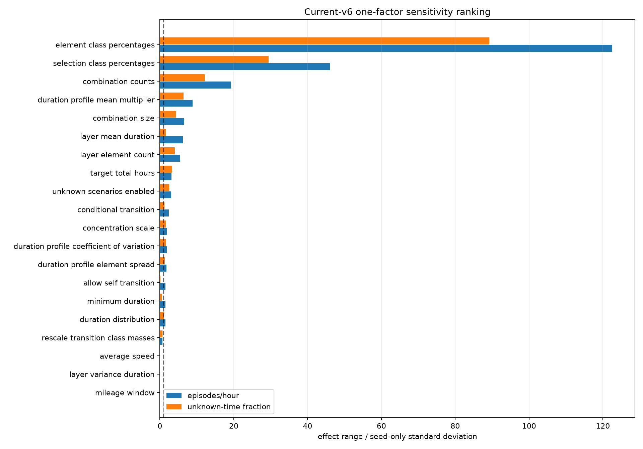
RESULTS
21 parameter studies: what actually moves the episode rate
Scale: 21 component studies · 1,160 simulations · ≥10 levels per numeric control · 3 replicates per level.
Dominant drivers of the unknown-episode rate: element class percentages (SNR 123), selection class percentages (46), combination counts (19), rarity duration multipliers (9).
Null checks behave: average speed and mileage-window size have exactly zero effect — they only relabel the same time axis, as designed.
Seed noise is large: seed-only sd of the rate is ≈28% of its mean — single-run rates carry real construction uncertainty (→ discussion).
Caveat: screening ranges are deliberately wide; the ranking describes tested ranges, not unit-free importance.
Study output — one-factor sensitivity: effect range ÷ seed-only standard deviation (SNR).
Unknown-Scenario Poisson Verification · Layered Scenario Simulator v6
21

Slide 22

DISCUSSION
So — is the Poisson assumption safe?
Supported
One nuance
Real caution
Conditional on a fixed world model, unknown-scenario manifestations are Poisson: proven in the rare-event limit, confirmed by the full test battery, and — after merging same-rule re-opens — by the v6 run itself (D = 1.08, KS p = 0.84). Miles between manifestations are exponential, exactly as the validation-mileage math assumes.
Raw v6 episode counts are ≈35% overdispersed (D = 1.355). Cause identified: the same rule re-opens within persistent slow-layer states. Definitional fix: count manifestations (debounced episodes), or carry the measured dispersion factor into the mileage budget as a safety margin.
Across differently-built worlds the counts are mixed Poisson — overdispersed by construction (seed-only rate sd ≈ 28%). A validation-mileage figure derived from one Poisson rate understates uncertainty about the world itself. Budget for model uncertainty, not just within-model noise.
Practical recommendation: base validation mileage on manifestation-level counts; where conditions are heterogeneous or the model uncertain, inflate targets by the measured dispersion index.
Unknown-Scenario Poisson Verification · Layered Scenario Simulator v6
22

Slide 23


CONCLUSIONS
Poisson holds where it is needed — and the exceptions are now understood
A verified instrument
A reproducible six-layer scenario simulator: exact class masses, per-element Gamma durations, planted C3–C6 unknowns, 1M-mile histories in seconds, 39 tests.
The assumption verified
Within a fixed world, unknown-scenario manifestations are Poisson — proven in the rare-event limit, confirmed by replication, window, and gap tests.
The deviation explained
Raw v6 overdispersion (D = 1.35) traces entirely to same-rule re-opens inside persistent slow-layer states; merged manifestations restore D = 1.08.
The boundary that matters
Across model builds, counts are mixed Poisson — validation mileage and acceptance-criteria decompositions should budget for world-model uncertainty.
Future work: calibrate layer catalogs and durations to field data · interaction studies beyond one-factor screening · conditional transition mode · multi-seed dispersion confidence intervals
Artifacts: simulator.py · config.yaml · episodes.csv / windows.csv / stats.json · poisson_proof.md · 21 studies under studies/
Unknown-Scenario Poisson Verification · Layered Scenario Simulator v6
23

