Slide 1

Checkpoint 1
Caroline Nutter, Joanna Land, Skyler Skinner, Nadia Alexander

Slide 2
Research Paper Analysis
“Cancer-driver-agnostic targeting of amplified surface proteins identifies MPZL1 for selective CAR-T cell therapy”
Caroline Nutter & Joanna Land

Slide 3

Pipeline & Datasets
  Evaluated cell-surface protein genes with a high presence in tumors.
    Cell Surface Protein Atlas: 1,492 cell-surface protein genes
    ICGA/TCGA: 2,703 patients
    GISTIC 2.0 & cBioPortal: scored the genes
    GEPIA2: genes in liver cancer vs normal liver
    UniProt/HPA: 6 plasma membrane genes
  Chose to analyze MPZL1.
    DepMap: MPZL1 is not a driver for cancer cell growth

Slide 4
Pipeline & Datasets
  Analyzed correlation between MPZL1 proteins and mRNA.
    13 patient livers: positive correlation between number of MPZL1 protein copies and mRNA present
  Analyzed MPZL1 presence in cancer tumors versus healthy tissue.
    2,335 tumors & 30 normal tissues: found that MPZL1 has a greater presence in cancer tumors than healthy tissue
  Built CAR-T cells with antibody grabber to latch onto MPZL1 containing cells.
  Tested in dishes, mice with human tumors, mice with liver tumors, and human tissue.

Slide 5


Contributions
  Determined MPZL1 proteins have additional copies in tumor cells, sit at the surface of the cell, do not contribute to tumor growth, and are more prevalent in cancer cells than healthy tissue.
  Built CAR-T cells that include a MPZL1-ChAb antibody.
  Found that the CAR-T cells respond to mice tumors, and infiltrated tumors over healthy human tissue.

Slide 6
Statistical Methods
Statistical analysis focus:
  MPZL1 genes are the appropriate gene to target in tumors.
  Understanding if CAR-T cells attack cells because of the presence of the MPZL1 protein.
Methods:
  Analysis of variance (ANOVA): how MPZL1 mRNA differs across normal liver, diploid HCC, and MPZL1-gain HCC and how volume differs across days after CAR-T treatment
  Tukey’s multiple-comparisons test: produced adjusted p values
  Correlation: whether more MPZL1 gene copies related to more MPZL1 mRNA
  Log-rank test: compared survival of mice with MPZL1 tumors and mice with MPZL1-KO tumors

Slide 7
Machine Learning Model
Skyler Skinner & Nadia Alexander

Slide 8
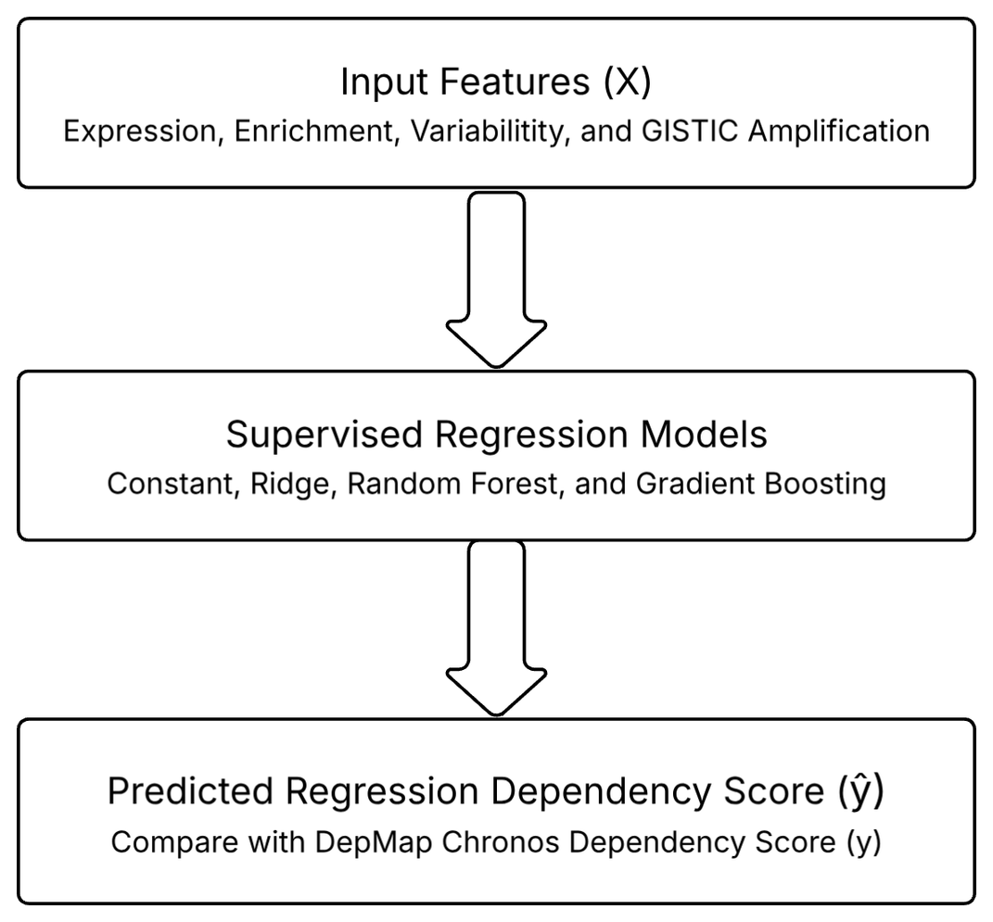
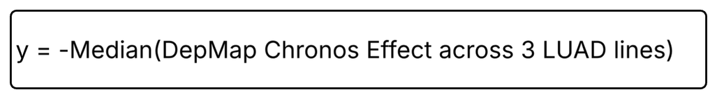

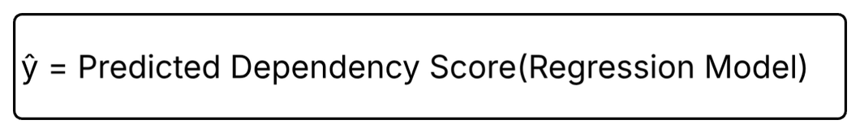
Feature vs. Label Diagram
Label:
Model Output:

Slide 9
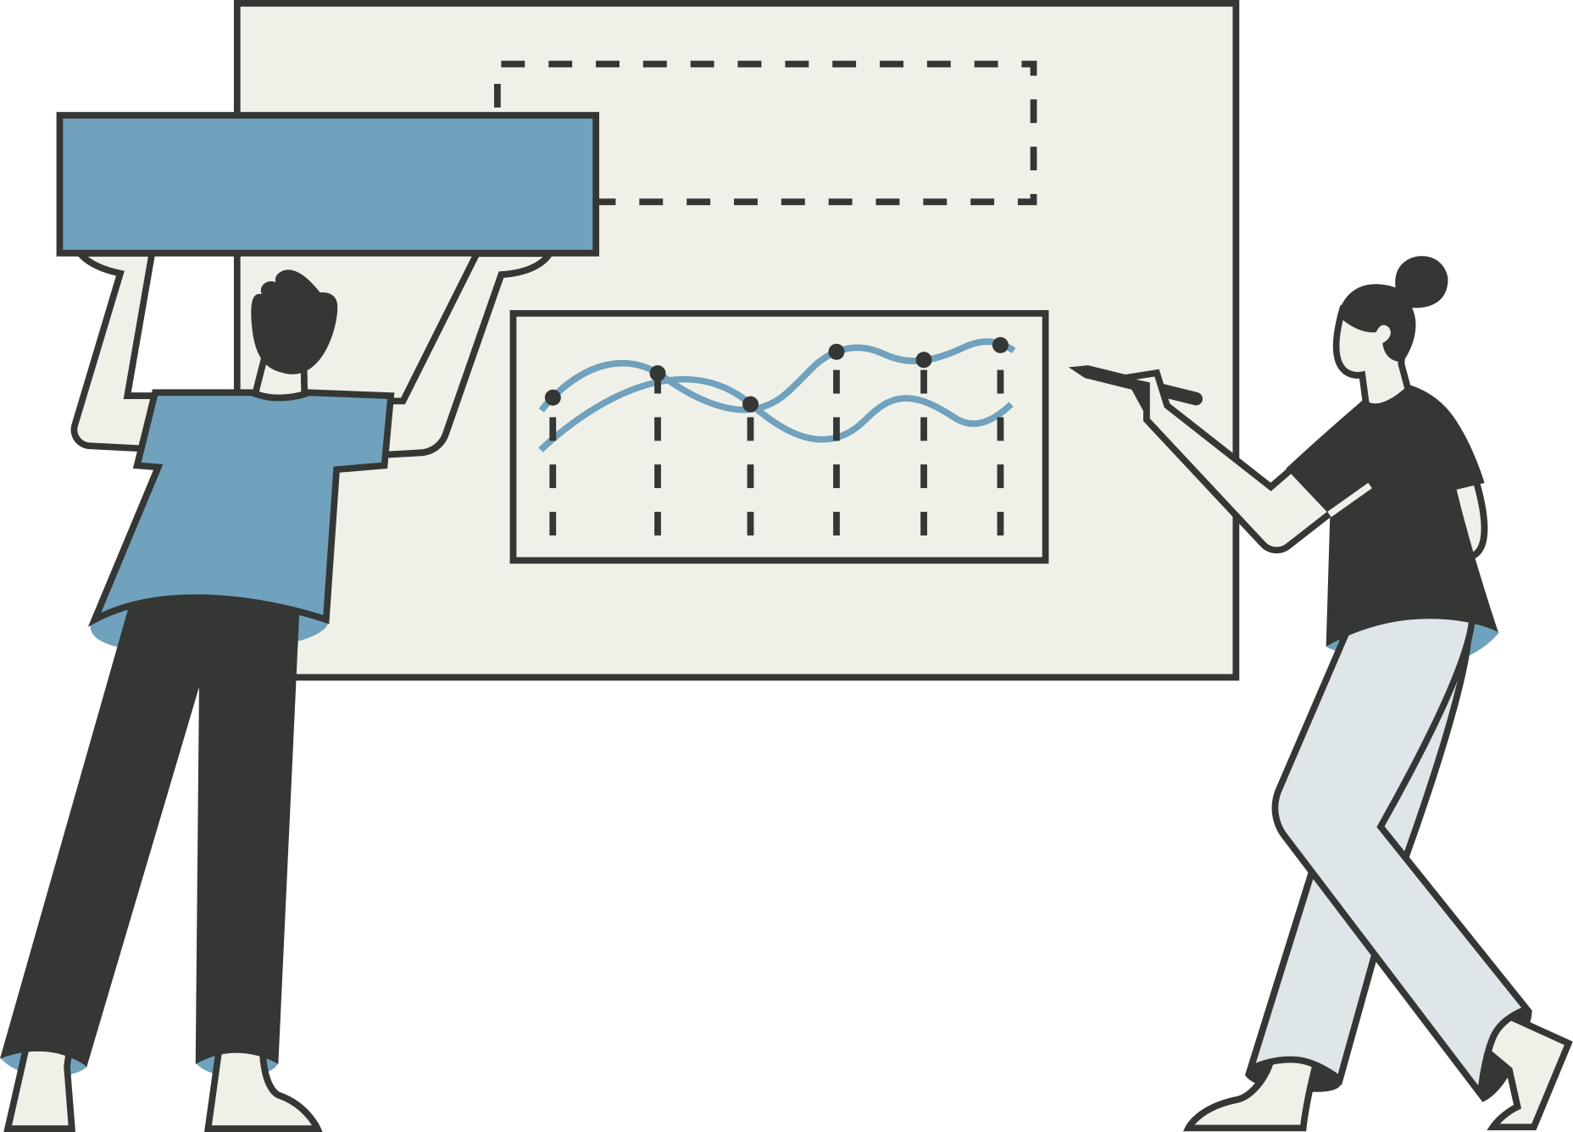
Evaluation Plan
1
Dataset Split (Surface stratified 70/15/15 splits)
2
Supervised Regression Models
(Constant, Ridge, Random Forest, Gradiant Boosting)
3
Evaluation Metrics (Mean Absolute Error, Spearman Correleation)
4
Model Improvements: Hyperparameter tuning & Adjust the threshold to determine effect on weights

Slide 10
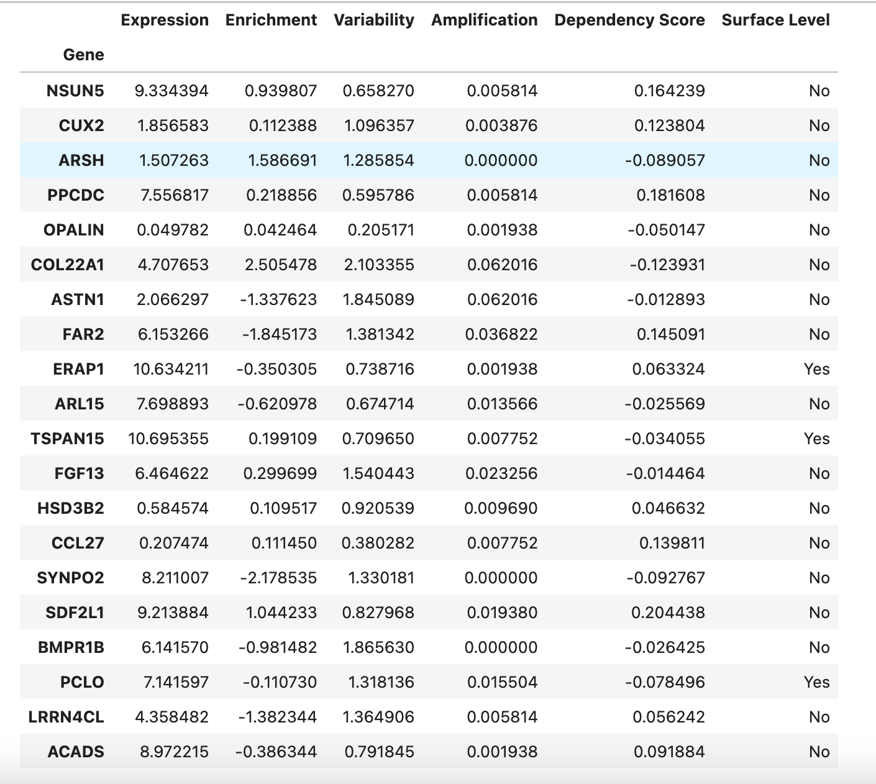

Practical Start Evidence
Libraries:
  Python, Jupyter Notebook, pandas, scikit-learn
  Checkpoint1_gene_dependency_model.ipynb
Sections:
  Load public expression, copy-number, and dependency data
  Clean and merge datasets into one row per gene
  Create input feature matrix X and dependency target y
  Surface-Stratified Splits
    70/15/15 split with 2000 labeled genes
    20 test surface candidates displayed to the right
  Train the constant and ridge baselines
  Compare models with MAE and Spearman correlation
Notes:
nadia. Explain the number of rows in this dataset btw!!!

Slide 11
Work Cited
Jiménez-Vázquez S, Berthel A, Patsis C, et al. Cancer-driver-agnostic targeting of amplified surface proteins identifies MPZL1 for selective CAR-T cell therapy. Nature Communications. 2026;17:9695. https://doi.org/10.1038/s41467-026-77465-5

Slide 12

Thank You
Thank you for your attention

