Slide 1
Patients
(N=84)
(A)
Tissue
tDNA
Baseline
ctDNA
PD
ctDNA
Blood
gDNA
(B)
EMR
(N=67)
BAM
(N=17)
BAM
BAM
BAM
PoN
(C)
(D)
VCF
VCF
VCF
(E)
MAF
Analyses

Slide 2
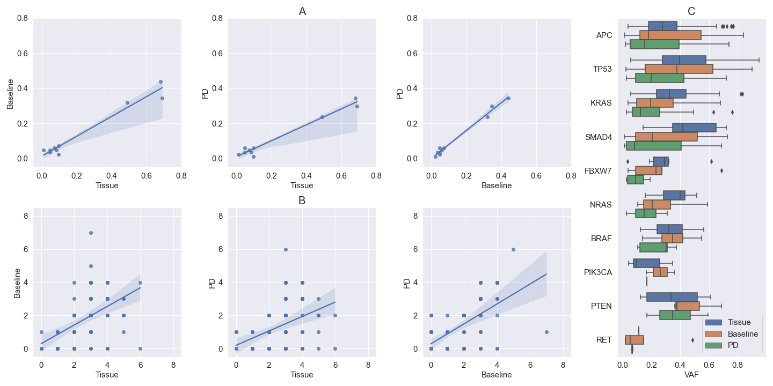
R² = 0.96
P = 7.84e-07
R² = 0.97
P = 2.08e-07
R² = 0.99
P = 4.61e-09
APC
KRAS
APC
APC
TP53
KRAS
TP53
TP53
KRAS
SMAD4
SMAD4
SMAD4
R² = 0.24
P = 2.02e-06
R² = 0.16
P = 1.48e-04
R² = 0.40
P = 8.21e-11

