Slide 1
Patients
(N=84)
(A)
Tissue
tDNA
Baseline
ctDNA
PD
ctDNA
Blood
gDNA
(B)
EMR
(N=67)
BAM
(N=17)
BAM
BAM
BAM
PoN
(C)
(D)
VCF
VCF
VCF
(E)
MAF
Analyses

Slide 2
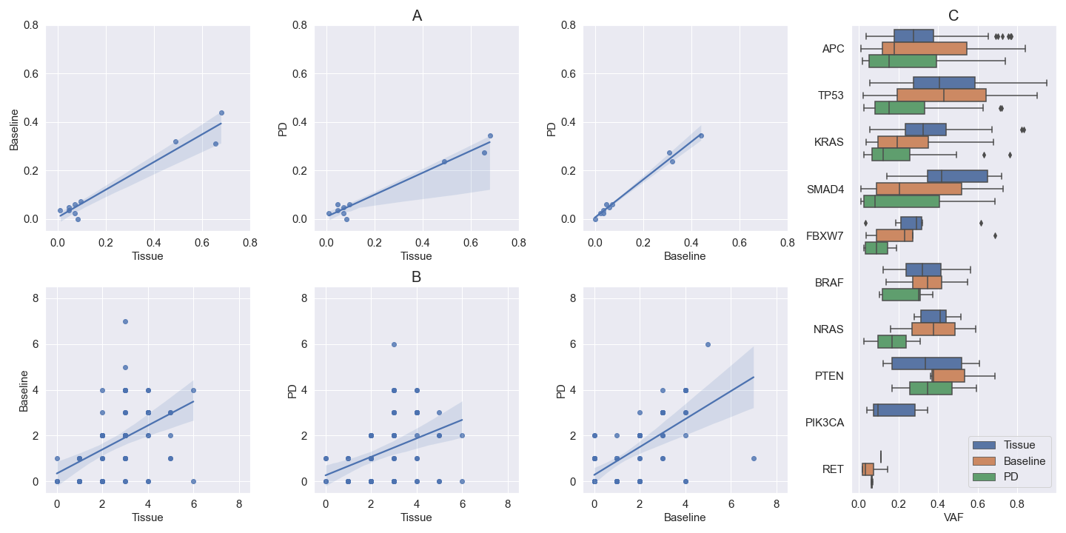
R² = 0.94
P = 2.99e-06
R² = 0.96
P = 6.35e-07
R² = 0.99
P = 3.58e-09
APC
KRAS
APC
APC
TP53
KRAS
TP53
TP53
KRAS
SMAD4
SMAD4
SMAD4
R² = 0.21
P = 1.38e-05
R² = 0.14
P = 3.96e-04
R² = 0.43
P = 1.10e-11

