Slide 1
Universal polarization

Slide 2

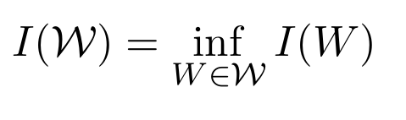

Universal Polarization
Compound Channels
For a class of BMS channels symmetric Capacity is:
A code of rate R< I(W) is universal if Pe vanishes over the class.
Degraded channels
X W1 W2
I(W1;X) >= I(W2;X)
Hassani et.al showed polar codes of Arikans construction are universal for this subclass
Less noisy comparable
T X YZ
Z (or W) is better than V
Wang et.al showed polar codes of Arikans construction are universal for this subclass

Slide 3
Universal Polarization for compound channels (Rx knows the channel)
2 step polarization
Slow polarization (ensures universality)
Combines distinct channels
Approximately 1/2 the channels are good.
Fast (Arikan’s) Polarization (Converges Z)
Combines identical channels

Slide 4


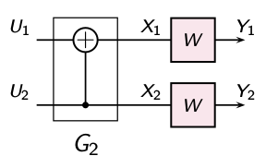
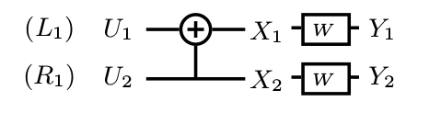
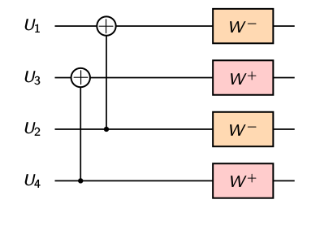
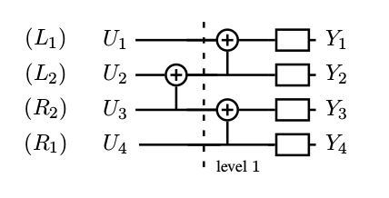
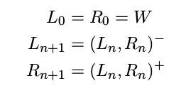

Butterflies
Arikan’s butterfly
Wangs butterfly
Stage 1 is same
Subsequent stages 2(types) distinct Channels are combined
(W-)
(W+)

Slide 5



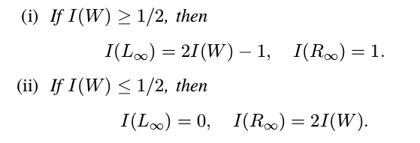
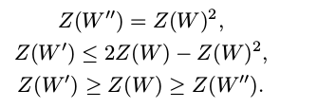

Inequalities and polarization
Arikan
I(W`) tends to 0
I(W``) tends to 1
Wang
This regulates the speed , for Arikan Z(w``) goes to zero faster, but for Wang Z(R) goes to zero while Z(L) goes to constant ( 1 if I(W)=1/2) hence Z(Rn+1) goes to 0 in a slower rate.

Slide 6
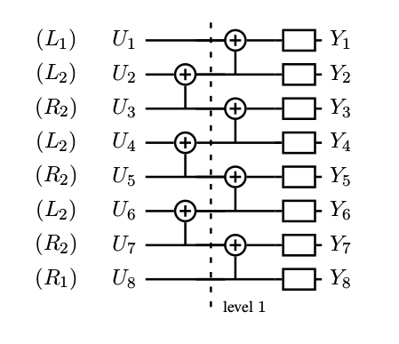

Observations
K(L1,R1) are combined to get (K-1)(L2,R2)
If K=4 in stage 2,
For N=16
4 (L1,R1) 3(L2,R2) 5(L3R3)
4( L1,R1) 3(L2,R2)
4 X1 , 2 X2 lost = 16 lost
For N=32
4 (L1,R1) 3(L2,R2) 5(L3,R3) 9(L4,R4)
4( L1,R1) 3(L2,R2)
4 (L1,R1) 3(L2,R2) 5(L3,R3)
4( L1,R1) 3(L2,R2)
8 X1, 4 X2, 2 X3 lost = 32 lost
For Block of N=2^{n-1}K
2^{n-i} lost at level i after nth recusion
Thus rate loss (below) can be neglected for large K.

Slide 7
Observations
The positions of Rn’s are independent of W
Makes it universal.
When a nice ‘I(Rn)’ is reached ,using 1/2 of these Rn channels , we apply arikan polarization.
This provides a rate 1/2 code

Slide 8
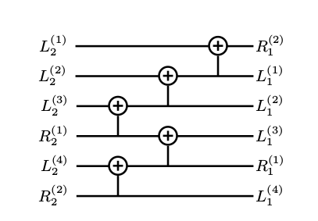
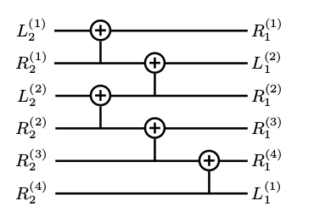




Arbitrary rates (g/b+g)
For ‘g/b’ <= 1/2
2/6
For ‘g/b’ > 1/2
4/6

Slide 9
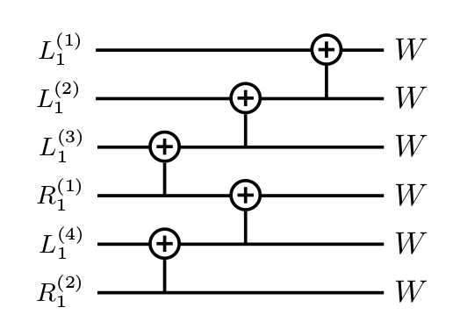
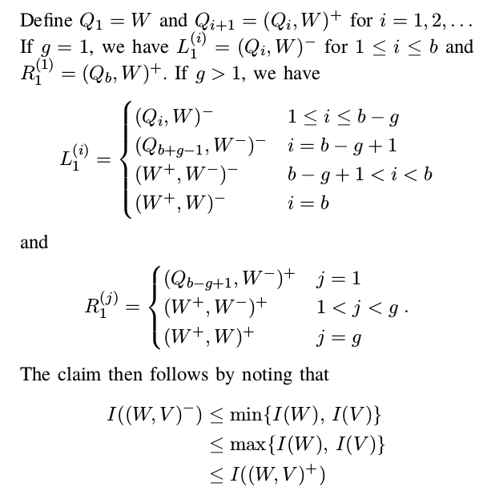

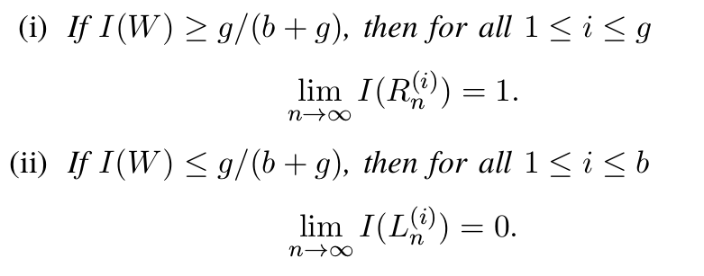

Arbitrary rates
figure for b=4,g=2,b-g+1=4
.
W
j=g
W
W⁺
W⁻
b-g+1
Capacity
Polarization

