Slide 1


Slide 2
NETWORK
W
X
Y
Z
^
^
^
^
^
^
^
^
^
^
^
^
X,Y,Z
W,Y,Z
W,X,Z
W,X,Y

Slide 3


^
X
H(X/Y)
Y
X

Slide 4
^
X
Bits at Rate > H(X|Y)
X
Y

Slide 5
^
X
NACK
X
Y
NACK
ACK

Slide 6
RELIABLE
T
DECODER
X_{N}
Y_{N}
^
W_{N}
U_{N}
U_{N}
FROZEN
UNRELIABLE

Slide 7
RELIABLE
T
DECODER
X_{N}
Y_{N}
^
W_{N}
U_{N}
U_{N}
FROZEN
(set to '0')
UNRELIABLE

Slide 8
T
DECODER
X_{N}
Y_{N}
W_{N}
^
U_{N}
U_{N}
FROZEN

Slide 9
T⁻¹
DECODER
T
X_{N}
Y_{N}
U_{N}
^
W_{N}
X_{N}
U_{N}
FROZEN

Slide 10
T⁻¹
DECODER
T
X_{N}
Y_{N}
U_{N}
^
W_{N}
X_{N}
U_{N}
FROZEN

Slide 11
Mapping to bit-channels
Most Reliable
Least Reliable
T⁻¹
Decoder with p₁
u₀ | u₁ | u₂ | u₃ | u₄ | u₅ | u₆ | u₇
X
BSC(p₃)
Y⁰
Error Detection
Error
present
U⁰
FROZEN
LLR
Iteration 1
Decoder with p₂
Error
present
Y⁰
Error Detection
u₀ | u₁ | u₂ | u₃ | u₄ | u₅ | u₆ | u₇
LLR
Iteration 2
Decoder with p₃
Error Detection
No
Error
Y⁰
u₀ | u₁ | u₂ | u₃ | u₄ | u₅ | u₆ | u₇
LLR
Iteration 3
^
X

Slide 12
T⁻¹
Decoder
BSC(p₃)
U
X
Y
Error Detection
LLR

Slide 13
Mapping to bit-channels
Most Reliable
Least Reliable
LLR
U
Polar Encoder
BSC(p₃)
Y⁰
Decoder
using p₁
u₀ | u₁ | u₂ | u₃ | u₄ | u₅ | 0 | 0
ED
Iteration 1
Error present
Polar Encoder
BSC(p₃)
Y¹
Decoder
using p₂
u₃ | u₄ | u₅ | 0 | 0 | 0 | 0 | 0
ED
Iteration 2
Error present
Y²
u₂ | u₅ | 0 | 0 | 0 | 0 | 0 | 0
Polar Encoder
BSC(p₃)
Decoder
using p₃
ED
Iteration 3
No Error
Final decoding (all decoders use p₃)
^
use u₂,u₃,u₄,u₅
decode u₀,u₁ from Y⁰
use u₅
decode u₃,u₄ from Y¹
U

Slide 14
'K' ASSUMED RELIABLE
PHY LAYER ERROR DETECTION
T
DECODER
X_{N}
Y_{N}
SOFT OUTPUTS
U_{N}
W_{N}
'N-K' FROZEN
INCREASE FROZEN BITS
NACK

Slide 15
1
2
3
4'
5'
6
7'
8
1
2
3
4
5
6
7
8
X
Y
^
X

Slide 16
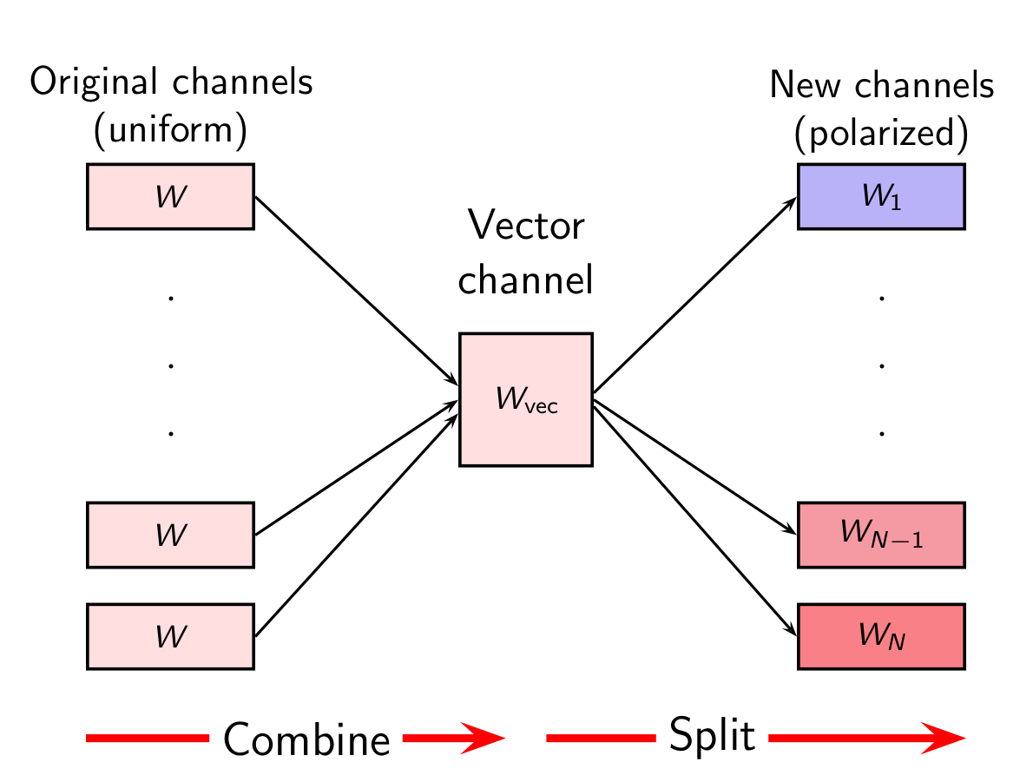
N channels with capacity C
NC channels with capacity 1

Slide 17
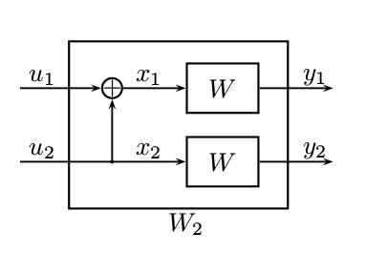
W-
W+

Slide 18
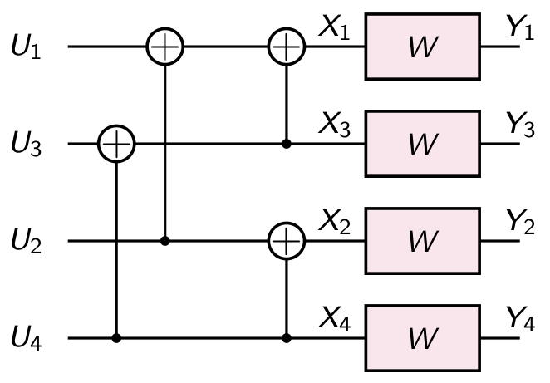
W--
W-
W+-
W+
W-+
W-
W++
W+

Slide 19
decoded bit
LLR
W--
L1
f(L1,L2)
W+-
L2
g(L1,L2)
W-+
W++

Slide 20
X
Y
^
^
Y
X

Slide 21
good channels
7
6
5
3
4
2
1
0
good channels
7
6
5
3
4
2
1
0
7
6
5
3
4
2
1
0
good channels
p₁ < p₂ < p₃

