Slide 1
Java EE Architecture

Slide 2
Goal
What is an enterprise Application
Requirements for an Enterprise Application
Layered Application design
Tiered Architecture
Distributed Computing
Java EE Framework and its Services
Java EE in detail

Slide 3
Enterprise Application
An enterprise means a business organization
Enterprise applications are those software applications that facilitate various activities in an enterprise
An enterprise application has the following challenges and complexity:
Diversity of information needs
Information is created and used in different ways
Complexity of business process
Involves complex information capture, processing and sharing
Diversity of applications
Applications are built using different architecture and technologies

Slide 4
Requirements for an Enterprise Application
Programming productivity
The applications should be developed and deployed as quickly as possible
Reliability and availability
Downtime is fatal to a business
The applications must provide guarantee of business transaction
Business process should proceed completely and accurately
Security
The application must be safe from illegal access and information theft
Scalability
Should be able to handle large number of clients
Should ensure effective use of system resources
Integration
Should be compatible with existing applications

Slide 5
Layers and Tier-s
Layers are the way to logically break code into components and tiers are the physical nodes to place the components on.
Notes:
Logical layers are merely a way of organizing your code. Typical layers include Presentation, Business and Data – the same as the traditional 3-tier model. But when we’re talking about layers, we’re only talking about logical organization of code. In no way is it implied that these layers might run on different computers or in different processes on a single computer or even in a single process on a single computer. All we are doing is discussing a way of organizing a code into a set of layers defined by specific function.
Physical tiers however, are only about where the code runs. Specifically, tiers are places where layers are deployed and where layers run. In other words, tiers are the physical deployment of layers.

Slide 6
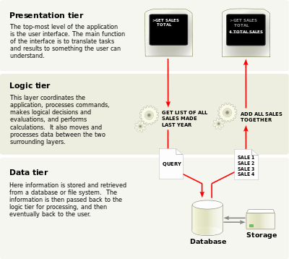
Layers in application
An application contains
Presentation layer
Business layer
Data layer

Slide 7
Presentation Layer
Presentation layer components implement the functionality required to allow users to interact with the application.
User interface (UI) components.
provide the mechanism for users to interact with the application. They format data and render it for display, and acquire and validate data entered by users.
UI process components.
To help synchronize and orchestrate user interactions, it can be useful to drive the process using separate UI process components. This prevents the process flow and state management logic from being hard-coded into the UI elements themselves, and allows you to reuse the same basic user interaction patterns in other user interfaces.

Slide 8
Business layer
Business layer components implement the core functionality of the system, and encapsulate the relevant business logic
Business Layer Components
Application façade
Business components
Business workflows
Business entity components
Notes:
Application façade. This is an optional feature that you can use to combine multiple business operations into single messaged-based operations. This feature is useful when you locate the presentation layer components on a separate physical tier from the business layer components, allowing you to optimize use of the communication method that connects them.
Business components. These components implement the business logic of the application. Regardless of whether a business process consists of a single step or an orchestrated workflow, your application is likely to require components that implement business rules and perform business tasks.
Business workflows. After the UI components collect the required data from the user and pass it to the business layer, the application can use this data to perform a business process. Many business processes involve multiple steps that must be performed in the correct order, and may interact with each other through an orchestration. Business workflow components define and coordinate long-running, multi-step business processes, and can be implemented using business process management tools.
Business entity components. Business entities are used to pass data between components. The data represents real-world business entities, such as products or orders. The business entities that the application uses internally are usually data structures, such as DataSets, DataReaders, or Extensible Markup Language (XML) streams, but they can also be implemented using custom object-oriented classes that represent the real-world entities that your application will handle.

Slide 9
Data Layer
Data layer components provide access to data that is hosted within the boundaries of the system, and data exposed by other back-end systems
Data access components
Data helper and utility components
Service agents
Notes:
Data Layer Components
Data layer components provide access to data that is hosted within the boundaries of the system, and data exposed by other back-end systems. The following types of components are commonly found in the data layer:
Data access components. These components abstract the logic required to access the underlying data stores. Doing so centralizes data access functionality and makes the application easier to configure and maintain.
Data helper and utility components. Most data access tasks require common logic that can be extracted and implemented in separate reusable helper components. This helps to reduce the complexity of the data access components and centralizes the logic, which simplifies maintenance. Other tasks that are common across data layer components, and not specific to any set of components, may be implemented as separate utility components. Both helper and utility components can often be reused in other applications.
Service agents. When a business component must use functionality provided by an external service, you might need to implement code to manage the semantics of communicating with that particular service. Service agents isolate the idiosyncrasies of calling diverse services from your application, and can provide additional services such as basic mapping between the format of the data exposed by the service and the format your application requires.

Slide 10
Tiers
Tiers represent the physical separation of the presentation, business, services, and data functionality of your design across separate computers and systems.
Common tiered design patterns are (one-tier?) two-tier, three-tier, and n-tier.
if 3 layers are present in one system - 1-tier if 3 layers are present in two systems - 2-tier if 3 layers are present in three system - 3-tier if 3 layer are present in n system - n-tier

Slide 11
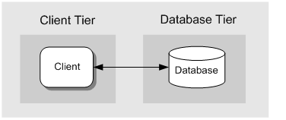
Two-Tier
The two-tier pattern represents a basic structure with two main components, a client and a server.
The client and server may exist on the same machine, or may be located on two different machines.
This tier contains the presentation layer logic and any required business layer logic.
The Web application communicates with a separate machine that hosts the database tier, which contains the data layer logic.
Notes:
The figure illustrates a common Web application scenario where the client interacts with a Web server located in the client tier.

Slide 12
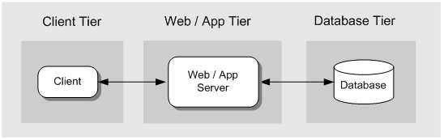
Three-Tier
In a three-tier design, the client interacts with application software deployed on a separate server, and the application server interacts with a database that is also located on a separate server.
This is a very common pattern for most Web applications and Web services

Slide 13
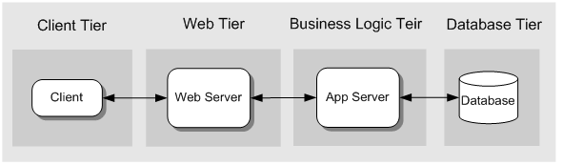
N-Tier
In this scenario, the Web server (which contains the presentation layer logic) is physically separated from the application server that implements the business logic.
This usually occurs for security reasons, where the Web server is deployed within a perimeter network and accesses the application server located on a different subnet through a firewall.
It is also common to implement a firewall between the client and the Web tier

Slide 14
How do these tiers relate to Java EE?

Slide 15
Java EE Platform
JavaEE is one of the best solutions so far to meet the requirements of today’s Enterprise
JavaEE platform is a distributed application – server environment for n-tier applications.
JavaEE is a Java Environment providing
A set of Java Extension APIs to build applications
A runtime infrastructure for hosting and managing applications

Slide 16
JavaEE Architecture
JavaEE is a Container centric architecture
JavaEE platform includes one or more Containers
(A container is a runtime to manage components developed according to the API specification, and to provide access to the JavaEE APIs )

Slide 17
JavaEE Architecture
JavaEE is a Container centric architecture
JavaEE platform includes one or more Containers
(A container is a runtime to manage components developed according to the API specification, and to provide access to the JavaEE APIs )

Slide 18
Container Architecture
Developers are required to provide
Application Components
Servlets, JSP Pages, EJBs etc
Deployment Descriptor
An XML file that describes the application

Slide 19
Container Types
Java EE server: The runtime portion of a Java EE product. A Java EE server provides EJB and web containers.
Enterprise JavaBeans (EJB) container: Manages the execution of enterprise beans for Java EE applications. Enterprise beans and their container run on the Java EE server.
Web container: Manages the execution of JSP page and servlet components for Java EE applications. Web components and their container run on the Java EE server.
Application client container: Manages the execution of application client components. Application clients and their container run on the client.
Applet container: Manages the execution of applets. Consists of a web browser and Java Plug-in running on the client together.

Slide 20
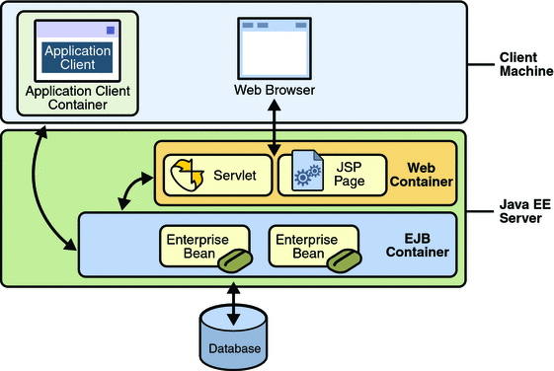
Container Types

Slide 21
Container Architecture
The container Provides
Component Contract
A set of APIs specified by the container that an application component is required to extend or implement
Container Service API
Additional services provided by the container required for applications e.g JDBC, JTS, JNDI, JMS stc.
Declarative Services
Container interposes these services based on the deployment descriptor of the application component e.g Transaction Security etc.
Other Container Services
Life cycle management of components
Resource pooling like Object pooling and Connection Pooling
Populating JNDI namespace based on the Deployment names associated with EJBs
Populating JNDI namspace with objects necessary for utilizing container service APIs

Slide 22
JavaEE Technologies
The Component Technologies
Web Components
Servlets, JSP Pages
Enterprise JavaBean Components
Session Beans
Entity Beans
Message Driven Beans
Service Technologies
JDBC, JTA, JNDI,JMS, JavaMail, JAAS
Communication Technologies
Internet Protocols
HTTP, TCP/IP, SSL
Remote Object Protocols
RMI, RMI-IIOP
JavaIDL

Slide 23
The Java EE platform uses a distributed multitiered application model for enterprise applications.
Application logic is divided into components according to function, and the various application components that make up a Java EE application are installed on different machines depending on the tier in the multitiered Java EE environment to which the application component belongs.

Slide 24
Distributed Multitiered Applications
In a multitiered java application
Client-tier components run on the client machine.
Web-tier components run on the Java EE server.
Business-tier components run on the Java EE server.
Enterprise information system (EIS)-tier software runs on the EIS server.

Slide 25
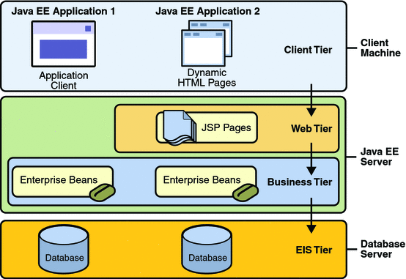
Distributed Multitiered Applications
Notes:
two multitiered Java EE applications divided into the tiers described in the following list. The Java EE application parts shown in Figure 1-1 are presented in Java EE Components.
Client-tier components run on the client machine.
Web-tier components run on the Java EE server.
Business-tier components run on the Java EE server.
Enterprise information system (EIS)-tier software runs on the EIS server.
Although a Java EE application can consist of the three or four tiers shown in Figure 1-1, Java EE multitiered applications are generally considered to be three-tiered applications because they are distributed over three locations: client machines, the Java EE server machine, and the database or legacy machines at the back end. Three-tiered applications that run in this way extend the standard two-tiered client and server model by placing a multithreaded application server between the client application and back-end storage.

Slide 26
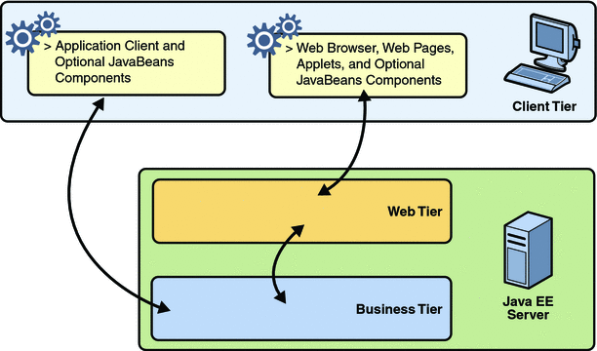
Java EE Server Communications

Slide 27
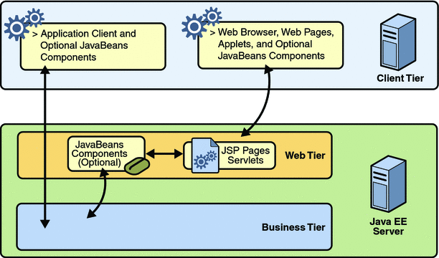
Web Tier and Java EE Applications
Notes:
Your Java EE application uses a thin browser-based client or thick application client. In deciding which one to use, you should be aware of the trade-offs between keeping functionality on the client and close to the user (thick client) and off-loading as much functionality as possible to the server (thin client). The more functionality you off-load to the server, the easier it is to distribute, deploy, and manage the application; however, keeping more functionality on the client can make for a better perceived user experience.

Slide 28
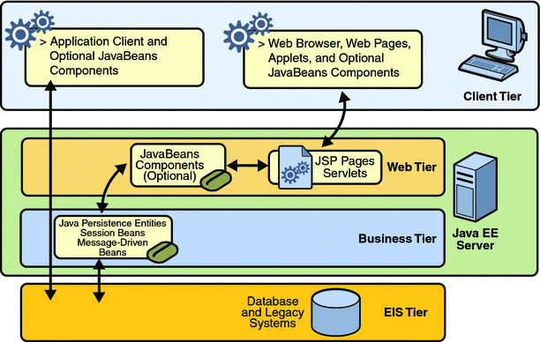
Business and EIS Tiers

Slide 29


Any Question?

Slide 30
Thank You

