Slide 1
HTTP Protocol

Slide 2
What is Hypertext and Hypermedia
Hypertext is text which contains links to other texts.
The term was coined by Ted Nelson around 1965
HyperMedia is a term used for hypertext which is not constrained to be text: it can include graphics, video and sound
Apparently Ted Nelson was the first to use this term too.

Slide 3
Introduction
HTTP is a protocol which allows the fetching of resources, such as HTML documents.
It is the foundation of any data exchange on the Web and it is a client-server protocol, which means requests are initiated by the recipient, usually the Web browser.
A complete document is reconstructed from the different sub-documents fetched,
for instance text, layout description, images, videos, scripts, and more.

Slide 4
Introduction
The Hyper Text Transfer Protocol (HTTP) is a client-server network protocol
In use by the World-Wide Web since 1990.
It is based on Request – Response Paradigm.

Slide 5
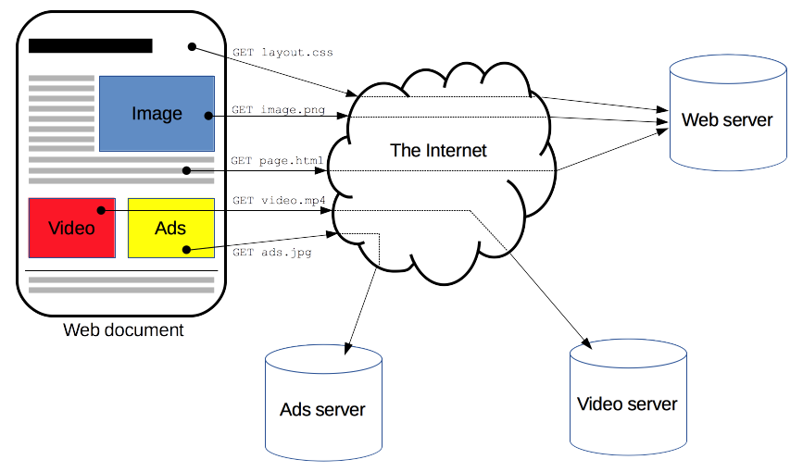
Introduction

Slide 6
Request and Response
Clients and servers communicate by exchanging individual messages (as opposed to a stream of data).
The messages sent by the client, usually a Web browser, are called requests
The messages sent by the server as an answer are called responses.

Slide 7
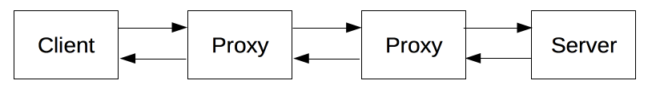
Components of HTTP-based systems

Slide 8
Client: the user-agent
The user-agent is any tool that acts on the behalf of the user.
This role is primarily performed by the Web browser
other possibilities are programs used by engineers and Web developers to debug their applications.
Curl, Postman etc

Slide 9
The Web Server
On the opposite side of the communication channel, is the server, which serves the document as requested by the client.
A server appears as only a single machine virtually
this is because it may actually be a collection of servers, sharing the load (load balancing) or a complex piece of software interrogating other computers (like cache, a DB server, or e-commerce servers), totally or partially generating the document on demand.
A server is not necessarily a single machine, but several server software instances can be hosted on the same machine.
With HTTP/1.1 and the Host header, they may even share the same IP address.

Slide 10
Basic Aspects of HTTP

Slide 11
HTTP is simple
HTTP is generally designed to be simple and human readable, even with the added complexity introduced in HTTP/2 by encapsulating HTTP messages into frames.
HTTP messages can be read and understood by humans, providing easier testing for developers, and reduced complexity for newcomers.

Slide 12
HTTP is extensible
Introduced in HTTP/1.0, HTTP headers make this protocol easy to extend and experiment with.
New functionality can even be introduced by a simple agreement between a client and a server about a new header's semantics.

Slide 13
HTTP is stateless, but not sessionless
HTTP is stateless: there is no link between two requests being successively carried out on the same connection.
This immediately has the prospect of being problematic for users attempting to interact with certain pages coherently, for example, using e-commerce shopping baskets.
But while the core of HTTP itself is stateless, HTTP cookies allow the use of stateful sessions.
Using header extensibility, HTTP Cookies are added to the workflow, allowing session creation on each HTTP request to share the same context, or the same state.

Slide 14
What can be controlled by HTTP

Slide 15
common features controllable with HTTP
Caching
Relaxing the origin constraint
Authentication
Proxy
Tunnelling
Sessions

Slide 16
Caching
How documents are cached can be controlled by HTTP. The server can instruct proxies and clients, about what to cache and for how long.
The client can instruct intermediate cache proxies to ignore the stored document.

Slide 17
Relaxing the Origin Constraint
To prevent snooping and other privacy invasions, Web browsers enforce strict separation between Web sites.
Only pages from the same origin can access all the information of a Web page.
Though such constraint is a burden to the server, HTTP headers can relax this strict separation on the server side, allowing a document to become a patchwork of information sourced from different domains; there could even be security-related reasons to do so.

Slide 18
Authentication
Some pages may be protected so that only specific users can access them.
Basic authentication may be provided by HTTP, either using the WWW-Authenticate and similar headers, or by setting a specific session using HTTP cookies.

Slide 19
Proxy and Tunnelling
Servers or clients are often located on intranets and hide their true IP address from other computers.
HTTP requests then go through proxies to cross this network barrier. Not all proxies are HTTP proxies.
The SOCKS protocol, for example, operates at a lower level. Other protocols, like ftp, can be handled by these proxies.

Slide 20
Sessions
Using HTTP cookies allows you to link requests with the state of the server.
This creates sessions, despite basic HTTP being a state-less protocol. This is useful not only for e-commerce shopping baskets, but also for any site allowing user configuration of the output.

Slide 21
Http Control Flow
Open a TCP Connection
Send an Http Message (Request)
Read the Response sent by the Server
Close or reuse the connection for further requests.

Slide 22
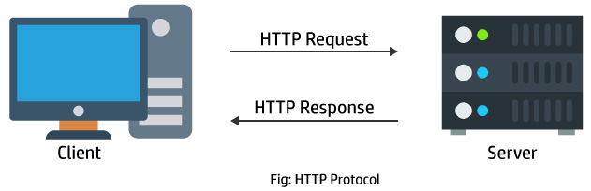
Open a TCP Connection
The TCP connection is used to send a request, or several, and receive an answer.
The client may open a new connection, reuse an existing connection, or open several TCP connections to the servers.

Slide 23

Send an HTTP Message
HTTP messages (before HTTP/2) are human-readable. With HTTP/2, these simple messages are encapsulated in frames, making them impossible to read directly, but the principle remains the same.

Slide 24
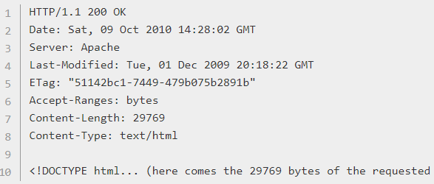
Read The Resposne..

Slide 25
Close or Reuse the Connection
If HTTP pipelining is activated, several requests can be sent without waiting for the first response to be fully received.
HTTP pipelining has proven difficult to implement in existing networks, where old pieces of software coexist with modern versions.
HTTP pipelining has been superseded in HTTP/2 with more robust multiplexing requests within a frame.

Slide 26
HTTP Messages

Slide 27
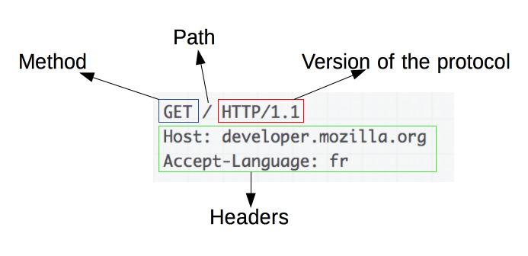
Request

Slide 28
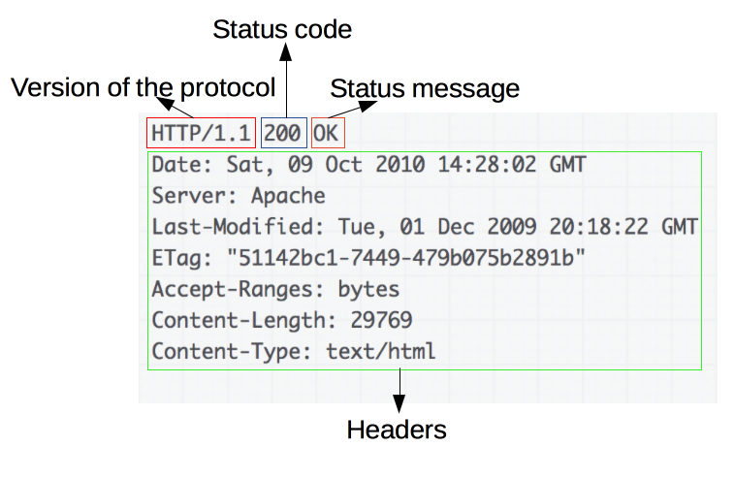
Response

Slide 29
HTTP Status Response Codes
100-199 Informational
200-299 Successful
200: OK
202: Accepted
204: No Content
300-399 Redirection
400-499 Incomplete
400: Bad Request
401: Unauthorized
403: Forbidden
404: Not Found
500-599 Server Error
500: Internal Server Error
501: Not Implemented

Slide 30
Http Request Methods
HTTP defines a set of request methods to indicate the desired action to be performed for a given resource.
Although they can also be nouns, these request methods are sometimes referred to as HTTP verbs.
Each of them implements a different semantic, but some common features are shared by a group of them: e.g. a request method can be safe, idempotent, or cacheable.

Slide 31
Http Request Methods
GET
The GET method requests a representation of the specified resource. Requests using GET should only retrieve data.
HEAD
The HEAD method asks for a response identical to that of a GET request, but without the response body.
POST
The POST method is used to submit an entity to the specified resource, often causing a change in state or side effects on the server.

Slide 32
Http Request Methods
PUT
The PUT method replaces all current representations of the target resource with the request payload.
DELETE
The DELETE method deletes the specified resource.
CONNECT
The CONNECT method establishes a tunnel to the server identified by the target resource.

Slide 33
Http Request Methods
OPTIONS
The OPTIONS method is used to describe the communication options for the target resource.
TRACE
The TRACE method performs a message loop-back test along the path to the target resource.
PATCH
The PATCH method is used to apply partial modifications to a resource.

