Slide 1
JSP
(Java Server Pages)

Slide 2
What do you mean by Static & Dynamic Contents?
Static contents
  Typically static HTML page
  Same display for everyone
Dynamic contents
  Content is dynamically generated based on conditions
  Conditions could be
    User identity
    Time of the day
    User entered values through forms and selections

Slide 3
What is JSP Page?
A text-based document capable of returning both static and dynamic content to a client browser
Static content and dynamic content can be intermixed
Static content
  HTML, XML, Text
Dynamic content
  Java code
  Displaying properties of JavaBeans
  Invoking business logic defined in Custom tags
The Java code is enclosed between the construct <% and %>, called a jsp “tag”
  <% out.println(“This is a jsp demo”);%>

Slide 4
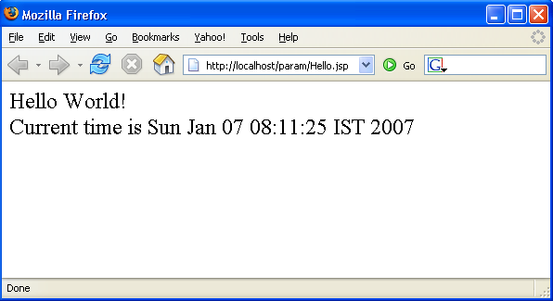
A Simple JSP Page
(Blue: static, Red: Dynamic contents)
<html>
<body>
Hello World!
<br>
Current time is <%= new java.util.Date() %>
</body>
</html>

Slide 5
JSP Benefits
Content and display logic are separated
Simplify web application development with JSP, JavaBeans and custom tags
Supports software reuse through the use of components (JavaBeans, Custom tags)
Automatic deployment
  Recompile automatically when changes are made to JSP pages
Easier to author web pages
Platform-independent

Slide 6
Why JSP over Servlet?
Servlets can do a lot of things, but it is pain to:
  Use those println() statements to generate HTML page
  Maintain that HTML page
No need for compiling, packaging, CLASSPATH setting

Slide 7
Do I have to Use JSP over Servlet or vice-versa?
No, you want to use both leveraging the strengths of each technology
  Servlet's strength is “controlling and dispatching”
  JSP's strength is “displaying”
In a typically production environment, both servlet and JSP are used in a so-called
MVC (Model-View-Controller) pattern
  Servlet handles controller part
  JSP handles view part

Slide 8
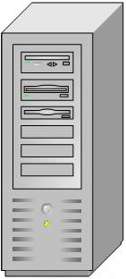

JSP Architecture
Each Java server page is compiled into a servlet before it can be used
The translation phase is typically carried out by the JSP engine itself, when it receives an incoming request for the JSP page for the first time
Hello.jsp
read
Translation Phase
request
generate
Hello_jsp.java
(Servlet)
compile
response
execute
Hello_jsp.class
(Servlet class)
Request processing
phase
Web Server/
Web Container

Slide 9
JSP Architecture
When a request is mapped to a JSP page, the web container first checks whether the JSP page's servlet is older than the JSP page.
If the servlet is older, the web container translates the JSP page into a servlet class and compiles the class.
During development, one of the advantages of JSP pages over servlets is that the build process is performed automatically.

Slide 10
How Does JSP Work
User Request
Server
JSP
Yes
File
Changed?
Create Source
No
Compile
Execute Servlet

Slide 11
Life Cycle of JSP
After the page has been translated and compiled, the JSP page's servlet (for the most part) follows the servlet life cycle
If an instance of the JSP page's servlet does not exist, the container
  Loads the JSP page's servlet class
  Instantiates an instance of the servlet class
  Initializes the servlet instance by calling the jspInit method
The container invokes the _jspService method, passing request and response objects.
If the container needs to remove the JSP page's servlet, it calls the jspDestroy method.

Slide 12
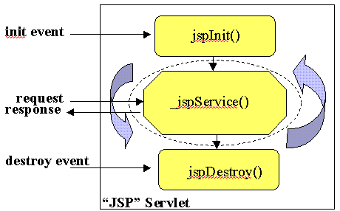
Life Cycle of JSP

Slide 13
JSP Syntax
JSP syntax is fairly straightforward, and can be classified into
Scripting elements
  allow us to write inline java code in a JSP
Directives
  JSP directives are messages for the JSP engine. They do not directly produce any visible output, but tell the engine what to do with the rest of the JSP page.
  JSP directives are always enclosed within the
  <%@ ... %> tag.
Standard actions
  affect the runtime behavior of the JSP Page

Slide 14
Scripting Elements
Scripting elements allow us to embed java code in the JSP page
These scripting elements will allow us to insert java code in different parts of the translated java servlet
Scripting elements
  JSP Comments <%-- ... --%>
  Declarations of the form <%! code %>
  Expressions of the form <%= expr %>
  Scriptlets of the form <% code %>

Slide 15
JSP Comment tag
Comments in a JSP page is written using JSP comment tag
Sysntax
  <%-- This is a comment --%>
  alternatively comments can be written in HTML comment syntax also
  <!-- This is a comment -->
The statement written in a comment tag will not be included in the translated java code

Slide 16
JSP Declaration tag
Declaration tag is used to declare instance variables and methods in the JSP page implementation class (translated servlet class )
Declarations are found within the <%! ... %> tag.
Always end variable declarations with a semicolon, as any content must be valid Java statements:
  <%! int i=0; %>
Methods can be declared using declaration tag
  For example, you can override the initialization event in the JSP life cycle by declaring:
    <%! public void jspInit() {
    //some initialization code
    } %>

Slide 17
JSP Declaration tag
For a declaration <%! declarations %> the Java statements are placed in the class outside the _jspService method.
Typical declarations can be Java instance variable declarations or Java methods
// declarations would go here
public void _jspService(...)
{
...
}

Slide 18
Declaration examples
Declaring instance variables
Declaring methods
<%! private int count = 0; %>
...
The count is <%= count++ %>.
<%!
private int toInt(String s)
{
return Integer.parseInt(s);
}
%>

Slide 19
JSP Expression tag
JSP expressions begin within <%= ... %> tags and do not include semicolons
For an expression scripting element like <%= expr %>, expr is evaluated and the result is converted to a string and placed into the JSP's servlet output stream. In a Java servlet this would be equivalent to
PrintWriter out = response.getWriter();
...
out.print(expr);

Slide 20
Expression examples
Displaying request parameters (request is an implicit object available in a JSP)
Doing calculations
Your name is <%= request.getParameter("name") %>
and your age is <%= request.getParameter("age") %>
The value of pi is <%= Math.PI %> and the square root
of two is <%= Math.sqrt(2.0) %> and today's date is
<%= new java.util.Date() %>.

Slide 21
JSP Scriplets
JSP code fragments or scriptlets are embedded within <% ... %> tags. This Java code is run when the request is serviced by the JSP page
For a scriplet <% statements %> the Java statements are placed in the translated servlet's _jspService method body
Example
<% String name = request.getParameter("name");
if (name == null)
{ %>
<h3>Please supply a name</h3>
<% }
else
{ %>
<h3>Hello <%= name %></h3>
<% } %>

Slide 22
JSP Declaration Example
<%!
int numTimes = 3;
public String sayHello(String name) {
return "Hello, " + name + "!";
}
%>
<html>
<head>
<title>Declaration test page</title>
</head>
<body>
<h1>Declaration test page</h1>
<p>The value of numTimes is <%= numTimes %>.</p>
<p>Saying hello to reader: "<%= sayHello("reader") %>".</p>
</body>
</html>

Slide 23
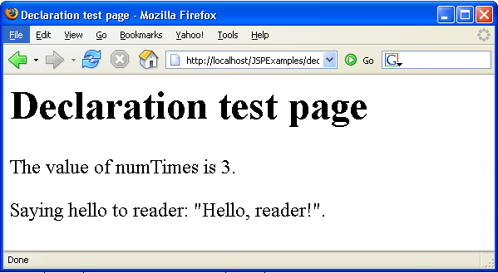
Output

Slide 24
JSP Scriptlet Example
<html>
<head>
<title>Scriptlet test page</title>
</head>
<body>
<h1>Scriptlet test page</h1>
<%
for(int i=0;i< 10;i++) {
out.println("<b>Hello World. This is a scriptlet test " + i +
"</b><br>");
System.out.println("This goes to the System.out stream " + i);
}
%>
</body>
</html>

Slide 25
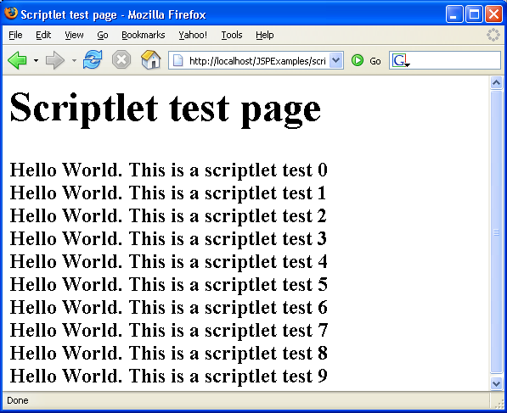
Output

Slide 26
JSP Expression Example
<html>
<head>
<title>Expression test page</title>
</head>
<body>
<h1>Expression test page</h1>
<%! int i=0 ; %>
<%
i++;
%>
Hello World!
<%= "This JSP has been accessed " + i + " times" %>
</body>
</html>

Slide 27
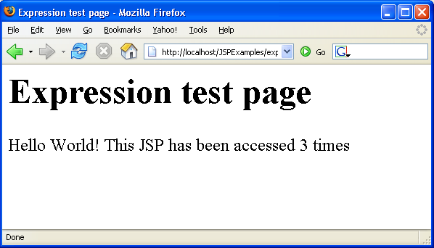
Output

Slide 28
Directives
The directive elements, specify information about the page itself that remains the same between requests
    for example if session tracking is required or not, buffering requirements, and the name of a page that should be used to report errors, if any, etc.
Syntax
  <%@ directivename attribute=“value” %>
The three main directives
  page directive
  include directive
  taglib directive

Slide 29
Directives
page directive
  Defines page-dependent attributes, such as session tracking, error page, and buffering requirements
Syntax
  <%@ page attribute=“value” %>
    <%@ page import="java.util.*,java.sql.*" %>
Attributes of Page directive
Name | Default value | Name | Default Value
language | Java | extends | ……
import | ……… | session | true
buffer |  | auto flush | true
isThreadSafe | true | info | …………
errorPage | ……… | isErrorPage | false
contentType | text/html

Slide 30
Directives
include directive
  Includes a file during the translation phase in place of the directive
Syntax
  <%@ include file=“filename” %>
    <%@ include file="header.html" %>
taglib directive
  Declares a tag library, containing custom actions, that is used in the page ( e.g. custom tags)
Syntax
  <%@ taglib uri=“location of tag library” %>

Slide 31
Page Directive Example
<%@ page language="Java" import="java.rmi.*,java.util.*"
session="true" buffer="12kb" autoFlush="true"
info="my page directive jsp" errorPage="error.jsp"
isErrorPage="false" isThreadSafe="true" %>
<html>
<head>
<title>Page directive test page</title>
</head>
<body>
<h1>Page directive test page</h1>
This is a JSP to test the page directive.
</body>
</html>

Slide 32
include Directive Example
<html>
<head>
<title>Include directive test page 1</title>
</head>
<body>
<h1>Include directive test page 1</h1>
<%@ include file="/copyright.html" %>
</body>
</html>

Slide 33
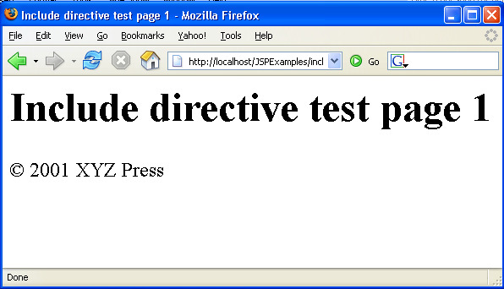
Output

Slide 34
Include Directive Example(2)
<html>
<head>
<title>Include directive test page 2</title>
</head>
<body>
<h1>Include directive test page 2</h1>
<%@ include file="included.jsp" %>
</body>
</html>

Slide 35
Include Directive Example(2)
included.jsp
<%@ page import="java.util.Date" %>
<%= "Current date is " + new Date() %>

Slide 36
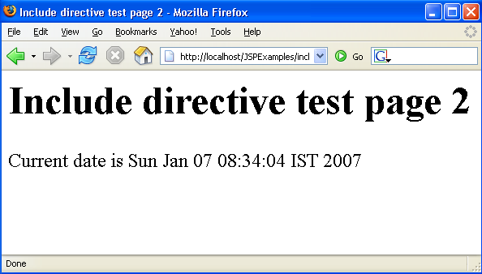
Output

Slide 37
Implicit Objects
A JSP page has access to certain implicit objects that are always available, without being declared first
Created by container
Corresponds to classes defined in Servlet
  These objects act as wrappers around underlying Java classes or interfaces typically defined within the Servlet API.

Slide 38
Implicit Objects
request: represents the HttpServletRequest
response: represents HttpServletResponse to the request.
pageContext: encapsulates implementation-dependent features in PageContext.
application: represents the ServletContext obtained from servlet configuration object.
out: a JspWriter object that writes into the output stream.
config: represents the ServletConfig for the JSP. Page scope.
page: synonym for the "this" operator, as an HttpJspPage.
session: An HttpSession. Session scope. More on sessions shortly.
exception: the uncaught Throwable object that resulted in the error page being invoked. Page scope.

Slide 39

Implicit Objects
Iimplicit objects are only visible within the system generated _jspService() method.
Theyare not visible within methods you define yourself in declarations.

Slide 40
JSP Actions
Action elements perform some action based on information that is required at the exact time the JSP page is requested by a browser.
An action can access parameters sent with the request to do a database lookup.
It can also dynamically generate HTML, such as a table filled with information retrieved from an external system.

Slide 41
JSP Actions
The JSP specification defines a few standard action elements
Action element | Description
<jsp:useBean> | Makes a JavaBeans component available in a page
<jsp:getProperty> | Gets a property value from a JavaBeans component and adds it to the response
<jsp:setProperty> | Sets a JavaBeans component property value
<jsp:include> | Includes the response from a servlet or JSP page during the request processing phase
<jsp:forward> | Forwards the processing of a request to servlet or JSP page
<jsp:param> | Adds a parameter value to a request handed off to another servlet or JSP page using <jsp:include> or <jsp:forward>
<jsp:plugin> | Generates HTML that contains the appropriate browser-dependent elements (OBJECT or EMBED) needed to execute an applet with the Java Plug-in software

Slide 42
include Action
Includes the response from a servlet or JSP page during the request processing phase

Slide 43
include Action Example
<html>
<head>
<title>Include Action test page</title>
</head>
<body>
<h1>Include Action test page</h1>
<h2>Using the include directive</h2>
<%@ include file="included2.html" %>
<%@ include file="included2.jsp" %>
<h2>Using the include action</h2>
<jsp:include page="included2.html" flush="true" />
<jsp:include page="included2.jsp" flush="true" />
</body>
</html>

Slide 44
forward Action
Forwards the processing of a request to servlet or JSP page

Slide 45
jsp:forward example(1)
forward.html
<html>
<head>
<title>Forward action test page</title>
</head>
<body>
<h1>Forward action test page</h1>
<form method="post" action="forward.jsp">
<p>Please enter your username:
<input type="text" name="userName">
<br>and password:
<input type="password" name="password">
</p>
<p><input type="submit" value="Log in">
</form>
</body>
</html>

Slide 46
jsp:forward example(2)
forward.jsp
<%
if ((request.getParameter("userName").equals("java")) &&
(request.getParameter("password").equals("java"))) {
%>
<jsp:forward page="forward2.jsp" />
<% } else { %>
<%@ include file="forward.html" %>
<% } %>

Slide 47
jsp:forward example(3)
forward2.jsp
<html>
<head>
<title>Forward action test: Login successful!</title>
</head>
<body>
<h1>Forward action test: Login successful</h1>
<p>Welcome, <%= request.getParameter("userName") %>
</body>
</html>

Slide 48
What are JavaBeans?
Java classes that can be easily reused and composed together into an application
Any Java class that follows certain design conventions can be a JavaBeans component
  properties of the class
  public methods to get and set properties
Within a JSP page, you can create and initialize beans and get and set the values of their properties
JavaBeans can contain business logic or data base access logic
JavaBeans components are Java classes that c

Slide 49
JavaBeans Design Conventions
JavaBeans maintain internal properties
A property can be
  Read/write, read-only, or write-only
  Simple or indexed
Properties should be accessed and set via getXxx and setXxx methods
  PropertyClass getProperty() { ... }
  setProperty(PropertyClass pc) { ... }
JavaBeans must have a zero-argument (empty) constructor

Slide 50
Why Use JavaBeans in JSP Page?
A JSP page can create and use any type of Java programming language object within a declaration or scriptlet like following:
  <%
  ShoppingCart cart = (ShoppingCart)session.getAttribute("cart");
  // If the user has no cart, create a new one
  if (cart == null) {
  cart = new ShoppingCart();
  session.setAttribute("cart", cart);
  }
  %>

Slide 51
Why Use JavaBeans in JSP Page?
JSP pages can use JSP elements to create and access the object that conforms to JavaBeans conventions
<jsp:useBean id="cart" class="cart.ShoppingCart“ scope="session"/>
Create an instance of “ShoppingCart” if none exists, stores it as an attribute of the session scope object, and makes the bean available throughout the session by the identifier “cart”

Slide 52
Compare the Two
  <%
  ShoppingCart cart = (ShoppingCart)session.getAttribute("cart");
  // If the user has no cart object as an attribute in Session scope
  // object, then create a new one. Otherwise, use the existing
  // instance.
  if (cart == null) {
  cart = new ShoppingCart();
  session.setAttribute("cart", cart);
  }
  %>
versus
  <jsp:useBean id="cart" class="cart.ShoppingCart"
  scope="session"/>

Slide 53
Why Use JavaBeans in JSP Page?
No need to learn Java programming language for page designers
Stronger separation between content and presentation
Higher reusability of code
Simpler object sharing through built-in sharing mechanism
Convenient matching between request parameters and object properties

Slide 54
Creating a JavaBeans
Declare that the page will use a bean that is stored within and accessible from the
specified scope by jsp:useBean element
  <jsp:useBean id="beanName"
  class="fully_qualified_classname" scope="scope"/>
or
  <jsp:useBean id="beanName"
  class="fully_qualified_classname" scope="scope">
  <jsp:setProperty .../>
  </jsp:useBean>

Slide 55
setting properties
To set a property of a bean use
<jsp:setProperty name="..."
property="..." value="..." />
To set a property using the value of a request parameter use
<jsp:setProperty name="..."
property="..." param="..." />

Slide 56
getting properties
To get a property of a bean use
<jsp:getProperty name="..."
property="..." />

