Slide 1
JavaScript

Slide 2
What is Java Script
JavaScript is the scripting language of the Web!
JavaScript is the most popular scripting language on the internet

Slide 3
What is Java Script
JavaScript was designed to add interactivity to HTML pages
JavaScript is a scripting language (a scripting language is a lightweight programming language)
A JavaScript consists of lines of executable computer code
A JavaScript is usually embedded directly into HTML pages
JavaScript is an interpreted language (means that scripts execute without preliminary compilation)
Everyone can use JavaScript without purchasing a license

Slide 4
What can a JavaScript Do?
JavaScript gives HTML designers a programming tool - HTML authors are normally not programmers, but JavaScript is a scripting language with a very simple syntax! Almost anyone can put small "snippets" of code into their HTML pages
JavaScript can put dynamic text into an HTML page - A JavaScript statement like this: document.write("<h1>" + name + "</h1>") can write a variable text into an HTML page
JavaScript can react to events - A JavaScript can be set to execute when something happens, like when a page has finished loading or when a user clicks on an HTML element
JavaScript can read and write HTML elements - A JavaScript can read and change the content of an HTML element
JavaScript can be used to validate data - A JavaScript can be used to validate form data before it is submitted to a server, this will save the server from extra processing
JavaScript can be used to detect the visitor's browser - A JavaScript can be used to detect the visitor's browser, and - depending on the browser - load another page specifically designed for that browser
JavaScript can be used to create cookies - A JavaScript can be used to store and retrieve information on the visitor's computer

Slide 5
How to Put a JavaScript Into an HTML Page
The HTML <script> tag is used to insert a JavaScript into an HTML page
<html>
<body>
<script type="text/javascript"> document.write("Hello World!")
</script>
</body>
</html>

Slide 6
JavaScript Where To ...
JavaScripts in the body section will be executed WHILE the page loads.
  <html>
  <head>
  </head>
  <body>
  <script type="text/javascript">
  ....
  </script>
  </body>
  <html>
JavaScripts in the head section will be executed when CALLED.
  <html>
  <head>
  <script type="text/javascript"> ....
  </script>
  </head>
  </html>

Slide 7
Using an External JavaScript
The external script cannot contain the <script> tag!
  <html>
  <head>
  <script src="xxx.js">
  </script>
  </head>
  <body>
  </body>
  </html>

Slide 8
HTML Versions and JavaScript
XHTML
  Most common version used with Ajax apps or Dynamic HTML apps (JavaScript apps that manipulate the DOM)
  Follows XML syntax, lowercase tags
HTML 5 (sort of)
  Growing in popularity for Ajax or DHTML apps.
  Version used now is basically XHTML but with a simpler DOCTYPE and <html> start tag
  Doesn’t matter if browser really supports HTML 5
HTML 4
  Very common in non-JavaScript apps
  Not recommended for Ajax apps

Slide 9
JavaScript Variables
A variable is a "container" for information you want to store
Rules for variable names:
  Variable names are case sensitive
  They must begin with a letter or the underscore character
IMPORTANT! JavaScript is case-sensitive! A variable named strname is not the same as a variable named STRNAME!

Slide 10
Declare a Variable
You can create a variable with the var statement:
  var strname = some value
You can also create a variable without the var statement:
  strname = some value

Slide 11
Variables in Java Script
Introduce with “var”
  For global variables (!) and local variables.
  No “var” for function arguments
You do not declare types
  Some people say JavaScript is “untyped” language, but technically it is “dynamically typed” language
  JavaScript is very liberal about converting types
There are only two scopes
  Global scope Be very careful with this when using Ajax.
    Can cause race conditions.
  Function (lexical) scope
  There is not block scope as in Java

Slide 12
Assign a Value to a Variable
You can assign a value to a variable like this:
  var strname = "Hege"Or like this:
  strname = "Hege

Slide 13
Operators and Statements
Almost same set of operators as Java
  + (addition and String concatenation), -, *, /
  &&, ||, ++, --, etc
  The == comparison is more akin to Java’s “equals”
  The === operator (less used) is like Java’s ==
Statements
Semicolons are technically optional
  But highly recommended
  – Consider
    return x
    Return
  x
They are not identical! The second one returns, then evaluates x. You should act as though semicolons are required as in Java.
Comments
  Same as in Java (/* ... */ and // ...)

Slide 14
JavaScript If...Else Statements

Slide 15
Example1
<script type="text/javascript">
var d = new Date()
var time = d.getHours()
if (time < 10)
{
document.write("<b>Good morning</b>")
}
</script>
<p>
This example demonstrates the If statement.
</p>
<p>
If the time on your browser is less than 10,
you will get a "Good morning" greeting.
</p>

Slide 16
JavaScript Popup Boxes
In JavaScript we can create three kind of popup boxes:
  Alert box
  Confirm box
  Prompt box.

Slide 17
Alert box
An alert box is often used if you want to make sure information comes through to the user.
When an alert box pops up, the user will have to click "OK" to proceed.
Syntax:
  alert("sometext")

Slide 18
Confirm Box
A confirm box is often used if you want the user to verify or accept something.
When a confirm box pops up, the user will have to click either "OK" or "Cancel" to proceed.
If the user clicks "OK", the box returns true. If the user clicks "Cancel", the box returns false.
Syntax:
  confirm("sometext")

Slide 19
Prompt Box
A prompt box is often used if you want the user to input a value before entering a page.
When a prompt box pops up, the user will have to click either "OK" or "Cancel" to proceed after entering an input value.
If the user clicks "OK" the box returns the input value. If the user clicks "Cancel" the box returns null.
Syntax:
  prompt("sometext","defaultvalue")

Slide 20
JavaScript Functions
A function is a reusable code-block that will be executed by an event, or when the function is called
To keep the browser from executing a script as soon as the page is loaded, you can write your script as a function.
A function contains some code that will be executed only by an event or by a call to that function.
You may call a function from anywhere within the page (or even from other pages if the function is embedded in an external .js file).
Functions are defined at the beginning of a page, in the <head> section

Slide 21
AN Example of a function
<html>
<head>
<script type="text/javascript">
function displaymessage() {
alert("Hello World!")
}
</script>
</head>
<body>
<form>
<input type="button" value="Click me!" onclick="displaymessage()" >
</form>
</body>
</html>

Slide 22
How to Define a Function
The syntax for creating a function is:
  function functionname(var1,var2,...,varX)
  {
  some code ;
  return something; // if required
  }

Slide 23
Loops in JavaScript
Two Types of Loops
  for loop
  while loop
JavaScript Break and Continue
  Break statement
  Use the break statement to break the loop.
  Continue statement
  Use the continue statement to break the current loop and continue with the next value.

Slide 24
JavaScript Events
Events are actions that can be detected by JavaScript
We define the events in the HTML tags.
Examples of events
  A mouse click
  A web page or an image loading
  Mousing over a hot spot on the web page
  Selecting an input box in an HTML form
  Submitting an HTML form
  A keystroke

Slide 25
Java Script Events
onload and onUnload
  The onload and onUnload events are triggered when the user enters or leaves the page
The onFocus, onBlur and onChange
  often used in combination with validation of form fields
    <input type="text" size="30" id="email" onchange="checkEmail()">;
onSubmit
  The onSubmit event is used to validate ALL form fields before submitting it
    <form method="post" action="xxx.htm" onsubmit="return checkForm()">

Slide 26
Java Script Events
onMouseOver and onMouseOut
  onMouseOver and onMouseOut are often used to create "animated" buttons
    <a href="http://www.jp.com" onmouseover="alert('An onMouseOver event');return false">
    <img src=“test.gif" width="100" height="30"> </a>

Slide 27
JavaScript Try...Catch Statement
The try...catch statement allows you to test a block of code for errors
Syntax
  try {
  //Run some code here
  } catch(identifier){
  //Handle exceptions here
  }

Slide 28
Example 1
<html>
<head>
<script type="text/javascript">
function message() {
adddlert("Welcome guest!")
}
</script>
</head>
<body>
<input type="button" value="View message" onclick="message()" />
</body>
</html>

Slide 29
Example 1
<html>
<head>
<script type="text/javascript">
var txt="" function message() {
try {
adddlert("Welcome guest!")
} catch(err) {
txt="There was an error on this page.\n\n“
txt+="Error description: " + err.description + "\n\n"
txt+="Click OK to continue.\n\n“
alert(txt)
}
}
</script>
</head>
<body>
<input type="button" value="View message" onclick="message()" />
</body>
</html>

Slide 30
The Throw Statement
The throw statement allows you to create an exception.
If you use this statement together with the try...catch statement, you can control program flow and generate accurate error messages.
Syntax
  throw(exception)
The exception can be a string, integer, Boolean or an object.
Note that throw is written in lowercase letters. Using uppercase letters will generate a JavaScript error!

Slide 31
The Throw Statement
<html>
<body>
<script type="text/javascript">
var x=prompt("Enter a number between 0 and 10:","")
try
{
if(x>10)
throw "Err1"
else if(x<0)
throw "Err2"
}
catch(er)
{
if(er=="Err1")
alert("Error! The value is to high")
if(er == "Err2")
alert("Error! The value is to low")
}
</script>
</body>
</html>

Slide 32
JavaScript The onerror Event
Using the onerror event is the old standard solution to catch errors in a web page
The onerror event is fired whenever there is a script error in the page
Syntax
  onerror=handleErr
  function handleErr(msg,url,l)
  {
  //Handle the error here
  return true or false
  }

Slide 33
<html>
<head>
<script type="text/javascript">
onerror=handleErr
var txt=""function handleErr(msg,url,l)
{
txt="There was an error on this page.\n\n"
txt+="Error: " + msg + "\n"
txt+="URL: " + url + "\n"
txt+="Line: " + l + "\n\n"
txt+="Click OK to continue.\n\n"
alert(txt)
return true
}function message()
{
adddlert("Welcome guest!")
}
</script>
</head><body>
<input type="button" value="View message" onclick="message()" />
</body></html>

Slide 34
JavaScript Objects Introduction
JavaScript is an Object Oriented Programming (OOP) language.
An OOP language allows you to define your own objects and make your own variable types

Slide 35
Properties
Properties are the values associated with an object.
the length property of the String object is used to return the number of characters in a string
  <script type="text/javascript">
  var txt="Hello World!"
  document.write(txt.length)
  </script>

Slide 36
Methods
Methods are the actions that can be performed on objects.
The toUpperCase() method of the String object displays a text in uppercase letters
  <script type="text/javascript">
  var str="Hello world!"
  document.write(str.toUpperCase())
  </script>

Slide 37
JavaScript String Objects
The String Object
  The String object is used to manipulate a stored piece of text

Slide 38
The Math Class
Almost identical to Java
  Like Java, static methods (Math.cos, Math.random, etc.)
    As we will see in next lecture, these are not really static methods, but syntax is similar to static methods in Java.
  Like Java, logs are base e, trig functions are in radians
Functions
  Math.abs, Math.acos, Math.asin, Math.atan, Math.atan2,Math.ceil, Math.cos, Math.exp, Math.floor, Math.log, Math.max, Math.min, Math.pow, Math.random,
Math.round, Math.sin, Math.sqrt, Math.tan
Constants
  Math.E, Math.LN10, Math.LN2, Math.LOG10E, Math.PI, Math.SQRT1_2, Math.SQRT2

Slide 39
JavaScript Date Object
The Date object is used to work with dates and times
Defining Dates
  var myDate=new Date()
Manipulate Dates
  set a Date object to a specific date (14th January 2010):
    var myDate=new Date() myDate.setFullYear(2010,0,14)
  set a Date object to be 5 days into the future:
    var myDate=new Date() myDate.setDate(myDate.getDate()+5)

Slide 40
JavaScript Date Object
Comparing Dates
  The following example compares today's date with the 14th January 2010
  var myDate=new Date()
  myDate.setFullYear(2010,0,14)
  var today = new Date()
  if (myDate>today)
  alert("Today is before 14th January 2010")
  else
  alert("Today is after 14th January 2010")

Slide 41
JavaScript Array Object
The Array object is used to store a set of values in a single variable name
Defining Arrays
  var myArray=new Array()
  var mycars=new Array()
    mycars[0]="Saab"
    mycars[1]="Volvo"
    mycars[2]="BMW“
  var mycars=new Array("Saab","Volvo","BMW")
var mycars=new Array(3)
mycars[0]="Saab"
mycars[1]="Volvo"
mycars[2]="BMW"

Slide 42
XML Parser
To read and update - create and manipulate - an XML document, you will need an XML parser

Slide 43
Microsoft's XML Parser
Microsoft's XML parser is a COM component that comes with Internet Explorer 5 and higher
Once Internet Explorer is installed, the parser is available to scripts
Microsoft's XML parser supports all the necessary functions to traverse the node tree, access the nodes and their attribute values, insert and delete nodes, and convert the node tree back to XML

Slide 44
Microsoft's XML Parser
To create an instance of Microsoft's XML parser with JavaScript, use the following code:
  var xmlDoc=new ActiveXObject("Microsoft.XMLDOM")
The following code loads an existing XML document ("note.xml") into Microsoft's XML parser:
  <script type="text/javascript">
  var xmlDoc=new ActiveXObject("Microsoft.XMLDOM")
  xmlDoc.async="false"
  xmlDoc.load("note.xml")
  ...
  </script>

Slide 45
XML Parser in Mozilla Browsers
Plain XML documents are displayed in a tree-like structure in Mozilla (just like IE)
Mozilla also supports parsing of XML data using JavaScript. The parsed data can be displayed as HTML.
To create an instance of the XML parser with JavaScript in Mozilla browsers, use the following code:
var xmlDoc=document.implementation.createDocument("ns","root",null)

Slide 46
XML Parser in Mozilla Browsers
var mlDoc=document.implementation
.createDocument("ns","root",null)
The first parameter, ns, defines the namespace used for the XML document
The second parameter, root, is the XML root element in the XML file
The third parameter, null, is always null because it is not implemented yet

Slide 47
Example
The following code loads an existing XML document ("note.xml") into Mozillas' XML parser:
  <script type="text/javascript">
  var xmlDoc=document.implementation.
  createDocument("","",null);
  xmlDoc.load("note.xml");
  ...
  </script>

Slide 48
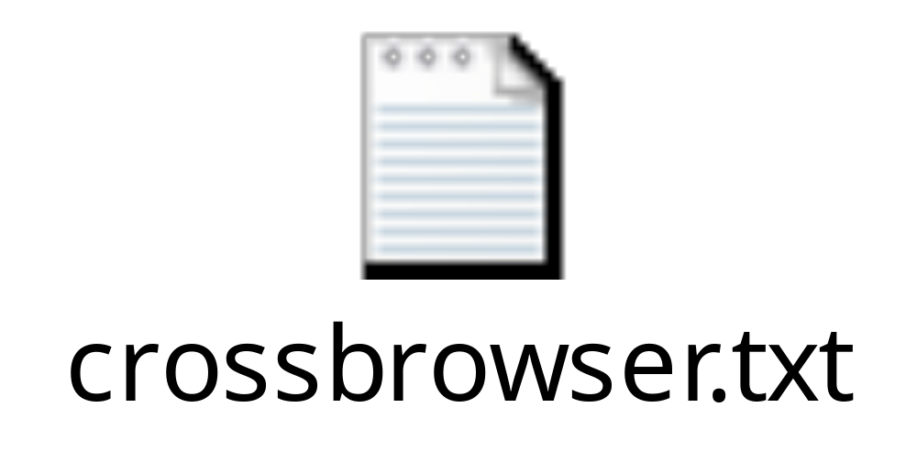
Loading an XML File - A Cross browser Example

Slide 49
Loading XML Text Into the Parser
Internet Explorer supports two ways of loading XML into a document object
the load() method and the loadXML() method
The load() method loads an XML file
The loadXML() method loads a text string that contains XML code

Slide 50
Example
<script type="text/javascript">
var txt="<note>"
txt=txt+"<to>Tove</to><from>Jani</from>"
txt=txt+"<heading>Reminder</heading>"
txt=txt+"<body>Don't forget me this weekend!</body>"
txt=txt+"</note>"
var xmlDoc=new ActiveXObject("Microsoft.XMLDOM")
xmlDoc.async="false"
xmlDoc.loadXML(txt)
...
</script>

Slide 51
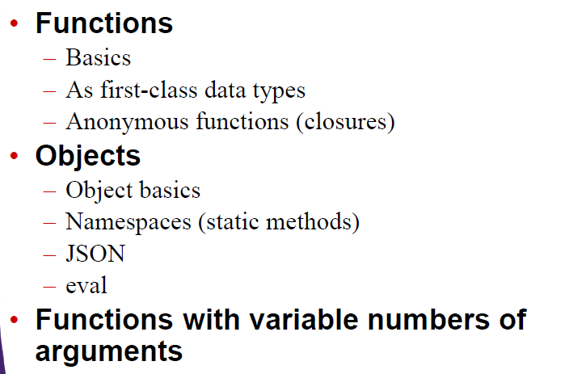
JavaScript Functions

Slide 52
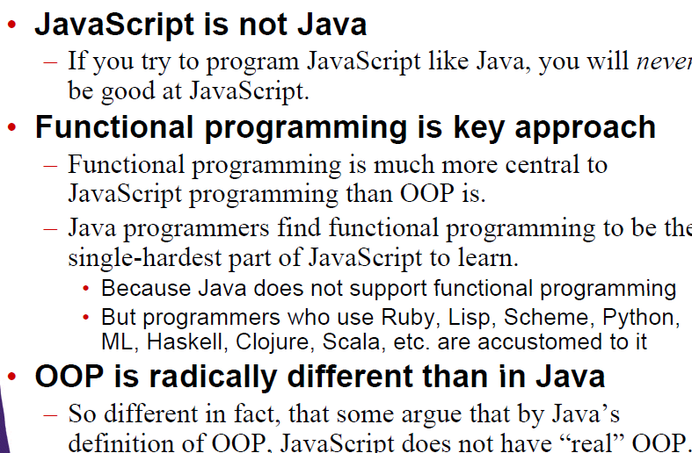
Getting good at Java Script

Slide 53
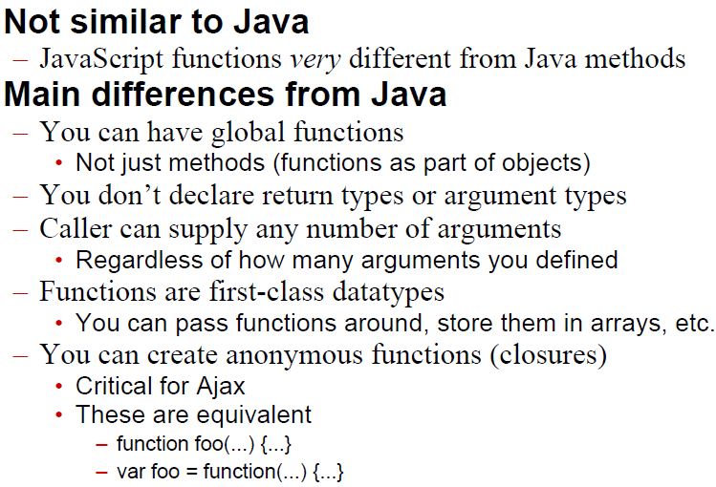
Functions

Slide 54
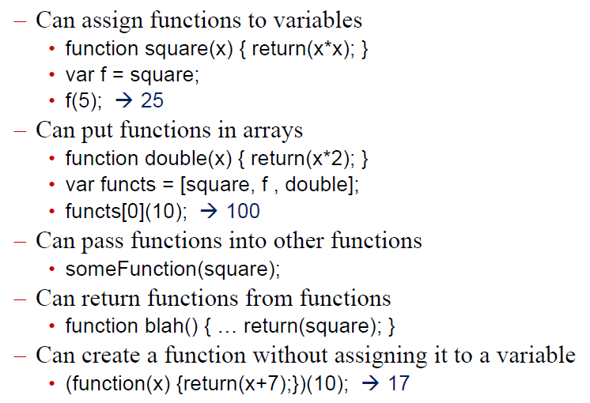
Functions Are First Class Data Types

Slide 55
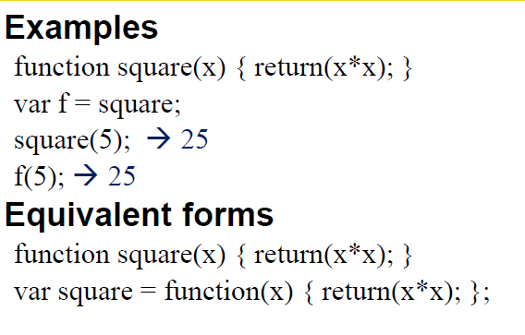
Assigning Functions to Variables

Slide 56
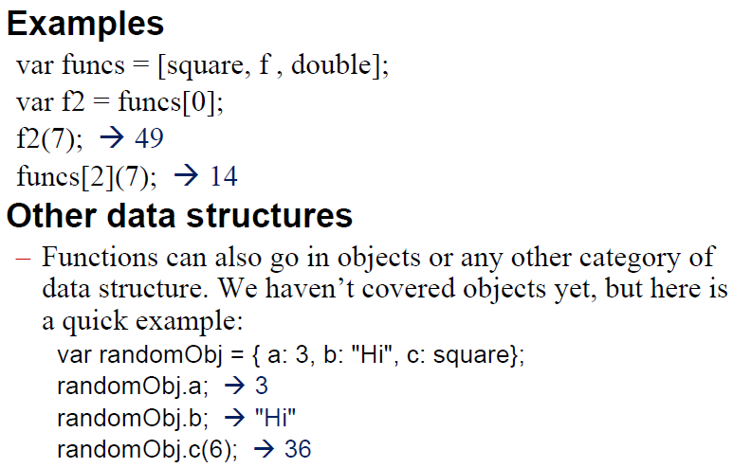
Putting Functions in Arrays

Slide 57
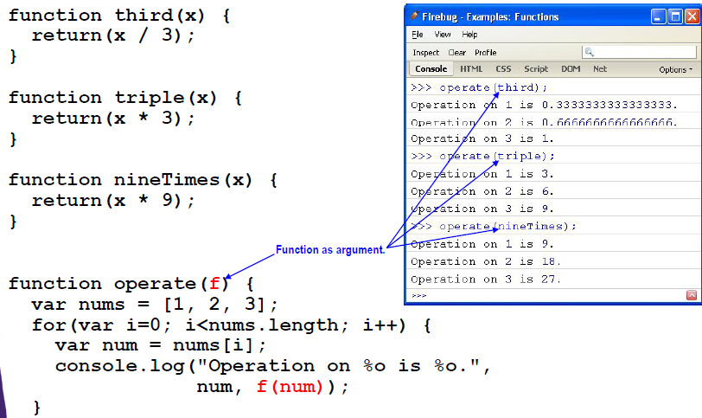
Passing Functions to Other Functions

Slide 58
Objects Basics

Slide 59
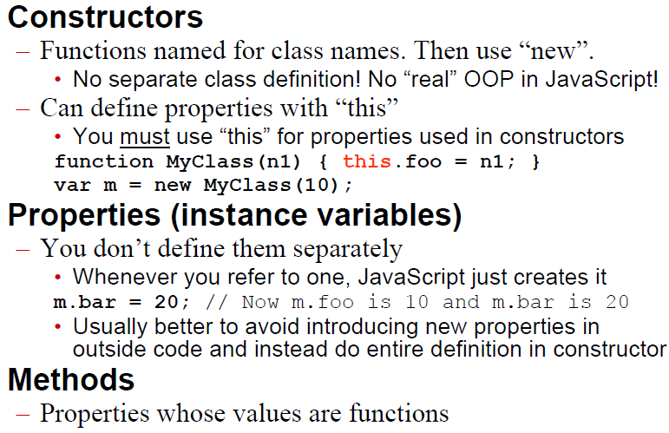
Basics

Slide 60
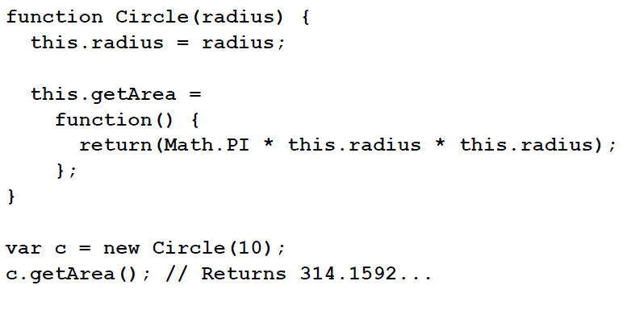
Object: An Example

Slide 61
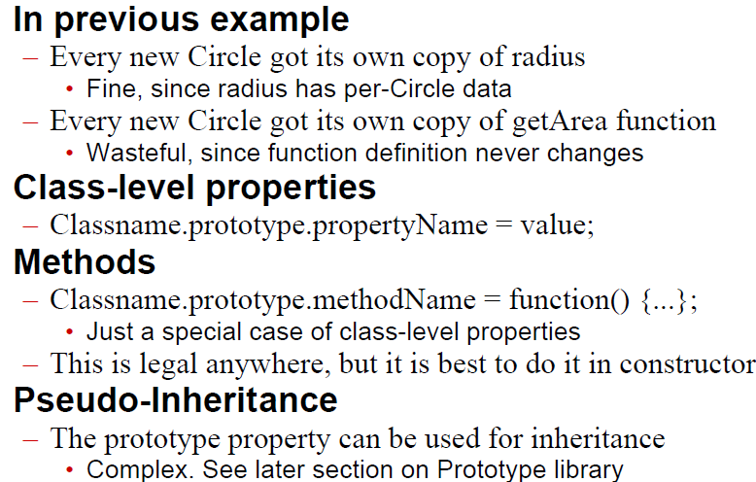
The prototype Property

