Slide 1
Angular UI Framework 8.0
Let’s build UI Smartly
Prerequisites: HTML,CSS, JavaScript (basics)

Slide 2
Agenda
Angular Framework
Elements of Angular Framework
Set Up your Environment
Angular programing elements
Modules
Component
Data Binding
Directives
Service
Dependency Injection

Slide 3
What is Angular?
Angular is a platform and framework for building client applications in HTML and TypeScript.
Angular is written in TypeScript. It implements core and optional functionality as a set of TypeScript libraries that you import into your apps.
Great for Single Page Applications(SPA)

Slide 4
Development Environment
Node JS
npm
Angular CLI
An Editor (like Visual Studio Code)
Steps
Install Node JS (Latest Stable)
Open a command Prompt and install Angular CLI
npm install –g @angular/cli

Slide 5
Angular Architecture
Building Blocks of Angular

Slide 6
Modules
Angular Applications are collection of modules
Each application has one or more modules
One application will have at least one module
Every Angular application has one root module named as AppModule
Root Module → AppModule
Modules are written in TypeScript
Files are Named as .module.ts
e.g. app.module.ts → root module
Angular App
module
module
customer
admin

Slide 7
Components
Controls the portion of view part
One component generally controls a portion of view
Every Angular application has at least one root component named AppComponent
Component1
(e.g. Navigation bar)
Component 2
(Side Bar)
Component 3
(Main Content)

Slide 8
Components
Root Component will nest other components
AppModule
RootComponent
navigation
Side bar
body
component2
component3
component1

Slide 9
Components
Every Component has
HTML Template
Class (TypeScript)
The class handles the logic for managing view
Component
< >
< >
Property Binding
Code
Event Binding
Template
Component Class

Slide 10
Services
Services are TypeScript Classes
They handle business logic for the UI
Reusable
Used to make http call to remote servers
Can be injected into a component class
Module
Component
Service

Slide 11
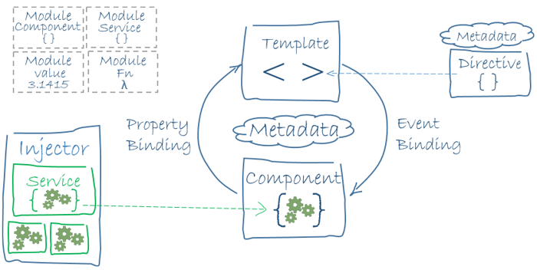
Summary
Angular App --- One or more angular modules
Module ---- One or more components and services
Image courtesy : http://angular.io

Slide 12
Inter Component Communication (send data from one component and receive it in other)
Details
Master
Details-component display
<app-heroes></app-heroes>
<h1>{{parentData}}</h1>
4
<app-hero-details [parentData] =“data”></app-hero-details>
3
1
@Component({
selector: 'app-heroes',
templateUrl: './heroes.component.html',
styleUrls: ['./heroes.component.css']
})
export class HeroesComponent implements OnInit {
data=“hello”;
2
@Component({
selector: 'app-hero-detail',
templateUrl: './hero-detail.component.html',
styleUrls: ['./hero-detail.component.css']
})
export class HeroDetailComponent implements OnInit {
@Input() parentData: String;
}

