Slide 1
Apache Maven

Slide 2
What is Apache Maven
Apache Maven is a project management and build automation tool.
You use maven to create and manage your projects.
It builds and deploys the projects as well.

Slide 3
Why Use Maven?
Simple project setup that follows best practices
Maven tries to avoid as much configuration as possible, by supplying project templates (named archetypes)
Dependency management
it includes automatic updating, downloading and validating the compatibility, as well as reporting the dependency closures (known also as transitive dependencies)
Isolation between project dependencies and plugins
with Maven, project dependencies are retrieved from the dependency repositories while any plugin’s dependencies are retrieved from the plugin repositories, resulting in fewer conflicts when plugins start to download additional dependencies
Central repository system
project dependencies can be loaded from the local file system or public repositories, such as Maven Central

Slide 4
Architecture of Maven
Maven does not do all the things itself other than validating and parsing the configuration XML file named ‘pom.xml’.
Maven uses Plugins to perform all the tasks for building the project
Maven
Plugin
Plugin
Goal
Goal
Goal
Goal

Slide 5
Project Object Management(POM)
POM is the fundamental unit of work in Maven
Maven projects are configured using an XML file named ‘pom.xml’ called ‘Project Object Management (POM)’ file.
The POM describes the project, manages dependencies, and configures plugins for building the software.

Slide 6
A Sample POM
<project>
<modelVersion>4.0.0</modelVersion>
<groupId>com.demo</groupId>
<artifactId>simple-app</artifactId>
<packaging>jar</packaging>
<version>1.0-SNAPSHOT</version>
<name>simple-app</name>
<dependencies>
<dependency>
<groupId>junit</groupId>
<artifactId>junit</artifactId>
<version>4.12</version>
<scope>test</scope>
</dependency>
</dependencies>
<build>
<plugins>
<plugin>
//...
</plugin>
</plugins>
</build>
</project>

Slide 7
Super POM
The Super POM is Maven's default POM.
All POMs extend the Super POM unless explicitly set, meaning the configuration specified in the Super POM is inherited by the POMs you created for your projects

Slide 8
Maven Co-Ordinates
Maven uses a set of identifiers to identify a project uniquely and to manage the dependencies.
These identifiers are known as ‘Maven Co ordinates’
groupId
A unique base name of the project creator organisation.
Organisation domain is used more frequently
artifactId
A unique name given to the project
version
The project release version
packaging
How the build shoud be packaged e.g. JAR,WAR,EAR etc.

Slide 9
Maven Coordinates
groupId:artifactId:version
forms the unique Identifier
<dependency> <groupId>org.springframework</groupId> <artifactId>spring-context </artifactId>
<version>5.1.2.RELEASE</version>
</dependency>

Slide 10
Dependency Management
Every project uses some dependency libraries (e.g JAR File).
Maven’s dependency management feature downloads libraries(jars) from central Repository to satisfy project’s needed dependency.
Once downloaded, the library jars are cached locally in <user_home>/.m2 folder.
The downloaded library is reused for other projects.
You don’t have to store them locally

Slide 11
Dependency Management
You declare the dependency as follows:
<dependency> <groupId>org.springframework</groupId> <artifactId>spring-context </artifactId>
<version>5.1.2.RELEASE</version>
</dependency>
The library jar and its dependency will be downloaded and cached in <USER_HOME/.m2

Slide 12
Maven Repositories
Maven stores build artifacts and dependencies of varying types in a repository.
The default local repository is located in the .m2/repository folder under the home directory of the user.
If an artifact or a plug-in is available in the local repository, Maven uses it. Otherwise, it is downloaded from a central repository and stored in the local repository. The default central repository is Maven Central

Slide 13
Third Party Repositories
Some libraries, e.g. those from Oracle, JBoss etc are not available in the central repository.
The companies maintain their own public repository.
For example, you can configure such repositories as follows :
Repository URL
<repositories>
<repository>
<id>JBoss repository</id>
<url>http://repository.jboss.org/nexus/content/groups/public/</url>
</repository>
</repositories>

Slide 14
Maven Properties
Properties can help to make your pom.xml file easier to read and maintain.
Developer generally defines one or more custom properties in pom.xml
Maven properties are value-placeholders and are accessible anywhere within a pom.xml by using the notation ${name}, where name is the property.
<properties>
<spring.version>5.1.4.RELEASE</spring.version>
</properties>
<dependencies>
<dependency>
<groupId>org.springframework</groupId>
<artifactId>spring-core</artifactId>
<version>${spring.version}</version>
</dependency>
<dependency>
<groupId>org.springframework</groupId>
<artifactId>spring-context</artifactId>
<version>${spring.version}</version>
</dependency>
</dependencies>

Slide 15
Build

Slide 16
Maven Build Lifecycles

Slide 17
Maven Build Lifecycle
Every Maven build follows a specified lifecycle.
You can execute several build lifecycle goals e.g.
compile the project’s code
create a package
install the archive file in the local Maven dependency repository.

Slide 18
Lifecycle Phases
The most important Maven lifecycle phases:
validate – checks the correctness of the project
compile – compiles the provided source code into binary artifacts
test – executes unit tests
package – packages compiled code into an archive file
integration-test – executes additional tests, which require the packaging
verify – checks if the package is valid
install – installs the package file into the local Maven repository
deploy – deploys the package file to a remote server or repository

Slide 19
Plugins and Goals
A Maven plugin is a collection of one or more goals.
Goals are executed in phases, which helps to determine the order in which the goals are executed.

Slide 20
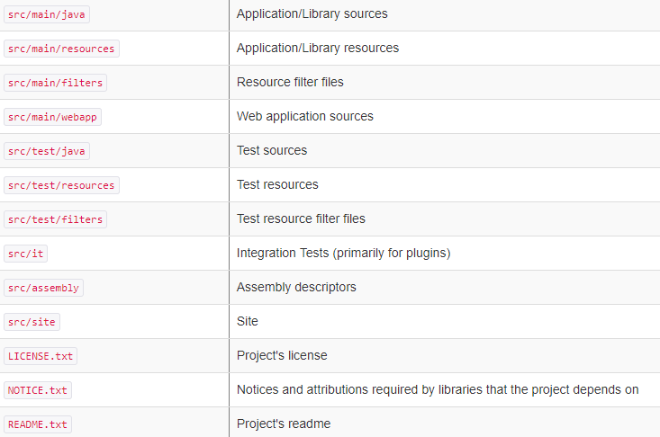
Maven Project Directory Layout

Slide 21
Maven Archetypes
Archetype is a Maven project templating toolkit.
An archetype is defined as an original pattern or model from which all other things of the same kind are made.
You use : mvn archetype:generate command to start creating a templated maven project
Example to create a simple java project:
mvn -B archetype:generate \
-DarchetypeGroupId=org.apache.maven.archetypes \
-DgroupId=com.demo.app \
-DartifactId=myapp

Slide 22
Create a Simple Maven Project
mvn -B archetype:generate \
-DarchetypeGroupId=org.apache.maven.archetypes
-DgroupId=com.demo.app \
-DartifactId=myapp
<project ..schema details ommited..>
<modelVersion>4.0.0</modelVersion>
<groupId>com.demo.app</groupId>
<artifactId>myapp</artifactId>
<packaging>jar</packaging>
<version>1.0-SNAPSHOT</version>
<name>myapp</name>
<url>http://maven.apache.org</url>
<dependencies>
<dependency>
<groupId>junit</groupId>
<artifactId>junit</artifactId>
<version>3.8.1</version>
<scope>test</scope>
</dependency>
</dependencies>
</project>

Slide 23
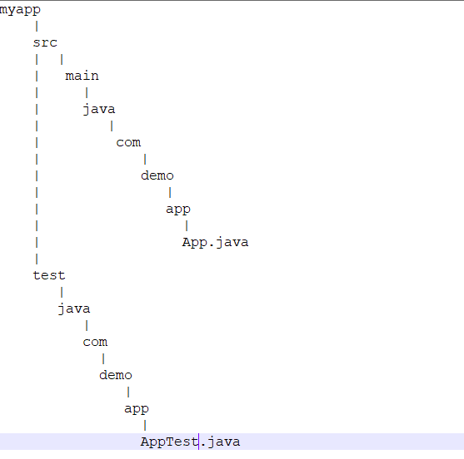
Created Directory Structure

Slide 24
Let’s Play with Maven now… Install, run and create Projects and Test..

