Slide 1
Spring Framework Basics

Slide 2
Topics
What is Spring framework?
Why Spring framework?
Spring framework architecture
Usage scenario
Dependency Injection (DI)
BeanFactory
Autowiring
ApplicationContext

Slide 3
Introduction to Spring Framework

Slide 4
Goal Of Spring Framework
The Spring Framework Mission Statement
J2EE should be easier to use
It's best to program to interfaces, rather than classes. Spring reduces the complexity cost of using interfaces to zero
JavaBeans offer a great way of configuring applications
OO design is more important than any implementation technology, such as J2EE
Checked exceptions are overused. A framework should not force to catch

Slide 5
What is Spring Framework? (1)
Light-weight yet comprehensive framework for building Java SE and Java EE applications
Spring Framework is a software library to build Java SE and Java Enterprise applications

Slide 6
Overview Of Spring Framework
The Spring Framework is a lightweight solution and a potential one-stop-shop for building your enterprise-ready applications.
Spring is modular, allowing you to use only those parts that you need, without having to bring in the rest.
You can use the IoC container, with Struts on top, but you can also use only the Hibernate integration code or the JDBC abstraction layer.
The Spring Framework supports declarative transaction management, remote access to your logic through RMI or web services, and various options for persisting your data.
It offers a full-featured MVC framework, and enables you to integrate AOP transparently into your software.

Slide 7
Overview Of Spring Framework
Spring is designed to be non-intrusive, meaning that your domain logic code generally has no dependencies on the framework itself.
In your integration layer (such as the data access layer), some dependencies on the data access technology and the Spring libraries will exist.
However, it should be easy to isolate these dependencies from the rest of your code base

Slide 8
Key Features (1)
JavaBeans-based configuration management, applying Inversion-of-Control principles, specifically using the Dependency Injection technique
This aims to reduce dependencies of components on specific implementations of other components.
A core bean factory, which is usable globally
Generic abstraction layer for database transaction management

Slide 9
Key Features (2)
Built-in generic strategies for JTA and a single JDBC DataSource
This removes the dependency on a Java EE environment for transaction support.
Integration with persistence frameworks Hibernate, JDO and iBATIS.
MVC web application framework, built on core Spring functionality, supporting many technologies for generating views, including JSP, FreeMarker, Velocity, Tiles, iText, and POI.

Slide 10
Key Features (3)
Extensive aspect-oriented programming (AOP) framework to provide services such as transaction management
As with the Inversion-of-Control parts of the system , this aims to improve the modularity of systems created using the framework.

Slide 11
Why Use Spring Framework?

Slide 12
Why Use Spring?
Wiring of components through Dependency Injection
Promotes de-coupling among the parts that make the application
Design to interfaces
Insulates a user of a functionality from implementation details
Test-Driven Development (TDD)
POJO classes can be tested without being tied up with the framework

Slide 13
Why Use Spring?
Declarative programming through AOP
Easily configured aspects, esp. transaction support
Simplify use of popular technologies
Abstractions insulate application from specifics, eliminate redundant code
Handle common error conditions
Underlying technology specifics still accessible

Slide 14
Why Use Spring?
Conversion of checked exceptions to unchecked
Extremely modular and flexible
Well designed
Easy to extend
Many reusable classes

Slide 15
Why Use Spring?
Integration with other technologies
EJB for J2EE
Hibernate, iBates, JDBC (for data access)
Velocity (for presentation)
Struts and WebWork (For web)

Slide 16
Spring Framework Architecture

Slide 17
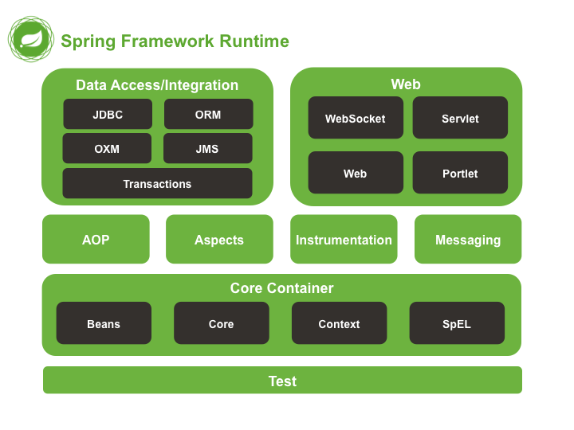
Spring Framework Modules

Slide 18
Usage Scenarios

Slide 19
Usage Scenarios
You can use Spring in all sorts of scenarios, from applets up to fully-fledged enterprise applications using Spring's transaction management functionality and web framework integration

Slide 20
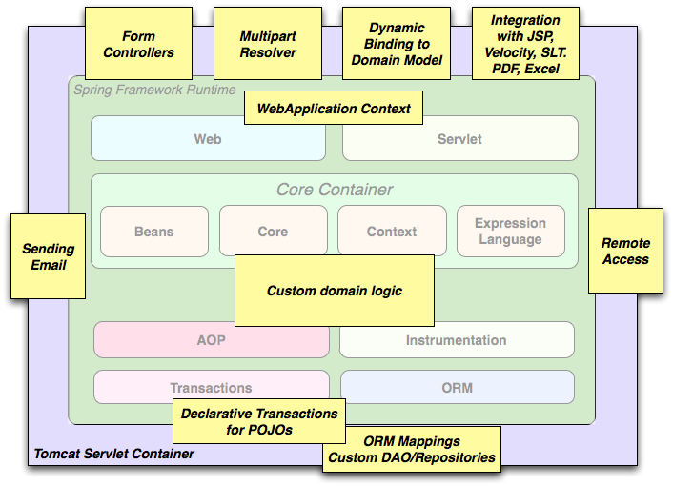
Typical Full-fledged Spring Web Application

Slide 21
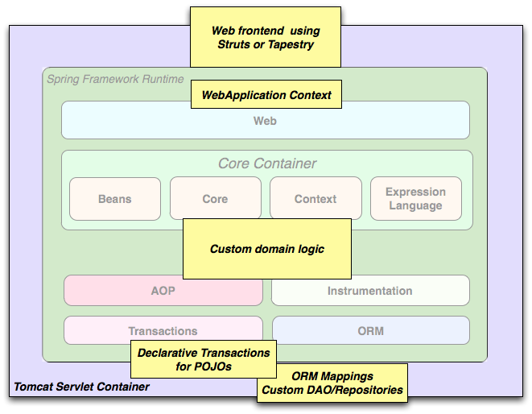
Spring Middle-tier Using 3rd party Web Framework

Slide 22
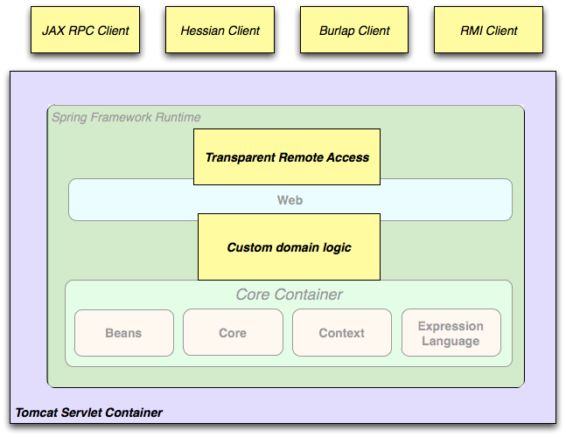
Remoting Usage Scenario

Slide 23
The IOC Container and Dependency Injection

Slide 24
Dependency Injection (DI): Basic concept

Slide 25
Spring Dependency Injection
A kind of Inversion of Control (IoC)
“Container” resolves (injects) dependencies of components by setting implementation object (push)
As opposed to component instantiating or Service Locator pattern where component locates implementation (pull)
Martin Fowler calls Dependency Injection

Slide 26
Two Dependency Injection Variants
Constructor dependency Injection
Dependencies are provided through the constructors of the component
Setter dependency injection
Dependencies are provided through the JavaBean style setter methods of the component
More popular than Constructor dependency injection

Slide 27
Constructor Dependency Injection
public class ConstructorInjection {
private Dependency dep;
public ConstructorInjection(Dependency dep) {
this.dep = dep;
}
}

Slide 28
Setter Dependency Injection
public class SetterInjection {
private Dependency dep;
public void setMyDependency(Dependency dep) {
this.dep = dep;
}
}

Slide 29
Dependency Injection (DI): DI Support in Spring
Beans and Containers

Slide 30
Beans
In Spring, those objects that form the backbone of your application and that are managed by the Spring IoC container are referred to as beans.
A bean is simply an object that is instantiated, assembled and otherwise managed by a Spring IoC container
there is nothing special about a bean (it is in all other respects one of probably many objects in your application).
These beans, and the dependencies between them, are reflected in the configuration metadata used by a container

Slide 31
The IoC container
The org.springframework.beans and org.springframework.context packages provide the basis for the Spring Framework's IoC container.
The BeanFactory interface provides an advanced configuration mechanism capable of managing objects of any nature.
The ApplicationContext interface builds on top of the BeanFactory (it is a sub-interface) and adds other functionality such as
easier integration with Spring's AOP features
message resource handling (for use in internationalization),
event propagation, and application-layer specific contexts such as the WebApplicationContext for use in web applications.

Slide 32
The container
The org.springframework.beans.factory.BeanFactory is the actual representation of the Spring IoC container that is responsible for containing and otherwise managing the aforementioned beans.
The BeanFactory interface is the central IoC container interface in Spring.
Its responsibilities include instantiating or sourcing application objects, configuring such objects, and assembling the dependencies between these objects.

Slide 33
Important Application Contexts
ClassPathXmlApplicationContext
WebApplicationContext
FileSystemApplicationContext
AnnotationConfigApplicationContext

Slide 34
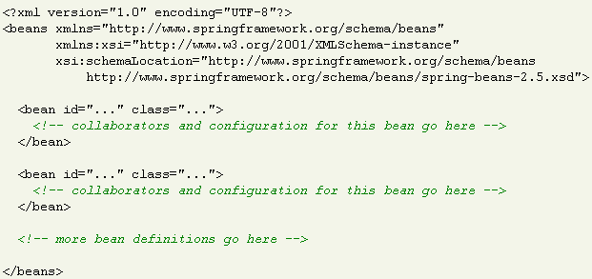
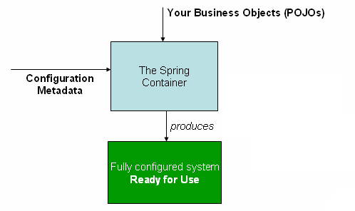
Configuration metadata
The Spring IoC container consumes some form of configuration metadata
This configuration metadata is nothing more than how you inform the Spring container as to how to “instantiate, configure, and assemble [the objects in your application]”. This configuration metadata is typically supplied in a simple and intuitive XML format.

Slide 35
Instantiating a container
Instantiating a Spring IoC container is straightforward.
ApplicationContext ctx=
new ClassPathXMLApplicationCOntext("context.xml");

Slide 36
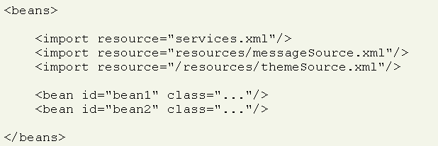
Composing XML-based configuration metadata
It can often be useful to split up container definitions into multiple XML files.
Notes:
One way to then load an application context which is configured from all these XML fragments is to use the application context constructor which takes multiple Resource locations. With a bean factory, a bean definition reader can be used multiple times to read definitions from each file in turn.
Generally, the Spring team prefers the above approach, since it keeps container configuration files unaware of the fact that they are being combined with others. An alternate approach is to use one or more occurrences of the <import/> element to load bean definitions from another file (or files). Let's look at a sample

Slide 37
Wiring a Bean

Slide 38
Beans
The term “bean” is used to refer any component managed by the BeanFactory
The “beans” are in the form of JavaBeans (in most cases)
no arg constructor
getter and setter methods for the properties
Beans are singletons by default
Properties the beans may be simple values or references to other beans
Beans can have multiple names

Slide 39
What is Wiring?
The act of creating associations between application components is referred to as wiring
There are many ways to wire a bean but common approach is via XML

Slide 40
Wiring example
<?xml version="1.0" encoding="UTF-8"?>
<!DOCTYPE beans PUBLIC "-//SPRING//DTD BEAN//EN"
"http://www.springframework.org/dtd/spring-beans.dtd">
<beans>
<bean id="greetBean“ class="GreetingServiceImpl">
<property name="greeting">
<value>Hello friends of Spring</value>
</property>
</bean>
</beans>

Slide 41
Wiring the beans
Prototype and Singleton beans
all spring beans are singleton
<bean id =“myBean” class=“com.jp.TestBean”
scope=“singletone”/>
Scope attribute has values:
Singleton
Prototype
Request
Session
Application
WebSocket

Slide 42
Wiring the beans
Initialization and Destruction
beans can be initialized and destroyed by calling bean specific methods
init-method : calls bean specific initialization method
destroy-method : calls bean specific cleanup method

Slide 43
Wiring the beans
Initialization and Destruction (example)
public class MyConnectionPool {
public void initialize(){
//initialize a connection;
}
public void cleanup() {
//release connection;
}
}
configuration:
<bean id=“myBean” class =“com.jp.MyConnectionPool”
init-method=“initialize” destroy-method=“cleanup” />

Slide 44
Spring Dependency Injection Revisited
Two types of Dependency Injection
setter injection
dependency injected via setter methods
constructor injection
dependency injected via constructor

Slide 45
Spring Dependency Injection
Setter Injection
<bean id=“test” class=“com.jp.TestBean”>
<property name=“greeting”>
<value>Hello friends</value>
</property>
</bean>
Set the greet property by
calling setGreeting( “Hello Friends” )

Slide 46
Spring Dependency Injection
Referencing other beans
<beans>
<bean id=“test” class =“com.jp.TestBean”>
<property name=“greeting”>
<ref bean=“greetBean”/>
</property>
<bean id=“greetBean” class =“com.jp.GreetBean” />
<beans>

Slide 47
Spring Dependency Injection
Constructor Injection
<bean id=“test” class=“com.jp.testBean”>
<constructor-arg>
<value>Hello friends</value>
</constructor-arg>
</bean>
<bean id=“test” class=“com.jp.testBean”>
<constructor-arg>
<ref bean=“greetBean”/>
</constructor-arg>
</bean>
constructs a
TestBean
object through
its constructor

Slide 48
Dependency Injection: Autowiring

Slide 49
Auto Wiring
So far we wired beans explicitly using <property> tag
Spring can also do Wiring automatically
<bean id="foo" class="com.jp.spring.Foo“ autowire= "autowire type"/>

Slide 50
Autowiring Properties
Beans may be auto-wired (rather than using <ref>)
Per-bean attribute autowire
Explicit settings override
autowire=“byName”
Bean identifier matches property name
autowire=“byType”
Type matches other defined bean
autowire=”constructor”
Match constructor argument types
autowire=”autodetect”
Attempt by constructor, otherwise “type”
Autowire=“no”
no autowire is allowed

Slide 51
Bean Naming
Each bean must have at least one name that is unique within the containing BeanFactory
Name resolution procedure
If a <bean> tag has an id attribute, the value of the id attribute is used as the name
If there is no id attribute, Spring looks for name attribute
If neither id nor name attribute are defined, Spring use the class name as the name
A bean can have multiple names
Specify comma or semicolon-separated list of names in the name attribute

Slide 52
Bean Naming Example
<bean id=”mybeanid” class=”mypackage.MyClass”/>
<bean name=”mybeanname” class=”mypackage.MyClass”/>
<bean class=”mypackage.MyClass”/>
<bean id=”mybeanid” name=”name1,name2,name3”
class=”mypackage.MyClass”/>

Slide 53
Spring Framework Annotations
Limited to Spring Core Configuration

Slide 54
Annotations To Define a Bean
Type Level Annotations (Used before Class definition)
@Component
@Service
@Repository
@Controller
@Configuration
Method Level Annotations (used before method)
@Bean

Slide 55
Examples (Type level)
@Repository
public class JdbcDaoImpl{
}
@Service
public class EmpService{
}
@Component
public class PrintAspect{
}
@Controller
public class LoginController{
}

Slide 56
Examples (method level)
@Configuration
public class JdbcConfig {
@Bean
public DriverManagerDataSource dataSource() {
//your code goes here
return ds;
}

Slide 57
How Dependency is Injected
Use @Autowired at the injection point to inject Dependency
@Autowired can be used at following levels
Type
Field
Method

Slide 58
Example @Autowired
@Service
public class HrService {
@Autowired
private EmpDao dao;
public String registerEmp(int id, String name, String city, double salary) {
String resp=dao.save(new Emp(id, name, city, salary));
return resp;
}
}

Slide 59
Loading Annotated Beans
Every Spring Application has at least one Configuration class
annotated with @Configuration
Spring Framework uses @ComponentScan to locate annotated beans in the project
You are generally advised to keep the main configuration class in the base package.

Slide 60
An Example
@Configuration
@ComponentScan(basePackages="com.demo.spring")
public class AppConfig {
@Bean
public EmpDaoJPAImpl jpaBean() {
return new EmpDaoJPAImpl();
}
}
ApplicationContext ctx
=new AnnotationConfigApplicationContext(AppConfig.class);
The Spring Container will be created from the AppConfig Class
and spring will scan all the sub packages of “com.demo.spring” including
the base package

Slide 61
Demo
We will See some Demonstration on Spring Annotations

