Slide 1
Microservices

Slide 2
Module Outline
Defining Microservices
Microservices Explanation
Understanding the Monolith
Understanding Microservices
Practical Considerations

Slide 3
What are Microservices?
Presently a lot of hype!
Best described as:
An architectural style
An alternative to more traditional 'monolithic' applications Decomposition of single system into a suite of small services, each running as independent processes and intercommunicating via open protocols
With all the benefits / risks this implies.

Slide 4
Definitions from the Experts
Developing a single application as a suite of small services, each running in its own process and communicating with lightweight mechanisms, often an HTTP resource API.
-Martin Fowler
Fine-grained SOA
–Adrian Cockcroft - Netflix

Slide 5
Microservices – Working Definition:
Composing a single application using a suite of small services …..(rather than a single, monolithic application)
… each running as independent processes (not merely modules / components within a single executable)
… intercommunicating via open protocols (Like HTTP/REST, or messaging)
…Separately written, deployed, scaled and maintained
(potentially in different languages)
Services encapsulate business capability (rather than language constructs (classes, packages) as primary way to encapsulate.
Services are independently replaceable and upgradable

Slide 6
Microservices are not:
The same as SOA
SOA is about integrating various enterprise applications. Microservices are mainly about decomposing single applications
A Solution for Everything!!
The microservices approach involves drawbacks and risks
It’s New! You may be using microservices now and not know it!

Slide 7
Microservices Example
Consider a monolithic shopping cart application:
Web / mobile interfaces
Functions for:
Searching for products
Product catalog
Inventory management
Shopping cart
Checkout
Fufillment
How would this look with microservices?

Slide 8
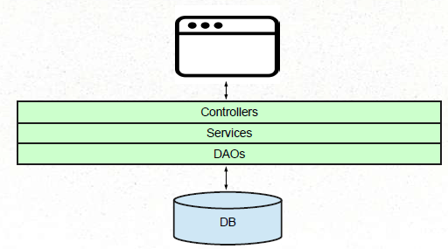
Monolithic Application Example
Monolithic Shopping cart Application
Image courtesy: Ken Krueger

Slide 9
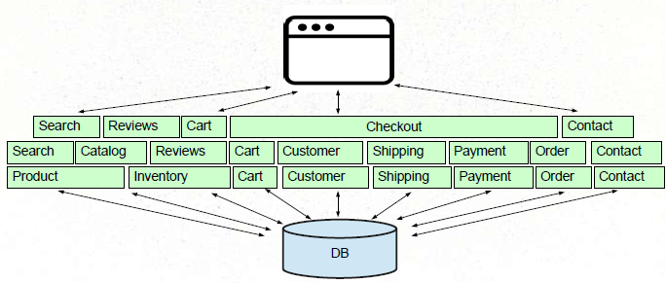
Monolithic Application Example
Understanding the Monolithic Architecture
Image courtesy: Ken Krueger

Slide 10
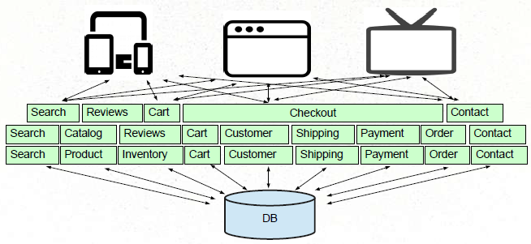
Challenges in Monolithic Applications
New Types of Client Applications
Image courtesy: Ken Krueger

Slide 11
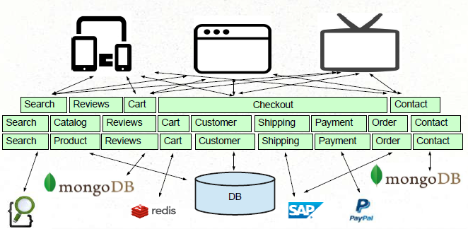
Challenges In Monolithic Application
New types of persistence / services

Slide 12
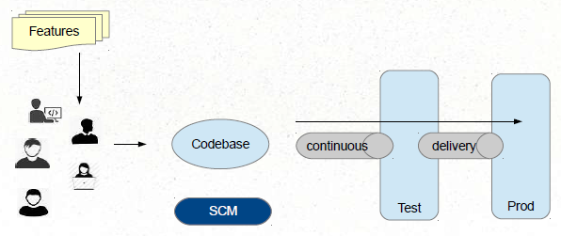
Challenges In Monolithic Application
Single Codebase, Deployment, Versioning, Team Size

Slide 13
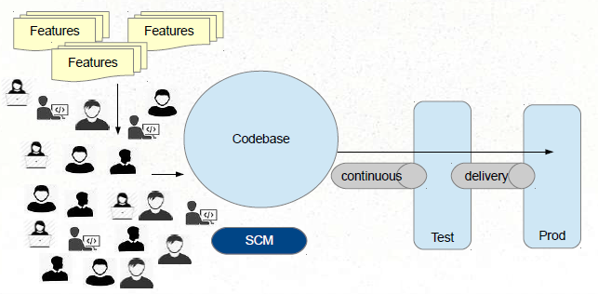
Challenges In Monolithic Application
Single Codebase, Deployment, Versioning, Team Size

Slide 14
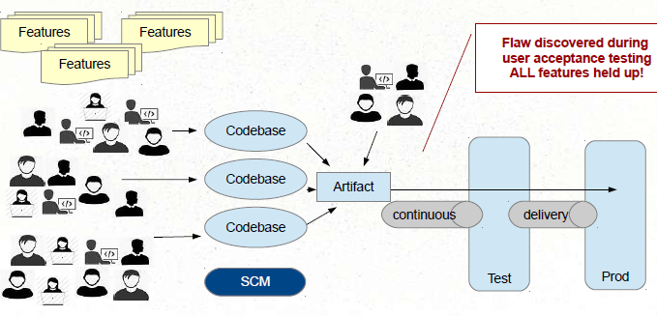
Challenges In Monolithic Application
Single Codebase, Deployment, Versioning, Team Size

Slide 15
Monolithic Implementation
Single application executable
Easy to comprehend, but not to digest. Must be written in a single language.
Modularity based on Program Language
Using the constructs available in that language (packages, classes, functions, namespaces, frameworks)
Various storage / service technologies used
RDBMS, Messaging, eMail, etc.

Slide 16
Monolithic Advantages
Easy to comprehend (but not digest)
Easy to test as a single unit (up to a size limit) Easy to deploy as a single unit.
Easy to manage (up to a size limit)
Easy to manage changes (up to a point) Easy to scale (when care is taken) Complexity managed by language constructs.

Slide 17
Drawbacks Of Monolithic
Language / Framework Lock
Entire app written with single technology stack. Cannot experiment / take advantage of emerging technologies
Digestion
Single developer cannot digest a large codebase Single team cannot manage a single large application
Deployment as single unit
Cannot independently deploy single change to single component.
Changes are “held-hostage ” by other changes

Slide 18
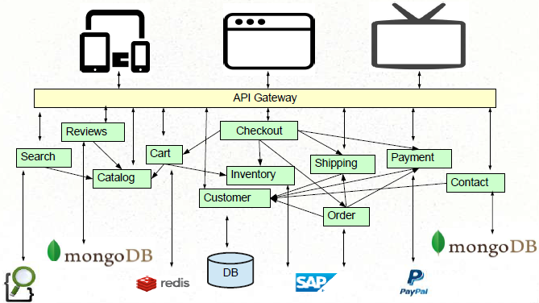
Enter The Microservices

Slide 19
Characteristics Of Microservices
Componentization via Services
Composed using suite of small services
Communication based on lightweight protocols
Services encapsulate business capabilities
Services easily managed
Decentralized Governance
Polyglot Persistence
Polyglot Programming

Slide 20
Componentization via Services
NOT language constructs.
Where services are small, independently deployable applications Forces the design of clear interfaces
Changes scoped to their affected service
checkout
Search
payment
order
review
cart
contact
catalogue
inventory
shipping
customer

Slide 21



Composed using suite of small services
Services are small, independently deployable applications
Not a single codebase
Not (necessarily) a single language / framework
checkout
Search
payment
order
review
cart
contact
catalogue
inventory
shipping
customer

Slide 22
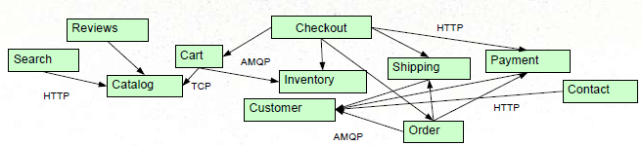
Communication based on lightweight protocols
HTTP, TCP, UDP, Messaging, etc.
Payloads: JSON, BSON, XML, Protocol Buffers, etc.
Forces the design of clear interfaces
Netflix's Cloud Native Architecture – Communicate via APIs – Not Common Database!

Slide 23
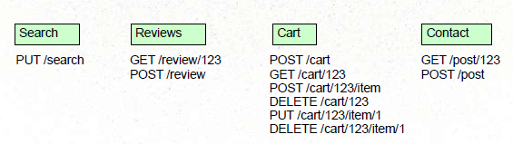
Services encapsulate business capabilities
Not based on technology stack
Vertical slices by business function (i.e. cart, catalog, checkout)
...Though technology chunk also practical (email service)
Suitable for cross-functional teams

Slide 24
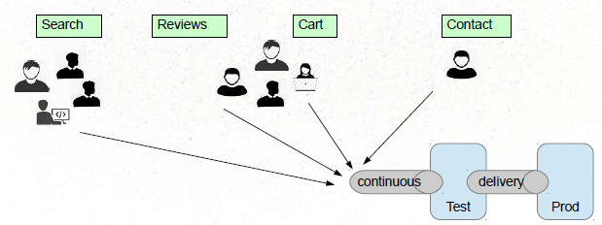
Services easily managed
Easy to comprehend, alter, test, version, deploy, manage, overhaul, replace
By small, cross-functional teams (or even individuals)

Slide 25
Decentralized Governance
Use the right tool (language, framework) for the job. Services evolve at different speeds, deployed and managed according to different needs.
Make services be “Tolerant Readers ”
Consumer-Driven Contracts
Antithesis of ESB

Slide 26
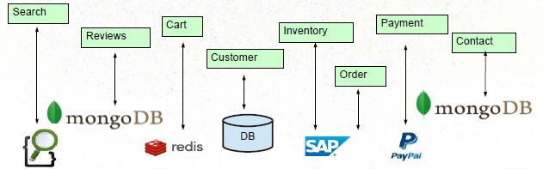
Polyglot Persistence
Freedom to use the best technology for the job
Don't assume single RDBMS is always best Very controversial.
No pan-enterprise data model!
No transactions!

Slide 27
Microservice Advantages
Easy to digest each service (difficult to comprehend whole)
VERY easy to test, deploy, manage, version, and scale single services
Change cycle decoupled
Easier to scale staff
No Language / Framework lock.

Slide 28
Challenges with Microservices
Complexity has moved out of the application, but into the operations layer
Services may be unavailable
Never needed to worry about this in a monolith! Design for failure, circuit breakers
“Everything fails all the time ” - Werner Vogels, CTO Amazon
Much more monitoring needed
Remote calls more expensive than in-process calls

Slide 29
Challenges with Microservices (continued)
Transactions: Must rely on eventual consistency over ACID
Features span multiple services
Change management becomes a different challenge
Need to consider the interaction of services Dependency management / versions
Refactoring Module Boundaries

Slide 30
Fallacies of Distributed Computing
The network is reliable.
Latency is zero.
Bandwidth is infinite.
The network is secure.
Topology doesn't change.
There is one administrator.
Transport cost is zero.
The network is homogeneous.

Slide 31
Practical Considerations

Slide 32
How Do You Break a Monolith into Microservices?
Primary consideration: business functionality:
Noun-based (catalog, cart, customer)
Verb-based (search, checkout, shipping)
Single Responsibility Principle
http://programmer.97things.oreilly.com/wiki/index.php/The_Single_Responsibility_Principle
Bounded Context
http://martinfowler.com/bliki/BoundedContext.html

Slide 33
How Micro is micro?
Size is not the compelling factor
Small enough for an individual developer to digest Small enough to be built and managed by small team
Amazon's two pizza rule
Documentation small enough to read and understand
Dozens of secrets, not hundreds.
Predictable.
Easy to experiment with

Slide 34
Differences with SOA
SOA addresses integration between systems.
Microservices address individual applications
SOA relies on orchestration.
Microservices rely on choreography
SOA relies on smart integration technology, dumb services
Microservices rely on smart services, dumb integration technology
Consider:
ps aux | grep office | grep -v p| awk '{print and filters $2}'

Slide 35
Summary
Microservices are an architectural style
Decomposition of single system into independent running, intercommunicating services
Alternative to Monolithic applications
Microservices have advantages and disadvantages
As do monoliths

Slide 36
Thank You
Image curtesy: Ken Krueger

