Slide 1
CI CD with Docker

Slide 2
Agenda
What is Continuous Integration
What is Continuous Delivery/Deployment
Tools
Jenkins
Docker
Hands on Demo

Slide 3
What is Continuous Integration
Continuous Integration (CI) is a development practice where developers integrate code into a shared repository frequently, preferably several times a day.
Each integration can then be verified by an automated build and automated tests.
By integrating regularly, you can detect errors quickly, and locate them more easily.

Slide 4

What is Continuous Integration
Build
Test
Release
Trigger
Feedback to developer

Slide 5
Continuous Delivery
Continuous delivery (CD) is a software engineering approach in which teams produce software in short cycles, ensuring that the software can be reliably released at any time and, when releasing the software, doing so manually.
It aims at building, testing, and releasing software with greater speed and frequency.
The approach helps reduce the cost, time, and risk of delivering changes by allowing for more incremental updates to applications in production.

Slide 6
Continuous Delivery
Continuous delivery (CD) is a software engineering approach in which teams produce software in short cycles, ensuring that the software can be reliably released at any time and, when releasing the software, doing so manually.
It aims at building, testing, and releasing software with greater speed and frequency.
The approach helps reduce the cost, time, and risk of delivering changes by allowing for more incremental updates to applications in production.

Slide 7
Continuous Delivery
Continuous Delivery goes one step further than Continuous Integration to automate the software release process, where code is deployed to environments and is prepared for Production release.

Slide 8
Continuous Deployment
Continuous Deployment is the next step of Continuous Delivery, where every code commit that passes the Automated Tests and other Acceptance tests, is automatically deployed to Production without any manual intervention.

Slide 9
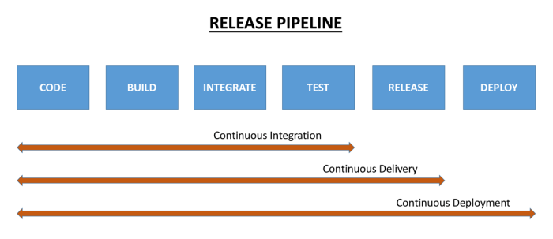
The Release Pipeline

Slide 10
What is CI/CD Pipeline
The stages which constitute various activities from development to final production deployment of a software is the CI/CD pipeline
Plan
Code
Build
Test
Release
Deploy
Operate
CD
CI

Slide 11
Docker CI/CD

Slide 12
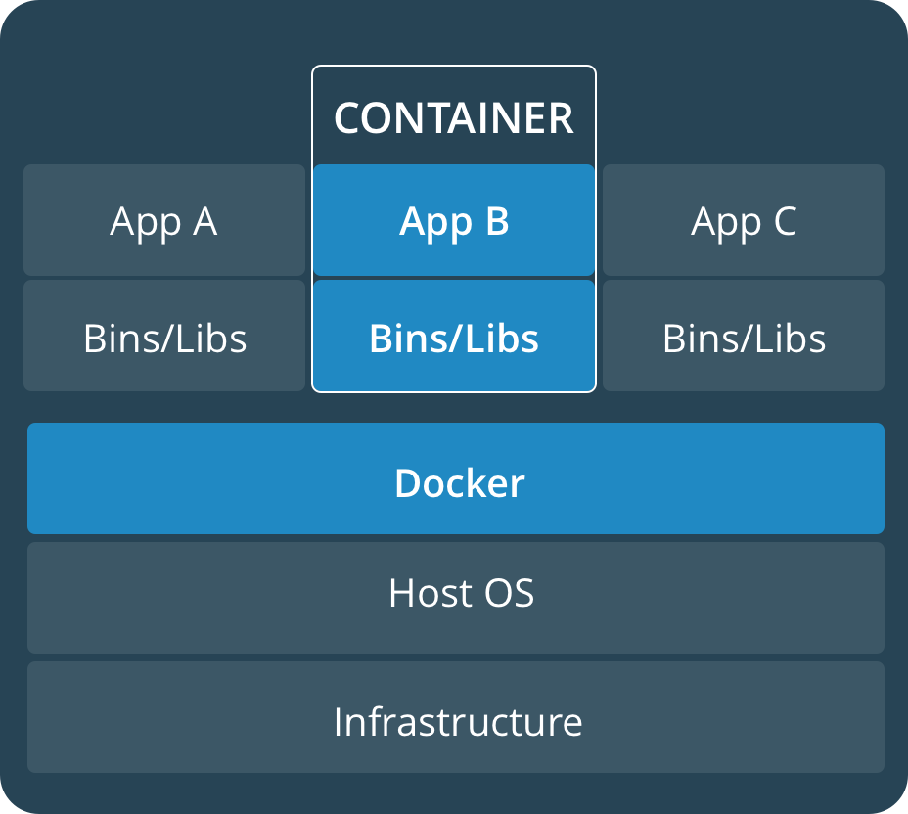
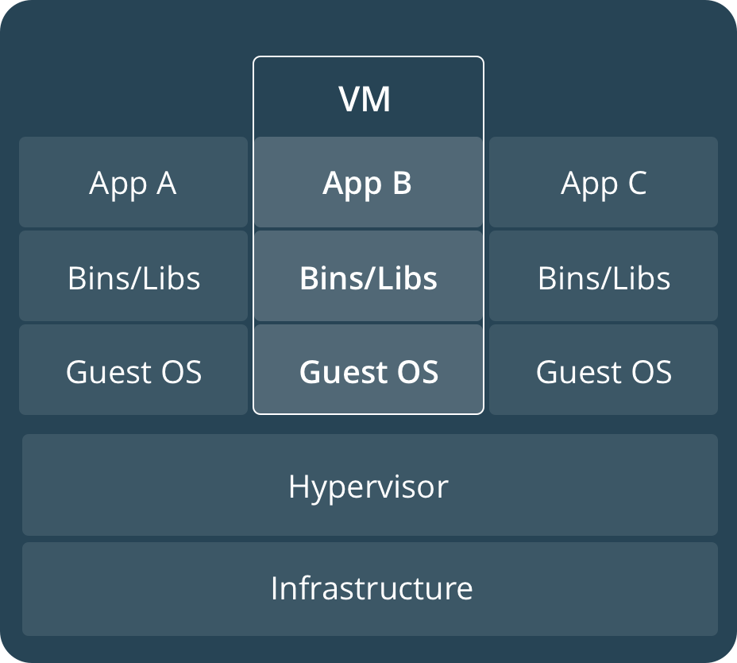
Comparing Containers and VMs
Containers are an app level construct
VMs are an infrastructure level construct to turn one machine into many servers
Notes:
Hypervisor based VM’s were a massive improvement over the one application on one server approach. But they were not without limitations.
First, each VM still required its own CPU, RAM, storage etc… and each VM needs to have an operating system installed. An entire operating system, which consumes a lot of resources but doesn’t provide us with much in return. We just have it there so we can run our application. And so the more VM’s you run, the more resources you need

Slide 13
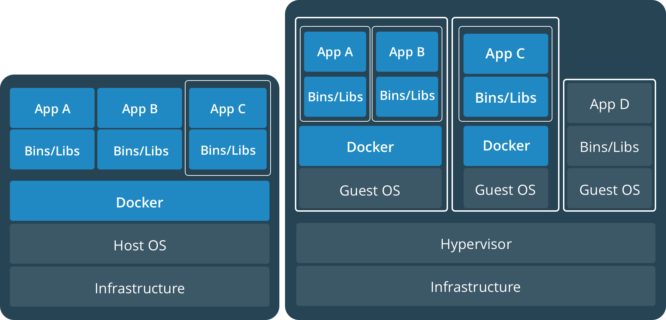
Containers and VMs together
PROD
DEV
Containers and VMs together provide a tremendous amount of flexibility for IT to optimally deploy and manage apps.
Notes:
Hypervisor based VM’s were a massive improvement over the one application on one server approach. But they were not without limitations.
First, each VM still required its own CPU, RAM, storage etc… and each VM needs to have an operating system installed. An entire operating system, which consumes a lot of resources but doesn’t provide us with much in return. We just have it there so we can run our application. And so the more VM’s you run, the more resources you need

Slide 14
Key Benefits of Docker Containers
Speed
No OS to boot = applications online in seconds
Portability
Less dependencies between process layers = ability to move between infrastructure
Efficiency
Less OS overhead
Improved VM density
Notes:
Hypervisor based VM’s were a massive improvement over the one application on one server approach. But they were not without limitations.
First, each VM still required its own CPU, RAM, storage etc… and each VM needs to have an operating system installed. An entire operating system, which consumes a lot of resources but doesn’t provide us with much in return. We just have it there so we can run our application. And so the more VM’s you run, the more resources you need

Slide 15
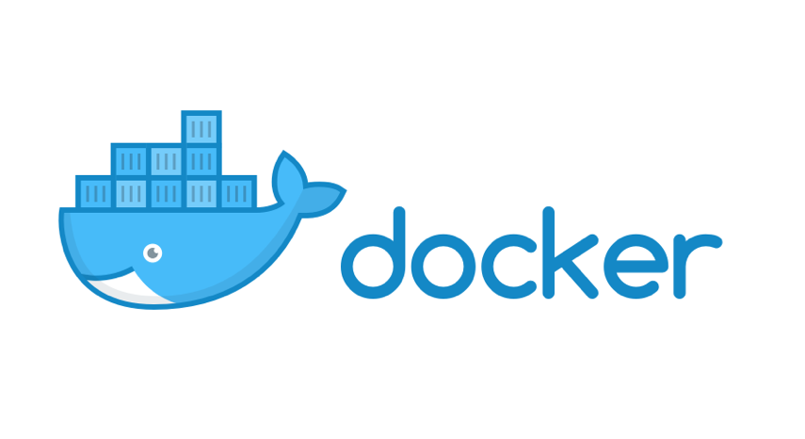
Container Solutions & Landscape

Slide 16




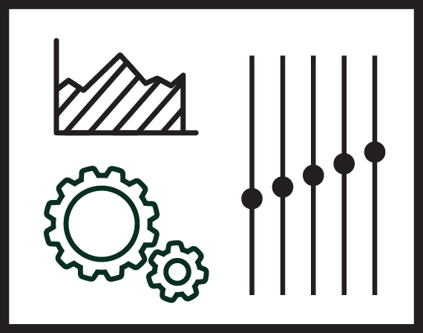
Docker Basics
Image
The basis of a Docker container. The content at rest.
Container
The image when it is ‘running.’ The standard unit for app service
Engine
The software that executes commands for containers. Networking and volumes are part of Engine. Can be clustered together.
Registry
Stores, distributes and manages Docker images
Control Plane
Management plane for container and cluster orchestration
Notes:
Let’s start with an image. The image is the basis of a Docker container - it is the content library from which you build a container. So when you execute the command “docker run”, you use the image to create a container.
The container, itself, is a standard unit for each application service. The application service can be any size and each container is isolated from other containers.
Where the containers run is the Docker engine. The Engine is the software that installed in the host operating system which can be on-prem, on bare metal, in a virtual machine, in the cloud - wherever. The customer can interact with Engine in order to pull an image, build an image, run or stop a container, manage the resources. This is also where you can also define networks and volumes and how the container interacts with other containers. So the Engine can be standalone on a single host, or multiple engines can be clustered together.
Now we mentioned pulling an image to create a container. That is because all images are stored in what we call a registry. This is a library that stores and manages all of the images. So essentially a central repository. Admins can manage access permissions and what images can be shared within a team. From here, users can push or pull images to create content and check it in, share with team members, and deploy it into a container running on an Engine.
The Control Plane is a management tool that lets users look across their deployment of applications, containers, and clusters and orchestrate them.

Slide 17
Building a Software Supply Chain
DEVELOPERS
IT OPERATIONS
Microservices
Image Registry
Control Plane
Traditional
Notes:
Next, there needs to be some connective tissue between developers working on code and the IT operations team who are expected to run and manage the apps, making it look and operate more like a supply chain. That means having tools and processes in place like a secure image registry and a control plane that lets organizations monitor and manage and deploy containers in a heterogeneous environment. We call this CaaS - or Containers as a Service.
But organizations also need to ensure that this supply chain is secure from end-to-end.

Slide 18


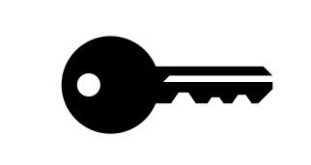
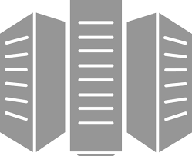
Containers as a Service
Developers
IT Operations
BUILD
Development Environments
SHIP
Secure Content & Collaboration
RUN
Deploy, Manage, Scale
Control plane
Registry
Multi-container apps
Engines running on servers in cloud or datacenter
Clients pull and push images
Images stored in repos
Notes:
So let’s take another look at the Containers as a Service diagram. Starting on the left... you have developers often working from their own laptops. The are pulling and pushing images from the registry. So they can pull an existing image from the registry, maybe add some more layers on there, add their code, and then push that image back into the registry.
The images are stored in their various repositories in the registry.
Docker Engines are running on various physical or virtual servers in the cloud or on prem. And then when you run the images on the engine, they become containers.
An application can be a single container or multiple containers - and the control plane will sit across that to allow the IT operations team to see and manage all of the clusters and containers running on them.
Local development environments
Self service app images
Build, Test, Deploy applications
Define app behavior and infra needs
Registry services for image storage, management and distribution
IT Ops maintains library of secure base content
Manage role based access to repos/images
Management consoles
Provision, manage infrastructure resources
Monitor, manage, scale infrastructure and applications

Slide 19
CI/CD with Docker and Jenkins

Slide 20
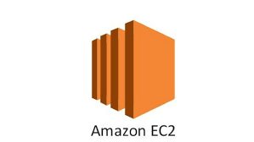
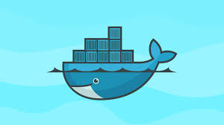
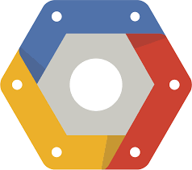
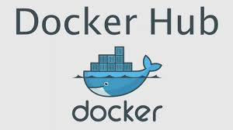
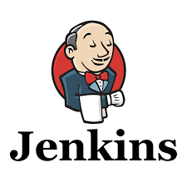

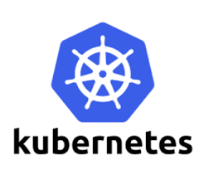
The CI/CD Landscape
SCM
Build
Test
Release
Deploy
< />
< />
Dockerfile
Dockerfile

Slide 21
The Demo Application
Without Docker
With Docker
TestWebApp
TestWebApp
TestWebApp
TestWebApp
Tomcat
Tomcat
Tomcat
Tomcat
Docker Image
Docker Image
VM (Guest OS)
VM (Guest OS)
Docker
Hypervisor
Host OS
Host OS
Infrastructure
Infrastructure

Slide 22
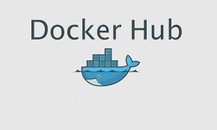

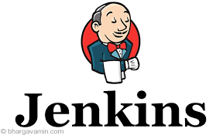

Our Course of Actions
compile
test
package
Build docker image
Publish image to docker hub
Test
Deploy

