Slide 1
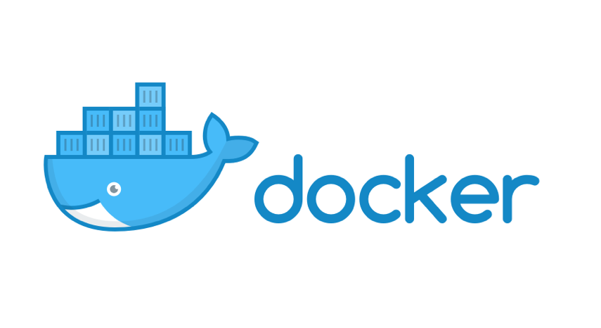
Introduction to Docker

Slide 2
The IT Landscape is Changing
Apps
Cloud
DevOps
Docker Survey: State of App development : Q1 - 2016
Notes:
Trends arounds hybrid cloud, app modernization and devops are at the top of everyone’s priority, even government agencies because they help to reduce costs and accelerate software projects

Slide 3
Movement in the cloud
Migrate workloads to cloud
80%
Portability across environments
Want to avoid cloud vendor lock-in
State of App development Survey: Q1 - 2016

Slide 4
Applications are transforming
~2000
Today
Loosely Coupled Services
Monolithic
Rapidly updated
Slow changing
Many Small Servers or devices
Big Servers

Slide 5
Application Modernization
Application Code
Developer Issues:
Minor code changes require full re-compile and re-test
Application becomes single point of failure
Application is difficult to scale
Microservices: Break application into separate operations
12-Factor Apps: Make the app independently scalable, stateless, highly available by design

Slide 6

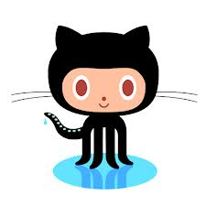




Continuous Integration and Delivery
1. Development
2. Test
3. Stage / Production
Version control
Sysadmin
Developer
QA / QE
Notes:
Benefits
Frictionless portability from dev to test
Faster cycle times
Higher quality releases

Slide 7
Tug of War Between Developers and Ops
Developers
IT Operations
Freedom to create and deploy apps fast
Define and package application needs
Quickly and flexibly respond to changing needs
Standardize, secure, and manage

Slide 8
Organizations Must Deal with Diverse Technology
Bare Metal
Virtual
On Premises
Cloud
Linux
Windows
Traditional
Microservices
Notes:
Even with the strong benefits in each of these areas, IT organizations – especially in large, enterprise businesses , have the challenge of dealing with a lot of diversity in their datacenter. They have physical and virtual servers, they’re looking both on- and off-prem, they have a mix of Linux and Windows workloads, and a mix of traditional and microservices workloads.

Slide 9
…and Diverse Organizations
Developers
IT Operations
Freedom to create and deploy apps fast
Define and package application needs
Quickly and flexibly respond to changing needs
Standardize, secure, and manage
Notes:
And there is still the natural tug-of-war between what developers want – which is the freedom to create and deploy new apps quickly and what IT ops is responsible for – which is to standardize and secure running applications.

Slide 10
The Myth of Bi-Modal IT
 | MICROSERVICES | TRADITIONAL APPS
Cloud or New Infrastructure | You are either here..
Old Infrastructure |  | …or here
Notes:
Our customers have heard from analysts that they should be building two practices in their organizations – one that is designed to manage traditional apps on old infrastructure and one for modern microservices-based applications running on cloud or new infrastructure. Two modes of operation for two different types of applications for two different types of infrastrucutre.

Slide 11
Enabling a Journey
 | MICROSERVICES | AGILE TRADITIONAL APPS | TRADITIONAL APPS
Cloud or New Infrastructure
Old Infrastructure
…that is past AND future proof
Notes:
Docker believes in helping customers run any type of application – whether its microservices or traditional apps, on any infrastructure - both existing and new, on- or off-prem. And the key is to make them all fast – make them all agile, scalable, portable, and easy to patch and update and re-deploy.

Slide 12
Docker and Container Overview

Slide 13
History of Docker
2013
Solomon Hykes starts Docker as an internal project within dotCloud
Feb 2016
Docker introduces first commercial product – now called Docker Enterprise Edition
2008
Linux containers (LXC 1.0) introduced
Mar 2013
Docker released to open source
Today
Open source community includes:
3,300+ contributors
43,000+ stars
12,000+ forks
2004
Solaris Containers / Zones technology introduced

Slide 14
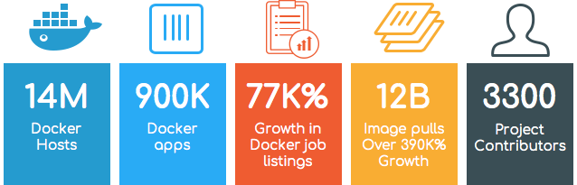
Incredible adoption in just 4 years

Slide 15

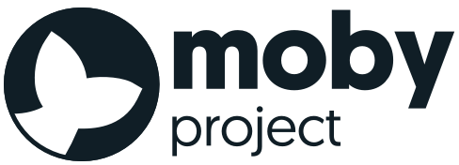
The Docker Family Tree
Subscription-based, commercially supported products for delivering a secure software supply chain
Enterprise Edition
Intended for:
Production deployments + Enterprise customers
Open source framework for assembling core components that make a container platform
Free, community-supported product for delivering a container solution
Intended for:
Open source contributors + ecosystem developers
Community Edition
Intended for:
Software dev & test
Notes:
The Docker solution started as an open source solution which is now called the Moby Project. The Moby Project has thousands of contributors and is an active community that includes employees from Docker, ecosystem partners, as well as strong contributions from unaffiliated individuals.
From the Moby project, Docker - the company - delivers two products. Docker Enterprise Edition is a set of commercially-supported, subscription-based products intended for production deployments and Enterprise customers. And Docker Community Edition which is a free, community-supported product. We will cover more about the differences between Community Edition and Enterprise Ediiton in the next module.

Slide 16
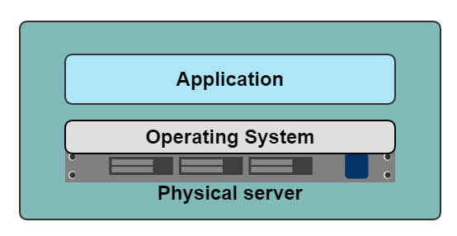
A History Lesson
In the Dark Ages
One application on one physical server
Notes:
So, lets take a trip down memory lane back in the dark ages of development and deployment of applications.
In those times, we used big server racks with many servers and each server would run one application. You can see from the diagram, you have the physical server, you install your desired operating system on it and then you install your application.

Slide 17
Historical limitations of application deployment
Slow deployment times
Huge costs
Wasted resources
Difficult to scale
Difficult to migrate
Vendor lock in
Notes:
What was wrong with this approach? Well a lot. For starters, you have to buy a physical server for each new application, and those servers were not cheap. Deployment times were often slow. Let’s say you’ve developed a new application and are ready to deploy to a staging environment. You contact your system admin to give you access to a server and low and behold, he tells you that there are no servers left. So then you have to start the process of buying a new server. After a few weeks, the server finally arrives and it takes an eternity to setup. Then you can finally install you application. See how long that took? That same problem also makes it difficult to scale your application.
Then there’s the wasted resources. Your application might only use up a fraction of the CPU, RAM and storage on the server. The rest is simply wasted.
You might also be locked into a particular vendor. If you bought an IBM server, you may not able to migrate your application to a HP server later on, at least not without having to make a few changes.
V0.6 revision
Changed slide title

Slide 18
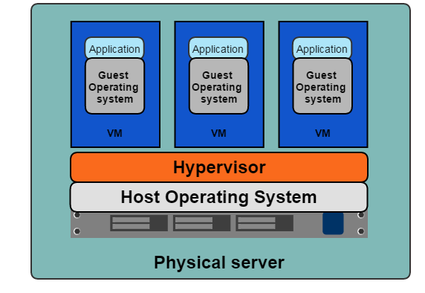
A History Lesson
Hypervisor-based Virtualization
One physical server can contain multiple applications
Each application runs in a virtual machine (VM)
Notes:
To solve those problems, we came up with the idea of the virtual machine, or to put it more technically, hypervisor based virtualization.
Here, we still have our physical server with its operating system. But using a hypervisor, we can install multiple VM’s on that one server. As you can see from the diagram, each VM has it’s own operating system and then we install our application on the VM. So we could have multiple VM’s each one with a different operating system and each one with a different application, on the same physical machine.

Slide 19
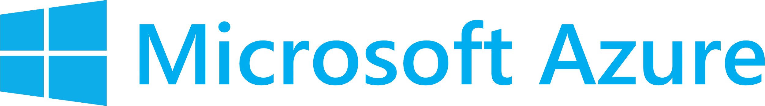
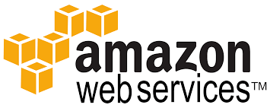
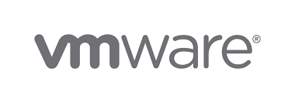
Benefits of VMs
Better resource pooling
One physical machine divided into multiple virtual machines
Easier to scale
VMs in the cloud
Rapid elasticity
Pay as you go model
Notes:
So this gives us the benefit of better resource pooling. We’ve divided that one machine into multiple VM’s and each one using it’s own amount of CPU, RAM and storage. It also makes it easier to scale our application. If we need more instances of our application, say for load balancing purposes, just spin up some more VM’s. We don’t have to go an order more servers and install them onto the rack.
At first, people installed VM’s onto their existing physical servers. But in more recent times, the trend has been to use VM’s in the cloud, with providers such as Amazon. In the cloud we get even more benefits such as rapid elasticity, where we can quickly provision additional capabilities based on demand. We also only pay for what we actually use, unlike before where you pay the same price for a physical server regardless of how much of it’s resources you actually end up using.

Slide 20
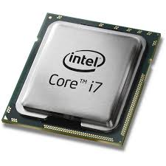
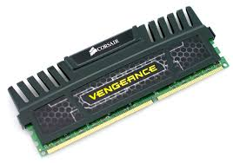
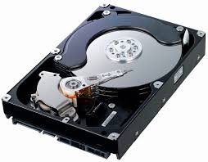
Limitations of VMs
Each VM stills requires
CPU allocation
Storage
RAM
An entire guest operating system
The more VMs you run, the more resources you need
Guest OS means wasted resources
Application portability not guaranteed
Notes:
Hypervisor based VM’s were a massive improvement over the one application on one server approach. But they were not without limitations.
First, each VM still required its own CPU, RAM, storage etc… and each VM needs to have an operating system installed. An entire operating system, which consumes a lot of resources but doesn’t provide us with much in return. We just have it there so we can run our application. And so the more VM’s you run, the more resources you need

Slide 21
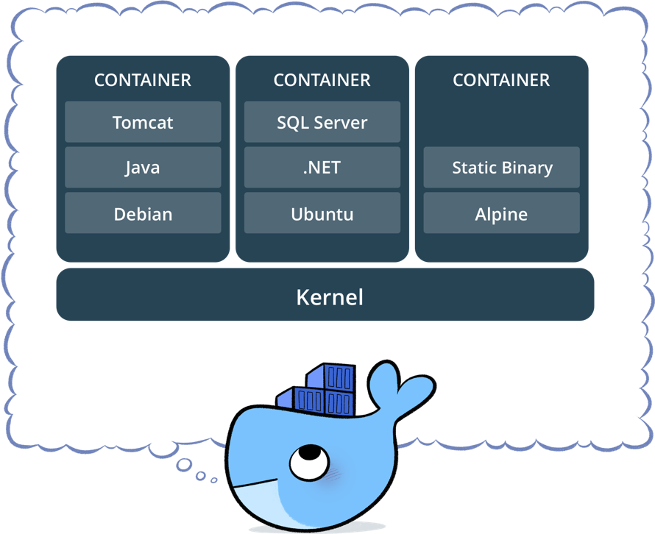
What is a container?
Standardized packaging for software and dependencies
Isolate apps from each other
Share the same OS kernel
Works with all major Linux and Windows Server
Notes:
Hypervisor based VM’s were a massive improvement over the one application on one server approach. But they were not without limitations.
First, each VM still required its own CPU, RAM, storage etc… and each VM needs to have an operating system installed. An entire operating system, which consumes a lot of resources but doesn’t provide us with much in return. We just have it there so we can run our application. And so the more VM’s you run, the more resources you need

Slide 22
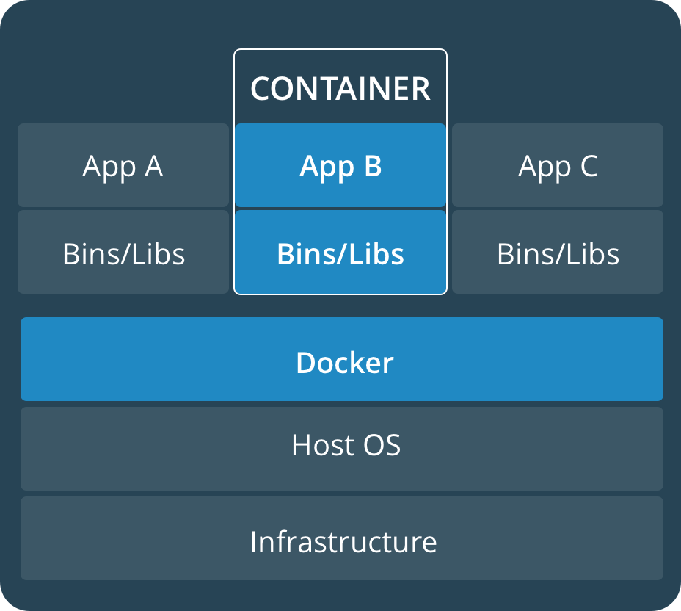
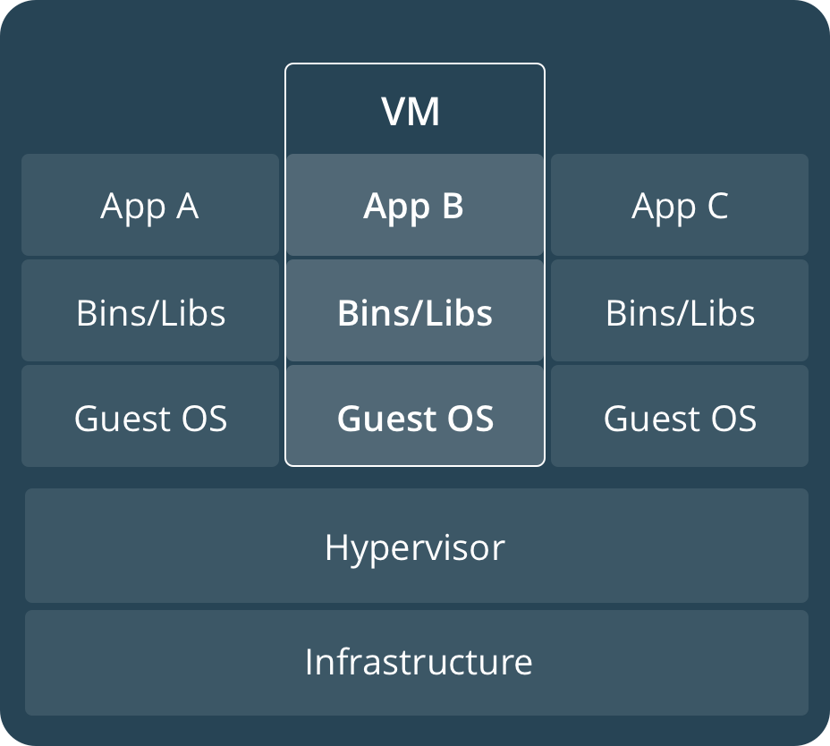
Comparing Containers and VMs
Containers are an app level construct
VMs are an infrastructure level construct to turn one machine into many servers
Notes:
Hypervisor based VM’s were a massive improvement over the one application on one server approach. But they were not without limitations.
First, each VM still required its own CPU, RAM, storage etc… and each VM needs to have an operating system installed. An entire operating system, which consumes a lot of resources but doesn’t provide us with much in return. We just have it there so we can run our application. And so the more VM’s you run, the more resources you need

Slide 23
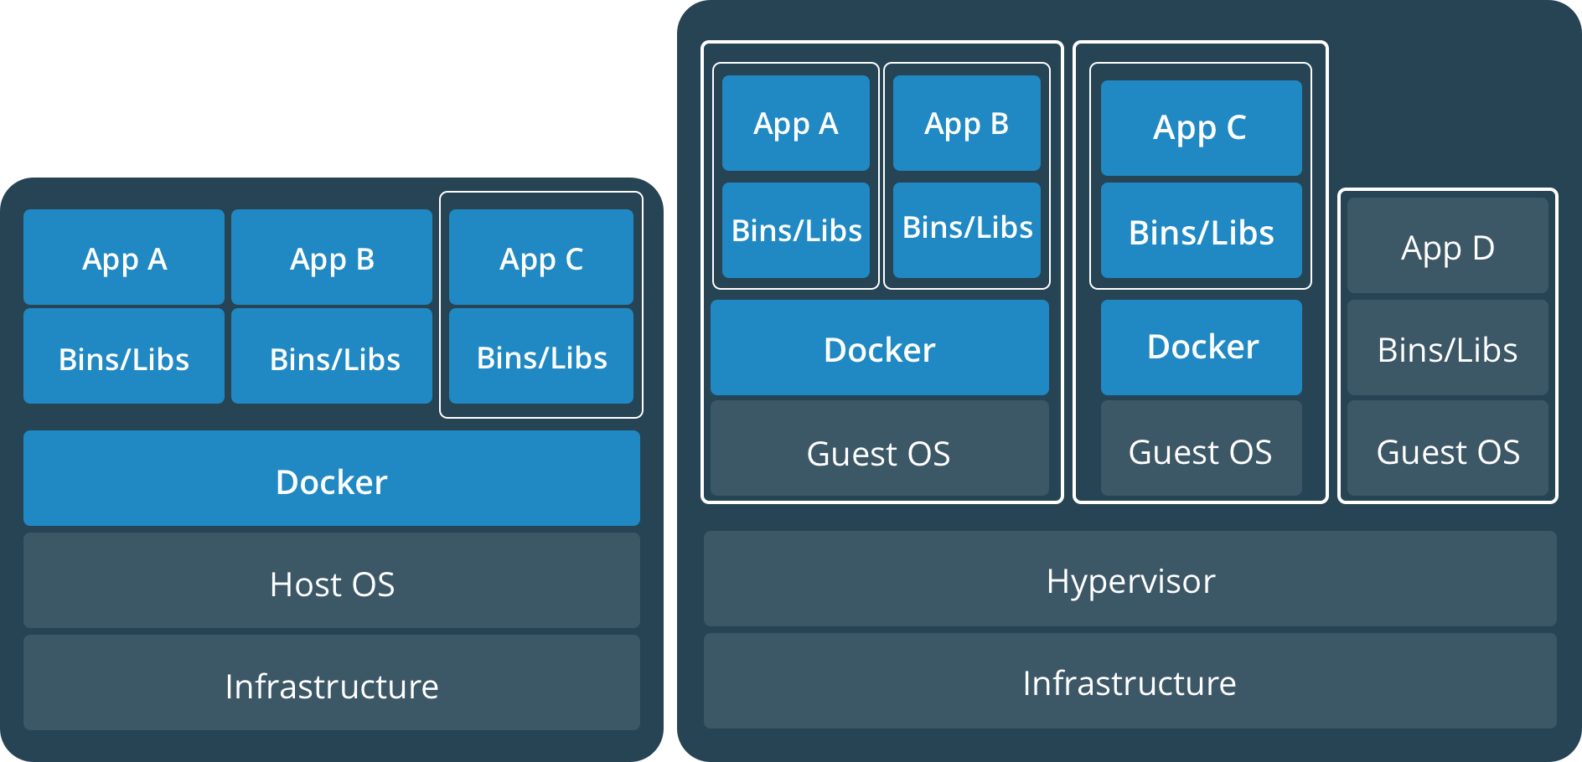
Containers and VMs together
PROD
DEV
Containers and VMs together provide a tremendous amount of flexibility for IT to optimally deploy and manage apps.
Notes:
Hypervisor based VM’s were a massive improvement over the one application on one server approach. But they were not without limitations.
First, each VM still required its own CPU, RAM, storage etc… and each VM needs to have an operating system installed. An entire operating system, which consumes a lot of resources but doesn’t provide us with much in return. We just have it there so we can run our application. And so the more VM’s you run, the more resources you need

Slide 24
Key Benefits of Docker Containers
Speed
No OS to boot = applications online in seconds
Portability
Less dependencies between process layers = ability to move between infrastructure
Efficiency
Less OS overhead
Improved VM density
Notes:
Hypervisor based VM’s were a massive improvement over the one application on one server approach. But they were not without limitations.
First, each VM still required its own CPU, RAM, storage etc… and each VM needs to have an operating system installed. An entire operating system, which consumes a lot of resources but doesn’t provide us with much in return. We just have it there so we can run our application. And so the more VM’s you run, the more resources you need

Slide 25
Container Solutions & Landscape

Slide 26

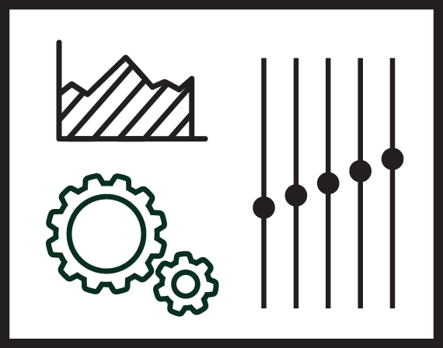
Docker Basics
Image
The basis of a Docker container. The content at rest.
Container
The image when it is ‘running.’ The standard unit for app service
Engine
The software that executes commands for containers. Networking and volumes are part of Engine. Can be clustered together.
Registry
Stores, distributes and manages Docker images
Control Plane
Management plane for container and cluster orchestration
Notes:
Let’s start with an image. The image is the basis of a Docker container - it is the content library from which you build a container. So when you execute the command “docker run”, you use the image to create a container.
The container, itself, is a standard unit for each application service. The application service can be any size and each container is isolated from other containers.
Where the containers run is the Docker engine. The Engine is the software that installed in the host operating system which can be on-prem, on bare metal, in a virtual machine, in the cloud - wherever. The customer can interact with Engine in order to pull an image, build an image, run or stop a container, manage the resources. This is also where you can also define networks and volumes and how the container interacts with other containers. So the Engine can be standalone on a single host, or multiple engines can be clustered together.
Now we mentioned pulling an image to create a container. That is because all images are stored in what we call a registry. This is a library that stores and manages all of the images. So essentially a central repository. Admins can manage access permissions and what images can be shared within a team. From here, users can push or pull images to create content and check it in, share with team members, and deploy it into a container running on an Engine.
The Control Plane is a management tool that lets users look across their deployment of applications, containers, and clusters and orchestrate them.

Slide 27
Foundation: Docker Engine
Integrated Security
Security
Network
Volumes
Docker Engine
Distributed State
Container Runtime
Orchestration
Notes:
But it’s not just the application runtime. It’s important to consider the network, security, and volumes, and distributed state. And these need to be handled in an integrated way which is secure by default. And this needs to work in all different kinds of environments. Docker Engine provides all of these basic set of capabilities and the Docker editions have been validated to work for Mac, for Windows, for Linux, with AWS, and Azure and other infrastructures.

Slide 28
DEVELOPERS
IT OPERATIONS
Microservices
Traditional
Notes:
As we mentioned, the world is diverse. It starts with a secure base that embraces and understands the diversity of your workloads and infrastructures. It needs to work for different developers, work with both Linux and Windows, and it needs to be deployed on-premises or off, on physical or virtual hardware.

Slide 29
Building a Software Supply Chain
DEVELOPERS
IT OPERATIONS
Microservices
Image Registry
Control Plane
Traditional
Notes:
Next, there needs to be some connective tissue between developers working on code and the IT operations team who are expected to run and manage the apps, making it look and operate more like a supply chain. That means having tools and processes in place like a secure image registry and a control plane that lets organizations monitor and manage and deploy containers in a heterogeneous environment. We call this CaaS - or Containers as a Service.
But organizations also need to ensure that this supply chain is secure from end-to-end.

Slide 30


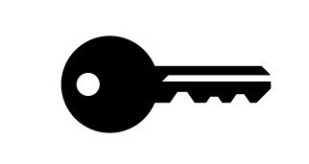
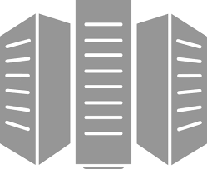
Containers as a Service
Developers
IT Operations
BUILD
Development Environments
SHIP
Secure Content & Collaboration
RUN
Deploy, Manage, Scale
Control plane
Registry
Multi-container apps
Engines running on servers in cloud or datacenter
Clients pull and push images
Images stored in repos
Notes:
So let’s take another look at the Containers as a Service diagram. Starting on the left... you have developers often working from their own laptops. The are pulling and pushing images from the registry. So they can pull an existing image from the registry, maybe add some more layers on there, add their code, and then push that image back into the registry.
The images are stored in their various repositories in the registry.
Docker Engines are running on various physical or virtual servers in the cloud or on prem. And then when you run the images on the engine, they become containers.
An application can be a single container or multiple containers - and the control plane will sit across that to allow the IT operations team to see and manage all of the clusters and containers running on them.
Local development environments
Self service app images
Build, Test, Deploy applications
Define app behavior and infra needs
Registry services for image storage, management and distribution
IT Ops maintains library of secure base content
Manage role based access to repos/images
Management consoles
Provision, manage infrastructure resources
Monitor, manage, scale infrastructure and applications

Slide 31
Building a Secure Supply Chain
Container App Lifecycle Workflow
Private Image Registry
Secure Access and User Management
Application and Cluster Management
Enterprise Edition
Image Scanning and Monitoring
Content Trust and Verification
Policy Management
Security
Network
Volumes
Docker Engine
Distributed State
Container Runtime
Orchestration
Usable Security
Trusted Delivery
Portable
Notes:
So, to build the secure supply chain, customers also need an integrated lifecycle management solution with things like policy management, image scanning and private registries.
And it needs to be secure by default.
Docker has 3 philosophies around security:
it must be usable
It must be easy to spot vulnerabilities both before and after it is deployed
And it needs to respect the diversity of the different infrastructures in a customer’s environment.

Slide 32
Docker Enterprise Edition

Slide 33
Docker Aligns to Multiple IT Initiatives
3 out 4
Top initiatives are app modernization
Apps
80%
Looking at Docker for Cloud Strategy
44%
Looking to adopt DevOps with Docker
Cloud
DevOps
Docker Survey: State of App development : Q1 - 2016
State of App development Survey: Q1 2016
Notes:
Trends arounds hybrid cloud, app modernization and devops are at the top of everyone’s priority, even government agencies because they help to reduce costs and accelerate software projects

Slide 34

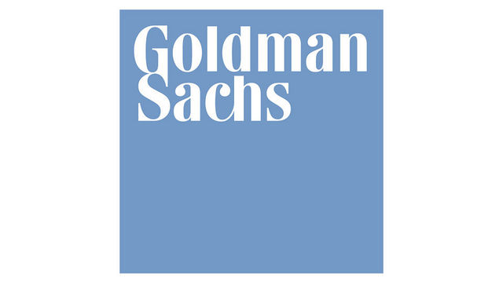
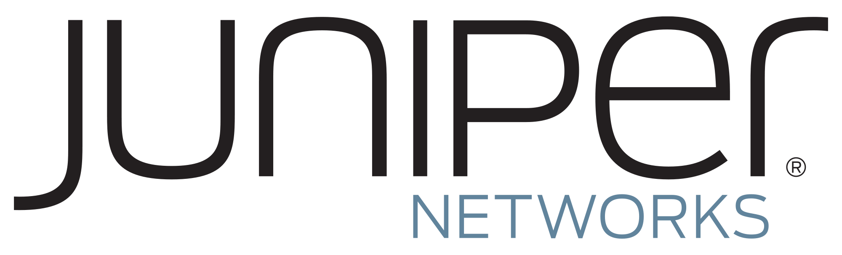





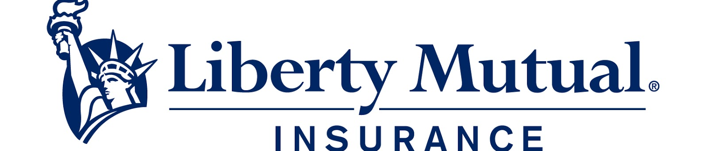


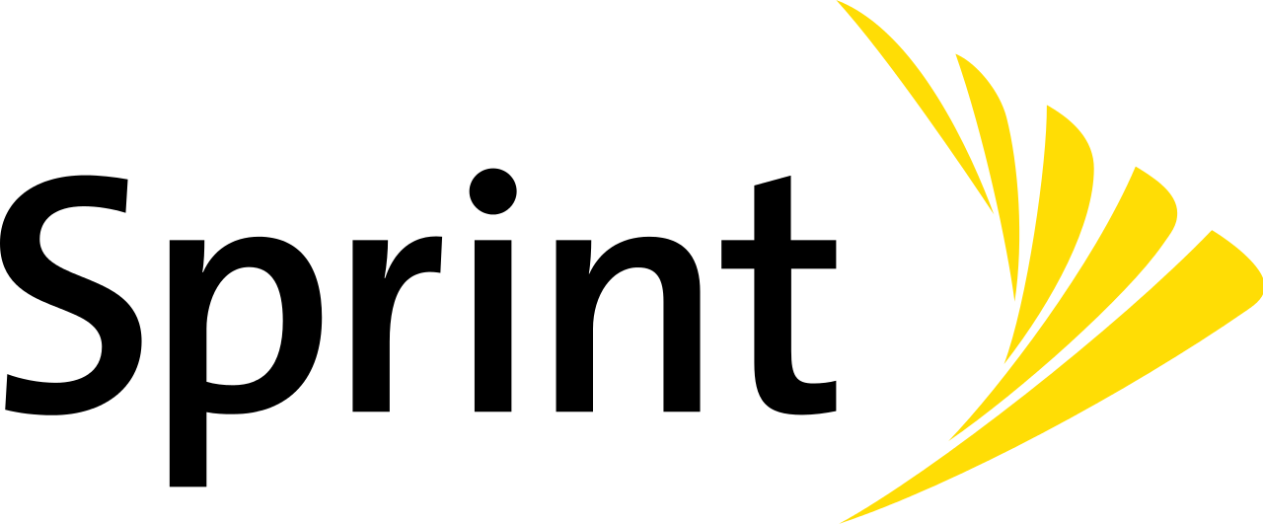
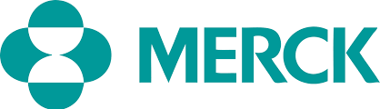


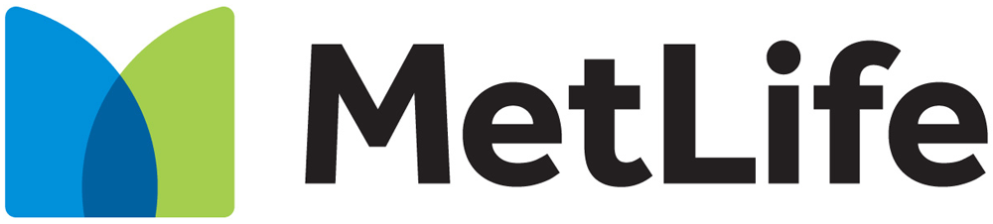

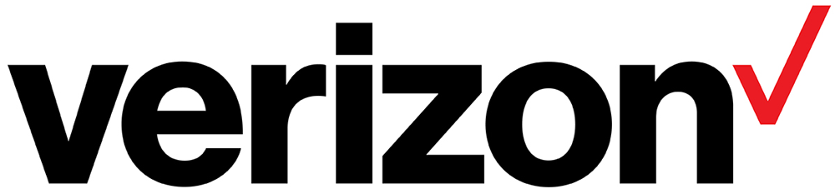
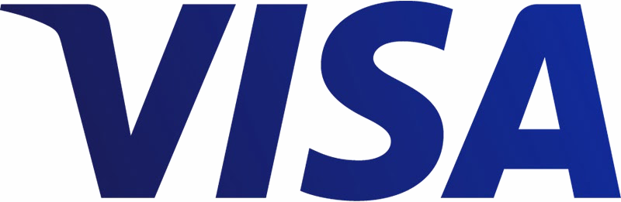
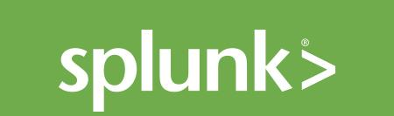
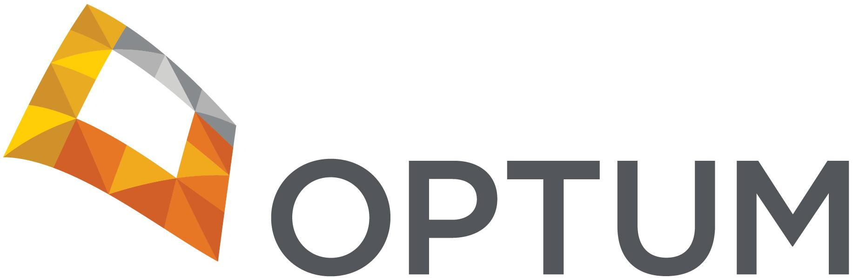


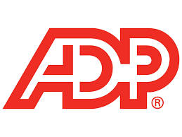

Docker Is in the Enterprise
Service Provider
Healthcare & Science
Financial
Services
Tech
Insurance
Public Sector
Notes:
And it is not just tech startups or small companies. Large organizations are adopting Docker Enterprise Edition at scale.

Slide 35
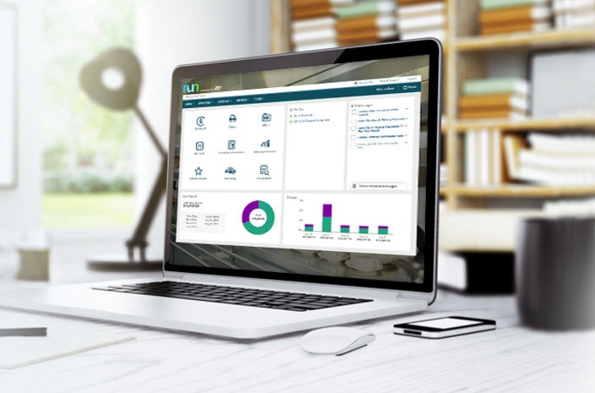

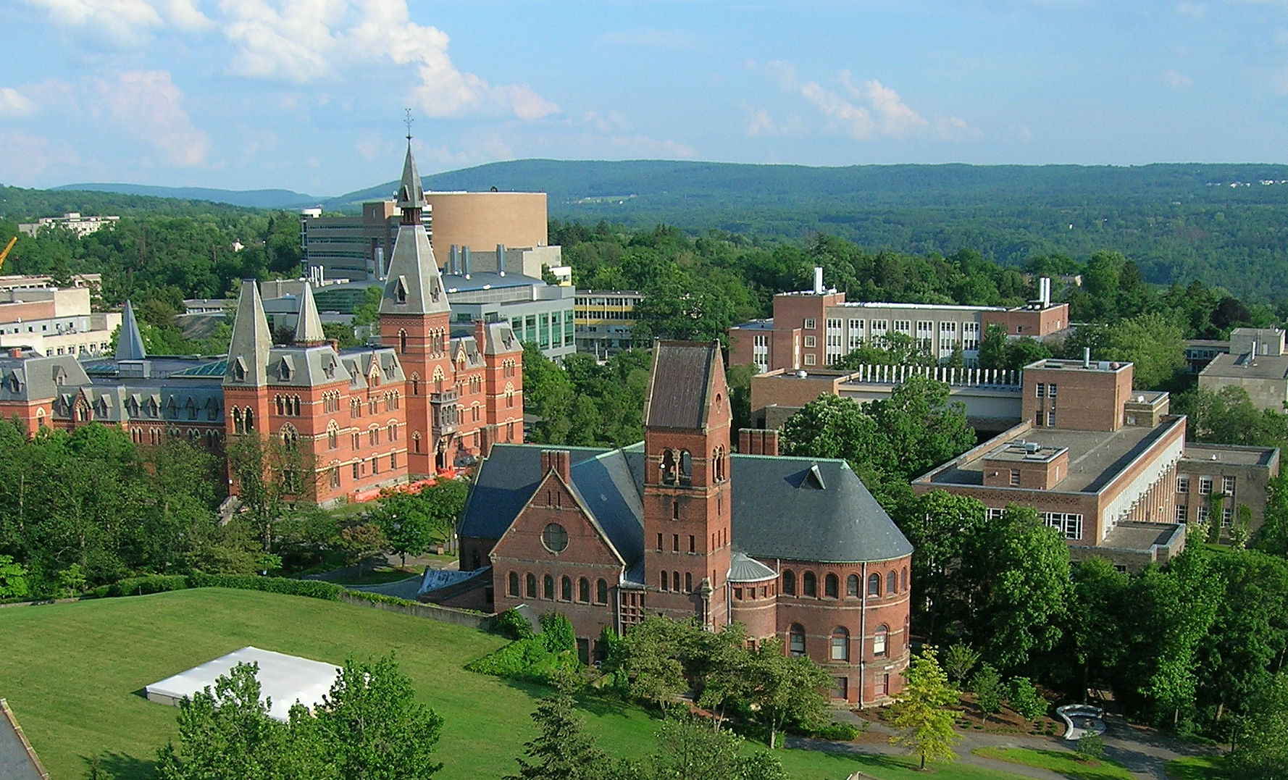


Docker delivers agility, security and cost savings
Hardened containers deliver new levels of security to monoliths on the transition to microservices
Transform monoliths to secure and agile DevOps environments
Reduce maintenance costs by 10X for legacy, commercial and new apps

Slide 36
Docker delivers agility, resiliency, portability security and cost savings for all applications
Commercial Off The Shelf Apps
Homegrown Traditional Apps
Microservices Apps
13X
More software releases
~47%
Reduction in VMs, OS licensing and Server costs
62%
Report reduction in MTTR
65%
Reduction in developer onboarding time
10X
Cost reduction in maintaining existing applications
Eliminate
“works on my machine” issues
Notes:
All apps
Agility – The speed and simplicity of Docker is what originally drew developers to Docker. They were fundamentally able to ship more software faster. This fundamentally changed the way in which companies could innovate
- ING went from shipping once every 9 months to shipping over 1,500 times a year by adoption Docker and DevOps
- CapitalOne was able to use Docker to transform how they use data to empower their data scientists and business decisions.
Portability – Just by the nature of the Docker technology, these developers realized they could easily move that containerized app from dev to test and ultimately to prod without any issue. No more finger pointing about why the app that worked fine in dev doesn’t work in prod. Having the app and dependencies packaged together made the container a self contained and independent unit. And beyond that, teams realized they could also move these apps across data centers and clouds – giving them a level of freedom and leverage not possible before. No more lock-in.
The combination of agility and portability led to the #1 most popular use case for Docker – Continuous Integration. But that’s only half the value. To realize the full value of Docker, these apps need to move to production and new requirements around manageability, security and monitoring are required to enforce SLAs.
Control – The Docker platform is the only solution that provides Agility AND Portability AND Control.
Docker standardizes your application environment, with native tooling to manage the infrastructure and applications. And we provide you the levers so YOU can decide how much control and freedom is appropriate for YOUR business. We don’t prescribe that for you. Our tools help unify your heterogeneous infrastructure, languages and systems.
are more agile, resilient, secure, portable and cost optimized

Slide 37
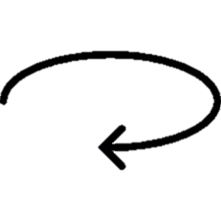
One platform and one journey for all applications
1
Traditional apps in containers
Gain portability, efficiency and security
2
Transform to Microservices
Look for shared services to transform
3
Accelerate New Applications
Greenfield innovation

Slide 38
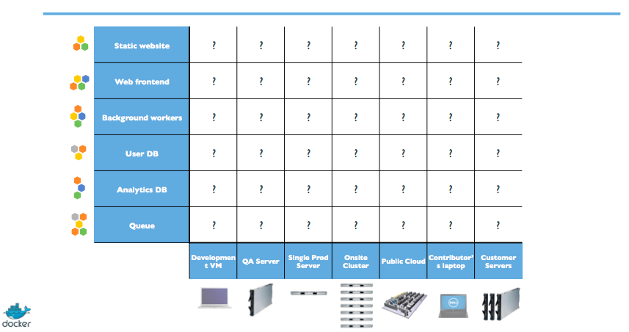
Multiple Stacks, Multiple Stages = Complexity
Notes:
Server drift, dependency hell…

Slide 39
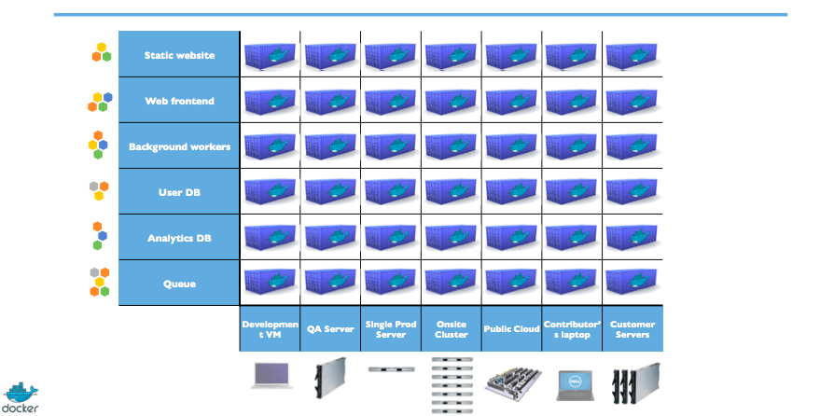
Solving the deployment matrix

Slide 40
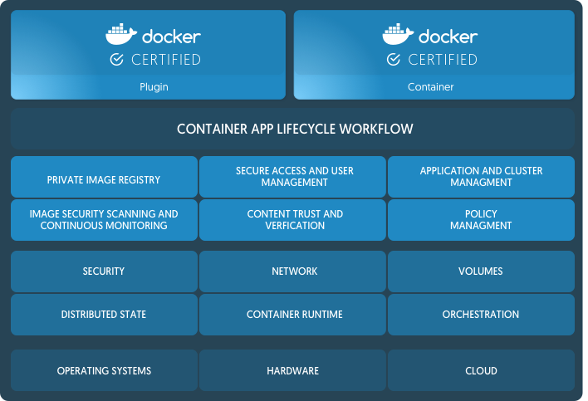
Docker Enterprise Edition (EE) is the CaaS enabled platform for developers and IT
Integrated orchestration, security and management
Predictable quarterly releases with one year of support and maintenance
Security patches and hotfixes backported to all supported versions
Enterprise class support (9am-6pm or 24x7x365)
Certified Infrastructure, Containers and Plugins

Slide 41
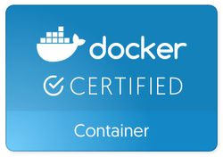

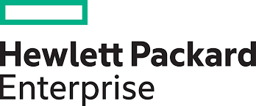
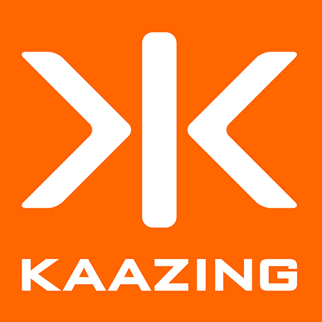
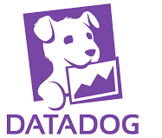

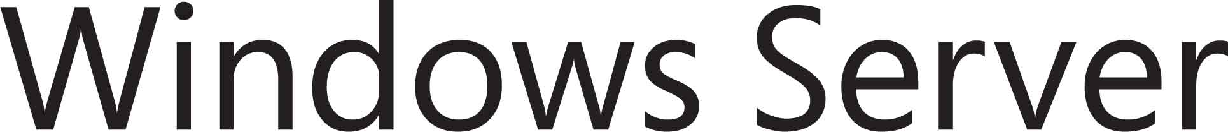

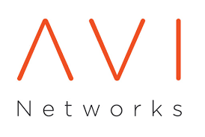
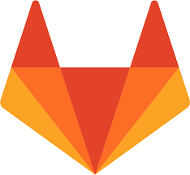


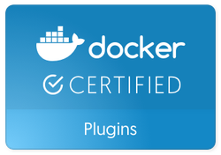
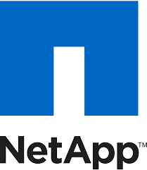
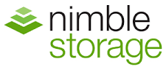


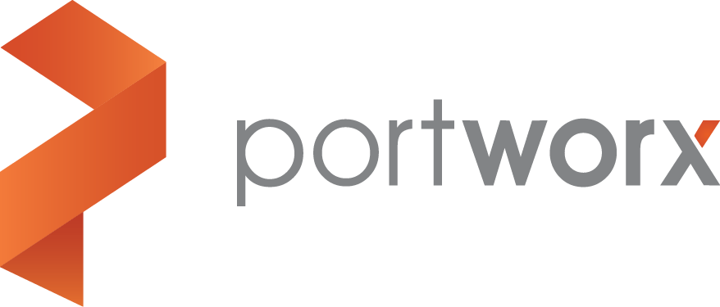

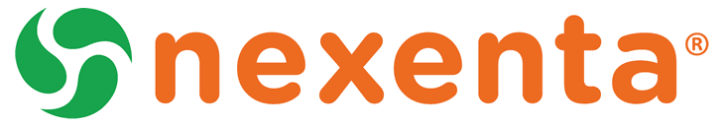


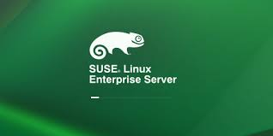
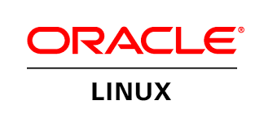




Certified technology extend the platform with assurances and support

