Slide 1
Spring DAO
(Data Access Module of Spring Framework)

Slide 2
Introduction
The Spring Data Access Object (DAO) support makes it easy to work with data access technologies like JDBC, Hibernate or JDO in a standardized way
Makes switching between databases easy and simple
Code without Worrying about catching exceptions
Spring will do it for you!!!

Slide 3
Introduction
Spring comes with a family of data-access frameworks that integrate with a variety of data-access technologies.
You can persist your data via direct JDBC or an object-relational mapping (ORM) framework such as Hibernate.
Spring removes the tedium of data access from your persistence code. Instead, you can lean on Spring to handle the

Slide 4
How Spring Applications Access Data?
Spring JDBC
Service Object
Repository Interface
HIBERNATE
JPA
Repository Implementation
TOPLINK

Slide 5
Spring’s data-access exception hierarchy

Slide 6
The Bad SQLException in Data Access
You can’t do anything with JDBC without being forced to catch SQLException.
SQLException means something went wrong while trying to access a database.
There’s little about that exception that tells you what went wrong or how to deal with it.
Many of the problems that trigger a SQLException can’t be remedied in a catch block.

Slide 7
Spring JDBC Consistent Exception Hierarchy
Spring JDBC provides a hierarchy of data-access exceptions that solve the problems associated with SQLException
Spring provides several data-access exceptions, each descriptive of the problem for which they’re thrown.
Spring Data Access Exceptions are Platform Agnostic
it isn’t associated with any particular persistence solution.
You can count on Spring to throw a consistent set of exceptions, regardless of which persistence provider you choose
Spring’s Data Access Exceptions are unchecked exceptions
You are not forced to catch them

Slide 8
Templating data access

Slide 9
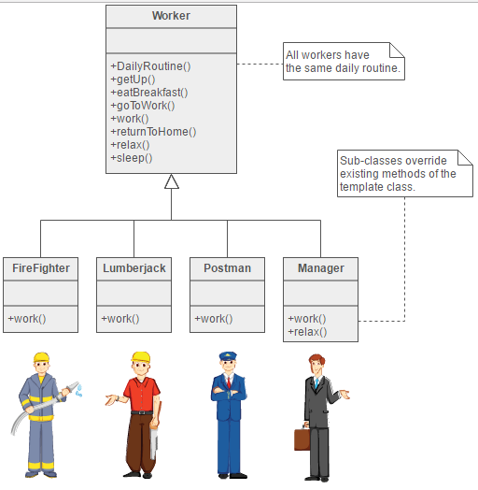
Template Method Pattern
A template method defines the skeleton of a process.
Defers some steps to subclasses.
In Template Method, some steps are Invariants (remains same) and some are Variants (Changes).

Slide 10
Template Method Pattern in Spring Data Access
No matter what technology you’re using, certain data-access steps are required.
Certain fixed steps are required by all data access technologies
Obtain a connection
Clean up resources
There are certain steps which are different for different data access technologies (e.g. JDBC, Hibernate, JPA…)
You query for different objects and update the data in different ways.
These are the variable steps in the data-access process

Slide 11
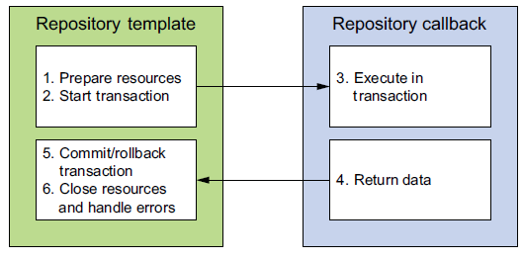
Template Method Pattern in Spring Data Access
The same Template Method pattern is used in Spring’s Data Access.
Spring separates the fixed and variable parts of the data-access process into two distinct classes:
templates
Callbacks
Templates manage the fixed part of the process, whereas your custom data-access code is handled in callbacks
Spring’s data-access template classes take responsibility for common data-access duties. For application-specific tasks, it calls back into a custom callback object.

Slide 12
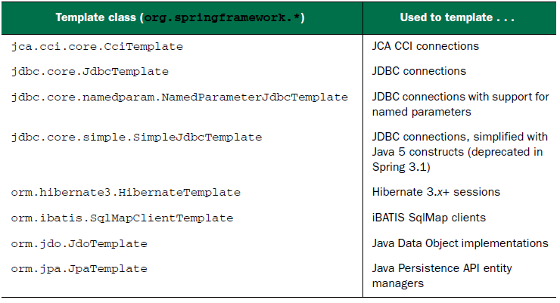
Spring’s Data Access Template Classes

Slide 13
Configuring a DataSource

Slide 14
What is a DataSource ?

Slide 15
JDBC Review
DB
Application
Get connection
JDBC driver
Perform SQL
Notes:
JDBC Review
The JDBC API is a natural Java interface for working with SQL. It builds on Open Database Connectivity (ODBC) rather than starting from the beginning, so programmers familiar with ODBC find it very easy to learn.
The value of JDBC lies in the fact that an application can access virtually any data source and run on any platform with a Java Virtual Machine (JVM). That is, with JDBC, it is not necessary to write one program to access a Sybase database, another to access an database, another to access an IBM DB2 database, and so on. You can write a single program using the JDBC API. Because the application is written in Java, you need not write different applications to run on different platforms, such as Windows and Linux.
JDBC accomplishes database connections by using a driver mechanism that translates the JDBC calls to native database calls. Although most available drivers are fully written in Java (Type 4) and are thus platform-independent, some drivers (Type 2) use native libraries and are targeted to specific platforms.
JBoss Server includes several Type 4 JDBC drivers, which are compliant with the JDBC 3.0 specification. In addition, the Type 4 drivers support the following JDBC 4.0 specification features:
Connection validation
Client information storage and retrieval
Auto-load driver classes (when using Java Platform, Standard Edition 6 (Java SE 6)

Slide 16
JDBC Data Sources
Data source
App
Pool
Connection
DB
App
JNDI lookup
Connection
Get connection Perform SQL
Connection
App
Connection
JDBC driver
Notes:
JDBC Data Sources
JBoss Server can manage your database connectivity through JDBC data sources and multidata sources. Each data source that you configure contains a pool of database connections that are created when the data source instance is created—when it is deployed or targeted, or at server startup. The connection pool can grow or shrink dynamically to accommodate the demand, as indicated by the dotted connection at the top of the pool.
Applications look up a data source on the Java Naming and Directory Interface (JNDI) tree or in the local application context (java:comp/env), depending on how you configure and deploy the object, and then request a database connection. When finished with the connection, the application uses the close operation on the connection, which simply returns the connection to the connection pool in the data source.
JBoss Server data sources allow connection information such as the JDBC driver, the database location (URL), and the username and password to be managed and maintained in a single location, without requiring the application to worry about these details. In addition, limiting the number of connections is important if you have a licensing limitation on your database or it can support only a specific capacity.

Slide 17
JDBC Connection Pooling
Application server
JNDI
JDBC Conn. Pool
DataSourceA
JDBC Conn. Pool
DataSourceB
: Connection
DBMS
Application
: Connection
: Connection
Component
: Connection
JDBC Conn. Pool
DataSourceC
Notes:
JDBC Connection Pooling
The diagram in the slide shows the flow from the applications through the JNDI tree, through the JDBC connection pools, and finally to the database. In JBoss Server, you can configure database connectivity by configuring the JDBC data sources and the multi-data sources, and then targeting or deploying the JDBC resources to the servers or clusters in your JBoss domain.
Each data source that you configure contains a pool of database connections that are created when the data source instance is created—when it is deployed or targeted, or at server startup. Applications look up a data source on the JNDI tree or in the local application context (java:comp/env), depending on how you configure and deploy the object, and then request a database connection. When finished with the connection, the application calls connection.close(), which returns the connection to the connection pool in the data source.

Slide 18
Benefits of Connection Pools
Connection time and overhead are saved by using an existing database connection.
It facilitates easier management because connection information is managed in one location.
The number of connections to a database can be controlled.
The DBMS can be changed without the application developer having to modify the underlying code.
A connection pool allows an application to “borrow” a DBMS connection.
Notes:
Benefits of Connection Pools
Making a DBMS connection is a very slow process when compared to assigning an existing connection. When JBoss Server starts, connections from the connection pools are opened and are available to all clients. When a client closes a connection from a connection pool, the connection is returned to the pool and is available for other clients; the connection itself is not closed. There is little cost in opening and closing pool connections. The alternative is for application code to make its own JDBC connections as needed. A DBMS runs faster with dedicated connections than if it has to handle incoming connection attempts at run time.
Connection information, such as the JDBC driver class name, the database location (URL), and the username and password can be managed in one location using the Administration Console. Application developers can obtain a connection without having to worry about these details.
Limiting the number of DBMS connections is important if you have a licensing limitation for DBMS connections or a resource concern.
Clients use a connection pool by “borrowing” a connection, using it, and then returning it to the pool by closing it. The connection pool can grow or shrink dynamically to accommodate demand. The Administration Console is used to set a connection pool’s initial capacity, maximum capacity, and capacity increment.

Slide 19

How Data Source Connection Pools Are Used
A client retrieves a data source through a JNDI lookup and uses it to obtain a database connection.
Client
Lookup data source
1
Managed server
Connection
pool
Return data source
2
3
JNDI
getConnection()
Data source
Return connection
4
DBMS
Connection
5
Database access
Notes:
How Data Source Connection Pools Are Used
This is an example of how a data source is used by the client. The sequence of events is as follows:
A client retrieves a data source object by performing a lookup in the JBoss Server JNDI tree (1 and 2). A data source object contains a reference to the connection pool.
After a data source object is obtained, the client can obtain a database connection (3 and 4).
The connection then directly accesses the database (5).

Slide 20
DataSource Support in Spring Framework
Spring has excellent support for DataSource
Spring DAO Module implements DataSource interface and gives you the benefits of Using DataSource without the need of Web Container or Application Server to create it
The out of the box implemented datasources are primarily used for development and testing your application.
When you deploy your application in production server, you are recommended to use datasource resourced from Web Server (e.g Tomcat) or Application Server (e.g. WebLogic).

Slide 21
Configuring a data source
For spring-supported data access you use, you’ll likely need to configure a reference to a data source.
Spring offers several options for configuring data-source beans in your Spring application, including these:
Data sources that are defined by a JDBC driver
Data sources that are looked up by JNDI
Data sources that pool connections
For production-ready applications, It is recommended to use a data source that draws its connections from a connection pool.

Slide 22
Using JNDI data sources
When a Spring application is deployed in a JEE Server (Application Server) like Jboss or WebLogic, or even a web container like Tomcat, it can get a DataSource resourced from JNDI.
Spring can wire a DataSourec in JEE environment using
<jee:jndi-lookup id="dataSource"
jndi-name="/jdbc/myDS“ resource-ref="true" />
Alternatively, if you’re using Java configuration, you can use JndiObjectFactoryBean to look up the DataSource from JNDI
@Bean
public JndiObjectFactoryBean dataSource() {
JndiObjectFactoryBean jndiObjectFB = new JndiObjectFactoryBean();
jndiObjectFB.setJndiName("jdbc/myDS");
jndiObjectFB.setResourceRef(true);
jndiObjectFB.setProxyInterface(javax.sql.DataSource.class);
return jndiObjectFB;
}

Slide 23
Using a pooled data source (XML Configuration)
You can configure a pooled data source directly in Spring.
Although Spring doesn’t provide a pooled data source, plenty of suitable ones are available.
A few popular open source options:
Apache Commons DBCP (http://jakarta.apache.org/commons/dbcp)
c3p0 (http://sourceforge.net/projects/c3p0/)
BoneCP (http://jolbox.com/)
DBCP’s BasicDataSource is configured in XML as
<bean id="dataSource" class="org.apache.commons.dbcp.BasicDataSource"
p:driverClassName="org.h2.Driver"
p:url="jdbc:h2:tcp://localhost/~/demodb"
p:username="sa"
p:password=""
p:initialSize="5"
p:maxActive="10" />

Slide 24
Using a pooled data source (Java Configuration)
@Bean
public BasicDataSource dataSource() {
BasicDataSource ds = new BasicDataSource();
ds.setDriverClassName(“com.mysql.jdbc.Driver");
ds.setUrl(“jdbc:mysql://localhost:3306/demodb");
ds.setUsername(“root");
ds.setPassword(“root");
ds.setInitialSize(5);
ds.setMaxActive(10);
return ds;
}

Slide 25
Using JDBC driver-based data sources
Spring Provided simplest DataSources for Development and testing.
Spring offers three such data-source classes to choose from.
DriverManagerDataSource
Returns a new connection every time a connection is requested.
Not pooled.
SimpleDriverDataSource
Works much the same as DriverManagerDataSource except that it works with the JDBC driver directly to overcome class loading issues that may arise in certain environments, such as in an OSGi container.
SingleConnectionDataSource
Returns the same connection every time a connection is requested.

Slide 26
How do We configure DriverManagerDataSource
@Bean
public DriverManagerDataSource dataSource() {
DriverManagerDataSource ds = new DriverManagerDataSource ();
ds.setDriverClassName(“com.mysql.jdbc.Driver");
ds.setUrl(“jdbc:mysql://localhost:3306/demodb");
ds.setUsername(“root");
ds.setPassword(“root");
return ds;
}
In XML, the DriverManagerDataSource can be configured as follows:
<bean id="dataSource"
class="org.springframework.jdbc.datasource.DriverManagerDataSource"
p:driverClassName=" com.mysql.jdbc.Driver "
p:url=" jdbc:mysql://localhost:3306/demodb "
p:username=“root"
p:password=“root" />

Slide 27
Using JDBC with Spring

Slide 28
Working with JDBC templates
Spring abstracts away the boilerplate data access code behind template classes.
For JDBC, Spring comes with three template classes to choose from:
JdbcTemplate
The most basic of Spring’s JDBC templates, this class provides simple access to a database through JDBC and indexed-parameter queries.
NamedParameterJdbcTemplate
This JDBC template class enables you to perform queries where values are bound to named parameters in SQL, rather than indexed parameters.
SimpleJdbcTemplate
This version of the JDBC template takes advantage of Java 5 features such as autoboxing, generics, and variable parameter lists to simplify how a JDBC template is used.

Slide 29
If we have to Access Data using JDBC …
Normally we write the code in the following way
Define connection parameters
Open the connection
Specify the statement
Prepare and execute the statement
Set up the loop to iterate through
the results (if any)
Do the work for each iteration
Process any exception
Handle transactions
Close the connection
You need to do only these steps in Spring JDBC

Slide 30
Using JDBCTemplate
Spring provides some out of the Box Callback interfaces which need to be implemented by the code using JDBCTemplate.
Some of the callbacks are
PreparedStatementCreator
Creates a PreparedStatement given a connection
CallableStatementCreator interface
which creates callable statement
RowCallbackHandler interface
extracts values from each row of a ResultSet
RowMapper
Maps rows of a ResultSet on a per-row basis.
Implementations of this interface perform the actual work of mapping each row to a result object, but don't need to worry about exception handling
ResultSetExtractor
used by JdbcTemplate's query methods. Implementations of this interface perform the actual work of extracting results from a ResultSet, but don't need to worry about exception handling

Slide 31
Configuring a JdbcTemplate
@Bean
public JdbcTemplate jdbcTemplate(DataSource dataSource) {
return new JdbcTemplate(dataSource);
}
OR
<bean id="jt" class="org.springframework.jdbc.core.JdbcTemplate">
<property name="dataSource" ref=“dataSource" />
</bean>

Slide 32
Demo:
Using JdbcTemplate

