Slide 1
Spring Framework Basics

Slide 2
Topics
What is Spring framework?
Why Spring framework?
Spring framework architecture
Usage scenario
Dependency Injection (DI)
  BeanFactory
  Autowiring
  ApplicationContext

Slide 3
What is Spring Framework?

Slide 4
What is Spring Framework?
Light-weight yet comprehensive framework for building Java SE and Java EE applications

Slide 5
What is Spring Framework?
The Spring Framework Mission Statement
  J2EE should be easier to use
  It's best to program to interfaces, rather than classes. Spring reduces the complexity cost of using interfaces to zero
  JavaBeans offer a great way of configuring applications
  OO design is more important than any implementation technology, such as J2EE
  Checked exceptions are overused. A framework should not force to catch

Slide 6
Key Features
JavaBeans-based configuration management, applying Inversion-of-Control principles, specifically using the Dependency Injection technique
  This aims to reduce dependencies of components on specific implementations of other components.
A core bean factory, which is usable globally
Generic abstraction layer for database transaction management

Slide 7
Key Features
Built-in generic strategies for JTA and a single JDBC DataSource
  This removes the dependency on a Java EE environment for transaction support.
Integration with persistence frameworks Hibernate, JDO and iBATIS.
MVC web application framework, built on core Spring functionality, supporting many technologies for generating views, including JSP, FreeMarker, Velocity, Tiles, iText, and POI.

Slide 8
Key Features
Extensive aspect-oriented programming (AOP) framework to provide services such as transaction management
  As with the Inversion-of-Control parts of the system , this aims to improve the modularity of systems created using the framework.

Slide 9
Why Use Spring Framework?

Slide 10
Why Use Spring?
Wiring of components through Dependency Injection
  Promotes de-coupling among the parts that make the application
Design to interfaces
  Insulates a user of a functionality from implementation details
Test-Driven Development (TDD)
  POJO classes can be tested without being tied up with the framework

Slide 11
Why Use Spring?
Declarative programming through AOP
  Easily configured aspects, esp. transaction support
Simplify use of popular technologies
  Abstractions insulate application from specifics, eliminate redundant code
    Handle common error conditions
    Underlying technology specifics still accessible

Slide 12
Why Use Spring?
Conversion of checked exceptions to unchecked
Extremely modular and flexible
Well designed
  Easy to extend
  Many reusable classes

Slide 13
Why Use Spring?
Integration with other technologies
  EJB for J2EE
  Hibernate, iBates, JDBC (for data access)
  Velocity (for presentation)
  Struts and WebWork (For web)

Slide 14
Spring Framework Architecture

Slide 15
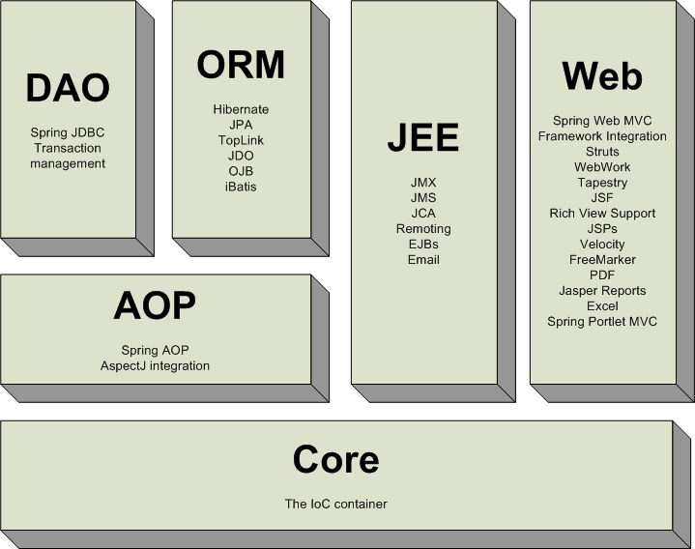
Spring Framework

Slide 16
Core Package
Core package is the most fundamental part of the framework and provides the IoC and Dependency Injection features
The basic concept here is the BeanFactory, which provides a sophisticated implementation of the factory pattern which removes the need for programmatic singletons and allows you to decouple the configuration and specification of dependencies from your actual program logic

Slide 17
DAO Package
The DAO package provides a JDBC-abstraction layer that removes the need to do tedious JDBC coding and parsing of database-vendor specific error codes
The JDBC package provides a way to do programmatic as well as declarative transaction management, not only for classes implementing special interfaces, but for all your POJOs (plain old Java objects)

Slide 18
ORM Package
The ORM package provides integration layers for popular object-relational mapping APIs, including JPA, JDO, Hibernate, and iBatis.
Using the ORM package you can use all those O/R-mappers in combination with all the other features Spring offers, such as the simple declarative transaction management feature mentioned previously

Slide 19
AOP Package
Spring's AOP package provides an AOP Alliance-compliant aspect-oriented programming implementation allowing you to define, for example, method-interceptors and pointcuts to cleanly decouple code implementing functionality that should logically speaking be separated
Using source-level metadata functionality you can also incorporate all kinds of behavioral information into your code

Slide 20
MVC Package
Spring's MVC package provides a Model-View-Controller (MVC) implementation for webapplications
Spring's MVC framework is not just any old implementation; it provides a clean separation between domain model code and web forms, and allows you to use all the other features of the Spring Framework.

Slide 21
Usage Scenarios

Slide 22
Usage Scenarios
You can use Spring in all sorts of scenarios, from applets up to fully-fledged enterprise applications using Spring's transaction management functionality and web framework integration

Slide 23
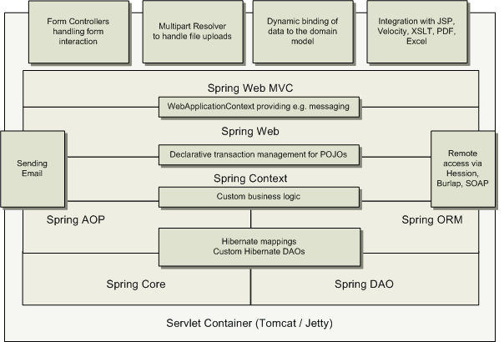
Typical Full-fledged Spring Web
Application

Slide 24
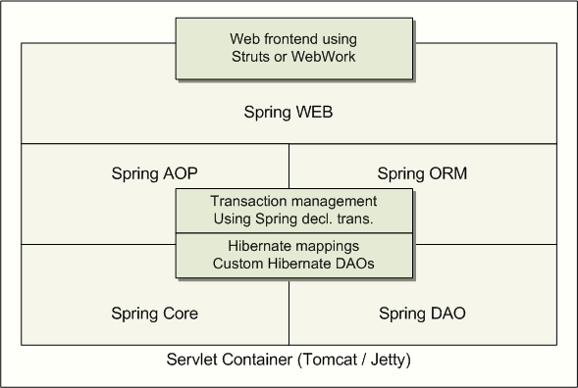
Spring Middle-tier Using 3rd party
Web Framework

Slide 25
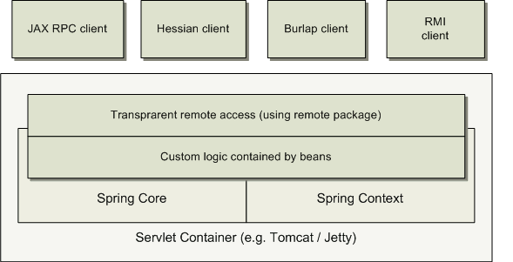
Remoting Usage Scenario

Slide 26
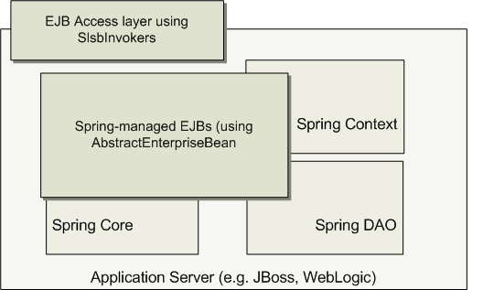
EJBs – Wrapping Existing POJOs

Slide 27
Dependency Injection (DI):
Basic concept

Slide 28
Spring Dependency Injection
A kind of Inversion of Control (IoC)
“Hollywood Principle”
  Don't call me, I'll call you
“Container” resolves (injects) dependencies of components by setting implementation object (push)
  As opposed to component instantiating or Service Locator pattern where component locates implementation (pull)
Martin Fowler calls Dependency Injection

Slide 29
Benefits of Dependency Injection
Flexible
  Avoid adding lookup code in business logic
Testable
  No need to depend on external resources or containers for testing
Maintainable
  Allows reuse in different application environments by changing configuration files instead of code
  Promotes a consistent approach across all applications and teams

Slide 30
Two Dependency Injection Variants
Constructor dependency Injection
  Dependencies are provided through the constructors of the component
Setter dependency injection
  Dependencies are provided through the JavaBean style setter methods of the component
  More popular than Constructor dependency injection

Slide 31
Constructor Dependency Injection
public class ConstructorInjection {
private Dependency dep;
public ConstructorInjection(Dependency dep) {
this.dep = dep;
}
}

Slide 32
Setter Dependency Injection
public class SetterInjection {
private Dependency dep;
public void setMyDependency(Dependency dep) {
this.dep = dep;
}
}

Slide 33
Dependency Injection (DI):
DI Support in Spring

Slide 34
BeanFactory
BeanFactory object is responsible for managing beans and their dependencies
Your application interacts with Spring's DI container through BeanFactory interface
  BeanFactory object has to be created by the application typically XmlBeanFactory
  BeanFactory object, when it gets created, read bean configuration file and performs the wiring
  Once created, the application can access the beans via BeanFactory interface

Slide 35
BeanFactory Implementations
XmlBeanFactory
  Convenience extension of DefaultListableBeanFactory
    that reads bean definitions from an XML document

Slide 36
Reading XML Configuration File via
XmlBeanFactory class
public class XmlConfigWithBeanFactory {
public static void main(String[] args) {
XmlBeanFactory factory =
new XmlBeanFactory(new FileSystemResource("beans.xml"));
SomeBeanInterface b =
(SomeBeanInterface) factory.getBean(“nameOftheBean”);
}
}

Slide 37
Bean Configuration File
Each bean is defined using <bean> tag under the root of the <beans> tag
The id attribute is used to give the bean its default name
The class attribute specifies the type of the bean

Slide 38
Bean Configuration File Example
<!DOCTYPE beans PUBLIC "-//SPRING//DTD BEAN//EN"
"http://www.springframework.org/dtd/spring-beans.dtd">
<beans>
<bean id="renderer" class="StandardOutMessageRenderer">
<property name="messageProvider">
<ref local="provider"/>
</property>
</bean>
<bean id="provider" class="HelloWorldMessageProvider"/>
</beans>

Slide 39
Wiring a Bean

Slide 40
Beans
The term “bean” is used to refer any component managed by the BeanFactory
The “beans” are in the form of JavaBeans (in most cases)
  no arg constructor
  getter and setter methods for the properties
Beans are singletons by default
Properties the beans may be simple values or references to other beans
Beans can have multiple names

Slide 41
What is Wiring?
The act of creating associations between application components is referred to as wiring
There are many ways to wire a bean but common approach is via XML

Slide 42
Wiring example
<?xml version="1.0" encoding="UTF-8"?>
<!DOCTYPE beans PUBLIC "-//SPRING//DTD BEAN//EN"
"http://www.springframework.org/dtd/spring-beans.dtd">
<beans>
<bean id="greetBean“ class="GreetingServiceImpl">
<property name="greeting">
<value>Hello friends of Spring</value>
</property>
</bean>
</beans>

Slide 43
Wiring the beans
Spring beans can be driven from any configuration
  Properties files
  Relational database
  an LDAP
Preferred Choice for configuration is XML
Several Spring containers support wiring through xml
  XmlBeanFactory
  ClasspathXmlApplicationContext
  FileSystemApplicationContext
  XmlWebApplicationContext

Slide 44
Wiring the beans
<?xml version="1.0" encoding="UTF-8"?>
<!DOCTYPE beans PUBLIC "-//SPRING//DTD BEAN//EN"
"http://www.springframework.org/dtd/spring-beans.dtd">
<beans>
<bean id=“mybean“ class=“com.jp.TestBean">
</bean>
</beans>
The root element
bean’s id
Bean instance
(beans class name)

Slide 45
Wiring the beans
Prototype and Singleton beans
  all spring beans are singleton
  but prototype beans can also be defined
  <bean id =“myBean” class=“com.jp.TestBean”
  singleton=“false”/>
  singleton = “false” returns a prototype bean
  singleton = “true” returns a singleton bean
  default value for “singleton” is “true”
In Spring Framework Version 2.x the configuration for scope is
  <bean id =“myBean” class=“com.jp.TestBean”
  scope=“singletone”/>
  Scope attribute has values:
  Singleton
  Prototype
  Request
  session

Slide 46
Wiring the beans
Initialization and Destruction
  beans can be initialized and destroyed by calling bean specific methods
    init-method : calls bean specific initialization method
    destroy-method : calls bean specific cleanup method

Slide 47
Wiring the beans
Initialization and Destruction (example)
  public class MyConnectionPool {
  public void initialize(){
  //initialize a connection;
  }
  public void cleanup() {
  //release connection;
  }
  }
configuration:
  <bean id=“myBean” class =“com.jp.MyConnectionPool”
  init-method=“initialize” destroy-method=“cleanup” />

Slide 48
Spring Dependency Injection Revisited
Two types of Dependency Injection
  setter injection
    dependency injected via setter methods
  constructor injection
    dependency injected via constructor

Slide 49
Spring Dependency Injection
Setter Injection
<bean id=“test” class=“com.jp.TestBean”>
<property name=“greeting”>
<value>Hello friends</value>
</property>
</bean>
Set the greet property by
calling setGreeting( “Hello Friends” )

Slide 50
Spring Dependency Injection
Referencing other beans
<beans>
  <bean id=“test” class =“com.jp.TestBean”>
  <property name=“greeting”>
  <ref bean=“greetBean”/>
  </property>
  <bean id=“greetBean” class =“com.jp.GreetBean” />
<beans>

Slide 51
Spring Dependency Injection
Constructor Injection
  <bean id=“test” class=“com.jp.testBean”>
  <constructor-arg>
  <value>Hello friends</value>
  </constructor-arg>
  </bean>
  <bean id=“test” class=“com.jp.testBean”>
  <constructor-arg>
  <ref bean=“greetBean”/>
  </constructor-arg>
  </bean>
constructs a
TestBean
object through
its constructor

Slide 52
Wiring Collections
Spring supports Many types of Collections as bean properties
Supported types are:
XML | Types
<list> | java.util.List, arrays
<set> | java.util.Set
<map> | java.util.Map
<props> | java.util.Properties

Slide 53
Wring Lists and Arrays
<property name="testList">
<list>
<value>value1</value>
<value>value2</value>
</list>
</property>
<bean id="exampleSessionFactory" class="org.springframework.orm.hibernate3.LocalSessionFactoryBean">
<property name="dataSource"><ref local="exampleDataSource"/>
<property name="hibernateProperties">
<ref bean="exampleHibernateProperties" />
</property>
<property name="mappingResources">
<list>
<value>Customer.hbm.xml</value>
<value>Account.hbm.xml</value>
</list>
</property>
</bean>

Slide 54
Wring Set and Map, Properties
<property name="barMap">
<map>
<entry key="key1">
<value>value1</value>
</entry>
<entry key="key1">
<value>value1</value>
</entry>
</map>
</property>
<property name="testSet">
<set>
<value>value1</value>
<value>value2</value>
</set>
</property>
<property name="barProperty">
<props>
<prop key="key1">value1</prop>
<prop key="key2">value2</prop>
<prop key="key3">value3</prop>
</props>
</property>

Slide 55
Dependency Injection: Autowiring

Slide 56
Auto Wiring
So far we wired beans explicitly using <property> tag
Spring can also do Wiring automatically
<bean id="foo" class="com.jp.spring.Foo“ autowire= "autowire type"/>

Slide 57
Autowiring Properties
Beans may be auto-wired (rather than using <ref>)
  Per-bean attribute autowire
  Explicit settings override
autowire=“byName”
  Bean identifier matches property name
autowire=“byType”
  Type matches other defined bean
autowire=”constructor”
  Match constructor argument types
autowire=”autodetect”
  Attempt by constructor, otherwise “type”
Autowire=“no”
  no autowire is allowed

Slide 58
Bean Naming
Each bean must have at least one name that is unique within the containing BeanFactory
Name resolution procedure
  If a <bean> tag has an id attribute, the value of the id attribute is used as the name
  If there is no id attribute, Spring looks for name attribute
  If neither id nor name attribute are defined, Spring use the class name as the name
A bean can have multiple names
  Specify comma or semicolon-separated list of names in the name attribute

Slide 59
Bean Naming Example
<bean id=”mybeanid” class=”mypackage.MyClass”/>
<bean name=”mybeanname” class=”mypackage.MyClass”/>
<bean class=”mypackage.MyClass”/>
<bean id=”mybeanid” name=”name1,name2,name3”
class=”mypackage.MyClass”/>

Slide 60
ApplicationContext

Slide 61
What is ApplicationContext?
Extension of BeanFactory
  It provides all the same functionality and more
  Reduces the amount of code you need
  In a more framework-oriented style
Add new features over BeanFactory
  Resource management and access
  Additional life-cycle interfaces
  Improved automatic configuration of infrastructure components
  Event publication
  Internationalization

Slide 62
Important Application Contexts
ClassPathXmlApplicationContext
WebApplicationContext
FileSystemApplicationContext

Slide 63
When to Use ApplicationContext?
Use ApplicationContext over BeanFactory to take advantage of its extended functionality
  Except for a few limited situations such as perhaps in an Applet, where memory consumption might be critical, and a few extra kilobytes might make a difference

Slide 64
Using MessageSource
The ApplicationContext interface extends an interface called MessageSource, and therefore provides messaging (i18n or internationalization)functionality
<beans>
<bean id="messageSource”
class="org.springframework.context.support.ResourceBundleMessageSource">
<property name="basenames">
<list>
<value>format</value>
<value>exceptions</value>
<value>windows</value>
</list>
</property>
</bean>
</beans>

Slide 65
Propagating Events
Event handling in the ApplicationContext is provided through the ApplicationEvent class and ApplicationListener interface
  If a bean which implements the ApplicationListener interface is deployed into the context, every time an ApplicationEvent gets published to the ApplicationContext, that bean will be notified
  Essentially, this is the standard Observer design pattern.

Slide 66
Three Built-in Events
ContextRefreshEvent
  ApplicationContext is initialized or refreshed
ContextClosedEvent
  ApplicationContext is closed
RequestHandleEvent
  A web-specific event telling all beans that a HTTP request has been serviced

Slide 67
Example: Event Handling
Configuration
<bean id="emailer" class="example.EmailBean">
<property name="blackList">
<list>
<value>black@list.org</value>
<value>white@list.org</value>
<value>john@doe.org</value>
</list>
</property>
</bean>
<bean id="blackListListener" class="example.BlackListNotifier">
<property name="notificationAddress" value="spam@list.org"/>
</bean>

Slide 68
Example: Event Handling
public class BlackListEvent extends ApplicationEvent{
String address;
String text;
// getters and setters
public BlackListEvent(String address, String text) {
super( address); //Required !!!
this.address = address;
this.text = text;
}
}

Slide 69
Example: Event Handling
Bean class
public class EmailBean implements ApplicationContextAware {
/** the blacklist */
private List blackList;
public void setBlackList(List blackList) {
this.blackList = blackList;
}
public void setApplicationContext(ApplicationContext ctx) {this.ctx = ctx;}
public void sendEmail(String address, String text) {
if (blackList.contains(address)) {
BlackListEvent evt = new BlackListEvent(address, text);
ctx.publishEvent(evt);
return;
}
}
}

Slide 70
Example: Event Handling
Notifier class
public class BlackListNotifier implement ApplicationListener {
/** notification address */
private String notificationAddress;
public void setNotificationAddress(String notificationAddress) {
this.notificationAddress = notificationAddress;
}
public void onApplicationEvent(ApplicationEvent evt) {
if (evt instanceof BlackListEvent) {
// notify appropriate person
}
}
}

Slide 71
Life Cycle of a Bean

Slide 72
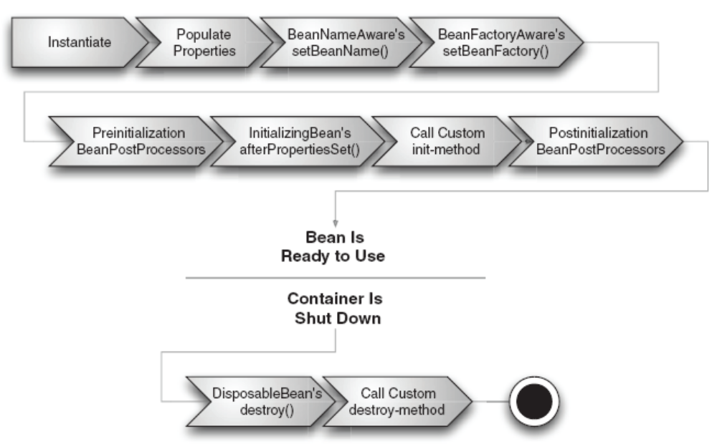
Life cycle of a bean in BeanFactory Container

Slide 73
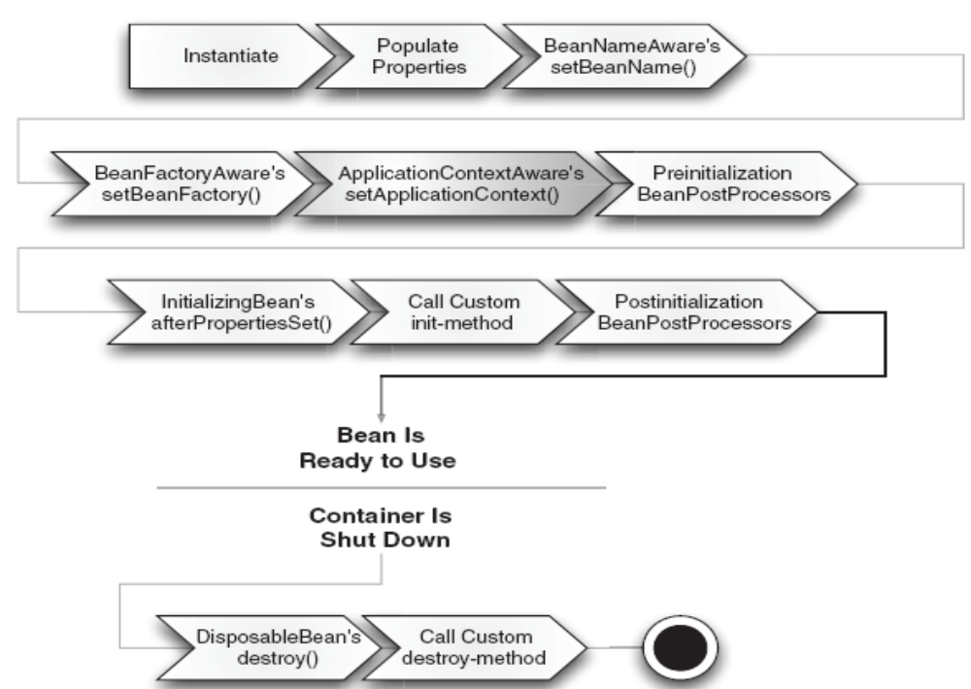
The lifecycle of a bean within a Spring application context

