Slide 1
Java Threads

Slide 2
Some Important Concepts

Slide 3
Synchronous and Asynchronous
Synchronous execution means the first task in a program must finish processing before moving on to executing the next task
Asynchronous execution means a second task can begin executing in parallel, without waiting for an earlier task to finish.

Slide 4
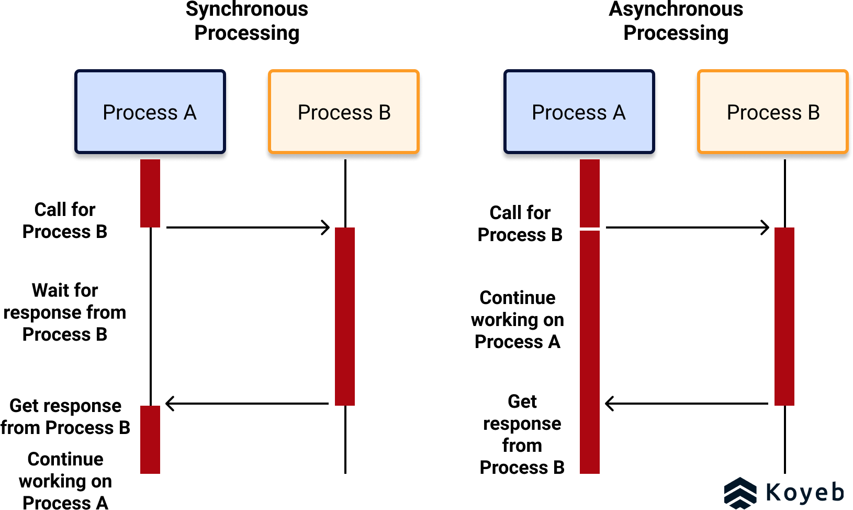
Synchronous and Asynchronous

Slide 5
Synchronous Processing
User Interfaces
  User interface (UI) designs are typically synchronous.
  Since UIs are spaces where humans and computers interact, it is ideal for them to replicate the communication standards and practices humans are familiar with. Humans expect an immediate response when they interact with a computer!
HTTP APIs
  HTTP APIs pass requests and responses in a synchronous fashion.
  Client programs sending HTTP requests usually expect a fast answer from the web server.

Slide 6
Asynchronous Processing
Batch-processing: is a data-processing method to handle large amounts of data asynchronously. With asynchronous batch-processing, large batches of data are processed at scheduled times to avoid blocking computing resources.
Long-running tasks: such as fulfilling an order placed on an e-commerce site are best handled asynchronously. There is no need to block resources while this task is executed.

Slide 7
CPU Bound and IO Bound

Slide 8
CPU Bound
CPU-bound describes a scenario where the execution of a task or program is highly dependent on the CPU.
In a CPU-bound environment, most times, the processor is the only component being used for execution.
other components in the computer system are rarely used during execution.
Due to this dependence, everything concerned with program execution is dependent on the CPU.
Consequently, if we want a program to run faster, then we have to increase the speed of the CPU.
CPU-bound operations tend to have few and long CPU bursts.
  CPU burst refers to the amount of time taken to execute a task, usually with the CPU. As a result, it’s always advisable to assign a lower priority to such tasks to prevent wasting resources:

Slide 9
CPU Bound Example
Applications that usually require lost of calculations are a classic example.
High-Performance Computing (HPC) systems can be thought of as CPU-bound.
Such systems combine the processing power of several powerful processors in the CPU to deliver higher computing performance.
Notes:
Due to the speed and efficiency of such systems, they’re capable of computing billions of calculations per second.
If we want to increase the performance of the HPC system, in addition to other components, we can increase the processor’s speed.
HPC systems have been employed in a number of areas, such as weather prediction, artificial intelligence, and research in general.
In addition to HPC systems, graphics operations are also CPU-bound in the sense that calculations have to be made to render graphics.

Slide 10
Advantages and Disadvantages
The main advantage is:
  The use of the CPU results in faster processing of tasks or programs.
The disadvantages are:
  The use of the processing unit alone results in other system components being idle, hence a waste of resources.
  Increasing CPU power is an expensive exercise because they’re generally expensive to purchase.

Slide 11
IO Bound
A task or program is I/O bound if its execution is dependent on the input-output system and its resources, such as disk drives and peripheral devices.
In I/O bound environments, we wait for resources to be retrieved through the input-output systems.
Hence, a program or task would execute faster if the input-output system worked faster
I/O bound operations are characterized by many and fewer CPU bursts during execution:

Slide 12
Examples Of IO Bound
Any application that involves reading and writing data from an input-output system, as well as waiting for information, is considered I/O bound.
These include applications like word processing systems, web applications, copying files, and downloading files.

Slide 13
Advantages and Disadvantages
The main advantage is:
  Due to the short CPU bursts, they’re usually assigned higher priority during scheduling to ensure that system resources are better used.
The disadvantages are:
  Programs that are I/O bound are often slower than CPU-bound programs.
  Due to the use of the input-output system, the time spent waiting for data to be read or written can be substantial. This is considerably slower than the time it takes a processor to complete operations.

Slide 14
Process and Threads

Slide 15
Process
A process is an instance of a program that is under execution.
A process can create other processes to perform multiple tasks at a time; the created processes are known as clone or child process, and the main process is known as the parent process.
Stack
Heap
Data
Text

Slide 16
Process States
New
Terminated
admitted
exited
schedule
Ready
Running
pre-empt
Waiting

Slide 17
What is a Thread
A thread is the subset of a process and is also known as the lightweight process.
A process can have more than one thread, and these threads are managed independently by the scheduler.
All the threads within one process are interrelated to each other.
Threads have some common information, such as data segment, code segment, files, etc., that is shared to their peer threads. But contains its own registers, stack, and counter.

Slide 18
Threads and Process
Single Threaded
Multi Threaded
Code
Data
Files
Code
Data
Files
Registers
Counters
Stack
Registers
Registers
Registers
Counters
Counters
Counters
Stack
Stack
Stack

Slide 19
Multitasking and Multithreading
Multitasking:
  refers to a computer's ability to perform multiple jobs concurrently
  more than one program are running concurrently, e.g., UNIX
Multithreading:
  A thread is a single sequence of execution within a program
  refers to multiple threads of control within a single program
  each program can run multiple threads of control within it, e.g., Web Browser

Slide 20
Concurrency vs. Parallelism
CPU
CPU1
CPU2

Slide 21
Threads and Processes
CPU
Process 1
Process 2
Process 3
Process 4
main
run
GC

Slide 22
What are Threads Good For?
To maintain responsiveness of an application during a long running task
To enable cancellation of separable tasks
Some problems are intrinsically parallel
To monitor status of some resource (e.g., DB)
Some APIs and systems demand it (e.g., Swing)

Slide 23
Application Thread
When we execute an application:
  The JVM creates a Thread object whose task is defined by the main() method
  The JVM starts the thread
  The thread executes the statements of the program one by one
  After executing all the statements, the method returns and the thread dies

Slide 24
Multiple Threads in an Application
Each thread has its private run-time stack
If two threads execute the same method, each will have its own copy of the local variables the methods uses
However, all threads see the same dynamic memory, i.e., heap (are there variables on the heap?)
Two different threads can act on the same object and same static fields concurrently

Slide 25
Creating Threads
There are two ways to create our own Thread object
  Subclassing the Thread class and instantiating a new object of that class
  Implementing the Runnable interface
In both cases the run() method should be implemented

Slide 26
Extending Thread
public class ThreadExample extends Thread {
public void run () {
for (int i = 1; i <= 100; i++) {
System.out.println(“---”);
}
}
}

Slide 27
Thread Methods
void start()
  Creates a new thread and makes it runnable
  This method can be called only once
void run()
  The new thread begins its life inside this method
void stop() (deprecated)
  The thread is being terminated

Slide 28
Thread Methods
void yield()
  Causes the currently executing thread object to temporarily pause and allow other threads to execute
  Allow only threads of the same priority to run
void sleep(int m) or sleep(int m, int n)
  The thread sleeps for m milliseconds, plus n nanoseconds

Slide 29
Implementing Runnable
public class RunnableExample implements Runnable {
public void run () {
for (int i = 1; i <= 100; i++) {
System.out.println (“***”);
}
}
}

Slide 30
A Runnable Object
When running the Runnable object, a Thread object is created from the Runnable object
The Thread object’s run() method calls the Runnable object’s run() method
Allows threads to run inside any object, regardless of inheritance
Example – an applet
that is also a thread

Slide 31
Starting the Threads
public class ThreadsStartExample {
public static void main (String argv[]) {
new ThreadExample ().start ();
new Thread(new RunnableExample ()).start ();
}
}
What will we see when running
ThreadsStartExample?

Slide 32
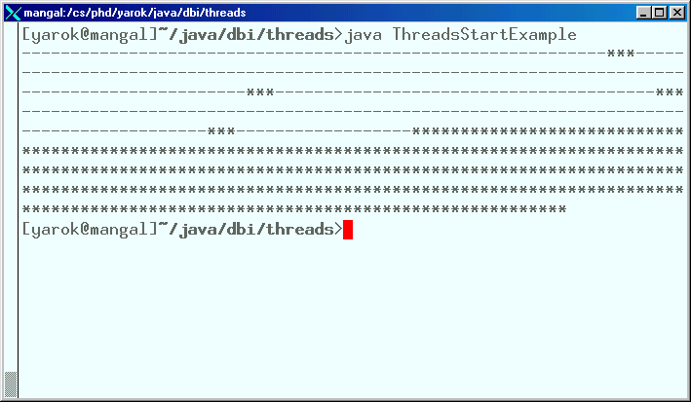

Slide 33
Scheduling Threads
start()
Ready queue
Newly created
threads
Currently executed
thread
I/O operation completes
What happens when
a program with a
ServerSocket calls
accept()?
Waiting for I/O operation to be completed
Waiting to be notified
Sleeping
Waiting to enter a synchronized section

Slide 34
Thread State Diagram
Alive
Running
new ThreadExample();
while (…) { … }
New Thread
Runnable
Dead Thread
thread.start();
run() method returns
Blocked
Object.wait()
Thread.sleep()
blocking IO call
waiting on a monitor

Slide 35
Example
public class PrintThread1 extends Thread {
String name;
public PrintThread1(String name) {
this.name = name;
}
public void run() {
for (int i=1; i<100 ; i++) {
try {
sleep((long)(Math.random() * 100));
} catch (InterruptedException ie) { }
System.out.print(name);
}
}

Slide 36
Example (cont)
public static void main(String args[]) {
PrintThread1 a = new PrintThread1("*");
PrintThread1 b = new PrintThread1("-");
a.start();
b.start();
}
}

Slide 37
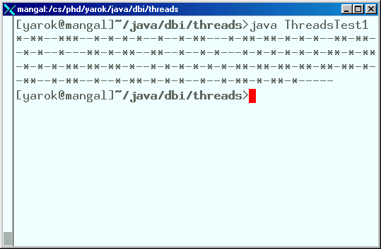

Slide 38
Scheduling
Thread scheduling is the mechanism used to determine how runnable threads are allocated CPU time
A thread-scheduling mechanism is either preemptive or nonpreemptive

Slide 39
Preemptive Scheduling
Preemptive scheduling – the thread scheduler preempts (pauses) a running thread to allow different threads to execute
Nonpreemptive scheduling – the scheduler never interrupts a running thread
The nonpreemptive scheduler relies on the running thread to yield control of the CPU so that other threads may execute

Slide 40
Starvation
A nonpreemptive scheduler may cause starvation (runnable threads, ready to be executed, wait to be executed in the CPU a very long time, maybe even forever)
Sometimes, starvation is also called a livelock

Slide 41
Time-Sliced Scheduling
Time-sliced scheduling
  the scheduler allocates a period of time that each thread can use the CPU
  when that amount of time has elapsed, the scheduler preempts the thread and switches to a different thread
Nontime-sliced scheduler
  the scheduler does not use elapsed time to determine when to preempt a thread
  it uses other criteria such as priority or I/O status

Slide 42
Java Scheduling
Scheduler is preemptive and based on priority of threads
Uses fixed-priority scheduling:
  Threads are scheduled according to their priority w.r.t. other threads in the ready queue

Slide 43
Java Scheduling
The highest priority runnable thread is always selected for execution above lower priority threads
When multiple threads have equally high priorities, only one of those threads is guaranteed to be executing
Java threads are guaranteed to be preemptive-but not time sliced
Q: Why can’t we guarantee time-sliced scheduling?
What is the danger of such scheduler?

Slide 44
Thread Priority
Every thread has a priority
When a thread is created, it inherits the priority of the thread that created it
The priority values range from 1 to 10, in increasing priority

Slide 45
Thread Priority (cont.)
The priority can be adjusted subsequently using the setPriority() method
The priority of a thread may be obtained using getPriority()
Priority constants are defined:
  MIN_PRIORITY=1
  MAX_PRIORITY=10
  NORM_PRIORITY=5
The main thread is
created with priority
NORM_PRIORITY

Slide 46
Some Notes
Thread implementation in Java is actually based on operating system support
Some Windows operating systems support only 7 priority levels, so different levels in Java may actually be mapped to the same operating system level
What should we do about this?
Furthermore, The thread scheduler may choose to run a lower priority thread to avoid starvation

Slide 47
Daemon Threads
Daemon threads are “background” threads, that provide services to other threads, e.g., the garbage collection thread
The Java VM will not exit if non-Daemon threads are executing
The Java VM will exit if only Daemon threads are executing
Daemon threads die when the Java VM exits
Q: Is the main thread a daemon thread?

Slide 48
Thread and the Garbage Collector
Can a Thread object be collected by the garbage collector while running?
  If not, why?
  If yes, what happens to the execution thread?
When can a Thread object be collected?

Slide 49
ThreadGroup
The ThreadGroup class is used to create groups of similar threads. Why is this needed?
“Thread groups are best viewed as an unsuccessful experiment, and you may simply ignore their existence.”
Joshua Bloch, software architect at Sun

Slide 50
Multithreading Client-Server

Slide 51
HelloServer
ConnectionHandler
ConnectionHandler
…
HelloClient
HelloClient

Slide 52
Server
import java.net.*;import java.io.*;
class HelloServer {
public static void main(String[] args) {
int port = Integer.parseInt(args[0]);
try {
ServerSocket server =
new ServerSocket(port);
} catch (IOException ioe) {
System.err.println(“Couldn't run “ +
“server on port “ + port);
return;
}

Slide 53
while(true) {
try {
Socket connection = server.accept();
ConnectionHandler handler =
new ConnectionHandler(connection);
new Thread(handler).start();
} catch (IOException ioe1) {
}
}

Slide 54
Connection Handler
// Handles a connection of a client to an HelloServer.
// Talks with the client in the 'hello' protocol
class ConnectionHandler implements Runnable {
// The connection with the client
private Socket connection;
public ConnectionHandler(Socket connection) {
this.connection = connection;
}

Slide 55
public void run() {
try {
BufferedReader reader =
new BufferedReader(
new InputStreamReader(
connection.getInputStream()));
PrintWriter writer =
new PrintWriter(
new OutputStreamWriter(
connection.getOutputStream()));
String clientName = reader.readLine();
writer.println(“Hello “ + clientName);
writer.flush();
} catch (IOException ioe) {}
}
}

Slide 56
Client side
import java.net.*; import java.io.*;
// A client of an HelloServer
class HelloClient {
public static void main(String[] args) {
String hostname = args[0];
int port = Integer.parseInt(args[1]);
Socket connection = null;
try {
connection = new Socket(hostname, port);
} catch (IOException ioe) {
System.err.println("Connection failed");
return;
}

Slide 57
try {
BufferedReader reader =
new BufferedReader(
new InputStreamReader(
connection.getInputStream()));
PrintWriter writer =
new PrintWriter(
new OutputStreamWriter(
connection.getOutputStream()));
writer.println(args[2]); // client name
String reply = reader.readLine();
System.out.println("Server reply: "+reply);
writer.flush();
} catch (IOException ioe1) {
}
}
Note that the Client has not changed from the networking-lecture example

Slide 58
Concurrency
An object in a program can be changed by more than one thread
Q: Is the order of changes that were preformed on the object important?

Slide 59
Race Condition
A race condition – the outcome of a program is affected by the order in which the program's threads are allocated CPU time
Two threads are simultaneously modifying a single object
Both threads “race” to store their value

Slide 60
Race Condition Example
How can we have
alternating colors?
Put red pieces
Put green pieces

Slide 61
Monitors
Each object has a “monitor” that is a token used to determine which application thread has control of a particular object instance
In execution of a synchronized method (or block), access to the object monitor must be gained before the execution
Access to the object monitor is queued

Slide 62
Monitor (cont.)
Entering a monitor is also referred to as locking the monitor, or acquiring ownership of the monitor
If a thread A tries to acquire ownership of a monitor and a different thread has already entered the monitor, the current thread (A) must wait until the other thread leaves the monitor

Slide 63
Critical Section
The synchronized methods define critical sections
Execution of critical sections is mutually exclusive. Why?

Slide 64
Example
public class BankAccount {
private float balance;
public synchronized void deposit(float amount){
balance += amount;
}
public synchronized void withdraw(float amount){
balance -= amount;
}
}

Slide 65

Critical Sections
t3
t2
t1
deposit()
Bank Account

Slide 66
Java Locks are Reentrant
Is there a problem with the following code?
public class Test {
public synchronized void a() {
b();
System.out.println(“I am at a”);
}
public synchronized void b() {
System.out.println(“I am at b”);
}
}

Slide 67
Static Synchronized Methods
Marking a static method as synchronized, associates a monitor with the class itself
The execution of synchronized static methods of the same class is mutually exclusive. Why?

Slide 68
Synchronized Statements
A monitor can be assigned to a block:
  synchronized(object) { some-code }
It can also be used to monitor access to a data element that is not an object, e.g., array:
  void arrayShift(byte[] array, int count) {
  synchronized(array) {
  System.arraycopy (array, count, array, 0, array.size - count);
  }
  }

Slide 69
The Followings are Equivalent
public synchronized void a() {
//… some code …
}
public void a() {
synchronized (this) {
//… some code …
}
}

Slide 70
The Followings are Equivalent
public static synchronized void a() {
//… some code …
}
public void a() {
synchronized (this.getClass()) {
//… some code …
}
}

Slide 71
Example
public class MyPrinter {
public MyPrinter() {}
public synchronized void printName(String name) {
for (int i=1; i<100 ; i++) {
try {
Thread.sleep((long)(Math.random() * 100));
} catch (InterruptedException ie) {}
System.out.print(name);
}
}
}

Slide 72
Example
public class PrintThread2 extends Thread {
String name;
MyPrinter printer;
public PrintThread2(String name, MyPrinter printer){
this.name = name;
this.printer = printer;
}
public void run() {
printer.printName(name);
}
}

Slide 73
Example (cont)
public class ThreadsTest2 {
public static void main(String args[]) {
MyPrinter myPrinter = new MyPrinter();
PrintThread2 a = new PrintThread2("*“, printer);
PrintThread2 b = new PrintThread2("-“, printer);
PrintThread2 c = new PrintThread2("=“, printer);
a.start();
b.start();
c.start();
}
}
What will happen?

Slide 74
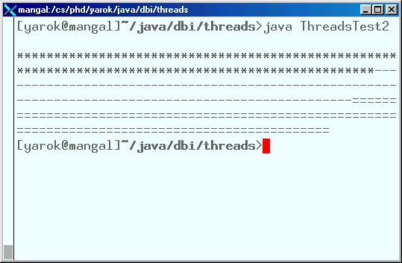

Slide 75
Deadlock Example
public class BankAccount {
private float balance;
public synchronized void deposit(float amount) {
balance += amount;
}
public synchronized void withdraw(float amount) {
balance -= amount;
}
public synchronized void transfer
(float amount, BankAccount target) {
withdraw(amount);
target.deposit(amount);
}
}

Slide 76
public class MoneyTransfer implements Runnable {
private BankAccount from, to;
private float amount;
public MoneyTransfer(
BankAccount from, BankAccount to, float amount){
this.from = from;
this.to = to;
this.amount = amount;
}
public void run() {
source.transfer(amount, target);
}
}

Slide 77
BankAccount aliceAccount = new BankAccount();
BankAccount bobAccount = new BankAccount();
...
// At one place
Runnable transaction1 =
new MoneyTransfer(aliceAccount, bobAccount, 1200);
Thread t1 = new Thread(transaction1);
t1.start();
// At another place
Runnable transaction2 =
new MoneyTransfer(bobAccount, aliceAccount, 700);
Thread t2 = new Thread(transaction2);
t2.start();

Slide 78

Deadlocks
t1
t2
aliceAccount
bobAccount
transfer()
?
transfer()
withdraw()
withdraw()
deposit()
deposit()

Slide 79



Thread Synchronization
We need to synchronized between transactions, for example, the consumer-producer scenario

Slide 80
Wait and Notify
Allows two threads to cooperate
Based on a single shared lock object
  Marge put a cookie wait and notify Homer
  Homer eat a cookie wait and notify Marge
    Marge put a cookie wait and notify Homer
    Homer eat a cookie wait and notify Marge

Slide 81
The wait() Method
The wait() method is part of the java.lang.Object interface
It requires a lock on the object’s monitor to execute
It must be called from a synchronized method, or from a synchronized segment of code. Why?

Slide 82
The wait() Method
wait() causes the current thread to wait until another thread invokes the notify() method or the notifyAll() method for this object
Upon call for wait(), the thread releases ownership of this monitor and waits until another thread notifies the waiting threads of the object

Slide 83
The wait() Method
wait() is also similar to yield()
  Both take the current thread off the execution stack and force it to be rescheduled
However, wait() is not automatically put back into the scheduler queue
  notify() must be called in order to get a thread back into the scheduler’s queue
  The objects monitor must be reacquired before the thread’s run can continue
What is the difference
between wait and sleep?

Slide 84
Consumer
Consumer:
  synchronized (lock) {
  while (!resourceAvailable()) {
  lock.wait();
  }
  consumeResource();
  }

Slide 85
Producer
Producer:
  produceResource();
  synchronized (lock) {
  lock.notifyAll();
  }

Slide 86
Wait/Notify Sequence
Lock Object
1. synchronized(lock){
3. produceResource()
2. lock.wait();
4. synchronized(lock) {
9. consumeResource();
5. lock.notify();
10. }
6.}
7. Reacquire lock
Consumer
Thread
8.Return from wait()
Producer
Thread

Slide 87
Wait/Notify Sequence
Lock Object
1. synchronized(lock){
3. produceResource()
2. lock.wait();
4. synchronized(lock) {
9. consumeResource();
5. lock.notify();
10. }
6.}
7. Reacquire lock
Consumer
Thread
8. Return from wait()
Producer
Thread

Slide 88
Wait/Notify Sequence
Lock Object
1. synchronized(lock){
3. produceResource()
2. lock.wait();
4. synchronized(lock) {
9. consumeResource();
5. lock.notify();
10. }
6.}
7. Reacquire lock
Consumer
Thread
8. Return from wait()
Producer
Thread

Slide 89
Wait/Notify Sequence
Lock Object
1. synchronized(lock){
3. produceResource()
2. lock.wait();
4. synchronized(lock) {
9. consumeResource();
5. lock.notify();
10. }
6.}
7. Reacquire lock
Consumer
Thread
8. Return from wait()
Producer
Thread

Slide 90
Wait/Notify Sequence
Lock Object
1. synchronized(lock){
3. produceResource()
2. lock.wait();
4. synchronized(lock) {
9. consumeResource();
5. lock.notify();
10. }
6.}
7. Reacquire lock
Consumer
Thread
8. Return from wait()
Producer
Thread

Slide 91
Wait/Notify Sequence
Lock Object
1. synchronized(lock){
3. produceResource()
2. lock.wait();
4. synchronized(lock) {
9. consumeResource();
5. lock.notify();
10. }
6.}
7. Reacquire lock
Consumer
Thread
8. Return from wait()
Producer
Thread

Slide 92
Wait/Notify Sequence
Lock Object
1. synchronized(lock){
3. produceResource()
2. lock.wait();
4. synchronized(lock) {
9. consumeResource();
5. lock.notify();
10. }
6.}
7. Reacquire lock
Consumer
Thread
8. Return from wait()
Producer
Thread

Slide 93
Wait/Notify Sequence
Lock Object
1. synchronized(lock){
3. produceResource()
2. lock.wait();
4. synchronized(lock) {
9. consumeResource();
5. lock.notify();
10. }
6.}
7. Reacquire lock
Consumer
Thread
8. Return from wait()
Producer
Thread

Slide 94
Wait/Notify Sequence
Lock Object
1. synchronized(lock){
3. produceResource()
2. lock.wait();
4. synchronized(lock) {
9. consumeResource();
5. lock.notify();
10. }
6.}
7. Reacquire lock
Consumer
Thread
8. Return from wait()
Producer
Thread

Slide 95
Wait/Notify Sequence
Lock Object
1. synchronized(lock){
3. produceResource()
2. lock.wait();
4. synchronized(lock) {
9. consumeResource();
5. lock.notify();
10. }
6.}
7. Reacquire lock
Consumer
Thread
8. Return from wait()
Producer
Thread

Slide 96
Wait/Notify Sequence
Lock Object
1. synchronized(lock){
3. produceResource()
2. lock.wait();
4. synchronized(lock) {
9. consumeResource();
5. lock.notify();
10. }
6.}
7. Reacquire lock
8. Return from wait()
Consumer
Thread
Producer
Thread

Slide 97
The Simpsons Scenario: SimpsonsTest
public class SimpsonsTest {
public static void main(String[] args) {
CookyJar jar = new CookyJar();
Homer homer = new Homer(jar);
Marge marge = new Marge(jar);
new Thread(homer).start();
new Thread(marge).start();
}
}
Notes:
Change

Slide 98
The Simpsons Scenario: Homer
public class Homer implements Runnable {
CookyJar jar;
public Homer(CookyJar jar) {
this.jar = jar;
}
public void eat() {
jar.getCooky("Homer");
try {
Thread.sleep((int)Math.random() * 1000);
} catch (InterruptedException ie) {}
}
public void run() {
for (int i = 1 ; i <= 10 ; i++) eat();
}
}
Notes:
Change

Slide 99
The Simpsons Scenario: Marge
public class Marge implements Runnable {
CookyJar jar;
public Marge(CookyJar jar) {
this.jar = jar;
}
public void bake(int cookyNumber) {
jar.putCooky("Marge", cookyNumber);
try {
Thread.sleep((int)Math.random() * 500);
} catch (InterruptedException ie) {}
}
public void run() {
for (int i = 0 ; i < 10 ; i++) bake(i);
}
}
Notes:
Change

Slide 100
The Simpsons Scenario: CookieJar
public class CookyJar {
private int contents;
private boolean available = false;
public synchronized void getCooky(String who) {
while (!available) {
try {
wait();
} catch (InterruptedException e) { }
}
available = false;
notifyAll();
System.out.println( who + " ate cooky " +
contents);
}
Notes:
Change

Slide 101
The Simpsons Scenario: CookieJar
public synchronized void putCooky(String who,
int value) {
while (available) {
try {
wait();
} catch (InterruptedException e) { }
}
contents = value;
available = true;
System.out.println(who + " put cooky " +
contents + " in the jar");
notifyAll();
}
}
Notes:
Change

Slide 102
Timers and TimerTask
The classes Timer and TimerTask are part of the java.util package
Useful for
  performing a task after a specified delay
  performing a sequence of tasks at constant time intervals

Slide 103
Scheduling Timers
The schedule method of a timer can get as parameters:
  Task, time
  Task, time, period
  Task, delay
  Task, delay, period
What to do
When to start
At which rate

Slide 104
Timer Example
import java.util.*;
public class CoffeeTask extends TimerTask {
public void run() {
System.out.println(“Time for a Coffee Break”);
}
public static void main(String args[]) {
Timer timer = new Timer();
long hour = 1000 * 60 * 60;
timer.schedule(new CoffeeTask(), 0, 8 * hour);
timer.scheduleAtFixedRate(new CoffeeTask(), new Date(), 24 * hour);
}
}

Slide 105
Stopping Timers
A Timer thread can be stopped in the following ways:
  Apply cancel() on the timer
  Make the thread a daemon
  Remove all references to the timer after all the TimerTask tasks have finished
  Call System.exit()

