Slide 1
Secure Socket Layer (SSL)

Slide 2
How does SSL Work
A browser requests a secure page (usually https://).
The web server sends its public key with its certificate.
The browser checks that the certificate was issued by a trusted party (usually a trusted root CA), that the certificate is still valid and that the certificate is related to the site contacted.
The browser then uses the public key, to encrypt a random symmetric encryption key and sends it to the server with the encrypted URL required as well as other encrypted http data.
The web server decrypts the symmetric encryption key using its private key and uses the symmetric key to decrypt the URL and http data.
The web server sends back the requested html document and http data encrypted with the symmetric key.
The browser decrypts the http data and html document using the symmetric key and displays the information.

Slide 3
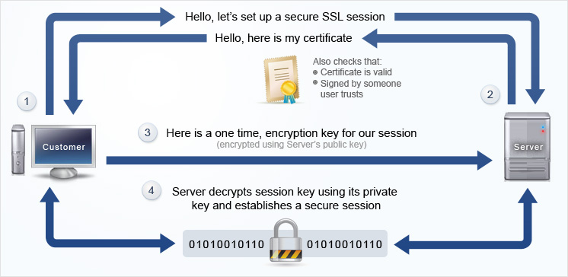
How does SSL Work

Slide 4
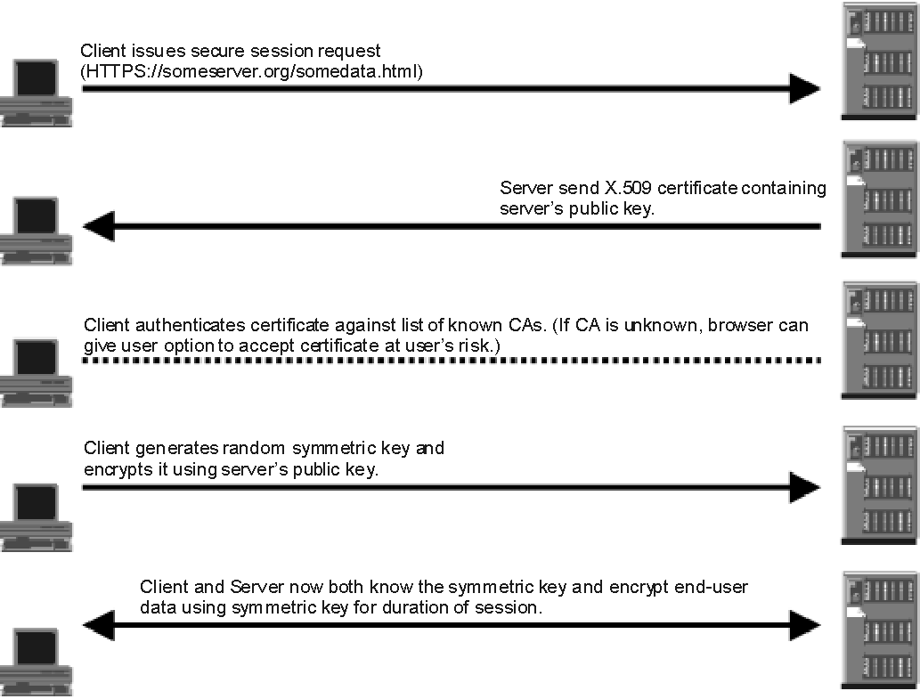
How does SSL Work

Slide 5
Definition
SSL or Secure Sockets Layer is a security protocol created by Netscape that has become an international standard on the Internet for exchanging sensitive information between a website and the computer communicating with it, referred to as the client.
SSL technology is embedded in all popular browsers and engages automatically when the user connects to a web server that is SSL-enabled.
It's easy to tell when a server is using SSL security because the address in the URL window of your browser will start with https.
The "s" indicates a secure connection

Slide 6
Public key – Private key Pair
SSL provides both privacy and security using a technique called "public/private key encryption“
  often called "asymmetric encryption" or simply "public key encryption".
A "public key" is a string of letters and numbers that can be used to encrypt a message so that only the owner of the public key can read it.
This is possible because every public key has a corresponding private key that is kept secret by the owner of the public key
encrypted
Message
Message
Public key
private key
Message
Client
Server
Notes:
The encryption using a private key/public key pair ensures that the data can be encrypted by one key but can only be decrypted by the other key pair. This is sometime hard to understand, but believe me it works. The keys are similar in nature and can be used alternatively: what one key emcrypts, the other key pair can decrypt. The key pair is based on prime numbers and their length in terms of bits ensures the difficulty of being able to decrypt the message without the key pairs. The trick in a key pair is to keep one key secret (the private key) and to distribute the other key (the public key) to everybody. Anybody can send you an encrypted message, that only you will be able to decrypt. You are the only one to have the other key pair, right? In the opposite , you can certify that a message is only coming from you, because you have encrypted it with you private key, and only the associated public key will decrypt it correctly. Beware, in this case the message is not secured you have only signed it. Everybody has the public key, remember!
One of the problem left is to know the public key of your correspondent. Usually you will ask him to send you a non confidential signed message that will contains his publick key as well as a certificate

Slide 7
The Certificate
The Certificate provides the Identity of the owner
A certificate, contains information about the owner of the certificate, like e-mail address, owner's name, certificate usage, duration of validity, resource location or Distinguished Name (DN) which includes the Common Name (CN) (web site address or e-mail address depending of the usage) and the certificate ID of the person who certifies (signs) this information.
It contains also the public key and finally a hash to ensure that the certificate has not been tampered with.
As you made the choice to trust the person who signs this certificate, therefore you also trust this certificate .

Slide 8
A certificate is a digitally signed statement from one entity (person, company, etc.), saying that the public key (and some other information) of some other entity has a particular value.
When data is digitally signed, the signature can be verified to check the data integrity and authenticity.
  Integrity means that the data has not been modified or tampered with, and authenticity means the data indeed comes from whoever claims to have created and signed it

Slide 9
Certificate Authority (CA)
A CA signs a certificate
  You get a certificate from a CA
Usually your browser or application has already loaded the root certificate of well known Certification Authorities (CA) or root CA Certificates.
The CA maintains a list of all signed certificates as well as a list of revoked certificates.
A certificate is insecure until it is signed, as only a signed certificate cannot be modified.
You can sign a certificate using itself, it is called a self signed certificate. All root CA certificates are self signed

Slide 10
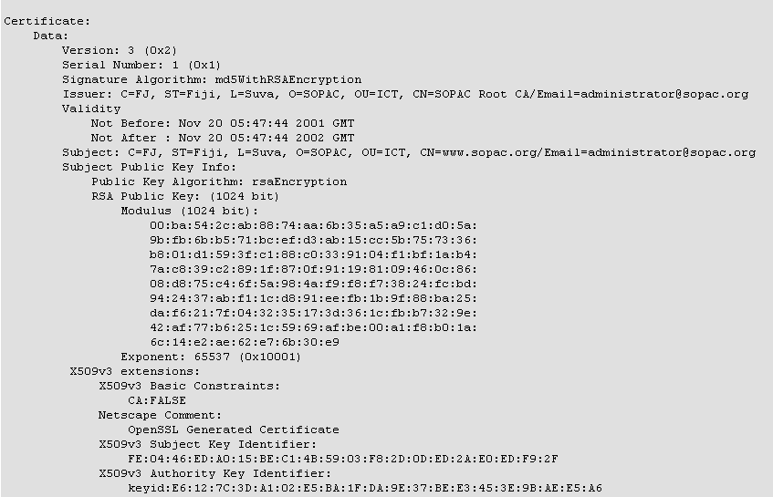
A Sample Certificate
Part of the
certificate

Slide 11
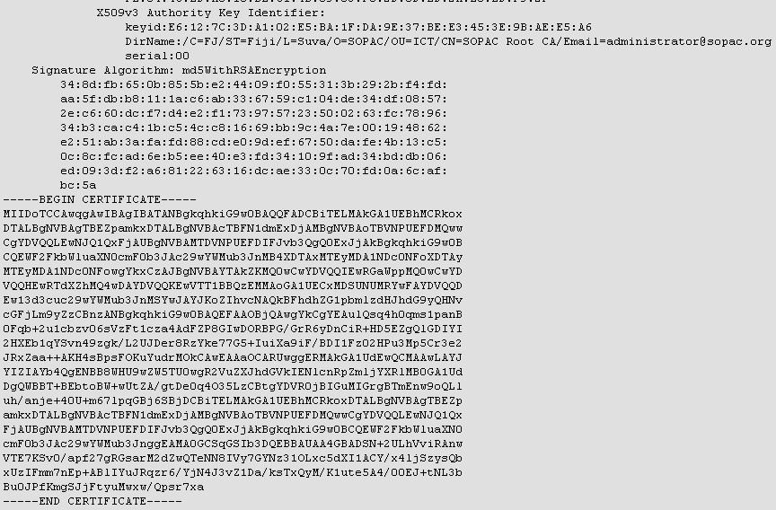
A Sample Certificate

Slide 12
The Symmetric key
Private Key/Public Key encryption algorithms are great, but they are not usually practical.
  It is asymmetric because you need the other key pair to decrypt.
  You can't use the same key to encrypt and decrypt. An algorithm using the same key to decrypt and encrypt is deemed to have a symmetric key.
A symmetric algorithm is much faster in doing its job than an asymmetric algorithm. But a symmetric key is potentially highly insecure.
If the enemy gets hold of the key then you have no more secret information.
You must therefore transmit the key to the other party without the enemy getting its hands on it.
As you know, nothing is secure on the Internet.
The solution is to encapsulate the symmetric key inside a message encrypted with an asymmetric algorithm.
You have never transmitted your private key to anybody, then the message encrypted with the public key is secure (relatively secure, nothing is certain except death and taxes).
The symmetric key is also chosen randomly, so that if the symmetric secret key is discovered then the next transaction will be totally different

Slide 13
The Symmetric key
Symmetric Key
Symmetric Key
1
5
Public Key
2
4
Private Key
3
Encrypted Symmetric Key
The Symmetric key used to encrypt the message

Slide 14
Encryption algorithm
A mathematical procedure for performing encryption on data.
Through the use of an algorithm, information is made into meaningless cipher text and requires the use of a key to transform the data back into its original form.
RSA,Blowfish, AES RC4, RC5, and RC6 are examples of encryption algorithms.

Slide 15
The Hash
A hash is a number given by a hash function from a message.
This is a one way function, it means that it is impossible to get the original message knowing the hash.
However the hash will drastically change even for the slightest modification in the message.
It is therefore extremely difficult to modify a message while keeping its original hash. It is also called a message digest.
Hash functions are used in password mechanisms, in certifying that applications are original (MD5 sum), and in general in ensuring that any message has not been tampered with.
It seems that the Internet Enginering Task Force (IETF) prefers SHA1 over MD5 for a number of technical reasons

Slide 16
Signing
Signing a message, means authentifying that you have yourself assured the authenticity of the message
The message can be a text message, or someone else's certificate.
To sign a message, you create its hash, and then encrypt the hash with your private key, you then add the encrypted hash and your signed certificate with the message.
The recipient will recreate the message hash, decrypts the encrypted hash using your well known public key stored in your signed certificate, check that both hash are equals and finally check the certificate.
The other advantage of signing your messages is that you transmit your public key and certificate automatically to all your recipients.

Slide 17
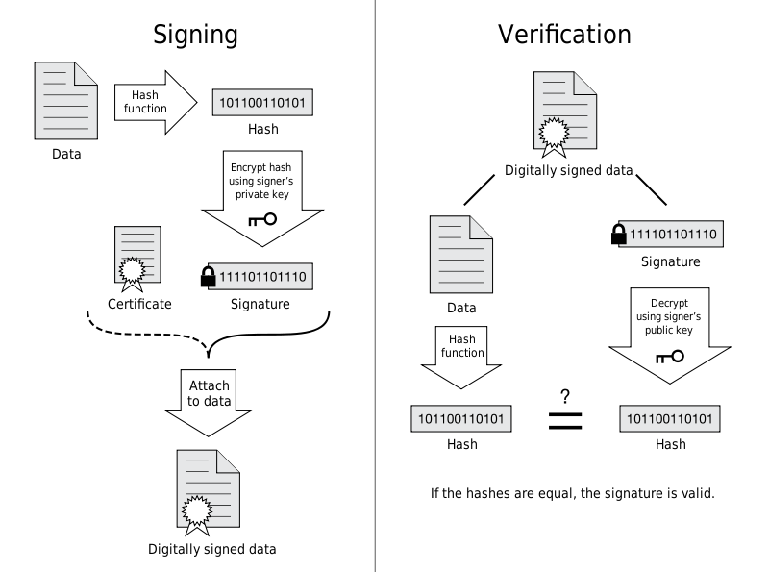
Signing a Message
Notes:
There are usually 2 ways to sign, encapsulating the text message inside the signature (with delimiters), or encoding the message altogether with the signature.
This later form is a very simple encryption form as any software can decrypt it if it can read the embedded public key.
The advantage of the first form is that the message is human readable allowing any non complaint client to pass the message as is for the user to read, while the second form does not even allow to read part of the message if it has been tampered with

Slide 18
PassPhrase
A passphrase is like a password except it is longer”.
In the early days passwords on Unix system were limited to 8 characters, so the term passphrase for longer passwords.
Longer is the password harder it is to guess.
Nowadays Unix systems use MD5 hashes which have no limitation in length of the password

Slide 19
Public Key Infrastructure
The Public Key Infrastructure (PKI) is the software management system and database system that allows to sign certificate, keep a list of revoked certificates, distribute public key,... You can usually access it via a website and/or ldap server.
There will be also some people checking that you are who you are... For securing individual applications, you can use any well known commercial PKI as their root CA certificate is most likely to be inside your browser/application.
The problem is for securing e-mail, either you get a generic type certificate for your e-mail or you must pay about USD100 a year per certificate/e-mail address.
There is also no way to find someone's public key if you have never received a prior e-mail with his certificate (including his public key)

Slide 20
Key Store
A keystore contains private keys, and the certificates with their corresponding public keys.
A keystore contains a private key. You only need this if you are a server, or if the server requires client authentication

Slide 21
Trust Store
A truststore contains certificates from other parties that you expect to communicate with, or from Certificate Authorities that you trust to identify other parties
A truststore contains CA certifcates to trust.
If your server’s certificate is signed by a recognized CA, the default truststore that ships with the JRE will already trust it (because it already trusts trustworthy CAs), so you don’t need to build your own, or to add anything to the one from the JRE
Typically, the trust store is used to store only public keys, for verification purposes, such as with X.509 authentication. For manageability purposes, it's quite common for admins or developers to simply conflate the two into a single store

Slide 22
Managing Keystores, keys and Certificates
Keytool
Key and Certificate Management Tool

Slide 23
What is Keytool?
keytool is a key and certificate management utility.
  It enables users to administer their own public/private key pairs and associated certificates for use in self-authentication (where the user authenticates himself/herself to other users/services) or data integrity and authentication services, using digital signatures.
  It also allows users to cache the public keys (in the form of certificates) of their communicating peers.
keytool stores the keys and certificates in a so-called keystore.
  The default keystore implementation implements the keystore as a file. It protects private keys with a password

Slide 24
Keystore Entries
There are two different types of entries in a keystore
key entries
  each holds very sensitive cryptographic key information, which is stored in a protected format to prevent unauthorized access.
  Typically, a key stored in this type of entry is a secret key, or a private key accompanied by the certificate "chain" for the corresponding public key.
  The keytool and jarsigner tools only handle the latter type of entry, that is private keys and their associated certificate chains.
Trusted certificate entries
  each contains a single public key certificate belonging to another party.
  It is called a "trusted certificate" because the keystore owner trusts that the public key in the certificate indeed belongs to the identity identified by the "subject" (owner) of the certificate.
  The issuer of the certificate vouches for this, by signing the certificate.

Slide 25
Keystore Aliases
All keystore entries (key and trusted certificate entries) are accessed via unique aliases.
Aliases are case-insensitive
  the aliases Romeo and romeo would refer to the same keystore entry.
An alias is specified when you add an entity to the keystore using the -genkey command to generate a key pair (public and private key) or the -import command to add a certificate or certificate chain to the list of trusted certificates.
Subsequent keytool commands must use this same alias to refer to the entity

Slide 26
Java Keytool Commands
Creating and Importing

Slide 27
Keytool commands
Generate a Java keystore and key pair
  keytool -genkey -alias mydomain -keyalg RSA -keystore keystore.jks
Generate a certificate signing request (CSR) for an existing Java keystore
  keytool -certreq -alias mydomain -keystore keystore.jks -file mydomain.csr
Import a root or intermediate CA certificate to an existing Java keystore
keytool -import -trustcacerts -alias root -file Thawte.crt -keystore keystore.jks
Import a signed primary certificate to an existing Java keystore
  keytool -import -trustcacerts -alias mydomain -file mydomain.crt -keystore keystore.jks
Generate a keystore and self-signed certificate
  keytool -genkey -keyalg RSA -alias selfsigned -keystore keystore.jks -storepass password -validity 360

Slide 28
Java Keytool Commands
Checking

Slide 29
Java Keytool Commands for Checking
Check a stand-alone certificate
  keytool -printcert -v -file mydomain.crt
Check which certificates are in a Java keystore
  keytool -list -v -keystore keystore.jks
Check a particular keystore entry using an alias
  keytool -list -v -keystore keystore.jks -alias mydomain

Slide 30
Other Java Keytool Commands
Delete a certificate from a Java Keytool keystore
  keytool -delete -alias mydomain -keystore keystore.jks
Change a Java keystore password
  keytool -storepasswd -new new_storepass -keystore keystore.jks
Export a certificate from a keystore
  keytool -export -alias mydomain -file mydomain.crt -keystore keystore.jks
List Trusted CA Certs
  keytool -list -v -keystore $JAVA_HOME/jre/lib/security/cacerts
Import New CA into Trusted Certs
  keytool -import -trustcacerts -file /path/to/ca/ca.pem -alias CA_ALIAS -keystore $JAVA_HOME/jre/lib/security/cacerts

Slide 31
Creating a Self signed Certificate
An Example

Slide 32
Creating a Self Signed Certificate
Use the keytool command as follows
  keytool -genkey -keyalg RSA -alias selfsigned -keystore keystore.jks -storepass password -validity 360
The above command creates a self signed certificate and a keystore where:
  Keystore Name: “keystore.jks”
  Key alias: ”selfsigned”
  Key Algorithm: RSA
  Key store password: ”password”
  Validity for certificate : 360 days

Slide 33
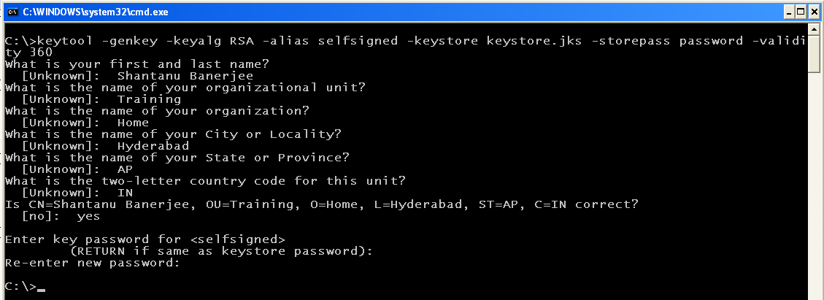
Creating a Self Signed Certificate

Slide 34
Managing Keys and certificates
OpenSSL

Slide 35
OpenSSL
OpenSSL is an open source implementation of the SSL and TLS protocols
The core library (written in the C programming language) implements the basic cryptographic functions and provides various utility functions.
Wrappers allowing the use of the OpenSSL library in a variety of computer languages are available.

Slide 36
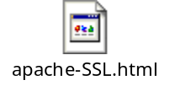
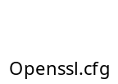
OpenSSL Commands
OpenSSL Command to make a private key
  openssl genrsa -des3 -out my-ca.key 2048
command that makes the X.509 certificate with a 10-year lifetime (this is a CA cert)
  openssl req -new -x509 -days 3650 -key my-ca.key -out my-ca.crt
Command that lets you view the completed certificate
  openssl x509 -in my-ca.crt -text -noout

Slide 37
Make a key and a certificate for the web server

Slide 38
Commands
Create the private key
  openssl genrsa -des3 -out myserver.key 1024
You need to do this step only for Windows Platform
  Openssl rsa -in myserver.key –out myserver1.key
  This removes the password for server key and myserver1.key does not have nay password.
Create CSR
  openssl req -new -key mars-server.key -out mars-server.csr
Create a certificate from the CSR
  openssl x509 -req -in mars-server.csr -out mars-server.crt
  -sha1 -CA my-ca.crt -CAkey my-ca.key -CAcreateserial
  -days 3650
View the certificate
  openssl x509 -in mars-server.crt -text -noout

