Slide 1
Kafka
Apache Kafka
Document version 1.0

Slide 2
Messaging and Why do we need it?
Let’s try to understand…

Slide 3
Data Exchange between two applications
Source System
Very Simple ☺
Data
Target System
But, If we need to make this communication among many systems, what happens

Slide 4
Data Exchange between many applications
Source System
Source System
Source System
Source System
Target System
Target System
Target System
Target System
4 source Systems and 4 Target Systems => 16 integrations (!!!)
Not Good

Slide 5
Disadvantages of Direct Integration
The Integration System has to handle a large number of connections (LOAD)
Each Integration between Systems comes with difficulties
Data Format -> How the data is exchanged(text, XML, JSON, Binary etc)
Protocol-> Which protocol is used in the communication (http,jdbc,ftp,tcp)
Schema Handling-> how the data is shaped and organised.

Slide 6
Data Exchange with messaging System
Source System
Source System
Source System
Source System
Messaging System
Target System
Target System
Target System
Target System

Slide 7
So, what is this messaging system?

Slide 8
Message Oriented Middleware
“Message Oriented Middleware is a concept that involves the passing of data between applications using a communication channel that carries self-contained units of information (messages).”
Msg1
Destination
Msg1
API
API
Application 2
Application 1
MOM
MOM

Slide 9
Communication in Message Oriented Middleware
In a MOM-based communication environment, messages are usually sent and received asynchronously.
Using message-based communications, applications are abstractly decoupled
senders and receivers are never aware of each other.
they send and receive messages to and from the messaging system
It is the responsibility of the messaging system (MOM) to get the messages to their intended destinations.

Slide 10
Communication in Message Oriented Middleware
In a messaging system, an application uses an API to communicate through a messaging client that is provided by the MOM vendor.
The messaging client sends and receives messages through a messaging system
Application A
Application B
Messaging API
MOM
Messaging API
Messaging
Client
message
message
Messaging
Client

Slide 11
Messaging System
The messaging system is the core of a Message Oriented Middleware
It is responsible for managing the connection points between multiple messaging clients, and for managing multiple channels of communication between the connection points.
Usually implemented as a software process, which is commonly known as a message server or a message broker.
Message servers are usually capable of being grouped together to form clusters
Clusters provide advanced capabilities such as load balancing, fault tolerance, and sophisticated routing using managed security domains.

Slide 12
Some Popular Messaging Systems
TIBCO Enterprise Message Service
IBM Websphere MQ
Sonic MQ
Apache Active MQ
Java Message Service (JMS) brokers
….. and many more

Slide 13
Messaging Models
Two Messaging Models
P2P (Point-to-Point)
Publish-Subscribe (PubSub messaging)

Slide 14
Point to Point Messaging
The point-to-point (P2P) model is intended for a one-to-one communication （Unicast） between two specific applications.
Based on Message Queue
message
message
producer
Queue
consumer
receives
sends
acknowledges

Slide 15
Point to Point Messaging
message
message
producer
Queue
receives
consumer
sends
acknowledges
In the point-to-point model, only one consumer may receive a message that is sent to a queue.
A point-to-point queue may have multiple consumers listening for the purposes of load-balancing or “hot backup”; however, only one receiver may consume each individual message.
There may also be no receivers listening, in which case the message stays in the queue until a receiver attaches itself to the queue to retrieve messages.

Slide 16
Publish Subscribe Messaging
The publish-and-subscribe (pub/sub) model is intended for a one-to-many broadcast (Multicast） of information
Based on Topic(s)
Message broker
subscriber
message
Publisher 1
topic1
subscriber
message
subscriber
Publisher 2
topic1
subscriber

Slide 17
Publish Subscribe Messaging
In the pub/sub model, multiple consumers may subscribe to, a topic.
A producer sends a message on that channel by publishing on that topic.
Each subscriber receives a copy of that message.
Message broker
subscriber
message
Publisher 1
topic1
subscriber
message
subscriber
Publisher 2
topic1
subscriber

Slide 18
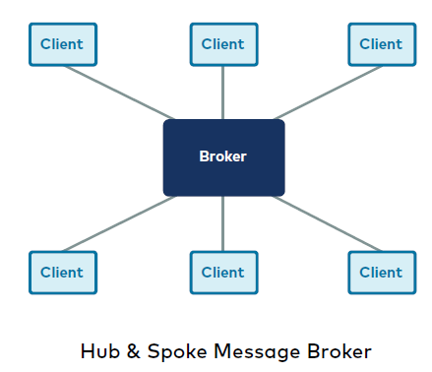
Problems With Traditional Messaging Systems
Spoke
Traditional Messaging Systems are not designed to be horizontally scalable
Most traditional messaging started with a hub and spoke design where each client application connects to only one server/broker at a time.
All the topics and queues reside on this central hub.
Hub

Slide 19
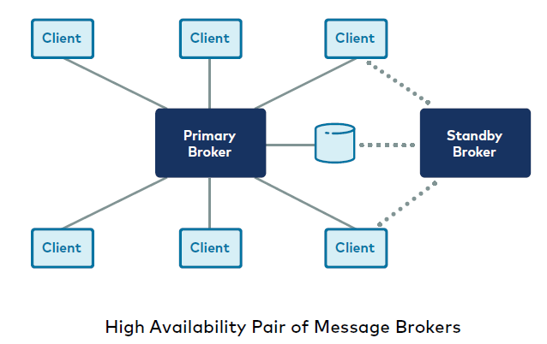
Problems With Traditional Messaging Systems
Hub and Spoke design has a single point of failure
Hence, brokers are deployed in High Availability (HA) pairs such
that the primary (active) broker has a hot backup (standby) which can take over if the primary should fail.
Even in this architecture, clients only connect to the one active broker where all active topics and queues reside.
Hub
Backup

Slide 20
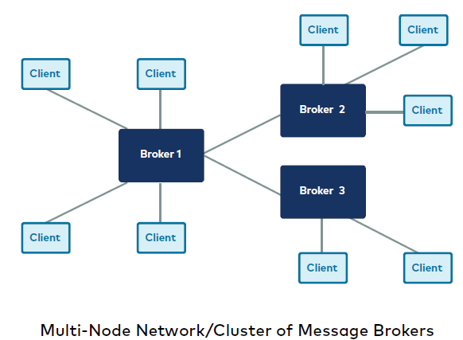
Problems With Traditional Messaging Systems
Hub/spoke messaging architectures in a more complicated multi-node networks, a single client application still only connects to one broker node at a time, even if the brokers themselves are bridged into a larger multi-node network.
It does not scale horizontally because as you increase the number of nodes, you also increase the amount of inter-node traffic between the nodes that are processing writes (i.e. handling publishers) versus the nodes that are processing reads (i.e. handling subscribers).

Slide 21
Then What Type of Messaging System do We need?
Messaging systems where topics and queues do not reside as a monolithic entity on a single node.
Instead, topics are broken into smaller pieces(partitions), and these topic partitions are spread across multiple nodes in the cluster.
A client can connect to any single node of the cluster, it should be able to get the metadata it needs to understand how to connect to any and all of the other nodes in the cluster that contain topic partitions of interest for either read or write.
Partition 1
Partition 2
Partition 3
Topic A
broker
broker
broker
Horizontal Scalability of Topic A

Slide 22

Enter

Slide 23
What is Kafka?
Apache Kafka is an open-source distributed event streaming platform for high-performance data pipelines, streaming analytics, data integration, and mission-critical applications.
--as per https://kafka.apache.org/

Slide 24
What is Kafka?
Producers
Kafka at its core is a message Broker
It becomes an event Streaming platform in the presence of the supported APIs
app
app
app
Streaming
Kafka Connect
Streaming
app
app
app
Consumers

Slide 25
Event Streaming Defined
Event streaming is the practice of capturing data in real-time from event sources like databases, sensors, mobile devices, cloud services, and software applications in the form of streams of events.
Storing these event streams durably for later retrieval.
Manipulating, processing, and reacting to the event streams in real-time as well as retrospectively.
Routing the event streams to different destination technologies as needed.
Event streaming thus ensures a continuous flow and interpretation of data so that the right information is at the right place, at the right time.

Slide 26
Apache Kafka Use Cases
Messaging System
Website Activity Tracking
Gather Metrics from many locations
Log Aggregation
Event Processing (with Kafka APIs)
Event Sourcing
Commit Log

Slide 27



Apache Kafka Use Cases
Tracking activity
monitoring
microservices
log aggregation
Apache Kafka
messaging
Vehicle
Tracking
Event
Sourcing
Hadoop
spark
… and many more …..

Slide 28
Kafka Concepts
Topic
Topic Partitions
Message Offset
Broker
Topic Replication
Producer
Consumer
Consumer Group
Zookeeper

Slide 29
Topic
A topic is a stream of data
In Kafka, events are organized and durably stored in topics.
A topic is similar to a folder in a filesystem, and the events are the files in that folder.
A topic can be thought of as a database table and events/messages can be compared to the rows of data.
A Topic is identified by a unique name

Slide 30
Topic Partitions
Kafka Topics are split into partition
Partition number starts from 0
Each partition is ordered
Each message within a partition gets an incremental id called “offset”
0
1
2
3
4
5
6
7
8
9
10
partition
1
1
2
3
4
5
6
7
8
partition
2
1
2
3
4
5
6
7
8
9
10
11
partition
Topic 1

Slide 31
Brokers
Kafka is organized around clusters
A cluster is composed of multiple Brokers
Broker in Kafka is a server application which hosts topics
Each Broker is identified by a unique id
Broker 0
Broker 1
Broker 2
Kafka Cluster

Slide 32
Topic Replication
Every partition can be replicated to make it fault-tolerant and highly-available
Replication happens at the partition level
Partitions are replicated across multiple brokers
Broker 1
Broker 2
Broker 3
Partition 0
Topic 1
Partition 0
Topic 1
Partition 1
Topic 2
Partition 1
Topic 2

Slide 33
Topic Replication
Every partition can be replicated to make it fault-tolerant and highly-available
Replication happens at the partition level
Partitions are replicated across multiple brokers
Topic 1
p0
Topic 1
Topic 2
p0
p0
Topic 2
p0

Slide 34
Topic Replication
Replication factor should be >1 (2 or 3)
Replication factor 3 is a production setting value generally used
Broker 1
Broker 2
Broker 3
Partition 0
Topic 1
Partition 0
Topic 1
Partition 1
Topic 2
Partition 1
Topic 2

Slide 35
Topic Replication
Replication factor should be >1 (2 or 3)
Replication factor 3 is a setting generally used in production.
Topic 1
p0
Topic 1
Topic 2
p0
p0
Topic 2
p0

Slide 36
Topic Replication
In the event of any broker failure, the other broker will be able to serve the producer/consumer
Broker 1
Broker 2
Broker 3
Partition 0
Topic 1
Partition 1
Topic 1
Partition 1
Topic 2
Partition 1
Topic 2

Slide 37
Topic Replication
In the event of any broker failure, the other broker will be able to serve the producer/consumer
Topic 1
p0
Topic 1
Topic 2
p0
p0
Topic 2
p0

Slide 38
Leader for a Partition
In Kafka We have a leader broker for replicated partition
At any given time, one broker will be the leader for the partition
Only leader will handle reads and writes
Every request to serve data will go through the leader
Broker 1
Broker 2
Broker 3
Partition 0
Topic 1
(leader)
Partition 0
Topic 1
Partition 1
Topic 2
(leader)
Partition 1
Topic 2

Slide 39
Leader And ISR
Except the leader broker, all other brokers will synchronize the data for the partition.
These brokers are called In-Synch-Replica (ISR)
Therefore, each partition has one leader and many ISR
Broker 1
Broker 2
Broker 3
Partition 1
Topic 1
(ISR)
Partition 0
Topic 1
(leader)
Partition 0
Topic 2 (ISR)
Partition 0
Topic 2
(leader)

Slide 40
Producer
A producer is an application that sends data to the broker
Kafka stores messages as byte array
Each message is a record
The producer may send message in any format but it is stored as byte array
message
Topic
Producer
Kafka Broker

Slide 41
Consumer
A consumer is an application that reads/receives data from the broker
message
message
Topic
Kafka Broker
Producer
Consumer

Slide 42
Consumer Group
When many producers send messages in volume to a topic, one consumer will not be able to process that data.
More than one consumer is needed.
Consumer group is a Group of consumers to share the work load
P0
P1
P2
P3
Kafka Cluster
Consumer Group
Producer(s)

Slide 43
Topic 1
p0
Topic 1
Topic 2
p0
p0
Topic 2
p0

