Slide 1
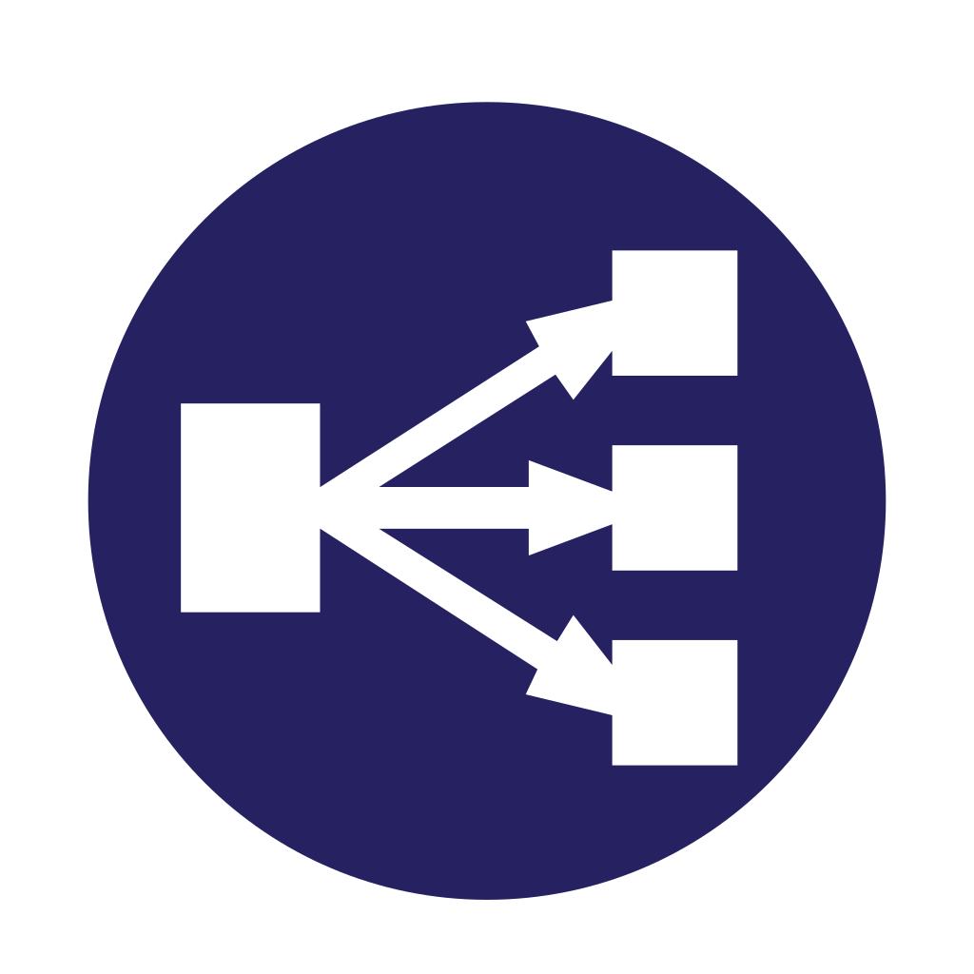
Service Discovery and Load Balancing
Service
Instance (A)
Localhost:8080
Discovery client
End User
Service
Client
(B)
Service
Instance
(A)
Localhost:8081
Discovery client
Discovery client
Service
Instance
(A)
Localhost:8082
Service Registry
Discovery client
B[localhost:8090]
A[localhost:8080,
localhost:8081,
localhost:8082]

Slide 2
Client Side Load Balancing
Spring Cloud Loadbalancer

Slide 3
Introduction to Client-Side Load Balancing
Definition:
Client-side load balancing distributes network or application traffic across multiple servers.
Use case:
Ensures even distribution of requests among available services in a microservice architecture.
Benefits:
Better resource utilization, fault tolerance, and improved scalability.

Slide 4
Client-Side Load Balancing vs. Server-Side Load Balancing
Server-Side Load Balancing:
Managed by the server; uses external load balancers like NGINX or HAProxy.
Client-Side Load Balancing:
Each client is aware of the available instances and chooses which one to call.
Example of frameworks:
Ribbon (deprecated).
Spring Cloud LoadBalancer.

Slide 5
Spring Cloud LoadBalancer Overview
Replaced Netflix Ribbon in Spring Cloud.
Integrated with Spring Boot and Spring Cloud microservices.
Automatically distributes requests among instances of a service.

Slide 6
How Spring Cloud LoadBalancer Works
The client retrieves a list of service instances from a Service Discovery mechanism (like Eureka).
Balancing logic runs on the client to decide which instance to invoke.
LoadBalancerClient manages the request distribution.

Slide 7
Configuration of Spring Cloud LoadBalancer
Add Spring Cloud LoadBalancer dependency:
Ensure Service Discovery integration (Eureka, Consul, etc.).
Enable client-side load balancing by annotating the RestTemplate or WebClient.

Slide 8
Client-Side Load Balancing in Spring Boot
Example using RestTemplate:
Example using WebClient:
@Bean
@LoadBalanced
public RestTemplate restTemplate() {
return new RestTemplate();
}
@Bean
@LoadBalanced
public WebClient.Builder webClientBuilder() {
return WebClient.builder();
}

Slide 9
Service Discovery Integration
Common integrations:
Eureka: Popular for service registry and discovery.
Consul: A more robust alternative for service discovery.
The LoadBalancer gets available instances from these registries.

Slide 10
Load Balancing Strategies
Round Robin: Distributes requests evenly in a circular order.
Random: Selects an instance at random.
Weighted: Requests are distributed based on pre-defined weights of instances.

Slide 11
Customizing Load Balancing Behavior
Custom rule implementation for specific needs:
@Bean
public ReactorLoadBalancer<ServiceInstance> customLoadBalancer(Environment environment) {
String name = environment.getProperty(LoadBalancerClientFactory.PROPERTY_NAME);
return new RandomLoadBalancer(name);
}

Slide 12
Monitoring & Troubleshooting
Use tools like Spring Boot Actuator to monitor service instances.
Common issues:
Misconfiguration of Service Discovery.
Inconsistent request distribution.
Health-check failures of instances.

Slide 13
Best Practices
Use retry mechanisms to handle failed requests.
Combine client-side load balancing with circuit breakers (e.g., Resilience4j).
Ensure health checks are configured for all service instances.

Slide 14
Service Discovery
Eureka Server

Slide 15
The Need for Service Discovery
Problem: As microservices scale, services need to find and communicate with each other dynamically.
Manual service registration vs. automated service discovery
Why hard-coding service locations doesn’t scale

Slide 16
What is Service Discovery?
Definition: A mechanism where services register themselves with a central registry and clients discover the service dynamically.
Importance in Microservices architecture
Types of Service Discovery: Client-Side and Server-Side

Slide 17
Client-Side Service Discovery
Definition and example
How clients (microservices) look up services directly from the registry
Diagram: Service Client interacting directly with Service Registry
Tools: Netflix Eureka, Consul, Zookeeper

Slide 18
Server-Side Service Discovery
Definition and example
Service registry is used by a load balancer or gateway
Diagram: Clients interacting with a load balancer that queries the registry
Tools: Kubernetes (Kube-DNS), AWS ELB, Nginx with Consul

Slide 19
Introducing Netflix Eureka
What is Netflix Eureka?
Role in the Spring ecosystem
Features: Service Registration, Heartbeats, Service Discovery

Slide 20
Setting up Eureka Server in Spring Boot
Add dependencies: spring-cloud-starter-netflix-eureka-server
Configurations for Eureka server:
server:
port: 8761
eureka:
client:
register-with-eureka: false
fetch-registry: false

Slide 21
Setting up Eureka Client in Spring Boot
Add dependencies: spring-cloud-starter-netflix-eureka-client
Service registration configuration:
eureka:
client:
service-url:
defaultZone: http://localhost:8761/eureka/
Registering multiple services in Eureka

Slide 22
Service Discovery in Action
How services register themselves on the Eureka Server
How clients discover other services via Eureka
Live demo: Register two microservices and use Eureka to discover them

Slide 23
Fault Tolerance in Service Discovery
Circuit breaker pattern with Spring Cloud and Resilience4j
Handling service unavailability
Fall-back mechanisms

Slide 24
Server-Side Discovery with Spring Cloud Gateway
Integrating Eureka with Spring Cloud Gateway
Dynamic routing based on service registry
Config example for using Spring Cloud Gateway with Eureka

Slide 25
Scaling and Performance Considerations
Horizontal scaling of Eureka servers
High availability with multiple Eureka instances
Performance tuning in large-scale applications

Slide 26
Alternatives to Eureka
Consul
Zookeeper
Kubernetes Service Discovery

Slide 27
Conclusion
Recap of Service Discovery benefits
Overview of Eureka in Spring Boot
Final thoughts on best practices

Slide 28
Circuit Breaker Pattern
Resilience4j in Spring Boot
Enhancing Microservice Resilience
V-1.0

Slide 29
Agenda
What is the Circuit Breaker Pattern?
Resilience in Microservices Architecture
Introduction to Resilience4j
Resilience4j Circuit Breaker with Spring Boot
Demonstration: Implementing Circuit Breaker
Key Takeaways

Slide 30
What is the Circuit Breaker Pattern?
Definition: A design pattern that helps prevent cascading failures in distributed systems by temporarily stopping the execution of requests to an external service that’s failing.
Phases:
Closed: Requests flow normally.
Open: Requests are blocked for a time.
Half-Open: Limited requests are sent to check if the service has recovered.

Slide 31
Why Use Circuit Breakers?
Prevent service overloads.
Improve application resilience.
Enhance fault tolerance in distributed architectures.
Handle failures gracefully.

Slide 32
Resilience in Microservices
Challenges in microservice communication:
Latency issues
Service failures
Network partitions
Solutions: Circuit Breakers, Retries, Bulkheads, Rate Limiters

Slide 33
Introduction to Resilience4j
Resilience4j: A lightweight, easy-to-use fault tolerance library for Java 8+ that provides implementations for circuit breakers, rate limiters, retries, etc.
Modular, compared to Netflix Hystrix (retired).
Key modules:
CircuitBreaker
Retry
RateLimiter
Bulkhead
TimeLimiter

Slide 34
How Circuit Breaker Works in Resilience4j
Circuit Breaker transitions between:
Closed: All requests pass through.
Open: Requests are blocked for a time.
Half-Open: Test requests pass through to see if the service has recovered.
Configurable parameters:
Failure rate threshold
Wait duration before opening
Sliding window size

Slide 35
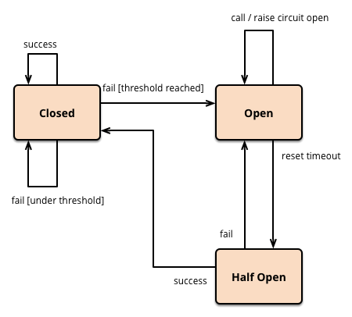

Slide 36
Integrating Resilience4j with Spring Boot
Resilience4j provides Spring Boot Starter libraries.
Configuration via application.properties or YAML files.
Integration steps:
Add the Resilience4j dependency.
Configure circuit breaker properties.
Annotate methods with @CircuitBreaker.

Slide 37
Dependency Management
<dependency>
<groupId>io.github.resilience4j</groupId>
<artifactId>resilience4j-spring-boot2</artifactId>
<version>1.7.0</version>
</dependency>

Slide 38
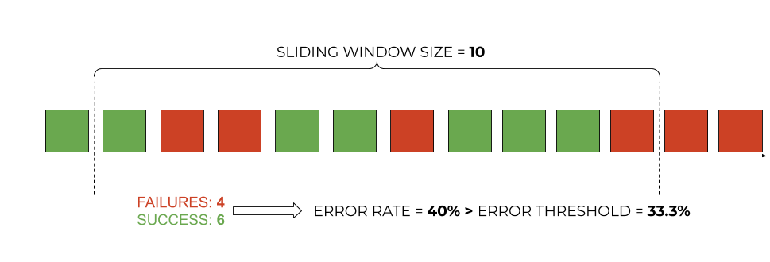
Properties
resilience4j.circuitbreaker:
instances:
message-service:
registerHealthIndicator: true
slidingWindowSize: 10
permittedNumberOfCallsInHalfOpenState: 3
slidingWindowType: COUNT_BASED
minimumNumberOfCalls: 5
waitDurationInOpenState: 5s
failureRateThreshold: 33.3
automaticTransitionFromOpenToHalfOpenEnabled: true

Slide 39
Code Example
@CircuitBreaker(name = "myService", fallbackMethod = "fallbackMethod")
public String myService() {
// Call to an external service
}
public String fallbackMethod(Throwable t) {
return "Service is currently unavailable.";
}

Slide 40
Demo: Circuit Breaker Implementation in Spring Boot
Short demo of how to create a circuit breaker-enabled service in Spring Boot.
Steps:
Setup dependencies.
Create a service class.
Configure circuit breaker.
Test with an external service failure.

Slide 41
Circuit Breaker Metrics and Monitoring
Micrometer integration: Monitor circuit breaker states.
Actuator: Use Spring Boot Actuator for health checks and exposing circuit breaker metrics.
Example:
/actuator/metrics/resilience4j.circuitbreaker.state

Slide 42
Fallback Strategies
Fallback methods ensure the application doesn’t crash.
Fallbacks can return default responses or cached data.
Example:
Static response
Another service call

Slide 43
Key Takeaways
Circuit breaker pattern improves the resilience of microservices.
Resilience4j offers a modular and efficient way to implement circuit breakers.
Easy integration with Spring Boot via annotations and configuration.

Slide 44
Questions?

Slide 45
API Gateway

Slide 46
Service Discovery and Load Balancing
DMZ
Service
Instance (A)
Public IP
Localhost:8080
API gateway
Discovery client
End User
Service
Client
(B)
Service
Instance
(A)
Localhost:8081
Discovery client
Discovery client
Service
Instance
(A)
Localhost:8082
Service Registry
Discovery client
B[localhost:8090]
A[localhost:8080,
localhost:8081,
localhost:8082]

Slide 47
Introduction to API Gateway Pattern
What is an API Gateway?
A server that acts as an entry point for all client requests.
It routes requests to the appropriate backend microservices.
Why use an API Gateway?
Centralized access control
Cross-cutting concerns (logging, security, caching)
Reduces complexity for clients
Helps decouple front-end clients from multiple microservices

Slide 48
Key Features of an API Gateway
Request Routing
Directs client requests to the right microservice
Load Balancing
Distributes incoming traffic across microservices
Security
Authentication, authorization, and SSL termination
Rate Limiting
Controls the number of requests per client
Logging & Monitoring
Tracks request flows, error logs, and metrics

Slide 49
Spring Cloud Gateway Overview
What is Spring Cloud Gateway?
A project built on top of Spring Boot for building API gateways.
Provides features like routing, filters, security, and more.
Why use Spring Cloud Gateway?
Built on top of Project Reactor for reactive programming
Easy integration with Spring ecosystem

Slide 50
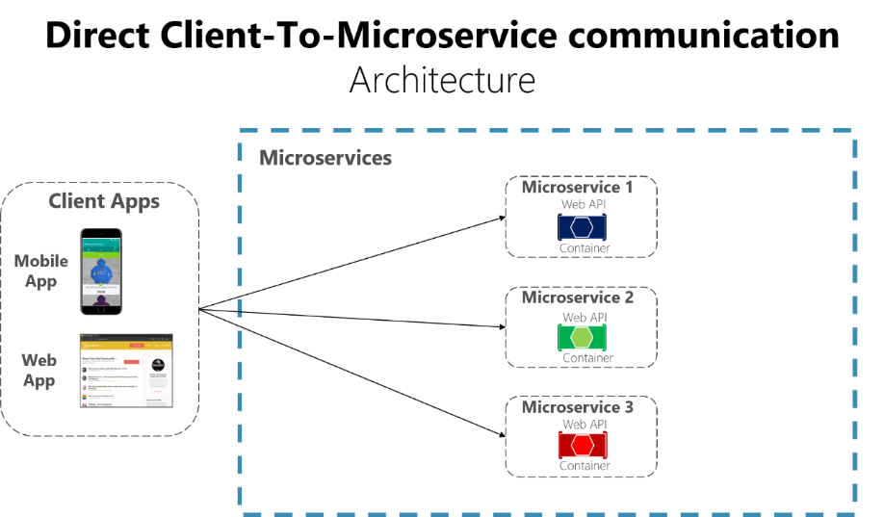
Direct Access: No API Gateway

Slide 51
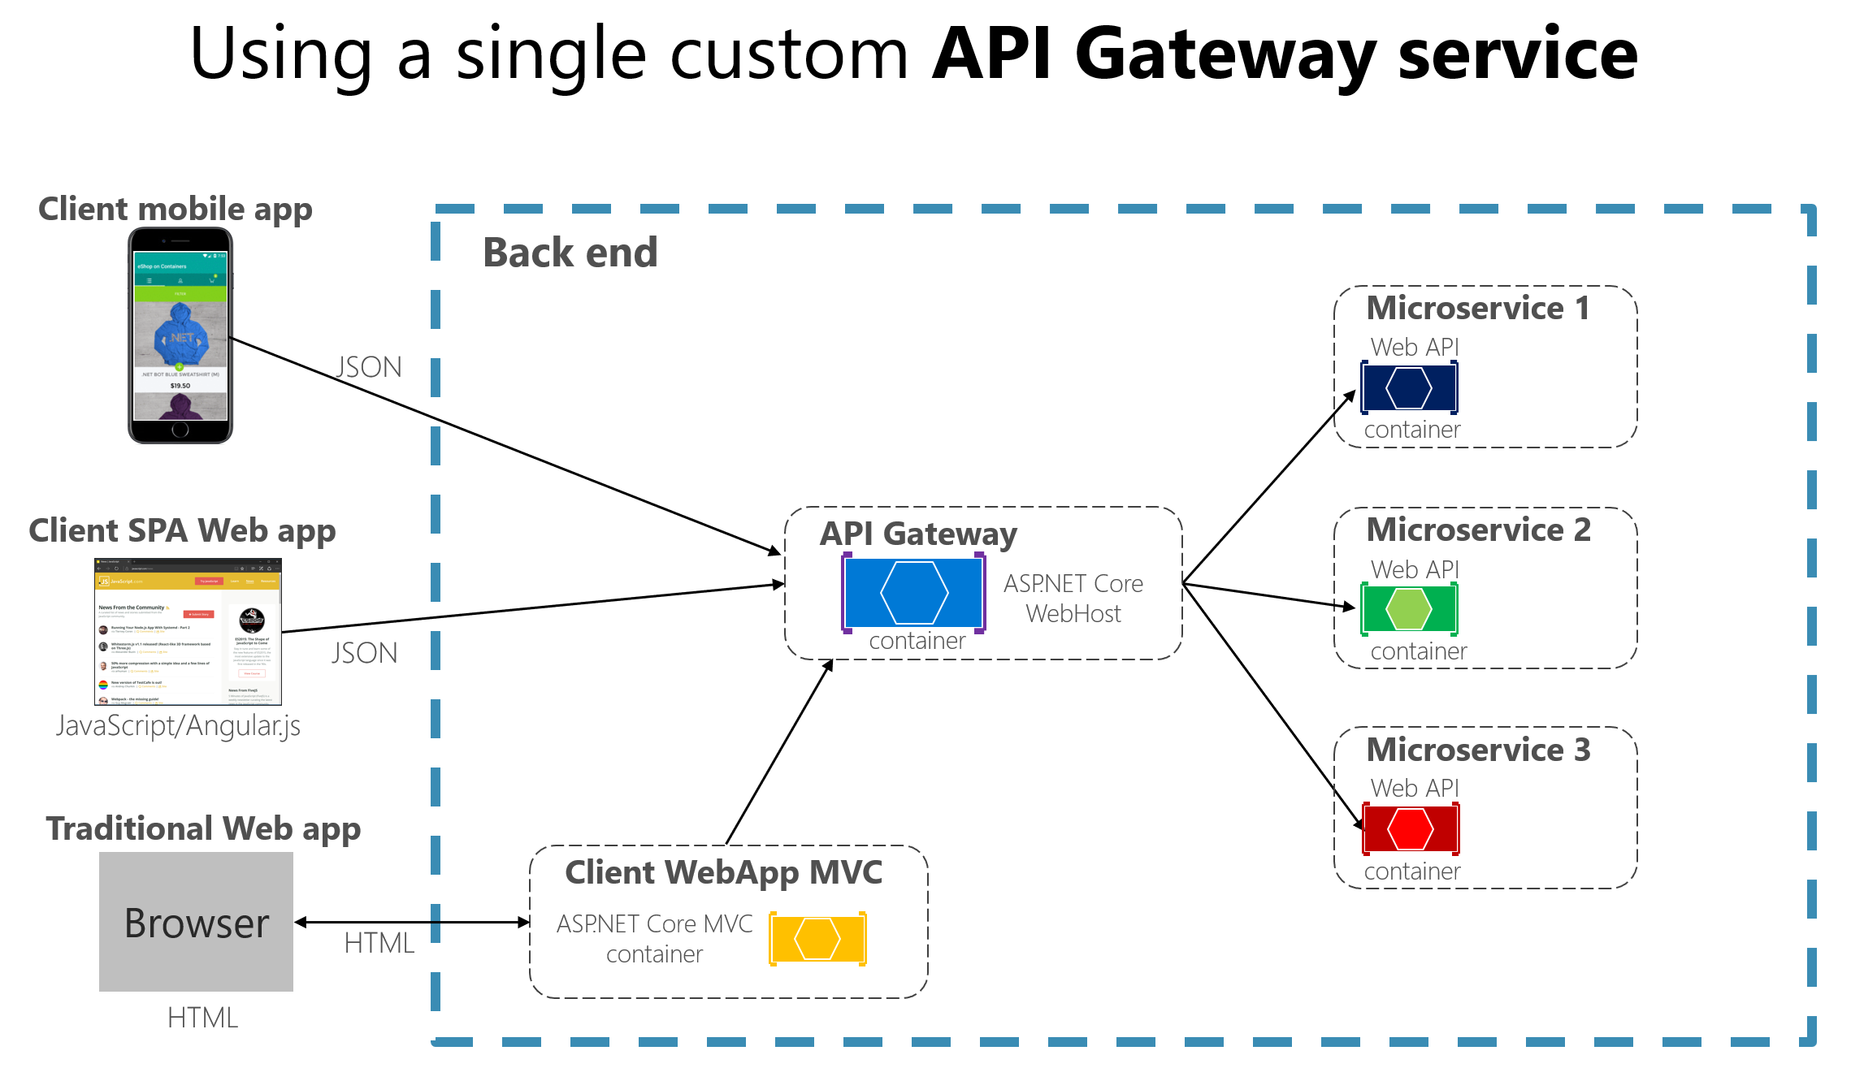
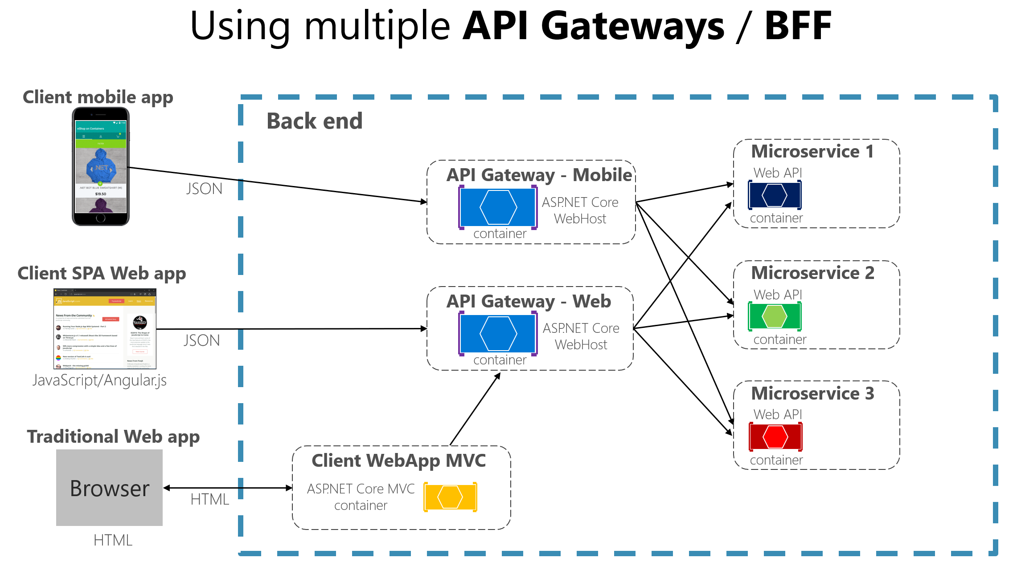
Architecture Diagram
Image Courtesy: Microsoft

Slide 52
API Gateway Flow in Spring Boot
Client Request
API Gateway (Spring Cloud Gateway)
Request routed to appropriate microservice
Microservice Communication
Response sent back through the gateway to the client

Slide 53
Setting up Spring Cloud Gateway
Dependencies in pom.xml:
xml
Copy code
<dependency>
<groupId>org.springframework.cloud</groupId>
<artifactId>spring-cloud-starter-gateway</artifactId>
</dependency>
Main Class Setup:
java
Copy code
@SpringBootApplication
public class ApiGatewayApplication {
public static void main(String[] args) {
SpringApplication.run(ApiGatewayApplication.class, args);
}
}

Slide 54
Configuring Routes in API Gateway
Example of Route Configuration in application.yml:
yaml
Copy code
spring:
cloud:
gateway:
routes:
- id: user-service
uri: http://localhost:8081
predicates:
- Path=/users/**
- id: order-service
uri: http://localhost:8082
predicates:
- Path=/orders/**
Explanation:
Define route IDs, URIs, and paths for microservices.

Slide 55
Filters in API Gateway
Global Filters:
Applied to all routes.
Examples: Security, logging.
Route-Specific Filters:
Applied to specific routes.
Example of a Filter:
yaml
Copy code
- id: order-service
uri: http://localhost:8082
filters:
- AddRequestHeader=Order,Service

Slide 56
Load Balancing with API Gateway
Enable Load Balancing:
Use Spring Cloud's spring-cloud-starter-loadbalancer.
Example Configuration:
yaml
Copy code
spring:
cloud:
gateway:
discovery:
locator:
enabled: true

Slide 57
Security in API Gateway
Authentication & Authorization:
Use Spring Security with OAuth2 or JWT.
Example Configuration:
Add JWT validation to requests before forwarding them to microservices.

Slide 58
Rate Limiting in API Gateway
Example Configuration for Rate Limiting:
yaml
Copy code
- id: rate_limiter
uri: http://localhost:8080
filters:
- name: RequestRateLimiter
args:
redis-rate-limiter:
replenishRate: 10
burstCapacity: 20

Slide 59
API Gateway Best Practices
Handle timeouts and retries effectively.
Ensure security policies are applied centrally.
Monitor the gateway for performance bottlenecks.
Implement caching for faster responses.

Slide 60
Conclusion
Recap:
API Gateway pattern simplifies microservice management.
Spring Cloud Gateway provides a powerful tool for implementing it in Spring Boot.

