Slide 1
Core Design Patterns

Slide 2
Outline
Introduction to design patterns
Creational patterns (constructing objects)
Structural patterns (controlling heap layout)
Behavioral patterns (affecting object semantics)

Slide 3
Design Pattern
Design patterns describe how objects communicate without becoming entangled in each other’s data models and methods.

Slide 4
Some Useful Definitions
A standard solution to a common programming problem
A technique for making code more flexible by making it meet certain criteria
A design or implementation structure that achieves a particular purpose
A high-level programming idiom
Shorthand for describing certain aspects of program organization
Connections among program components
The shape of a heap snapshot or object model

Slide 5
Pattern
A Pattern is a solution to a recurring problem in a context
Context:is environment, surroundings,situation or etc
Problem: unsettled question, something that needs to be investigated or solved
Solution: answer to the problem

Slide 6
Identify the problem
It is a similar problem
Identify the characteristics and document it
Consider the initial documents to be a candidate patterns.
Then form a compete pattern
Rule of three:pattern should appear in atleast 3 different systems.

Slide 7
Patterns Vs Strategies
Each pattern includes various strategies that provide lower level implementation details.
Pattern exist at higher level of abstraction than strategies.
Patters include most recommended or most common implementations strategies

Slide 8
Simple template of a pattern
Pattern name :
Problem :
Describes the design issue faced by the developer
Forces :
What are the conditions which forced the pattern to occur
Solution :
describes the solution in two forms Structure & strategies
Structure :
uses UML diagrams to represent the problem
Strategies:
how the pattern may be implemented

Slide 9
Simple template of a pattern (2)
Consequences:
results of using the patterns notes pros and cons
Sample Code:
Limitations:
Related Patterns:
other related patterns which use this pattern

Slide 10
When (not) to use design patterns
Rule 1: delay
Design patterns can increase or decrease understandability
Add indirection, increase code size
Improve modularity, separate concerns, ease description
If your design or implementation has a problem, consider design patterns that address that problem
Canonical reference: the "Gang of Four" book
Design Patterns: Elements of Reusable Object-Oriented Software, by Erich Gamma, Richard Helm, Ralph Johnson, and John Vlissides, Addison-Wesley, 1995.
Another good reference for Java
Effective Java: Programming Language Guide, by Joshua Bloch, Addison-Wesley, 2001.

Slide 11
How many design patterns?
Many
A site says at least 250 existing patterns are used in OO world, including Spaghetti which refers to poor coding habits
The 23 design patterns by GOF are well known, and more are to be discovered on the way
Note that the design patterns are not idioms or algorithms or components.

Slide 12
What is the relationship among these patterns?
Generally, to build a system, you may need many patterns to fit together
Different designer may use different patterns to solve the same problem, Usually:
Some patterns naturally fit together
One pattern may lead to another
Some patterns are similar and alternative
Patterns are discoverable and documentable
Patterns are not methods or framework
Patterns give you hint to solve a problem effectively

Slide 13
Types of Patterns
Creational Patterns
Structural Patterns
Behavioral Patterns

Slide 14
Creational Patterns
Creational patterns deal with the best way to create instances of objects
The Factory Method
provides a simple decision making class that returns one of several possible subclasses of an abstract base class depending on the data that are provided.
The Abstract Factory Method
provides an interface to create and return one of several families of related objects.
The Builder Pattern
separates the construction of a complex object from its representation, so that several different representations can be created depending on the needs of the program.
The Prototype Pattern
starts with an initialized and instantiated class and copies or clones it to make new instances rather than creating new instances.
The Singleton Pattern
is a class of which there can be no more than one instance. It provides a single global point of access to that instance

Slide 15
Structural Patterns
Structural patterns describe how classes and objects can be combined to form larger structures
The difference between class patterns and object patterns is that class patterns describe how inheritance can be used to provide more useful program interfaces
Object patterns, on the other hand, describe how objects can be composed into larger structures using object composition, or the inclusion of objects within other objects

Slide 16
Structural Patterns
The Adapter pattern, used to change the interface of one class to that of another one.
The Bridge pattern, intended to keep the interface to your client program constant while allowing you to change the actual kind of class you display or use. You can then change the interface and the underlying class separately.
The Composite pattern, a collection of objects, any one of which may be either itself a Composite, or just a primitive object.

Slide 17
Structural Patterns
The Decorator pattern, a class that surrounds a given class, adds new capabilities to it, and passes all the unchanged methods to the underlying class.
The Façade pattern, which groups a complex object hierarchy and provides a new, simpler interface to access those data.
The Flyweight pattern, which provides a way to limit the proliferation of small, similar class instances by moving some of the class data outside the class and passing it in during various execution methods.
The Proxy pattern, which provides a simple place-holder class for a more complex class which is expensive to instantiate

Slide 18
Behavioral Patterns
specifically concerned with communication between objects
The Observer pattern
defines the way a number of classes can be notified of a change,
The Mediator
defines how communication between classes can be simplified by using another class to keep all classes from having to know about each other

Slide 19
Behavioral Patterns
The Chain of Responsibility
allows an even further decoupling between classes, by passing a request between classes until it is recognized
The Template pattern
provides an abstract definition of an algorithm
The Interpreter Pattern
provides a definition of how to include language elements in a program.
The Strategy pattern
encapsulates an algorithm inside a class,

Slide 20
Behavioral Patterns
The Visitor pattern
adds function to a class,
The State pattern
provides a memory for a class’s instance variables.
The Command pattern
provides a simple way to separate execution of a command from the interface environment that produced it, and
The Iterator pattern
formalizes the way we move through a list of data within a class

Slide 21
Patterns In Detail

Slide 22
Factory Method

Slide 23
Factory Method
Definition
A Factory pattern is one that returns an instance of one of several possible classes depending on the data provided to it
Provides an abstraction or an interface and lets subclass or implementing classes decide which class or method should be instantiated or called, based on the conditions or parameters given

Slide 24
Definition
Define an interface for creating an object, but let subclasses decide which class to instantiate. Factory Method lets a class defer instantiation to subclasses.

Slide 25
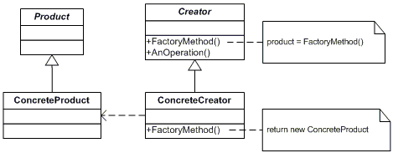
UML Class Diagram

Slide 26
Participants
Product
defines the interface of objects the factory method creates
ConcreteProduct
implements the Product interface
Creator
declares the factory method, which returns an object of type Product. Creator may also define a default implementation of the factory method that returns a default ConcreteProduct object.
may call the factory method to create a Product object.
ConcreteCreator
overrides the factory method to return an instance of a ConcreteProduct

Slide 27
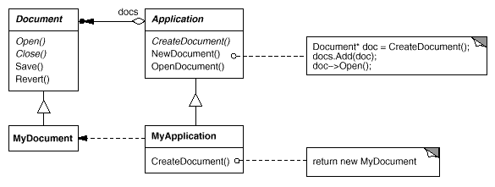
Motivation
Frameworks use abstract classes to define and maintain relationships between objects. A framework is often responsible for creating these objects as well.
Notes:
Consider a framework for applications that can present multiple documents to the user. Two key abstractions in this
framework are the classes Application and Document. Both classes are abstract, and clients have to subclass them to
realize their application-specific implementations. To create a drawing application, for example, we define the
classes DrawingApplication and DrawingDocument.
The Application class is responsible for managing Documents
and will create them as required—when the user selects Open or New from a menu, for example.
Because the particular Document subclass to instantiate is application-specific, the Application class can't predict
the subclass of Document to instantiate—the Application class only knows when a new document should be created,
not what kind of Document to create. This creates a dilemma: The framework must instantiate classes, but it only
knows about abstract classes, which it cannot instantiate.
The Factory Method pattern offers a solution. It encapsulates the knowledge of which Document subclass to create
and moves this knowledge out of the framework.
Application subclasses redefine an abstract CreateDocument operation on Application to return the appropriate
Document subclass. Once an Application subclass is instantiated, it can then instantiate application-specific
Documents without knowing their class. We call CreateDocument a factory method because it's responsible for
"manufacturing" an object.

Slide 28
Applicability
Use the Factory Method pattern when
a class can't anticipate the class of objects it must create.
a class wants its subclasses to specify the objects it creates.
classes delegate responsibility to one of several helper subclasses, and you want to localize the knowledge of which helper subclass is the delegate.

Slide 29
Abstract Factory

Slide 30
Definition
Provide an interface for creating families of related or dependent objects without specifying their concrete classes.
Abstract Factory

Slide 31
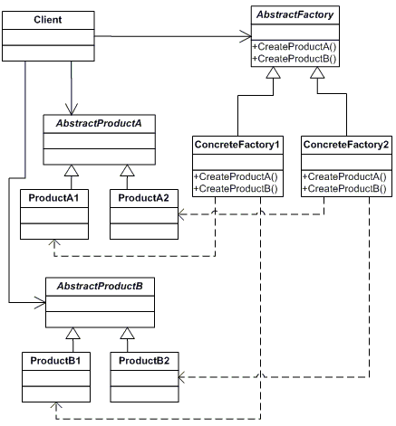
UML Class Diagram
Abstract Factory

Slide 32
Participants
The classes and/or objects participating in this pattern are:
AbstractFactory (ContinentFactory)
declares an interface for operations that create abstract products
ConcreteFactory (AfricaFactory, AmericaFactory)
implements the operations to create concrete product objects
AbstractProduct (Herbivore, Carnivore)
declares an interface for a type of product object
Product (Wildebeest, Lion, Bison, Wolf)
defines a product object to be created by the corresponding concrete factory implements the AbstractProduct interface
Client (AnimalWorld)
uses interfaces declared by AbstractFactory and AbstractProduct classes
Abstract Factory

Slide 33
Builder

Slide 34
Definition
Separate the construction of a complex object from its representation so that the same construction process can create different representations.
Builder

Slide 35
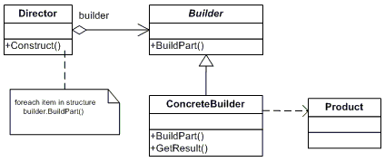
UML Class Diagram
Builder

Slide 36
Participants
Builder (VehicleBuilder)
specifies an abstract interface for creating parts of a Product object
ConcreteBuilder (MotorCycleBuilder, CarBuilder, ScooterBuilder)
constructs and assembles parts of the product by implementing the Builder interface
defines and keeps track of the representation it creates
provides an interface for retrieving the product
Director (Shop)
constructs an object using the Builder interface
Product (Vehicle)
represents the complex object under construction. ConcreteBuilder builds the product's internal representation and defines the process by which it's assembled
includes classes that define the constituent parts, including interfaces for assembling the parts into the final result
Builder

Slide 37
Prototype

Slide 38
Definition
Specify the kind of objects to create using a prototypical instance, and create new objects by copying this prototype.

Slide 39
Applicability
Use the Prototype pattern
when a system should be independent of how its products are created, composed, and represented
when the classes to instantiate are specified at run-time, for example, by dynamic loading; or
to avoid building a class hierarchy of factories that parallels the class hierarchy of products; or
when instances of a class can have one of only a few different combinations of state. It may be more convenient to install a corresponding number of prototypes and clone them rather than instantiating the class manually, each time with the appropriate state.

Slide 40
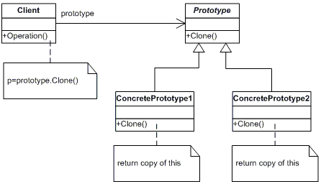
UML Class Diagram

Slide 41
Participants
Prototype (ColorPrototype)
declares an interace for cloning itself
ConcretePrototype (Color)
implements an operation for cloning itself
Client (ColorManager)
creates a new object by asking a prototype to clone itself

Slide 42

Singleton
Ensure a class has only one instance and provide a global point of access to it.
UML Class Diagram
Participants
Singleton (LoadBalancer)
defines an Instance operation that lets clients access its unique instance. Instance is a class operation.
responsible for creating and maintaining its own unique instance.

Slide 43
Adapter

Slide 44
Definition
Convert the interface of a class into another interface clients expect. Adapter lets classes work together that couldn't otherwise because of incompatible interfaces.

Slide 45
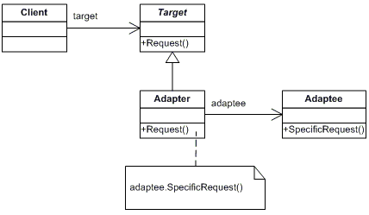
UML Class Diagram

Slide 46
Participants
Target (ChemicalCompound)
defines the domain-specific interface that Client uses.
Adapter (Compound)
adapts the interface Adaptee to the Target interface.
Adaptee (ChemicalDatabank)
defines an existing interface that needs adapting.
Client (AdapterApp)
collaborates with objects conforming to the Target interface

Slide 47
Bridge

Slide 48
Definition
Decouple an abstraction from its implementation so that the two can vary independently.

Slide 49
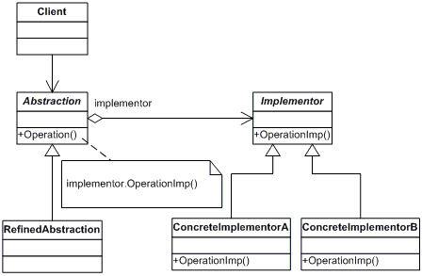
UML Class Diagram

Slide 50
Participants
Abstraction (BusinessObject)
defines the abstraction's interface.
maintains a reference to an object of type Implementor.
RefinedAbstraction (CustomersBusinessObject)
extends the interface defined by Abstraction.
Implementor (DataObject)
defines the interface for implementation classes. This interface doesn't have to correspond exactly to Abstraction's interface; in fact the two interfaces can be quite different. Typically the Implementation interface provides only primitive operations, and Abstraction defines higher-level operations based on these primitives.
ConcreteImplementor (CustomersDataObject)
implements the Implementor interface and defines its concrete implementation.

Slide 51
Composite

Slide 52
Composite
Compose objects into tree structures to represent part-whole hierarchies. Composite lets clients treat individual objects and compositions of objects uniformly.

Slide 53
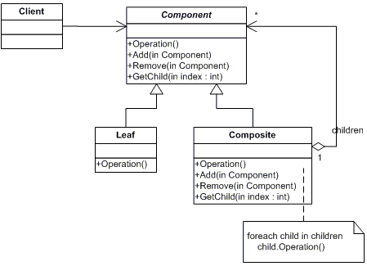
UML Class Diagram

Slide 54
Participants (slide1)
Component (DrawingElement)
declares the interface for objects in the composition.
implements default behavior for the interface common to all classes, as appropriate.
declares an interface for accessing and managing its child components.
(optional) defines an interface for accessing a component's parent in the recursive structure, and implements it if that's appropriate.
Leaf (PrimitiveElement)
represents leaf objects in the composition. A leaf has no children.
defines behavior for primitive objects in the composition.

Slide 55
Participants (slide 2)
Composite (CompositeElement)
defines behavior for components having children.
stores child components.
implements child-related operations in the Component interface.
Client (CompositeApp)
manipulates objects in the composition through the Component interface.

Slide 56
Decorator

Slide 57
Definition
Attach additional responsibilities to an object dynamically. Decorators provide a flexible alternative to subclassing for extending functionality

Slide 58
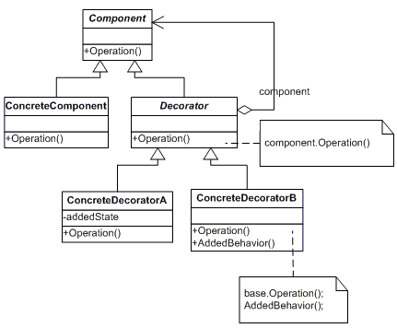
UML Class Diagram

Slide 59
Participants
Component (LibraryItem)
defines the interface for objects that can have responsibilities added to them dynamically.
ConcreteComponent (Book, Video)
defines an object to which additional responsibilities can be attached.
Decorator (Decorator)
maintains a reference to a Component object and defines an interface that conforms to Component's interface.
ConcreteDecorator (Borrowable)
adds responsibilities to the component.

Slide 60
Facade

Slide 61
Definition
Provide a unified interface to a set of interfaces in a subsystem. Façade defines a higher-level interface that makes the subsystem easier to use.

Slide 62
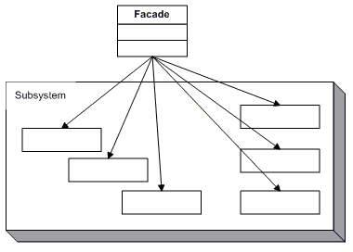
UML Class Diagram

Slide 63
Participants
Facade (MortgageApplication)
knows which subsystem classes are responsible for a request.
delegates client requests to appropriate subsystem objects.
Subsystem classes (Bank, Credit, Loan)
implement subsystem functionality.
handle work assigned by the Facade object.

Slide 64
Flyweigt

Slide 65
Definition
Use sharing to support large numbers of fine-grained objects efficiently.

Slide 66
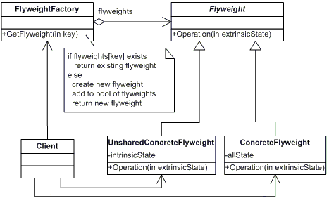
UML Class Diagram

Slide 67
Participants (slide1)
Flyweight (Character)
declares an interface through which flyweights can receive and act on extrinsic state.
ConcreteFlyweight (CharacterA, CharacterB, ..., CharacterZ)
implements the Flyweight interface and adds storage for intrinsic state, if any. A ConcreteFlyweight object must be sharable. Any state it stores must be intrinsic, that is, it must be independent of the ConcreteFlyweight object's context.

Slide 68
Participants (slide2)
UnsharedConcreteFlyweight ( not used )
not all Flyweight subclasses need to be shared. The Flyweight interface enables sharing, but it doesn't enforce it. It is common for UnsharedConcreteFlyweight objects to have ConcreteFlyweight objects as children at some level in the flyweight object structure (as the Row and Column classes have).
FlyweightFactory (CharacterFactory)
creates and manages flyweight objects
ensures that flyweight are shared properly. When a client requests a flyweight, the FlyweightFactory objects supplies an existing instance or creates one, if none exists.
Client (FlyweightApp)
maintains a reference to flyweight(s).
computes or stores the extrinsic state of flyweight(s).

Slide 69
Proxy

Slide 70
Definition
Provide a surrogate or placeholder for another object to control access to it.

Slide 71
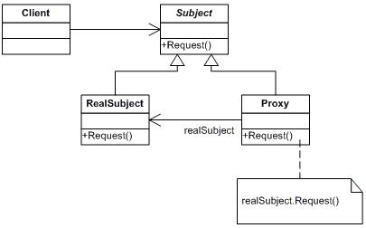
UML Class Diagram

Slide 72
Participants
Proxy (MathProxy)
maintains a reference that lets the proxy access the real subject. Proxy may refer to a Subject if the RealSubject and Subject interfaces are the same.
provides an interface identical to Subject's so that a proxy can be substituted for for the real subject.
controls access to the real subject and may be responsible for creating and deleting it.
other responsibilites depend on the kind of proxy:
remote proxies are responsible for encoding a request and its arguments and for sending the encoded request to the real subject in a different address space.
virtual proxies may cache additional information about the real subject so that they can postpone accessing it. For example, the ImageProxy from the Motivation caches the real images's extent.
protection proxies check that the caller has the access permissions required to perform a request.

Slide 73
Subject (IMath)
defines the common interface for RealSubject and Proxy so that a Proxy can be used anywhere a RealSubject is expected.
RealSubject (Math)
defines the real object that the proxy represents.

Slide 74
Chain of Responsibility

Slide 75
Definition
Avoid coupling the sender of a request to its receiver by giving more than one object a chance to handle the request. Chain the receiving objects and pass the request along the chain until an object handles it.

Slide 76
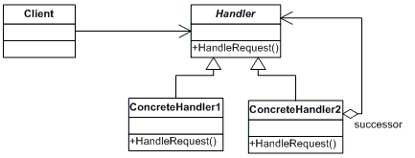
UML Class Diagaram

Slide 77
Participants
Handler (Approver)
defines an interface for handling the requests
(optional) implements the successor link
ConcreteHandler (Director, VicePresident, President)
handles requests it is responsible for
can access its successor
if the ConcreteHandler can handle the request, it does so; otherwise it forwards the request to its successor
Client (ChainApp)
initiates the request to a ConcreteHandler object on the chain

Slide 78
Command

Slide 79
Definition
Encapsulate a request as an object, thereby letting you parameterize clients with different requests, queue or log requests, and support undoable operations.

Slide 80
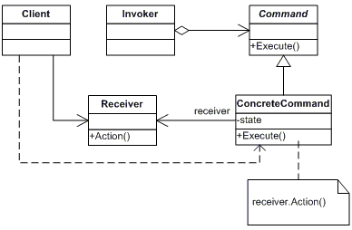
UML Class Diagram

Slide 81
Participants
Command (Command)
declares an interface for executing an operation
ConcreteCommand (CalculatorCommand)
defines a binding between a Receiver object and an action
implements Execute by invoking the corresponding operation(s) on Receiver
Client (CommandApp)
creates a ConcreteCommand object and sets its receiver
Invoker (User)
asks the command to carry out the request
• Receiver (Calculator)
knows how to perform the operations associated with carrying out the request.

Slide 82
Interpreter

Slide 83
Definition
Given a language, define a representation for its grammar along with an interpreter that uses the representation to interpret sentences in the language..

Slide 84
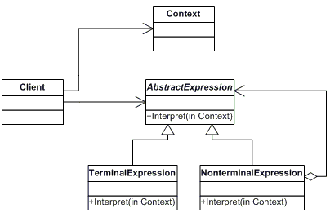
UML Class Diagram

Slide 85
Participants
AbstractExpression (Expression)
declares an interface for executing an operation
TerminalExpression ( ThousandExpression, HundredExpression, TenExpression, OneExpression )
implements an Interpret operation associated with terminal symbols in the grammar.
an instance is required for every terminal symbol in the sentence.
NonterminalExpression ( not used )
one such class is required for every rule R ::= R1R2...Rn in the grammar
maintains instance variables of type AbstractExpression for each of the symbols R1 through Rn.
implements an Interpret operation for nonterminal symbols in the grammar. Interpret typically calls itself recursively on the variables representing R1 through Rn.

Slide 86
Participants
Context (Context)
contains information that is global to the interpreter
Client (InterpreterApp)
builds (or is given) an abstract syntax tree representing a particular sentence in the language that the grammar defines. The abstract syntax tree is assembled from instances of the NonterminalExpression and TerminalExpression classes
invokes the Interpret operation

Slide 87
Iterator

Slide 88
Definition
Provide a way to access the elements of an aggregate object sequentially without exposing its underlying representation..

Slide 89
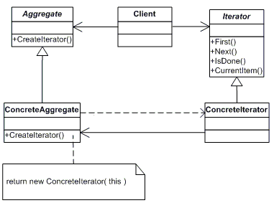
UML Class Diagram

Slide 90
Participants
Iterator (AbstractIterator)
defines an interface for accessing and traversing elements.
ConcreteIterator (Iterator)
implements the Iterator interface.
keeps track of the current position in the traversal of the aggregate.
Aggregate (AbstractCollection)
defines an interface for creating an Iterator object
ConcreteAggregate (Collection)
implements the Iterator creation interface to return an instance of the proper ConcreteIterator

Slide 91
Mediator

Slide 92
Definition
Define an object that encapsulates how a set of objects interact.
Mediator promotes loose coupling by keeping objects from referring to each other explicitly, and it lets you vary their interaction independently.
Mediator pattern is used to reduce communication complexity between multiple objects or classes.
This pattern provides a mediator class which normally handles all the communications between different classes and supports easy maintenance of the code by loose coupling

Slide 93
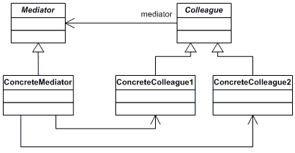
UML Class diagram

Slide 94
Participants
Mediator (IChatroom)
defines an interface for communicating with Colleague objects
ConcreteMediator (Chatroom)
implements cooperative behavior by coordinating Colleague objects
knows and maintains its colleagues
Colleague classes (Participant)
each Colleague class knows its Mediator object
each colleague communicates with its mediator whenever it would have otherwise communicated with another colleague

Slide 95
Memento

Slide 96
Definition
Memento pattern is a behavioral design pattern.
Without violating encapsulation, capture and externalize an object's internal state so that the object can be restored to this state later.
Memento pattern is used to restore state of an object to a previous state.
As your application is progressing, you may want to save checkpoints in your application and restore back to those checkpoints later.

Slide 97
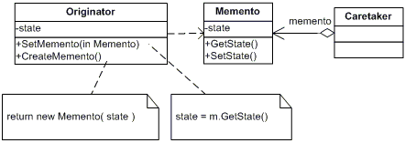
UML Class Diagram

Slide 98
Participants
Memento (Memento)
stores internal state of the Originator object. The memento may store as much or as little of the originator's internal state as necessary at its originator's discretion.
protect against access by objects of other than the originator. Mementos have effectively two interfaces. Caretaker sees a narrow interface to the Memento -- it can only pass the memento to the other objects. Originator, in contrast, sees a wide interface, one that lets it access all the data necessary to restore itself to its previous state. Ideally, only the originator that produces the memento would be permitted to access the memento's internal state.
Originator (SalesProspect)
creates a memento containing a snapshot of its current internal state.
uses the memento to restore its internal state
Caretaker (Caretaker)
is responsible for the memento's safekeeping
never operates on or examines the contents of a memento.

Slide 99
Observer

Slide 100
Definition
Define a one-to-many dependency between objects so that when one object changes state, all its dependents are notified and updated automatically.

Slide 101
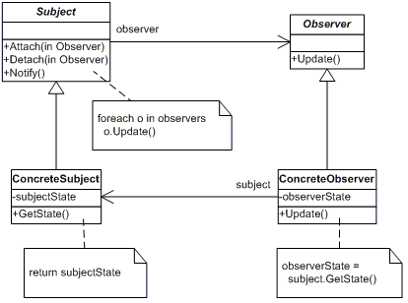
UML Class Diagram

Slide 102
Participants
Subject (Stock)
knows its observers. Any number of Observer objects may observe a subject
provides an interface for attaching and detaching Observer objects.
ConcreteSubject (IBM)
stores state of interest to ConcreteObserver
sends a notification to its observers when its state changes
Observer (IInvestor)
defines an updating interface for objects that should be notified of changes in a subject.
ConcreteObserver (Investor)
maintains a reference to a ConcreteSubject object
stores state that should stay consistent with the subject's
implements the Observer updating interface to keep its state consistent with the subject's

Slide 103
State
23

Slide 104
Definition
Allow an object to alter its behavior when its internal state changes.
The main idea of State pattern is to allow the object for changing its behavior without changing its class.
By implementing it, the code should remain cleaner without many if/else statements.
The State pattern minimizes conditional complexity, eliminating the need for if and switch statements in objects that have different behavior requirements unique to different state transitions

Slide 105
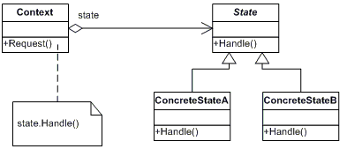

Slide 106
Participants
Context (Account)
defines the interface of interest to clients
maintains an instance of a ConcreteState subclass that defines the current state.
State (State)
defines an interface for encapsulating the behavior associated with a particular state of the Context.
Concrete State (RedState, SilverState, GoldState)

Slide 107
Strategy
22

Slide 108
Definition
Define a family of algorithms, encapsulate each one, and make them interchangeable. Strategy lets the algorithm vary independently from clients that use it.

Slide 109
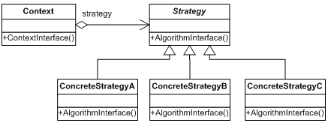
UML Class Diagram

Slide 110
Participants
Strategy (SortStrategy)
declares an interface common to all supported algorithms. Context uses this interface to call the algorithm defined by a ConcreteStrategy
ConcreteStrategy (QuickSort, ShellSort, MergeSort)
implements the algorithm using the Strategy interface
Context (SortedList)
is configured with a ConcreteStrategy object
maintains a reference to a Strategy object
may define an interface that lets Strategy access its data.

Slide 111
Template Method

Slide 112
Definition
Define the skeleton of an algorithm in an operation, deferring some steps to subclasses. Template Method lets subclasses redefine certain steps of an algorithm without changing the algorithm's structure.

Slide 113
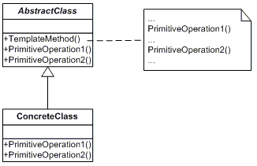
Template Method

Slide 114
Participants
AbstractClass (DataObject)
defines abstract primitive operations that concrete subclasses define to implement steps of an algorithm
implements a template method defining the skeleton of an algorithm. The template method calls primitive operations as well as operations defined in AbstractClass or those of other objects.
ConcreteClass (CustomerDataObject)
implements the primitive operations ot carry out subclass-specific steps of the algorithm

Slide 115
Visitor

Slide 116
Definition
Represent an operation to be performed on the elements of an object structure. Visitor lets you define a new operation without changing the classes of the elements on which it operates.

Slide 117
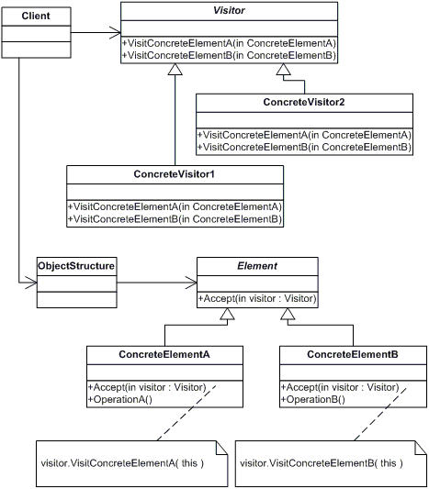
UML Class Diagram

Slide 118
Participants
Visitor (Visitor)
declares a Visit operation for each class of ConcreteElement in the object structure. The operation's name and signature identifies the class that sends the Visit request to the visitor. That lets the visitor determine the concrete class of the element being visited. Then the visitor can access the elements directly through its particular interface
ConcreteVisitor (IncomeVisitor, VacationVisitor)
implements each operation declared by Visitor. Each operation implements a fragment of the algorithm defined for the corresponding class or object in the structure. ConcreteVisitor provides the context for the algorithm and stores its local state. This state often accumulates results during the traversal of the structure.
Element (Element)
defines an Accept operation that takes a visitor as an argument.
ConcreteElement (Employee)
implements an Accept operation that takes a visitor as an argument
ObjectStructure (Employees)
can enumerate its elements
may provide a high-level interface to allow the visitor to visit its elements
may either be a Composite (pattern) or a collection such as a list or a set

Slide 119
Gang Of Four- The GOF
Erich Gamma
Richard Helm
Ralph Johnson
John Vlissides
The authors of Design Patterns have suggested that every pattern start with an abstract class and that you derive concrete working classes from that abstraction
←BACK

