Slide 1
Introduction to JMX
May 2008

Slide 2
An Introduction to JMX
JMX is Java Management Extension API
JMX is the best tool for integration of software
It provides a common spine that allows the user to integrate modules, containers, and plug-ins
JMX components are defined by the Java Management Extensions Instrumentation and Agent Specification, v1.2, which is available from the JSR003

Slide 3
An Introduction to JMX
JMX is a standard for managing and monitoring all varieties of software and hardware components from Java
Further, JMX aims to provide integration with the large number of existing management standards

Slide 4
What is JMX?
Standard API for developing observable applications – JSR 3 and JSR 160
Provides access to information such as
  Number of classes loaded
  Virtual machine uptime
  Operating system information
Applications can use JMX for
  Management – changing configuration settings
  Monitoring – getting statistics and notifications
Mandatory from J2SE 5.0 and J2EE

Slide 5
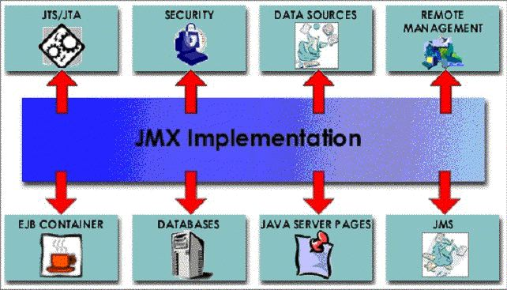
An Introduction to JMX

Slide 6
Introduction to JMX
The three levels of JMX
  Instrumentation
    which are the resources to manage
  Agents
    which are the controllers of the instrumentation level objects
  Distributed services
    the mechanism by which administration applications interact with agents and their managed objects

Slide 7
JMX Architecture
Instrumentation Level
  MBeans instruments resources, exposing attributes and operations
Agent Level
  MBean Server
  Predefined services
Remote Management
  Protocol Adaptors and Standard Connectors enables remote Manager Applications

Slide 8
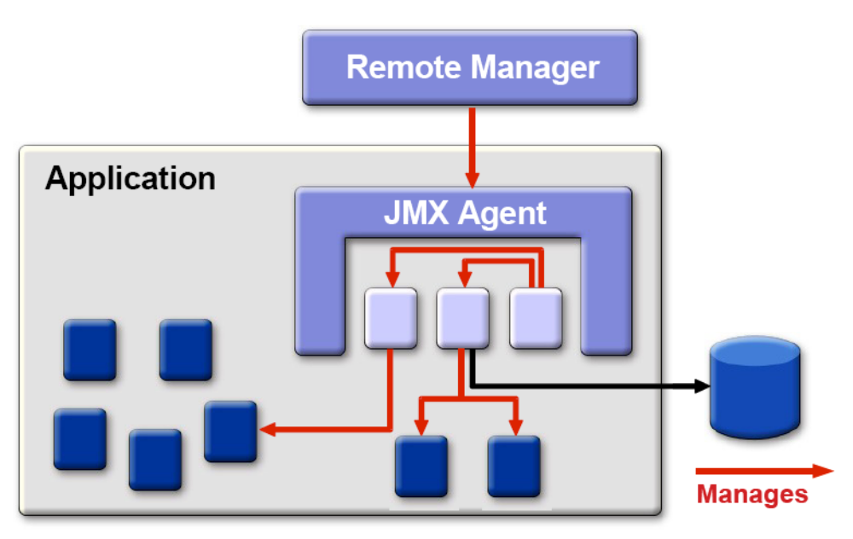
JMX Architecture

Slide 9
Managed Beans(MBeans)
A MBean is a named managed object representing a resource
  An application configuration setting
  Device
  Etc.
A MBean can have
  Attributes that can be read and/or written
  Operations that can be invoked
  Notifications that the MBean can broadcast

Slide 10
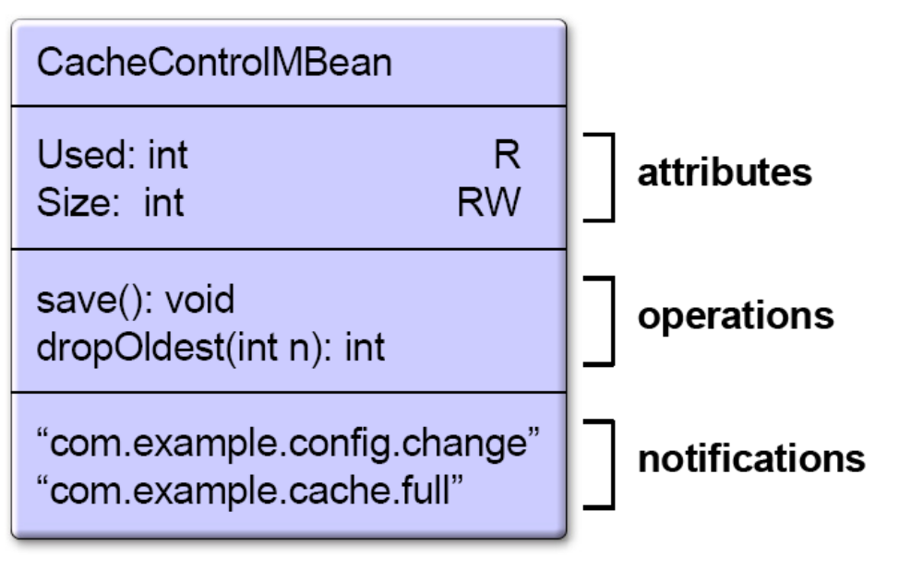
A MBean Example

