Slide 1
Introduction to NoSQL

Slide 2
What is NoSQL?
Class of database management systems (DBMS)
"Not only SQL"
Does not use SQL as querying language
Distributed, fault-tolerant architecture
No fixed schema (formally described structure)
No joins (typical in databases operated with SQL)
Expensive operation for combining records from two or more tables into one set
Joins require strong consistency and fixed schemas
Lack of these makes NoSQL databases more flexible
It's not a replacement for a RDBMS but compliments it

Slide 3
Database Scaling
RDBMS are "scaled up" by adding hardware processing power
NoSQL is "scaled out" by spreading the load
Partitioning (sharding) / replication
 | App
Load balancer
 | App
Load balancer
Users |  | Users |  | Users |  | Users |  | Users |  | Users |  | Users |  | Users
A-K |  | L-O |  | P-S |  | T-Z |  | A-Z |  | A-Z |  | A-Z |  | A-Z

Slide 4
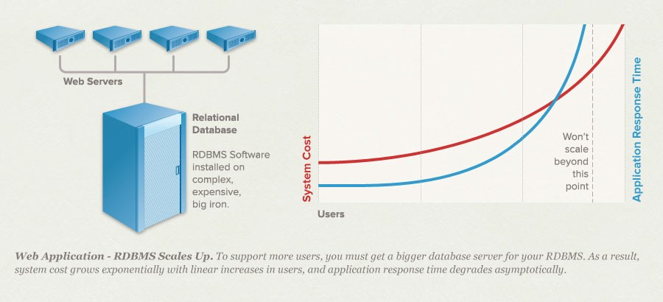
Relational DB Scaling
At certain point relational database won't scale

Slide 5
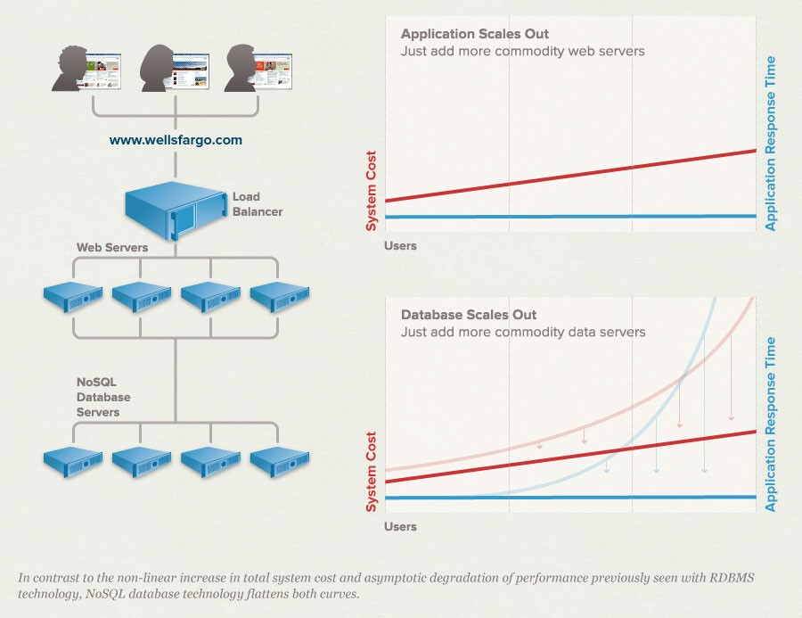
NoSQL DB Scaling
Scaling horizontally is possible with NoSQL
Scaling up / down is easy
Supports rapid production-ready prototyping
Better handling of
traffic spikes

Slide 6










Where NoSQL Is Used?
Google (BigTable, LevelDB)
LinkedIn (Voldemort)
Facebook (Cassandra)
Twitter (Hadoop/Hbase, FlockDB, Cassandra)
Netflix (SimpleDB, Hadoop/HBase, Cassandra)
CERN (CouchDB)

Slide 7
History of NoSQL
MultiValue databases at TRW in 1965.
DBM is released by AT&T in 1979.
Lotus Domino released in 1989.
Carlo Strozzi used the term NoSQL in 1998 to name his lightweight, open-source relational database that did not expose the standard SQL interface.
Graph database Neo4j is started in 2000.
Google BigTable is started in 2004. Paper published in 2006.
CouchDB is started in 2005.
The research paper on Amazon Dynamo is released in 2007.
The document database MongoDB is started in 2007 as a part of a open source cloud computing stack and first standalone release in 2009.
Facebooks open sources the Cassandra project in 2008.
Project Voldemort started in 2008.
The term NoSQL was reintroduced in early 2009.
Some NoSQL conferences
NoSQL Matters, NoSQL Now!, INOSA

Slide 8
CAP Theorem 1/2
It is impossible for a distributed computer system to simultaneously provide all three of the following guarantees:
Consistency (all nodes see the same data at the same time)
Availability (a guarantee that every request receives a response about whether it was successful or failed)
Partition tolerance (the system continues to operate despite arbitrary message loss or failure of part of the system)
A distributed system can satisfy any two of these guarantees
at the same time, but not all three.
Gilbert and Lynch, Brewer's conjecture and the feasibility of consistent, available, partition-tolerant web services, 2002

Slide 9
CAP Theorem 2/2
In other words, CAP can be expressed as "If the network is broken, your database won’t work"
"won't work" = down OR inconsistent
In RDBMS we do not have P (network partitions)
Consistency and Availability are achieved
In NoSQL we want to have P
Need to select either C or A
Drop A -> Accept waiting until data is consistent
Drop C -> Accept getting inconsistent data sometimes

Slide 10
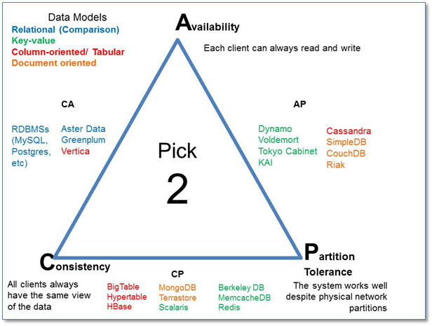
NoSQL Systems and CAP

Slide 11
ACID vs BASE
Scalability and better performance of NoSQL is achieved by sacrificing ACID compatibility.
Atomic, Consistent, Isolated, Durable NoSQL is having BASE compatibility instead.
Basically Available, Soft state, Eventual consistency

Slide 12
ACID -- Requirement for SQL DBs
Atomicity. All of the operations in the transaction will complete, or none will.
Consistency. Transactions never observe or result in inconsistent data.
Isolation. The transaction will behave as if it is the only operation being performed upon the database (i.e. uncommitted transactions are isolated) Durability. Upon completion of the transaction, the
operation will not be reversed (i.e. committed transactions are permanent)

Slide 13
BASE -- Basically Available
Use replication and sharding to reduce the likelihood of data unavailability and use sharding, or partitioning the data among many different storage servers, to make any remaining failures partial.
The result is a system that is always available, even if subsets of the data become unavailable for short periods of time.

Slide 14
BASE and Availability
The availability of BASE is achieved through supporting partial failures without total system failure.
Example. If users are partitioned across five database servers, BASE design encourages crafting operations in such a way that a user database failure impacts only the 20 percent of the users on that particular host.
This leads to higher perceived availability of the system. Even though a single node is failing, the interface is still operational.

Slide 15
BASE -- Eventually Consistent
Although applications must deal with instantaneous consistency, NoSQL systems ensure that at some future point in time the data assumes a consistent state.
In contrast to ACID systems that enforce consistency at transaction commit, NoSQL guarantees consistency only at some undefined future time.
Where ACID is pessimistic and forces consistency at the end of every operation, BASE is optimistic and accepts that the database consistency will be in a state of flux.

Slide 16
BASE and Consistency
As DB nodes are added while scaling up, need for synchronization arises
If absolute consistency is required, nodes need to communicate when read/write operations are performed on a node
Consistency over availability -> bottleneck
As a trade-off, "eventual consistency" is used
Consistency is maintained later
Numerous approaches for keeping up "distributed consistency" are available
Amazon Dynamo - consistent hashing
CouchDB - asynchronous master-master replication
MongoDB - auto-sharding+replication cluster with a master server

Slide 17
BASE -- Soft State
While ACID systems assume that data consistency is a hard requirement, NoSQL systems allow data to be inconsistent and relegate designing around such inconsistencies to application developers.
In other words, soft state indicates that the state of the system may change over time, even without input.
This is because of the eventual consistency model (the acronym is a bit contrived).

Slide 18
Some breeds of NoSQL solutions
Key-Value Stores
Column Family Stores
Document Databases
Graph Databases
In addition: Object and RDF databases as well as Tuple stores

Slide 19
Key-Value Stores
Dynamo, Voldemort, Rhino DHT ...
DeCandia et al. "Dynamo: Amazon’s Highly Available Key-value Store", 2007
Key-Value is based on a hash table where there is a unique key and a pointer to a particular item of data.
Mappings are usually accompanied by cache mechanisms to maximize performance.
API is typically simple -- implementation is often complex.

Slide 20
Column Family Stores
BigTable, Cassandra, HBase, Hadoop ...
Chang et al. "Bigtable: A Distributed Storage System for Structured Data", 2006
Store and process very large amounts of data distributed over many machines.
"Petabytes of data across thousands of servers"
Keys point to multiple columns
jim_87 | Age | Name | Gender | Phone
 | 25 | Jim | M | 123456
jill_90 | Age | Name | Gender | Phone
 | 22 | Jill | F | 654321

Slide 21
Document Databases (Stores)
CouchDB, MongoDB, Lotus Notes, Redis ...
Documents are addressed in the database via a unique key that represents that document.
Semi-structured documents can be XML or JSON formatted, for instance.
In addition to the key, documents can be retrieved with queries.
Redis is sometimes referred to as data structure server since keys can contain strings, hashes, lists, sets and sorted sets.

Slide 22
Graph Databases
Neo4J, FlockDB, GraphBase, InfoGrip, ...
Graph Databases are built with nodes, relationships between nodes (edges) and the properties of nodes.
Nodes represent entities (e.g. "Bob" or "Alice").
Similar in nature to the objects as in object-oriented programming.
Properties are pertinent information related to nodes (e.
g. age: 18).
Edges connect nodes to nodes or nodes to properties.
Represent the relationship between the two.
Scaling graph DBs is problematic
Neo4J: cache sharding, sharding strategy heuristics

Slide 23
Some NoSQL Challenges
Lack of maturity -- numerous solutions still in their beta stages
Lack of commercial support for enterprise users
Lack of support for data analysis
Maintenance efforts and skills are required -- experts are hard to find

Slide 24
Quiz
Q. Select the NoSQL Database
Oracle 12c
Neo4J
Hive
Derby

Slide 25
Quiz
Q. All NoSQL databases are inherently consistent
True
False

Slide 26
Quiz
Q. Which of the following is not a reason NoSQL has become a popular solution for some organizations?
A. Better scalability
B. Improved ability to keep data consistent
C. Faster access to data than relational database management systems (RDBMS)
D. More easily allows for data to be held across multiple servers

Slide 27
Quiz
Q. While NoSQL databases avoid the rigid schemas of relational databases, the types of NoSQL technologies vary and can be separated into the following primary categories:
Document databases, graph databases, key-value databases and wide column stores
CouchDB, MongoDB, Cassandra and HBase
Those that manage data in the cloud and those that don't
Oracle NoSQL database, NoSQL for Windows Azure and IBM DB2

Slide 28
MongoDB

Slide 29
Agenda
What is MongoDB?
Features
Installation
CRUD Commands
Advanced Features

Slide 30
What is MongoDB?

Slide 31
What is MongoDB?
MongoDB is a cross-platform, document oriented database that provides, high performance, high availability, and easy scalability.
It is a powerful, flexible, and scalable general-purpose database.
It combines the ability to scale out with features such as secondary indexes, range queries, sorting, aggregations, and geospatial indexes.

Slide 32
Features
Easy to use
Document Oriented
No fixed schema
No foreign keys
No rows and columns
Easy Scaling
MongoDB was designed to scale out.
It can scale horizontally very easily

Slide 33
Features
Indexing
MongoDB supports generic secondary indexes, allowing a variety of fast queries, and provides unique, compound, geospatial, and full-text indexing capabilities as well.
Aggregation
MongoDB supports an “aggregation pipeline” that allows you to build complex aggregations from simple pieces and allow the database to optimize it.
Special collection types
MongoDB supports time-to-live collections for data that should expire at a certain time, such as sessions. It also supports fixed-size collections, which are useful for holding recent data, such as logs.
File storage
MongoDB supports an easy-to-use protocol for storing large files and file metadata

Slide 34
Features
Incredible performance
MongoDB adds dynamic padding to documents and preallocates data files to trade extra space usage for consistent performance.
It uses as much of RAM as it can as its cache and attempts to automatically choose the correct indexes for queries.
Almost every aspect of MongoDB was designed to maintain high performance.
Although MongoDB is powerful and attempts to keep many features from relational systems, it is not intended to do everything that a relational database does.
Whenever possible, the database server offloads processing and logic to the client side (handled either by the drivers or by a user’s application code).
Maintaining this streamlined design is one of the reasons MongoDB can achieve such high performance.

Slide 35
MongoDB
Getting Started

Slide 36
MongoDB Concepts-Database
Database is a physical container for collections.
Each database gets its own set of files on the file system.
A single MongoDB server typically has multiple databases.

Slide 37
MongoDB Concepts-Collection
Collection is a group of MongoDB documents.
It is the equivalent of an RDBMS table.
A collection exists within a single database.
Collections do not enforce a schema.
Documents within a collection can have different fields.
Typically, all documents in a collection are of similar or related purpose.

Slide 38
MongoDB Concepts-Document
A document is a set of key-value pairs.
Documents have dynamic schema.
Dynamic schema means that documents in the same collection do not need to have the same set of fields or structure, and common fields in a collection's documents may hold different types of data.

Slide 39
A Sample Document
{ _id: ObjectId("5099803df3f4948bd2f98391"),
name: { first: "Alan", last: "Turing" },
birth: new Date('Jun 23, 1912'),
death: new Date('Jun 07, 1954'),
contribs: [ "Turing machine", "Turing test",
"Turingery" ],
views : NumberLong(1250000)
}

Slide 40
Key
Every document has a special key, "_id", that is unique within a collection.
The keys in a document are strings.
Any UTF-8 character is allowed in a key, with a few notable exceptions:
Keys must not contain the character \0 (the null character).
This character is used to signify the end of a key.
The . and $ characters have some special properties and should be used only in certain circumstances
In general, they should be considered reserved, and drivers will complain if they are used inappropriately

Slide 41
RDBMS and MongoDB (rough mapping)
RDBMS | MongoDB
Database | Database
Table | Collection
Tuple/Row | Document
column | Field
Table Join | Embedded Documents
Primary Key | Primary Key (Default key _id provided by mongodb itself)

Slide 42
MongoDB Features

Slide 43
Advantages of MongoDB over RDBMS
Schema less : MongoDB is document database in which one collection holds different different documents. Number of fields, content and size of the document can be differ from one document to another.
Structure of a single object is clear
No complex joins
Deep query-ability. MongoDB supports dynamic queries on documents using a document-based query language that's nearly as powerful as SQL
Tuning
Ease of scale-out: MongoDB is easy to scale
Conversion / mapping of application objects to database objects not needed
Uses internal memory for storing the (windowed) working set, enabling faster access of data

Slide 44
Why should use MongoDB
Document Oriented Storage : Data is stored in the form of JSON style documents
Index on any attribute
Replication & High Availability
Auto-Sharding
Rich Queries
Fast In-Place Updates
Professional Support By MongoDB

Slide 45
Where should use MongoDB?
Big Data
Content Management and Delivery
Mobile and Social Infrastructure
User Data Management
Data Hub

Slide 46
Install MongoDB on CentOS
Download the MongoDB tar ball (32 bit/64bit) for your platform.
https://fastdl.mongodb.org/linux/mongodb-linux-i686-3.0.6.tgz
Untar the above downloaded file in a suitable location
Create a new text file in the bin subfolder named mongodb.config and add just few lines like:
dbpath=/var/lib/mongodb/data
Start MongoDB server as :
<mongodb_home>/bin/mongod –config=<path to config file>
Start the Client as:
<mongodb_home>/bin/mongo

Slide 47
Some general commands
MongoDB Help
db.help()
Get Statistics:
db.stats()

Slide 48
The ‘use’ Command
MongoDB use DATABASE_NAME is used to create database.
The command will create a new database, if it doesn't exist otherwise it will return the existing database.
Sysntax:
use <Database Name>
Example:
use unicorns;

Slide 49
Drop a Database
Command : dropDatabase()
Sysntax: db.dropDatabase()
Example:
use unicorns;
db.dropDatabase();

Slide 50
Create Collection
Command: db.createCollection(name,options)
name – name of the collection
options – a document
Example:
>use unicorns
switched to db unicorns
>db.createCollection("mycollection")
{ "ok" : 1 }
>
Note: you generally need not create a collection. When you
Insert data, the collection gets created automatically

Slide 51
Drop a collecction
Command : db.<collection Name>.drop()
Example:
>use mydb
switched to db mydb
>show collections
unicorns
system.indexes
demo
>db.unicorns.drop()

Slide 52
Data Types
String : This is most commonly used datatype to store the data. String in mongodb must be UTF-8 valid.
Integer : This type is used to store a numerical value. Integer can be 32 bit or 64 bit depending upon your server.
Boolean : This type is used to store a boolean (true/ false) value.
Double : This type is used to store floating point values.
Min/ Max keys : This type is used to compare a value against the lowest and highest BSON elements.
Arrays : This type is used to store arrays or list or multiple values into one key.
Timestamp : ctimestamp. This can be handy for recording when a document has been modified or added.

Slide 53
Data Types
Object : This datatype is used for embedded documents.
Null : This type is used to store a Null value.
Symbol : This datatype is used identically to a string however, it's generally reserved for languages that use a specific symbol type.
Date : This datatype is used to store the current date or time in UNIX time format. You can specify your own date time by creating object of Date and passing day, month, year into it.
Object ID : This datatype is used to store the document’s ID.
Binary data : This datatype is used to store binay data.
Code : This datatype is used to store javascript code into document.
Regular expression : This datatype is used to store regular expression

Slide 54
Insert a document
Command: db.collection.insert(document)
Example:
db.testemp.insert(
{
name:'shantanu',
address:'Hyderabad',
designation:'Trainer',
salary:70000
});

Slide 55
Querying the data from MongoDB
To query data from a collection we use find() method.
db.collection.find() will list all that data available in the collection.
To get formatted data use db.collection.find().pretty()
Example:
db.testemp.find().pretty()

Slide 56
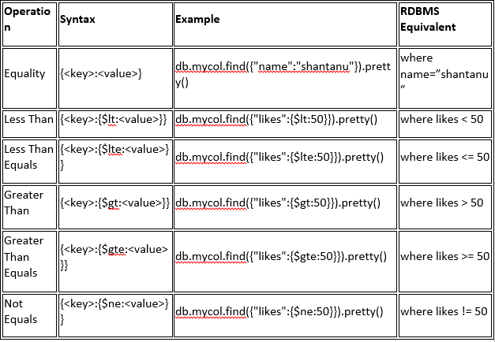
RDBMS Where Clause Equivalents in MongoDB

Slide 57
Logical Operators in MongoDB
AND
>db.mycol.find({key1:value1, key2:value2}).pretty()
OR
>db.mycol.find(
{
$or: [
{key1: value1}, {key2:value2}
]
}
).pretty()

Slide 58
Update data in MongoDB
>db.COLLECTION_NAME.update(SELECTIOIN_CRITERIA, UPDATED_DATA)
> db.testemp.find().pretty();
{
"_id" : ObjectId("5604a0b707926b0876c248d7"),
"name" : "shantanu",
"address" : "Hyderabad",
"designation" : "Trainer",
"salary" : 70000
}
> db.testemp.update({name:'shantanu'},{$set:{salary:90000}})
> db.testemp.find().pretty();
{
"_id" : ObjectId("5604a0b707926b0876c248d7"),
"name" : "shantanu",
"address" : "Hyderabad",
"designation" : "Trainer",
"salary" : 90000
}

Slide 59
Replace document
>db.COLLECTION_NAME.save({_id:ObjectId(),NEW_DATA})

Slide 60
Delete Document
MongoDB's remove() method is used to remove document from the collection. remove() method accepts two parameters. One is deletion criteria and second is justOne flag
deletion criteria : (Optional) deletion criteria according to documents will be removed.
justOne : (Optional) if set to true or 1, then remove only one document.
>db.COLLECTION_NAME.remove(DELLETION_CRITTERIA)
>db.COLLECTION_NAME.remove(DELETION_CRITERIA,1)

Slide 61
Projection
Use the same find method to execute a projection query.
db.coll.find({CONTION},{What do you want}
e.g.
db.coll.find({salary:{$gt:30000}},{name:1,_id:0})
This will list all the emps who has salary >30000 and only name will be listed.

Slide 62
Sorting Records
To sort documents in MongoDB, you need to use sort() method.
sort()method accepts a document containing list of fields along with their sorting order.
To specify sorting order 1 and -1 are used.
1 is used for ascending order while -1 is used for descending order.
Example:
db.users.find({},{"name":1,_id:0}).sort({"name":-1})

Slide 63
Indexing
Indexes support the efficient resolution of queries.
Without indexes, MongoDB must scan every document of a collection to select those documents that match the query statement.
This scan is highly inefficient and require the mongodb to process a large volume of data.
Indexes are special data structures, that store a small portion of the data set in an easy to traverse form.
The index stores the value of a specific field or set of fields, ordered by the value of the field as specified in index.

Slide 64
Indexing
You use ensureIndex() method for Indexing.
Syntax: db.collection.ensureIndex(KEY:1)
Here key is the name of filed on which you want to create index and 1 is for ascending order.
To create index in descending order you need to use -1.

Slide 65
Example
Demo
Insert some data as follows:
> for (i=0; i<1000000; i++) {
... db.users.insert(
... {
... "i" : i,
... "username" : "user"+i,
... "age" : Math.floor(Math.random()*120),
... "created" : new Date()
... }
... );
... }

Slide 66
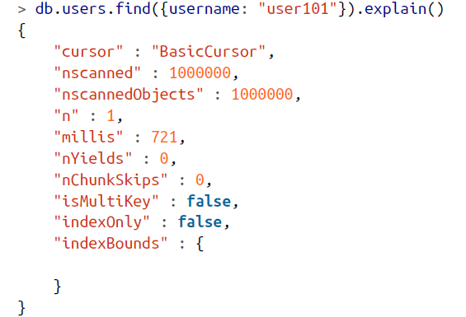
Check the Query Result
Notice the number of scans it performs

Slide 67
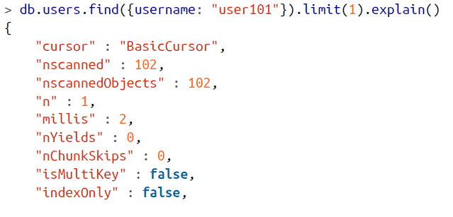
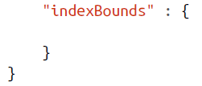
Limit the scan (no Indexing!)
To optimize this query, we could limit it to one result so that MongoDB would stop looking after it found user101

Slide 68
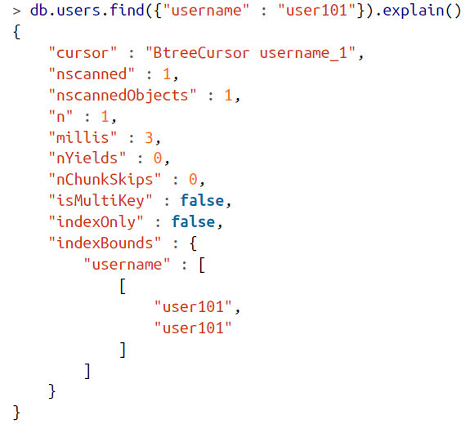
Now Index and Check the efficiency
> db.users.ensureIndex({"username" : 1})

Slide 69
Backup and Restore
Backup : mongodump
Restore: mongorestore

Slide 70
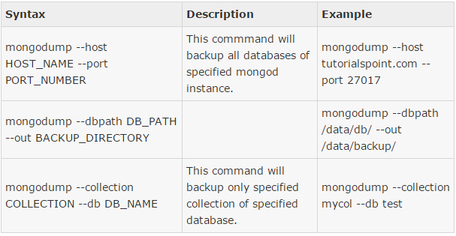
Take a Backup

Slide 71
Restore your Data

Slide 72
Store and Retrieve Large files
MongoDb uses its own GridFS Specification to manage large file.
GridFS is the MongoDB specification for storing and retrieving large files such as images, audio files, video files, etc.
It is kind of a file system to store files but its data is stored within MongoDB collections.
GridFS has the capability to store files even greater than its document size limit of 16MB.

Slide 73
How does MongoDB use GridFS
GridFS divides a file into chunks and stores each chunk of data in a separate document, each of maximum size 255k.
GridFS by default uses two collections fs.files and fs.chunks to store the file's metadata and the chunks.
Each chunk is identified by its unique _id ObjectId field. The fs.files severs as a parent document.
The files_id field in the fs.chunks document links the chunk to its parent.

Slide 74
Command Syntax
You use mongofiles tool to store and retrieve large files.
To Put :
mongofiles –d <database name> put <file path>
To get:
mongofiles –d <database name> get <file store loc>

Slide 75
Adding a file
mongofiles -d emdb put lecture11.pdf
The command stores a .pdf file into ‘emdb’ database.
To query the data from mongo client use:
>use emdb
>db.fs.files.find()

Slide 76
Get the file
mongofiles -d emdb get lecture11.pdf

Slide 77
MongoDB
Replication

Slide 78
Motivation
Running a standalone MongoDB Server in production is very dangerous.
The Server may fail/crash making it Unavailable
If there are problems with the hardware, you may have to move your data to another machine.
In the worst case, disk or network issues could leave you with corrupt or inaccessible data.

Slide 79

What is Replication?
Replication is a way of keeping identical copies of your data on multiple servers and is recommended for all production deployments.
Replication keeps your application running and your data safe, even if something happens to one or more of your servers.
Data
Data
Data

Slide 80
What is Replication?
Replication is the process of synchronizing data across multiple servers.
Replication provides redundancy and increases data availability with multiple copies of data on different database servers, replication protects a database from the loss of a single server.
Replication also allows you to recover from hardware failure and service interruptions.
With additional copies of the data, you can dedicate one to disaster recovery, reporting, or backup

Slide 81
Why Replication?
To keep your data safe
High (24*7) availability of data
Disaster Recovery
No downtime for maintenance (like backups, index rebuilds, compaction)
Read scaling (extra copies to read from)
Replica set is transparent to the application

Slide 82
Replica set features
A cluster of N nodes
Anyone node can be primary
All write operations goes to primary
Automatic failover
Automatic Recovery
Consensus election of primary

Slide 83
How replication works in MongoDB
MongoDB achieves replication by the use of replica set.
A replica set is a group of mongod instances that host the same data set.
In a replica one node is primary node that receives all write operations.
All other instances, secondaries, apply operations from the primary so that they have the same data set.
Replica set can have only one primary node.

Slide 84
How replication works in MongoDB
Replica set is a group of two or more nodes (generally minimum 3 nodes are required).
In a replica set one node is primary node and remaining nodes are secondary.
All data replicates from primary to secondary node.
At the time of automatic failover or maintenance, election establishes for primary and a new primary node is elected.
After the recovery of failed node, it again join the replica set and works as a secondary node

Slide 85
How replication works in MongoDB
A replica set can have only one primary capable of confirming writes with w: majority write concern; although in some circumstances, another mongod instance may transiently believe itself to also be primary.
The primary accepts all write operations from clients and records all changes to its data sets in its operations log, i.e. oplog.

Slide 86
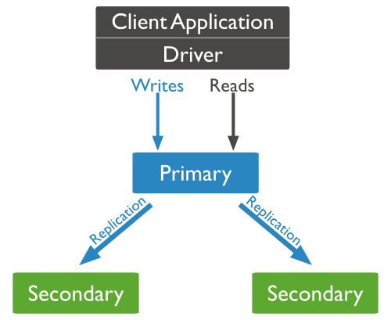
How replication works in MongoDB

Slide 87
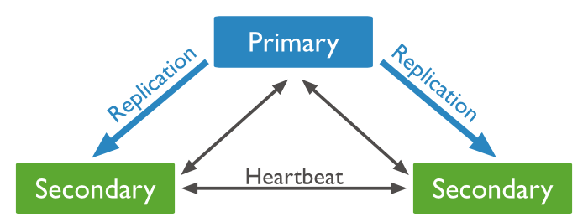
How replication works in MongoDB
The secondaries replicate the primary’s oplog and apply the operations to their data sets such that the secondaries’ data sets reflect the primary’s data set.
If the primary is unavailable, an eligible secondary will hold an election to elect itself the new primary.

Slide 88
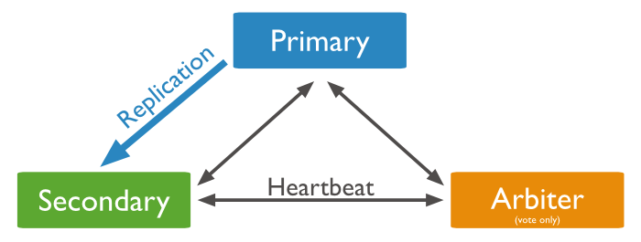
Arbiter in a Replication
An arbiter is an extra instance of mongod.
Arbiters do not maintain a data set.
Maintain a quorum in a replica set by responding to heartbeat and election requests by other replica set members.
Arbiters do not require dedicated hardware.
An arbiter will always be an arbiter whereas a primary may step down and become a secondary and asecondary may become the primary during an election.

Slide 89
Asynchronous Replication
Secondaries apply operations from the primary asynchronously.
By applying operations after the primary, sets can continue to function despite the failure of one or more members.

Slide 90
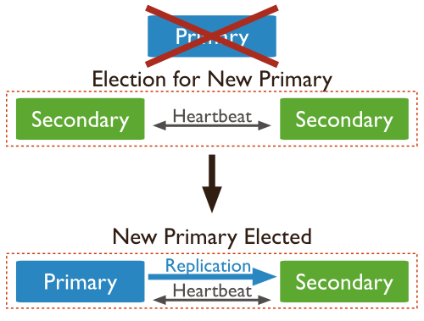
Automatic Failover
When a primary does not communicate with the other members of the set for more than 10 seconds, an eligible secondary will hold an election to elect itself the new primary.
The first secondary to hold an election and receive a majority of the members’ votes becomes primary.

Slide 91
Set up Replication (Quick start)
Assumption
This quick-start method stores data in /data/db, so make sure that directory exists and is writable by your user before running this code.
Step 1: set up mongo shell without mongod
$ mongo –nodb
Step2: Create a replica set by running the following command:
> replicaSet = new ReplSetTest({"nodes" : 3})

Slide 92
Set up Replication (Quick start)
Step3:
> // starts three mongod processes
> replicaSet.startSet()
>
> // configures replication
> replicaSet.initiate()
You should now have three mongod processes running locally on ports 31000, 31001, and 31002.
They will all be dumping their logs into the current shell, which is very noisy,
so put this shell aside and open up a new one.

Slide 93
Set up Replication (Quick start)
Step 4:In the second shell, connect to the mongod running on port 31000:
> conn1 = new Mongo("localhost:31000")
connection to localhost:31000
testReplSet:PRIMARY>
testReplSet:PRIMARY> primaryDB = conn1.getDB("test")
test

Slide 94
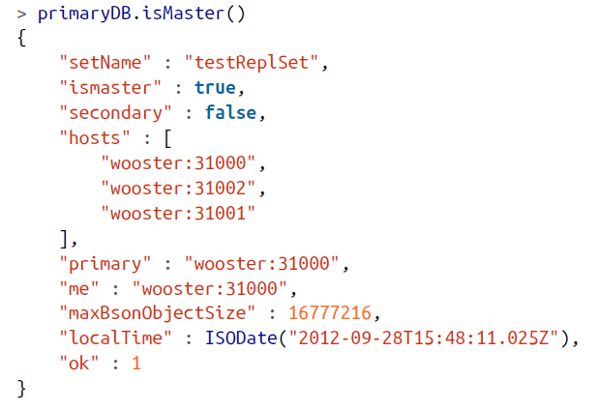
Set up Replication (Quick start)
Use your connection to the primary to run the isMaster command.
This will show you the status of the set
"testReplSet" is
an identifier for this set; testReplSet is the default name ReplSetTest uses.

Slide 95
Testing the Replica Set
First, insert 1,000 documents:
> for (i=0; i<1000; i++) { primaryDB.coll.insert({count: i}) }
>
> // make sure the docs are there
> primaryDB.coll.count()
1000

Slide 96
Testing the Replica Set
Now check one of the secondaries and verify that they have a copy of all of these documents.
Connect to either of the secondaries:
> conn2 = new Mongo("localhost:31001")
connection to localhost:31001
> secondaryDB = conn2.getDB("test")
test

Slide 97

Testing the Replica Set
Secondaries may fall behind the primary (or lag) and not have the most current writes, so secondaries will refuse read requests by default to prevent applications from accidentally reading stale data.
Thus, if you attempt to query a secondary, you’ll get an error that it’s not primary:
This is to protect your application from accidentally connecting to a secondary and reading stale data. To allow queries on the secondary, we set an “I’m okay with reading from secondaries” flag, like so:
> conn2.setSlaveOk()

Slide 98
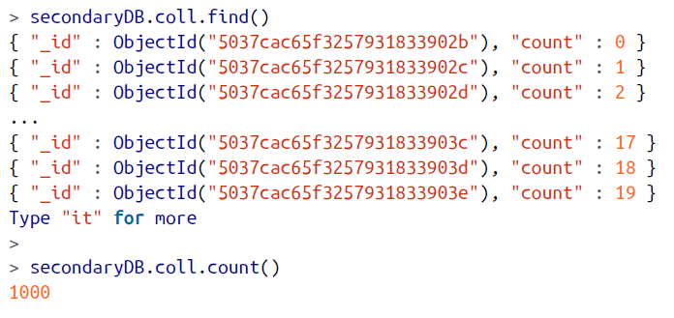
Testing the Replica Set
After you set conn2.setSlaveOk() read data from the server and verify:

Slide 99
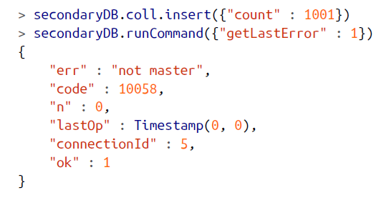
Testing the Replica Set
Now, try to write to a secondary:
the secondary does not accept the write. The secondary will only perform writes that it gets through replication, not from clients.

Slide 100
Now Test Automatic Failover!!
If the primary goes down, one of the secondaries will automatically be elected primary.
To try this out, stop the primary:
> primaryDB.adminCommand({"shutdown" : 1})
Run isMaster on the secondary to see who has become the new primary:
> secondaryDB.isMaster()

Slide 101
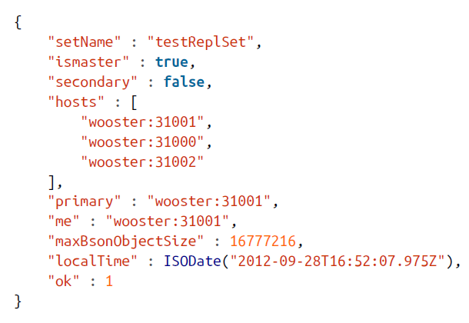
Now Test Automatic Failover!!
The output should be like:
The Elected New Primary

Slide 102
MongoDB
Sharding

Slide 104
Sharding
Sharding refers to the process of splitting data up across machines.
Partitioning is also sometimes used to describe this concept.
It is a cluster of database servers.
Each server holds a fraction of data.
In Sharding, it becomes possible to store more data and handle more load without requiring larger or more powerful machines, just a larger quantity of less-powerful machines

Slide 105
Sharding in MongoDB
MongoDB supports autosharding, which tries to both abstract the architecture away from the application and simplify the administration of such a system.
MongoDB allows your application to ignore the fact that it isn’t talking to a standalone MongoDB server, to some extent.
On the operations side, MongoDB automates balancing data across shards and makes it easier to add and remove capacity.
Sharding is the most difficult and complex way of configuring MongoDB, both from a development and operational point of view.

Slide 106
Components of a Cluster
MongoDB’s sharding allows you to create a cluster of many machines (shards) and break up your collection across them, putting a subset of data on each shard.
This allows your application to grow beyond the resource limits of a standalone server or replica set.

Slide 107
Components of a Cluster
mongos process
It is a routing process in front of the shards.
It keeps a “table of contents” that tells it which shard contains which data.
Applications can connect to this router and issue requests normally.
The router, knowing what data is on which shard, is able to forward the requests to the appropriate shard(s).
If there are responses to the request, the router collects them, merges them, and sends them back to the application.
As far as the application knows, it’s connected to a standalone mongod,

Slide 108
Components of a Cluster
Config Servers
Config servers are the brains of your cluster.
They hold all of the metadata about which servers hold what data.
They must be set up first and the data they hold is extremely important: make sure that they are running with journaling enabled and that their data is stored on non-ephemeral drives.
Each config server should be on a separate physical machine, preferable geographically distributed.
The config servers must be started before any of the mongos processes, as mongos pulls its configuration from them.

Slide 109
Shard Servers
These are the normal mongod instances which holds data.
They are generally from a replica set.

Slide 110
A Sharded cluster

Slide 111
Sharded Data
Sharding

Slide 112
Data on Shards (physical machines)

Slide 113
Set up your cluster
Demo

Slide 114
MongoDB
Security

Slide 115
Role-Based Access Control
MongoDB employs Role-Based Access Control (RBAC) to govern access to a MongoDB system.
A user is granted one or more roles that determine the user’s access to database resources and operations.
Outside of role assignments, the user has no access to the system.

Slide 116
Enable Access Control
MongoDB does not enable access control by default.
You can enable authorization using the --auth or the security.authorization setting.
Enabling internal authentication also enables client authorization.
Once access control is enabled, users must authenticate themselves.

Slide 117
Roles
A role grants privileges to perform the specified actions on resource.
Each privilege is either specified explicitly in the role or inherited from another role or both.

Slide 118
Privileges
A privilege consists of a specified resource and the actions permitted on the resource.
A resource is either a database, collection, set of collections, or the cluster. If the resource is the cluster, the affiliated actions affect the state of the system rather than a specific database or collection. For information on the resource documents, see Resource Document.
An action specifies the operation allowed on the resource.

Slide 119
Inherited Privileges
A role can include one or more existing roles in its definition, in which case the role inherits all the privileges of the included roles.
A role can inherit privileges from other roles in its database. A role created on the admin database can inherit privileges from roles in any database.
You can view the privileges for a role by issuing the rolesInfo command with the showPrivileges and showBuiltinRoles fields both set to true.

Slide 120
Users and Roles
You can assign roles to users during the user creation. You can also update existing users to grant or revoke roles.
A user assigned a role receives all the privileges of that role.
A user can have multiple roles. By assigning to the user roles in various databases, a user created in one database can have permissions to act on other databases.

Slide 121
Database User Roles
Role | Task
read | Provides the ability to read data on all non-system collections and on the following system collections: system.indexes, system.js, and system.namespacescollections.
readWrite | Provides all the privileges of the read role and the ability to modify data on all non-system collections and the system.js collection.

Slide 122
Database Administration Roles
Role | Task
dbAdmin | Provides the ability to perform administrative tasks such as schema-related tasks, indexing, gathering statistics. This role does not grant privileges for user and role management.
dbOwner | Provides the ability to perform any administrative action on the database. This role combines the privileges granted by the readWrite, dbAdmin and userAdminroles.
userAdmin | Provides the ability to create and modify roles and users on the current database. Since the userAdmin role allows users to grant any privilege to any user, including themselves, the role also indirectly provides superuser access to either the database or, if scoped to the admin database, the cluster.

Slide 123
Cluster Administration Roles
Role | Task
clusterAdmin | Provides the greatest cluster-management access. This role combines the privileges granted by the clusterManager, clusterMonitor, and hostManager roles. Additionally, the role provides the dropDatabase action.
clusterManager | Provides management and monitoring actions on the cluster. A user with this role can access the config and local databases, which are used in sharding and replication, respectively.
clusterMonitor | Provides read-only access to monitoring tools, such as the MongoDB Cloud Manager and Ops Manager monitoring agent.
hostManager | Provides the ability to monitor and manage servers.

Slide 124
Backup and Restoration Roles
Role | Task
backup | Provides privileges needed to back up data except for the system.profilecollection. This role provides sufficient privileges to use the MongoDB Cloud Manager backup agent, Ops Manager backup agent, or to use mongodump.
restore | Provides privileges needed to restore data with mongorestore without the --oplogReplay option.

Slide 125
All-Database Roles
Role | Task
readAnyDatabase | Provides the same read-only permissions as read, except it applies to all databases in the cluster. The role also provides the listDatabases action on the cluster as a whole.
readWriteAnyDatabase | Provides the same read and write permissions as readWrite, except it applies to alldatabases in the cluster. The role also provides the listDatabases action on the cluster as a whole.
userAdminAnyDatabase | Provides the same access to user administration operations as userAdmin, except it applies to all databases in the cluster. Since the userAdminAnyDatabase role allows users to grant any privilege to any user, including themselves, the role also indirectly provides superuser access.

Slide 126
All-Database Roles
Role | Task
dbAdminAnyDatabase | Provides the same access to database administration operations as dbAdmin, except it applies to all databases in the cluster. The role also provides thelistDatabases action on the cluster as a whole.

Slide 127
Superuser Roles
Role | Task
root | Provides access to the operations and all the resources of thereadWriteAnyDatabase, dbAdminAnyDatabase, userAdminAnyDatabaseand clusterAdmin roles combined.

Slide 128
Internal Role
Role | Task
__system | Provides privileges to take any action against any object in the database. Do not assign this role to user objects representing applications or human administrators, other than in exceptional circumstances.

Slide 129
Shutdown the Replica Set
To shutdown the set, run:
> replicaSet.stopSet()
Congratulations! You just set up, used, and tore down replication.

Slide 130
MongoDB
Set up Replica in Production

Slide 131
Please follow the document

