Slide 1
Understanding and Analyzing
Java Performance
Notes:
Points to emphasize:
- tutorial is mainly for understanding the elements of Java that are different and important from the performance point of view
- should help analyze Java programs better for performance e.g. estimating capacity and and scalability bottlenecks.

Slide 2
Background
Notes:
Java History
Main plusses of Java
Is performance a problem?

Slide 3
Java : A Brief History
Appeared in 1993
Initially developed for
  Networked, handheld devices
Coincided with emergence of WWW
  Target market shifted to Internet
First showcased in the form of applets
Notes:
Ask these points as questions to the audience :
- When did Java first appear ?
- What was the original intent of the Java technology?
- How did it come to be part of the Internet/WWW ?
- Which of the following were the first instances of Java technology?
Servlet, applet, JSP.

Slide 4
…Java- A Brief History
Server-side Java applets or Servlets introduced as demand increased for dynamic page generation
Java Beans - for reusable software components
Java Server Pages - for decoupling dynamic data from HTML presentation
“Java 2” - Java 1.3
  HotSpot Compiler, enhancements
Notes:
Java technologies : Ask questions :
Are you familiar with Java jargon?
Can you name Java technologies?

Slide 5
Java - Features
Platform - independence
Security
Robustness
Network mobility
Multi-threaded
Built - in memory management
Rich API for Internet and Web Programming
Notes:
Ask audience for features of Java
Ask somebody to get up and write them on the board

Slide 6
Why Java ?
Faster, less troublesome development
Easy porting to multiple platforms
Easier software distribution
Security features
Rich APIs (Internet, Web,…)
API = Application Programmer’s Interface

Slide 7
Where’s the catch ?
Performance !
Generally true : rich programming features come at the cost of performance. Solutions:
  Do not use rich environments
  Understand the environment and do “enlightened” development
×
√
Notes:
Ask audience: What are the disadvantages ?

Slide 8
Other Disadvantages
Buggy Virtual Machines
“Write once - Debug Everywhere”
Platform Independence “independence” from useful OS features
Bottom Line: Java has become extremely popular, equally among new programmers as well as seasoned C++ gurus.

Slide 9
Motivation

Slide 10
Is Java “slow”?
Simple Example: Java vs. C++
  Java with “Just-in-time” compilation and without
class Salutation {
private static final String hello = "Hello, world!";
private static final String greeting = "Greetings, planet!";
private static final String salutation = "Salutations, orb!";
private static int choice;
public static void main(String[] args) {
int i;
for (i = 0; i <= 10000; i ++) {
choice = (int) (Math.random() * 2.99);
String s = hello;
if (choice == 1) {
s = greeting;
}
else if (choice == 2) {
s = salutation;
}
System.out.println(s);
}
}
}
#include<stdio.h>
#include<iostream.h>
#include<stdlib.h>
#include<string.h>
void main () {
char* hello = "Hello World!";
char* greeting = "Greetings, Planet!";
char* salutation = "Salutation, Orb!";
char* s;
int choice;
int i;
for (i =0; i <= 10000; i ++) {
choice = ((int) rand()) % 3;
s = hello;
if (choice == 1) {
s = greeting;
}
else if (choice == 2) {
s = salutation;
}
cout << s << endl;
}
}
Java
C++

Slide 11
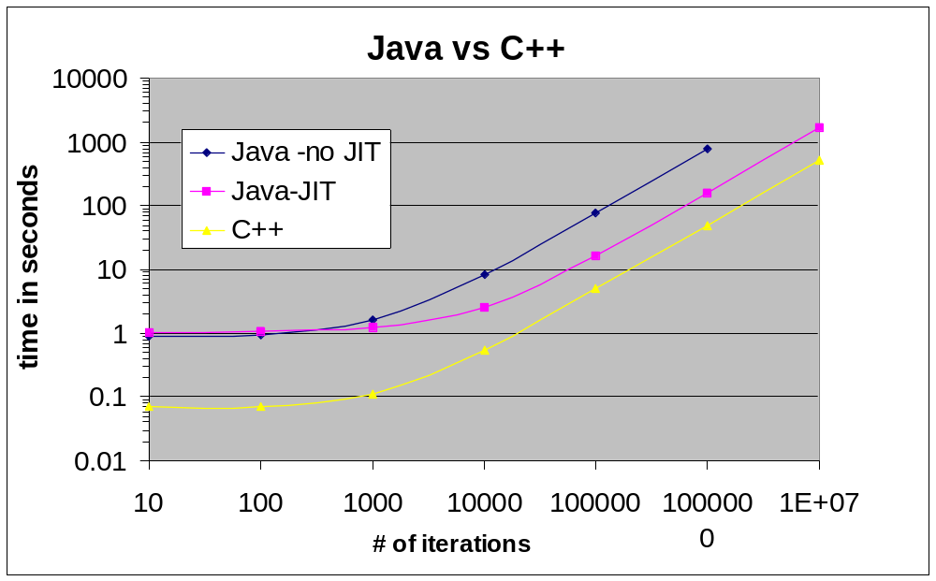
Java vs C++
Simple Example

Slide 12
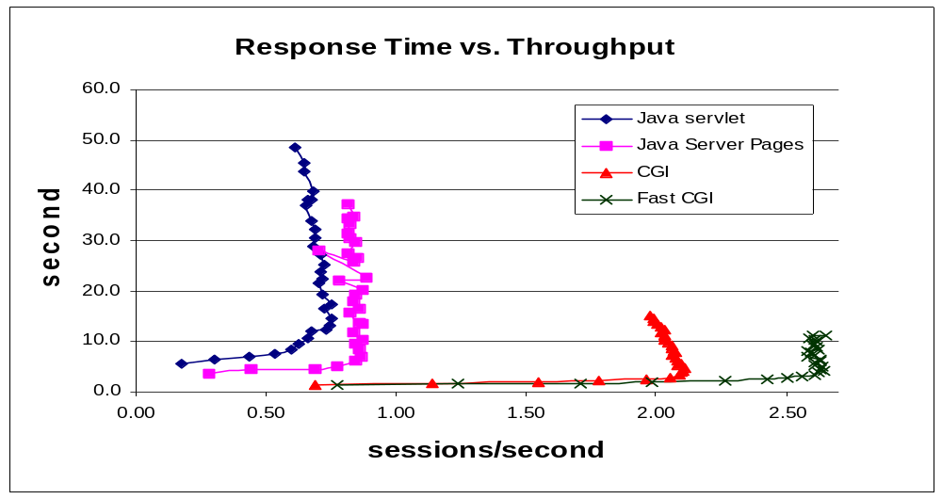
Is Java Slow ?
Realistic Example : A messaging application implemented in Java (servlets and JSP) and C++ (CGI and FastCGI) [5]

Slide 13
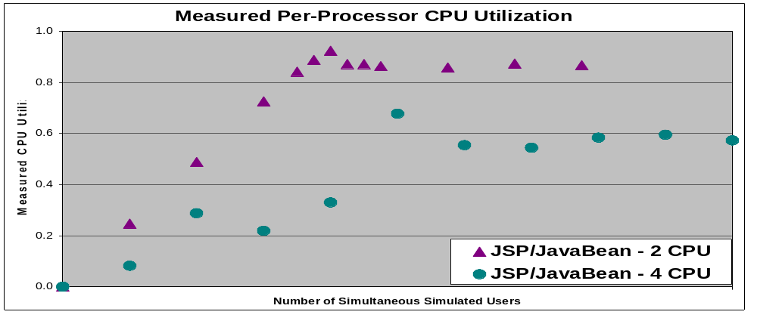
Does Java have scalability problems?
Figure from “Implications of Servlet/Javabean technology on Web server scaling”: Cura, Ehrlich, Gotberg, Reeser
Bottleneck prevents use of multiple CPUs efficiently
Thorough analysis pointed to inherent Java bottleneck

Slide 14
Java scalability
Some history of poor scalability: e.g. Java 1.1.7
  Article in JavaWorld, August 2000 - “Java Threads may not use all your CPUs”, P. Killelea.
    Two programs:one in C, that does an empty loop, same in Java.
    Run the program as multiple processes on 12-CPU machine scalabilityof C++ process
    Run the Java program as multiple threads

Slide 15
Java Scalability
The C program:
main() {
unsigned long i
for (i = 0; i < 1000000000; i ++);
}
Perl Wrapper creates multiple processes
The Java program:
class Loop implements Runnable {
public static void main (String[] args) {
for (int t = 0; t < Integer.parseInt(args[0]); t++)
new Thread(new Loop()).start();
}
public void run() {
for (int i = 0; i < 1000000000; i ++);
}

Slide 16
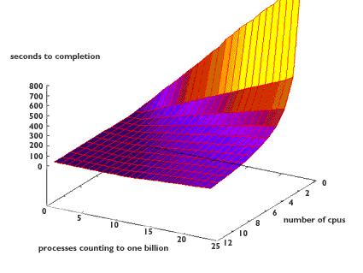
CPU Scalability -
C processes
Figure 3 from article by P.Killelea, JavaWorld,
August 2000.

Slide 17
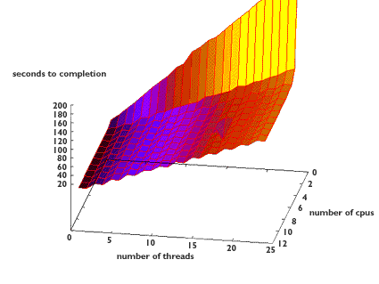
CPU scalability-
Java Threads
Figure 5 from article by P.Killelea, JavaWorld,
August 2000.

Slide 18
Initial Conclusion
Java has performance problems
  Root cause often hard to understand
But Java has immense technical and business advantages
  Use of Java for server programs will continue increasing
Developers and analysts need to educate themselves on Java architecture and performance

Slide 19
Tutorial Goal
Basic understanding of how Java works
Identify elements of Java architecture that impact performanc
Intro to issues in performance analysis of Java programs
Guidelines to improving Java performance (references, papers, etc)

Slide 20
Java Architecture

Slide 21
How Java Works
1. Write code in Java : foo1.java, foo2.java
2. Compile:
  javac foo1.java foo2.java
  (javac is the Java compiler)
  generates bytecodes in a class file:
    foo1.class, foo2.class
3. Run:
  java foo1.class
  (“java” is the JVM: Java virtual machine)
Note: No linked executable
Each application runs inside its own JVM

Slide 22
Java Platform Components
Programming Language
Class file format
API
JVM
JVM+API = platform for which Java programs are compiled

Slide 23
Programming Language
Object Oriented
Robustly checked (type checking, array bounds, memory references…)
No explicit memory management functions (no free(), destroy())
Syntactically like C++
Has a rich class library - vectors, hastables, Internet, Web, …
Naturally multithreaded

Slide 24
Java Class File
Binary file format of Java programs
Completely describes a Java class
Contains bytecodes - the “machine language” for a Java virtual machine
Designed to be compact
  minimizes network transfer time
Dynamically Linked
  can start a Java program without having all classes - good for applets

Slide 25
The Java Virtual Machine
Application’s
class files
Java API
class files
Class
loader
bytecodes
Execution
Engine
native method invocations
Host Operating System
*Figure 1-4, from Venners[1]

Slide 26
JVM (Java Virtual Machine)
JVM Class loader loads classes from the program and the Java API
Bytecodes are executed in the execution engine
Interpreted or
just-in-time complied : method compiled to native instructions when first compiled, then cached

Slide 27
The Java API
Set of runtime libraries that provide a standard way to access system resources on a host machine
JVM+Java API are required components of the Java Platform
The combination of loaded class files from a program, the Java API and any DLLs constitutes a full program executed by the JVM

Slide 28
Java Under the Hood

Slide 29
Java VM architecture
class files
Class
loader
method
area
heap
Java
stacks
pc
registers
native
method
stacks
native method
interface
native method
libraries
Execution
Engine
Figure 5-1, from Venners[1]

Slide 30
JVM: Run-Time Data Areas
Shared:
Method Area
Heap Area
class
data
object
object
class
data
object
object
class
data
class
data
Figure 5-2, from Venners[1]
class
data
object
object
object
Exclusive for each thread:
Java stacks
thread1
thread2
thread3
Native method
stack
pc registers
stack
stack
stack
thread3
thread1
stack
thread2
thread3
Figure 5-3, from Venners[1]

Slide 31
Method Area:
Class loader loads class information in this area
All threads share the same method area - must be thread-safe
  If one thread is loading a class, the other must wait
Method area could be allocated on the heap also
Can be garbage collected
  Collect unreferenced classes
Type information:name, superclass name,field info, method info, method bytecodes, a reference to class “Class”,...
Method Area
class
data
class
data
class
data
class
data
class
data

Slide 32
The Heap
Heap Area
Area where memory is allocated for objects created during run-time
Each object has instance data, and pointer to class data in the method area
Not shared between two applications (each runs inside its own JVM)
object
object
object
object
object
object
object
Shared between multiple threads of the same application
  Access to heap must be thread-safe
  Access to objects must be thread-safe
Is managed by JVM using automatic garbage collection (GC)
  Memory from unreferenced objects is reclaimed
May have an associated handle pool that points to the actual objects
  Object reference: Pointer into handle pool
  When objects are moved during GC - update only the handle pool

Slide 33
Stacks, PCs
thread1
thread2
Java stacks
thread3
thread3
pc registers
stack
stack
stack
Native method
stack
thread1
stack
thread2
thread3
Each thread has separate stack -
  no danger of access by another thread
Method calls generate stack frames - containing parameters, local variables etc
  may also be allocated on the heap

Slide 34
Lifetime of a class
Verifies semantics of class files, symbolic references, etc
Load
Link
Verify
Memory allocation, default initial values
Reads, parses binary data
Creates an object of type “Class” on the heap
Prepare
Resolve
Initialize
Replace symbolic references with direct ones
Actual initial value

Slide 35
Class Instantiation
Object Creation
Explicit
Implicit
new
String objects for cmd-line args
newInstance()
Class object on loading
clone()
String constants
getObject() (deserialization)
String concatenation
Initialize
Use in
program
Allocate
Memory
on heap

Slide 36
Discarding objects
Unrefenced
object
(optionally)
Run
finalize()
Reclaimed
during
garbage
collection
Discarding classes
Unreachable
class
Reclaimed
during
garbage
collection

Slide 37
Garbage Collection
JVM recycles memory used by objects that are no longer referenced
GC needs to
  Determine which objects can be freed, free them
  Take care of heap fragmentation
Various algorithms for GC, JVM specification doesn’t force any one.

Slide 38
Garbage Collection Algorithms
Tracing Collectors:
  Trace from roots (e.g. local variables, operands) down the reference graph. Collect unreachable objects
Counting Collectors:
  Maintain reference count for objects.
  Collect when count goes down to zero.
    Cannot detect circular references

Slide 39
Garbage Collection -Heap Compaction
Compacting Collectors:
  Slide live objects over to occupy free space
Copying Collectors
free
free
free
unused
unused
unused
free
free
unused
unused
unused
unused
Figure 9-1- from Venners[1]

Slide 40
Garbage Collection -Compaction
Generational Collectors: Two observations:
  1. Most objects are short-lived
  2. Some objects have long lives
  Group objects by age or “generations”
  GC younger generation more frequently
  Surviving objects move up generations

Slide 41
Synchronization
Java has a multi-threaded architecture
  Easy to write code that will not work well with multiple threads
Use synchronization constructs for
  Mutual Exclusion: For coherent use of shared data
    Synchronized statements
    Synchronized methods
  Co-operation
    Working together towards a common goal
    wait and notify commands

Slide 42
…Synchronization
Implemented by acquiring locks on objects
  Synch statements - lock any object
  class someClass {
  int someVar;
  synchronized(anObject) {
  someVar++;}
  }
  }
  Synch methods - lock the object on which the method was called
  class someClass {
  int someVar;
  synchronized void incr {
  someVar++;
  }
  }

Slide 43
Exceptions
Error handling mechanism
  programmer can “throw” exception
  Exception object is created with string comment and stack trace
Involves object creation, initialization

Slide 44
Security
Security achieved by:
  Strict rules about class loading (will prevent loading malicious classes)
  verification of class files
  run-time checking by JVM
  Security manager and the Java API (manages access to resources outside the JVM)

Slide 45
Performance Impact of Java Architecture

Slide 46
Why is Java slow ?
“Obvious” contributors :
  Bytecode Interpretation (if not jit-ed)
    Server-side applications may spend only 10-20 % of time executing Jit-ed code (IBM Systems Journal Paper[3].)
  If jit-ed, compilation cost (one-time), footprint cost
    OS memory management overhead (paging, scanning etc)

Slide 47
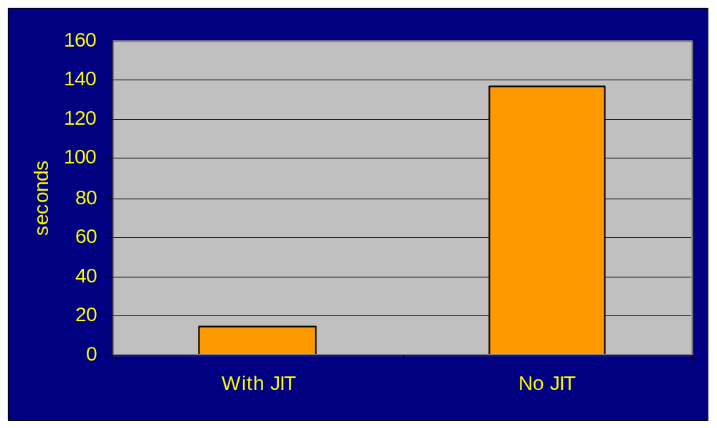
Example
M/M/1 Queue Simulation: Factor of 10 difference in execution time

Slide 48
More Basic Features Impacting Performance
Dynamic Linking
Checking of array bounds on each access
Checking for null references
Primitive types are the same- not adjusted to the most efficient type for each platform
….

Slide 49
Why is Java slow? - Major contributors
Non-obvious, but deeply impacting performance:
  Object creation
  Garbage collection
  Synchronization
  API classes too general
    General-purpose design always implies performance penalty
    Improper use of Classes and APIs

Slide 50
Performance Impact of Object Creation
Can
be
expensive!
Object Creation involves:
Allocating memory
  including for superclasses
Initializing instance variables to Java defaults
Calling Constructors
  including superclass constructors
Initializing instance variables as programmed

Slide 51
Performance Impact of Object Creation
Example 1: Code piece A is 95 % faster than Code piece B
Example 2: Code piece A is 60 % faster than Code piece B
B :
ucA = a.toUpperCase();
ucB = b.toUpperCase();
boolean bool = ucA.equals(ucB);
A :
boolean bool = a.equalsIgnoreCase(b);
A :
Vector v = new Vector();
for (i=0; i<n; i++)
{ v.clear(); v.addElement… }
B:
for (i=0; i<n; i++)
{Vector v = new Vector(); v.addElement..}

Slide 52
Object Creation
Two Overheads:
Creating the object in the heap (previous slide)
Since the heap is shared by all threads -
  overhead due to contention for the heap

Slide 53
Object Creation… Scalability
Concurrency efficiency of object creation across threads
  Program that creates 500,000 objects, on 6-cpu machine
public void run () {
int i;
myObj obj;
Thread ct = Thread.currentThread();
String thrName = ct.getName()+ ":";
obj = new myObj();
for (i = 0; i < mt; i++) {
if (c == 1) obj = new myObj();
}
}

Slide 54
Object Creation… Scalability
Time program with varying number of threads- but total # of objects created is always 500,000.
# threads
execution time
“ideal” time
1
2
3
4
5
6
15 s
10 s
8.5 s
7.6 s
8.5 s
8.3 s
15 s
7.5 s
5 s
3.75 s
3 s
2.5 s
>

Slide 55
Scalability :
Sanity check
Concurrency efficiency of cpu-bound program
for (i = 0; i < mt; i++) {
for (j = 0; j< 100; j++)
f = (i)/ (j+1);
}
  Timings with varying # of threads (# of loop iterations is constant)
# threads
execution time
“ideal” time
1
2
3
4
5
6
18.9 s
9.9 s
6.9 s
5.6 s
4.6 s
4.1 s
18.9 s
9.4 s
6.3 s
4.7 s
3.8 s
3.1 s
≈

Slide 56
Object Creation
Observations
  Has a basic overhead
  Programs doing lot of object creation (explicit/implicit) will have unexpected scalability problems
  Each created object adds to garbage collection overhead
    must be traversed
    must be collected, when unreferenced.
    Having many short-lived objects can be a performance bottleneck

Slide 57
Performance Impact of Garbage Collection
Garbage collection adds a run-time overhead
  In older JVMs GC could stop all processing
    GC could result in user perceivable delays
    Delays could be 5-10 seconds for large heaps (100-500 MB)[3]

Slide 58
Performance Impact of Garbage Collection
Newer JDKs have improved algorithms
  Sun JDK 1.3 has
    Generational garbage collection
    Train algorithm for the old generation sub-heap
  Overhead is now smaller
    e.g. Queue simulation example : 53 ms out of 13 s running time. Heap size b/w 160KB and 2MB
  Is larger if heap is large

Slide 59
Performance Impact of Garbage Collection
Garbage collection can be timed (java -verbosegc)
Test GC in a program in which number of objects, and heap size keep increasing
class create implements Runnable {
static int m, c, mt;
public void run () {
int i;
myObj obj[]= new myObj[1000000];
Thread ct = Thread.currentThread();
String thrName = ct.getName()+ ":";
long st = System.currentTimeMillis();
for (i = 0; i < mt; i++) {
if (c == 1) obj[i] = new myObj();
//System.out.println(thrName+obj);
}
long diff = System.currentTimeMillis() -st;
System.out.println("Time: "+ diff);
}

Slide 60
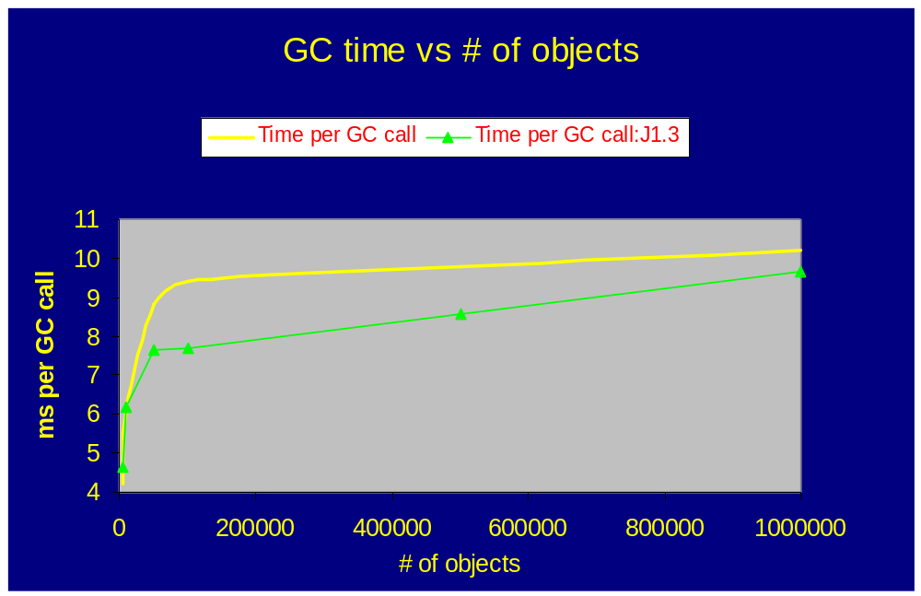
Performance Impact of Garbage Collection

Slide 61
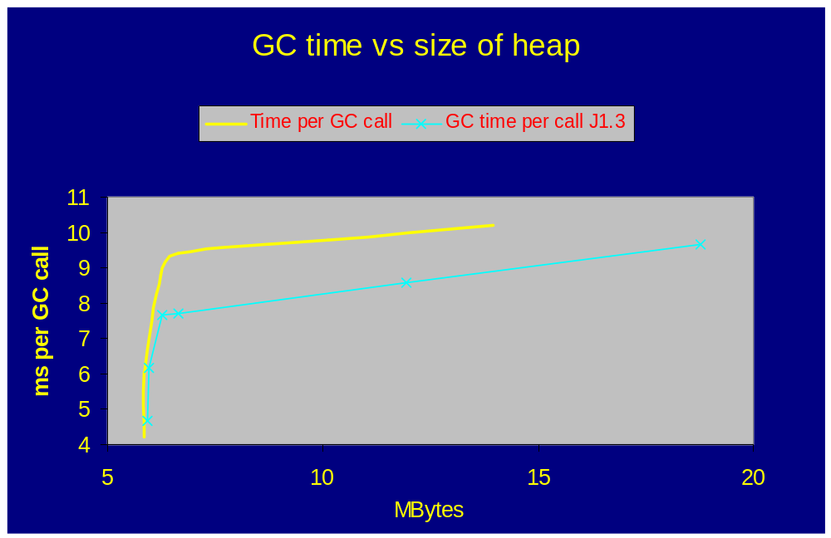
Performance Impact of Garbage Collection

Slide 62
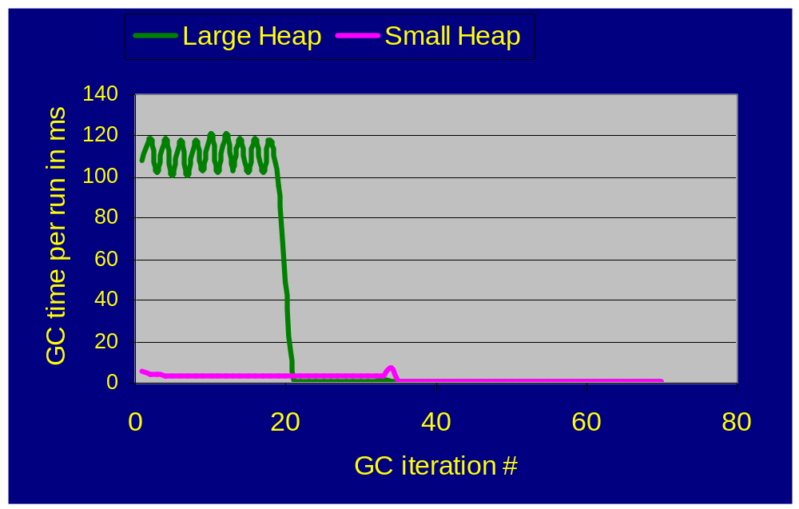
Performance Impact of Garbage Collection
Test queue simulation program, after allocating a large array of objects in the beginning, and then running the simulation as usual.
Looks like GC learns about the long-lived object and does not include that in later GC?

Slide 63
Performance Impact of Synchronization
“Obvious” :
  In a multithreaded application, synchronized pieces will be the bottlenecks (Java-independent issue)
Non-obvious (Java-isms ):
  Big synchronization overhead
  Java API classes may have synchronized methods - a big overhead in cases where synchronization is not necessary (access only by one thread)
  Implicitly shared objects internal to the JVM - e.g. heap. Access will be synchronized

Slide 64
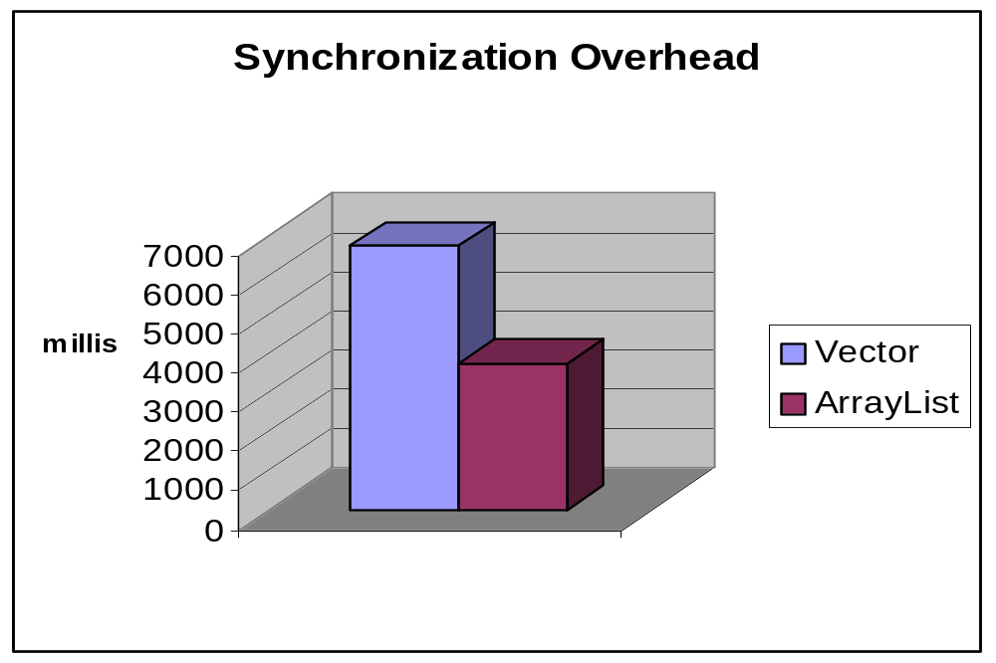
Performance Impact of Synchronization
Example: Vector vs ArrayList (example creates vector/array list, adds elements, then accesses them)
Vector is a
synchronized
class
From Bulka[2]

Slide 65
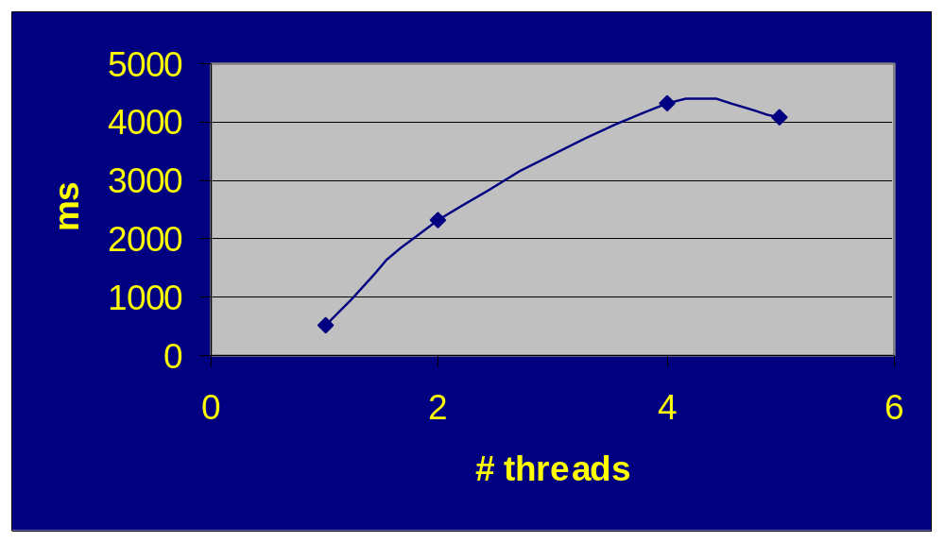
Performance Impact of Synchronization
Contention for synchronized code:
Example Bulka[2]: increase a counter using synchronized method. Use increasing # of threads to do the same amount of total work. Results from 6-cpu machine.

Slide 66
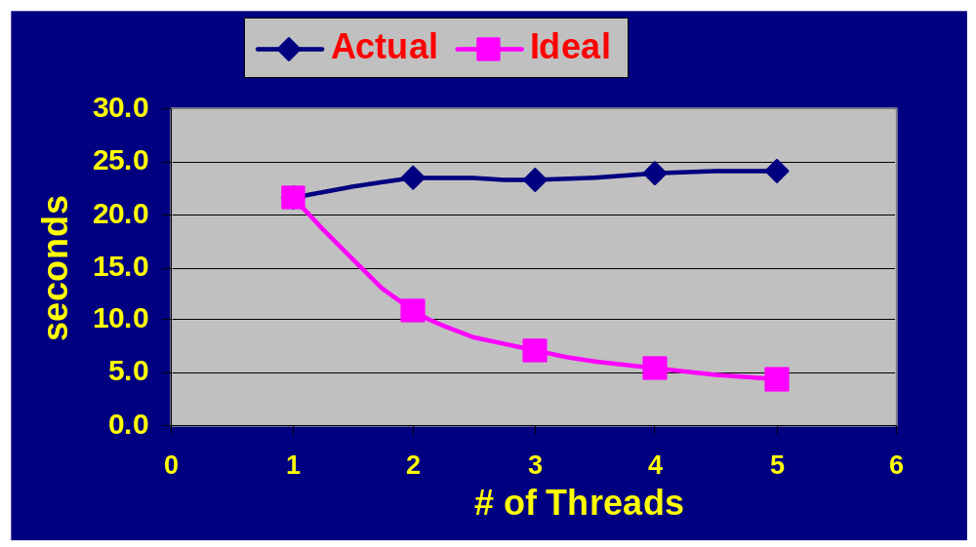
Performance Impact of Synchronization
Implicitly synchronized code:
Object creation example, with printing inside the loop (System.out. Println - not an explicitly synchronized function in Java. Access possibly serialized by OS)

Slide 67
Performance Impact of Synchronization
class WorkerThread extends Thread {
private int iter;
private int tid;
private static double num;
public WorkerThread (int iterationCount, int id) {
this.iter = iterationCount;
this.tid = id;
}
public void run() {
for (int i = 0; i < iter; i++) {
num += Math.random();
}
}
}
Example: Multiple threads increment a shared variable by calling Math.random()
Run this program with increasing number of threads, keeping the total number of iterations the same - on 6-CPU machine

Slide 68
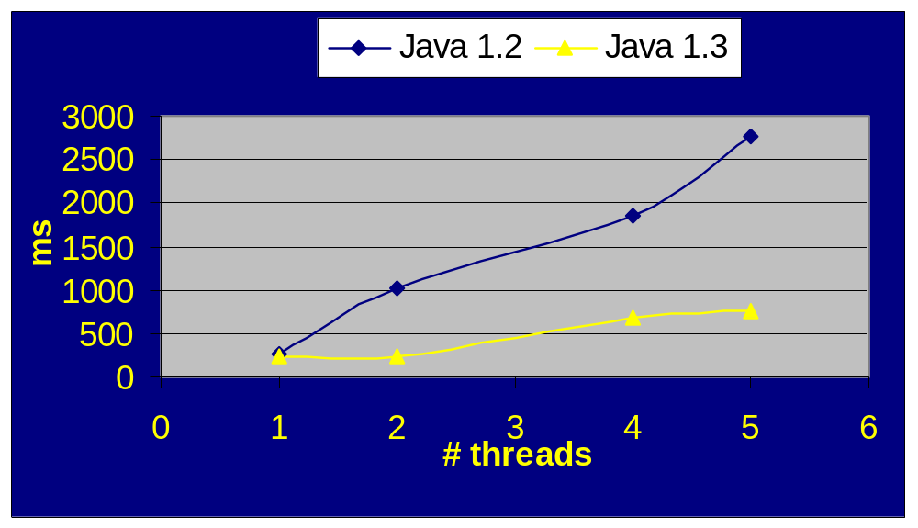
Performance Impact of Synchronization
Example of multiple threads calling Math.random() - a synchronized method

Slide 69
Performance Impact of Synchronization
Object creation can be viewed as a special case of access to synchronized data structures and methods
We saw similar effects there

Slide 70
General-Purpose API classes
Generally true: When a class/API provides maximum flexibility and features, there will be an associated performance cost. Examples:
  Vector Class
    Some applications may need their own efficient vector implementation
  Date
    Using native Date functions thru JNI might prove better performing

Slide 71
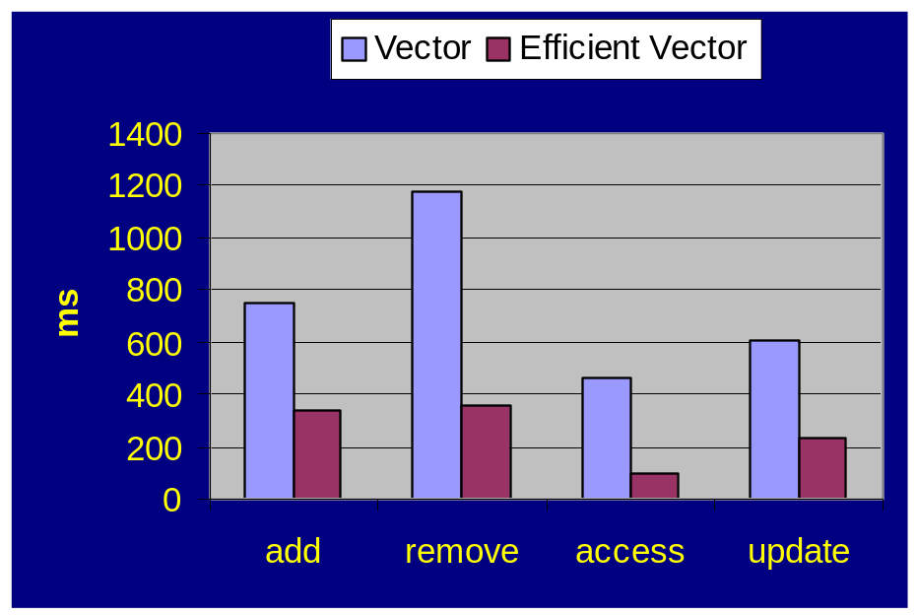
General-Purpose API classes
Example 1: Vector class provides basic access/update functions, growing capacity if needed, range checking, synchronization, iterator
Example from Bulka[2]:
Speed up due to a “light” implementation of Vector class, offering few features.

Slide 72
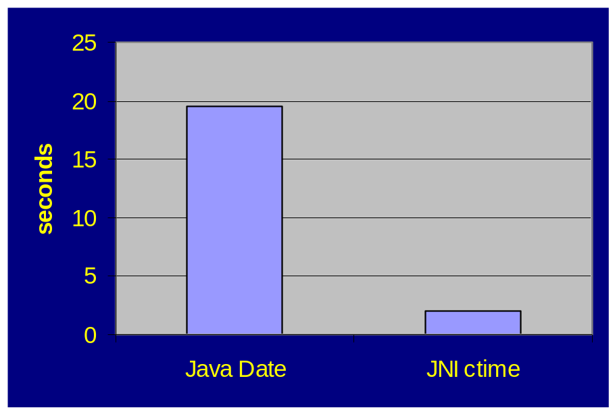
Performance Impact of “Heavy” API classes
Date is a computationally expensive class
Example from Bulka[2]:
Speed up due to a use of native call instead of the Java Date class

Slide 73
Java Memory Issues
Contributors to memory usage in Java:
  Objects
  Classes
    Bytecode
    JIT compiled code
    Constant pool entries
    Data structures representing methods and fields
  Threads
  Native data structures
    e.g. OS-specific structures
Too much memory usage will result in OS virtual memory overheads - and possible slow down in garbage collection

Slide 74
Java Memory Issues
No method for calculating object size
  Methods returning total memory and free memory of heap
  Object size can be estimated indirectly using garbage collection, and heap memory methods
Class loading can be tracked with java -verbose: lists all the classes being loaded

Slide 75
Key Recommendations
Limit object creation (various techniques…)
Do not use synchronized API classes if not needed
Rewrite “heavy” API classes, if light ones are needed
Apply various optimizations (books, papers).

Slide 76
Performance/Capacity Analysis of Java Applications

Slide 77




Two kinds of Java apps
Internet
Server Side Java Applications (servlets, JSP,…)
Applets

Slide 78
Applet performance Issues
Internet
Download time
  downloads can be sped up using jar files instead of individual class files
Dynamically linked classes that are downloaded when needed (will affect user response time on first use)
Needs to be fast (usually used as a GUI)
Usually no thread contention issues

Slide 79
Capacity Analysis for Server Applications
Typical industry problem:
  Given a Java server application, size the server center to support volume of N requests per second.
  Available data: measurement data from load testing at smaller volume and on systems smaller than “production” systems.

Slide 80
Issues in Java App capacity analysis
Bottleneck capacity may not be that of a hardware resource
Bottleneck may be
  a piece of synchronized code
  object creation, if a large number of objects are being created.
  garbage collection, if large number of short-lived objects.
  I/O (poorly coded)

Slide 81
Issues in Java App capacity analysis
Possibly no capacity increase with additional processors (threads)
  CPU may not be the bottleneck
Speed up due to more memory
  Configure larger heap size
Speed up with more servers
CPU time per transaction may increase going from small to large number of users

Slide 82
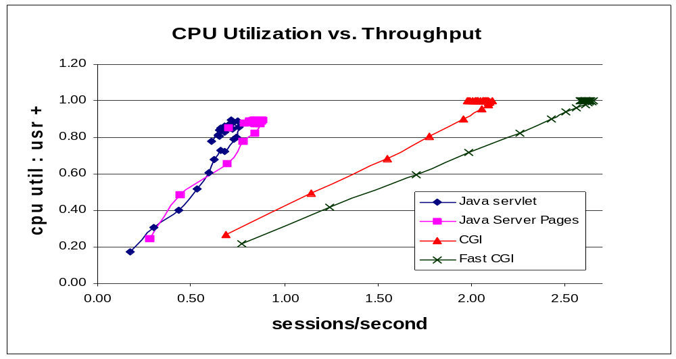
Messaging Example
From Hansen, Mainkar, Reeser, 2001 [6]

Slide 83
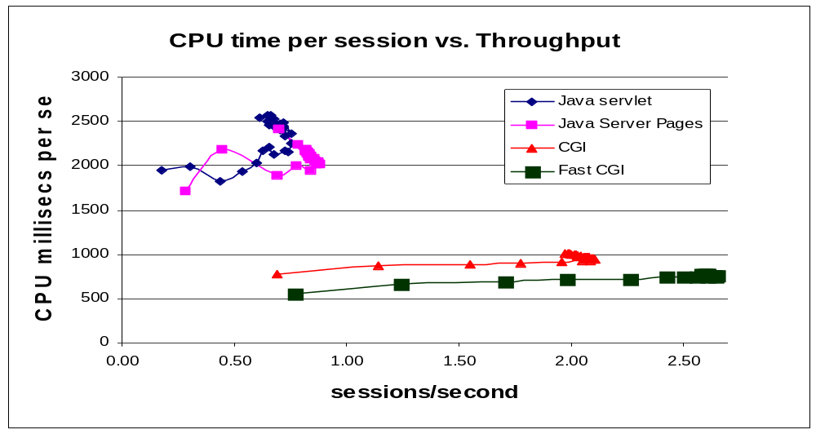
Messaging Example
From Hansen, Mainkar, Reeser, 2001 [6]

Slide 84
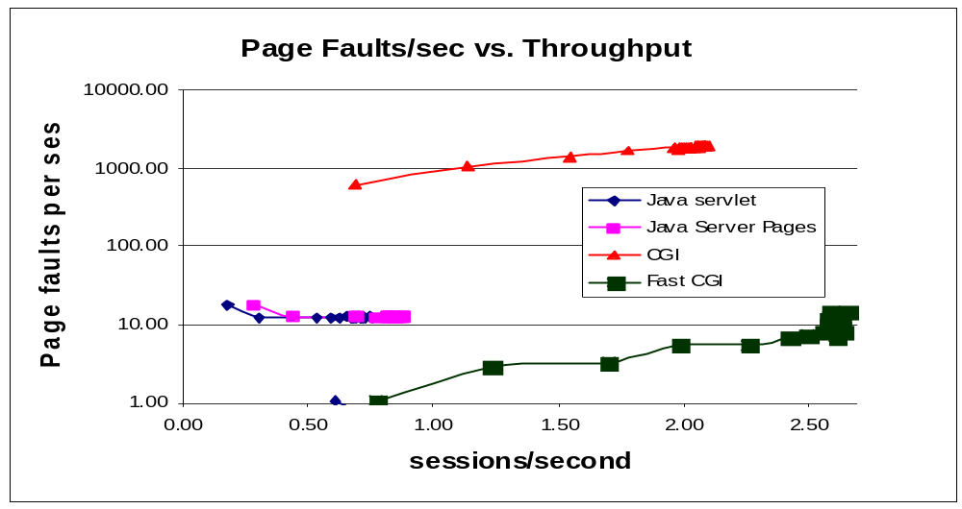
Messaging Example
From Hansen, Mainkar, Reeser, 2001 [6]

Slide 85
Delay Analysis
Apart from hardware resources, Java’s software resources should also be analyzed as queues -
  should take into account synchronized portion of code, and contention for it in a delay model.
Should take into account garbage collection - service time in queues may be load-dependent

Slide 86
Previous Work
Reeser[5] modelled a Java application with software “code lock” as a separate queue
  “Abstract” bottleneck, - paper does not say which particular Java resource was the bottleneck
  Model fits well

Slide 87
Reeser model example
Front-End Sub-System
SW Bottleneck
(Code Lock)
Back-End Sub-System
4
CPUs
1 server
Infinite
server
FIGURE 6: QUEUEING MODEL
Figure 6 from “Using Stress Test Results to Drive Performance Modeling: A Case Study in “Gray-Box” Vendor Analysis”, ITC-16, Brazil, 2001.

Slide 88
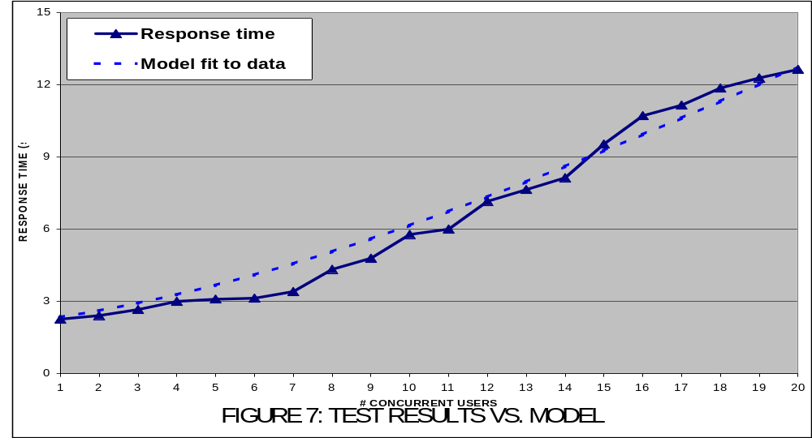
Reeser model example
Figure 7 from “Using Stress Test Results to Drive Performance Modeling: A Case Study in “Gray-Box” Vendor Analysis”, ITC-16, Brazil, 2001.

Slide 89
Profiling Tools
Java VM comes with a profiler
  Can report times spent in method calls, heap data etc.
  Hard to read and understand
Commercial Profilers
  Jprobe, OptimizeIt
Useful to developers to really tune their code
Useful to analysts for understanding GC time and other bottlenecks

Slide 90
Future Directions
Better models and techniques to analyze and predict capacity and performance of Java applications

Slide 91
References
1. B. Venners. Inside the Java 2 Virtual Machine. 2nd Ed. McGraw Hill, 1999.
2. D. Bulka. Java Performance and Scalability, Vol. 1. Addison-Wesley, 2000.
3. IBM Systems Journal Vol. 39, No.1, 2000. Special Issue on Java Performance.
4. J. Shirazi. Java Performance Tuning. O’Reilly, 2000.
5. P. Reeser, “Using Stress-Test Results to Drive Performance Modeling: A Case-Study in Vendor Gray-Box Modeling”.
6. T. Hansen,V.Mainkar,P.Reeser, “Performance Comparison of Dynamic Web Platforms”, SPECTS 2001.

