Slide 1
Spring Framework
A Comprehensive Guide to Spring Framework
Architecture, Features, and Dependency Injection

Slide 2
Introduction to Spring Framework

Slide 3
Spring Framework
Why Use Spring?
Simplifies Java application development.
Provides dependency injection for loose coupling.
Supports aspect-oriented programming (AOP).
Offers a rich set of APIs for different functionalities:
Spring MVC (Web applications)
Spring Data (Database access)
Spring Security (Authentication & Authorization)
Spring Batch (Batch Processing)
Spring Cloud (Microservices)
Integrates well with other frameworks like Hibernate, JPA, and JMS

Slide 4
Spring Framework Architecture

Slide 5
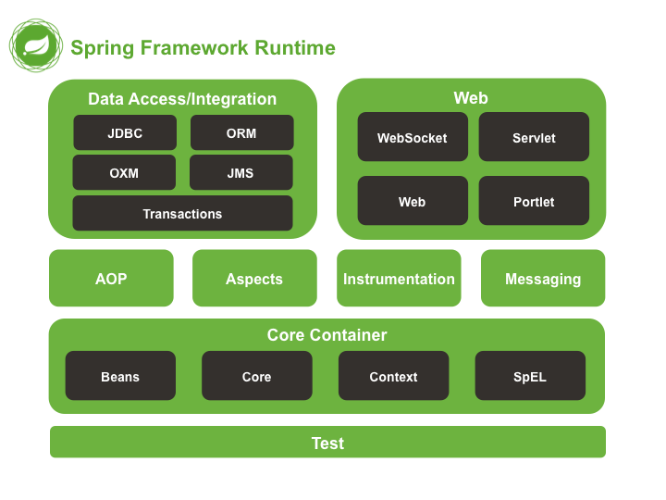
Overview of Spring Architecture
Core Container
Beans, Core, Context, Expression Language
Data Access/Integration
JDBC, ORM, JMS, Transactions
Web Module
Spring MVC, WebSocket, WebFlux
AOP (Aspect-Oriented Programming)
AspectJ, Spring AOP
Instrumentation & Messaging
Integration with RabbitMQ, Kafka, etc.
Test Module
Unit Testing, Spring TestContext

Slide 6
Overview of Spring Architecture

Slide 7
Spring Framework Features
Lightweight
Uses POJOs, minimal overhead.
Dependency Injection (DI)
Reduces dependencies, increases modularity.
Aspect-Oriented Programming (AOP)
Allows separation of cross-cutting concerns.
Spring MVC
A framework for web applications.

Slide 8
Spring Framework Features
Spring Boot
Simplifies Spring application development.
Provides Autoconfiguration and Opinionated Support
Spring Security
Manages authentication and authorization.
Spring Data
Provides easy integration with databases.
Spring Cloud
Supports microservices development.
Reactive Programming Support
WebFlux for non-blocking applications.

Slide 9
Advantages of Spring Framework
Loose Coupling
Uses DI to reduce dependencies.
Modular Architecture
Allows using only needed modules.
Integration Support
Works well with Hibernate, JPA, Kafka, etc.
Enterprise-Ready
Used in large-scale applications.
Declarative Transactions
Simplifies transaction management.
Testability
Built-in testing support with JUnit & Mockito.
Scalability
Suitable for microservices and enterprise applications
Declarativ Security
Simple security configuration and Setup

Slide 10
Disadvantages of Spring Framework
Complex Configuration
XML-based configurations can be difficult (Spring Boot simplifies this).
Learning Curve
Large ecosystem, requires time to master.
Performance Overhead
Uses proxies, which can add slight overhead.
Verbosity
Some features require additional boilerplate code.

Slide 11
Spring Dependency Injection

Slide 12
Dependency Injection
Definition:
A design pattern used in Spring to achieve loose coupling by injecting dependencies from external sources instead of creating them inside classes.
Why use DI?
Improves testability.
Reduces code complexity.
Enhances maintainability.

Slide 13
Dependency Injection Types in Spring
Constructor Injection
Setter Injection
Field Injection (Not recommended)

Slide 14
Constructor Injection
// Dependency Class
@Component
class EmailService {
public void sendEmail(String message) {
System.out.println("Email sent: " + message);
}
}
// Dependent Class
@Component
class UserService {
private final EmailService emailService;
// Constructor Injection
@Autowired
public UserService(EmailService emailService) {
this.emailService = emailService;
}
public void notifyUser() {
emailService.sendEmail("Welcome to Dependency Injection!");
}
}

Slide 15
Setter Injection
// Dependency Class
@Component
class EmailService {
public void sendEmail(String message) {
System.out.println("Email sent: " + message);
}
}
// Dependent Class
@Component
class UserService {
private final EmailService emailService;
// Setter Injection
@Autowired
public SetEmailService(EmailService emailService) {
this.emailService = emailService;
}
public void notifyUser() {
emailService.sendEmail("Welcome to Dependency Injection!");
}
}

Slide 16
Field Injection (Not Recommended)
// Dependency Class
@Component
class EmailService {
public void sendEmail(String message) {
System.out.println("Email sent: " + message);
}
}
// Dependent Class
@Component
class UserService {
@Autowired
private final EmailService emailService;
public void notifyUser() {
emailService.sendEmail("Welcome to Dependency Injection!");
}
}

Slide 17
Beans and IOC

Slide 18
Beans
In Spring, those objects that form the backbone of your application and that are managed by the Spring IoC container are referred to as beans.
A bean is simply an object that is instantiated, assembled and otherwise managed by a Spring IoC container
there is nothing special about a bean (it is in all other respects one of probably many objects in your application).
These beans, and the dependencies between them, are reflected in the configuration metadata used by a container

Slide 19
The IoC container
The org.springframework.beans and org.springframework.context packages provide the basis for the Spring Framework's IoC container.
The BeanFactory interface provides an advanced configuration mechanism capable of managing objects of any nature.
The ApplicationContext interface builds on top of the BeanFactory (it is a sub-interface) and adds other functionality such as
easier integration with Spring's AOP features
message resource handling (for use in internationalization),
event propagation, and application-layer specific contexts such as the WebApplicationContext for use in web applications.

Slide 20
The container
The org.springframework.beans.factory.BeanFactory is the actual representation of the Spring IoC container that is responsible for containing and otherwise managing the aforementioned beans.
The BeanFactory interface is the central IoC container interface in Spring.
Its responsibilities include instantiating or sourcing application objects, configuring such objects, and assembling the dependencies between these objects.

Slide 21
Important Application Contexts
ClassPathXmlApplicationContext
Loads configuration .xml from classpath to creat the ApplicationContext
WebApplicationContext
Creats an ApplicationContext for Web Application
FileSystemApplicationContext
Loads Configuration from FileSystem (e.g. file PATH) to creat the ApplicationContext
AnnotationConfigApplicationContext
Loads Configuration from annotated java class to creat the ApplicationContext

Slide 22
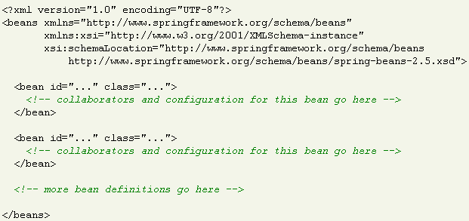
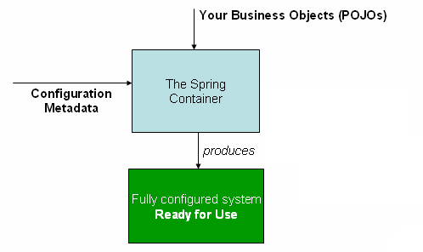
Configuration metadata
The Spring IoC container consumes some form of configuration metadata
This configuration metadata is nothing more than how you inform the Spring container as to how to “instantiate, configure, and assemble [the objects in your application]”. This configuration metadata is typically supplied in a simple and intuitive XML format or Java Based Configuration.

Slide 23
Instantiating a container
Instantiating a Spring IoC container is straightforward.
ApplicationContext ctx=
new ClassPathXMLApplicationCOntext("context.xml");

Slide 24
How Dependency Injectcion Works

Slide 25
ApplicationContext
configuration
@Component
class EmailService {
}
emailService
Dpenedency injection
@Component
class UserService {
private final EmailService emailService;
// Constructor Injection
@Autowired
public UserService(EmailService emailService) {
this.emailService = emailService;
}
}
userService
ApplicationConext ctx=………..;
UserService userService=ctx.getBean(“userService”)
Spring DI Container/IOC

Slide 26
Bean Scopes
Sigleton(Default)
A single instance of the bean is created and shared across the entire Spring container.
@Component
@Scope("singleton") // Default scope
public class MyBean { }
2. Prototype
A new instance of the bean is created every time it is requested.
@Component
@Scope("prototype")
public class MyBean { }

Slide 27
Bean Scopes
3. Request (Web Context Only)
A new bean instance is created for each HTTP request.
@Component
@Scope("request")
public class MyRequestScopedBean { }
4. Session (Web Context Only)
A new bean instance is created for each HTTP session.
@Component
@Scope("session")
public class MySessionScopedBean { }

Slide 28
Bean Scopes
5. Application (Web Context Only)
A single bean instance is shared across the entire web application context.
@Component
@Scope("application")
public class MyApplicationScopedBean { }
6. WebSocket (Web Context Only)
A single bean instance is created per WebSocket session.
@Component
@Scope(“websocket")
public class MyWebsocketScopedBean { }

Slide 29
Bean Autowiring Types
Autowire byType
Uses @autowired
Autowire byName
Uses @Autowired + @Qualifier
Autowire By Constructor
Uses either ByType or ByName and Constructor

Slide 30
Autowiring by Type (Uses @Autowired)
Spring injects a dependency based on the type of the property.
@Component
public class MyService {
@Autowired
private MyRepository myRepository;
}

Slide 31
Autowiring by Name (@Autowired + @Qualifier)
If multiple beans of the same type exist, we can specify which one to inject using @Qualifier.
@Component("myCustomRepo")
public class MyRepository { }
@Component
public class MyService {
@Autowired
@Qualifier("myCustomRepo")
private MyRepository myRepository;
}

Slide 32
Autowiring by Constructor
Uses @Autowired on Constructor
If multiple beans of the same type exist, we can specify which one to inject using @Qualifier.
@Component
public class MyService {
private final MyRepository myRepository;
@Autowired
public MyService(MyRepository myRepository) {
this.myRepository = myRepository;
}
}

Slide 33
Spring Framework Annotations
Limited to Spring Core Configuration

Slide 34
Annotations To Define a Bean
Type Level Annotations (Used before Class definition)
@Component
@Service
@Repository
@Controller
@Configuration
Method Level Annotations (used before method)
@Bean

Slide 35
Examples (Type level)
@Repository
public class JdbcDaoImpl{
}
@Service
public class EmpService{
}
@Component
public class PrintAspect{
}
@Controller
public class LoginController{
}

Slide 36
Examples (method level)
@Configuration
public class JdbcConfig {
@Bean
public DriverManagerDataSource dataSource() {
//your code goes here
return ds;
}

Slide 37
How Dependency is Injected
Use @Autowired at the injection point to inject Dependency
@Autowired can be used at following levels
Type
Field
Method

Slide 38
Example @Autowired
@Service
public class HrService {
@Autowired
private EmpDao dao;
public String registerEmp(int id, String name, String city, double salary) {
String resp=dao.save(new Emp(id, name, city, salary));
return resp;
}
}

Slide 39
Loading Annotated Beans
Every Spring Application has at least one Configuration class
annotated with @Configuration
Spring Framework uses @ComponentScan to locate annotated beans in the project
You are generally advised to keep the main configuration class in the base package.

Slide 40
An Example
@Configuration
@ComponentScan(basePackages="com.demo.spring")
public class AppConfig {
@Bean
public EmpDaoJPAImpl jpaBean() {
return new EmpDaoJPAImpl();
}
}
ApplicationContext ctx
=new AnnotationConfigApplicationContext(AppConfig.class);
The Spring Container will be created from the AppConfig Class
and spring will scan all the sub packages of “com.demo.spring” including
the base package

Slide 41
Demo
We will See some Demonstration on Spring Annotations

