Slide 1
Spring Framework - Security
Spring Security FRAMEWORK
Spring Security 4.0

Slide 2
Application security
Security is arguably one of the most critical architectural components of any application written in the 21st century

Slide 3
What is Spring Security
a powerful and highly customizable authentication
and access-control framework
build on top of Spring Framework
de-facto standard for securing Spring-based
applications

Slide 4
Fundamentals (1)
principal
user that performs the action
authentication
confirming truth of credentials
authorization
define access policy for principal

Slide 5
Fundamentals (2)
Authentication
the principal in a Spring Security-specific manner
GrantedAuthority
application-wide permissions granted to a principal
SecurityContext
hold the Authentication and other security information
SecurityContextHolder
provide access to SecurityContext

Slide 6
SecurityContextHolder
provide access to SecurityContext
strategies
ThreadLocal
InreritableThreadLocal
Global

Slide 7
Getting started
SecurityContext context = SecurityContextHolder.getContext(); Object principal = context.getAuthentication().getPrincipal();
if (principal instanceof UserDetails) {
String username = ((UserDetails)principal).getUsername();
} else {
String username = principal.toString();
}

Slide 8
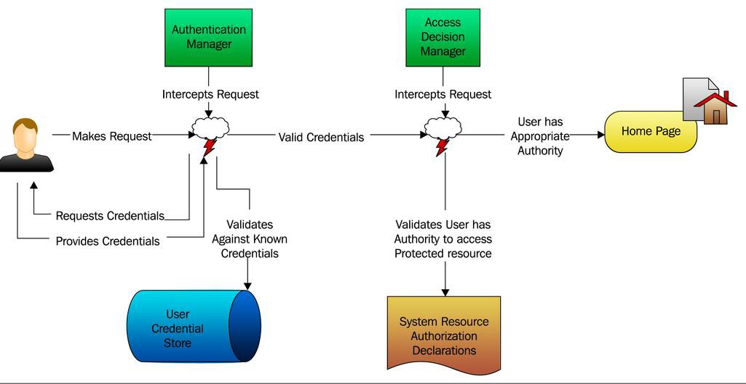
Use case

Slide 9
Namespace
xmlns="http://www.springframework.org/schema/beans" xmlns:sec="http://www.springframework.org/schema/security" xmlns:xsi="http://www.w3.org/2001/XMLSchema-instance" xsi:schemaLocation="
http://www.springframework.org/schema/beans http://www.springframework.org/schema/beans/spring-beans-4.0.xsd
http://www.springframework.org/schema/security http://www.springframework.org/schema/security/spring-security-4.0.xsd">
<beans

Slide 10

Filters

Slide 11
Security filter (web.xml)
<filter>
<filter-name>springSecurityFilterChain</filter-name>
<filter-class> org.springframework.web.filter.DelegatingFilterProxy
</filter-class>
</filter>
<filter-mapping>
<filter-name>springSecurityFilterChain</filter-name>
<url-pattern>/*</url-pattern>
</filter-mapping>

Slide 12
Web Security Config
@EnableWebSecurity
public class WebSecurityConfig extends WebSecurityConfigurerAdapter {
@Bean
public UserDetailsService userDetailsService() throws Exception {
InMemoryUserDetailsManager manager =
new InMemoryUserDetailsManager();
manager.createUser(User.withUsername("user")
.password("password")
.roles("USER").build());
return manager;
}
}

Slide 13
Security Filter (Java Configuration)
public class SecurityWebApplicationInitializer
extends AbstractSecurityWebApplicationInitializer {
}
public class MvcWebApplicationInitializer extends
AbstractAnnotationConfigDispatcherServletInitializer {
@Override
protected Class<?>[] getRootConfigClasses() {
return new Class[] { WebSecurityConfig.class };
}
// ... other overrides ...
}

Slide 14
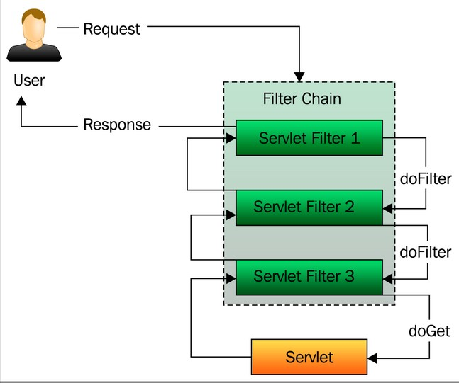
Filter chain

Slide 15
Filter chain (2)
pattern="/login.do*" filters="none"/> pattern="/**.do*"
filters="
securityContextPersistenceFilter, logoutFilter, usernamePasswordAuthenticationFilter, rememberMeAuthenticationFilter, exceptionTranslationFilter, filterSecurityInterceptor" />
<bean id="springSecurityFilterChain" class="org.springframework.security.web.FilterChainProxy">
<sec:filter-chain-map path-type="ant">
<sec:filter-chain
<sec:filter-chain
</sec:filter-chain-map>
</bean>

Slide 16
Basic filters
Filter | Description
ChannelProcessingFilter | ensures that a request is being sent over HTTP or HTTPS
SecurityContextPersistentFilter | Populates the security context using information obtained from the repository (http session)
LogoutFilter | Used to log a user out of the application
UsernamePasswordAuthenticationFilter | Accepts the user’s principal and credentials and attempts to authenticate the user
BasicAuthenticationFilter | Attempts to authenticate a user by processing an HTTP Basic authentication
ExceptionTranslationFilter | Handles any AccessDeniedException or AuthenticationException
FilterSecurityInterceptor | Decides whether or not to allow access to a secured resource

Slide 17
Authentication

Slide 18
Authentication variants
credential-based
two-factor
hardware
other…

Slide 19
Authentication mechanisms
basic
form
◻ x.509
JAAS
etc.

Slide 20
Authentication storage
RDMBS
LDAP
custom storage
etc.

Slide 21
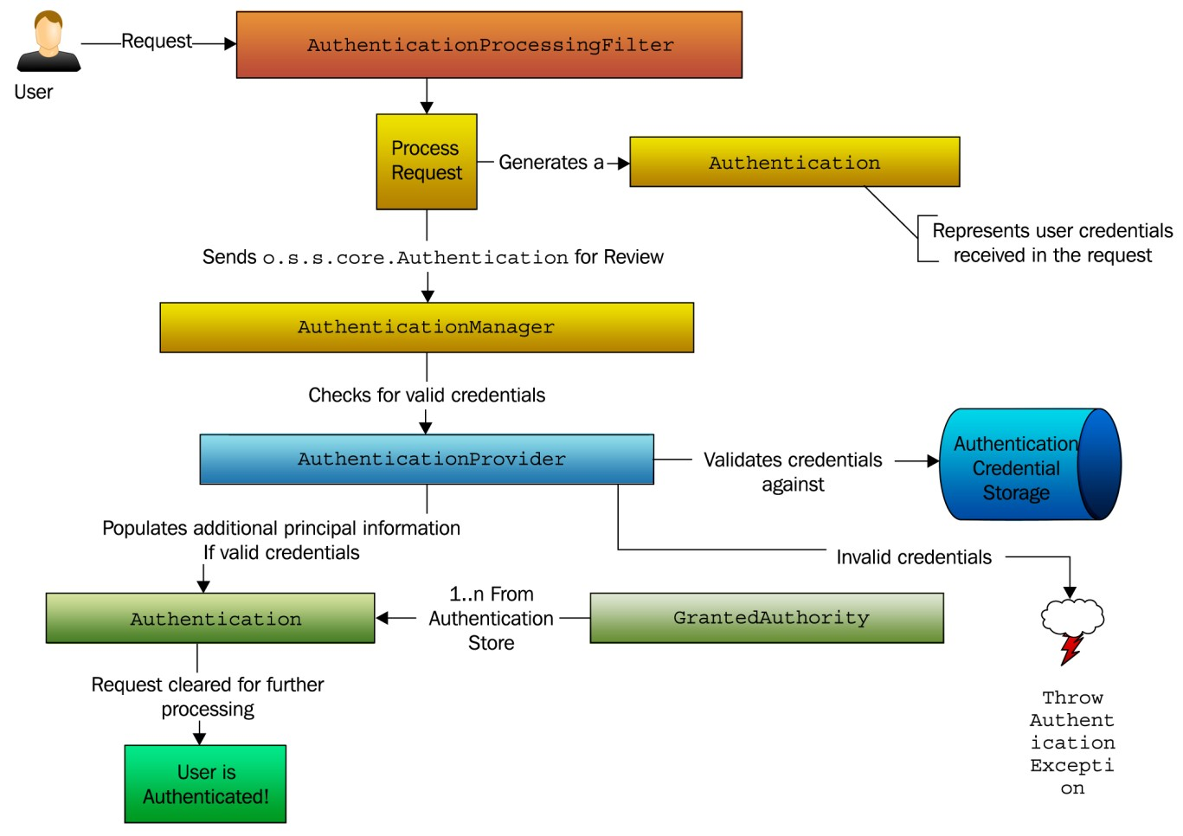
Fundamentals
Filter Manager
Provider
Authentication UserDetails

Slide 22
HTML form
<c:url value="/login" var="loginUrl"/>
<form action="${loginUrl}" method="post"> 1
<c:if test="${param.error != null}"> 2
<p>
Invalid username and password.
</p>
</c:if>
<c:if test="${param.logout != null}">
<p>
You have been logged out.
</p>
</c:if>
<p>
<label for="username">Username</label>
<input type="text" id="username" name="username"/>
</p>
<p>
<label for="password">Password</label>
<input type="password" id="password" name="password"/>
</p>
<input type="hidden"
name="${_csrf.parameterName}"
value="${_csrf.token}"/>
<button type="submit" class="btn">Log in</button>
</form>

Slide 23
Username-password filter
<bean class="...security.web.authentication.SavedRequestAwareAuthenticationSuccessHandler">
<property name="defaultTargetUrl" value="/index.do"/>
</bean>
</property>
<property name="authenticationFailureHandler">
<bean class="...security.web.authentication.SimpleUrlAuthenticationFailureHandler">
<property name="defaultFailureUrl" value="/login.do"/>
</bean>
</property>
<property name="rememberMeServices" ref="rememberMeService"/>
</bean>
<bean id="..." class="...security.web.authentication.UsernamePasswordAuthenticationFilter">
<property
<property
<property
<property
<property
name="authenticationManager" ref="authenticationManager"/> name="filterProcessesUrl" value="/j_spring_security_check"/> name="usernameParameter" value="login"/> name="passwordParameter" value="password"/> name="authenticationSuccessHandler">

Slide 24
Core authentication services
AuthenticationManager
handles authentication requests
AuthenticationProvider
performs authentication
UserDetailsService
responsible for returning an UserDetails object
UerDetails
provides the core user information

Slide 25
AuthenticationManager
public interface
AuthenticationManager {
authenticate the passed Authentication object, fully populated Authentication object (including
/* Attempts to
* returning a
*
*
*
*
granted authorities) if successful.
@param authentication the authentication request object
@return a fully authenticated object including credentials
@throws AuthenticationException if authentication fails */
Authentication authenticate(Authentication authentication)
throws AuthenticationException;
}

Slide 26
AuthenticationProvider
public interface AuthenticationProvider {
/* | Performs authentication.
* | @param authentication the authentication | request object.
@return a fully authenticated object including credentials.
@throws AuthenticationException if authentication fails.*/
Authentication authenticate(Authentication authentication)
throws AuthenticationException;
/*Returns true if this provider supports the indicated
*Authentication object.*/
boolean supports(Class<? extends Object> authentication);
}

Slide 27
UserDetailsService
which loads user-specific data.*/ UserDetailsService {
/* Locates the user based on the username.
*
*
*
@param username the username identifying the user
@return a fully populated user record (never null)
@throws UsernameNotFoundException if the user could not be
found or the user has no GrantedAuthority
* @throws DataAccessException if user could not be found for a
repository-specific reason*/
/*Core interface
public interface
UserDetails loadUserByUsername(String username)
throws UsernameNotFoundException, DataAccessException;
}

Slide 28
UserDetails
/* Provides core user information.*/
public interface UserDetails extends Serializable {
Collection<GrantedAuthority> getAuthorities(); String getPassword();
String getUsername();
boolean boolean boolean boolean
isAccountNonExpired(); isAccountNonLocked(); isCredentialsNonExpired(); isEnabled();
}

Slide 29
Authentication manager
<bean id="..." class="...security.authentication.ProviderManager">
<property name="providers">
<list>
<ref
<ref
<ref
</list>
local="casAuthenticationProvider"/> local="daoAuthenticationProvider"/> local="ldapAuthenticationProvider"/>
</property>
</bean>

Slide 30
Authentication provider
<bean id="daoAuthenticationProvider" class="org.springframework.security.authentication.dao.DaoAuthenticationProvider">
<property
<property
<property
</bean>
name="userDetailsService" ref="userDetailsService"/> name="saltSource" ref bean="saltSource"/> name="passwordEncoder" ref="passwordEncoder"/>
<bean id="userDetailsService" class="org.springframework.security.core.userdetails.jdbc.JdbcDaoImpl">
<property name="dataSource" ref="dataSource"/>
</bean>

Slide 31
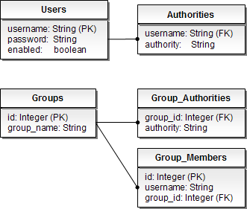
Authentication DB schema

Slide 32
Password encoding
PasswordEncoder
MD5
SHA
SaltSource
SystemWide
reflection

Slide 33
Session management
<bean id="sessionManagementFilter" class="org.springframework.security.web.session.SessionManagementFilter">
<property name="invalidSessionUrl" value="/timeout.do"/>
<property name="sessionAuthenticationStrategy" ref="strategy"/>
</bean>
<bean id="strategy"
class="…SessionFixationProtectionStrategy">
<property name="alwaysCreateSession" value="true"/>
<property name="migrateSessionAttributes" value="true"/>
</bean>

Slide 34
Logout
<bean id="logoutFilter" class="org.springframework.security.web.authentication.logout.LogoutFilter">
<constructor-arg>
<bean class="…SimpleUrlLogoutSuccessHandler">
<property name="defaultTargetUrl" value="/login"/>
</bean>
</constructor-arg>
<constructor-arg>
<bean class="…SecurityContextLogoutHandler"/>
</constructor-arg>
<property name="filterProcessesUrl" value="/logout"/>
</bean>

Slide 35
Remember Me authentication
RememberMeAuthenticationFilter
RememberMeServices
RememberMeAuthenticationProvider

Slide 36
RememberMe service
public interface RememberMeServices {
Authentication autoLogin(HttpServletRequest request,
HttpServletResponse response);
void loginFail(HttpServletRequest request,
HttpServletResponse response);
void loginSuccess(HttpServletRequest request,
HttpServletResponse response, Authentication successfulAuthentication);
}

Slide 37
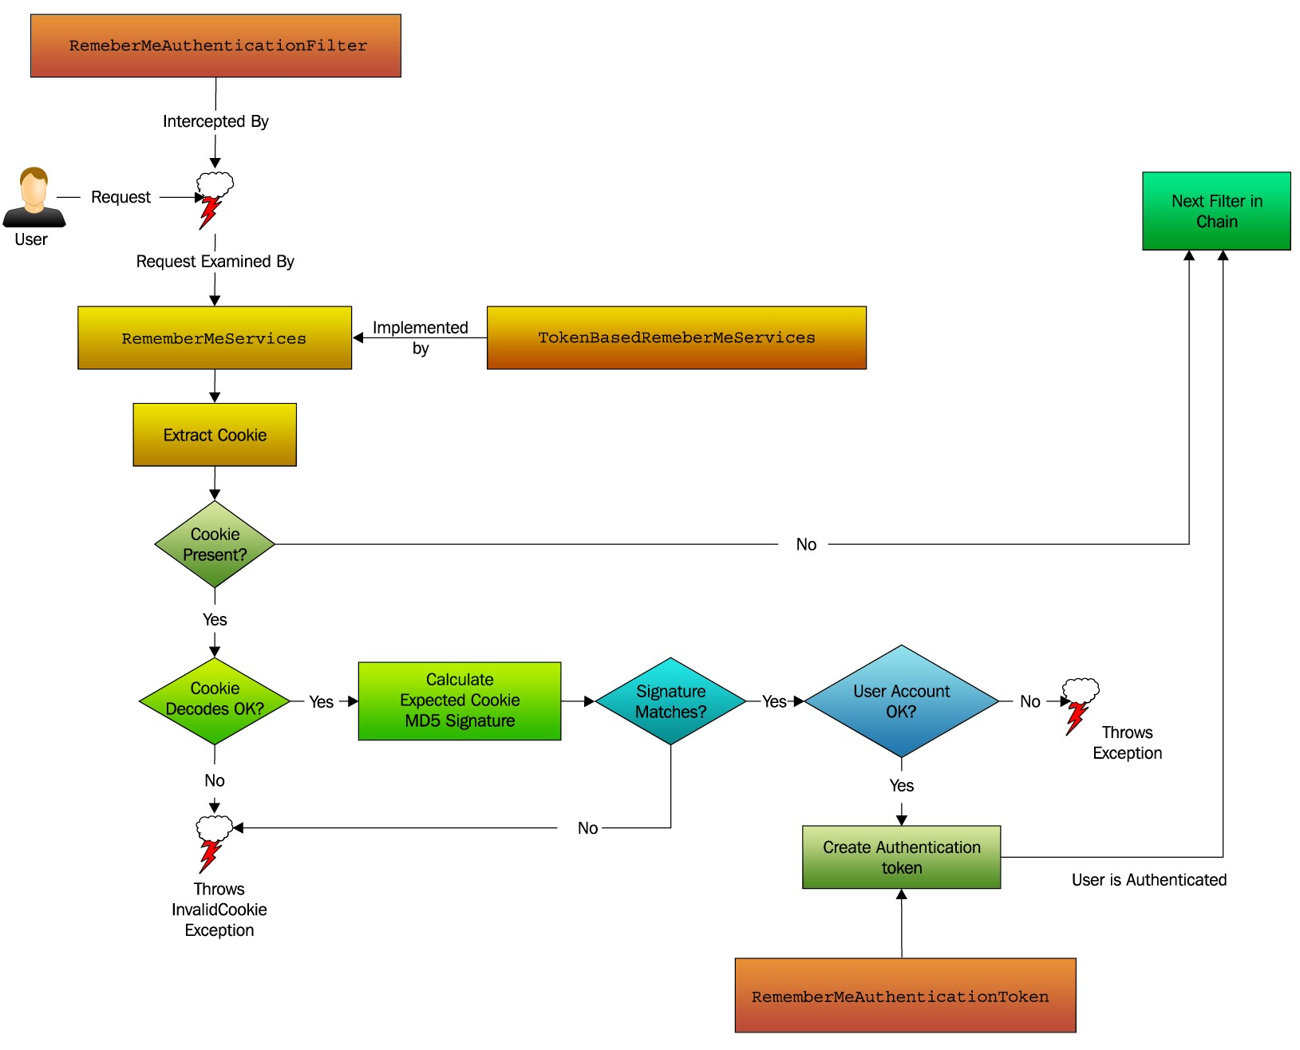
Remember Me shema

Slide 38
Anonymous authentication
<bean id="anonymousAuthenticationFilter" class="...web.authentication.AnonymousAuthenticationFilter">
<property name="key" value="foobar"/>
<property name="userAttribute" value="anonymous,ROLE_ANONYMOUS"/>
</bean>
<bean id="anonymousAuthenticationProvider" class="...authentication.AnonymousAuthenticationProvider">
<property name="key" value="foobar"/>
</bean>

Slide 39
Authentication with magic tags
<sec:http auto-config="true">
<sec:form-login login-page="" login-processing-url=""/>
<sec:anonymous enabled="true"/>
<sec:logout invalidate-session="true" logout-url=""/>
<sec:remember-me services-ref=""/>
</sec:http>

Slide 40
Authorizationon

Slide 41
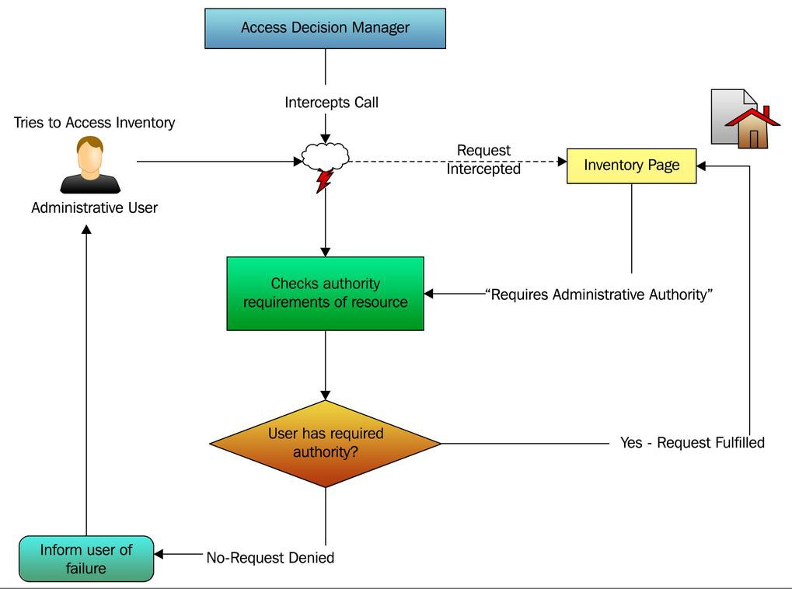
Use case

Slide 42
Authorization
handling
pre-invocation
after invocation
implementations
voting based
expression based

Slide 43
Security layers
WEB (URLs)
Servlet Filter
methods
Spring AOP
AspectJ
content
JSP tag

Slide 44
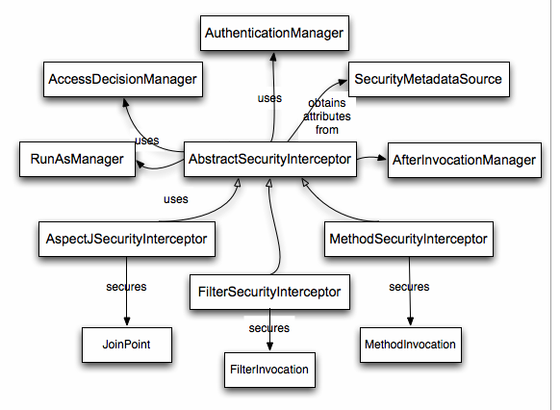
Security interceptor (1)

Slide 45






Security interceptor (2)
Security Interceptor
Authentication Manager
Access Decision Manager
Run-As Manager
After-Invocation Manager

Slide 46
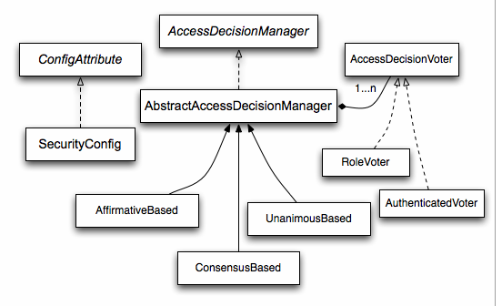
Voting based
DecisionManager DecisionVoter
ConfigAttribute

Slide 47
Decision managers
Decision manager | Description
AffirmativeBased | Allows access if at least one voter votes to grant access
ConsensusBased | Allows access if a consensus of voters vote to grant access
UnanimousBased | Allows access if all voters vote to grant access

Slide 48
Decision voter
public interface AccessDecisionVoter {
int ACCESS_GRANTED = 1;
int ACCESS_ABSTAIN = 0;
int ACCESS_DENIED = -1;
boolean supports(ConfigAttribute attribute);
boolean supports(Class<?> clazz);
int vote(Authentication authentication, Object object,
Collection<ConfigAttribute> attributes);
}

Slide 49
Basic expressions
Expression | Description
hasRole(‘ROLE_USER’) | Returns true if the current principal has the specified role
hasAnyRole(‘ROLE_USER’, ‘ROLE_ADMIN’) | Returns true if the current principal has any of the roles
principal | Allows direct access to the principal object representing the current user
authentication | Allows direct access to the current Authentication object obtained from the SecurityContext
permitAll | Always evaluates to true
denyAll | Always evaluates to false
isAnonymous() | Returns true if the current principal is an anonymous user
isRememberMe() | Returns true if the current principal is a remember-me user

Slide 50
WEB authorization

Slide 51
Web authorization
<bean id="..." class="web.access.intercept.FilterSecurityInterceptor">
<property
<property
<property
name="authenticationManager" ref="authManager"/> name="accessDecisionManager" ref="decisionManager"/> name="securityMetadataSource">
<sec:filter-security-metadata-source>
<sec:intercept-url pattern="/index.do*"
access="IS_AUTHENTICATED_FULLY"/>
<sec:intercept-url pattern="/**"
access="ROLE_USER" filters="none" method="GET"
requires-channel="https"/>
</sec:filter-security-metadata-source>
</property>
</bean>

Slide 52
WEB authorization with magic tags
<sec:http use-expressions="true">
<sec:intercept-url
pattern="/index*" access="isAuthenticated()"/>
<sec:intercept-url
pattern="/**" access="hasRole('ROLE_USER')" filters="none"
method="GET"
requires-channel="https"/>
</sec:http>

Slide 53
WEB authorization
<bean id="webExpressionHandler" class="…DefaultWebSecurityExpressionHandler"/>
<bean id="webExpressionVoter" class="…WebExpressionVoter">
<property name="expressionHandler" ref="webExpressionHandler"/>
</bean>
<bean class="org.springframework.security.access.vote.AffirmativeBased">
<property name="decisionVoters">
<list>
<ref bean="webExpressionVoter"/>
</list>
</property>
</bean>

Slide 54
Custom expression root
public class CustomWebSecurityExpressionRoot
extends WebSecurityExpressionRoot {
public CustomWebSecurityExpressionRoot(Authentication a,
FilterInvocation
super(a, fi);
}
fi) {
public boolean hasAllRoles(String... roles) {
return false;
}
}

Slide 55
Custom expression handler
public class CustomWebSecurityExpressionHandler
extends DefaultWebSecurityExpressionHandler {
@Override
public EvaluationContext createEvaluationContext(Authentication a,
FilterInvocation fi) {
StandardEvaluationContext ctx =
(StandardEvaluationContext)super.createEvaluationContext(a, fi); SecurityExpressionRoot root =
new CustomWebSecurityExpressionRoot(a, fi); ctx.setRootObject(root);
return ctx;
}
}

Slide 56
Method authorization

Slide 57
Method authorization
annotation driven
voting based - @Secured
expression based - @Pre/@Post
JSR-250 - @RolesAllowed
xml driven

Slide 58
Configuration
<sec:global-method-security>
access-decision-manager-ref="accessDecisionManager" jsr250-annotations="disabled"
pre-post-annotations="disabled"
secured-annotations="enabled"
</sec:global-method-security>

Slide 59
Annotation driven (voting)
voting
@Secured({"ROLE_USER"})
void create(Customer customer);
◻ jsr-250
@RolesAllowed({"ROLE_USER"})
void create(Customer customer);

Slide 60
Annotation driven (expression)
◻ 1
@PreAuthorize("hasRole('ROLE_USER')")
void create(Customer customer);
◻ 2
@PreAuthorize("hasRole('ROLE_USER') and
void create(Customer customer);
◻ 3
hasRole('ROLE_ADMIN')")
@PreAuthorize("hasAnyRole('ROLE_USER', 'ROLE_ADMIN')")
void create(Customer customer);

Slide 61
XML driven authorization (1)
<bean id="methodInterceptor" class="…MethodSecurityInterceptor">
<property
<property
<property
<value>
name="authenticationManager" ref="authManager"/> name="accessDecisionManager" ref="decisionManager"/> name="securityMetadataSource">
org.training.AccountService.createAccount=ROLE_USER
org.training.AccountService.delete*=ROLE_ADMIN
</value>
</property>
</bean>

Slide 62
XML driven authorization (2)
<bean id="accountService" class="org.training.AccountServiceImpl">
<sec:intercept-methods>
<sec:protect access="ROLE_USER" method="createAccount"/>
<sec:protect access="ROLE_ADMIN" method="delete*"/>
</sec:intercept-methods>
</bean>

Slide 63
Domain Object Security

Slide 64
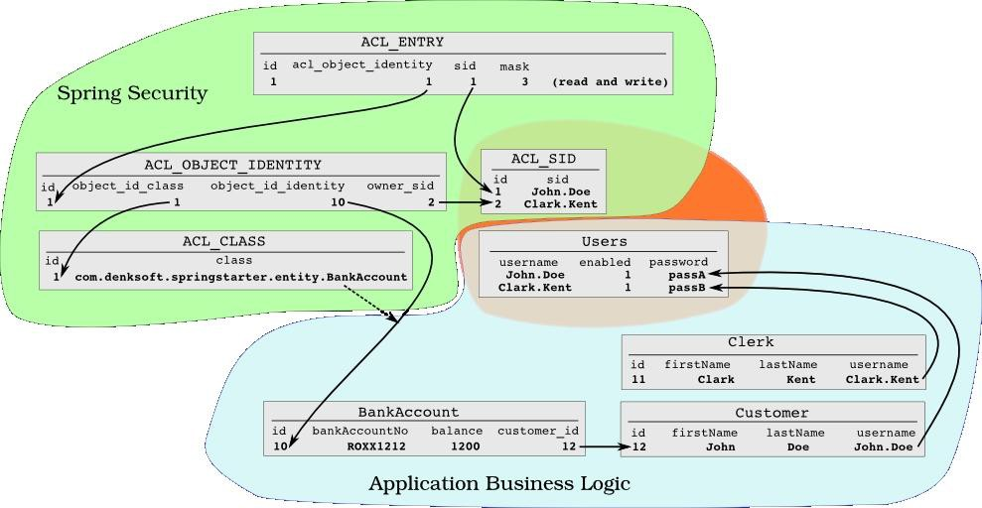
ACL DB scheme

Slide 65
ACL_CLASS
ACL_SID
ACL_OBJECT_IDENTITY
ACL_ENTRY

Slide 66
Basic classes
Acl
AccessControlEntry
Permission
Sid
ObjectIdentity
represents the identity of an individual domain object

Slide 67
Basic ACL services
AclService
MutableAclService
LookupStrategy
ObjectIdentityRetrievalStrategy
SidRetrievalStrategy

Slide 68
Permissions
base permissions
read (1)
write (2)
create (4)
delete (8)
administration (16)
custom permissions

Slide 69
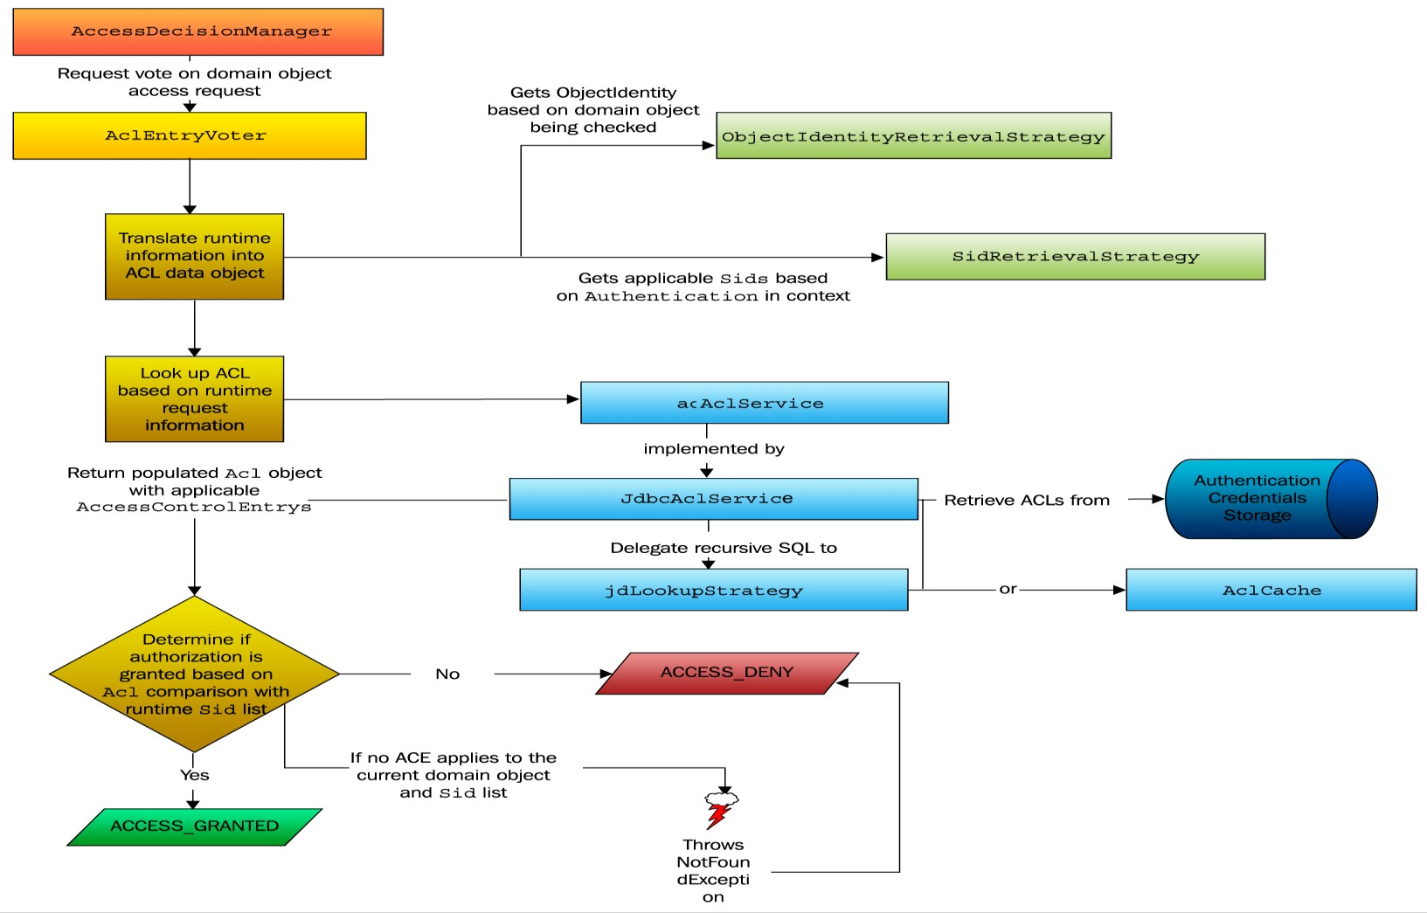

Slide 70
Configuration (voting)
<sec:global-method-security
access-decision-manager-ref="accessDecisionManager" secured-annotations="enabled">
</sec:global-method-security>
<bean id="accessDecisionManager" class="…AffirmativeBased">
<property name="decisionVoters">
<list>
<ref bean="voter1"/>
<ref bean="voter2"/>
</list>
</property>
</bean>

Slide 71
@Secured
annotation
@Secured("ACL_CUSTOMER_READ")
public Customer getProjectsByCustomer(Customer
voter
customer) {}
<bean id="customerReadVoter" class="…AclEntryVoter">
<constructor-arg ref="aclService"/>
<constructor-arg value="ACL_CUSTOMER_READ"/>
<constructor-arg>
<array>
<util:constant static-field="…BasePermission.READ"/>
</array>
</constructor-arg>
<property name="processDomainObjectClass" value="…Customer"/>
</bean>

Slide 72
Configuration (expressions)
<sec:global-method-security pre-post-annotations="enabled">
<sec:expression-handler ref="expressionHandler"/>
</sec:global-method-security>
<bean id="expressionHandler"
class="…DefaultMethodSecurityExpressionHandler">
<property name="permissionEvaluator" ref="permissionEvaluator"/>
</bean>
<bean id="permissionEvaluator" class="…AclPermissionEvaluator">
<constructor-arg ref="aclService"/>
</bean>

Slide 73
Permission evaluator
public interface PermissionEvaluator {
boolean
hasPermission(Authentication authentication,
Object targetDomainObject, Object permission);
boolean
hasPermission(Authentication authentication,
Serializable targetId,
String targetType, Object permission);
}

Slide 74
@PreAuthorize
by domain object
@PreAuthorize("hasPermission(#customer,
public void delete(Customer customer);
by identifier
@PreAuthorize(
'delete')")
"hasPermission(#id, 'org.training.Customer',
"hasPermission(#id, 'org.training.Customer',
public Customer getById(Long id);
hardcode
'read') or " +
'admin')")
@PreAuthorize("#customer.owner.id == principal.id")
public void create(Customer customer);

Slide 75
@PreFilter
single parameter
@PreFilter("hasPermission(filterObject, 'read')")
public List<Customer> filterCustomers(List<Customer> customers) {
return customers;
}
multiple parameters
@PreFilter(filterTarget = "customers",
value = "hasPermission(filterObject, 'update')")
public void updateCustomers(List<Customer> customers, State st) {
}

Slide 76
Additional features

Slide 77
RunAsManager
/*Creates a new temporary Authentication
public interface RunAsManager {
object.*/
/ *Returns a replacement Authentication object for the current
*secure object, or null if replacement not required*/
Authentication buildRunAs(Authentication authentication,
Object object,
Collection<ConfigAttribute> attr);
boolean supports(ConfigAttribute attribute);
boolean supports(Class<?> clazz);
}

Slide 78
RunAs configuration (1)
<bean id="runAsManager" class="…RunAsManagerImpl">
<property name="rolePrefix" value="ROLE_"/>
<property name="key" value="someKey"/>
</bean>
<bean class="…RunAsImplAuthenticationProvider">
<property name="key" value="someKey"/>
</bean>

Slide 79
RunAs configuration (2)
magic tag
<sec:global-method-security run-as-manager-ref="runAsManager">
</sec:global-method-security>
interceptor bean
<bean class="…MethodSecurityInterceptor">
<property name="runAsManager" ref="runAsManager"/>
</bean>

Slide 80
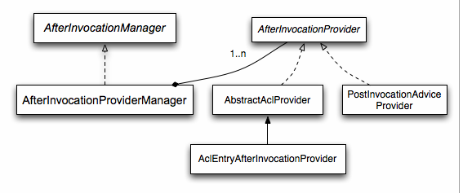
After invocation

Slide 81
Basic services
public interface AfterInvocationManager {
Object decide(Authentication authentication, Object object, Collection<ConfigAttribute> attributes,
Object returnedObject) throws AccessDeniedException;
boolean supports(ConfigAttribute attribute);
boolean supports(Class<?> clazz);
}
public interface AfterInvocationProvider {
Object decide(Authentication authentication, Object object, Collection<ConfigAttribute> attributes,
Object returnedObject) throws AccessDeniedException;
boolean supports(ConfigAttribute attribute);
boolean supports(Class<?> clazz);
}

Slide 82
Configuration
custom provider
<sec:global-method-security>
<sec:after-invocation-provider
</sec:global-method-security>
custom manager
ref="myProvider"/>
<bean class="…MethodSecurityInterceptor">
<property name="afterInvocationManager" ref="myManager"/>
</bean>

Slide 83
@Post
@PostAuthorize
@PreAuthorize("hasRole('ROLE_USER')")
@PostAuthorize("hasPermission(returnObject,
'read')")
public Employee getEmployeeByName(String
}
@PostFilter
@PreAuthorize("hasRole('ROLE_USER')")
@PostFilter("hasPermission(filterObject, public List<Employee> getEmployees() {
}
name) {
'read')")

Slide 84
JSP tag library

Slide 85
Authentication
<%@ taglib prefix="sec"
uri="http://www.springframework.org/security/tags" %>
<sec:authentication property="principal" var="user"/>
<div class="links"><div>Logged in: ${user.name}</div></div>
<div class="links">
<div><sec:authentication property="principal.name"/></div>
</div>

Slide 86
Authorize (1)
<%@ taglib prefix="sec"
uri="http://www.springframework.org/security/tags" %>
<sec:authorize ifAllGranted="ROLE_ADMIN, ROLE_SUPERVISOR">
</sec:authorize>
<security:authorize ifAnyGranted="ROLE_ADMIN, ROLE_SUPERVISOR">
</security:authorize>
<security:authorize ifNotGranted="ROLE_ADMIN, ROLE_SUPERVISOR">
</security:authorize>

Slide 87
Authorize (2)
<%@ taglib prefix="sec"
uri="http://www.springframework.org/security/tags" %>
<sec:authorize access="hasRole('supervisor')">
This content will only be visible to users who have the "supervisor" authority in their list of
<tt>GrantedAuthority</tt>s.
</sec:authorize>

Slide 88
Authorize (3)
JSP
<sec:authorize url="/admin"
This content will only be
>
visible to users who are authorized
to send requests to the "/admin" URL.
</sec:authorize>
security interceptor
<bean id="..." class="web.access.intercept.FilterSecurityInterceptor">
<property name="securityMetadataSource">
<sec:filter-security-metadata-source>
<sec:intercept-url pattern="/admin*" access="ROLE_ADMIN"/>
</sec:filter-security-metadata-source>
</property>
</bean>

Slide 89
ACL
<%@ taglib
prefix="sec" uri="http://www.springframework.org/security/tags" %>
<sec:accesscontrollist hasPermission="1,2" domainObject="object"> This will be shown if the user has either of the permissions represented by the values "1" or "2" on the given object.
</sec:accesscontrollist>

Slide 90
Summary

Slide 91
Separation of concerns
business logic is decoupled from security concern
authentication and authorization are decoupled

Slide 92
Flexibility
authentication mechanisms
basic, form, cookies, SSO
user data storage
RDBMS, LDAP, etc.
based on Spring

Slide 93
Portability
portable across containers
can be deployed as-is
runs in standalone environment

Slide 94
Links
main features
http://static.springsource.org/spring-security/site/features.html
articles
http://static.springsource.org/spring-security/site/articles.html
reference
http://static.springsource.org/spring- security/site/docs/3.0.x/reference/springsecurity.html
blog
http://blog.springsource.com/category/security/
refcardz
http://refcardz.dzone.com/refcardz/expression-based- authorization

Slide 95

Questions
Spring Framework - Core

Slide 96
The end

