Slide 1
Spring Framework Basics
Spring Core and IOC

Slide 2
Topics
What is Spring framework?
Why Spring framework?
Spring framework architecture
Usage scenario
Dependency Injection (DI)
  BeanFactory
  Autowiring
  ApplicationContext

Slide 3
What is Spring Framework?

Slide 4
What is Spring Framework?
Light-weight yet comprehensive framework for building Java SE and Java EE applications

Slide 5
What is Spring Framework?
The Spring Framework Mission Statement
  J2EE should be easier to use
  It's best to program to interfaces, rather than classes. Spring reduces the complexity cost of using interfaces to zero
  JavaBeans offer a great way of configuring applications
  OO design is more important than any implementation technology, such as J2EE
  Checked exceptions are overused. A framework should not force to catch

Slide 6
Spring Framework Architecture

Slide 7
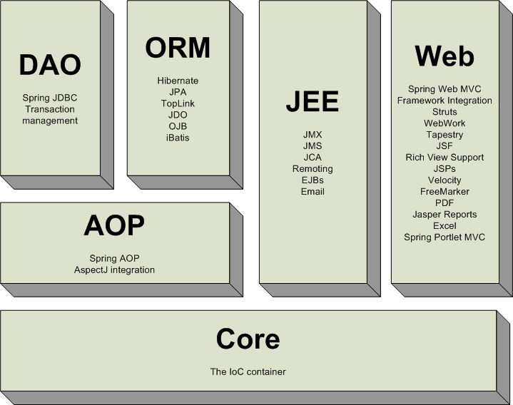
Spring Framework

Slide 8
Usage Scenarios

Slide 9
Usage Scenarios
You can use Spring in all sorts of scenarios, from applets up to fully-fledged enterprise applications using Spring's transaction management functionality and web framework integration

Slide 10
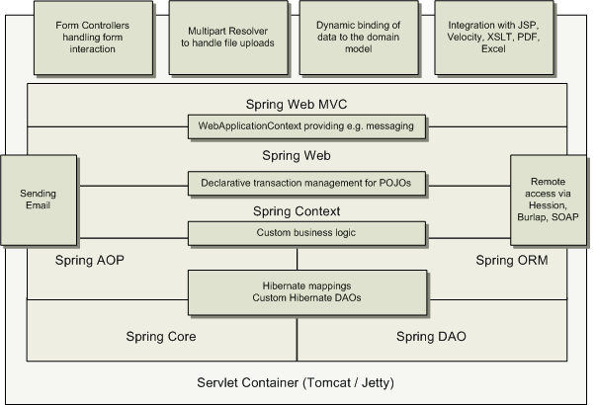
Typical Full-fledged Spring Web
Application

Slide 11
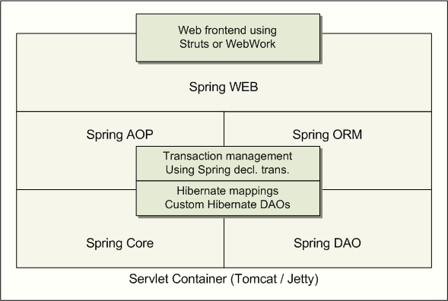
Spring Middle-tier Using 3rd party
Web Framework

Slide 12
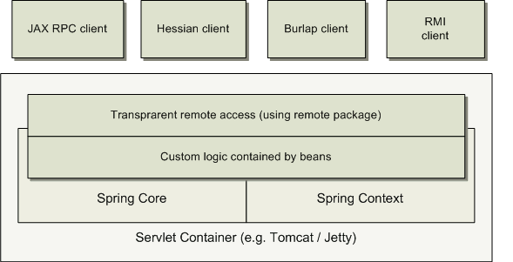
Remoting Usage Scenario

Slide 13
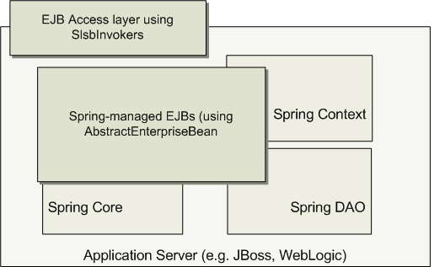
EJBs – Wrapping Existing POJOs

Slide 14
Spring Core
Ioc Container

Slide 15
The IoC container
The org.springframework.beans and org.springframework.context packages provide the basis for the Spring Framework's IoC container.
The BeanFactory interface provides an advanced configuration mechanism capable of managing objects of any nature.
The ApplicationContext interface builds on top of the BeanFactory (it is a sub-interface) and adds other functionality such as
  easier integration with Spring's AOP features
  message resource handling (for use in internationalization),
  event propagation, and application-layer specific contexts such as the WebApplicationContext for use in web applications.

Slide 16
The container
The org.springframework.beans.factory.BeanFactory is the actual representation of the Spring IoC container that is responsible for containing and otherwise managing the aforementioned beans.
The BeanFactory interface is the central IoC container interface in Spring.
Its responsibilities include instantiating or sourcing application objects, configuring such objects, and assembling the dependencies between these objects.

Slide 17
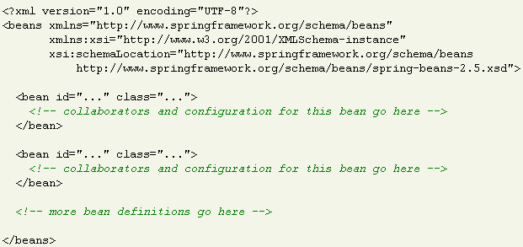

Configuration metadata
The Spring IoC container consumes some form of configuration metadata
This configuration metadata is nothing more than how you inform the Spring container as to how to “instantiate, configure, and assemble [the objects in your application]”. This configuration metadata is typically supplied in a simple and intuitive XML format.

Slide 18
Instantiating a container
Instantiating a Spring IoC container is straightforward.
ApplicationContext ctx=new ClassPathXMLApplicationCOntext(
"src/applicationContext.xml"));

Slide 19
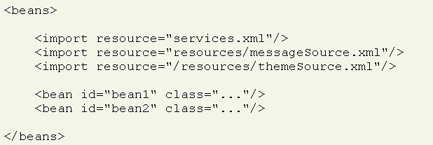
Composing XML-based configuration metadata
It can often be useful to split up container definitions into multiple XML files.
Notes:
One way to then load an application context which is configured from all these XML fragments is to use the application context constructor which takes multiple Resource locations. With a bean factory, a bean definition reader can be used multiple times to read definitions from each file in turn.
Generally, the Spring team prefers the above approach, since it keeps container configuration files unaware of the fact that they are being combined with others. An alternate approach is to use one or more occurrences of the <import/> element to load bean definitions from another file (or files). Let's look at a sample

Slide 20
The beans
A Spring IoC container manages one or more beans.
These beans are created using the configuration metadata that has been supplied to the container
  typically in the form of XML <bean/> definitions.
Within the container itself, these bean definitions are represented as BeanDefinition objects, which contain (among other information) the following metadata:
  a package-qualified class name: typically this is the actual implementation class of the bean being defined.
  bean behavioral configuration elements, which state how the bean should behave in the container (scope, lifecycle callbacks, and so forth).
  references to other beans which are needed for the bean to do its work; these references are also called collaborators or dependencies.
Notes:
other configuration settings to set in the newly created object. An example would be the number of connections to use in a bean that manages a connection pool, or the size limit of the pool.

Slide 21
Instantiating beans
A bean definition essentially is a recipe for creating one or more objects.
The container looks at the recipe for a named bean when asked, and uses the configuration metadata encapsulated by that bean definition to create (or acquire) an actual object.
If you are using XML-based configuration metadata, you can specify the type (or class) of object that is to be instantiated using the 'class' attribute of the <bean/> element

Slide 22
Instantiating beans
Spring IOC Container can instantiate a bean in one of the following ways
  Instantiation using a constructor
  Instantiation using a static factory method
  Instantiation using an instance factory method

Slide 23


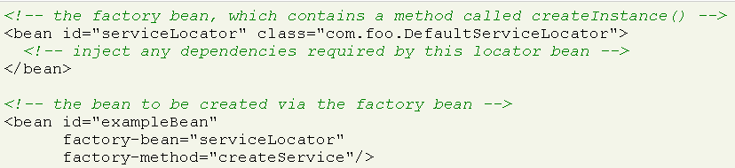
Instantiating a bean
Using constructor
Using static factory method
Using an instance static factory method

Slide 24
Dependency Injection (DI)
Basic concept

Slide 25
Spring Dependency Injection
A kind of Inversion of Control (IoC)
“Container” resolves (injects) dependencies of components by setting implementation object (push)
  As opposed to component instantiating or Service Locator pattern where component locates implementation (pull)
Martin Fowler calls Dependency Injection

Slide 26
Two Dependency Injection Variants
Constructor dependency Injection
  Dependencies are provided through the constructors of the component
Setter dependency injection
  Dependencies are provided through the JavaBean style setter methods of the component
  More popular than Constructor dependency injection

Slide 27
Constructor Dependency Injection
public class ConstructorInjection {
private Dependency dep;
public ConstructorInjection(Dependency dep) {
this.dep = dep;
}
}

Slide 28
Setter Dependency Injection
public class SetterInjection {
private Dependency dep;
public void setMyDependency(Dependency dep) {
this.dep = dep;
}
}

Slide 29
Dependency Injection (DI)
DI Support in Spring

Slide 30
BeanFactory
BeanFactory object is responsible for managing beans and their dependencies
Your application interacts with Spring's DI container through BeanFactory interface
  BeanFactory object has to be created by the application typically XmlBeanFactory
  BeanFactory object, when it gets created, read bean configuration file and performs the wiring
  Once created, the application can access the beans via BeanFactory interface

Slide 31
BeanFactory Implementations
XmlBeanFactory
  Convenience extension of DefaultListableBeanFactory
    that reads bean definitions from an XML document

Slide 32
Reading XML Configuration File via
XmlBeanFactory class
public class XmlConfigWithBeanFactory {
public static void main(String[] args) {
XmlBeanFactory factory =
new XmlBeanFactory(new FileSystemResource("beans.xml"));
SomeBeanInterface b =
(SomeBeanInterface) factory.getBean(“nameOftheBean”);
}
}

Slide 33
Bean Configuration File
Each bean is defined using <bean> tag under the root of the <beans> tag
The id attribute is used to give the bean its default name
The class attribute specifies the type of the bean

Slide 34
Bean Configuration File Example
<!DOCTYPE beans PUBLIC "-//SPRING//DTD BEAN//EN"
"http://www.springframework.org/dtd/spring-beans.dtd">
<beans>
<bean id="renderer" class="StandardOutMessageRenderer">
<property name="messageProvider">
<ref local="provider"/>
</property>
</bean>
<bean id="provider" class="HelloWorldMessageProvider"/>
</beans>

Slide 35
Wiring a Bean

Slide 36
Beans
The term “bean” is used to refer any component managed by the BeanFactory
The “beans” are in the form of JavaBeans (in most cases)
  no arg constructor
  getter and setter methods for the properties
Beans are singletons by default
Properties the beans may be simple values or references to other beans
Beans can have multiple names

Slide 37
What is Wiring?
The act of creating associations between application components is referred to as wiring
There are many ways to wire a bean but common approach is via XML

Slide 38
Wiring example
<?xml version="1.0" encoding="UTF-8"?>
<!DOCTYPE beans PUBLIC "-//SPRING//DTD BEAN//EN"
"http://www.springframework.org/dtd/spring-beans.dtd">
<beans>
<bean id="greetBean“ class="GreetingServiceImpl">
<property name="greeting">
<value>Hello friends of Spring</value>
</property>
</bean>
</beans>

Slide 39
Wiring the beans
<?xml version="1.0" encoding="UTF-8"?>
<!DOCTYPE beans PUBLIC "-//SPRING//DTD BEAN//EN"
"http://www.springframework.org/dtd/spring-beans.dtd">
<beans>
<bean id=“mybean“ class=“com.jp.TestBean">
</bean>
</beans>
The root element
bean’s id
Bean instance
(beans class name)

Slide 40
Wiring the beans
Prototype and Singleton beans
  all spring beans are singleton
  but prototype beans can also be defined
  <bean id =“myBean” class=“com.jp.TestBean”
  singleton=“false”/>
  singleton = “false” returns a prototype bean
  singleton = “true” returns a singleton bean
  default value for “singleton” is “true”
In Spring Framework Version 2.x the configuration for scope is
  <bean id =“myBean” class=“com.jp.TestBean”
  scope=“singletone”/>
  Scope attribute has values:
  Singleton
  Prototype
  Request
  session

Slide 41
Spring Dependency Injection Revisited
Two types of Dependency Injection
  setter injection
    dependency injected via setter methods
  constructor injection
    dependency injected via constructor

Slide 42
Spring Dependency Injection
Setter Injection
<bean id=“test” class=“com.jp.TestBean”>
<property name=“greeting”>
<value>Hello friends</value>
</property>
</bean>
Set the greet property by
calling setGreeting( “Hello Friends” )

Slide 43
Spring Dependency Injection
Referencing other beans
<beans>
  <bean id=“test” class =“com.jp.TestBean”>
  <property name=“greeting”>
  <ref bean=“greetBean”/>
  </property>
  <bean id=“greetBean” class =“com.jp.GreetBean” />
<beans>

Slide 44
Spring Dependency Injection
Constructor Injection
  <bean id=“test” class=“com.jp.testBean”>
  <constructor-arg>
  <value>Hello friends</value>
  </constructor-arg>
  </bean>
  <bean id=“test” class=“com.jp.testBean”>
  <constructor-arg>
  <ref bean=“greetBean”/>
  </constructor-arg>
  </bean>
constructs a
TestBean
object through
its constructor

Slide 45
Wiring Collections
Spring supports Many types of Collections as bean properties
Supported types are:
XML | Types
<list> | java.util.List, arrays
<set> | java.util.Set
<map> | java.util.Map
<props> | java.util.Properties

Slide 46
Wring Lists and Arrays
<property name="testList">
<list>
<value>value1</value>
<value>value2</value>
</list>
</property>
<bean id="exampleSessionFactory" class="org.springframework.orm.hibernate3.LocalSessionFactoryBean">
<property name="dataSource"><ref local="exampleDataSource"/>
<property name="hibernateProperties">
<ref bean="exampleHibernateProperties" />
</property>
<property name="mappingResources">
<list>
<value>Customer.hbm.xml</value>
<value>Account.hbm.xml</value>
</list>
</property>
</bean>

Slide 47
Wring Set and Map, Properties
<property name="barMap">
<map>
<entry key="key1">
<value>value1</value>
</entry>
<entry key="key1">
<value>value1</value>
</entry>
</map>
</property>
<property name="testSet">
<set>
<value>value1</value>
<value>value2</value>
</set>
</property>
<property name="barProperty">
<props>
<prop key="key1">value1</prop>
<prop key="key2">value2</prop>
<prop key="key3">value3</prop>
</props>
</property>

Slide 48
ApplicationContext

Slide 49
What is ApplicationContext?
Extension of BeanFactory
  It provides all the same functionality and more
  Reduces the amount of code you need
  In a more framework-oriented style
Add new features over BeanFactory
  Resource management and access
  Additional life-cycle interfaces
  Improved automatic configuration of infrastructure components
  Event publication
  Internationalization

Slide 50
Important Application Contexts
ClassPathXmlApplicationContext
WebApplicationContext
FileSystemApplicationContext

Slide 51
When to Use ApplicationContext?
Use ApplicationContext over BeanFactory to take advantage of its extended functionality
  Except for a few limited situations such as perhaps in an Applet, where memory consumption might be critical, and a few extra kilobytes might make a difference

Slide 52
Using MessageSource
The ApplicationContext interface extends an interface called MessageSource, and therefore provides messaging (i18n or internationalization)functionality
<beans>
<bean id="messageSource”
class="org.springframework.context.support.ResourceBundleMessageSource">
<property name="basenames">
<list>
<value>format</value>
<value>exceptions</value>
<value>windows</value>
</list>
</property>
</bean>
</beans>

Slide 53
Life Cycle of a Bean

Slide 54
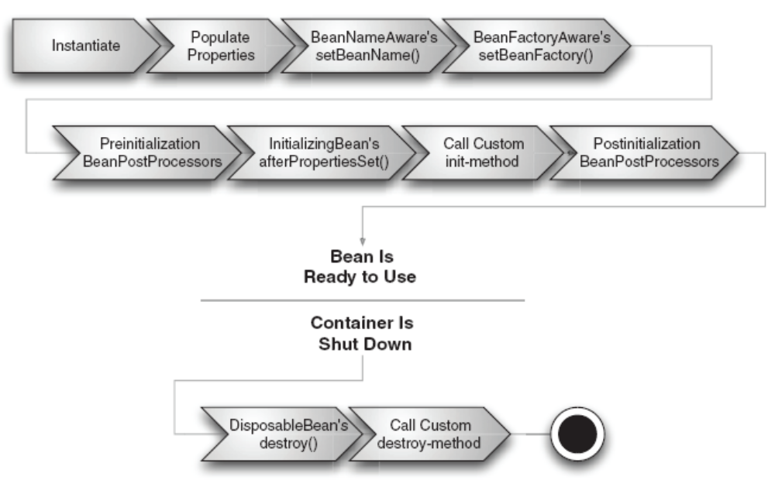
Life cycle of a bean in BeanFactory Container

Slide 55
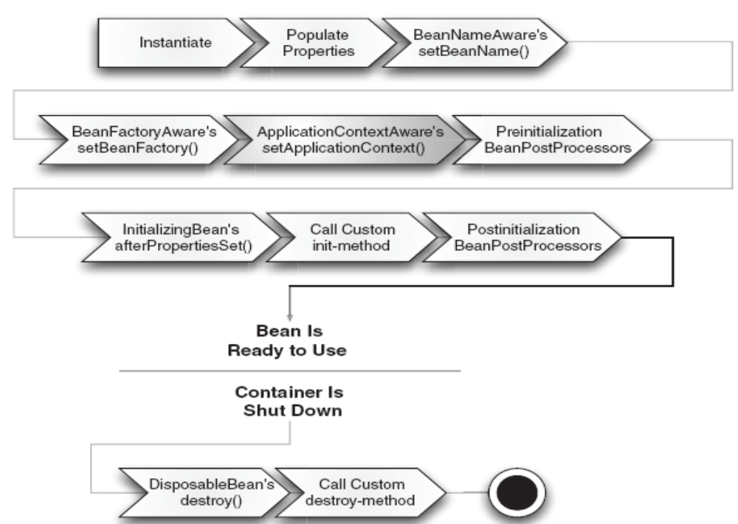
The lifecycle of a bean within a Spring application context

