Slide 1

JSON Web Token

Slide 2
What is JSON Web Token
JSON Web Token (JWT) is an open standard (RFC 7519) that defines a compact and self-contained way for securely transmitting information between parties as a JSON object.
This information can be verified and trusted because it is digitally signed. JWTs can be signed using a secret (with the HMAC algorithm) or a public/private key pair using RSA or ECDSA.

Slide 3
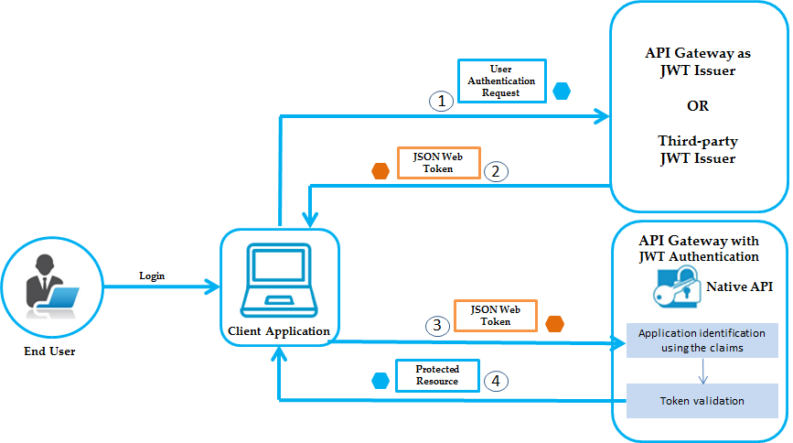
JWT Flow

Slide 4
When should you use JSON Web Tokens?
Authorization
This is the most common scenario for using JWT. Once the user is logged in, each subsequent request will include the JWT, allowing the user to access routes, services, and resources that are permitted with that token.
Single Sign On is a feature that widely uses JWT nowadays, because of its small overhead and its ability to be easily used across different domains.

Slide 5
When should you use JSON Web Tokens?
Information Exchange
JSON Web Tokens are a good way of securely transmitting information between parties.
Because JWTs can be signed—for example, using public/private key pairs—you can be sure the senders are who they say they are.
Additionally, as the signature is calculated using the header and the payload, you can also verify that the content hasn't been tampered with.

Slide 6
What is the JSON Web Token structure?
JWT Token
HEADER
PAYLOAD
SIGNATURE

Slide 7
What is the JSON Web Token structure?
JWT typically looks like the following.
xxxxx.yyyyy.zzzzz

Slide 8
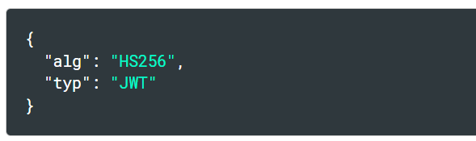
What is the JSON Web Token structure?
Header
The header typically consists of two parts:
the type of the token, which is JWT.
the signing algorithm being used, such as HMAC SHA256 or RSA.
The JSON is Base64Url encoded to form the first part of the JWT.

Slide 9
What is the JSON Web Token structure?
Payload
The second part of the token is the payload, which contains the claims. Claims are statements about an entity (typically, the user) and additional data.
There are three types of claims: registered, public, and private claims.

Slide 10
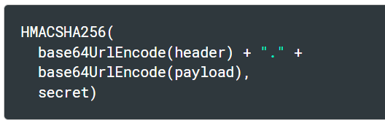
What is the JSON Web Token structure?
Signature
To create the signature part you have to take the encoded header, the encoded payload, a secret, the algorithm specified in the header, and sign that.
For example if you want to use the HMAC SHA256 algorithm, the signature will be created in the following way:

Slide 11
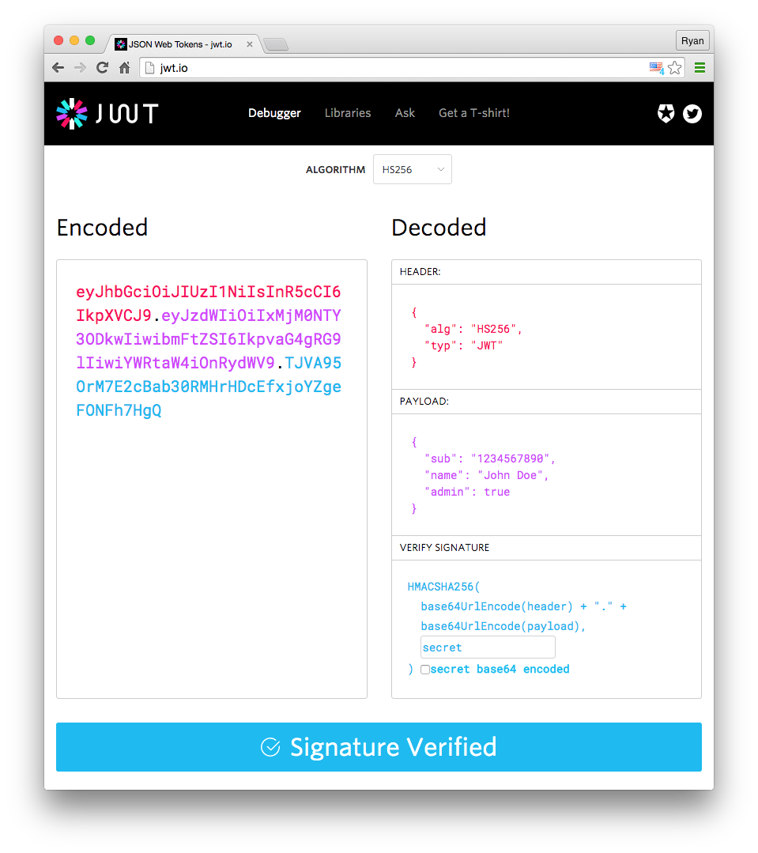
Putting it altogether

