Slide 1

WebLogic Server Overview
WebLogic Scripting Tool (WLST)
May 2008

Slide 2
An Introduction to JMX
JMX is Java Management Extension API
JMX is the best tool for integration of software
It provides a common spine that allows the user to integrate modules, containers, and plug-ins
JMX components are defined by the Java Management Extensions Instrumentation and Agent Specification, v1.2, which is available from the JSR003

Slide 3
An Introduction to JMX
JMX is a standard for managing and monitoring all varieties of software and hardware components from Java
Further, JMX aims to provide integration with the large number of existing management standards

Slide 4
What is JMX?
Standard API for developing observable applications – JSR 3 and JSR 160
Provides access to information such as
  Number of classes loaded
  Virtual machine uptime
  Operating system information
Applications can use JMX for
  Management – changing configuration settings
  Monitoring – getting statistics and notifications
Mandatory from J2SE 5.0 and J2EE

Slide 5
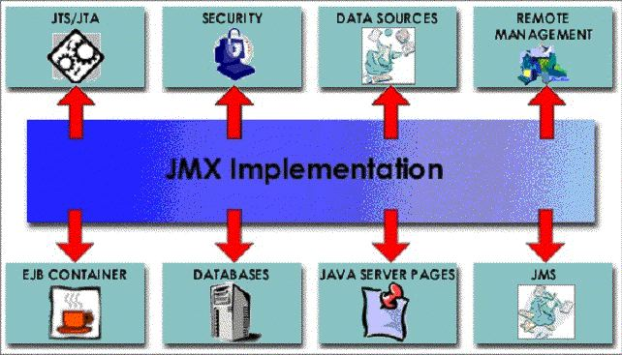
An Introduction to JMX

Slide 6
Introduction to JMX
The three levels of JMX
  Instrumentation
    which are the resources to manage
  Agents
    which are the controllers of the instrumentation level objects
  Distributed services
    the mechanism by which administration applications interact with agents and their managed objects

Slide 7
JMX Architecture
Instrumentation Level
  MBeans instruments resources, exposing attributes and operations
Agent Level
  MBean Server
  Predefined services
Remote Management
  Protocol Adaptors and Standard Connectors enables remote Manager Applications

Slide 8
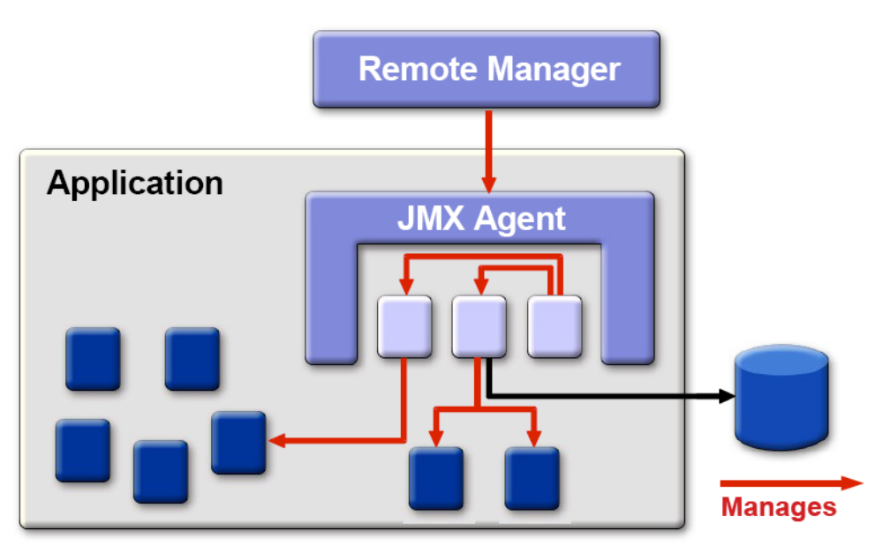
JMX Architecture

Slide 9
Managed Beans(MBeans)
A MBean is a named managed object representing a resource
  An application configuration setting
  Device
  Etc.
A MBean can have
  Attributes that can be read and/or written
  Operations that can be invoked
  Notifications that the MBean can broadcast

Slide 10
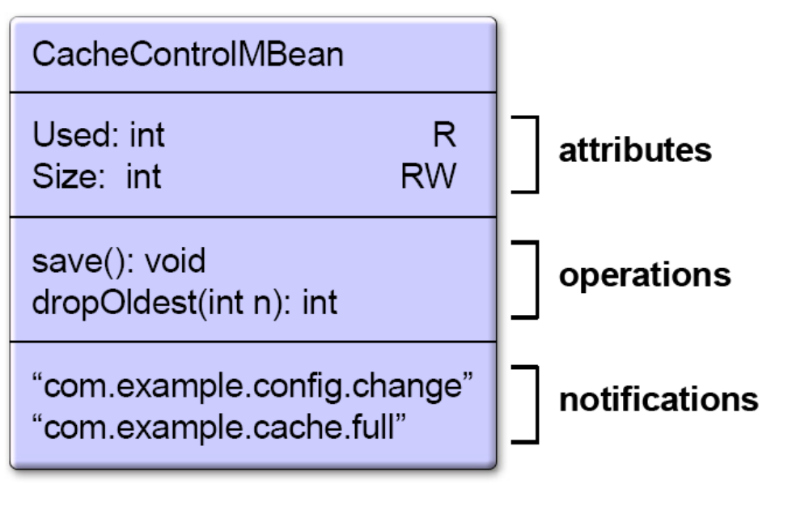
A MBean Example

Slide 11
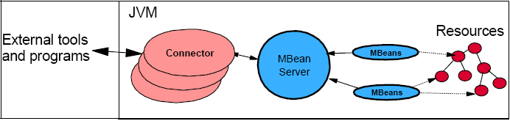
Interaction Scripts with Resources

Slide 12
Agenda
WLS Configuration Review
Intro to WebLogic Scripting Tool (WLST)
WLST Offline
WLST Online
  JMX Client
  Deployment (JSR-88) Client
  Miscellaneous Clients - Node Manager, JNDI, etc.
Customizing WLST
Tips and Best Practices

Slide 13
Agenda
WLS Configuration Review
Intro to WebLogic Scripting Tool (WLST)
WLST Offline
WLST Online
  JMX Client
  Deployment (JSR-88) Client
  Miscellaneous Clients - Node Manager, JNDI, etc.
Customizing WLST
Tips and Best Practices

Slide 14

WLS Configuration Review
WebLogic Server configuration is segmented by domain
  Each domain represents a logically related group of WebLogic Server instances that you manage from a single set of configuration files.
  Each domain has one Administration Server, and can have multiple managed servers and clusters
Administration Server - Central configuration controller for the entire domain
Managed Server - A running instance that hosts applications and resources needed by those applications - The real work horses in a WebLogic domain
Cluster - group of Managed Servers running simultaneously and working together to provide increased scalability and reliability
Node Manager is a per-machine process used to start and stop WebLogic Server instances.
  Independent of all domains
mydomain
Managed Servers
Admin Server
config.xml
Admin Console

Slide 15
Two-Phase Configuration Changes
Changes activated in batches:
  Reliability, consistency:
    Make (related) changes as a group
    Validate before making the change
    Activate or Roll back as a single unit (all changes on all servers)
General process:
  Get an edit lock
  make changes
    changes are stored in the pending directory
  activate your changes (with implicit validation through the Admin Console or WLST)
    changes are distributed to servers in the domain
    Two phases: prepare and commit
    Prepared on all servers; any failures will cause total rollback

Slide 16
Administration Tools
Configuration Wizard
  GUI/scriptable tool to create and extend WebLogic domains
  Template based
Administration Console
  Browser-based tool for configuring and monitoring domains, deploying applications, and controlling servers
WebLogic Scripting Tool (WLST)
  Script or command line tool to do the same thing as the Administration Console and Configuration Wizard
  Note that we will cover details on WLST in a separate document
weblogic.Admin
  Deprecated command line tool for configuring a domain
  Recommend using WLST instead
weblogic.Deployer
  Command line tool for deploying applications
Notes:
weblogic.Deployer
Command line tool for deploying and undeploying applications
More info:
http://e-docs.bea.com/wls/docs100/deployment/deploy.html
weblogic.Admin
Command-line interface that you can use to administer, configure, and monitor WebLogic Server
Deprecated. Replaced by WLST Online
More info:
http://e-docs.bea.com/wls/docs100/admin_ref/cli.html

Slide 17
Agenda
WLS Configuration Review
Intro to WebLogic Scripting Tool (WLST)
WLST Offline
WLST Online
  JMX Client
  Deployment (JSR-88) Client
  Miscellaneous Clients - Node Manager, JNDI, etc.
Customizing WLST
Tips and Best Practices

Slide 18
WebLogic Scripting Tool (WLST)
Scripting tool for administering a domain (create, configure, manage, monitor, deploy applications)
Based on Jython – pure Java implementation of Python
Great for automating repetitive tasks
Heavily used by customers and within BEA

Slide 19
Interaction Modes
Interactive
  enter a command and view the response at a command-line prompt
  In online mode: shell maintains a persistent connection to a WLS instance
Script
  text file with a .py file extension
  executed using Jython commands for running scripts
  invoke a sequence of WLST commands without requiring your input
Embedded
  instantiate the WLST interpreter in your Java code
  execute WLST commands from a Java program
Notes:
Interactive Mode
Interactive mode, in which you enter a command and view the response at a command-line prompt, is useful for learning the tool, prototyping command syntax, and verifying configuration options before building a script. Using WLST interactively is particularly useful for getting immediate feedback after making a critical configuration change. The WLST scripting shell maintains a persistent connection with an instance of WebLogic Server.
WLST can write all of the commands that you enter during a WLST session to a file. You can edit this file and run it as a WLST script. For more information, see startRecording and stopRecording.
Script Mode
Scripts invoke a sequence of WLST commands without requiring your input, much like a shell script. Scripts contain WLST commands in a text file with a .py file extension, for example, filename.py. You use script files with the Jython commands for running scripts.
Using WLST scripts, you can:
Automate WebLogic Server configuration and application deployment
Apply the same configuration settings, iteratively, across multiple nodes of a topology
Take advantage of scripting language features, such as loops, flow control constructs, conditional statements, and variable evaluations that are limited in interactive mode
Schedule scripts to run at various times
Automate repetitive tasks and complex procedures
Configure an application in a hands-free data center
For information about sample scripts that WebLogic Server installs, see WLST Sample Scripts.
Embedded Mode
In embedded mode, you instantiate the WLST interpreter in your Java code and use it to run WLST commands and scripts. All WLST commands and variables that you use in interactive and script mode can be run in embedded mode.

Slide 20
Connection Modes
Offline: analogous to the Configuration Wizard
  Uses the Offline Configuration Framework
    Also used by the Configuration Wizard
    Consistent results when using either tool
  read and write access to the configuration data that is persisted in the domain’s config directory or in a domain template JAR
  Intended to create a domain or modify a non-running domain
  Used during WLS install to create samples domains
Online: analogous to the Administration Console
  JMX client
  Interacts with a server’s MBeans
  Intended as a runtime management tool: configuration, management, deployment, monitoring
Notes:
Using WLST Offline
Without connecting to a running WebLogic Server instance, you can use WLST to create domain templates, create a new domain based on existing templates, or extend an existing, inactive domain. You cannot use WLST offline to view performance data about resources in a domain or modify security data (such as adding or removing users).
WLST offline provides read and write access to the configuration data that is persisted in the domain's config directory or in a domain template JAR created using Template Builder. For information about a domain's configuration documents, see Domain Configuration Schema Reference and other schema reference documents listed on the BEA WebLogic 10.0 Reference page.
Note the following restrictions for modifying configuration data with WLST offline:
BEA recommends that you do not use WLST offline to manage the configuration of an active domain. Offline edits are ignored by running servers and can be overwritten by JMX clients such as WLST online or the WebLogic Server Administration Console.
As a performance optimization, WebLogic Server does not store most of its default values in the domain's configuration files. In some cases, this optimization prevents entire management objects from being displayed by WLST offline (because WebLogic Server has never written the corresponding XML elements to the domain's configuration files). For example, if you never modify the default logging severity level for a domain while the domain is active, WLST offline will not display the domain's Log management object. If you want to change the default value of attributes whose management object is not displayed by WLST offline, you must first use the create command to create the management object. Then you can cd to the management object and change the attribute value. See create.
Using WLST Online
You can use WLST to connect to a running Administration Server and manage the configuration of an active domain, view performance data about resources in the domain, or manage security data (such as adding or removing users). You can also use WLST to connect to Managed Servers, but you cannot modify configuration data from Managed Servers.
WLST online is a Java Management Extensions (JMX) client. It interacts with a server's in-memory collection of Managed Beans (MBeans), which are Java objects that provide a management interface for an underlying resource. For information on WebLogic Server MBeans, see " Understanding WebLogic Server MBeans" in Developing Custom Management Utilities with JMX.

Slide 21
WLST Offline Can/Can’t Do
Can Do:
Create/modify templates
Create domains
Extend domains
Access and modify the configuration for an offline domain
Can’t Do:
View runtime performance data
Modify security data

Slide 22
WLST Online Can/Can’t Do
Can Do:
Change configuration
View runtime data
Deploy applications
Start and stop servers
Can’t Do:
Create a domain (must be offline mode)

Slide 23
Agenda
WLS Configuration Review
Intro to WebLogic Scripting Tool (WLST)
WLST Offline
WLST Online
  JMX Client
  Deployment (JSR-88) Client
  Miscellaneous Clients - Node Manager, JNDI, etc.
Customizing WLST
Tips and Best Practices

Slide 24
WLST Offline
Uses the Offline Configuration Framework
  Also used by the Configuration Wizard; Consistent results when using either tool
Uses domain templates to create a domain
  Several shipped with WLS
  Create your own using Template Builder
  Modify an existing template using WLST Offline
Intended to create a domain or modify a non-running domain
Used during WLS install to create samples domains
Used by WL Platform products for creating domain configurations (use specific templates for each product)
Note: Do not use WLST offline to manage the configuration of an active domain. Offline edits are ignored by running servers and can be overwritten by JMX clients such as WLST online or the WebLogic Server Administration Console.
Notes:
BEA recommends that you do not use WLST offline to manage the configuration of an active domain. Offline edits are ignored by running servers and can be overwritten by JMX clients such as WLST online or the WebLogic Server Administration Console.

Slide 25
WLST Offline – Two Models:
Templates and Scripts
Recommended for:
Out of the box config for a layered product
Reason: domain is self-contained
Templates (put everything in the template)
  Use Template Builder to capture current domain configuration and artifacts into a rich template
  Use that template to create new domains, migrate from dev to production
  Bundles required files
  Used by WebLogic Platform products
Scripts (put little in the template and most in scripts)
  Use more basic templates for domain creation
  Use WLST scripts along with some predefined or custom domain templates to create the target domain
  Modify/customize domain configuration through scripts, and effectively track configuration changes through source control
Recommended for:
Customer configuration migration
QA automation
Reason: easily make and track changes to a domain config
Notes:
Template-based Provisioning
The predefined domain and extension templates contain the main attributes and files required for building or extending a particular WebLogic domain. After you have added new resources and applications to your domain, you can use the Domain Template Builder to create a custom domain template, which can be used later for creating a target domain through the Configuration Wizard.
The template-based approach leverages the Domain Template Builder functionality to capture the various configuration details and artifacts of the current domain. To use the template-based approach, you would start with a working domain. It can be a single server development domain or a clustered production domain. In addition, you should have a thorough understanding of the existing domain so as not to miss out on including critical configuration information when creating the template. During template creation you have an opportunity to customize the settings of some domain resources, but you can also opt to apply customization in a later stage when you are actually configuring the domain using the created template.
WLST-based Provisioning
WebLogic Server Scripting Tool (WLST) is a command-line scripting interface (built with Jython) that you use to interact with and configure a WebLogic Server. WLST supports both online and offline modes of operation. WLST Online operates while connected to a running server. WLST Offline adds commands to support Configuration Wizard functionality, enabling creation and extension of WebLogic domains without being connected to a running server. WLST Offline supports the predefined domain templates provided with WebLogic Platform, as well as custom domain templates created using the Template Builder tool.
The WLST-based provisioning approach leverages the WLST Offline and WLST Online functionality to record the various domain configuration details in a set of WLST scripts and use these scripts along with some predefined or custom domain templates to create the target domain. Using the WLST-based approach, you can easily change domain configuration through scripts, and effectively track configuration changes through source control.

Slide 26
Starting WLST
Setup the environment:
  setWLSEnv.sh/cmd – sets path and classpath
  Adds WebLogic Server classes to the CLASSPATH and WL_HOME\server\bin to the PATH
Invoke WLST:
  java weblogic.WLST
  or
  java weblogic.WLST c:\myscripts\myscript.py
Starts in Offline mode
Notes:
Remote clients – use wlfullclient.jar ?

Slide 27
Creating a Domain (WLST Offline)
Syntax
  createDomain(domainTemplate, domainDir, user, password)
Example
  wls:/offline> createDomain('c:/bea/wlserver_103/common/templates/domains/wls.jar','c:/mydomain', 'weblogic', 'weblogic')

Slide 28
Changing a Domain in WLST Offline
Step | Syntax
Open a domain for editing | readDomain(domainDirName)
Extend the domain (optional) | addTemplate(templateFileName)
Make changes (optional) | Various commands
Save | updateDomain()
Close the domain for editing | closeDomain()

Slide 29
Browsing and Editing in WLST Offline
Browsing:
  cd(), ls()
Editing:
  Add an application to a domain:
    addTemplate(templateFileName)
  Create and delete management objects:
    create(name, childMBeanType)
    delete(name, childMBeanType)
  Get and set attribute values:
    get(attrName)
    set(attrName, value)
  Set domain creation or update options:
    setOption(optionName, value)
  Load SQL files into a database:
    loadDB(dbVersion, connectionPoolName)
Notes:
Assign resources to one or more destinations (such as assigning servers to clusters):
assign(sourceType, sourceName, destinationType, destinationName)
unassign(sourceType, sourceName, destinationType, destinationName)
ASSIGN
Use the following guidelines for setting the sourceType and destinationType:
When assigning application deployments, set the values as follows:
sourceType: AppDeployment
destinationType: Target
When assigning libraries, set the values as follows:
sourceType: Library
destinationType: Target
When assigning services, set the values as follows:
sourceType: Name of the specific service, such as JDBCSystemResource
destinationType: Target
When assigning servers to clusters, set the values as follows:
sourceType: Server
destinationType: Cluster
When assigning subdeployments, set the values as follows:
sourceType: service.SubDeployment, where service specifies the parent of the SubDeployment, such as JMSSystemResource.SubDeployment; you can also specify nested subdeployments (such as AppDeployment.SubDeployment.SubDeployment)
destinationType: Target
When assigning security types, set the values as follows:
sourceType: Name of the security type, such as User
destinationType: Name of the destination security type, such as Group
Example
The following examples:
Assign the servers myServer and myServer2 to the cluster myCluster. wls:/offline/mydomain> assign("Server", "myServer,myServer2", "Cluster", "myCluster")
-------------------------------
setOption - Sets options related to a domain creation or update.
Available options for domain creation include:
CreateStartMenu—Boolean value specifying whether to create a Start Menu shortcut on a Windows platform. This option defaults to true.
Note:If a user with Administrator privileges installed the software and chose to create the Start menu entries in the All Users folder, only users with Administrator privileges can create Start menu entries in the same folder when creating a domain using the Configuration Wizard or WLST. That is, if a user without Administrator privileges uses the Configuration Wizard or WLST from this installation to create domains, Start menu shortcuts to the domains are not created. In this case, the users can manually create shortcuts in their local Start menu folder, if desired.
DomainName—Name of the domain. By default, the name of the domain is derived from the name of the domain directory. For example, for a domain saved to c:/bea/user_projects/domains/myMedrec, the domain name is myMedrec. By setting DomainName, the name of the created domain will be independent of the domain directory name.
JavaHome—Home directory for the JVM to be used when starting the server. The default for this option depends on the platform on which you install WebLogic Server.
OverwriteDomain—Boolean value specifying whether to allow an existing domain to be overwritten. This option defaults to false.
ServerStartMode—Mode to use when starting the server for the newly created domain. This value can be dev (development) or prod (production). This option defaults to dev.
Available options for domain updates include:
AllowCasualUpdate—Boolean value specifying whether to allow a domain to be updated without adding an extension template. This option defaults to true.
ReplaceDuplicates—Boolean value specifying whether to keep original configuration elements in the domain or replace the elements with corresponding ones from an extension template when there is a conflict. This option defaults to true.
Available options for both domain creation and domain updates include:
AppDir—Application directory to be used when a separate directory is desired for applications, as specified by the template. This option defaults to BEAHOME/user_projects/applications/domainname, where BEAHOME specifies the BEA home directory and domainname specifies the name of the domain.
AutoAdjustSubDeploymentTarget—Boolean value specifying whether WLST automatically adjusts targets for the subdeployments of AppDeployments. This option defaults to true. To deactivate this feature, set the option to false and explicitly set the targeting for AppDeployment subdeployments before writing or updating the domain or domain template.
AutoDeploy—Boolean value specifying whether to activate auto deployment when a cluster or multiple Managed Servers are created. This option defaults to true. To deactivate this feature, set the option to false on the first line of your script.

Slide 30
WLST Offline – accessing a domain
Offline – reading a domain:
  readDomain('c:/bea/user_projects/domains/medrec')
Domain configuration data is a collection of XML documents that expresses a hierarchy of management objects
WLST represents this hierarchy as a file system
  The root is the management object that represents the WebLogic Server domain (domain directory)
  Each managed-object type is a sub directory of the root
  Each instance of the type is a subdirectory under the type directory
  Each management attribute and operation is a file within a directory
wl_server
JDBCSystemResource
examples-demoXA
Name
Target
Notes:
The name of an instance directory matches the value of the management object’s Name attribute. If the management object does not have a Name attribute, WLST generates a directory name using the following pattern: NO_NAME_number, where number starts at 0 (zero) and increments by 1 for each additional instance.

Slide 31
Syntax
Command names and arguments are case sensitive.
Enclose arguments in single or double quotes. For example, 'newServer' or "newServer".
If you specify a backslash character (\) in a string, either precede the backslash with another backslash or precede the entire string with a lower-case r character.
  For example when specifying a file pathname that contains a backslash:
    readTemplate('c:\\userdomains\\mytemplates\\mytemplate.jar') or
    readTemplate(r'c:\userdomains\mytemplates\mytemplate.jar')
When using WLST offline, the following characters are not valid in names of management objects: period (.), forward slash (/), or backward slash (\).
  If you need to cd to a management object whose name includes a forward slash (/), surround the object name in parentheses. For example:
    cd('JMSQueue/(jms/REGISTRATION_MDB_QUEUE)')

Slide 32
Demo
Create a basic WLS domain
Read the domain
Add a Managed Server

Slide 33
Agenda
WLS Configuration Review
Intro to WebLogic Scripting Tool (WLST)
WLST Offline
WLST Online
  JMX Client
  Deployment (JSR-88) Client
  Miscellaneous Clients - Node Manager, JNDI, Diagnostics
Customizing WLST
Tips and Best Practices

Slide 34
WLST Online
Analogous to the Administration Console, but without the GUI
JMX client; maintains a persistent connection
Interacts with a server’s/domain’s MBeans
Intended as a runtime management tool: configuration, management, deployment, monitoring

Slide 35
WLST Online – connecting to a domain
Setup the environment:
  setWLSEnv.sh (in WL_HOME\server\bin)
  Adds WebLogic Server classes to the CLASSPATH and WL_HOME\server\bin to the PATH
Invoke WLST:
  java weblogic.WLST
Starts in Offline mode
Connect to a domain:
  wls:/offline> connect('weblogic','weblogic','localhost:7001')
Notes:
Disconnect?

Slide 36
Traversing MBean Trees
Simpler than JMX – no need to know the JMX object name
MBeans are hierarchical, similar to a file system, with the DomainMBean at the top of the tree
Multiple MBean trees (described later)
Use commands similar to Unix commands to traverse the tree:
  cd(), ls()
Syntax is the same as with WLST Offline
Domain MBean (root)
  |- - - MBean type (ServerMBean)
    |- - - MBean instance (ManagedServer1)
      |- - - MBean attributes & operations (AutoRestart)
    |- - - MBean instance (MedRecServer)
      |- - - MBean attributes & operations (StartupMode)

Slide 37
Available MBean Trees
domainConfig
  configuration hierarchy of the entire domain; represents the configuration MBeans in RuntimeMBeanServer
  read only
serverConfig
  configuration hierarchy (configuration MBeans) of the server your are connected to
  read only
domainRuntime
  hierarchy of runtime MBeans for the entire domain
  read only
serverRuntime
  hierarchy of runtime MBeans for the server you are connected to
  read only
edit
  writable domain configuration with pending changes; represents the configuration MBeans in the EditMBeanServer
jndi
  read-only JNDI tree for the server you are connected to
custom
  list of custom MBeans
  can be hierarchical/grouped if MBeans use namespaces appropriately

Slide 38
Switching Between Trees
Use the appropriate command to move to a different tree
  domainConfig()
  serverConfig()
  domainRuntime()
  serverRuntime()
  edit()
  jndi()
  custom()
When returning to a tree, you return to the place where you left, except custom and jndi (goes to the root)

Slide 39
Changing Configuration in WLST Online
Step | Syntax
Change to the edit tree | wls:/wl_server/domainConfig> edit()
Get an edit lock | wls:/wl_server/edit> startEdit()
Make changes | wls:/wl_server/edit !> svr = cmo.createServer("managedServer") wls:/wl_server/edit !> svr.setListenPort(8001) wls:/wl_server/edit !> svr.setListenAddress("my-address")
Save (and implicitly validate) your changes | wls:/wl_server/edit !> save()
Activate/distribute, release lock | wls:/wl_server/edit !> activate()

Slide 40
Current Management Object
CMO variable – current management object
  Java object that serves as a proxy for direct access to the WLS MBean
  Makes it easy to directly interact with the MBean – get and set attributes, other commands
  Always set to the current WLST path
  Only available for WLS MBeans, not custom MBeans
Example:
  wls:/mydomain/edit> cmo.setAdministrationPort(9092)
  (This example changes the Administration Port in the Domain MBean)

Slide 41
Deploying an Application
In Online mode, use the deploy command to deploy applications
  Syntax: deploy(appName, path, [targets], [stageMode], [planPath], [options])
  deploy("mainWebApp","C:/samples/server/examples/build/mainWebApp“,”server-1”)
  Note: You do not need to be in an edit session to deploy applications.
Reminder: in Offline mode, add an application using an extension template

Slide 42
Common Online Deployment Commands
deploy Deploy an application to a WebLogic Server instance.
distributeApplication Copy the deployment bundle to the specified targets.
redeploy Redeploy a previously deployed application
startApplication Start an application, making it available to users.
stopApplication Stop an application, making it unavailable to users.
undeploy Undeploy an application from the specified servers.
updateApplication Updates an application configuration using a new deployment plan.
Returns a WLSTProgressObject to track the progress of the command
  You query the progress object to get the status; (pull, not push)

Slide 43
Interacting with the Node Manager
You can use WLST to do the following with Node Manager:
  Start a Node Manager.
  Connect to a Node Manager, then use the Node Manager to start and stop servers on the machine on which Node Manager is running.
Preferred method:
  Use the Node Manager to start the Administration Server
  Connect to the Admin Server
  Start Managed Servers using the standard WLST lifecycle commands
  Enables you to start all servers in the domain with one connection, regardless of which machines host the Managed Servers
Notes:
http://e-docs.bea.com/wls/docs100/config_scripting/manage_servers.html
Configure Node Manager to start servers. See “ Using Node Manager to Control Servers” in Managing Server Startup and Shutdown.
Start Node Manager. Usually, as part of configuring Node Manager, you create a Windows service or a daemon that automatically starts Node Manager when the host computer starts. See “ Starting and Running Node Manager” in Managing Server Startup and Shutdown.
If Node Manager is not already running, you can log on to the host computer and use WLST to start it:
c:\>java weblogic.WLST
wls:/offline> startNodeManager()
For more information about startNodeManager, see startNodeManager.
Start WLST. java weblogic.WLST
Connect WLST to a Node Manager by entering the nmConnect command. wls:/offline>nmConnect('username','password','nmHost','nmPort','domainName','domainDir','nmType')
For example,
nmConnect('weblogic', 'weblogic', 'localhost', '5556', 'mydomain','c:/bea/user_projects/domains/mydomain','ssl')
Connecting to Node Manager ...
Successfully connected.
wls:/nm/mydomain>
For detailed information about nmConnect command arguments, see nmConnect.
Use the nmStart command to start a server. wls:/nm/mydomain>nmStart('AdminServer')
starting server AdminServer
...
Server AdminServer started successfully
wls:/nm/mydomain>
Monitor the status of the Administration Server by entering the nmServerStatus command. wls:/nm/mydomain>nmServerStatus('serverName')
RUNNING
wls:/nm/mydomain>
Stop the server by entering the nmKill command. wls:/nm/mydomain>nmKill('serverName')
Killing server AdminServer
Server AdminServer killed successfully
wls:/nm/mydomain>

Slide 44
Common WLST Node Manager Commands
startNodeManager – starts Node Manager on the current machine.
nm - Determines whether WLST is connected to Node Manager
nmConnect - Connects WLST to Node Manager to establish a session. (Specify domain and credentials)
nmDisconnect - Disconnects WLST from a Node Manager session.
nmStart - Starts a server in the current domain using Node Manager.
nmKill - Kills the specified server instance that was started with Node Manager.

Slide 45
Managing Server Lifecycle with WLST
You can also manage server lifecycle through WLST without directly using Node Manager.
The following WLST lifecycle commands are available:
  startServer - Start the Administration Server. (Online or Offline)
  start - Start a Managed Server instance or a cluster using Node Manager.
  suspend - Suspend a running server.
  resume - Resume a server instance that is suspended or in ADMIN state.
  shutdown - Gracefully shut down a running server instance or cluster.
  migrate - Migrate services to a target server within a cluster.
Notes:
http://e-docs.bea.com/wls/docs100/config_scripting/manage_servers.html
Use the WLST startServer command to start the Administration Server.
startServer([adminServerName], [domainName], [url], [username], [password],[domainDir], [block], [timeout], [serverLog], [systemProperties], [jvmArgs])
For example,
wls:offline/>startServer('AdminServer','mydomain','t3://localhost:7001','weblogic','weblogic','c:/bea/user_projects/domains/mydomain','true','60000','false')

Slide 46
Demo: WLST Online
Start Node Manager
Start the Administration Server in the new domain
Create a Managed Server

Slide 47
Agenda
WLS Configuration Review
Intro to WebLogic Scripting Tool (WLST)
WLST Offline
WLST Online
  JMX Client
  Deployment (JSR-88) Client
  Miscellaneous Clients - Node Manager, JNDI, etc.
Customizing WLST
Tips and Best Practices

Slide 48
Customizing WLST
Add custom commands by:
  Creating the commands in a .py file
  Add the file to the WLST home directory
  WLST home directory – WL_HOME/common/wlst (by default)
Add custom commands to another namespace:
  Create the commands in a .py file
  Add file to the WLST_home/lib directory
  Execute commands using <module>.<command>
http://e-docs.bea.com/wls/docs100/config_scripting/using_WLST.html#wp1093407

Slide 49
Support for Custom MBeans
You can register custom MBeans and then access them using WLST in the “custom” MBean tree
WLST treats all non-WebLogic Server MBeans as custom MBeans:
  Instead of arranging custom MBeans in a hierarchy, WLST organizes and lists custom MBeans by JMX object name.
    All MBeans with the same JMX domain name are listed in the same WLST directory. For example, if you register all of your custom MBeans with JMX object names that start with mycompany:, then WLST arranges all of your MBeans in a directory named mycompany.
  Custom MBeans cannot use the cmo variable because a stub is not available.
  Custom MBeans are editable, but not subject to the WebLogic Server change management process.
    You can use MBean get, set, invoke, and create and delete commands on them without first entering the startEdit command.
Notes:
Register the MBean
If you want to instantiate your MBeans as part of application deployment, create an ApplicationLifecycleListener that registers your MBean when the application deploys (see Use ApplicationLifecycleListener to Register Application MBeans):
Create a class that extends weblogic.application.ApplicationLifecycleListener.
In this ApplicationLifecycleListener class, implement the ApplicationLifecycleListener.postStart(ApplicationLifecycleEvent evt) method. In your implementation of this method:
Construct an object name for your MBean. BEA recommends this naming convention:
your.company:Name=Parent-module,Type=MBean-interface-classname
To get the name of the parent module, use ApplicationLifecycleEvent to get an ApplicationContext object. Then use ApplicationContext to get the module's identification.
Access the WebLogic Server Runtime MBean Server through JNDI. If the classes for the JMX client are part of a Java EE module, such as an EJB or Web application, then the JNDI name for the Runtime MBeanServer is:
java:comp/env/jmx/runtime
If the classes for the JMX client are not part of a Java EE module, then the JNDI name for the Runtime MBean Server is:
java:comp/jmx/runtime
For example:
InitialContext ctx = new InitialContext();
MBeanServer server = (MBeanServer)
ctx.lookup("java:comp/env/jmx/runtime");
See Make Local Connections to the Runtime MBean Server in Developing Custom Management Utilities with JMX.
Register your MBean using MBeanServer.registerMBean(Object object, ObjectName name) where: object is an instance of your MBean implementation class.
name is the JMX object name for your MBean.
When your application deploys, the WebLogic deployment service emits ApplicationLifecycleEvent notifications to all of its registered listeners. When the listener receives a postStart notification, it invokes its postStart method. See Programming Application Lifecycle Events in Developing Applications with WebLogic Server.
In the same class, implement the ApplicationLifecycleListener.preStop(ApplicationLifecycleEvent evt) method. In your implementation of this method, invoke the
javax.management.MBeanServer.unregister(ObjectName MBean-name) method to unregister your MBean.
Register your class as an ApplicationLifecycleListener by adding the following element to your application's weblogic-application.xml file: <listener>
<listener-class>
fully-qualified-class-name
</listener-class>
</listener>
No CMO Support
wls:/mydomain/config> objs = jarray.array([java.lang.String('oamserver')],java.lang.Object)
wls:/mydomain/edit> strs = jarray.array(['java.lang.String'],java.lang.String)
wls:/mydomain/edit> invoke('lookupServer',objs,strs) true
wls:/mydomain/edit>
vs
cmo.lookupServer("'oamserver'")
-----------------
Accessing Other BEA MBeans and Custom MBeans
In addition to accessing WebLogic Server MBeans, WLST can access MBeans that WebLogic Integration and WebLogic Portal provide. It can also access MBeans that you create and register (custom MBeans) to configure or monitor your own resources. (For information on creating and registering your own MBeans, see “ Instrumenting and Registering Custom MBeans” in Developing Manageable Applications with JMX.)
To navigate other BEA MBeans or custom MBeans, enter the custom command when WLST is connected to an Administration Server or a Managed Server instance.
WLST treats all non-WebLogic Server MBeans as custom MBeans:
Instead of arranging custom MBeans in a hierarchy, WLST organizes and lists custom MBeans by JMX object name. All MBeans with the same JMX domain name are listed in the same WLST directory. For example, if you register all of your custom MBeans with JMX object names that start with mycompany:, then WLST arranges all of your MBeans in a directory named mycompany.
Custom MBeans cannot use the cmo variable because a stub is not available.
Custom MBeans are editable, but not subject to the WebLogic Server change management process. You can use MBean get, set, invoke, and create and delete commands on them without first entering the startEdit command. See Using WLST Online to Update an Existing Domain.
The following is an example of navigating custom MBeans:
wls:/mydomain/serverConfig> custom()
Location changed to custom tree. This is a writable tree with No root. For more help, use help('custom')
wls:/mydomain/custom> ls()
drw- mycompany
drw- anothercompany
wls:/mydomain/custom> cd("mycompany")
wls:/mydomain/custom/mycompany> ls()
drw- mycompany:y1=x
drw- mycompany:y2=x
wls:/mydomain/custom/mycompany> cd("mycompany:y1=x")
wls:/mydomain/custom/mycompany/mycompany:y1=x> ls()
-rw- MyAttribute 10
wls:/mydomain/custom/mycompany/mycompany:y1=x>

Slide 50
Agenda
WLS Configuration Review
Intro to WebLogic Scripting Tool (WLST)
WLST Offline
WLST Online
  JMX Client
  Deployment (JSR-88) Client
  Miscellaneous Clients - Node Manager, JNDI, etc.
Customizing WLST
Tips and Best Practices

Slide 51
Reduce WLST Startup Time
Cache directory for scanned files:
  java -Dpython.cachedir="c:\demo\wlst_cache" weblogic.WLST
New startup option in WLS 10.3:
-skipWLSModuleScanning
  Default behavior: on startup, WLST scans weblogic.jar and all of the classes referenced in its manifest classpath
  With this option, files in the modules directory are not scanned
  If needed, you can manually add files to the classpath

Slide 52
Some Standard Best Practices
Parameterize your script and use the preamble for assigning variables
  easily assigned and changed
Before creating something, check to see that it exists
  try:
  cd(‘/servers/’ + serverID)
  print ‘The server ‘ + serverID + ‘ already exists’
  exit()
  except WLSTException:
  pass

Slide 53
Redirecting Error and Debug Output to a File
To redirect WLST information, error, and debug messages from standard out to a file, enter:
  redirect(outputFile,[toStdOut])
This command also redirects the output of the dumpStack() and dumpVariables() commands.
For example, to redirect WLST output to the logs/wlst.log file under the directory from which you started WLST, enter the following command:
  wls:/mydomain/serverConfig> redirect('./logs/wlst.log')

Slide 54
Run a WLST Script within a Domain Template
The configuration framework can execute WLST offline scripts embedded in domain/extension templates (e.g., final.py).
Very useful in satisfying some complex auto-configuration requirements (e.g., proper targeting of various resources)

Slide 55
Running WLST from Ant
WebLogic Server provides a custom Ant task, wlst, that invokes a WLST script from an Ant build file.
You can create a WLST script (.py) file and then use this task to invoke the script file, or you can create a WLST script in a nested element within this task.
http://e-docs.bea.com/wls/docs100/config_scripting/using_WLST.html#wp1093337

Slide 56
More Resources
WLST Guide:
  http://e-docs.bea.com/wls/docs100/config_scripting/index.html
Dev2Dev Articles and Projects:
  https://wlst.projects.dev2dev.bea.com/
  http://dev2dev.bea.com/pub/a/2005/01/wlst_offline.html
  http://dev2dev.bea.com/pub/a/2005/05/automatic_provisioning.html
Template Builder:
  http://e-docs.bea.com/common/docs100/tempbuild/index.html
Samples (installed with WLS 10.3):
  wlserver_103\common\templates\scripts\wlst
  wlserver_103\common\wlst\lib
  samples\server\examples\src\examples\wlst\online
  samples\server\examples\src\examples\diagnostics\wldfprofiles\src
  samples\server\examples\src\examples\jdbc\multidatasource

Slide 57
Q
&
A

Slide 58
startServer(‘serverName’,’domainName’,’AdminUrl’,’userName’,’password’,’domainDir’);

