Slide 1
Ascendas-Singbridge Assignment
Shawn Ban

Slide 2
Pre-processing and exploration
7 categorical variables: District, Region, Subzone, Property Type, Address, Ascendas Building, Lease
3 continuous variables: Sqft, Sqm, Psf
14,367 observations, very clean dataset
Geocoded the addresses using Google Maps API (~30 minutes)

Slide 3
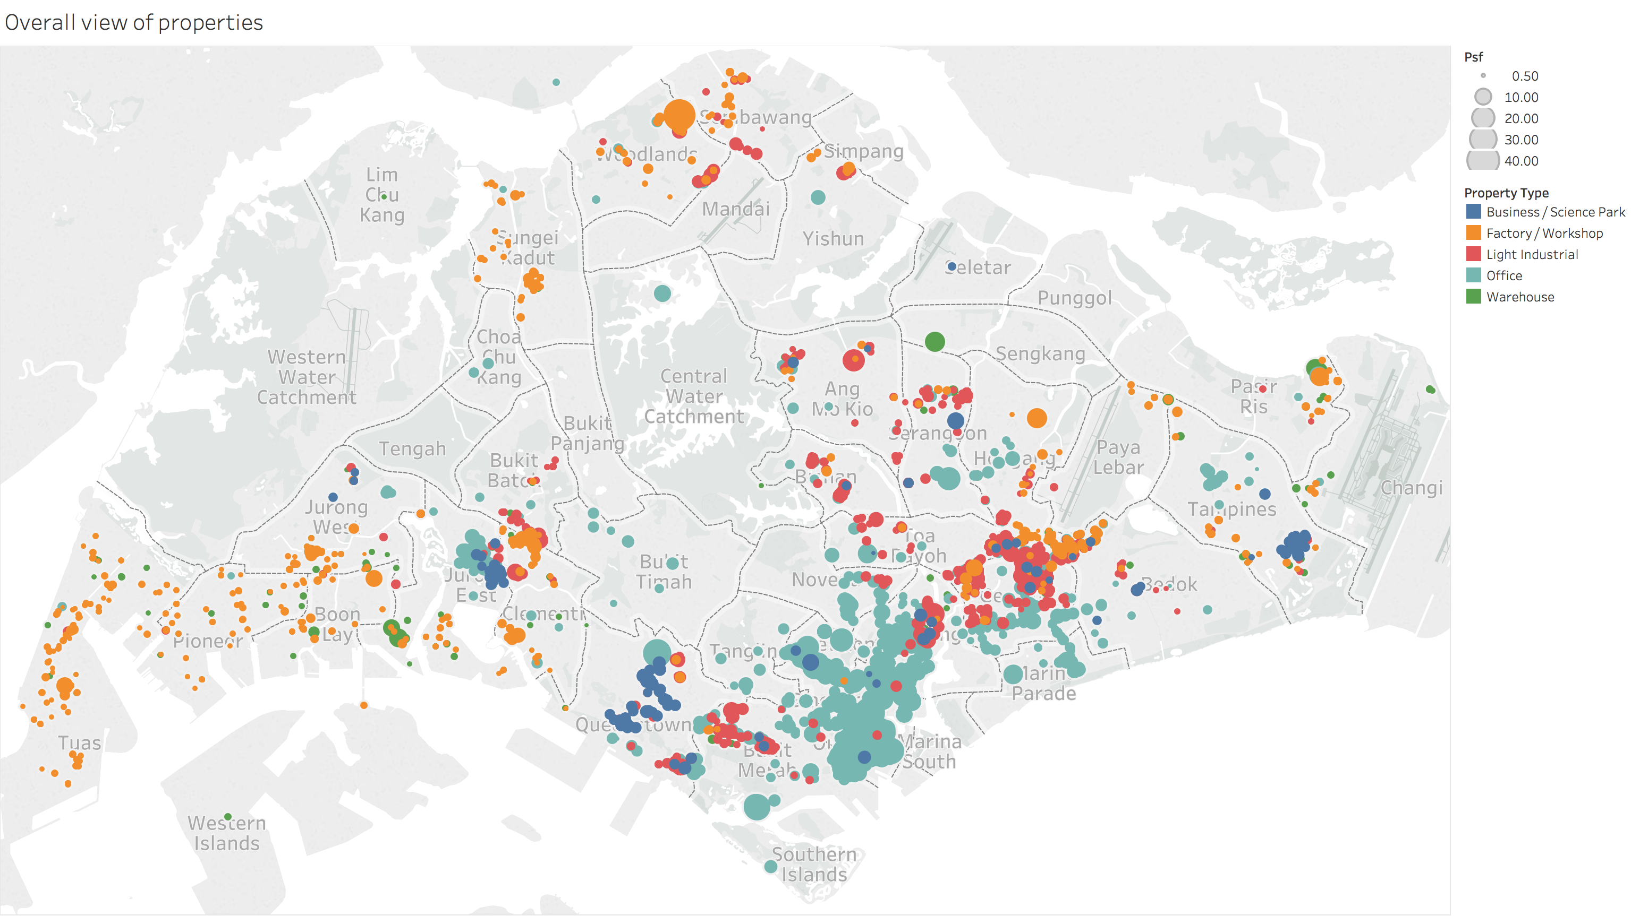
Mapping the dataset

Slide 4
Mapping the dataset
Higher-priced office properties in CBD, lower-priced factories in North, West
Ascendas: mostly concentrated in science parks, some light industrial
Some outliers
Tableau demo
Differences between Ascendas and non-Ascendas portfolio
Explore factors that determine price

Slide 5
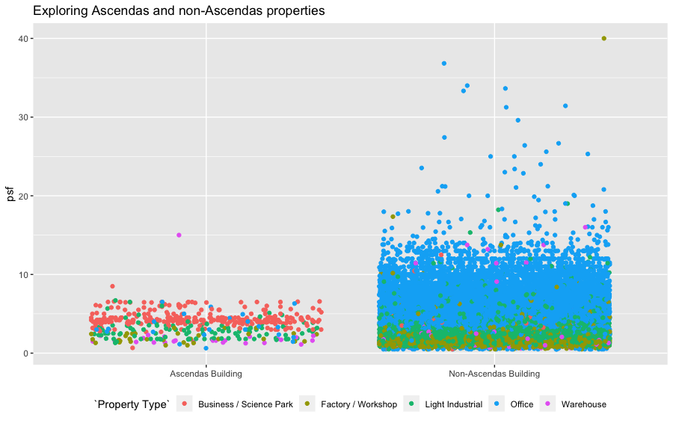
Ascendas portfolio vs. non-Ascendas
Ascendas buildings mostly business/science park or industrial, non-Ascendas skewed by offices
Small number of outliers

Slide 6
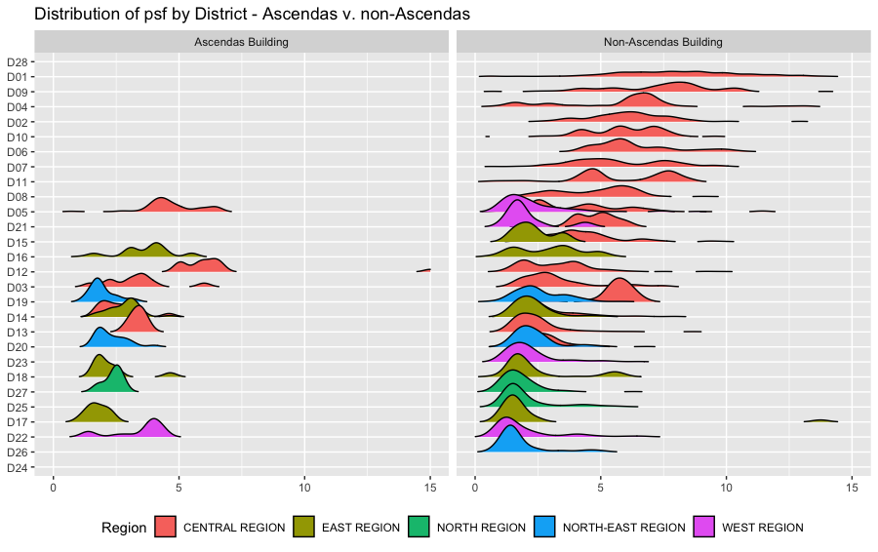
Ascendas vs. non-Ascendas by district
Some major differences in price within districts, e.g. D22

Slide 7
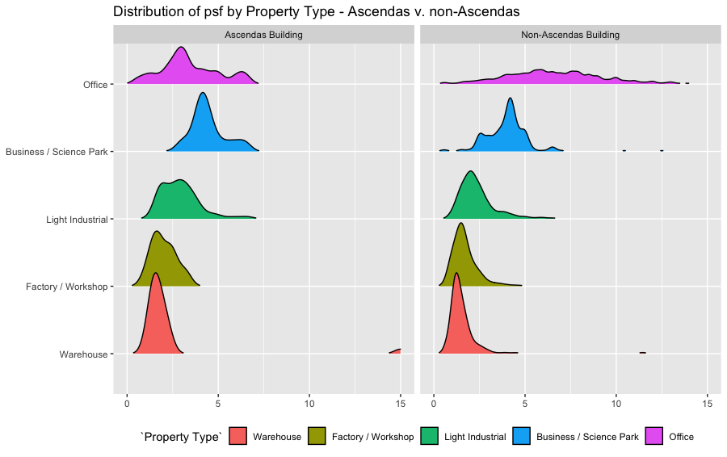
Ascendas vs. non-Ascendas by type
Not much difference in pricing within same property types

Slide 8
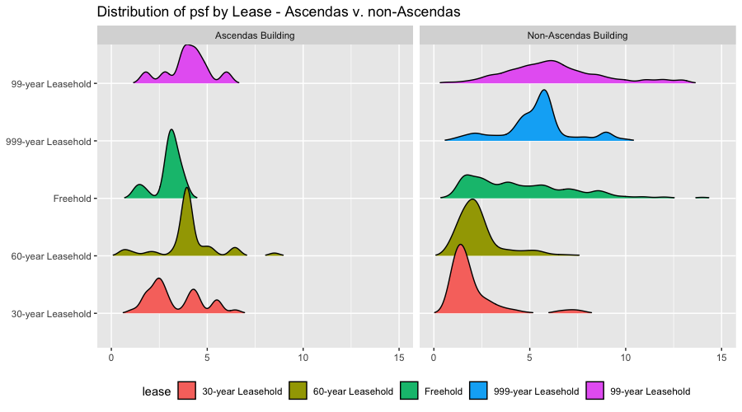
Ascendas vs. non-Ascendas by lease
Significant difference in prices between Ascendas and non-Ascendas
Ascendas 60-year leasehold tends to be higher priced

Slide 9
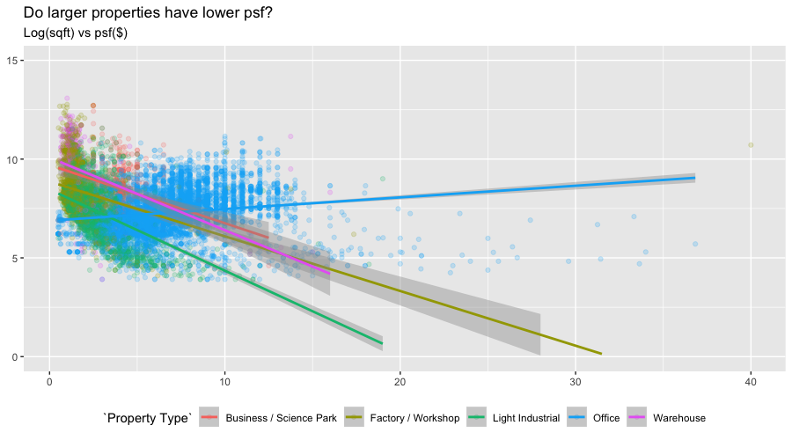
Size vs. Price
Inverse relationship between size and price for all types except Office

Slide 10
Further areas of study
Predictive modelling of prices
More data, e.g. time series, other features

