Slide 1
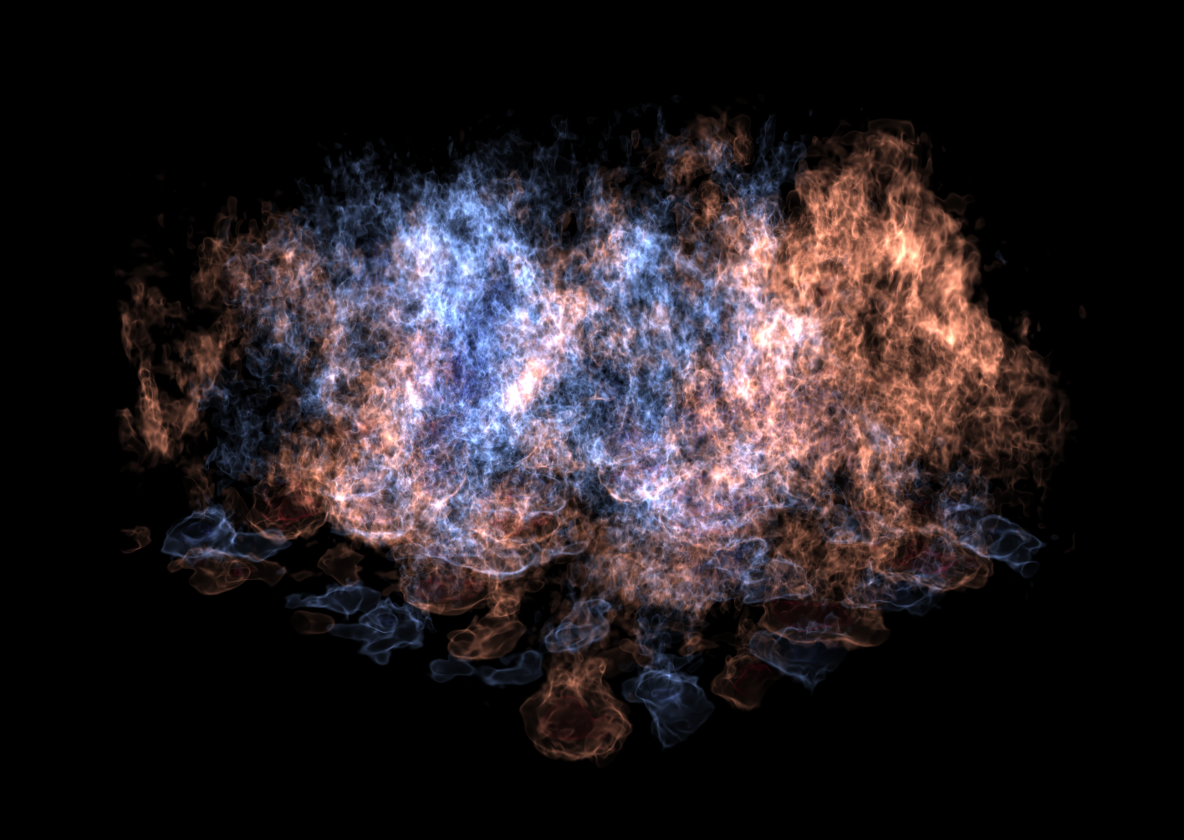

Improved Coupling of Hydrodynamics and Nuclear Burning in Astrophysical Flows using SDC
Michael Zingale
(Stony Brook University) in collaboration with
John Bell, Andy Nonaka, Weiqun Zhang (LBNL),
Max Katz (NVIDIA)
@Michael_Zingale
http://github.com/zingale
Support from DOE Office of Nuclear Physics, DOE ECP
Computer time via DOE INCITE @ OLCF/ORNL and NERSC/LBNL

Slide 2
Astrophysical Environments
Convective burning and explosions
  Supernovae (both thermonuclear and gravitational)
  X-ray bursts and novae (thermonuclear explosion of accreted material on a surface of compact object)
  General stellar evolution, including post main-sequence evolution of massive stars
Convection challenges
  Often the convection is highly subsonic
  Difficult for traditional astrophysical hydrodynamics codes
Explosive challenges
  Burning and hydrodynamics can decouple
New algorithms are needed for efficient simulation of convective astrophysical flows

Slide 3
Challenges of Multiphysics
Stars involve:
  Hydrodynamics (including turbulence and instabilities)
  Combustion
  Self-gravity
  Radiation / diffusion
  Magnetic fields
Timestep restricted by stiffest system
Large range of length scales
  Type Ia supernova:
    Star: 10⁸ cm to flame: 10⁻³ – 0.1 cm
  X-ray burst:
    Star: 10⁶ cm to flame: 10 cm
Timescales
  Stellar evolution: ~ 10⁶ – 10⁹ yr
  Simmering convective phase ~ millenia to days/hours
  Explosion ~ seconds to hours
  Radiation transport ~ weeks to months

Slide 4
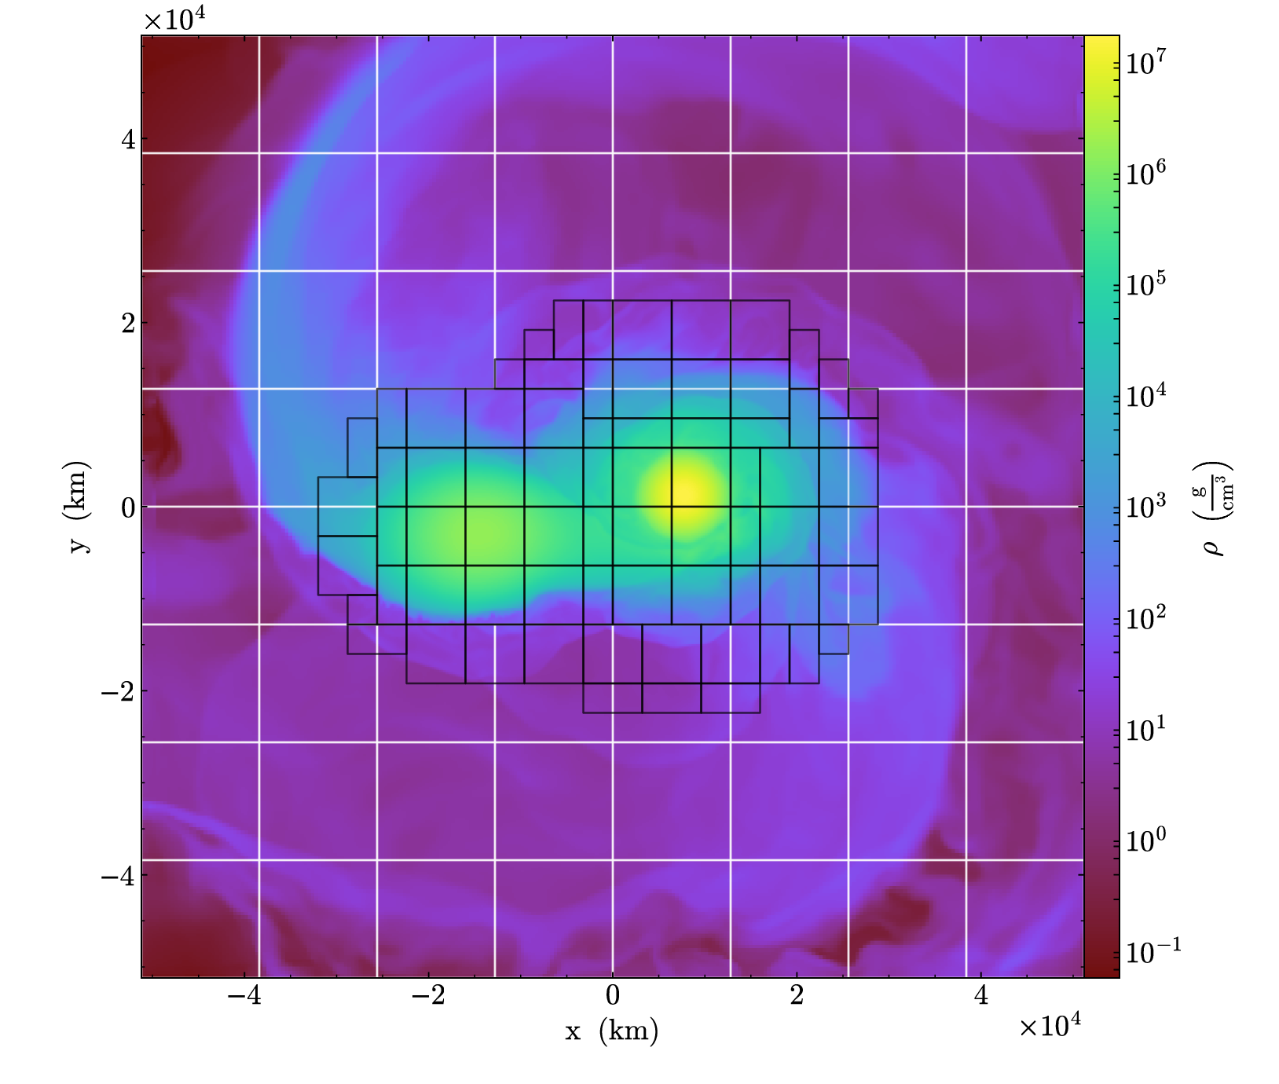
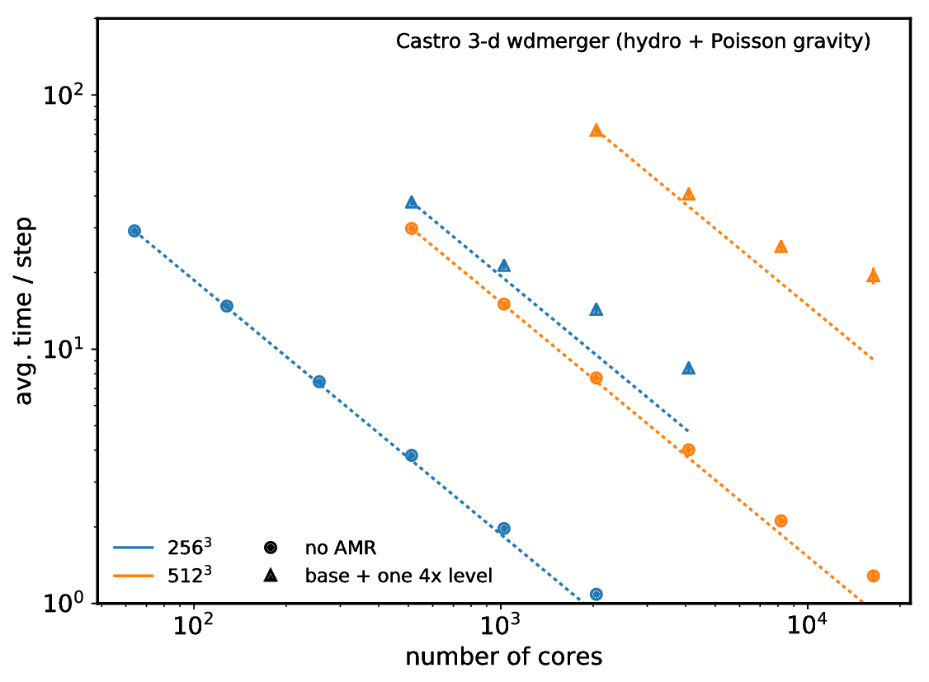
Castro
Castro is our compressible hydrodynamics code
  Unsplit CTU, method-of-lines PPM, or SDC (new)
  Multigroup flux-limited diffusion radiation hydro, including terms to O(v/c)
  AMR with subcycling; jumps of 2× and 4×
  Arbitrary equation of state
  General nuclear reaction networks
  Explicit thermal diffusion
  Full Poisson gravity, conservative flux formulation
  Rotation (in the co-rotating frame) in 2-d axisymmetric and 3-d
refs: Almgren et al. 2010, Zhang et al. 2011, Zhang et al. 2013

Slide 5
XRB Advancements
XRB flame works well with new SDC approach
Can move to 4th order in space and time to help with simulation scales
New approach generalizes to GPUs more easily
  Don’t need an ODE solver on GPUs, just a linear solve for each node per iteration
  May be able to leverage batched solves (cuBLAS) for better performace

Slide 6
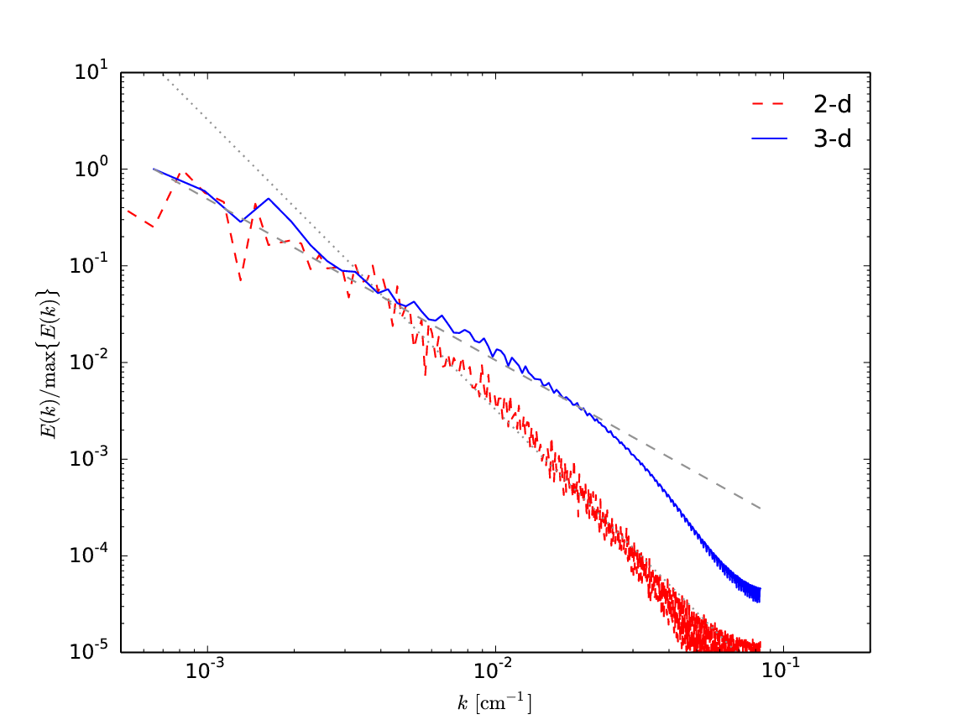
We Need 3-d!
Convection requires 3-d
Turbulence and instabilities are only properly realized in 3-d
  We'll never resolve dissipation scale—Re ~ 10¹⁴ for some of these systems
Note that capturing turbulence requires a minimum of 512 zones across in our experience. If turbulence is important to your problem, you really need to do high resolution.
turbulent kinetic energy spectrum in Maestro XRB calculations

Slide 7
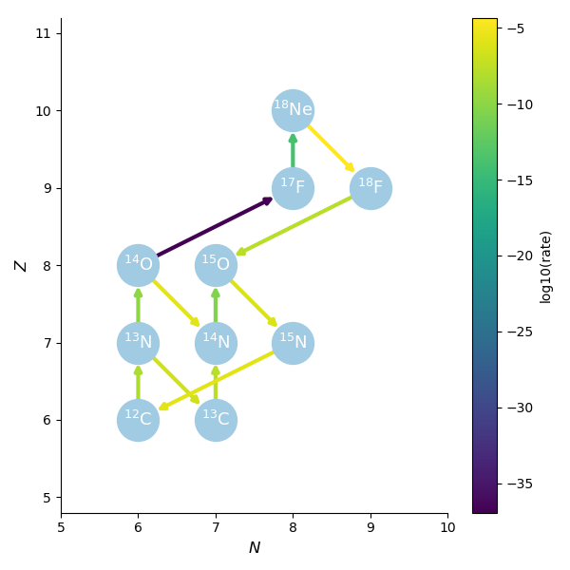
Reaction Networks
Nuclear species are linked together by reactions to form a network
The strength of the connection depends on the thermodynamic state
This network can be written as a system of ODEs giving the time-evolution of each nuclei

Slide 8
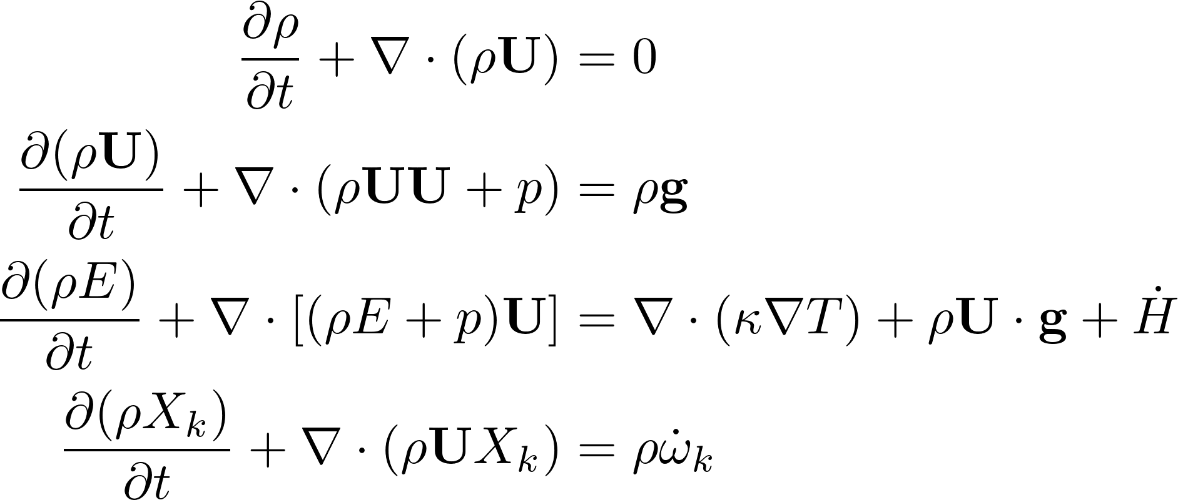

Reactive Flow
Our hydrodynamics system is:
  Energy source from nuclear reactions can be strongly temperature dependent, e.g., ∝ T⁴⁰ for He burning
Species creation rates found via system of ODEs:

Slide 9
Reactive Flow
Reactions and hydrodynamics change on different timescales
We want to use different integration techniques for these two processes
  But they need to remain coupled together.

Slide 10


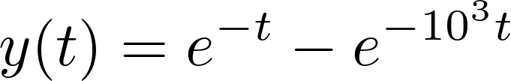
Stiff Equations / Implicit Methods
Consider the ODE (example from Byrne & Hindmarsh 1986):
This has the exact solution:
  Looking at this, we see that there are two characteristic timescales for change, τ₁ = 1 and τ₂ = 10⁻³
  A problem with dramatically different timescales for change is called stiff
Stiff ODEs can be hard for the methods we discussed so far
  Stability requires that we evolve on the shortest timescale

Slide 11
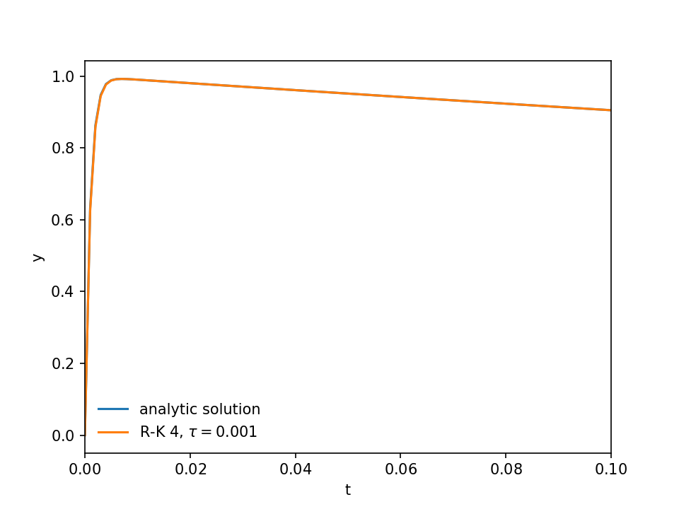
Stiff Equations / Implicit Methods
4th order Runge-Kutta solution with timestep τ = 10⁻³
code: stiff.py

Slide 12
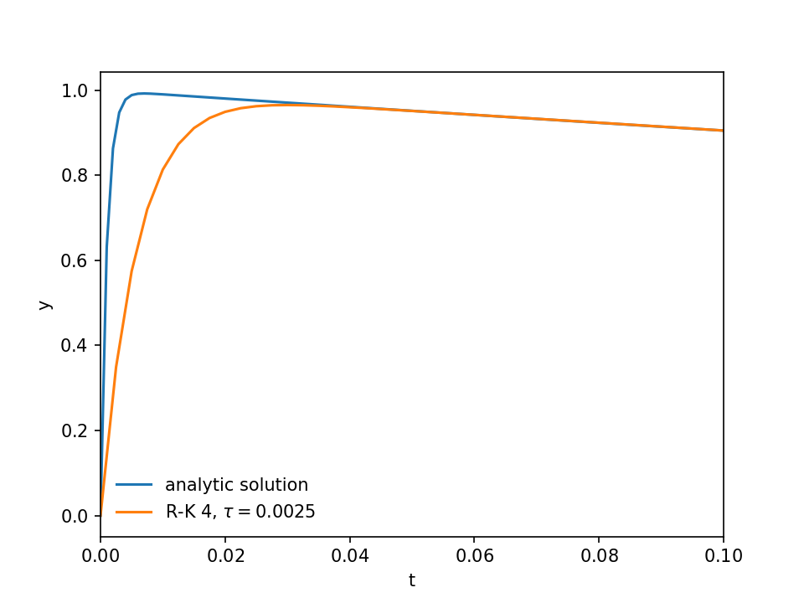
Stiff Equations / Implicit Methods
4th order Runge-Kutta solution with timestep τ = 2.5 ⋅ 10⁻³
Note that the solution is still accurate at long times, but because of the size of our step, we cannot resolve the initial transient, so we diverge there.
code: stiff.py

Slide 13
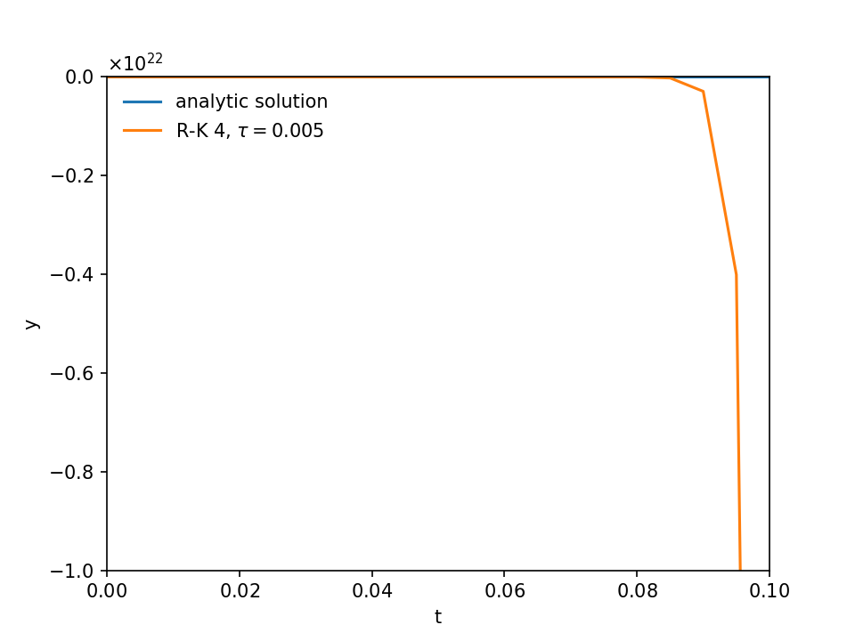
Stiff Equations / Implicit Methods
4th order Runge-Kutta solution with timestep τ = 5 ⋅ 10⁻³
Look at the vertical scale!!!
code: stiff.py

Slide 14
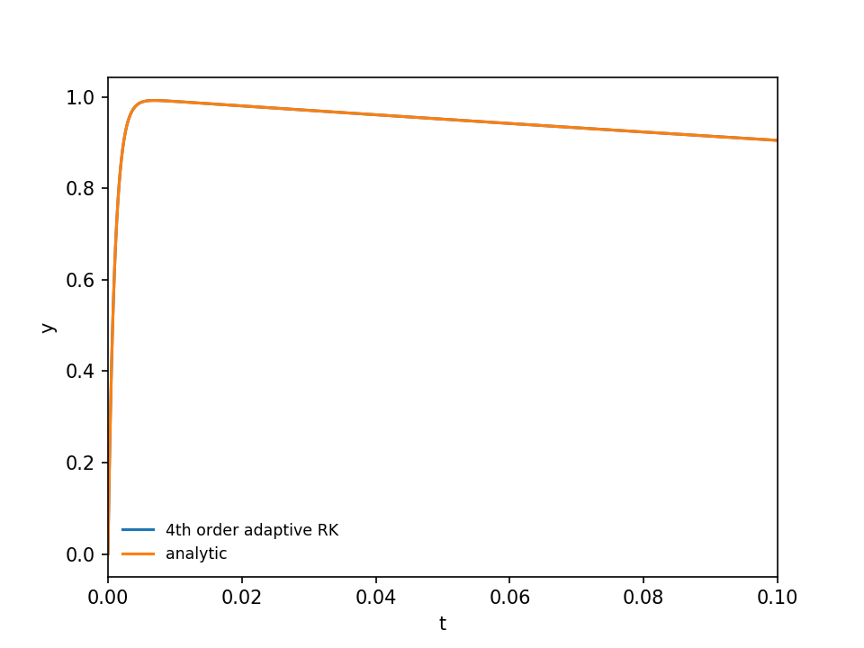
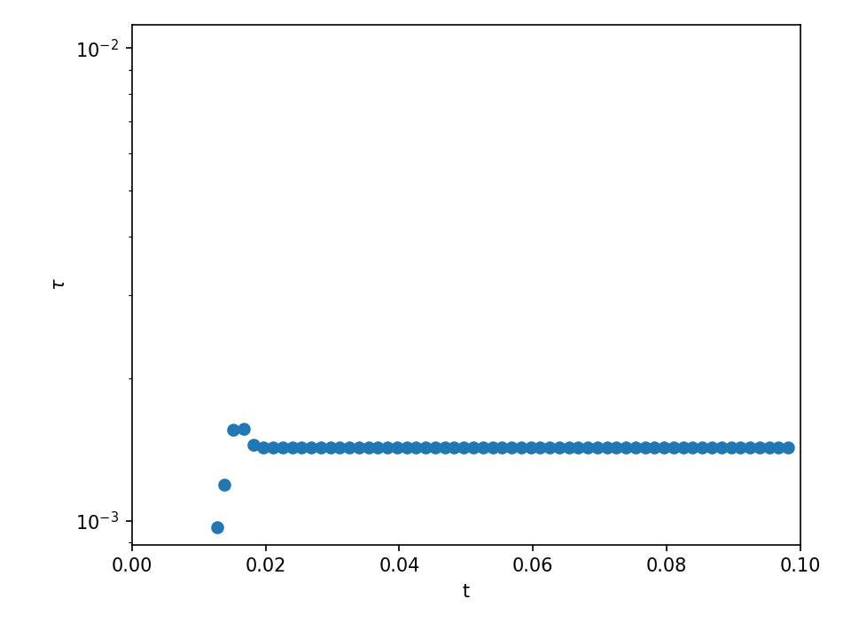
Stiff Equations / Implicit Methods
Adaptive RK4 basically finds that it needs to walk along at the most restrictive timestep, even though the solution is not changing much after that initial transient
code: stiff-rk4-adapt.py

Slide 15

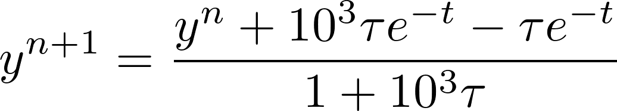
Stiff Equations / Implicit Methods
4th-order Runge-Kutta has been our star so far, but it fails miserably
Consider instead a simple implicit method
  Here the new state depends on the new state
  For our model problem, we can solve for the new state algebraically:
This method is the backward-Euler or implicit Euler method.
  It is first-order accurate

Slide 16
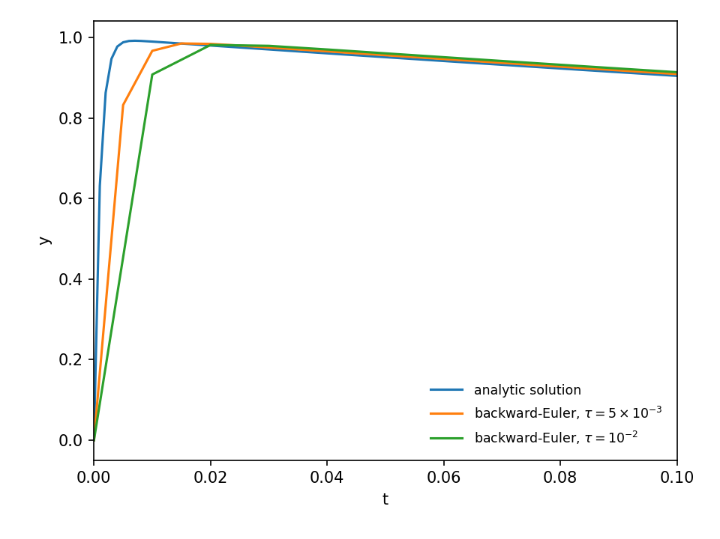
Stiff Equations / Implicit Methods
Notice that even with these large timesteps, none of the solutions blow-up!
Even for these large timesteps, we stay stable. We get the right long time behavior.
We cannot resolve the initial transient though, but this suggests that adaptive timestepping would work well.
code: stiff.py

Slide 17



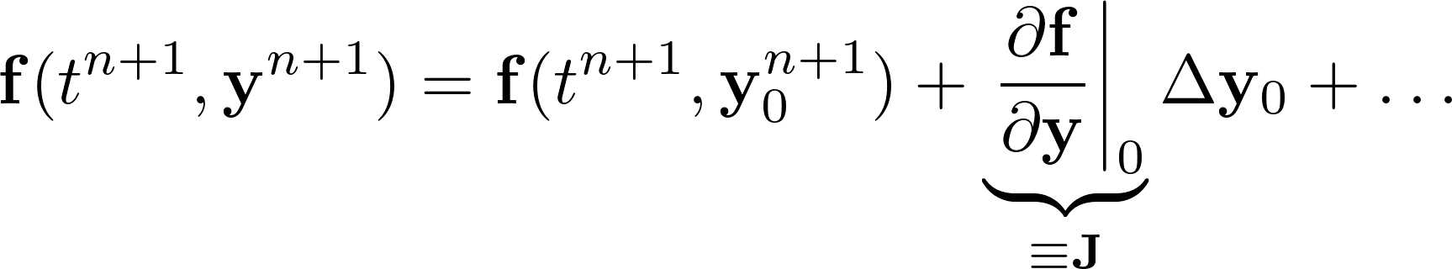
Non-linear Stiff Systems
What about a non-linear system of equations?
  We discretize this as:
  Now, pick a guess for the new solution,
    This gives us a correction:
  Taylor expand our function using this guess

Slide 18

Non-linear Stiff Systems
Our linearized system becomes:
  or in terms of the correction:
This is a linear system (Ax = b) that we solve for the correction.
  Apply the correction
  Check for convergence:
  Iterate, finding the next correction, until we converge

Slide 19
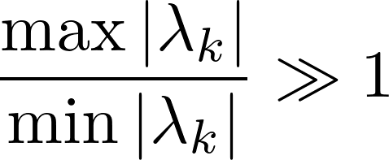
Practical Definition of Stiff
Common definition: look at the eigenvalues of the Jacobian. If
and the eigenvalue are negative, then the problem is called stiff (see, e.g. LeVeque Ch. 8)
More rigorous (Shampine & Gear 1979, as discussed in Byrne & Hindmarsh 1986)
  “By a stiff problem we mean one for which no solution component is unstable (no eigenvalue [of the Jacobian matrix] has a real part which is at all large and positive) and at least some component is very stable (at least one eigenvalue has a real part which is large and negative). Further, we will not call a problem stiff unless its solution is slowly varying with respect to the most negative part of the eigenvalues...Consequently a problem may be stiff for some intervals and not for others.”

Slide 20
Practical Definition of Stiff
Pragmatic definition (Byrne & Hindmarsh 1986)
  “Perhaps the most pragmatic way to determine the stiffness of a system of ODEs is simply to solve it with a non-stiff differential equation package … Then, record the cost of solving the problem. By the way, it would be prudent to impose a limit on CPU time or the number of function evaluations. Similarly, solve the problem with a stiff ODE package … Upper bounds on the cost should again be imposed. Now compare the costs of the two solutions over the same time interval. If the stiff ODE solver was substantially less expensive to use than the non-stiff solver, then the problem was stiff.”

Slide 21
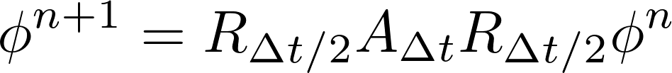
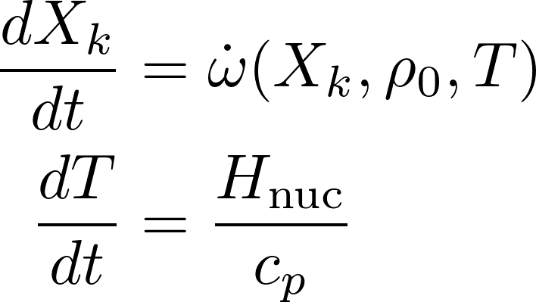
Strang Splitting
Treat each process independent of the others
Ex: advection-reaction:
  Hydro and burning can decouple when t_{hydro} ~ t_{burn}
  Limited to 2nd order
Reaction rate sensitivity ~T⁴⁰
  Some codes ignore this in rate evaluation
Operator split energy equation
Misses effects of advection and diffusion; density doesn’t evolve
Assumes constant pressure in the T evolution, for a compressible code / explosive nucleosynthesis, you might do constant ρ

Slide 22
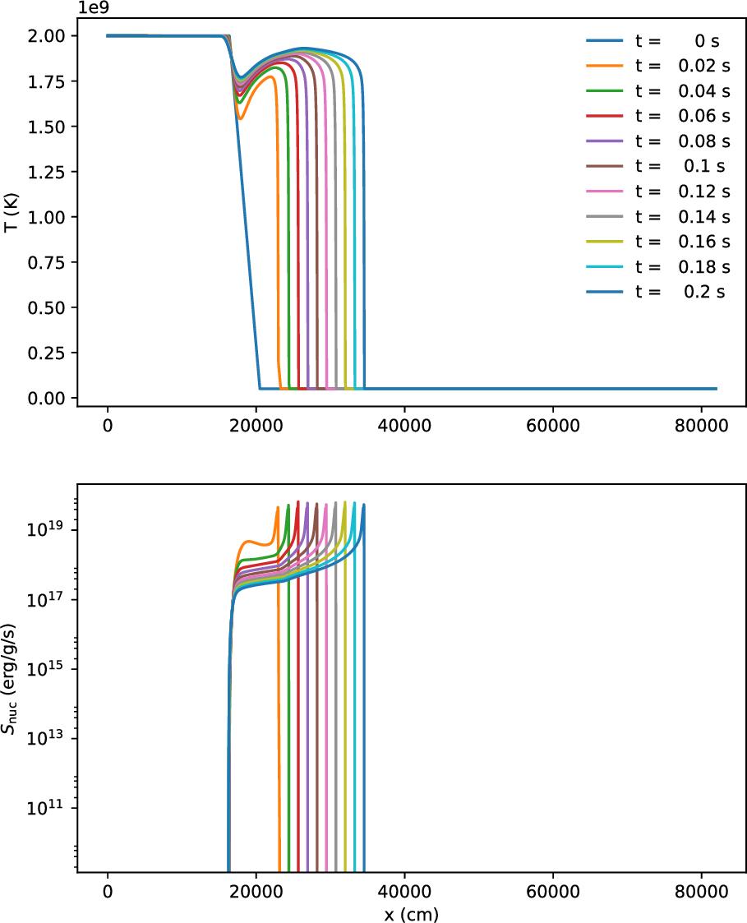
Laminar Flames
Smallest scales: we need to resolve the flame
  Flame is not thin compared to scale height
Experience says ~ 5 points in the thermal thickness
  For our He flame, this gives ~20 cm
Laminar flame speed is slow
  Should accelerate
  We boost the speed to start
Timescale set by how long it takes the flame to cross our domain

Slide 23
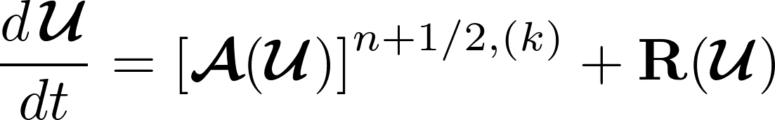
Castro “Simple” SDC
Simple methodology that uses the CTU PPM hydro solver with characteristic tracing
  Do sdc iteration k:
    Predict advective update 𝒜 using iteratively lagged reaction source term
    Solve reaction ODE system with piecewise-constant-in-time advective source :
    Defines 𝒰^{(k+1)}
    Construct new reaction source term for next iteration
  Typically, we need 2 iterations for second order

Slide 24
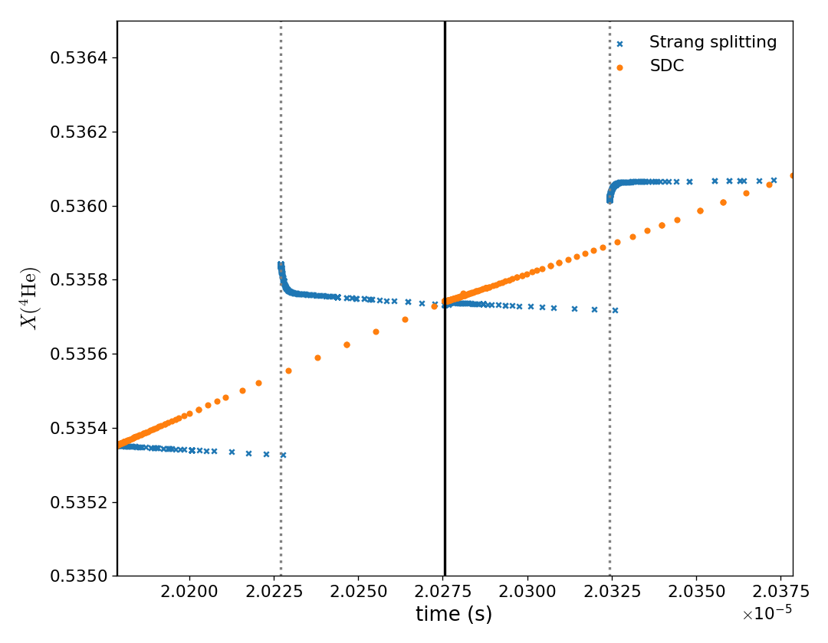
Castro “Simple” SDC
SDC can remove some stiffness from the system
Splitting can require smaller timesteps to improve coupling
  For terrestrial flames, it has been shown that SDC can allow for larger timesteps
For detonations, this might help with NSE
Example from a He detonation, showing He abundance

Slide 25
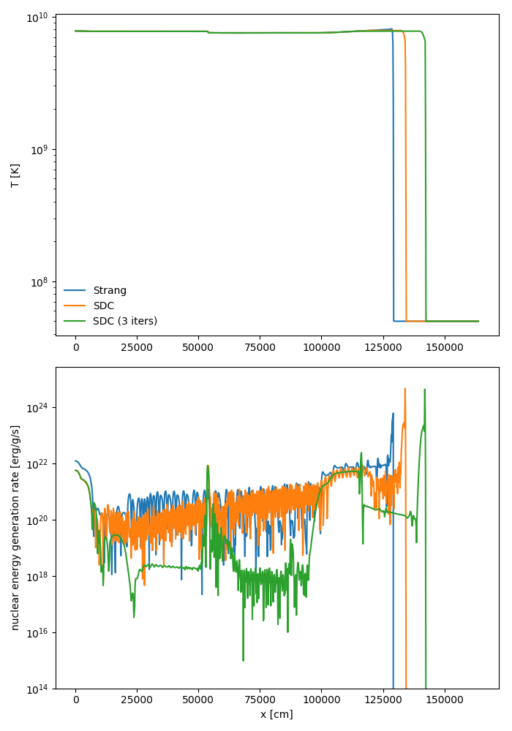
Application: He Detonation
Above 4 billion K, nuclear statistical equilibrium sets in
  Forward and reverse rates balance
  Equilibrium abundance of ⁴He, ⁵⁶Ni, … produced
  Very challenging for a hydro code: large positive flows in one step followed by large negative in the next
Typical modeling solution: drop the timestep

Slide 26
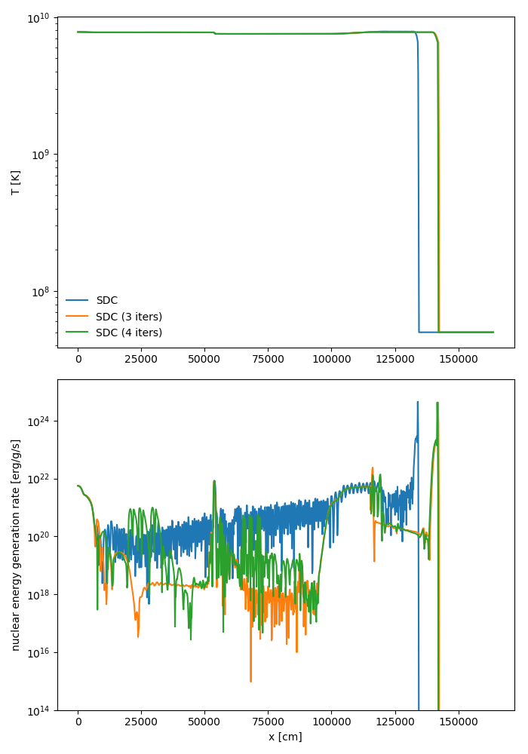
Application: He Detonation
SDC seems to converge with number of iterations

Slide 27
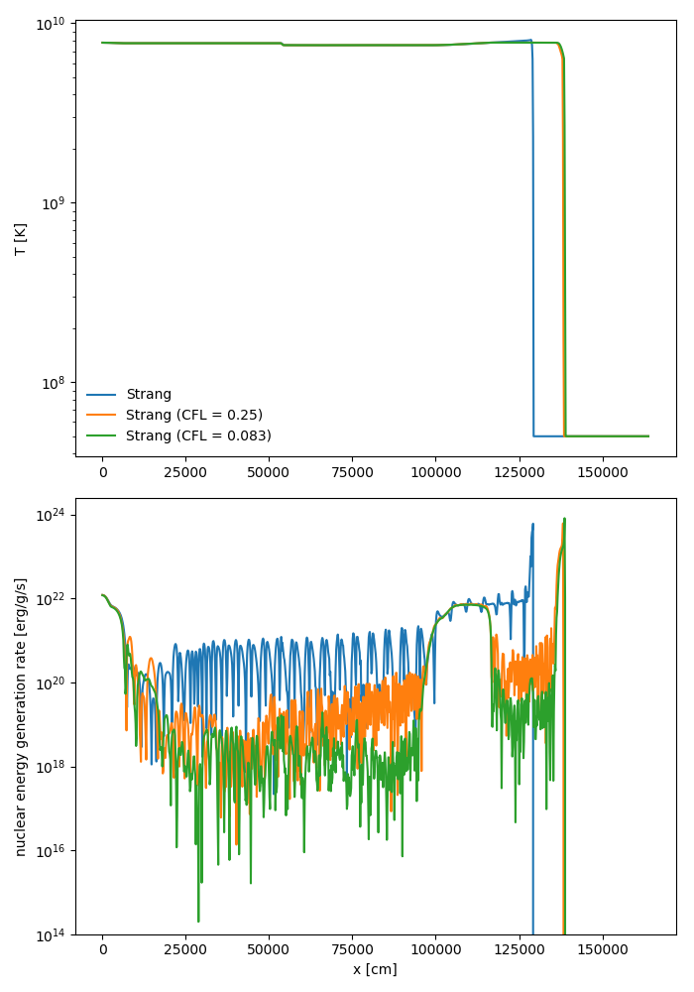
Application: He Detonation
Strang converges with timestep size

Slide 28
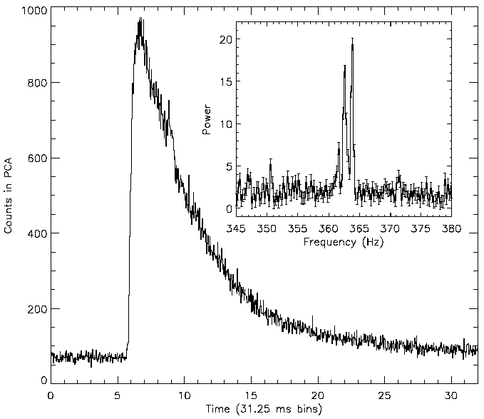
X-ray Bursts
Thermonuclear runaway in thin accreted H/He layer on surface of a neutron star
Accretion timescale ~ hours to days
Runaway timescale ~ seconds
> 70 sources known, some with 10s or more individual bursts.
Potential site for rp-process nucleosynthesis
Strohmayer et al., 1996, ApJ, 469:L9

Slide 29
Outstanding XRB Questions
How does the fuel spread over the surface?
How does the ignition begin?
Is the burning localized?
Does convection modify the nucleosynthesis?
What are the effects of rotation?
Does convection bring ash to the surface?
These are all multi-dimensional effects

Slide 30
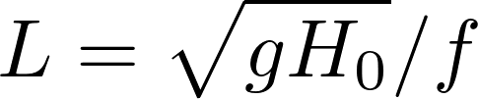
Lateral Flame Spreading
Lateral flame propagation with resolved nuclear physics
  Lengthscale for Coriolis force to balance pressure gradient (Rossby length): ~ few km
    Much bigger domain that we currently use
Capturing lengthscale is challenging: we want to go higher order
vfront

Slide 31
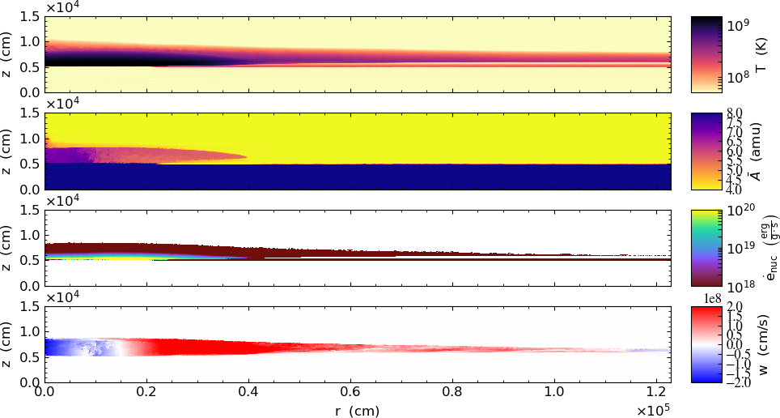
XRB Flame Spreading
Coriolis force confines lateral spreading (geostrophic balance)

Slide 32
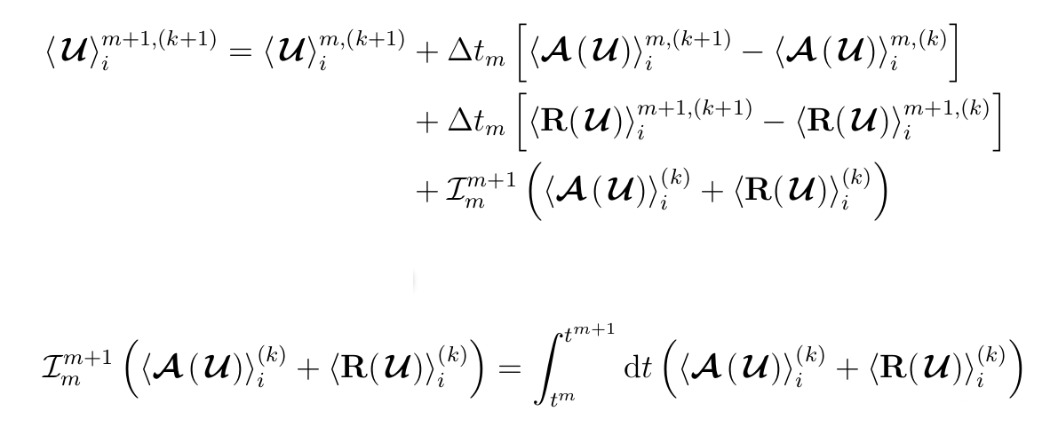
High-order SDC
Capturing range of lengthscales in XRB simulations is challenging
4th order finite-volume method + SDC time integration
  Last term is integral over temporal nodes
  4th order achieved with Simpson’s rule

Slide 33
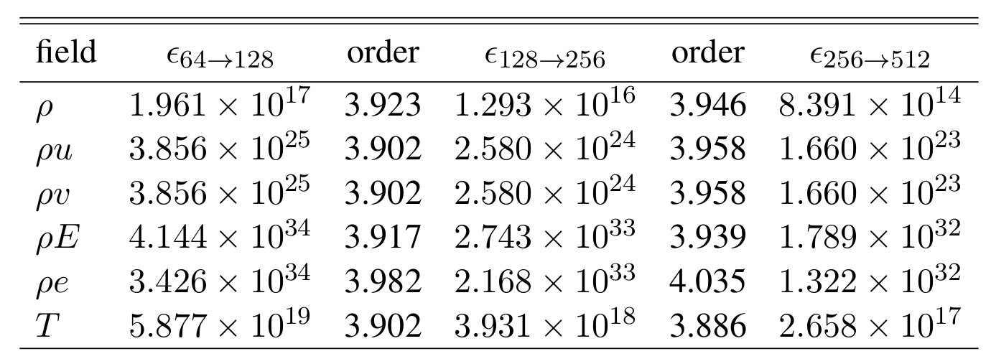
High-order SDC
Current status:
  Hydro with general equation of state converges 4th order

Slide 34
Summary/Future
Chandra SNe Ia:
  Single-point, off-center ignition
  Urca process calculations are starting
Sub-Ch SNe Ia: variety, likely single-point…
WD mergers: infrastructure developed to allow for accurate, high-resolution modeling
XRBs: we are resolving laterally propagating flames to understand dynamics
Astrophysical modeling requires the cooperation of many different domain scientists
Maestro development directions: rotation, higher-order, acoustics, MHD, ???
Castro development: improved coupling of hydro and reactions, GPU performance portability
Releasing simulation codes / problem files is part of scientific reproducibility

