Slide 1
Testing

Slide 2
What Kinds of Testing Exist?
This is a big topic:
  https://en.wikipedia.org/wiki/Software_testing
We most commonly hear about:
  Unit testing
    Tests that a single function does what it was designed to do
  Integration testing
    Tests whether the individual pieces work together as intended
    Sometimes done one piece at a time (iteratively)
  Regression testing
    Checks whether changes have changed answers
  Verification & Validation (from the science perspective)
    Verification: are we solving the equations correctly?
    Validation: are we using the right equations in the first place?

Slide 3
Automation
The best testing is automated—you don’t need to remember to run it
  Developers can forget to manually run tests
Github / bitbucket have continuous integration service that can be run on pull requests
  This is commonly used on large development projects

Slide 4
Unit Testing
We want to test the smallest piece of functionality alone
  E.g., a simple test that ensures that a function does what it is designed to do
Unit testing alone is not enough
  Although it gives you confidence that each piece works alone as designed, it doesn’t test what happens when you put it all together
  Integration testing is a much harder problem

Slide 5

Unit vs. Integration Testing

Slide 6
Unit Testing
When to write tests?
  Some people advocate writing a unit test for a specification before you write the functions they will test
    This is called Test-driven development (TDD): https://en.wikipedia.org/wiki/Test-driven_development
    This helps you understand the interface, return values, side-effects, etc. of what you intend to write
  Often we already have code, so we can start by writing tests to cover some core functionality
    Add new tests when you encounter a bug, precisely to ensure that this bug doesn’t arise again
Tests should be short
  You want to be able to run them frequently

Slide 7
Unit Testing
There are several frameworks for unit testing in python—we’ll focus on pytest
  Note: like packaging, unit testing frameworks in python appear in a state of flux
  For a long time, nose was one of the most popular frameworks, but its development has ceased
    nose2 is a successor to nose that may become standard soon
  unittest is built into python, and may interact with nose2 in the future
  pytest (sometimes py.test) seems to be the most popular now—we’ll explore that
Basic elements:
  Discoverability: it will find the tests
  Automation
  Fixtures (setup and teardown)

Slide 8
pytest Unit Testing
Install (single-user) via: pip3 install -U pytest –user
  pytest should now be in your path
    Note: older name was py.test
  For user-install, it may be that ~/.local/bin/ comes later in your PATH than a system-wide directory with an older pytest
    You may need to explicitly alias it
For coverage reports: pip3 install -U pytest-cov --user

Slide 9
pytest Unit Testing
Test discovery makes unit testing easy—adhere to these conventions and your tests will be found:
  File names should start or end with “test”:
    test_example.py
    example_test.py
  For tests in a class, the class name should begin with “Test”
    e.g., TestExample
    There should be no __init__()
  Test method / function names should start with “test_”
    e.g., test_example()
https://pytest.readthedocs.io/en/reorganize-docs/new-docs/user/naming_conventions.html

Slide 10
pytest Unit Testing
Tests use assertions (via python’s assert statement) to check behavior at runtime
  https://docs.python.org/3/reference/simple_stmts.html#assert
  Basic usage: assert expression
    Raises AssertionError if expression is not true
    e.g., assert 1 == 0 will fail with an exception

Slide 11
Simple pytest Example
Here’s a simple example (examples/testing/pytest/simple/ in our git repo):
  There are 2 tests here
    First will pass, second will fail
  Run the tests as: pytest -v .
def multiply(a, b):
return a*b
def test_multiply():
assert multiply(4, 6) == 24
def test_multiply2():
assert multiply(5, 6) == 24

Slide 12
pytest Fixtures
Unit tests sometimes require some setup to be done before the test
  Fixtures provide this capability
  We’ll look at setup and teardown functions/methods for tests
    These are sometimes referred to the standard xUnit fixtures
    pytest supports a more flexible system for fixtures in addition to these, but we won’t look at it here
    http://pytest.org/dev/fixture.html
By default, pytest will capture stdout, and only show it on failures
  See, e.g., https://docs.pytest.org/en/latest/capture.html
  This can be changed with the -s flag
Example of function-level setup/teardown in examples/testing/pytest/function_setup/

Slide 13
pytest Unit Testing
Class example
  Note, a class used for testing is not a full-fledged class—it simply helps to organize data used for a bunch of tests with common needs
  In particular, it does not have a constructor (__init__())
    See, e.g., https://stackoverflow.com/questions/21430900/py-test-skips-test-class-if-constructor-is-defined
We’ll look at an example with a NumPy array
  examples/testing/pytest/class/ in our class git
  We always want the array to exist for our tests, so we’ll use fixtures (in particular setup_method()) to create the array
  Using a class means that we can access the array created in setup from our class
NumPy has its own assertion functions
  https://docs.scipy.org/doc/numpy/reference/routines.testing.html
  Note in particular, the approximately equal tests

Slide 14
pytest Coverage
We can determine the coverage of our testing
  Note just because a line / function is covered in our suite, doesn’t mean we’ll capture every error—there can always be corner-cases, things you don’t anticipate
  Adding unit tests is an ongoing process
Basic running:
  pytest --cov .
  Here, ‘.’ is the path we are testing
Detailed report (lines missed):
  pytest --cov-report term-missing --cov .

Slide 15
pytest Coverage
.
├── advection
│ ├── problems
│ └── tests
├── advection_rk
│ ├── problems -> ../advection/problems
│ └── tests
├── analysis
├── compressible
│ ├── problems
│ └── tests
├── compressible_react
├── compressible_rk
│ ├── problems -> ../compressible/problems
│ └── tests
├── diffusion
│ ├── problems
│ └── tests
├── incompressible
│ ├── problems
│ └── tests
├── lm_atm
│ ├── problems
│ └── tests
├── lm_combustion
├── mesh
│ ├── experiments
│ └── tests
├── multigrid
│ └── tests
├── radhydro
├── util
│ └── tests
└── www
Let’s look at a larger example:
  pyro is my tutorial hydrodynamics code: https://github.com/zingale/pyro2
pyro has both unit tests (via pytest) and regression testing (more on that later)
Tests are stored in the various tests/ subdirectories

Slide 16
Regression Testing
Basic idea:
  Pick some problems / workflows that exercise your codebase
    Might need many tests to get good coverage / explore all options
  Store a benchmark containing the “right” answer
  Each time you change your code, run the regression tests
  Compare the new answer to the stored benchmark
If a regression test fails, then either:
  You’ve introduced a bug—look at what changed and fix it
  You fixed a bug—update the benchmarks

Slide 17
Regression Testing
Automating the testing
  You need a tool to do the comparisons
  Store benchmarks in a separate directory (so they are not overwritten when you run)
  Run your code, at the end of the run, compare the new output to the stored benchmark and report
Our example, pyro, has regression testing built in with the --compare_benchmark option
Here’s another example from my research codes: http://bender.astro.sunysb.edu/Castro/test-suite/test-suite-gfortran/

Slide 18
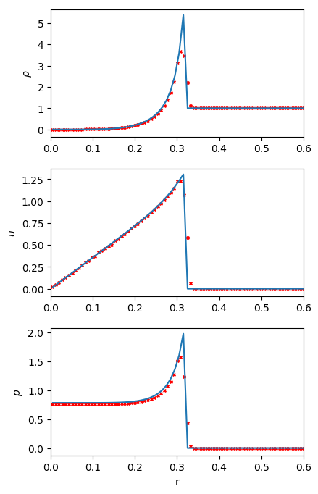
Verification
For science codes, verification means test our algorithm against a known solution to the system of equations we are solving
  This doesn’t help us understand if we picked the right equations (e.g., correct model of reality) to begin with
For the equations of hydrodynamics, the Sedov blast wave problem is a common verification problem
  A lot of energy is put into a small volume in a uniform domain
  Spherical blast wave develops
  Analytic solution found in the 1940s

Slide 19
Our Class Slack
After the semester, I’ll keep on our class Slack for as long as people want to continue to chat
  Feel free to continue to ask questions that might help with your research, etc
I’ll share links to new developments / conferences / summer schools, etc. that might be of interest

Slide 20
Next Semester: Numerical Methods
I’m offering PHY 604: Computational Methods in Physics and Astronomy II next semester
  All the “II” means is that you know how to program
Topics:
  basic of computing
  software engineering (git, testing, …)
  differentiation and integration
  interpolation
  root finding
  ODEs (explicit/implicit methods, two point boundary problems, eigenvalue problems)
  linear algebra
  fast Fourier transforms
  fitting
  Monte Carlo (integration, Markov chain Monte Carlo, simulated annealing)
  PDEs (hyperbolic, elliptic/multigrid, & parabolic)
  genetic algorithms
  machine learning / neural nets
  intro to parallel computing
  computational fluid dynamics
http://bender.astro.sunysb.edu/classes/numerical_methods/

