Slide 1
Software Engineering
Practices for Python

Slide 2
Coding Experiences
Good development practices help with the following situations:
  You swear that the code worked perfectly 6 months ago, but today it doesn't, and you can't figure out what changed
  Your research group is all working on the same code, and you need to sync up with everyone's changes, and make sure no one breaks the code
  Your code always worked fine on machine X, but now you switch to a new system/architecture, and you code gives errors, crashes, ...
  Your code ties together lots of code: legacy code from your advisor's advisor, new stuff you wrote, all tied together by a driver. The code is giving funny behavior sometime—how do you go about debugging such a beast?

Slide 3
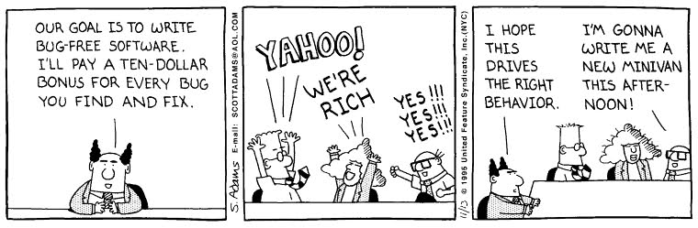
Software Engineering Practices
We'll look at some basic python style guidelines and some tools that help with the development process
  Also helps reproducibility of your science results
  You can google around for specific details, more in-depth tutorials, etc.

Slide 4
Software Engineering Practices
Some basic practices that can greatly enhance your ability to write maintainable code
  Version control
  Documentation
  Testing procedures
  For compiled languages, I would add Makefiles, profilers, code analysis tools (like valgrind)
There is an official python coding standard: PEP 8
  Helps you interact with a distributed group of developers—everyone writes code with the same convention

Slide 5
Python Style
The recommended python style is described in a “Python Enhancement Proposal”, PEP-8
  http://legacy.python.org/dev/peps/pep-0008/
  Based on the idea that “code is read much more often than it is written”
Some highlights:
  Indentation should use 4 spaces (no tabs)
  Lines should be less than 79 characters
    Continuation via '\' or ()
  Classes should be capitalized of form MyClass
  Function names, objects, variables, should be lower case, with _ separating words in the name
  Constants in ALL_CAPS
We'll look at the basic programming styles at the official PEP-8 page

Slide 6
Python Bits We Glossed Over
With
Try/except
Pickle
...

Slide 7
with
with uses a context manager that has a special __enter__ and __exit__ function.
Simplifies some common constructions
Eg.
with open("x.txt") as f:
data = f.read()
do something with data
  This will open the file, return the file object f, allow you to work with it, and close the file automatically when this block is over
http://effbot.org/zone/python-with-statement.htm

Slide 8
try/except
We skipped over this originally.
try/except provide a good way to catch errors
try: f = open("existing-file", "r")
except:
print "Error openning the file"
else:
# work with the file
It is good practice to use these when interacting with files, the user, etc., to allow you to recover from errors.

Slide 9
pickle
pickle takes an object and “serializes” it so it can be written to disk
You can then read in a pickled object and it is restored as the original object.
Ex:
pF = open(filename + ".pyro", "wb")
pickle.dump(self, pF, pickle.HIGHEST_PROTOCOL)
pF.close()
pF = open(filename, "rb")
data = pickle.load(pF)
pF.close()

Slide 10
Coding Style
Don't make assumptions
  For if clauses, have a default block (else) to catch conditions outside of what you may have expected
  Use try/except to catch errors
Use functions/subroutines for repetitive tasks
  Check return values for errors
  Use well-tested libraries instead of rolling your own when possible

Slide 11
Version Control
Old days: create a tar file with the current source, mail it around, manually merge different people's changes...
Version control systems keep track of the history of changes to source code
  Logs describe the changes to each file over time
  Allow you to request the source as it was at any time in the past
  Multiple developers can share and synchronize changes
    Merges changes by different developers to the same file
    Provide mechanisms to resolve conflicting changes to files
  Provide mechanisms to create a branch to develop new features and then merge it back into the main source.

Slide 12
Version Control
Even for a single developer version control is a great asset
  Common task: you notice that your code is giving different answers/behavior than you've seen in the past
    Check out an old copy where you know it was working
    Bisect the history between the working and broken dates to pin down the change
Can also use it for papers and proposals—all the authors can work on the same LaTeX source and share chages
All of these slides are stored in version control—let's me work on them from anywhere easily
  Fun trick: LibreOffice files are zipped XML, but you can have it store the output as uncompressed “flat” XML files (.fodp instead of .odp)

Slide 13
Centralized vs. Distributed Version Control
Centralized (e.g. CVS, subversion)
  Server holds the master copy of the source, stores history, changes
  User communicates with server
    Checkout source
    Commit changes back to the source
    Request the log (history) of a file from the server
    Diff your local version with the version in the server
  Doesn't scale well for very large projects
  “Older” style of version control
Distributed (e.g. git, mercurial)
  Everyone has a full-fledged repository
  You clone another person's repo
  Commits, history, diff, logs are all local operations (these operations are faster)
  You push your changes back to others.
  Each copy is a backup of the whole history of the project
  Easier to fork—just clone and go
Any version control system is better than none!

Slide 14

Distributed Version Control
you
group member
Add,
commit
Add,
commit
Working copy
pull
Working copy
checkout,
log
checkout,
log
push
push
pull
pull
pull
external
collaborator
Group server
Add,
commit
Working copy
checkout,
log

Slide 15
Distributed Version Control
In an ideal world, people only pull from others, never push.
  See, e.g. http://bitflop.com/document/111
Github/bitbucket provide a centralized repo built around pull requests

Slide 16
Version Control
Note that with git, every change generates a new “hash” that identifies the entire collection of source.
  You cannot update just a single sub-directory—it's all or nothing.
Branches in a repo allow you to work on changes in a separate are from the main source.
  You can perfect them, then merge back to the main branch, and then push back to the remote.
LOTS of resources on the web.
Best way to learn is to practice.
There is more than one way to do most things
Free (for open source), online, web-based hosting sites exist (e.g. Github, BitBucket, ...)

Slide 17

Git
(xkcd)

Slide 18
Quick git Example
Start your project out
mkdir myproject
cd my project
git init
Now create a file (or two), add it to the repository (so git knows about it) and commit your changes
emacs -nw README
<enter something in the file and save>
git add README
git commit README
Notice that when you commit, an editor will pop up asking for a log message—this is important. Take the time to write an explanation of the change.

Slide 19
Quick git Example
We'll look at the example of having people work with a shared remote repository—this is common with groups.
  Each developer will have their own clone that they interact with, develop in, branch for experimentation, etc.
  You can push and pull to/from the remote repo to stay in sync with others
  You probably want to put everyone in the same UNIX group on the server
Creating a master bare repo:
git init --bare --shared myproject.git
chgrp -R groupname myrepo.git
Note the permissions set the sticky bit for the group

Slide 20
Quick git Example
This repo is empty, and bare—it will only contain the git files, not the actual source files you want to work on
Each user should clone it
  In some other directory. User A does:
git clone /path/to/myrepo.git
  Now you can operate on it
Create a file (README)
Add it to your repo: git add README
Commit it to your repo: git commit README
Push it back to the bare repo: git push
  Note that for each commit you will be prompted to add a log message detailing the change
* older versions of git won't know where push to. Instead of this, you can tell git to use the proposed new (git 2.0) behavior by doing:
git config --global push.default simple
git push

Slide 21
Quick git Example
Now user B comes along and wants to play too:
  In some other directory. User B does:
git clone /path/to/myrepo.git
  Note that they already have the README file
Edit README
Commit you changes locally: git commit README
Push it back to the bare repo: git push
Now user A can get this changes by doing: git pull
  Note that I did this on my laptop for demonstration, but the different users can be on completely different machines (and in different countries), as long as they have access to the same server
  In general, you can push to a bare repo, but you can pull from anyone

Slide 22
Quick git Example
You can easily look at the history by doing: git log
You can checkout an old version using the hash:
git checkout hash
Make changes, use this older version
Look at the list of branches: git branch
Switch back to the tip: git checkout master
Other useful commands:
  git diff
  git status
  Branching
    git branch experiment
    git checkout experiment
  git blame
git checkout -b experiment

Slide 23
Quick git Example
You can also put a link to your bare repo on the web and people can clone it remotely
  Note you need to do git update-server-info -f after each change to the repo

Slide 24
Github example
Don't want to use your own server, use github or bitbucket
  Free for public (open source) projects
  Pay for private projects
These class notes are on github:
  Create a github account (free)
  git clone https://github.com/sbu-python-class/python-science
Note: since you are not a member of that project, you cannot push back to it
  You don't have write access
  Instead:
    Fork the project into your own account
    Push back to your fork
    Issue a pull-request asking for your changes to be incorporated
    Feel free to try this out with the class repo!

Slide 25
Version Control
There's no reason not to use version control
  Pick one (git or hg) and use it
Even if you are working alone
  Each clone has all the history of the project
  Cloning on different machines means you have backups
  Allows you to sync up your work between home and the office

Slide 26
Unit Testing
When writing a complex program (e.g. a simulation code), there can be many separate steps / solvers involved in getting your answer.
  Finding out the source of errors in such a complicated code can be tough.
Unit testing is the practice in which each smallest, self-contained unit of the code is tested independently of the others.
  You could, for example, start by writing tests for each of the major physics units, and then worry about lower levels
Implementation:
  Either write your own simple driver for each routine to be tested
  Unit testing frameworks automate some tasks

Slide 27
Unit Testing
Simple example: matrix inversion
  Your code have a matrix inversion routine that computes A⁻¹
  A unit test for this routine can be:
    Pick a vector x
    Compute b = A x
    Compute x = A⁻¹ b
    Does the x you get match (to machine tol) the original x?
More complicated example: a hydro program may consist of
  Advection routines, EOS calls (and inverting the EOS), Particles, Diffusion, Reactions
  Each of these can be tested alone
There is a python unit testing framework called nose—we can explore that in the discussion forum if there is interest.

Slide 28
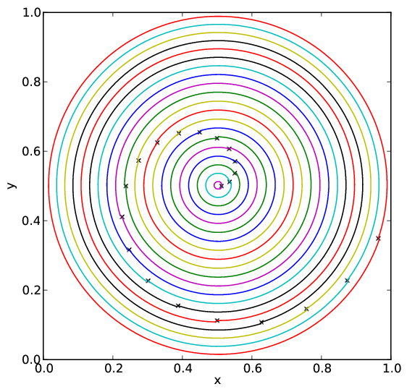
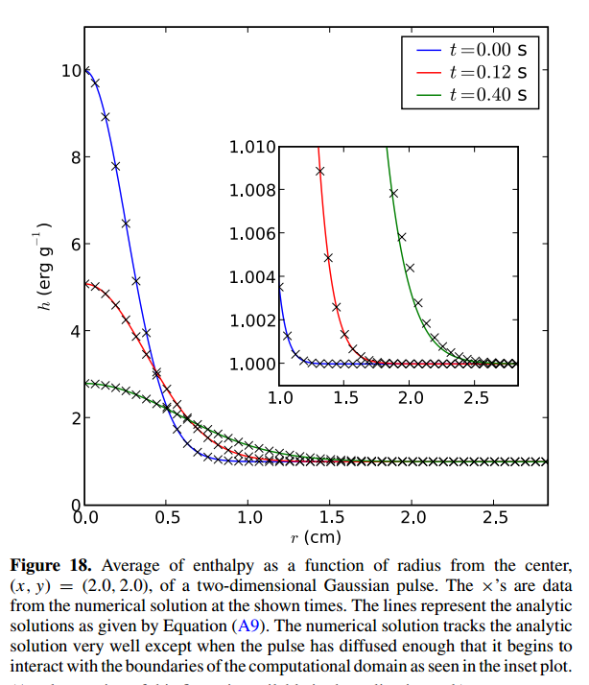
Unit Testing
Test of particle advection in our low Mach hydro code, Maestro
Test of diffusion in our low Mach hydro code, Maestro
(Malone et al. 2011)

Slide 29
Unit Testing
Whenever you important some legacy code into your project, write a unit test
  Verifies that it performs as the authors intend
  Allows for tests to interface changes you make to the code

Slide 30
Regression Testing
Imagine you've “perfected” your program
  You are confident that the answer it gives is “right”
  You want to make sure that any changes you do in the future do not change the output
  Regression testing tests whether changes to the code change the solution
Regression testing:
  Store a copy of the current output (a benchmark)
  Make some changes to the code
  Compare the new solution to the previous solution
  If the answers differ, either:
    You've introduced a bug  fix it
    You've fixed a bug  update your benchmark

Slide 31
Regression Testing
Simplest requirements:
  You just need a tool to compare the current output to benchmark
  You can build up a more complex system from here with simple scripting
Big codes need a bunch of tests to exercise all possible options for the code
  If you spend a lot of time hunting down a bug, once you fix it, put a test case in your suite to check that case
  You'll never have complete coverage, but your number of tests will grow with time, experience, and code complexity
Simple example with my python hydro code
  ./pyro.py --compare_benchmark advection smooth inputs.smooth

Slide 32
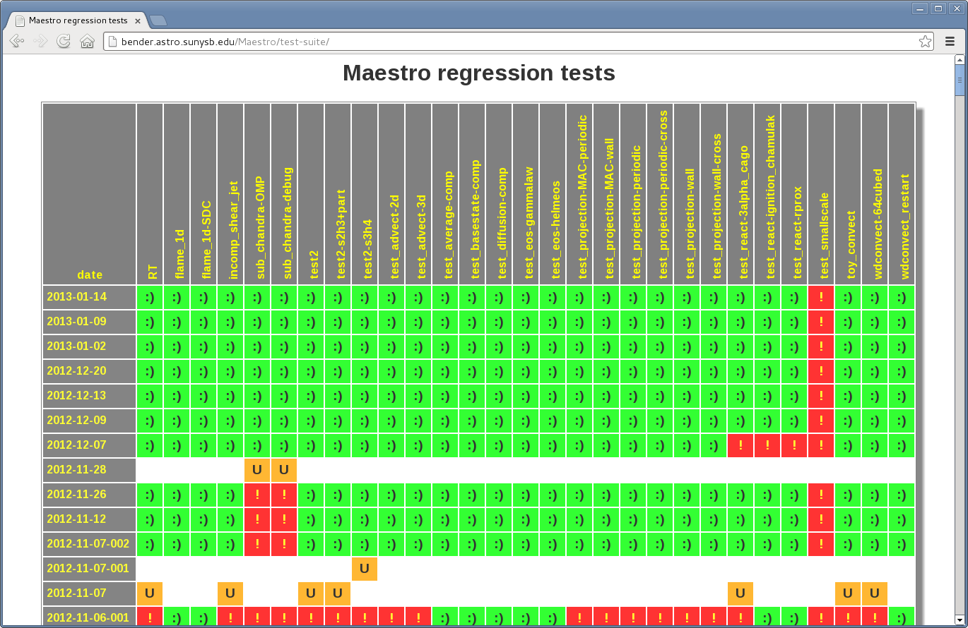
Regression Testing
Maestro (automated regression testing)

Slide 33
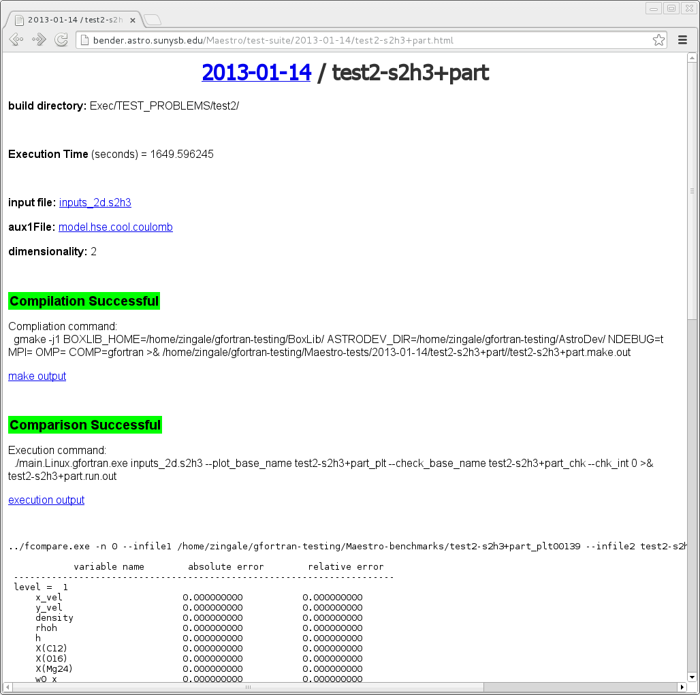

Slide 34
General Rules
When you write code, think to yourself: “if I come back to this 6 months from now, while I understand what I've done?”
  If not, take the time now to make things clearer, document (even a simple README) what you've done, where the equations come from, etc.
  You'll be surprised and how long your code lives on!
Some languages let you do cute tricks.
  Even if they might offer a small speed bump, if they complicate the code a lot to the point that it is hard to follow, then they're probably not worth it.
Get things working before obsessing on performance

Slide 35
Automating Reproducibility
Store meta-data in your output files that tell you where, when, what, and how the data was produced.
  Already saw the example of the git hash in the makefile examples
  Maestro example...

Slide 36
===============================================================================
Job Information
===============================================================================
job name:
inputs file: inputs_2d
number of MPI processes 1
number of threads 1
CPU time used since start of simulation (CPU-hours) 0.1473997255E-01
===============================================================================
Plotfile Information
===============================================================================
output date: 2013-05-08
output time: 11:39:43
output dir: /home/zingale/development/MAESTRO/Exec/TEST_PROBLEMS/test2
time to write plotfile (s) 0.5483140945
===============================================================================
Build Information
===============================================================================
build date: 2013-05-08 11:38:04.553714
build machine: Linux nan.astro.sunysb.edu 3.8.9-200.fc18.x86_64 #1 SMP Fri Apr 26 12:50:07 UTC 2013 x8
6_64 x86_64 x86_64 GNU/Linux
build dir: /home/zingale/development/MAESTRO/Exec/TEST_PROBLEMS/test2
BoxLib dir: /home/zingale/development/BoxLib/
MAESTRO git hash: bad8ea8d66871a2172dcb276643edce53f739695
BoxLib git hash: febf34dba7cc701a78c73e16a543f062cf36d587
AstroDev git hash: 5316edb829577f80977fd2db8a113ccc4da42e02
modules used:
Util/model_parser
Util/random
Util/VODE
Util/BLAS
Source
../../../Microphysics/EOS
../../../Microphysics/EOS/helmeos
../../../Microphysics/networks/ignition_simple
../../../Microphysics/conductivity/timmes_stellar

Slide 37
FCOMP: gfortran
FCOMP version: gcc version 4.7.2 20121109 (Red Hat 4.7.2-8) (GCC)
F90 compile line: mpif90 -Jt/Linux.gfortran.debug.mpi/m -It/Linux.gfortran.debug.mpi/m -g -fno-range-
check -O1 -fbounds-check -fbacktrace -Wuninitialized -Wunused -ffpe-trap=invalid -finit-real=nan -I..
/../../Microphysics/EOS/helmeos -c
F77 compile line: gfortran -Jt/Linux.gfortran.debug.mpi/m -It/Linux.gfortran.debug.mpi/m -g -fno-ran
ge-check -O1 -fbounds-check -fbacktrace -Wuninitialized -Wunused -ffpe-trap=invalid -finit-real=nan -
I../../../Microphysics/EOS/helmeos -c
C compile line: gcc -std=c99 -Wall -g -O1 -DBL_Linux -DBL_FORT_USE_UNDERSCORE -c
linker line: mpif90 -Jt/Linux.gfortran.debug.mpi/m -It/Linux.gfortran.debug.mpi/m -g -fno-range-
check -O1 -fbounds-check -fbacktrace -Wuninitialized -Wunused -ffpe-trap=invalid -finit-real=nan -I..
/../../Microphysics/EOS/helmeos
===============================================================================
Grid Information
===============================================================================
level: 1
number of boxes = 60
maximum zones = 384 640
Boundary Conditions
-x: periodic
+x: periodic
-y: slip wall
+y: outlet
===============================================================================
Species Information
===============================================================================
index name short name A Z
-------------------------------------------------------------------------------
1 carbon-12 C12 12.00 6.00
2 oxygen-16 O16 16.00 8.00
3 magnesium-24 Mg24 24.00 12.00
+ values of all runtime parameters...

Slide 38
Debuggers
Simplest debugging: lots of prints!
Interactive debuggers let you step through your code line-by-line, inspect the values of variables as they are set, etc.
pdb is the python debugger
If you just want to know how the code gets to a certain function:
import traceback
traceback.print_stack()

Slide 39
Profiling
Profililers examine your code when it runs and determine where you spend most of your time
gprof is the standard GNU profiler
  Just add -pg to the compile lines
  Run as normal
  'gprof executable' to get information on the subroutine/function level
  'gprof -l executable' to get information on the line-by-line level

Slide 40
Commenting and Documentation
The only thing worse than no comments are wrong comments
  Comments can easily get out of date as code evolves
Comments should convey to the reader the basic idea of what the next set of lines will accomplish.
  Avoid commenting obvious steps if you've already described the basic idea
Many packages allow for automatic documentation of routines/interfaces using pragmas put into the code as comments.

Slide 41
Source Code Libraries
There are many sources for open, well-tested, published codes that may already do what you want.
  This makes it easier to get going, may offer better algorithms than you were prepared to code.
  Benefits from a community of developers and maturity
  Still need to test, examine return codes, etc.
Many of these mature codes are already wrapped for you in SciPy.
For other codes, we'll look next at how to extend python in Fortran and C

Slide 42
Summary
Some basic coding practices can greatly improve the reliability of your code
  Frees you to do science
Small learning curve is greatly offset by the improved productivity and stability

