Slide 1
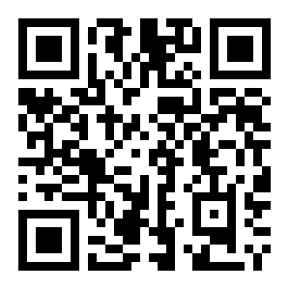
Python for Scientific Computing
a weekly graduate seminar on techniques for scientific programming
instructor: Michael Zingale (michael.zingale@stonybrook.edu)
Python has seen wide adoption in the scientific community for data analysis, simulation, prototyping, and visualization. It provides a simple, yet powerful means to build applications. This seminar introduces python and its use in scientific computing.
Course format:
  Weekly 1 hour discussions with interactive examples distributed as IPython notebooks
  Extensive use of the online discussion forum in Blackboard
  Students will be encouraged to share their knowledge and issues and contribute to the discussion
  Grading is based on participation
Students should bring laptops to class
Register for 1 credit only
Introductions to:
  Python
  Version control with git/github
  IPython for workflow management
  The NumPy array package
  The SciPy tools and basics of numerical methods
  Matplotlib and MayaVi for visualization
  SymPy for symbolic mathematics
  Building applications
  Interfacing with Fortran/C
  System operations with python
  What is Julia?
Details:
  PHY 683*, Spring 2015
  Mondays, 3:00-3:53pm
*Note: despite the word “Astronomy” in the official PHY 683 course name, this is a general scientific programming course

