Slide 1
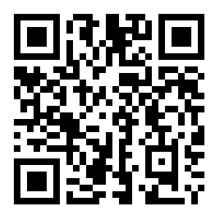
Python for Scientific Computing
a weekly graduate seminar on techniques for scientific programming
instructor: Michael Zingale (michael.zingale@stonybrook.edu)
Python has seen wide adoption in the scientific community for data analysis, simulation, prototyping, and visualization. It provides a simple, yet powerful means to build applications. This seminar introduces python and its use in scientific computing.
Course format:
  Flipped format:
    We’ll work through interactive notebooks outside of class
    Class time will be used for exercises that we discuss together
    Extensive use of the online chat outside of class
  Grading is based on participation
    Sharing examples and contributing to the discussion
Students should bring laptops to class
Topics include:
  Python
  Version control with git/github
  Jupyter notebooks /workflow management
  The NumPy array package
  The SciPy tools and basics of numerical methods
  Matplotlib and MayaVi for visualization
  SymPy for symbolic mathematics
  Pandas and the dataframe
  Building applications
  Interfacing with Fortran/C
Details:
  PHY 546*, Spring 2015
  Mondays, 3:00-3:53pm

