Slide 1
Intro to NumPy: Arrays
NumPy provides a multidimensional array
  All elements must be the same data type
  Many different datatypes supported
Arithmetic operations work on arrays
Provides MANY functions that operate on whole arrays
  These operations are written in a compiled language, and run fast
  Generally speaking, you want to avoid loops to get the best performance.
    Can sometimes make code unreadable
Lots of ways to create arrays
Array creation and property examples...

Slide 2
Intro to NumPy: Array Operations
Arithmetic operator (+, -, /, *) work elementwise
  A * B is not a matrix product, but instead multiples the corresponding elements in each array together
  dot(A,B) does a dot product
Universal functions (sin, cos, exp, ...) work elementwise
Array operations examples...

Slide 3
Intro to NumPy: Array Indexing/Slicing
Biggest source of confusion: selecting a range is best thought of as referring to the “edges” of the array locations
  Differs from Fortran, IDL
  For the array above:
    A[2] = 2
    A[2:3] = [2]
    A[2:4] = [2 3]
  Note also: zero-based indexing
0
1
2
3
4
5
6
7
8
0
1
2
3
4
5
6
7
8
9
Index of array element
Index of “edges”
Note: this same behavior applies to Python lists and strings when slicing

Slide 4

Intro to NumPy: Array Indexing/Slicing
Remember, multi-dimensional arrays are stored in row-major fashion
  Rows are stored one after the other, within a row, the column data is closest to one another
  You see this when you print an array:
    a = numpy.arange(15).reshape(3,5)
    print a
    [[ 0 1 2 3 4]
    [ 5 6 7 8 9]
    [10 11 12 13 14]]
Some slicing examples...
3 rows,
5 columns
Note that the braces [ ] show that the columns are together

Slide 5
Intro to NumPy: Array Views/Copies
When “copying”, need to understand if two arrays, A and B, point to:
  the same array (including shape and data/memory space)
  the same data/memory space (but perhaps different shapes)
  a separate copy of the data (i.e. stored separately in memory)
B = A (assignment)
  No copy is made. A and B point to the same data in memory and share the same shape, etc.
B = A[:] (view or shallow copy)
  The shape info for A and B are stored independently, but both point to the same memory location for the data
B = A.copy() (deep copy)
  The data in B is stored completely separately in memory from A
Copying examples...

Slide 6
Intro to NumPy: Boolean Indexing
Many fancy ways to index arrays
A[A > 4] = 0
  Boolean indexing
  Similar to IDL's where command
Boolean indexing example...

Slide 7
More NumPy
See the tutorial for some other features:
  Shape manipulation
  Merging/splitting arrays
  Fancier indexing
  Other numpy functions/methods
NumPy functions page...

Slide 8
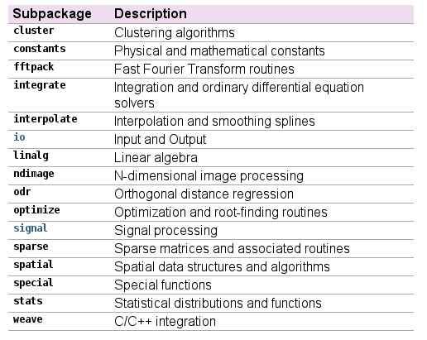
Intro to SciPy
SciPy is a collection of numerical algorithms that is used with NumPy
We'll use a few for convenience
(docs.scipy.org)

