Slide 1
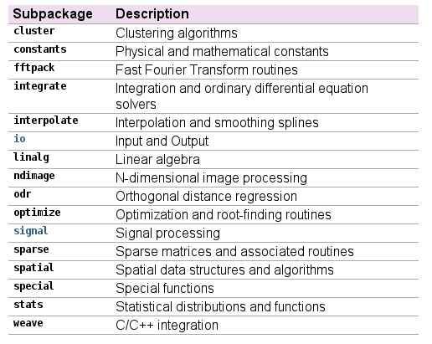
Intro to SciPy
SciPy is a collection of numerical algorithms that is used with NumPy
We'll use a few for convenience
(docs.scipy.org)

