Slide 1
Python for Scientific Computing
http://bender.astro.sunysb.edu/classes/python-science

Slide 2
Course Goals
Simply: to learn how to use python to do
  Numerical analysis
  Data analysis
  Plotting and visualizations
  Symbol mathematics
  Write applications
  ...

Slide 3
Why Python?
Very high-level language
  Provides many complex data-structures (lists, dictionaries, ...)
  Your code is shorter than a comparable algorithm in a compiled language
Many powerful libraries to perform complex tasks
  Parse structured inputs files
  send e-mail
  interact with the operating system
  make plots
  make GUIs
  do scientific computations
  ...
Easy to prototype new tools
Cross-platform and Free

Slide 4
Why Python?
Dynamically-typed
Object-oriented foundation
Extensible (easy to call Fortran, C/C++, ...)
Automatic memory management (garbage collection)
Ease of readability (whitespace matters)
... and for this course ...
Very widely adopted in the scientific community
  Mostly due to the very powerful array library NumPy

Slide 5
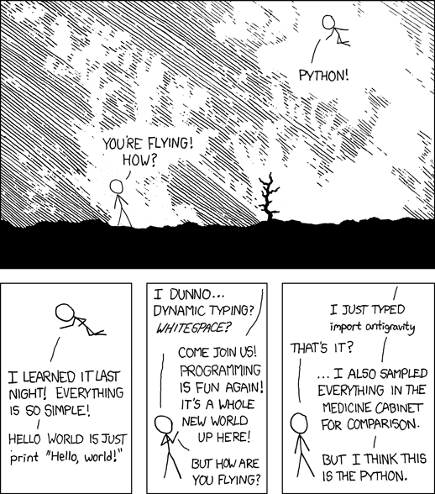
Python
(xkcd)

Slide 6
Hello, World!
If you have python installed properly, you can start python simply by typing python at your command line prompt
  The python shell will come up
  Our hello world program is simply:
  print “Hello, World!”
  Or, in python 3.x (more on this later...):
  print(“Hello World”)

Slide 7
Communities
Many scientific disciplines have their own python communities that
  Provide tutorials
  Cookbooks
  Libraries to do standard analysis in the field
For the most part, these uild on the Open nature of python
I've put links on our course page to some information on the python communities for:
  Astronomy
  Atmospheric Science
  Biology
  Cognitive Science
  Psychology
  Let me know of any others!

Slide 8
Python in Astro
Python is seeing rapidly increasing adoption in Astrophysics
  Open-source alternative to IDL
Python for IDL users: https://www.cfa.harvard.edu/~jbattat/computer/python/science/idl-numpy.html
Astropython: http://www.astropython.org/
  Lots of tutorials, links to resources, forum, ...
Astropy mailing list: http://mail.scipy.org/mailman/listinfo/astropy

Slide 9
Python in Biology
Biopython (http://biopython.org/wiki/Main_Page) provides tools for using python for computational molecular biology and bioinformatics projects
  Able to parse many different bioinformatics file formats
  Access online databases
  Do analysis, operate on sequences, ...
See Python—All a Scientist Needs by J. B. Lucks (arxiv:0803.1838)

Slide 10
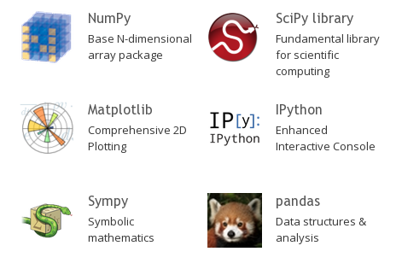
Scientific Python Stack
Most scientific libraries in python build on the Scientific Python stack:
(scipy.org)

Slide 11
Starters...
Before we get into python, we'll review some of the core ideas about numerical computing

Slide 12
Basics of Computation
Computers store information and allow us to operate on it.
  That's basically it.
  Computers have finite memory, so it is not possible to store the infinite range of numbers that exist in the real world, so approximations are made.
Great floating point reference
  What Every Computer Scientist Should Know About Floating-Point Arithmetic by D. Goldberg

Slide 13
Integers
Basic unit of information in a computer is a bit: 0 or 1
8 bits = 1 byte
Different types of information require more bits/bytes to store.
  A logical (T or F) can be stored in a single bit.
    C/C++: bool datatype
    Fortran: logical datatype
  Integers:
    Standard in many languages is 4-bytes. This allows for 2³²-1 distinct values.
      This can store: -2,147,483,648 to 2,147,483,647 (signed)
        C/C++: int (usually) or int32_t
        Fortran: integer or integer*4
      Or it can store: 0 to 4,294,967,295 (unsigned)
        C/C++: uint or uint32_t
        Fortran (as of 95): unsigned

Slide 14
Integers
  Integers (continued):
    Sometimes 2-bytes. This allows for 2¹⁶-1 distinct values.
      This can store: -32,768 to 32,767 (signed)
        C/C++: short (usually) or int16_t
        Fortran: integer*2
      Or it can store: 0 to 65,535 (unsigned)
        C/C++: uint16_t
        Fortran (as of 95): unsigned*2
    Note for IDL users: the standard integer in IDL is a 2-byte integer. If you do
    i = 2
    that's 2-bytes. To get a 4-byte integer, do:
    i = 2l

Slide 15
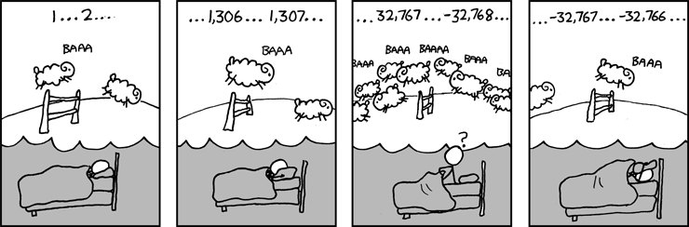
Overflow
(xkcd)
Overflow example...

Slide 16
Overflow
iold = -1
i = 1
type_init = type(i)
print "type currently: ", type_init
while (i > iold):
print i
iold = i
i *= 2
if (not type(i) == type_init):
print "type changed, now: ", type(i)
break
print i

Slide 17
Integers
Python allows for the date size of the integer to scale with the size of the number: https://www.python.org/dev/peps/pep-0237/
  Initially, it is the largest value supported in hardware on a machine (64-bits on a 64-bit machine—see sys.maxint
This prints:
def fac(x):
if (x == 0):
return 1
else:
return x*fac(x-1)
a = fac(52)
print a
print a.bit_length()
80658175170943878571660636856403766975289505440883277824000000000000
226
Note: python 3.x does away with the distinction between int and long altogether.

Slide 18
Real Numbers
Floating point format
  Infinite real numbers on the number line need to be represented by a finite number of bits
  Approximations made
    Finite number of decimal places stored, maximum range of exponents.
  Not every number can be represented.
    In base-2 (what a computer uses), 0.1 does not have an exact representation (see S 2.1 of Goldberg)

Slide 19
Exact Representations
0.1 as represented by a computer:
>>> b = 0.1
>>> print type(b)
<type 'float'>
>>> print "{:30.20}”.format(b)
0.10000000000000000555
>>> import sys
>>> print sys.float_info

Slide 20
Floating Point
In the floating point format, a number is represented by a significand (or mantissa), and exponent, and a sign.
  Base 2 is used (since we are using bits)
  0.1 ~ (1 + 1·2⁻¹ + 0·2⁻² + 0·2⁻³ + 1·2⁻⁴ + 1·2⁻⁵ + ...) · 2⁻⁴
  All significand's will start with 1, so it is not stored
  Single precision:
    Sign: 1 bit; exponent: 8 bits; significand: 24 bits (23 stored) = 32 bits
    Range: 2⁷-1 in exponent (because of sign) = 2¹²⁷ multiplier ~ 10³⁸
    Decimal precision: ~6 significant digits
  Double precision:
    Sign: 1 bit; exponent: 11 bits; significand: 53 bits (52 stored) = 64 bits
    Range: 2¹⁰-1 in exponent = 2¹⁰²³ multiplier ~ 10³⁰⁸
    Decimal precision: ~15 significant digits
significand

Slide 21
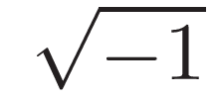
Floating Point
Overflows and underflows can still occur when you go outside the representable range.
  The floating-point standard will signal these (and compilers can catch them)
Some special numbers:
  NaN = 0/0 or
  Inf is for overflows, like 1/0
  Both of these allow the program to continue, and both can be trapped (and dealt with)
  -0 is a valid number, and -0 = 0 in comparison
Floating point is governed by an IEEE standard
  Ensures all machines do the same thing
  Aggressive compiler optimizations can break the standard

Slide 22
Numerical Precision
Finite number of bits used to represent #s means there is a finite precision, the machine epsilon, ε
  One way to find this is to ask when 1 + ε = 1
  This gives 2.22044604925e-16
x = 1.0
eps = 1.0
while (not x + eps == x):
eps = eps/2.0
# machine precision is 2*eps, since that was the last
# value for which 1 + eps was not 1
print 2*eps

Slide 23
Numerical Precision
This means that most real numbers do not have an exact representation on a computer.
  Spacing between numbers varies with the size of numbers
  Relative spacing is constant

Slide 24
Round-off Error
Round-off error is the error arising from the fact that no every number is exactly representable in the finite precision floating point format.
  Can accumulate in a program over many arithmetic operations

Slide 25
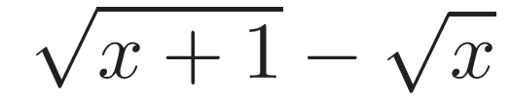

Round-off Example 1
(Yakowitz & Szidarovszky)
Imagine that we can only keep track of 4 significant digits
Compute
  Take
  Keeping only 4 digits each step of the way,
  We've lost a lot of precision
Instead, consider:
Then

Slide 26
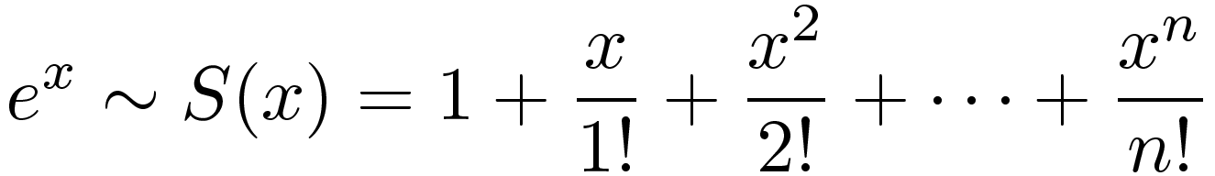
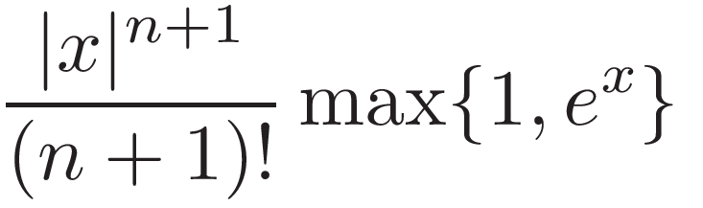
Round-off Example 2
(Yakowitz & Szidarovszky)
Consider computing exp(-24) via a truncated Taylor series
The error in this approximation is less than
We can compute S(-24) by adding terms until the term is less than machine precision
  We find S(-24) = 3.44305354288101977E-007
  But exp(-24) = 3.77513454427909773E-011
  The error is far bigger than the true answer!

Slide 27
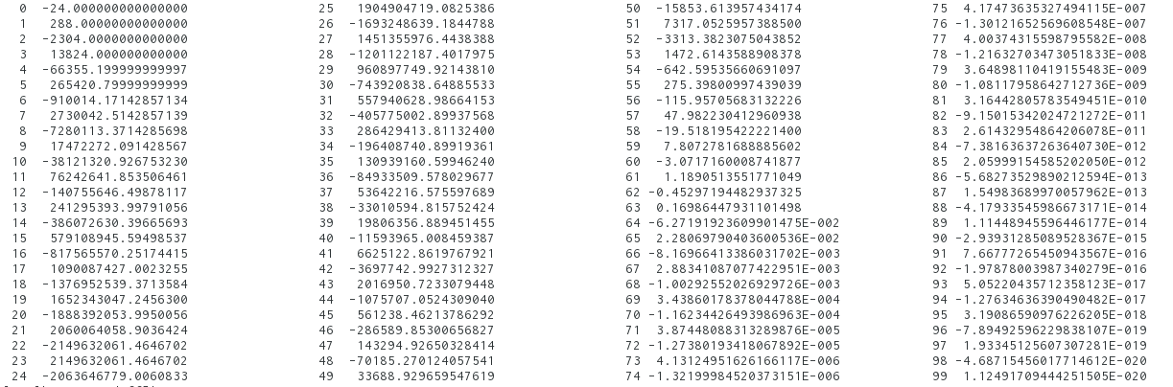
Round-off Example 2
(Yakowitz & Szidarovszky)
Look at the terms—we are relying on cancellation to get our result

Slide 28
Round-off Example 2
(Yakowitz & Szidarovszky)
Instead recognize:
S(-1) is well behaved, since each term is smaller in absolute magnitude than the previous.
  S(-1) = 0.36787944117144245
  S(-1)²⁴ = 3.77513454427912681E-011
  exp(-24) = 3.77513454427909773E-011

Slide 29
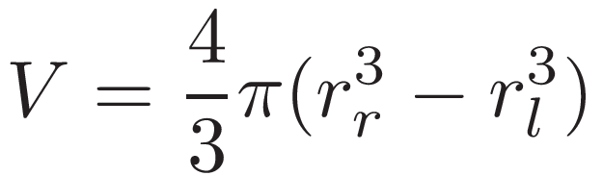
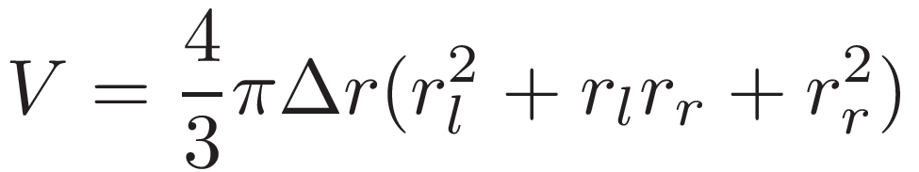
Round-off Example 3
In spherically-symmetric codes (like a stellar evolution code), it is common to compute the volume of a spherical shell as
  This relies on the cancellation of two very big numbers.
  Rewriting reduces round-off errors:

Slide 30

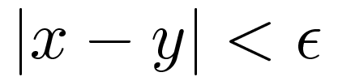
Comparing Floating Point #s
When comparing two floating point #s, we need to be careful
If you want to check whether 2 computed values are equal, instead of asking if
it is safer to ask whether they agree to within some tolerance

Slide 31
Associative Property
You learned in grade school that: (a + b) + c = a + (b + c)
  Not true with floating point
  You can use parenthesizes to force order of operations
  If you want to enforce a particular association, use parenthesis

Slide 32
Associative Property
Adding lots of numbers together can compound round-off error
  One solution: sort and add starting with the smallest numbers
Kahan summation (see reading list)
  Algorithm for adding sequence of numbers while minimizing roundoff accumulation
  Keeps a separate variable that accumulates small errors
  Requires that the compiler obey parenthesis

Slide 33
Python for Scientific Computing
http://bender.astro.sunysb.edu/classes/python-science

Slide 34
Computer Languages
You can write any algorithm in any programming language—they all provide the necessary logical constructs
  However, some languages make things much easier than others
  C
    Excellent low-level machine access (operating systems are written in C)
    Multidimensional arrays are “kludgy”
  Fortran (Formula Translate)
    One of the earliest complied languages
    Large code base of legacy code
    Modern Fortran offers many more conveniences than old Fortran
    Great support for arrays
  Python
    Offers many high-level data-structures (lists, dictionaries, arrays)
    Great for quick prototyping, analysis, experimentation
    Increasingly popular in scientific computing

Slide 35
Computer Languages
  IDL
    Proprietary
    Great array language
    Modern (like object-oriented programming) features break the “clean-ness” of the language
  C++
  Others
    Ruby, Perl, shell scripts, ...

Slide 36
Computer Languages
Compiled languages (Fortran, C, C++, ...)
  Compiled into machine code—machine specific
  Produce faster code (no interpretation is needed)
  Can offer lower level system access (especially C)
Interpreted languages (python, IDL, perl, Java (kind-of) ...)
  Not converted into machine code, but instead interpreted by the interpreter
  Great for prototyping
  Can modify itself while running
  Platform independent
  Often has dynamic typing and scoping
  Many offer garbage collection
http://en.wikipedia.org/wiki/Interpreted_language

Slide 37
Computer Languages
Vector languages
  Some languages are designed to operate on entire arrays at once (python + NumPy, many Fortran routines, IDL, ...)
    For interpreted languages, getting reasonable performance requires operating on arrays instead of explicitly writing loops
      Low level routines are written in compiled language and do the loop behind the scenes
    We'll see this in some detail when we discuss python
  Next-generation computing = GPUs ?
    Hardware is designed to do the same operations on many pieces of data at the same time

Slide 38
Object-Oriented Languages
Python is an object-oriented language
Think of an object as a container that holds both data and functions (methods) that know how to operate on that date.
  Objects are build from a datatype called a class—you can create as many instances (objects) from a class as memory allows
    Each object will have its own memory allocated
Objects provide a convenient way to package up data
  In Fortran, think of a derived type that also has it's own functions
  In C, think of a struct that, again, also has it's own functions
Everything, even integers, etc. is an object

Slide 39
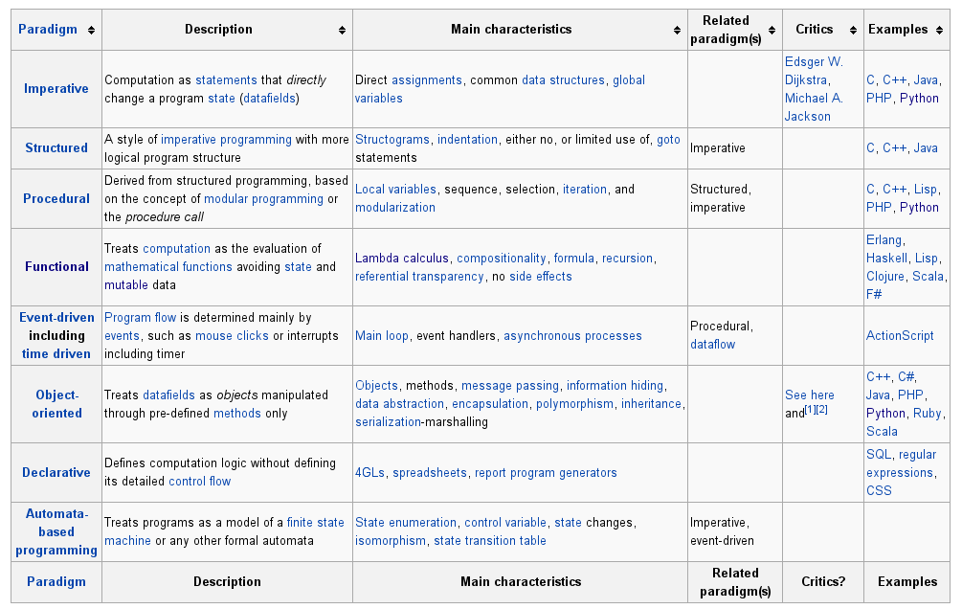
Programming Paradigms
(Wikipedia)

Slide 40

Arrays and Memory Layout
Building block of many numerical methods
Row vs. Column major: A(m,n)
  First index is called the row
  Second index is called the column
  Multi-dimensional arrays are flattened into a one-dimensional sequence for storage
  Row-major (C, python): rows are stored one after the other
  Column-major (Fortran, matlab): columns are stored one after the other
Ordering matters for:
  Passing arrays between languages
  Deciding which index to loop over first
Row major
Column major

Slide 41
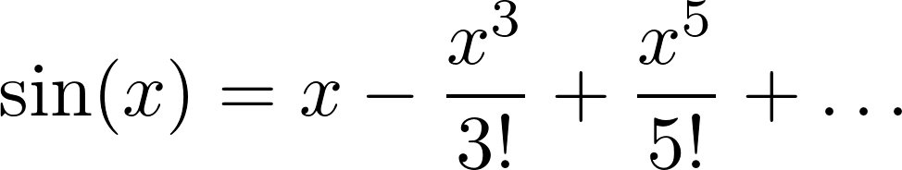
Roundoff vs. Truncation Error
Roundoff error is just one of the errors we deal with
Translating continuous mathematical expressions into discrete forms introduces truncation error
Consider the Taylor series expansion for sine:
If x is small, then we can neglect the higher-order terms (we truncate the series). This introduces an error.

Slide 42
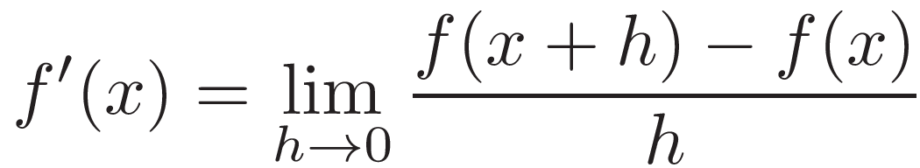
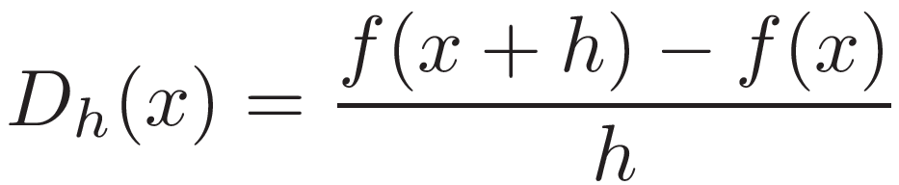
Roundoff vs. Truncation Error
(Yakowitz & Szidarovszky)
Roundoff error is just one of the errors we deal with
Translating continuous mathematical expressions into discrete forms introduces truncation error
Consider the definition of a derivative:
We can't take the limit to 0. Our discrete version will be:
If we choose h small enough, this should be a good approximation.

Slide 43
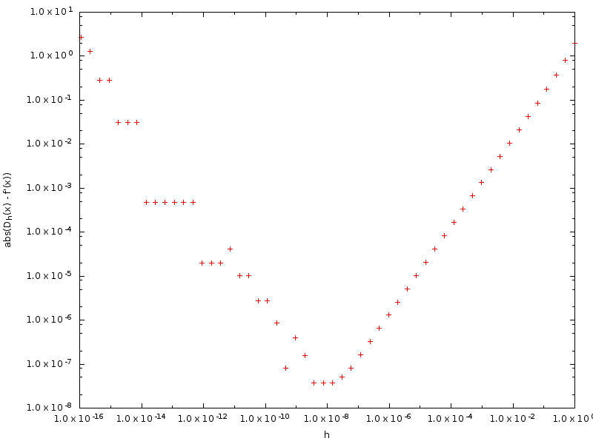
Roundoff vs. Truncation Error
(Yakowitz & Szidarovszky)
Roundoff error dominates
Truncation error dominates

Slide 44
Potential Topics
General python
Advanced python / special modules
  Regular expressions
  Command line/input file parsing
  Filesystem operations
NumPy
SciPy and numerical methods
  Integration
  ODEs
  Curve fitting/optimization
  Interpolation
  Signal processing (FFT)
  Linear algebra
Plotting / visualization
  matplotlib
  MayaVi
Workflow management with IPython
Extending python w/ Fortran and C/C++
Symbolic math with SymPy
Writing python applications
GUI programming
Unit testing
Git/github
Others?

Slide 45
Introduction to Python

Slide 46
Class Participation
We'll learn by interactively trying out some ideas and looking at code
  I want to learn from all of you—share you experiences and expertise
We'll use the Discussion Forum on Blackboard to interact with one-another outside of class.
Try out ideas and report to the class what you've learned
  I can set up an account for you on one of my Linux servers if you want a place to try things out (you would log in remotely)

Slide 47
What Do You Want To Learn?
From your posts (in some order by popularity):
  Replace matlab (most popular)
  Linear algebra (for solving linear systems, e.g. from discretizing PDEs, etc.)
  Visualization (including 3-d visualization)
  Solve systems of ODEs
  General scripting / glue for C + Fortran programs
  Statistics / data mining / fitting / FFTs
  Symbolic math
  Monte Carlo
Less frequently cites:
  PyCUDA, parallel processing, GUIs

Slide 48
Python Shell
This is the standard (and most basic) interactive way to use python
  Runs in a terminal window
  Provides basic interactivity with the python language
Simply type python at your command prompt
  You can scroll back through the history using the arrows

Slide 49
IPython Shell
Type ipython at your prompt
Like the standard shell, this runs in a terminal, but provides many conveniences (type %quickref to see an overview)
  Scrollback history preserved between sessions
  Build-in help with ?
    function-name?
    object?
  Magics (%lsmagic lists all the magic functions)
    %run script: runs a script
    %timeit: times a command
    Lots of magics to deal with command history (including %history)
  Tab completion
  Run system commands (prefix with a !)
  Last 3 output objects are referred to via _, __, ___

Slide 50
IPython Notebooks
A web-based environment that combines code and output, plots, plain text/stylized headings, LaTeX (later versions), ...
  Notebooks can be saved and shared
  Viewable on the web via: http://nbviewer.ipython.org/
  Provides a complete view of your entire workflow
Start with ipython notebook
I'll provide notebooks for a lot of the lectures to follow so you can play along on your own

Slide 51
Python Scripts
Scripts are a non-interactive means of writing python code
  filename.py
  Can be executable by adding:
  #!/usr/bin/env python
  as the first line and setting the executable bit for the file
This is also the way that you write python modules that can be import-ed into other python code (more on that later...)

Slide 52
Python 2.x vs. Python 3
See https://wiki.python.org/moin/Python2orPython3
Mostly about cleaning up the language and making things consistent
  e.g. print is a statement in python 2.x but a function in 3.x
Some trivial differences
.pyc are now stored in a __pycache__ directory
Some gotyas:
  1/2 will give different results between python 2 and 3
It's possible to write code that works with both python 2 and 3—often we will do so by importing from __future__

Slide 53
Python 2.x vs. Python 3
Write for both
  In python 2.6+, do
  from __future__ import print_function
  and then use the new print() style
  exec cmd becomes exec(cmd)
  Some small changes to how __init__.py are done (more on this later)
One some systems, you can have python 2.x and 3.x installed side by side
  May need to install packages twice, e.g. python-numpy and python3-numpy

Slide 54
Intro to Python: Data Types
Python has the same basic data types as most languages: integer, floating point, complex, strings
  data type IPython notebook
And it has more complex data structures, including lists and dictionaries built-in
  advanced data type IPython notebook

Slide 55
Lists vs. Arrays
Lists (note that python lists are not implemented as a simple linked-list: see http://docs.python.org/2/faq/design.html#how-are-lists-implemented )
  Implemented as a variable-length array
  Can store multiple different datatypes in a single list
  Easy to add items to the end (increasing list length)
  Accessing a[i] is independent of list length (unlike a traditional linked list)
Arrays:
  Generally used for fixed-length, homogeneous data
  Less overhead than a list
  We'll use a special array library (NumPy) for performance later

Slide 56
Intro to Python: Control Flow
Python uses indentation to denote blocks of code (no explicit endif, enddo, ...)
Control flow via. while, if, for , ...
  Can iterate over items in a list—very useful
  control flow IPython notebook

Slide 57
Intro to Python: Functions
No distinction between functions and procedures/subroutines
  Always return something. If not explicitly set, then None
Can have default values for arguments, optional arguments, variable number of arguments
Can return multiple values, objects
Function examples...

Slide 58
Intro to Python: Classes
Classes are a fundamental concept of object-oriented programming
An object is an instance of a class
  Carries data (state) and has methods that can act on that data
  Objects are easy to pass around
Simplest use is just as a container to carry associated data together (similar to a struct in C)
Inheritance, operator overloading, ... all supported. See the tutorial.
Classes example...

Slide 59
Intro to Python: Modules
Modules are a collection of python statements, functions, variables, grouped together in a file ending with .py
  Can be imported to be used by any routine
  Python includes a host of useful modules
  You can define your own. Python will look in the current directory and then in the PYTHONPATH
Modules have their own namespace
  Variables (even global variables) don't clash with those with the same name in the importing program
  You can change the name of a module on import or import it into the current namespace (*).
General practice: put all the imports at the top of your code

Slide 60
Intro to Python: Modules
Example: profile.py—a simple timing module for measuring code performance
In the python shell:
  import profile
  help(profile)
Note that this module can also be run on its own
  if __name__ == "__main__": clause at the end
Let's look at an example of using this module in a notebook

Slide 61
Intro to Python: Exceptions
Exceptions are raised if an action you tried (e.g. opening a file) fails.
  Left alone, the code will abort, printing the exception
  You can catch the exception, and take appropriate action to fix the situation
Built-in exceptions have particular names that let you check for specific failure modes
  Allows you to write robust code for other users
Exceptions example...

Slide 62
Intro to Python: I/O
Basic I/O
File I/O
CSV reading
INI file reading

Slide 63
Caveats
Slicing (we'll look at this with arrays soon)
Function defaults: default values are only evaluated once.
  From python tutorial:
  Prints:
  Correct way:
def f(a, L=[]):
L.append(a)
return L
print f(1)
print f(2)
print f(3)
[1]
[1, 2]
[1, 2, 3]
def f(a, L=None):
if L is None:
L = []
L.append(a)
return L

