Slide 1
Python for Scientific Computing
Goals of the course:

Slide 2
Why Python?
Very high-level language
  Provides many complex data-structures (lists, dictionaries, ...)
Many modules to perform complex tasks (parse structured inputs files, send e-mail, interact with the operating system, make plots, make GUIs, do scientific computations, ...)
Complex tasks in short amounts of code
Easy to prototype new tools
Cross-platform and Free
We'll look at some basics from: http://docs.python.org/2/tutorial/

Slide 3
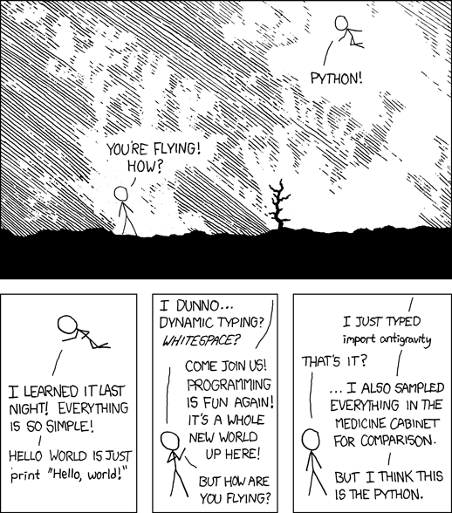
Python
(xkcd)

Slide 4
Python 2.x vs. Python 3
See https://wiki.python.org/moin/Python2orPython3
Mostly about cleaning up the language and making things consistent
Some trivial differences
  print is a function instead of a statement in python 3
Some gotyas:
  1/2 will give different results between python 2 and 3
For most of what we are doing, the choice doesn't really matter

Slide 5
Scientific Python Stack

Slide 6
Python in Astro
Python is seeing rapidly increasing adoption in Astrophysics
  Open-source alternative to IDL
Python for IDL users: https://www.cfa.harvard.edu/~jbattat/computer/python/science/idl-numpy.html
Astropython: http://www.astropython.org/
  Lots of tutorials, links to resources, forum, ...
Astropy mailing list: http://mail.scipy.org/mailman/listinfo/astropy

Slide 7
Basics of Computation
Computers store information and allow us to operate on it.
  That's basically it.
  Computers have finite memory, so it is not possible to store the infinite range of numbers that exist in the real world, so approximations are made.
Great floating point reference
  “What Every Computer Scientist Should Know About Floating-Point Arithmetic” by D. Goldberg

Slide 8
Integers
Basic unit of information in a computer is a bit: 0 or 1
8 bits = 1 byte
Different types of information require more bits/bytes to store.
  A logical (T or F) can be stored in a single bit.
    C/C++: bool datatype
    Fortran: logical datatype
  Integers:
    Standard is 4-bytes. This allows for 2³²-1 distinct values.
      This can store: -2,147,483,648 to 2,147,483,647 (signed)
        C/C++: int (usually) or int32_t
        Fortran: integer or integer*4
      Or it can store: 0 to 4,294,967,295 (unsigned)
        C/C++: uint or uint32_t
        Fortran (as of 95): unsigned

Slide 9
Integers
  Integers (continued):
    Sometimes 2-bytes. This allows for 2¹⁶-1 distinct values.
      This can store: -32,768 to 32,767 (signed)
        C/C++: short (usually) or int16_t
        Fortran: integer*2
      Or it can store: 0 to 65,535 (unsigned)
        C/C++: uint16_t
        Fortran (as of 95): unsigned*2
    Note for IDL users: the standard integer in IDL is a 2-byte integer. If you do
    i = 2
    that's 2-bytes. To get a 4-byte integer, do:
    i = 2l

Slide 10
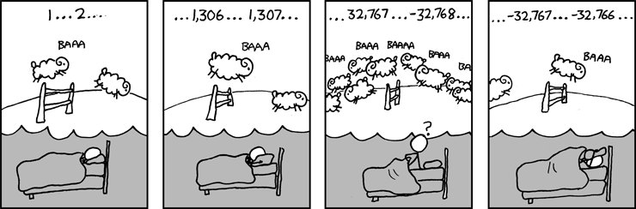
Overflow
(xkcd)
Overflow example...

Slide 11
Integers
Note some languages (e.g. Python) allow for the date size of the integer to scale with the size of the number
This prints:
def fac(x):
if (x == 0):
return 1
else:
return x*fac(x-1)
a = fac(52)
print a
print a.bit_length()
80658175170943878571660636856403766975289505440883277824000000000000
226

Slide 12
Real Numbers
Floating point format
  Infinite real numbers on the number line need to be represented by a finite number of bits
  Approximations made
    Finite number of decimal places stored, maximum range of exponents.
  Not every number can be represented.
    In base-2 (what a computer uses), 0.1 does not have an exact representation (see S 2.1 of Goldberg)

Slide 13
Exact Representations
0.1 as represented by a computer:
This gives: 0.10000000000000001
program test
double precision :: a
a = 0.1d0
print *, a
end program test

Slide 14
Floating Point
In the floating point format, a number is represented by a significand (or mantissa), and exponent, and a sign.
  Base 2 is used (since we are using bits)
  0.1 ~ (1 + 1·2⁻¹ + 0·2⁻² + 0·2⁻³ + 1·2⁻⁴ + 1·2⁻⁵ + ...) · 2⁻⁴
  All significand's will start with 1, so it is not stored
  Single precision:
    Sign: 1 bit; exponent: 8 bits; significand: 24 bits (23 stored) = 32 bits
    Range: 2⁷-1 in exponent (becase of sign) = 2¹²⁷ multiplier ~ 10³⁸
    Decimal precision: ~6 significant digits
  Double precision:
    Sign: 1 bit; exponent: 11 bits; significand: 53 bits (52 stored) = 64 bits
    Range: 2¹⁰-1 in exponent = 2¹⁰²³ multiplier ~ 10³⁰⁸
    Decimal precision: ~15 significant digits
significand

Slide 15
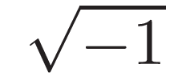
Floating Point
Overflows and underflows can still occur when you go outside the representable range.
  The floating-point standard will signal these (and compilers can catch them)
Some special numbers:
  NaN = 0/0 or
  Inf is for overflows, like 1/0
  Both of these allow the program to continue, and both can be trapped (and dealt with)
  -0 is a valid number, and -0 = 0 in comparison
Floating point is governed by an IEEE standard
  Ensures all machines do the same thing
  Aggressive compiler optimizations can break the standard

Slide 16
Numerical Precision
Finite number of bits used to represent #s means there is a finite precision, the machine epsilon, ε
  One way to find this is to ask when 1 + ε = 1
  This gives 2.22044604925e-16
x = 1.0
eps = 1.0
while (not x + eps == x):
eps = eps/2.0
# machine precision is 2*eps, since that was the last
# value for which 1 + eps was not 1
print 2*eps

Slide 17
Numerical Precision
This means that most real numbers do not have an exact representation on a computer.
  Spacing between numbers varies with the size of numbers
  Relative spacing is constant

Slide 18
Round-off Error
Round-off error is the error arising from the fact that no every number is exactly representable in the finite precision floating point format.
  Can accumulate in a program over many arithmetic operations

Slide 19
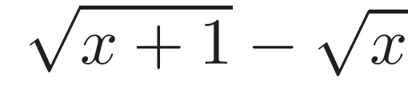

Round-off Example 1
(Yakowitz & Szidarovszky)
Imagine that we can only keep track of 4 significant digits
Compute
  Take
  Keeping only 4 digits each step of the way,
  We've lost a lot of precision
Instead, consider:
Then

Slide 20
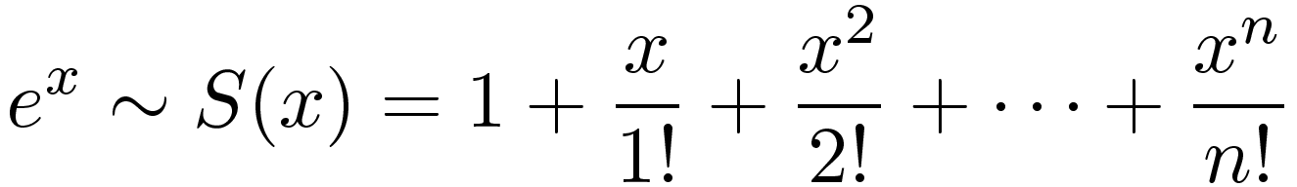
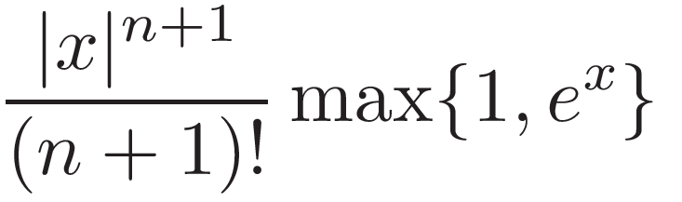
Round-off Example 2
(Yakowitz & Szidarovszky)
Consider computing exp(-24) via a truncated Taylor series
The error in this approximation is less than
We can compute S(-24) by adding terms until the term is less than machine precision
  We find S(-24) = 3.44305354288101977E-007
  But exp(-24) = 3.77513454427909773E-011
  The error is far bigger than the true answer!

Slide 21
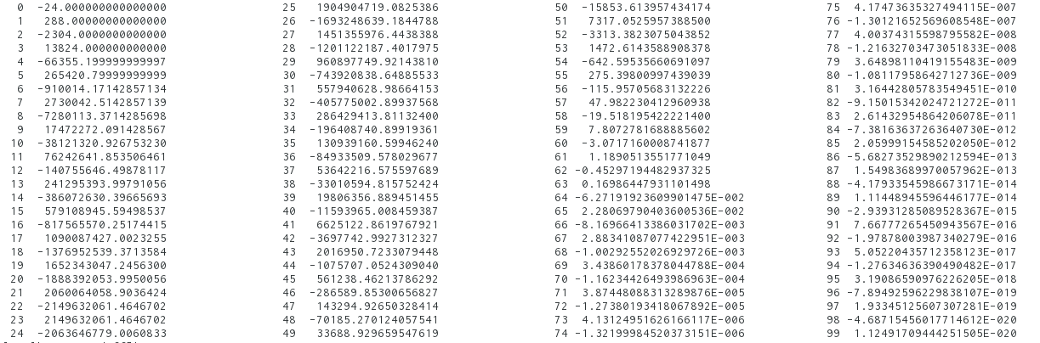
Round-off Example 2
(Yakowitz & Szidarovszky)
Look at the terms—we are relying on cancellation to get our result

Slide 22
Round-off Example 2
(Yakowitz & Szidarovszky)
Instead recognize:
S(-1) is well behaved, since each term is smaller in absolute magnitude than the previous.
  S(-1) = 0.36787944117144245
  S(-1)²⁴ = 3.77513454427912681E-011
  exp(-24) = 3.77513454427909773E-011

Slide 23
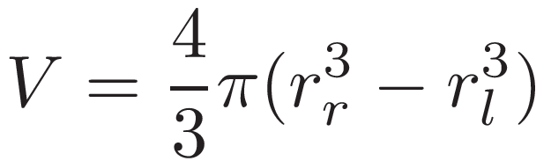
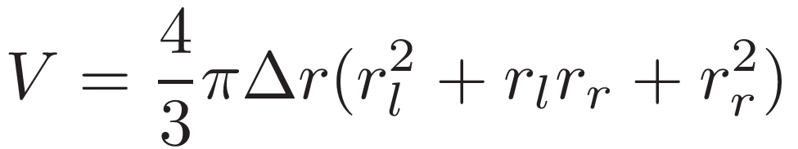
Round-off Example 3
In spherically-symmetric codes (like a stellar evolution code), it is common to compute the volume of a spherical shell as
  This relies on the cancellation of two very big numbers.
  Rewriting reduces round-off errors:

Slide 24

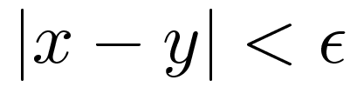
Comparing Floating Point #s
When comparing two floating point #s, we need to be careful
If you want to check whether 2 computed values are equal, instead of asking if
it is safer to ask whether they agree to within some tolerance

Slide 25
Associative Property
You learned in grade school that: (a + b) + c = a + (b + c)
  Not true with floating point
  You can use parenthesizes to force order of operations
  Some compilers with aggressive optimization will assume associativity in transforms they do, changing the answer.

Slide 26
Associative Property
Adding lots of numbers together can compound round-off error
  One solution: sort and add starting with the smallest numbers
Kahan summation (see reading list)
  Algorithm for adding sequence of numbers while minimizing roundoff accumulation
  Keeps a separate variable that accumulates small errors
  Requires that the compiler obey parenthesis

Slide 27
Computer Languages
You can write any algorithm in any programming language—they all provide the necessary logical constructs
  However, some languages make things much easier than others
  C
    Excellent low-level machine access (operating systems are written in C)
    Multidimensional arrays are “kludgy”
  Fortran (Formula Translate)
    One of the earliest complied languages
    Large code base of legacy code
    Modern Fortran offers many more conveniences than old Fortran
    Great support for arrays
  Python
    Offers many high-level data-structures (lists, dictionaries, arrays)
    Great for quick prototyping, analysis, experimentation
    Increasingly popular in Astronomy

Slide 28
Computer Languages
  IDL
    Proprietary
    Great array language
    Modern (like object-oriented programming) features break the “clean-ness” of the language
  C++
  Others
    Ruby, Perl, shell scripts, ...

Slide 29
Computer Languages
Compiled languages (Fortran, C, C++, ...)
  Compiled into machine code—machine specific
  Produce faster code (no interpretation is needed)
  Can offer lower level system access (especially C)
Interpreted languages (python, IDL, perl, Java (kind-of) ...)
  Not converted into machine code, but instead interpreted by the interpreter
  Great for prototyping
  Can modify itself while running
  Platform independent
  Often has dynamic typing and scoping
  Many offer garbage collection
http://en.wikipedia.org/wiki/Interpreted_language

Slide 30
Computer Languages
Vector languages
  Some languages are designed to operate on entire arrays at once (python + numpy, many Fortran routines, IDL, ...)
    For interpreted languages, getting reasonable performance requires operating on arrays instead of explicitly writing loops
      Low level routines are written in compiled language and do the loop behind the scenes
    We'll see this in some detail when we discuss python
  Next-generation computing = GPUs ?
    Hardware is designed to do the same operations on many pieces of data at the same time

Slide 31
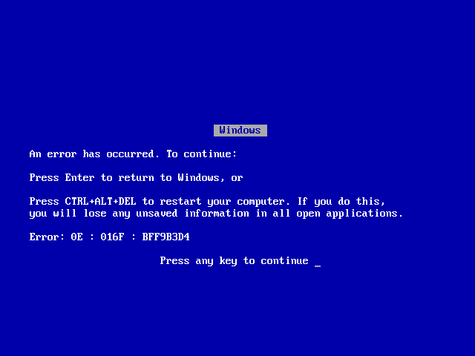

Slide 32

Bugs
One of the first real computer bugs (1947)
(Naval Surface Warfare Center, Dahlgren, VA.; Wikipedia)

Slide 33

Arrays
Building block of many numerical methods
Row vs. Column major: A(m,n)
  First index is called the row
  Second index is called the column
  Multi-dimensional arrays are flattened into a one-dimensional sequence for storage
  Row-major (C, python): rows are stored one after the other
  Column-major (Fortran, matlab): columns are stored one after the other
Ordering matters for:
  Passing arrays between languages
  Deciding which index to loop over first
Row major
Column major

Slide 34
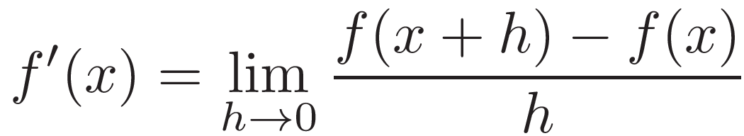
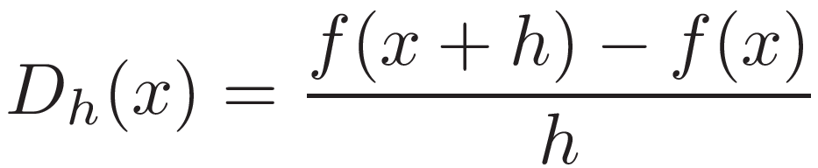
Roundoff vs. Truncation Error
(Yakowitz & Szidarovszky)
Roundoff error is just one of the errors we deal with
Translating continuous mathematical expressions into discrete forms introduces truncation error
Consider the definition of a derivative:
We can't take the limit to 0. Our discrete version will be:
If we choose h small enough, this should be a good approximation.

Slide 35
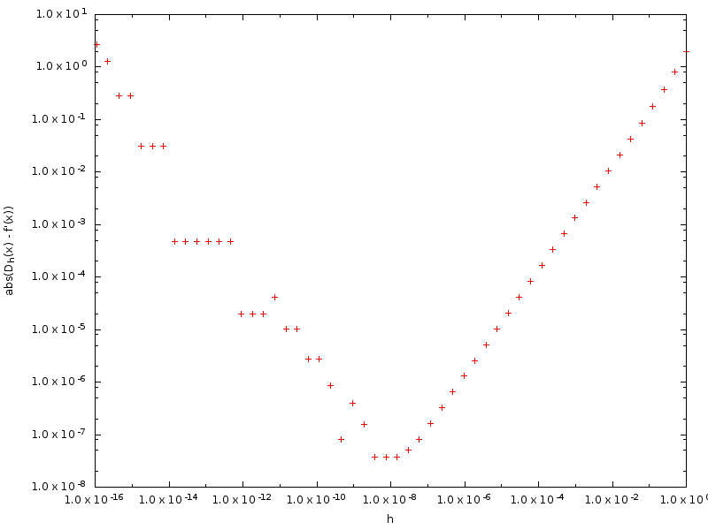
Roundoff vs. Truncation Error
(Yakowitz & Szidarovszky)
Roundoff error dominates
Truncation error dominates

Slide 36
Intro to Python: Overview
Dynamically-typed
Automatic memory management (garbage collection)
Whitespace matters

Slide 37
Python Shell

Slide 38
Python Scripts

Slide 39
Intro to Python: Data Types
Beyond the standard integer, floating point, string types that most languages provide, python has some other built-in data-structures
Lists are perhaps the most useful
Data type examples...

Slide 40
Intro to Python: Control Flow
Python uses indentation to denote blocks of code (no explicit endif, enddo, ...)
Control flow via. while, if, for , ...
  Can iterate over items in a list—very useful
Control flow examples...

Slide 41
Intro to Python: Functions
No distinction between functions and procedures/subroutines
  Always return something. If not explicitly set, then None
Can have default values for arguments, optional arguments, variable number of arguments
Can return multiple values, objects
Function examples...

Slide 42
Intro to Python: More Data Structures
Lists have methods to
  append, pop, sort, count, ...
  We already saw how easy it is to loop over the elements in a list
  Lots of advanced ways to construct lists—see the tutorial
Tuples and sets—see the tutorial for these
Dictionaries
  Keyword + value (indexed by keyword instead of a number)
  Keys must be unique
  Useful, for instance, for managing runtime parameters in a code
Lists and dictionaries examples...

Slide 43
Intro to Python: Modules
Modules are a collection of python statements, functions, variables, grouped together in a file ending with .py
  Can be imported to be used by any routine
  Python includes a host of useful modules
  You can define your own. Python will look in the current directory and then in the PYTHONPATH
Modules have their own namespace
  Variables (even global variables) don't clash with those with the same name in the importing program
  You can change the name of a module on import or import it into the current namespace (*).
General practice: put all the imports at the top of your code
Modules examples...

Slide 44
Intro to Python: Exceptions
Exceptions are raised if an action you tried (e.g. opening a file) fails.
  Left alone, the code will abort, printing the exception
  You can catch the exception, and take appropriate action to fix the situation
Built-in exceptions have particular names that let you check for specific failure modes
  Allows you to write robust code for other users
Exceptions example...

Slide 45
Intro to Python: Classes
Classes are a fundamental concept of object-oriented programming
An object is an instance of a class
  Carries data (state) and has methods that can act on that data
  Objects are easy to pass around
Simplest use is just as a container to carry associated data together (similar to a struct in C)
Inheritance, operator overloading, ... all supported. See the tutorial.
Classes example...

Slide 46
Caveats
Slicing (we'll look at this with arrays soon)
Function defaults: default values are only evaluated once.
  From python tutorial:
  Prints:
  Correct way:
def f(a, L=[]):
L.append(a)
return L
print f(1)
print f(2)
print f(3)
[1]
[1, 2]
[1, 2, 3]
def f(a, L=None):
if L is None:
L = []
L.append(a)
return L

