Slide 1

Machine Learning

Slide 2
Machine Learning
Machine learning is a big topic
We’ll focus on neural networks
  We want to use known data (inputs with corresponding outputs) to predict the output for any input
  We’ll follow the notation of Franklin, Computational Methods for Physics, Ch. 14 with ideas from Rashid, Make Your Own Neural Network

Slide 3
Neural Network Overview
Neural networks attempt to mimic the action of neurons in a brain
Applications generally involve predicting the output from some input or classification (separate populations in some parameter space)
Some uses:
  Character / image recognition
  AI for games (the “Go” program that beat a human)
  Classification of data (e.g., galaxy typing)
  Finance (stock market trends)

Slide 4
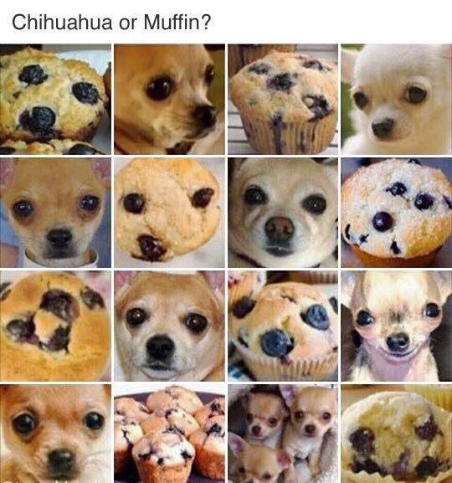
Neural Network Overview
Computers are good at arithmetic but not great at pattern recognition
  Neural nets attempt to model how neurons transmit information
(original source unknown)

Slide 5
Neural Networks
Basic idea
  Create a nonlinear fitting routine with free parameters
  Train the network on data with known input and output to set the parameters
  Trained network can be used on new inputs to predict outcome
A linear example:
  Inputs: x ∊ ℝ^{n}
  Outputs: z ∊ ℝ^{m}
  Neutral network is a map, ℝ^{n} → ℝ^{m} that can be expressed as a matrix, A
    z = Ax
    A is an m × n matrix
  Given enough input, we could know all the matrix elements in A

Slide 6
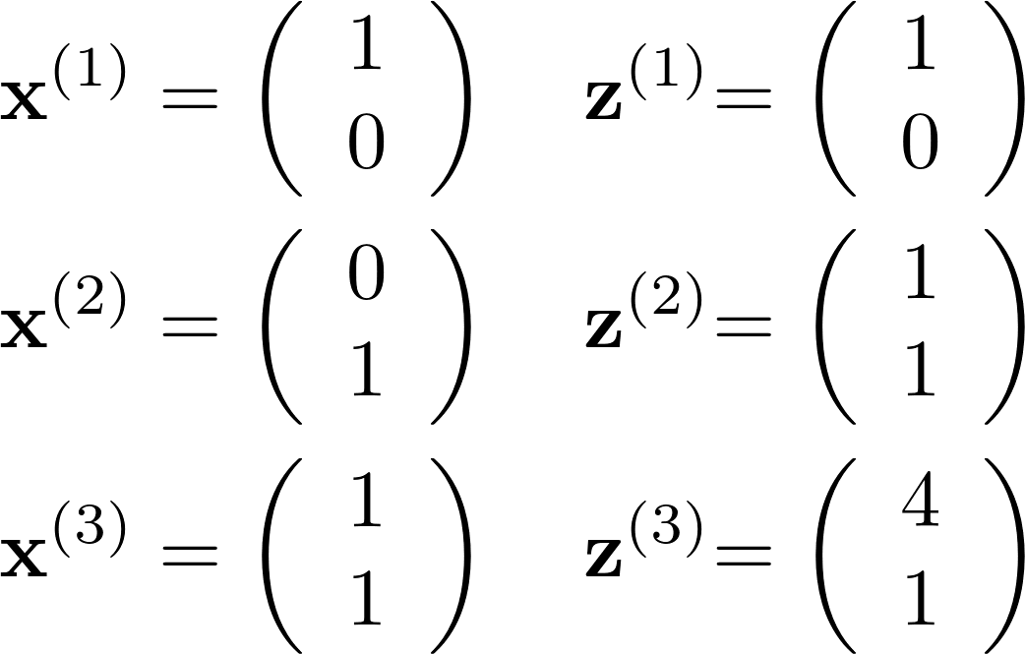
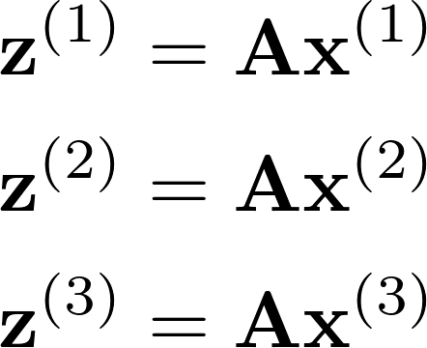
Need for Nonlinear
A linear map cannot capture all of these input/output pairs
  We need to find A such that
    We cannot satisfy all 3 constraints with a linear model

Slide 7
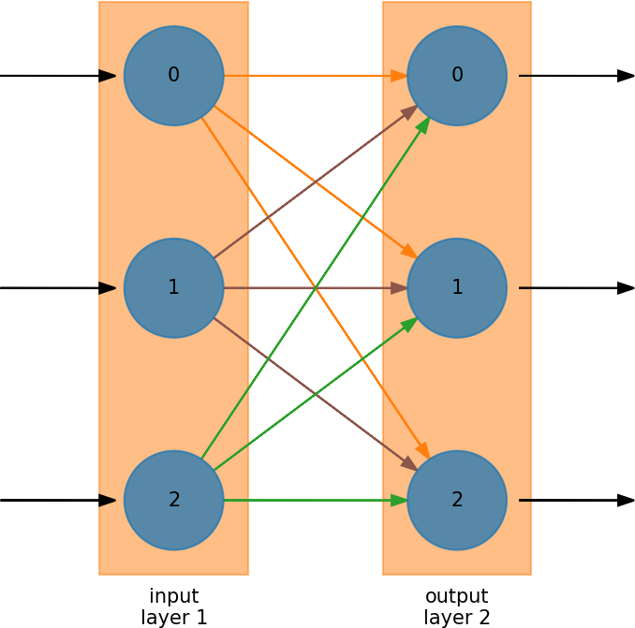
Neural Network Overview
Some nomenclature:
  Neural networks are divided into layers
    There is always an input layer—it doesn’t do any processing—just accepts the input
    There is always an output layer
  Within a layer, there are neurons or nodes
    For input, there will be one node for each input variable
  Every node in the first layer connects to every node in the next layer
    The weight associated with the connection can vary—these are the matrix elements
  In this example, the processing is done in layer 2 (output)

Slide 8
Neural Network Overview
When you train a neural network, you are adjusting the weights connecting the nodes
Some connections may have zero weight
This mimics nature—a single neuron can connect to several (or lots) of other neurons
Linear algebra problem:
  Inputs: x ∊ ℝ^{n}
  Outputs: z ∊ ℝ^{m}
  Neutral network is a map, ℝ^{n} → ℝ^{m} that can be expressed as a matrix, A
    z = Ax
  Given enough input, we could know all the matrix elements in A

Slide 9
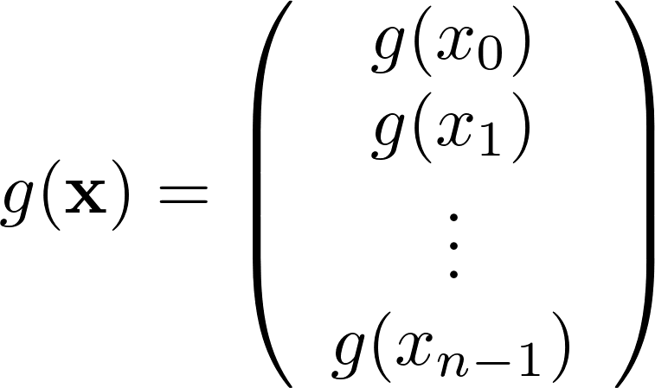
Nonlinear Model
We’ll use a nonlinear function, g(p), that acts on a vector:
  then z = g(A x)
New procedure: set the entries of A via training, using a simple, nonlinear, g(p) that fits our training data
From the graphical representation, the nonlinear function is applied on the output layer

Slide 10
Nonlinear Model
Again, this mirrors biology
  Neurons don’t act linearly
  There is a threshold that needs to be reached before a neuron “fires”
A step function would work, but we want something differentiable
There are a lot of different choices in the literature

Slide 11
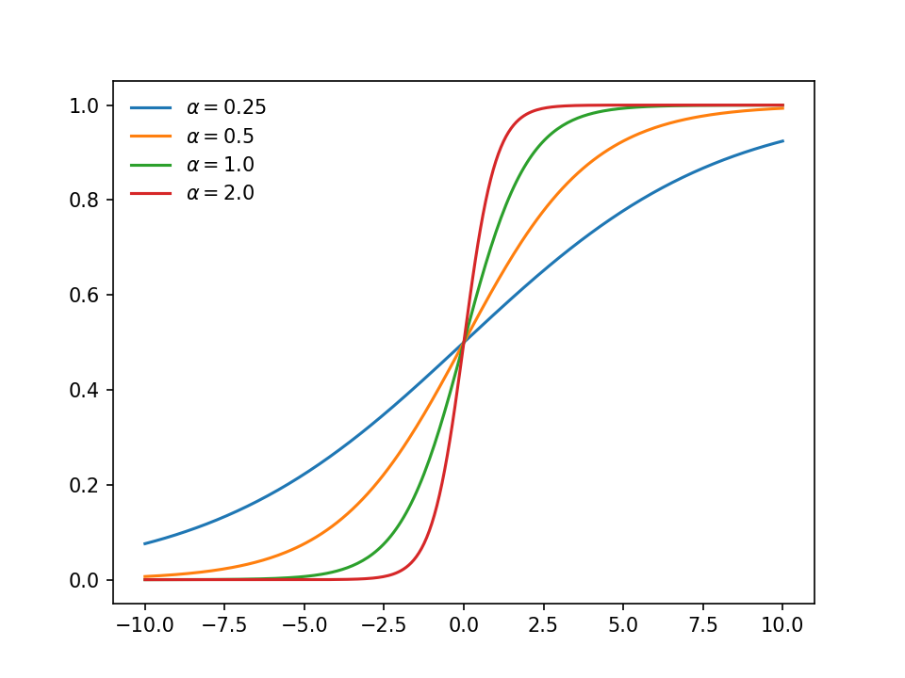
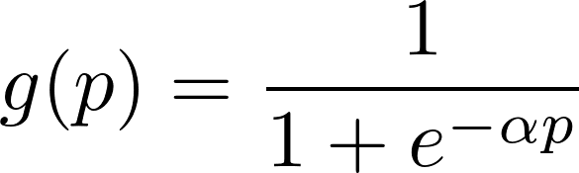
Sigmoid Function
Common choice: sigmoid function
Note, all outputs are scaled to be z_{j} ∊ (0, 1)
We’ll take α = 1

Slide 12
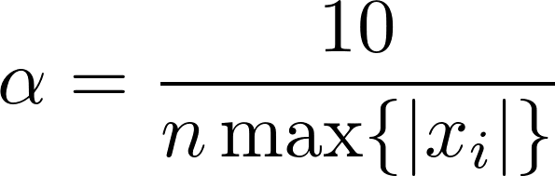
Sigmoid Function
There seem to be differing opinions on α
  Using α = 1 seems to work well—this is what we’ll do
    Perhaps scale inputs to be in (0, 1]
    Note, we don’t want inputs to be 0, because they cancel out weights
  Franklin: there is a narrow range of nonlinearity—pick α so that our inputs fall in that range
    Elements of A are O(1)
    p = A x is O(n max{|x|})
    Choose:

Slide 13
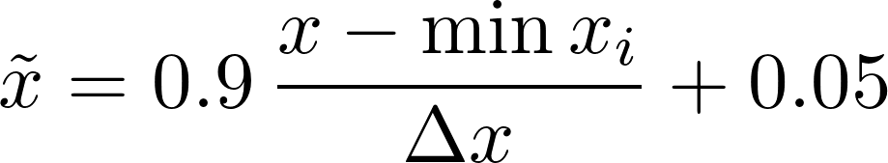
Scaling Output
Note that since the sigmoid maps all output to (0, 1), we need to make sure that the output in our training set is likewise mapped to (0, 1)
  If the data doesn’t already fall in (0, 1), we can just use a linear transformation:
    here, Δx is the largest possible range of x_{i} in the inputs
Actually, (0, 1] works fine—we just need to avoid a 0, since that cancels out weights in the matrices

Slide 14
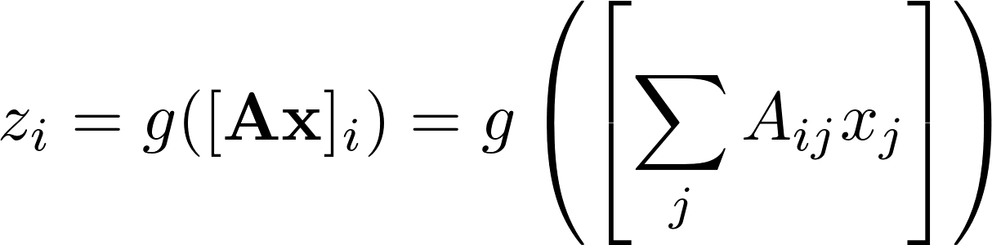
Implementation
Basic operation
  Train the model with known input/output to get all A_{ij}
  Use z = g(A x) to get output for a new input x
Training:
  We have T pairs (x^{k}, y^{k}) for k = 1, …, T
    Important: remember that our y’s have to be scaled to be in (0, 1), so they are in the same range that our function g(p) maps to
  We require that g(A x^{k}) = y^{k} for all k
    Recall, that g(p) is a scalar function that works element-by-element:

Slide 15
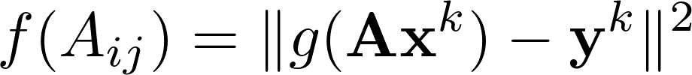
Implementation
Training (cont.)
  We find the elements of A
    This can be expressed as a minimization problem, where we alter the matrix elements to achieve this agreement
    There may not be a unique set of A_{ij}, so we will loop randomly over all training data multiple times to optimize A
      This looks like a least-squares minimization
The function we minimize is called the cost function
  There are other choices than the square of the error

Slide 16
Implementation
Minimization
  A common technique for minimization is gradient descent (sometimes called steepest descent)
    This looks at the local derivative of the function f with respect to the parameters A_{ij} and moves a small distance downhill, and iterates…
  We’ll also compare to an external library for minimization
Caveats
  When you minimize with one set of training data, there is no guarantee that you are still minimized with respect to the previous sets
  In practice, you feed the training data multiple times, in random order, to the minimizer—each pass is called an epoch

Slide 17
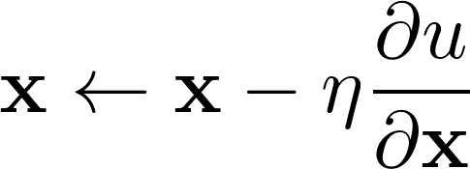
Aside: Minimization
Steepest descent minimization
  Start at a point x₀ and evaluate the gradient
  Move downhill by following the gradient by some amount η
  Correct our initial guess and iterate
Need to choose the amount to move each iteration
  Sometimes we instead define a unit vector in the direction of the local gradient, and then η represents the distance to travel in that direction
You can think about this as what happens if you put a marble on a surface—it rolls to a minimum
  May not be the global minimum—we can get stuck in a local minimum

Slide 18
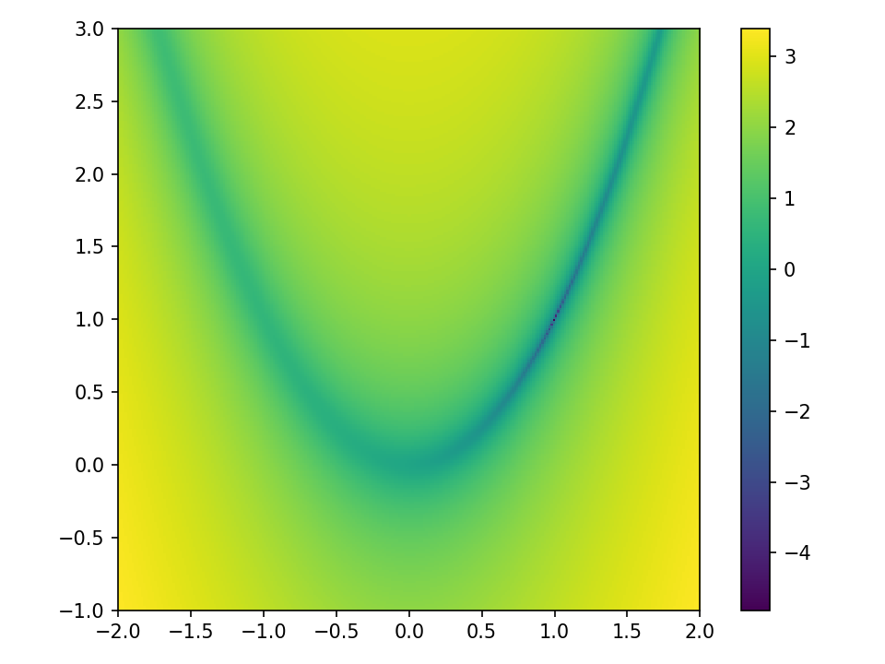
Aside: Minimization
Example: Rosenbrock (banana) function
  This is a hard problem for optimization
  Global minimum is at (a, a²)
Note: this is the log of the function plotted
code: steepest_descent.py

Slide 19
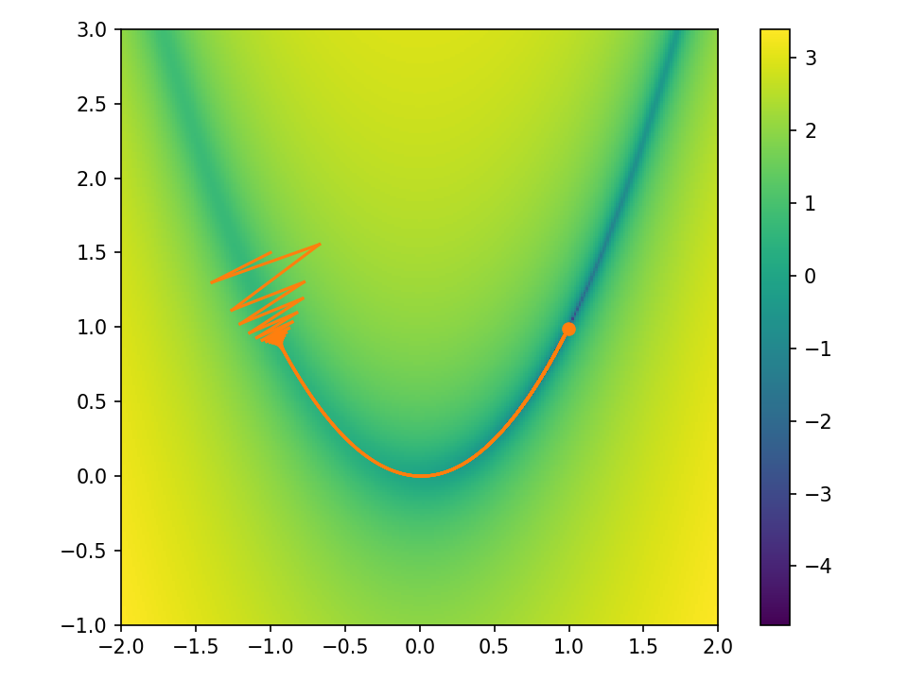
Aside: Minimization
Minimization with gradient descent is very sensitive to choice of η
  Too large and you may shoot off far from the minimum
  Too small and you do a lot of extra work
code: steepest_descent.py

Slide 20
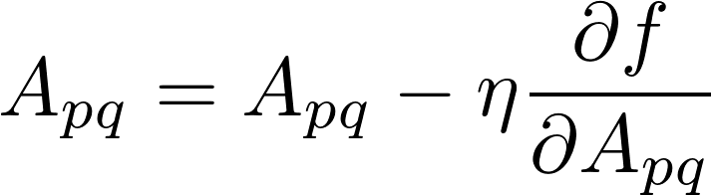
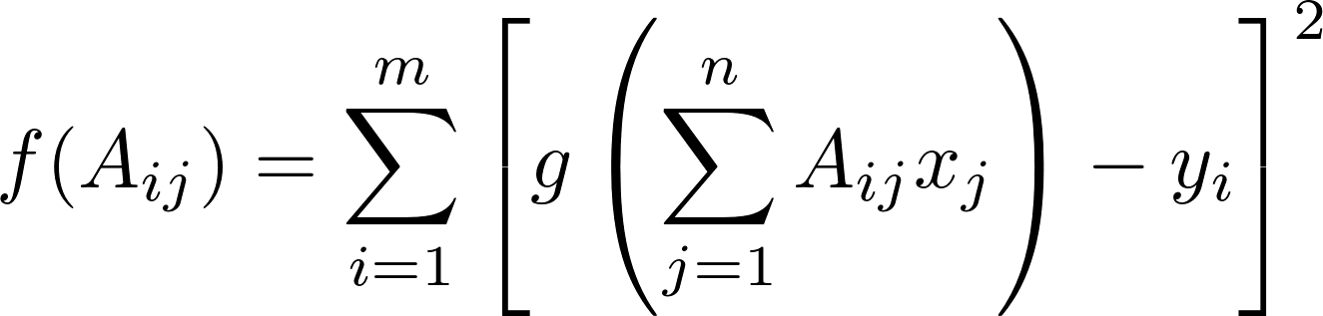
Neural Net Minimization
For our function,
  Note, this definition is for a single training pair, (x^{k}, y^{k})
  Our update would be
  where

Slide 21
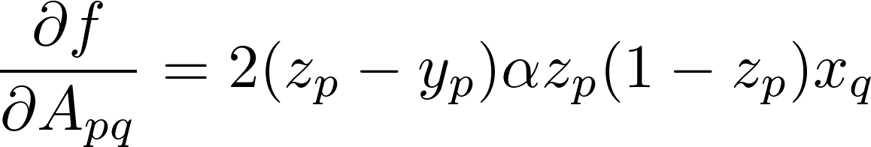
Neural Net Minimization
Working out the derivative:
  We could then use steepest descent, looping over the matrix elements and doing the minimization on them one by one, iterating until we converge
    Instead, we just do one push “downhill” following the gradient for a single training set and then move to the next.
    η is often called the learning rate
Gradient descent is often used for neural nets because it only requires the first derivative
  Newton’s method would require the second derivatives (Hessian matrix)

Slide 22
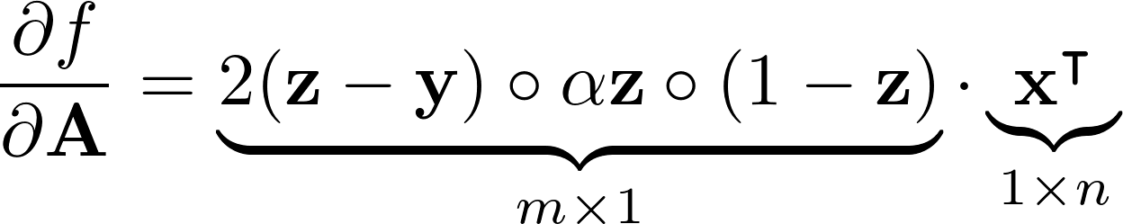

Neural Net Minimization
Recall,
  A is m × n matrix
  x is n × 1 vector
  y (and hence z) is m × 1 vector
We can write our derivative as:
Then the correction to our matrix is:
Here, a ∘ b is an element-wise product

Slide 23
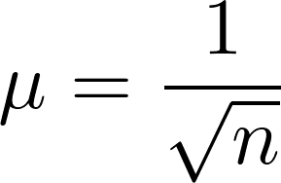
Initialization
A common choice for initializing A is to set the elements to random numbers in [-1, 1]
  It is suggested (see, e.g., Rashid) that a better choice is initializing the elements to Gaussian normal random numbers with width
    This should be coupled with α = 1
The initialization sets the starting point in the minimization, so different realizations can converge to different (local) minima

Slide 24
Simple Example
Here’s a simple example
  Given an input vector of 10 numbers drawn from a sample, set the output to the last element of the input
    Draw from: [0.05, 0.15, 0.25, 0.35, 0.45, 0.55, 0.65, 0.75, 0.85, 0.95]
    Example input and output:
      Input: [0.15, 0.35, 0.65, 0.45, 0.05, 0.15, 0.75, 0.35, 0.25, 0.85]
      Output: [0.85]
  We want to train a neural net on a bunch of input/output pairs and then see if it can predict the correct output given some new input vectors
    This type of example seems to be a very common intro example
  We’ll restrict the output of the network to be the closest member of the set

Slide 25
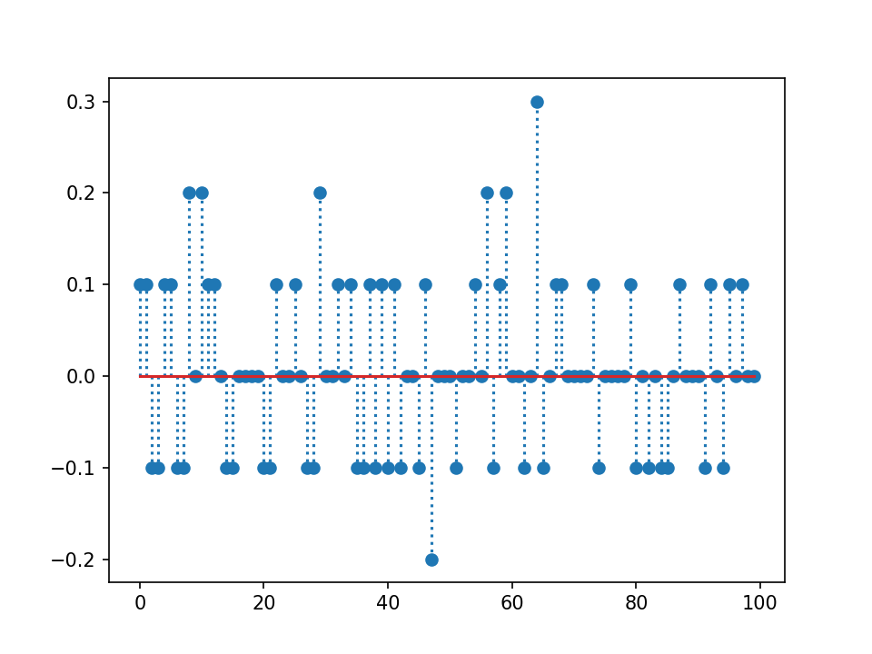
Simple Example
After training, our model does an okay job at recognizing the trained data
code: last_num.py

Slide 26
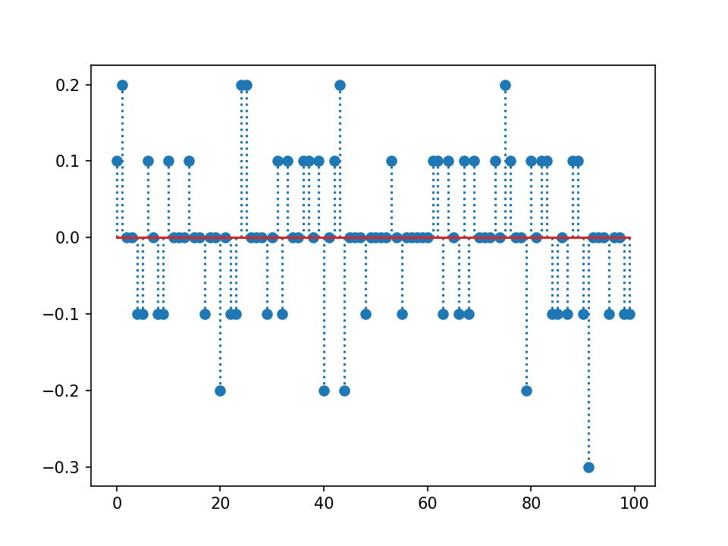
Simple Example
And about 45% success on data we’ve never seen before

Slide 27
Simple Example
The matrix A has elements:
  Notice that the last element is by far the largest—as expected
[[-0.64781066 -0.5222319 -0.3895293 -0.56014527 -0.51573424
-0.7674345 -0.29920656 -0.48140874 -0.61986531 4.84708543]]

Slide 28
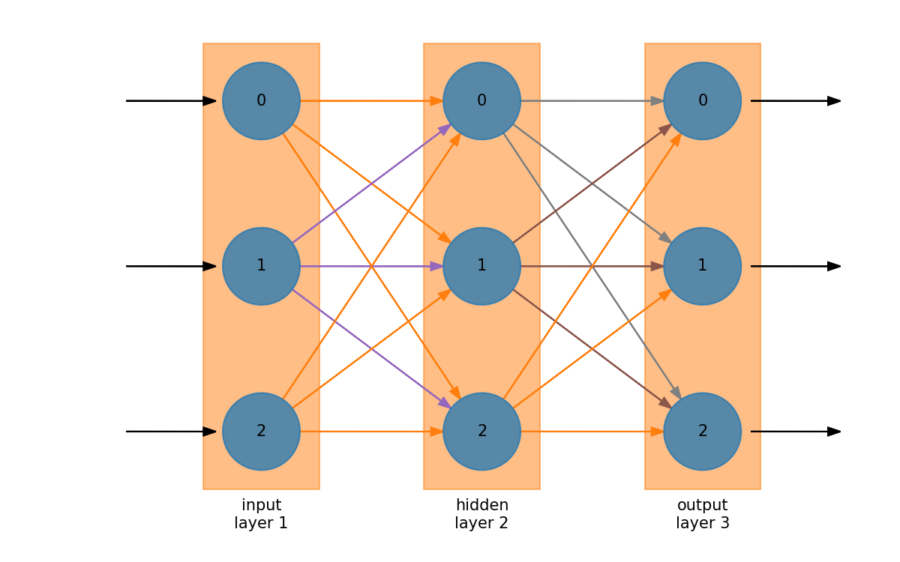
Hidden Layers
We can add more more parameters by another layer of nodes/neurons

Slide 29
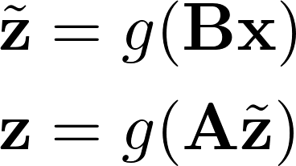
Hidden Layers
Hidden layers sit between the input and output
For hidden layer of dimension k:
  Inputs: x ∊ ℝ^{n}
  Outputs: z ∊ ℝ^{m}
  A is an m × k matrix
  B is an k × n matrix
  The product AB is m × n, as we had before
Universal approximation theorem: single layer network can represent any continuous function
We transform the input in two steps:

Slide 30
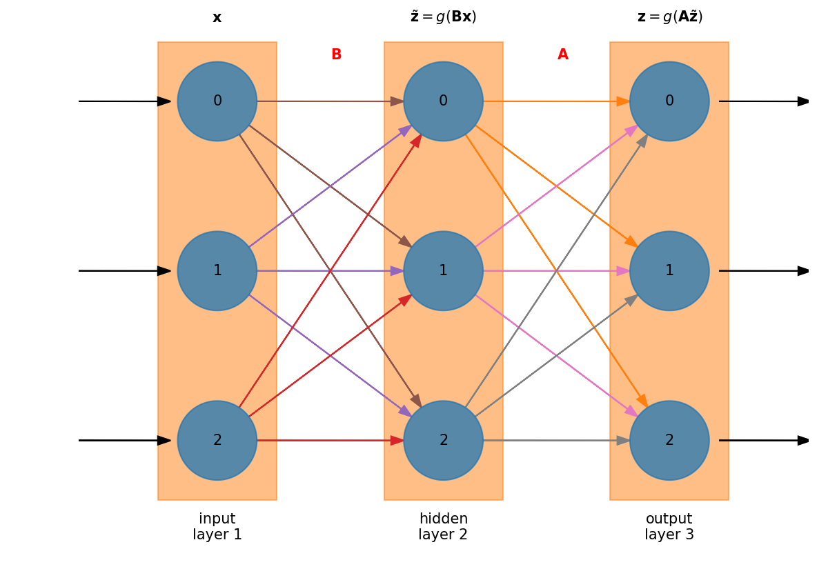
Hidden Layers
Graphically this appears as:

Slide 31
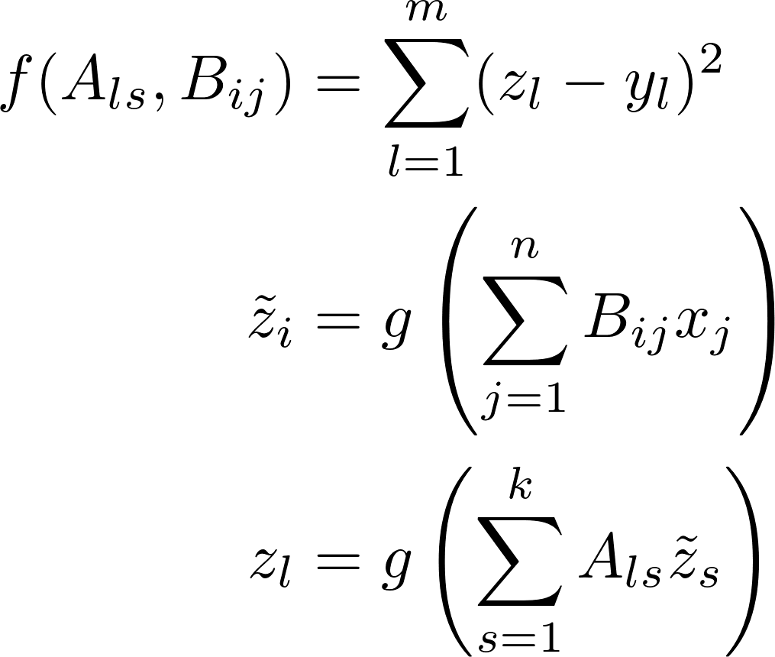
Hidden Layers
Now we minimize:

Slide 32
Minimization
We need to do the minimization now for both sets of weights (matricies)
In practice, we do them one at a time, with each seeing the result from its layer
  This process is also called backpropagation in neural networks—we are using the errors at the end to change the weights that came earlier in the network

Slide 33
Backpropagation
In the evaluation step, we progress though the neural network in a forward direction: input layer → hidden layer → output layer
Backpropagation is the process of taking the errors that we compute at the output layer and moving them backwards to the hidden layer

Slide 34
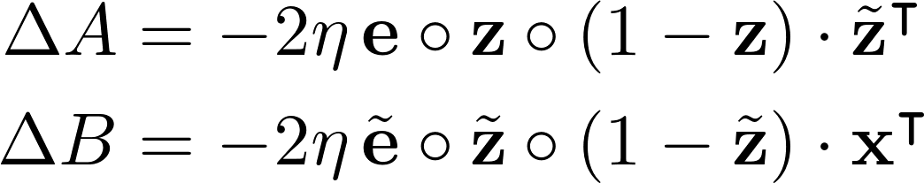
Gradient Descent
We can do our gradient descent on A and B separately now
  This is the strength of backpropagation and gradient descent vs. some “canned” minimization routine—we are not optimizing the entire system all together
Differentiating our error and lots of chain rule gives:
  With
Note: this is a single dot product, the combination of vectors on the left are multiplied element-by-element (the Hadamard product)
This approximation seems to be commonly made and supposedly doesn’t affect convergence much

Slide 35
Hidden Layers
Usually only a single hidden layer is needed
n > k > m should be reasonable
Interactive exploration of hidden layers:
  http://playground.tensorflow.org

Slide 36
Image Classification
We’ll try to recognize a digit (0 – 9) from an image of a handwritten digit.
  MNIST dataset (http://yann.lecun.com/exdb/mnist/)
    Popular dataset for testing out maching learning techniques
    Training set is 60,000 images
      Approximately 250 different writers
    Test set is 10,000 images
    Correct answer is know for both sets so we can test our performance
Image details:
  28 × 28 pixels, grayscale (0 – 255 intensity)
The best learning algorithms can get accuracy > 99%

Slide 37
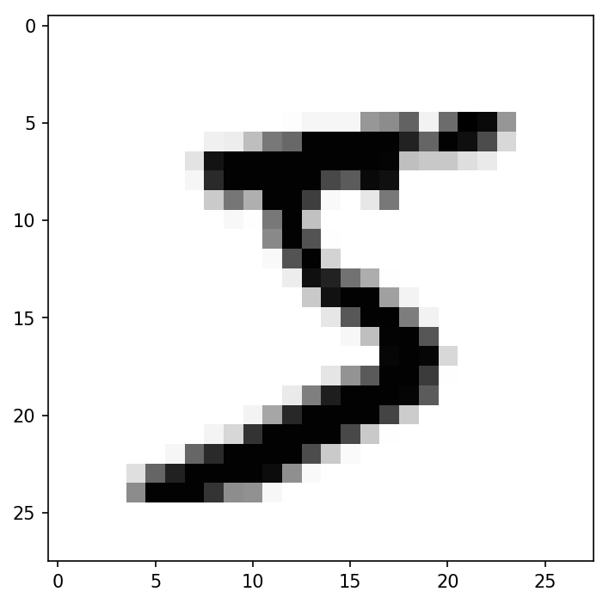
Image Classification
Neural network characteristics:
  Input layer will be 784 nodes
    One for each pixel in the input image
  Output layer will be 10 nodes
    An array with an entry for each possible digit
    “3” would be represented as: [0, 0, 0, 1, 0, 0, 0, 0, 0, 0]
  We’ll start with a hidden layer size of 100
We’ll train on the training set, using up to 60000 images
  Rescale the input to be in [0.01, 1]
We’ll test on the test set of 10000 images
First digit MNIST in the training set

Slide 38
Image Classification
Default configuration:
  The full training set (60000 images)
  Hidden layer of 100 nodes
  5 epochs of training
  Learning rate of 0.1
We achieve 95 – 96% accuracy
code: char_recognition.py

Slide 39
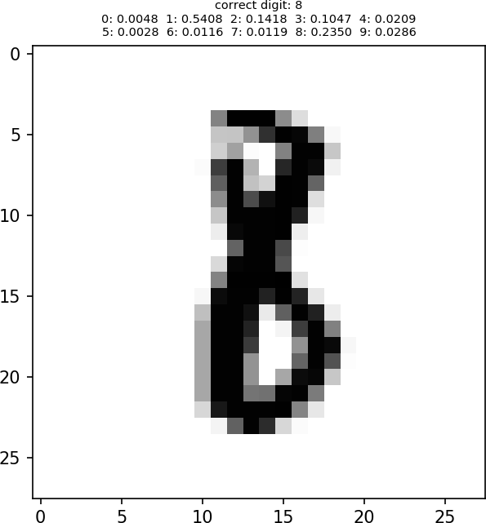
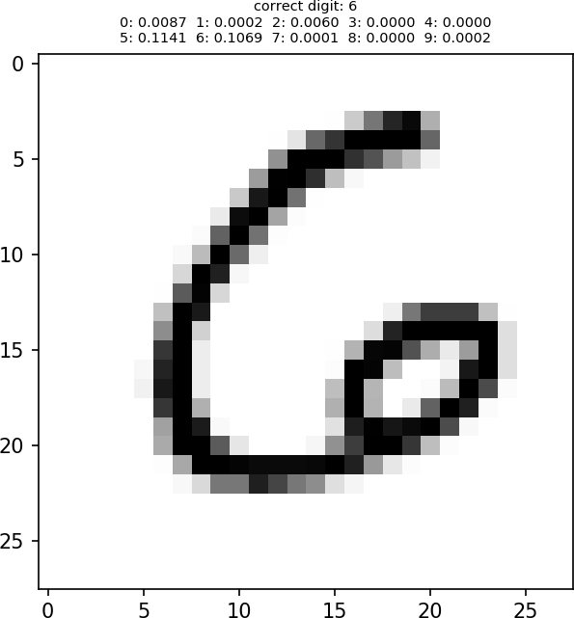
Some Image Classification Failures

Slide 40
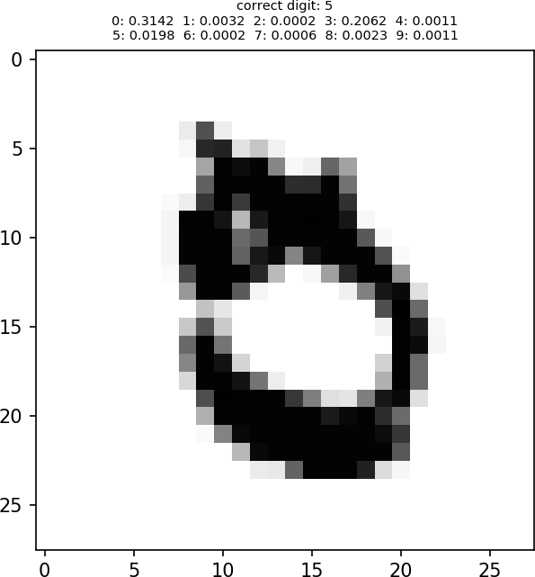
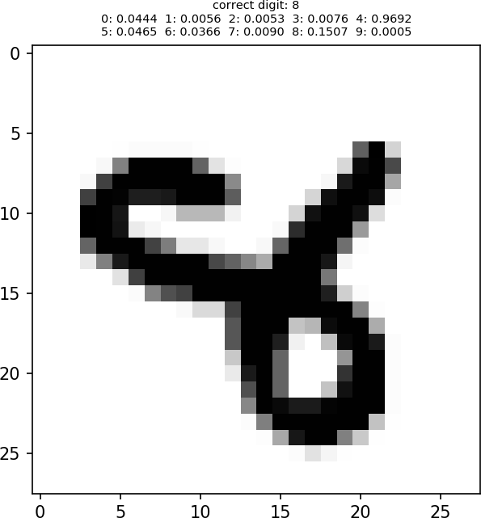
Some Image Classification Failures

Slide 41
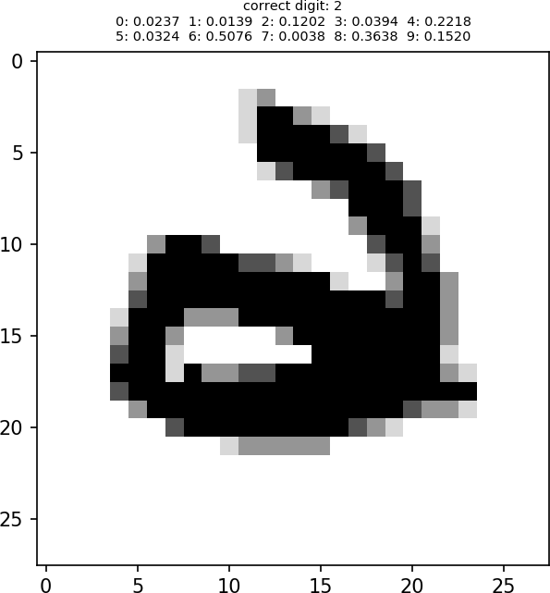
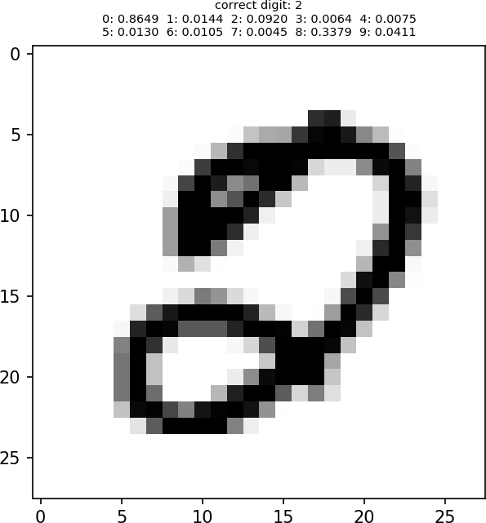
Some Image Classification Failures

Slide 42
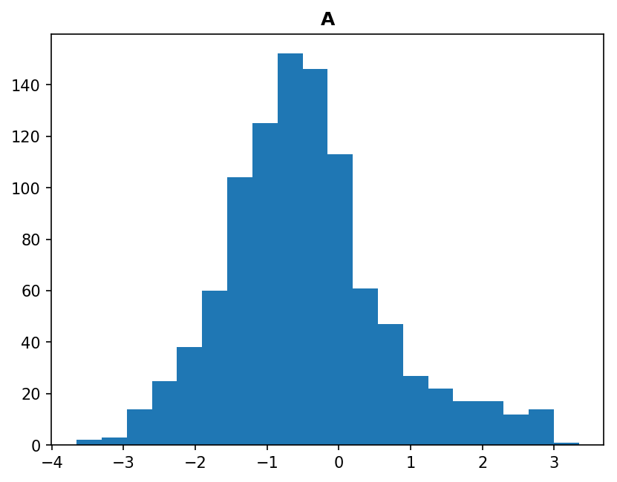
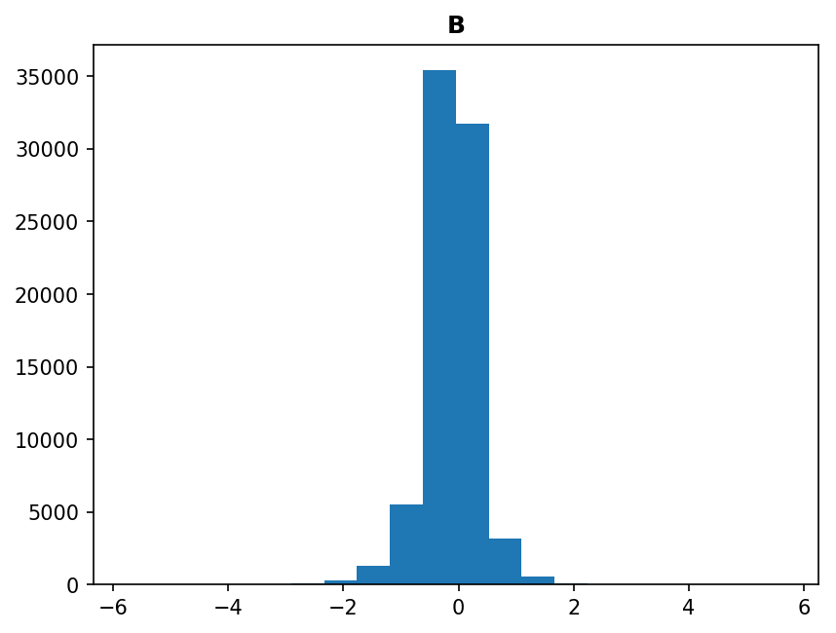
Image Classification Weights
Weights (matrix elements of A and B) seem symmetric about 0
  Interestingly, with more training, the width of the distribution seems to grow

Slide 43
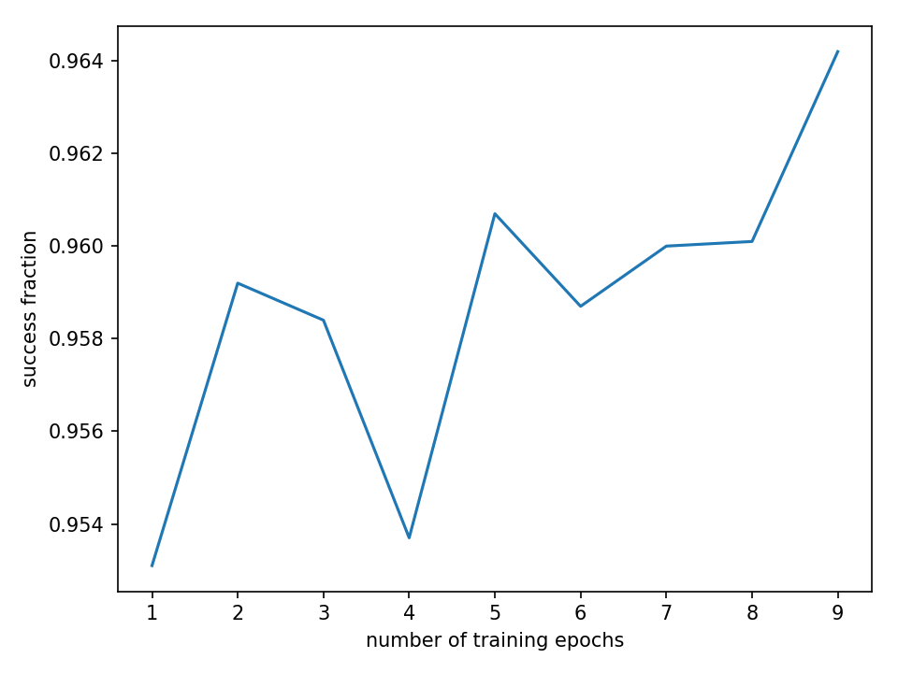
Effect of Number of Epochs
When we use the full training set (60000 images) the number of epochs (passes through the training data) doesn’t seem to matter much

Slide 44
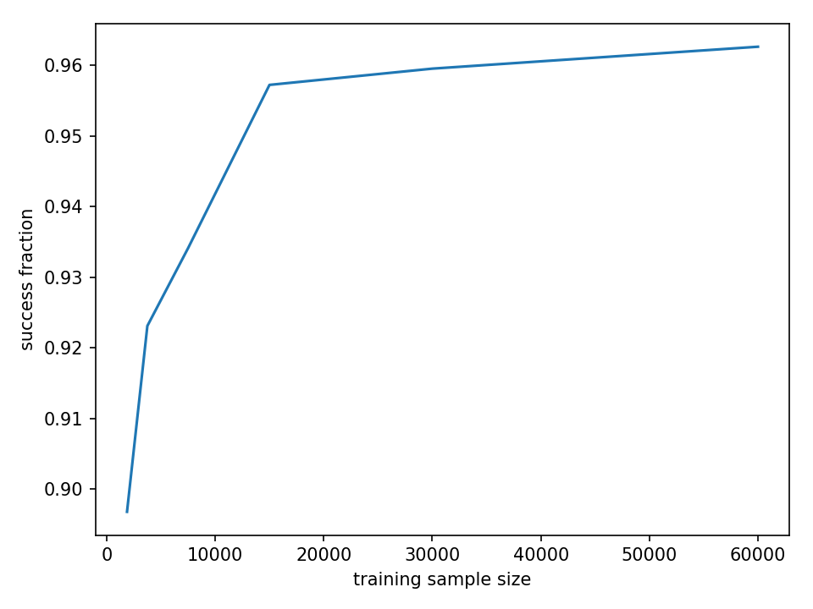
Effect of Training Set Size
No surprise: the larger the training set, the better we do

Slide 45
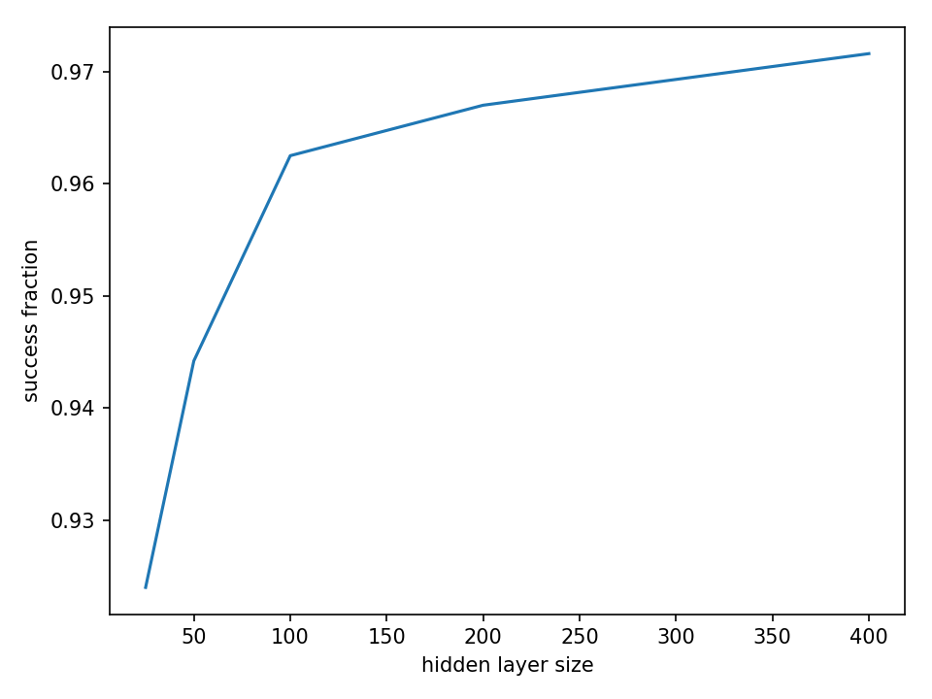
Effect of Hidden Layer Size
Also not unexpected: the larger the hidden layer the better we do

Slide 46
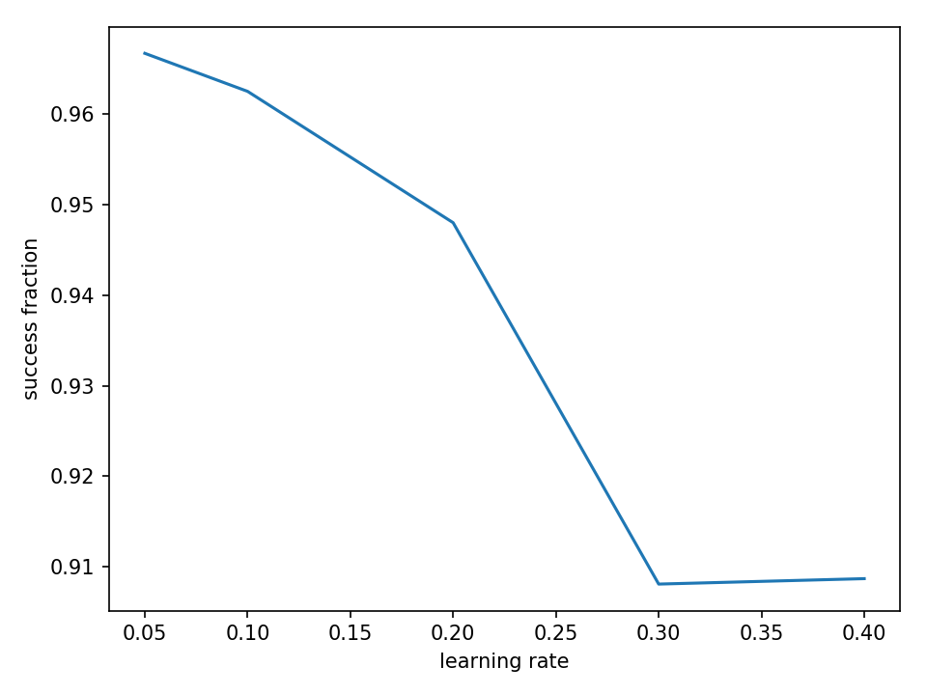
Effect of Learning Rate
A smaller learning rate seems to do better

Slide 47
Deep Learning
A deep neural network is one with many hidden layers (certainly > 1 hidden)
  Very nice discussion: https://stats.stackexchange.com/questions/182734/what-is-the-difference-between-a-neural-network-and-a-deep-neural-network
There are other learning algorithms aside from neural networks—there’s a link to a text on the class website

