Slide 1
Finding the best location for opening a new vegan restaurant in LA
Steffen Buergers

Slide 2
“Vegan restaurants are on the rise” – Forbes magazine
A vegan diet is being adopted by more and more people in the US, and the demand for vegan restaurants is correspondingly increasing. This is particularly true in large multicultural cities such as Los Angeles.
We will use machine learning leveraging location data from Foursquare and Yelp to try to predict the best location to open a vegan restaurant in LA.

Slide 3
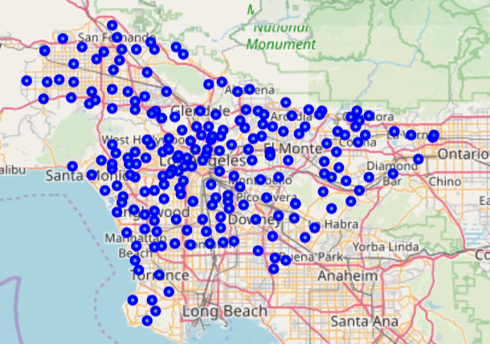
Step 1: Find geospatial coordinates neighborhoods in LA
We scraped neighbourhood names from the la-times website.

Slide 4
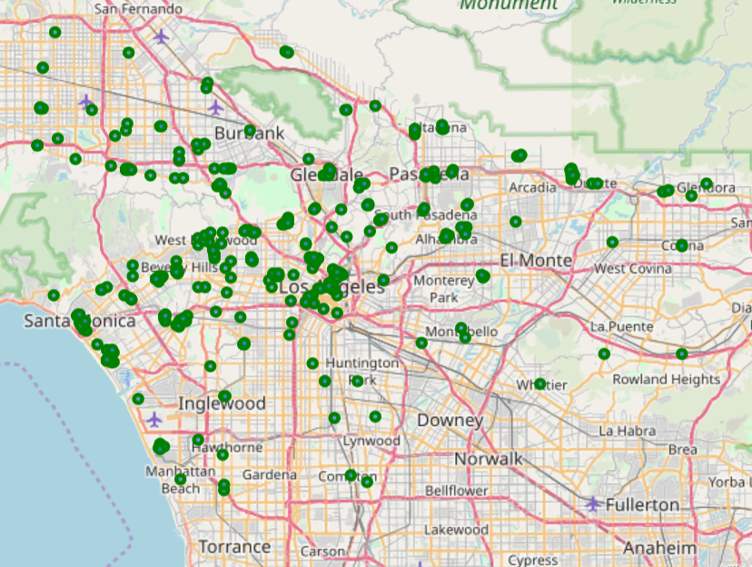
Step 2: Find vegan venues around these neighborhoods
Vegan venues were obtained via the Yelp API.

Slide 5
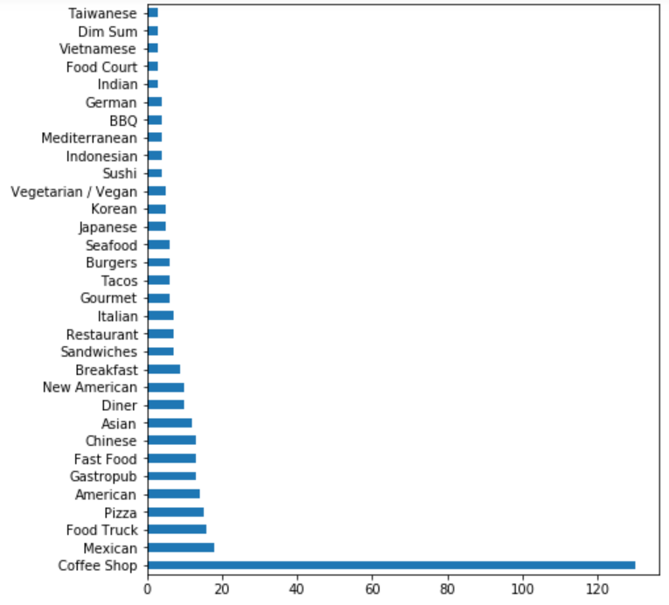
The majority of these “vegan” venues are actually coffee shops
Venue category
Number of venues

Slide 6
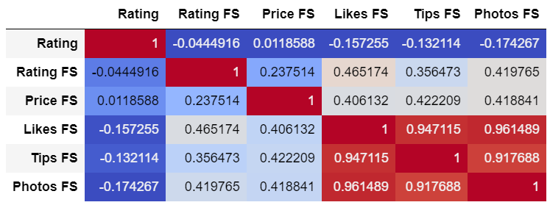
Customer ratings on Yelp and Foursquare are surprisingly uncorrelated
Rating (customer rating on Yelp)
Rating FS (customer rating on Foursquare)
Price FS (price tier from Foursquare)
Likes FS (number of likes on Foursquare)
Tips FS (number of tips on Foursquare)
Photos FS (number of photos posted on Foursquare)

Slide 7
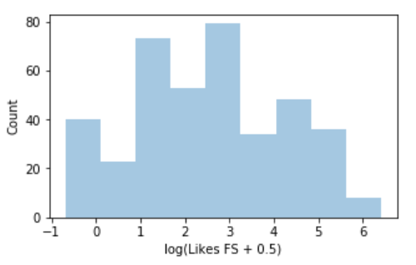
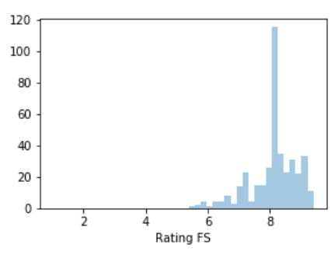
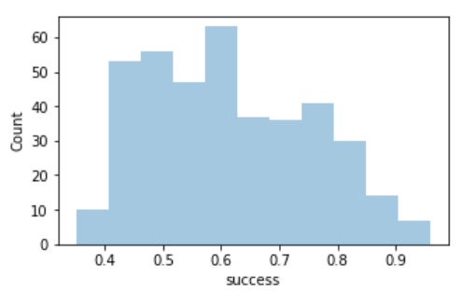
Step 3: Compute a measure of restaurant “success”
Success is a combination of rating and likes:
Likes FS
Rating FS
Success

Slide 8
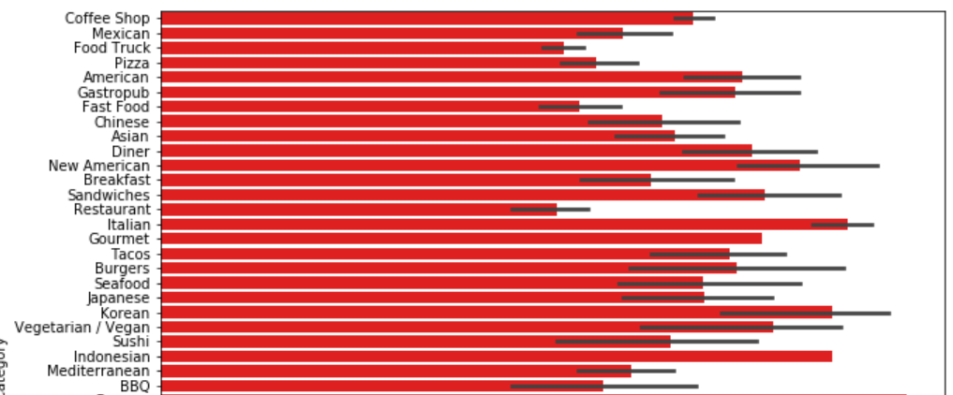
Italian restaurants are most successful
Restaurant success

Slide 9
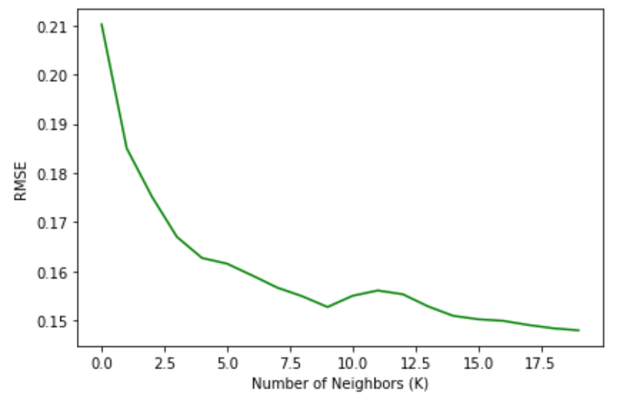
Step 4: Predict restaurant success based on surrounding venues within walking distance
Use K-Nearest Neighbor regression
  Dependent variable: Restaurant success
  Features: Proportion of venue type within walking distance relative to all venues
Best K = 9

Slide 10
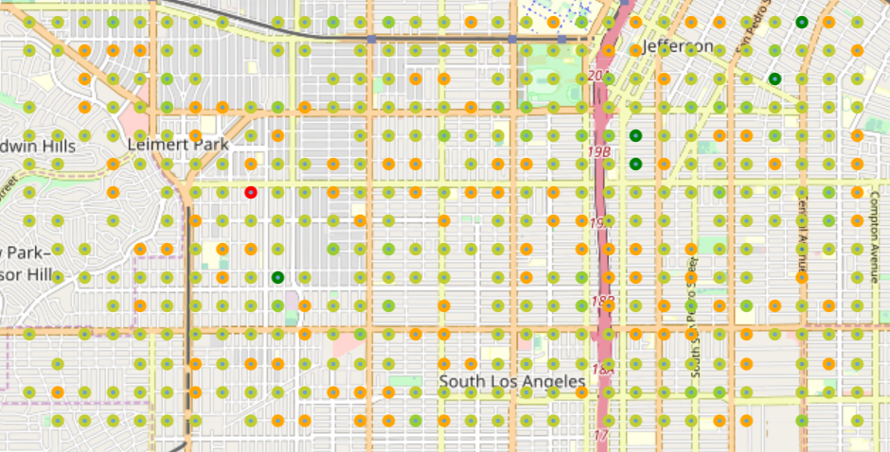
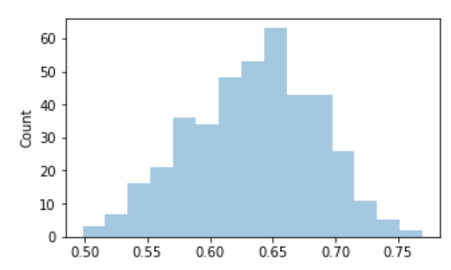
Step 5: Within a pre-specified area, what is the best location to open a new restaurant?
Dark green = most likely to be successful
Predicted success

Slide 11
Conclusions and future directions
The K-nearest Neighbour model is able to quantify likely success for a vegan venue given its neighbourhood Characteristics.
However, the available data shows large heterogeneity in vegan venue type and it is doubtful that similar characteristics favour all venue categories (e.g. compare coffee shops vs Indian restaurant).
In the future it might be useful to gather a larger dataset over multiple cities to be able to discern the best location for a given restaurant type (e.g. vegan-Italian).
Similarly, it might be worth exploring what features will give the best results and prune the number of features compared to what was done in this analysis.

