Slide 1
TYPO3 × BUSINESS AVIATION
Fly the Upgrade
How pilots would fly a TYPO3 upgrade
Stefan Bürk TYPO3 Core Team — Framework Maintainer · stefan@buerk.tech
Fly the Upgrade — Stefan Bürk
01 / 88

Slide 2
FLIGHT PLAN
Today's routing
BRIEFING
Why aviation has checklists — and why you need them
CROSS-CHECK
The Core Changelog: your NOTAM package
PHASE 1
Dispatch & Pre-Flight — everything before you touch composer
PHASE 2
Take-Off & Cruise — the upgrade window itself
PHASE 3
Approach, Landing & Debrief — the part everyone skips
DEBRIEF
Takeaways you can use on Monday
Fly the Upgrade — Stefan Bürk
02 / 88

Slide 3
WHO IS FLYING
Stefan Bürk
◆ PHP developer since 2003
◆ TYPO3 developer since 2012
◆ TYPO3 Core Team — Framework Maintainer & Merger
◆ Maintainer of typo3/testing-framework
◆ Fluid maintainer
◆ Aviation addict
Fly the Upgrade — Stefan Bürk
03 / 88

Slide 4
SCOPE
What this is (not) about
This is not
This is
◆ A copy-paste, step-by-step upgrade script
◆ A claim that one specific tool solves it
◆ A promise that nothing will go wrong
◆ A repeatable process built from phases
◆ Checklists you can actually take to work
◆ Where each tool fits — and where it stops
◆ How to prepare for what you cannot foresee
Fly the Upgrade — Stefan Bürk
04 / 88

Slide 5
Checklists were not invented by careful people.
They were invented after a crash.
On 30 October 1935 the Boeing Model 299 — the B-17 prototype — crashed on take-off at Wright Field because the gust locks were still engaged. The crew were among the best pilots in the country. The aircraft was simply more complex than memory could hold. The answer was not better pilots. The answer was the checklist.
Fly the Upgrade — Stefan Bürk
05 / 88

Slide 6
A TYPO3 upgrade is more complex than your memory.
That is not a criticism. That is the job description.
Nobody holds 526 changelog entries, 40 extensions, a PHP jump, a schema migration and a rollback plan in their head at 23:00 on a Thursday.
Fly the Upgrade — Stefan Bürk
06 / 88

Slide 7
BE HONEST
“The TYPO3 upgrade is on your task list.”
😱
🙂
Dread
Anticipation
Unknown scope. Unknown errors. Unknown hours. A weekend you will not get back.
Known scope. Expected errors. Planned hours. A procedure you have flown before.
The difference is not talent. It is preparation.
Fly the Upgrade — Stefan Bürk
07 / 88

Slide 8
SITUATION
Where the fleet stands today
TYPO3 v11
2024-10-31
TYPO3 v12
2026-04-30
TYPO3 v13
2027-12-31
TYPO3 v14
2029-06-30
■ FREE SUPPORT ■ ELTS (PAID) ■ TODAY, 24 AUGUST 2026
Free support for v12 ended on 30 April 2026. If you are still on v12 today, you are flying on ELTS reserves — legal, paid for, and not a long-term plan.
Fly the Upgrade — Stefan Bürk
08 / 88

Slide 9
SITUATION
Your dispatcher already noticed
composer refuses to release the aircraft
$ ddev composer require webvision/flight-ops -W
Problem 26
- Root composer.json requires webvision/flight-ops @dev
-> satisfiable by webvision/flight-ops[dev-main].
- webvision/flight-ops dev-main requires typo3/cms-core ^12.4
-> found typo3/cms-core[v12.4.0, ..., v12.4.45] but these were not
loaded, because they are affected by security advisories
("PKSA-2yr3-by9d-r1gh", "PKSA-q3vc-jr63-rrrj", "PKSA-gj1k-954p-nhmk",
"PKSA-gr4f-6g49-cg8v", "PKSA-32mm-z25f-2ysj", ... 25 more).
Installation failed, reverting ./composer.json and ./composer.lock
◆ This is real output from the demo instance for this talk, on a fully patched v12.4.45.
◆ Once free support ends, the last public release stays frozen while advisories keep landing.
◆ You can silence it. You cannot fix it without ELTS — or an upgrade.
Fly the Upgrade — Stefan Bürk
09 / 88

Slide 10
THE MODEL
Three phases, one flight
1
2
3
Pre-Flight
Flight
Post-Flight
DISPATCH, BRIEFING, WALKAROUND
TAKE-OFF, CRUISE, THE STERILE COCKPIT
LANDING, TECH LOG, DEBRIEF
Everything before you touch composer
The upgrade window itself
Verification and the next flight's plan
THE CORE CHANGELOG RUNS UNDERNEATH ALL THREE
Fly the Upgrade — Stefan Bürk
10 / 88

Slide 11
THE MODEL
The mapping
AVIATION
TYPO3 UPGRADE
NOTAM briefing
Core Changelog: Breaking, Deprecation, Feature, Important
Airworthiness Directive with a compliance date
Deprecation — flies today, grounded later
Runway closed / navaid out of service
Breaking change — replan or do not depart
Pre-flight walkaround
Is the current version clean? Zero known deprecations
Performance calculation
composer why-not, platform and PHP constraints
MEL — Minimum Equipment List
Findings you accept deliberately, in writing, with a date
Departure briefing
The written plan, shared with the whole team
V1 — decision speed
Schema migration and wizards: the point of no return
Sterile cockpit below 10,000 ft
Code and content freeze during the window
QRH — Quick Reference Handbook
Prepared responses for the errors you expect
Stabilised approach criteria → go-around
Written rollback criteria, executed without ego
Autopilot quietly trimming out an imbalance
TCA auto-migration — it keeps flying, and it hides the problem
Tech log write-up
Deprecation log, debrief, and the next upgrade's input
Fly the Upgrade — Stefan Bürk
11 / 88

Slide 12
✚
YOUR NOTAM PACKAGE
The Changelog
Read before every flight. Not once, not sometimes. Every flight.
Fly the Upgrade — Stefan Bürk
12 / 88

Slide 13
CHANGELOG
What a NOTAM actually is
◆ A NOTAM — Notice to Air Missions — tells a crew what changed since last time.
◆ Runway 07 closed. Navaid out of service. New obstacle 1.2 NM short of threshold.
◆ It is not interesting reading. It is mandatory reading.
◆ No crew departs on the assumption that the airport is the same as last month.
Yet we routinely upgrade TYPO3 on exactly that assumption.
Fly the Upgrade — Stefan Bürk
13 / 88

Slide 14
CHANGELOG
Four types, four different demands
Breaking
Deprecation
Feature
Important
RUNWAY CLOSED
AIRWORTHINESS DIRECTIVE WITH A COMPLIANCE DATE
NEW EQUIPMENT FITTED
OPERATIONAL BULLETIN
Something was removed or changed incompatibly.
Still works — and is already scheduled for removal.
New API or capability you may adopt.
Behaviour changed in a way you should know about.
Fix before you can run on the new version. No grace period.
Fix now, on your schedule, or it becomes a Breaking change later.
Optional — but often the migration target of a deprecation.
Read it. It is where the surprises hide.
Fly the Upgrade — Stefan Bürk
14 / 88

Slide 15
CHANGELOG
The size of the briefing package
Changelog entries shipped in typo3/cms-core
TYPO3 v11
351 entries
71
113
131
36
TYPO3 v12
526 entries
128
128
217
53
■ BREAKING ■ DEPRECATION ■ FEATURE ■ IMPORTANT
Counted in the Documentation/Changelog folder of the shipped core. You do not read all of them — you triage them. That is a skill, and it is the job.
Fly the Upgrade — Stefan Bürk
15 / 88

Slide 16
CHANGELOG
Anatomy of an entry
Deprecation: #96136 — Deprecate inline JavaScript in backend update signals
Description
What changed and why.
“… is deprecated and will be ignored in TYPO3 v13.0.”
Impact
What breaks, and what it will do instead.
Affected Installations
Whether this is even your problem.
Migration
typo3/cms-core, Documentation/Changelog/12.0/Deprecation-96136-DeprecateInlineJavaScriptInBackendUpdateSignals.rst
The concrete replacement. This is the response half of the checklist.
Every entry carries its own migration instructions. The work is reading them, not inventing them.
Fly the Upgrade — Stefan Bürk
16 / 88

Slide 17
Today's Deprecation is tomorrow's Breaking change.
Deprecated in 12.0 → removed in 13.0. The changelog told you two years in advance.
This is why deprecation is not a phase-1 task. It is checked in all three phases, for three different reasons.
Fly the Upgrade — Stefan Bürk
17 / 88

Slide 18
CHANGELOG
Deprecation is checked in every phase
1 Pre-Flight
2 Flight
3 Post-Flight
Which deprecations of my CURRENT version am I still using?
Which of them actually bite now that they are gone?
Which NEW deprecations did I just inherit?
They are the removals of the version you are flying to. Clear them while the old version still runs and still forgives you.
What was a warning yesterday is a fatal error today. The scanner now ships the target version's rules.
The version you just landed on deprecates things too. That list is the flight plan for the next upgrade.
Extension Scanner · rector --dry-run
Extension Scanner (v13 rules) · rector · fractor
Deprecation log · Extension Scanner · rector, next level set
Fly the Upgrade — Stefan Bürk
18 / 88

Slide 19
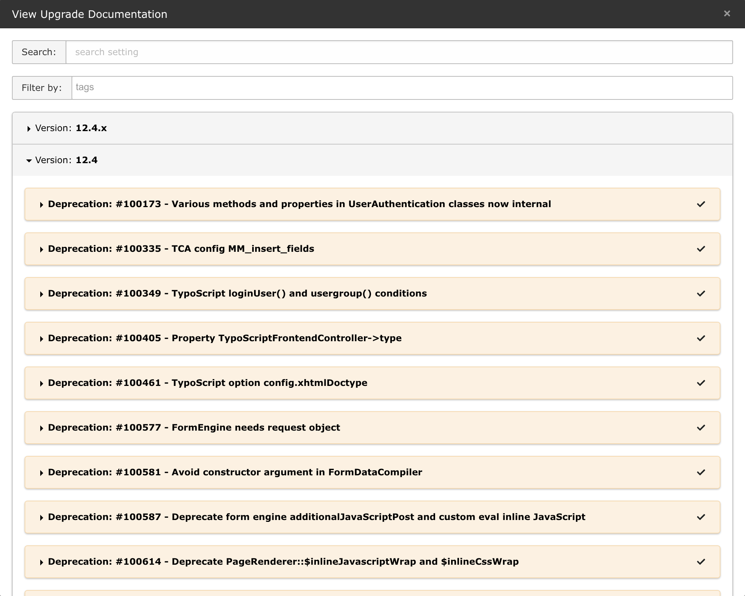
CHANGELOG
The briefing is in your backend
◆ Every changelog entry that ships with your core, searchable and filterable by tag.
◆ Mark entries as read so the list shrinks as you triage.
◆ You do not need the internet to do your NOTAM briefing.
Admin Tools › Upgrade › View Upgrade Documentation — TYPO3 12.4.45
Fly the Upgrade — Stefan Bürk
19 / 88

Slide 20
CHANGELOG
Where to read them
Rendered documentation
docs.typo3.org/c/typo3/cms-core/main/en-us/Index.html
Filterable by version and type. The canonical source.
Shipped with the core
vendor/typo3/cms-core/Documentation/Changelog/
Offline, grep-able, and exactly matching your installed version.
In the Install Tool
Admin Tools › Upgrade › View Upgrade Documentation
Same entries, with read/unread state.
Fly the Upgrade — Stefan Bürk
20 / 88

Slide 21
1
EVERYTHING BEFORE YOU TOUCH COMPOSER
Dispatch & Pre-Flight
The flight is won or lost before engine start.
Fly the Upgrade — Stefan Bürk
21 / 88

Slide 22
PHASE 1
How a crew starts the day
◆ Dispatch prepares a flight information package before the crew ever reaches the aircraft.
◆ Route, weather, NOTAMs, fuel, alternates, payload, and the MEL are already on paper.
◆ The crew verifies it — they do not invent it at the gate.
◆ Then they walk around the aircraft and look at it with their own eyes.
Nobody improvises a departure. The improvisation budget is saved for the things that actually go wrong.
Fly the Upgrade — Stefan Bürk
22 / 88

Slide 23
PHASE 1
Pre-Flight checklist
Challenge — Response. Read it out. Answer it honestly.
CURRENT VERSION
▸ known, patched, documented
TARGET VERSION
▸ decided, dated, justified
CHANGELOGS
▸ read and triaged
DEPRECATIONS, CURRENT VERSION
▸ cleared or on the MEL
EXTENSION SCAN
▸ run — strong matches at zero
TCA MIGRATIONS
▸ checked — list is empty
THIRD-PARTY EXTENSIONS
▸ target-version ready
PHP / DB / PLATFORM
▸ compatible and pinned
TESTS
▸ green and meaningful
BACKUP AND RESTORE
▸ rehearsed, not assumed
ROLLBACK CRITERIA
▸ written down before departure
TEAM
▸ briefed — shared mental map
Fly the Upgrade — Stefan Bürk
23 / 88

Slide 24
PHASE 1
Know your aircraft
You cannot plan a flight for an aircraft you have not inventoried.
# What am I actually running?
./vendor/bin/typo3 --version
composer show typo3/cms-core
php --version && composer show | wc -l
# What is installed, and what of it is mine?
./vendor/bin/typo3 extension:list
composer show --direct
# What is abandoned, outdated, or about to become someone else's problem?
composer outdated --direct
composer audit
◆ Write the answers down. This is the aircraft you are flying, not the one you remember.
◆ Every extension is one of four things: maintained, adoptable, replaceable, or a reason not to depart.
Fly the Upgrade — Stefan Bürk
24 / 88

Slide 25
You do not take a known-broken aircraft on a long leg.
Clear the deprecations of your CURRENT version first — while it still runs, still warns, and still forgives you.
Every deprecation you leave behind is a removal you will meet mid-flight instead.
Fly the Upgrade — Stefan Bürk
25 / 88

Slide 26
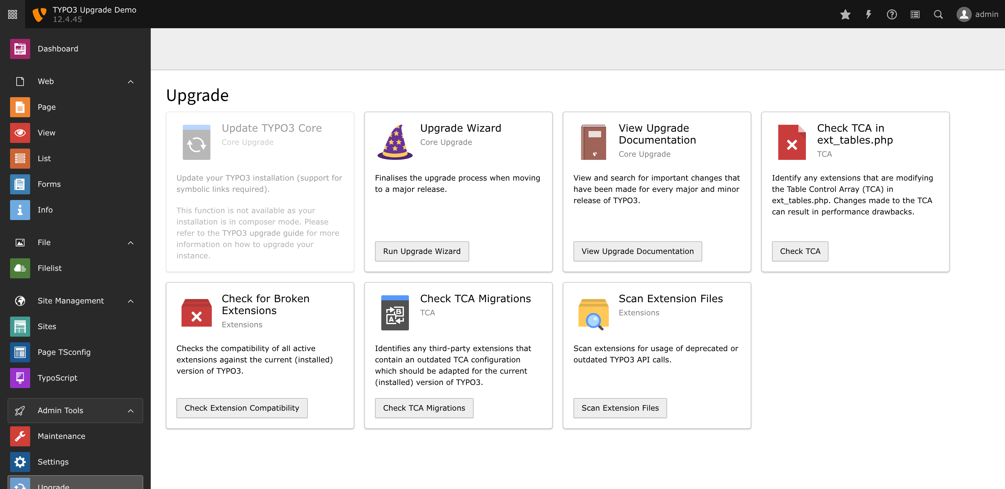
PHASE 1 · TOOLING
The Extension Scanner
◆ Ships with the core. Nothing to install, nothing to configure.
◆ Scans your extensions for deprecated and removed API from the version you are running.
◆ Also here: upgrade wizards, the changelog viewer, and the compatibility check.
Admin Tools › Upgrade — TYPO3 12.4.45
Fly the Upgrade — Stefan Bürk
26 / 88

Slide 27
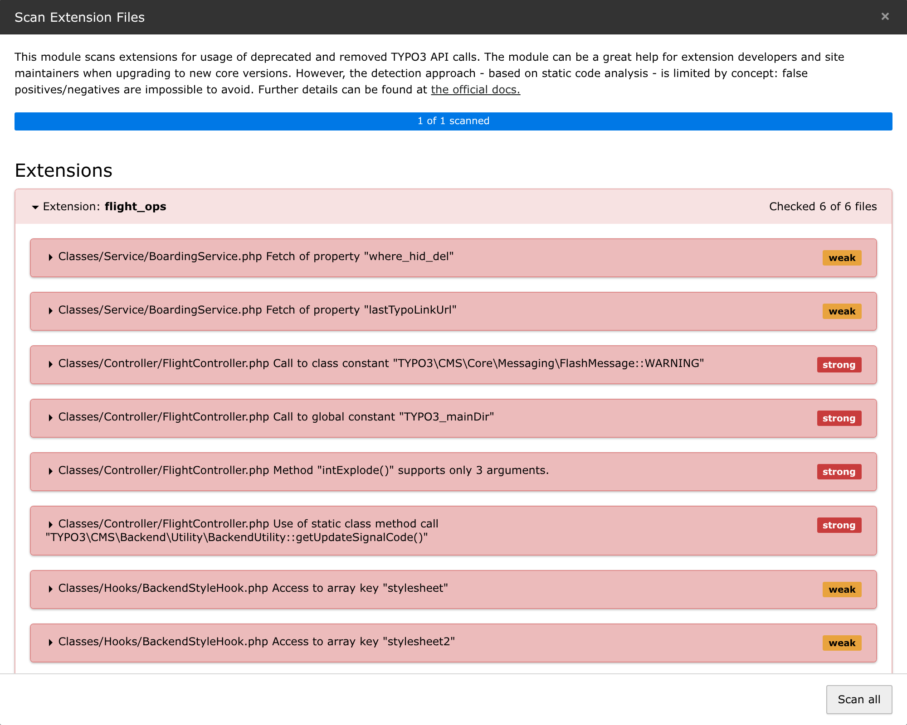
PHASE 1 · TOOLING
What it tells you
◆ 13 findings in 6 files: 6 strong, 7 weak.
◆ Each finding names the file, the line, and the changelog entry behind it.
◆ This list is your work package — and your estimate.
Scan Extension Files — the demo extension flight_ops on TYPO3 12.4.45
Fly the Upgrade — Stefan Bürk
27 / 88

Slide 28
PHASE 1 · TOOLING
Strong and weak matches
strong
6 findings
weak
7 findings
The scanner resolved the type and is certain. A definite usage of deprecated or removed API.
The name matches, but the type could not be resolved — $obj->getTreeList() might be TYPO3's, or might be entirely yours.
Fix it. This will break.
Verify by hand. Then decide, and record the decision.
“The detection approach — based on static code analysis — is limited by concept: false positives/negatives are impossible to avoid.” — the Extension Scanner, about itself
A weak match is not noise. It is an item you have not decided about yet.
Fly the Upgrade — Stefan Bürk
28 / 88

Slide 29
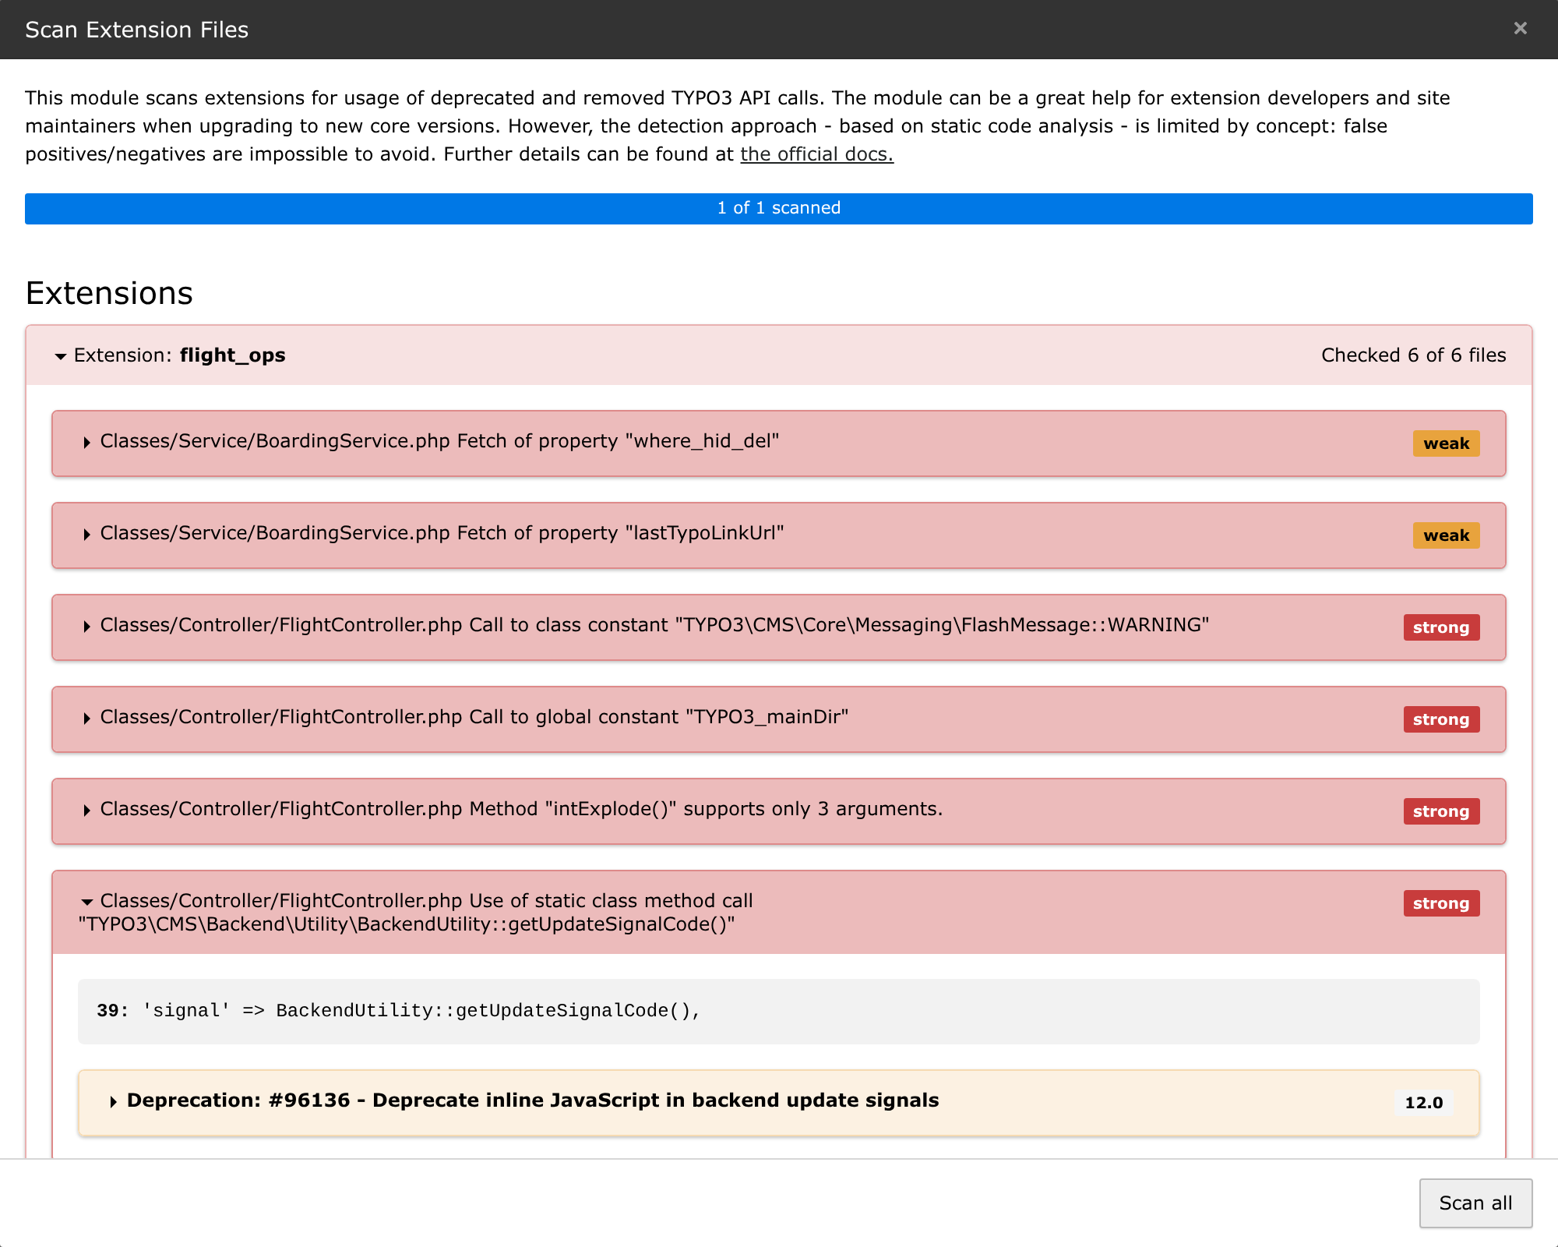
PHASE 1 · TOOLING
From finding to changelog in one click
◆ The exact line: 39: 'signal' => BackendUtility::getUpdateSignalCode(),
◆ The exact entry: Deprecation #96136, shipped in 12.0.
◆ And in that entry: the migration you are supposed to apply.
Scanner → changelog → migration. That loop is the whole pre-flight method.
A strong match, expanded — TYPO3 12.4.45
Fly the Upgrade — Stefan Bürk
29 / 88

Slide 30
PHASE 1 · TOOLING
Where the scanner stops
It only reads PHP
It does not have a rule for everything
TypoScript, Fluid, TCA, YAML, FlexForms and .htaccess are never looked at.
QueryBuilder->execute() has been deprecated since 12.0 — and has no scanner rule at all.
It cannot resolve dynamic code
It scans code, not behaviour
String class names, variable method calls, and $GLOBALS juggling stay invisible.
Changed defaults and changed rendering do not appear in any static scan.
This is not a flaw. It is one layer of defence — which is exactly why you add more.
Fly the Upgrade — Stefan Bürk
30 / 88

Slide 31
PHASE 1 · TOOLING
The same scanner, on the command line
netresearch/extension-scanner-cli — the Install Tool check, in CI
$ ./vendor/bin/typo3 extension:scan flight_ops --no-progress
Results for: flight_ops
=======================
+-----------------------------------------+------+--------------------------------+------------------------------------------+-----------+
| File | Line | Type | Message | Indicator |
+-----------------------------------------+------+--------------------------------+------------------------------------------+-----------+
| Classes/Service/BoardingService.php | 41 | Property Protected | Fetch of property "where_hid_del" | WEAK |
| Classes/Service/BoardingService.php | 36 | Property Public | Fetch of property "lastTypoLinkUrl" | WEAK |
| Classes/Controller/FlightController.php | 31 | Class Constant | Call to class constant "FlashMes..." | STRONG |
| Classes/Controller/FlightController.php | 40 | Constant | Call to global constant "TYPO3_mainDir" | STRONG |
| Classes/Controller/FlightController.php | 25 | Method Argument Dropped Static | Method "intExplode()" supports only 3... | STRONG |
| Classes/Controller/FlightController.php | 39 | Method Call Static | Use of static call "getUpdateSignal..." | STRONG |
| Classes/Hooks/BackendStyleHook.php | 17 | Array Global | Access to array global "TBE_STYLES" | STRONG |
+-----------------------------------------+------+--------------------------------+------------------------------------------+-----------+
[ERROR] Found 6 strong match(es) that WILL break on upgrade.
[WARNING] Found 7 weak match(es) that MAY need attention.
Total issues: 13 (6 strong, 7 weak)
◆ Reuses the matcher classes from EXT:install — the results are identical to the backend module.
◆ --format=json | checkstyle, --all, --fail-on-weak, and a non-zero exit code for CI.
◆ Not on Packagist today: install from the GitHub repository or the TER.
Fly the Upgrade — Stefan Bürk
31 / 88

Slide 32
PHASE 1 · TOOLING
Make the aircraft stay clean
A scan you run once is a snapshot. A scan in CI is a standard.
# .gitlab-ci.yml
extension-scanner:
stage: qa
script:
- composer install --no-progress
- ./vendor/bin/typo3 extension:scan --all --no-progress
# exits non-zero on strong matches -> the pipeline fails
# Checkstyle output for the merge-request annotations
- ./vendor/bin/typo3 extension:scan --all --format=checkstyle > scan.xml
artifacts:
reports:
codequality: scan.xml
◆ New deprecated usage never gets merged in the first place.
◆ The next upgrade then starts from zero instead of from archaeology.
Fly the Upgrade — Stefan Bürk
32 / 88

Slide 33
PHASE 1 · TOOLING
TCA is migrated behind your back
◆ On every single request, TYPO3 rewrites outdated TCA in memory before anything uses it.
◆ Your old configuration keeps working — so nothing ever tells you it is old.
◆ TcaFactory::migrateTca() raises a single E_USER_DEPRECATED carrying the full list of what it changed.
◆ In production that goes into the deprecation log, if you enabled it. Usually nobody looks.
This is the autopilot quietly trimming out an imbalance. The aircraft flies straight — right up until the day the autopilot is removed.
Fly the Upgrade — Stefan Bürk
33 / 88

Slide 34
“…these migrations will be removed.”
The core says it out loud, on every request, in the deprecation it raises. An auto-migration is not a fix. It is an Airworthiness Directive with an open deadline.
Verbatim from TcaFactory: “Automatic TCA migration done during bootstrap. Please adapt TCA accordingly, these migrations will be removed. The backend module ‘Configuration → TCA’ shows the modified values.”
Fly the Upgrade — Stefan Bürk
34 / 88

Slide 35
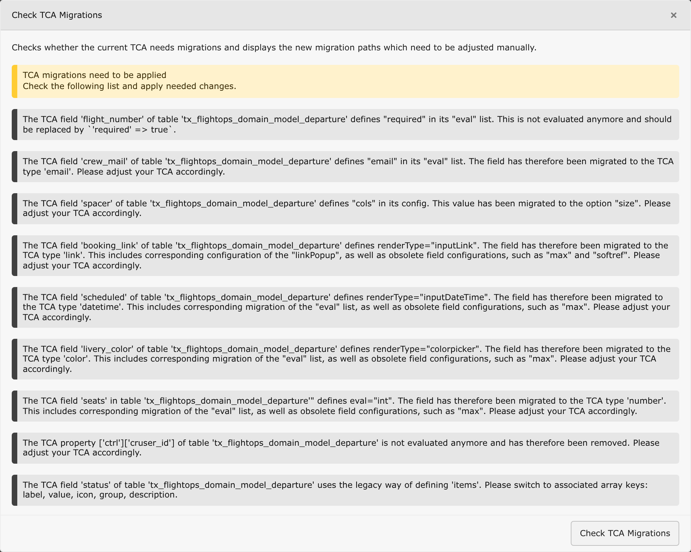
PHASE 1 · TOOLING
The tool nobody opens
◆ Nine findings from one small demo extension — required, email, cols, renderTypes, items, cruser_id.
◆ The Extension Scanner never reports these. Rector does not fix them. Fractor does not read TCA.
◆ Its sibling card, Check TCA in ext_tables.php, finds TCA built in the wrong place.
There is no CLI command for this one. It is backend-only — which is exactly why it gets skipped.
Admin Tools › Upgrade › Check TCA Migrations — TYPO3 13.4.34
Fly the Upgrade — Stefan Bürk
35 / 88

Slide 36
PHASE 1 · TOOLING
Your functional tests already knew
typo3/testing-framework ships failOnDeprecation="true"
$ vendor/bin/phpunit -c Build-FunctionalTests.xml
PHPUnit 11.5.56 by Sebastian Bergmann and contributors.
D 1 / 1 (100%)
1 test triggered 1 deprecation:
1) .../cms-core/Classes/Configuration/Tca/TcaFactory.php:176
Automatic TCA migration done during bootstrap. These migrations will
be removed. Please adapt these areas:
The TCA field 'flight_number' defines "required" in its "eval" list.
... 9 more messages
OK, but there were issues! Tests: 1, Assertions: 1, Deprecations: 1.
◆ The assertion passed. The suite still failed — exit code 1, because one deprecation was raised.
◆ This is why CI turns red after a core bump when you changed nothing at all.
◆ Do not silence it. That red build is the only thing that noticed.
FlexFormTools does the same for FlexForm data structures — same deprecation, same red build.
Fly the Upgrade — Stefan Bürk
36 / 88

Slide 37
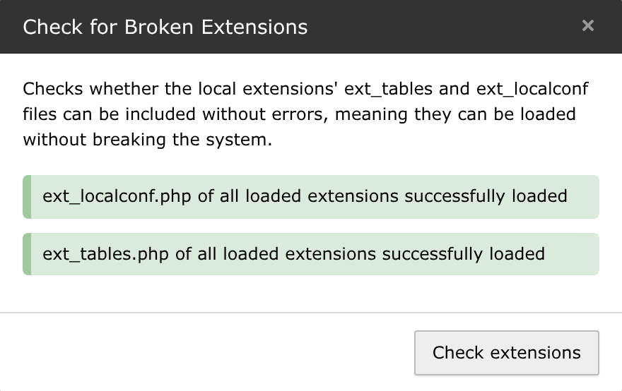
PHASE 1 · TOOLING
Does it even load?
◆ Includes every ext_localconf.php and ext_tables.php and reports what explodes.
◆ The cheapest possible check — and the first one worth running after any bump.
Green means loadable. It does not mean correct. Nothing here says your site works.
Admin Tools › Upgrade › Check for Broken Extensions
Fly the Upgrade — Stefan Bürk
37 / 88

Slide 38
PHASE 1 · TOOLING
Rector as reconnaissance
--dry-run changes nothing and tells you the size of the job
$ ./vendor/bin/rector process --dry-run
4 files with changes
====================
1) packages/flight_ops/Classes/Controller/FlightController.php:27
- FlashMessage::WARNING,
+ \TYPO3\CMS\Core\Type\ContextualFeedbackSeverity::WARNING,
Applied rules:
* RenameClassConstFetchRector
3) packages/flight_ops/Classes/Service/BoardingService.php:20
- ->select('*')
- ->from('tx_flightops_domain_model_departure')
- ->execute()
+ ->select('*')->from('tx_flightops_domain_model_departure')->executeQuery()
Applied rules:
* MigrateContentObjectRendererLastTypoLinkPropertiesRector
* MigrateQueryBuilderExecuteRector
[OK] 4 files would have been changed (dry-run) by Rector
◆ ssch/typo3-rector, configured with Typo3LevelSetList::UP_TO_TYPO3_13.
◆ It found ->execute() — the deprecation the Extension Scanner has no rule for.
◆ In phase 1 you only look. You do not let it write yet.
Fly the Upgrade — Stefan Bürk
38 / 88

Slide 39
PHASE 1 · TOOLING
Fractor covers the other half
Everything that is not PHP — and nothing else looks at it
$ ./vendor/bin/fractor process --dry-run
1 file with changes
===================
1) packages/flight_ops/Configuration/TypoScript/setup.typoscript:1
@@ Line 1 @@
-<INCLUDE_TYPOSCRIPT: source="FILE:EXT:flight_ops/.../Board.typoscript">
-<INCLUDE_TYPOSCRIPT: source="DIR:EXT:flight_ops/.../Partials" extensions="typoscript">
+@import 'EXT:flight_ops/Configuration/TypoScript/Plugin/Board.typoscript'
+@import 'EXT:flight_ops/Configuration/TypoScript/Partials/*.typoscript'
@@ Line 12 @@
-[globalVar = TSFE:id = 42]
+[traverse(page, "uid") == 42]
-[globalVar = GP:type = 98]
+[request && traverse(request.getQueryParams(), 'type') == 98]
Applied rules:
* MigrateLegacyTypoScriptConditionsFractor
* MigrateTypoScriptPageConditionToTraverseFractor
* MigrateIncludeTypoScriptSyntaxFractor
[OK] 1 file would have been changed (dry-run) by Fractor
◆ a9f/typo3-fractor: TypoScript, Fluid, YAML, XML, XLIFF, FlexForm, .htaccess, composer.json.
◆ The Extension Scanner never opened this file. Rector never opened this file.
Fly the Upgrade — Stefan Bürk
39 / 88

Slide 40
PHASE 1 · TOOLING
Four tools, four blind spots
Real numbers from the demo extension in this talk
10
2
1
9
FOUND ONLY BY THIS TOOL
FOUND ONLY BY THIS TOOL
FOUND ONLY BY THIS TOOL
FOUND ONLY BY THIS TOOL
Extension Scanner
Rector
Fractor
TCA migration check
13 issues, 10 of them reported by no other tool
->execute() and clearCacheOnLoad — neither of them has a scanner rule
The TypoScript file none of the others ever opens
9 TCA messages — no other tool here reports a single one of them
Only 3 of the scanner's 13 findings are auto-fixed by Rector.
No single tool clears the aircraft. That is the whole point of layered defences — the holes in the slices do not line up.
Fly the Upgrade — Stefan Bürk
40 / 88

Slide 41
PHASE 1
Can the fleet even fly?
Every third-party extension is a go / no-go item
$ composer why-not typo3/cms-core 13.4
typo3/cms-base-distribution - requires typo3/cms-core (^12.4)
typo3/cms-backend v12.4.45 requires typo3/cms-core (12.4.45)
typo3/cms-extbase v12.4.45 requires typo3/cms-core (12.4.45)
...
webvision/flight-ops dev-main requires typo3/cms-core (^12.4)
typo3/cms-core v13.4.0 requires doctrine/dbal (^4.2.1)
typo3/cms-base-distribution - does not require doctrine/dbal (but 3.10.6 is installed)
◆ For every blocker: is there a compatible release, a fork, a replacement — or is it yours to adopt?
◆ An abandoned extension is not a technical problem. It is a decision, and it belongs in phase 1.
Fly the Upgrade — Stefan Bürk
41 / 88

Slide 42
PHASE 1
Your own tooling can ground you
A real failure from building this talk
$ composer require typo3/cms-core:^13.4 ... -W
Your requirements could not be resolved to an installable set of packages.
Problem 1
- Root composer.json requires typo3/cms-install ^13.4
-> satisfiable by typo3/cms-install[v13.4.0, ..., v13.4.34].
- typo3/cms-install[v13.4.10, ..., v13.4.34] require nikic/php-parser ^5.4.0
-> found nikic/php-parser[v5.4.0, ..., v5.8.0] but these were not loaded,
likely because it conflicts with another require.
Installation failed, reverting ./composer.json and ./composer.lock
◆ The blocker was not the project. It was rector, pinning nikic/php-parser in require-dev.
◆ Dev tools share your dependency graph — until you isolate them.
◆ Fix: update the tools in the same transaction, or install them in their own tools/ directory.
Fly the Upgrade — Stefan Bürk
42 / 88

Slide 43
PHASE 1
The MEL — what you accept as broken
◆ Aviation has a legal list of equipment that may be inoperative while the aircraft still dispatches.
◆ Every item carries a condition, a procedure, and a rectification deadline.
◆ You will not fix every finding before departure. That is normal and professional.
◆ What is not professional is not writing down which ones you skipped, and why.
An undocumented accepted finding is not accepted. It is forgotten — and it will be rediscovered at the worst possible moment.
Fly the Upgrade — Stefan Bürk
43 / 88

Slide 44
PHASE 1
Tests are your instruments
◆ Clicking through the site is VFR — fine in daylight, useless at night and in cloud.
◆ A functional test boots an actual TYPO3 and runs your code against the real core.
◆ That is the difference: every other tool in this talk READS your code. Tests RUN it.
◆ No tests? Then a smoke checklist before you depart — not after it breaks.
Instruments do not stop turbulence. They tell you which way is up while it happens.
Fly the Upgrade — Stefan Bürk
44 / 88

Slide 45
Every line your tests execute is a line the core can warn you about.
Deprecations are raised at runtime. Removed API fails at runtime. A line of code no test ever executes is a line no tool can warn you about — until an editor executes it in production.
This is why coverage is not a code-quality nicety during an upgrade. It is the difference between finding things in week one and finding them on the night.
Fly the Upgrade — Stefan Bürk
45 / 88

Slide 46
PHASE 1 · COVERAGE
Reading the code vs running it
Static analysis — reads
Tests — run
◆ Extension Scanner, Rector, Fractor, PHPStan
◆ Limited to a fixed list of known patterns
◆ Cannot resolve dynamic calls or string class names
◆ Never sees your TCA, TypoScript or data as the core sees them
◆ Fast, cheap, runs on every commit
◆ The real core, the real bootstrap, a real database
◆ Whatever your code actually does, including the dynamic parts
◆ Catches changed defaults and changed rendering
◆ Reports the core's own deprecation text, verbatim
◆ Slower, and the only layer that executes anything
You need both. Static analysis narrows the search; tests prove the result.
Fly the Upgrade — Stefan Bürk
46 / 88

Slide 47
PHASE 1 · COVERAGE
Cover what touches the core
Services and repositories
Plugins and controllers
Anything calling QueryBuilder, FAL, links, language or context. This is where removed API hides.
One functional request per plugin. Registration, routing and TypoScript all change between majors — and a plugin that stops rendering is silent.
ViewHelpers and templates
Event listeners, hooks and middleware
Fluid changes quietly. A render test costs minutes and catches silent output changes.
Registration APIs move. A test proves yours is still called at all.
TCA and FlexForms
Commands and scheduler tasks
A test that only boots is already enough — the core reports its own migrations for you.
Nobody clicks these during a smoke test. They break in the night, unattended.
Rule of thumb: if it calls TYPO3 API, one functional test that executes it pays for itself at every single upgrade — forever.
Fly the Upgrade — Stefan Bürk
47 / 88

Slide 48
PHASE 1 · COVERAGE
What each kind of problem looks like in a test run
Breaking change
Deprecation
◆ The API is gone — the code cannot run at all
◆ PHPUnit reports an ERROR, with file and line
◆ Call to undefined method QueryBuilder::execute()
◆ Urgency: now. It cannot run on the new version.
◆ Still works — the core raises E_USER_DEPRECATED
◆ failOnDeprecation turns it into a build failure
◆ The message contains the migration instruction
◆ Urgency: before the next major. On your schedule.
One test run separates “must fix to boot” from “must fix before the next flight” — and hands you the migration text for both.
Fly the Upgrade — Stefan Bürk
48 / 88

Slide 49
PHASE 1
Write the QRH
Quick Reference Handbook — the prepared answer to the expected failure
WHEN THIS HAPPENS
DO THIS
REFERENCE
Class not found: ObjectManager
Removed in v12 — inject dependencies via constructor
Breaking #96107
Call to undefined method QueryBuilder::execute()
executeQuery() / executeStatement()
Deprecation #96972
FlashMessage severity type error
ContextualFeedbackSeverity enum
Deprecation #97787
TypoScript condition never matches
[loginUser()] / [usergroup()] gone — use frontend.user / backend.user
Deprecation #100349
An error you predicted is a checklist item. The same error unpredicted is an emergency. Same error — different day.
Fly the Upgrade — Stefan Bürk
49 / 88

Slide 50
PHASE 1
The departure briefing
◆ Say the plan out loud to the people who will fly it with you.
◆ Who runs which step, in which order, and who watches what.
◆ What going wrong looks like — concretely, not as a feeling.
◆ Who is reachable, and who is explicitly not on duty.
A shared mental map is the reason two pilots are better than one. Two people with different plans are worse than one person with a plan.
Fly the Upgrade — Stefan Bürk
50 / 88

Slide 51
PHASE 1
Go / No-Go
GO
NO-GO
✓ Strong matches at zero, or on the MEL with a date
✓ All third-party extensions resolved
✓ Backup restored successfully at least once
✓ Rollback criteria written and understood
✓ The window is long enough for the plan plus surprises
✕ “We will find out during the upgrade”
✕ An unowned extension nobody can update
✕ A backup that has never been restored
✕ A window that fits only the happy path
✕ The person who knows the system is on holiday
No-Go is a valid, professional outcome. Delaying a flight costs money. The alternative costs more.
Fly the Upgrade — Stefan Bürk
51 / 88

Slide 52
2
THE UPGRADE WINDOW ITSELF
Take-Off & Cruise
Now you fly the plan you wrote. You do not write a new one.
Fly the Upgrade — Stefan Bürk
52 / 88

Slide 53
PHASE 2
Sterile cockpit
◆ Below 10,000 feet, crews may only discuss what is necessary for the flight.
◆ No small talk, no paperwork, no non-essential radio calls. It is a rule, not a mood.
◆ Your equivalent: content freeze, code freeze, deploy freeze — announced in advance.
◆ “While you are in there anyway, could you also…” — no. That is a separate flight.
Most upgrade disasters are not caused by the upgrade. They are caused by the third thing someone did during it.
Fly the Upgrade — Stefan Bürk
53 / 88

Slide 54
PHASE 2
Upgrade checklist
Challenge — Response
FREEZE ANNOUNCED
▸ content, code, deploys
BRANCH CREATED
▸ everything under version control
BACKUP TAKEN
▸ database and files, verified
PLATFORM RAISED
▸ PHP and composer platform config
PACKAGES UPGRADED
▸ core and extensions, one transaction
RECTOR RUN
▸ AFTER packages — reviewed hunk by hunk
FRACTOR RUN
▸ AFTER packages — reviewed hunk by hunk
EXTENSION SCAN
▸ re-run with the TARGET version's rules
TCA MIGRATIONS
▸ re-checked on the new core
SCHEMA UPDATED
▸ database compare, deliberately
WIZARDS RUN
▸ listed, executed, verified
CACHES FLUSHED
▸ and warmed
SMOKE TEST
▸ frontend and backend, by a human
Fly the Upgrade — Stefan Bürk
54 / 88

Slide 55
PHASE 2
The order is not a preference
Do these in this order, or do them twice
1
Branch
git checkout -b upgrade/v13 — everything after this is reversible
2
Platform
PHP version, composer config platform.php, extension constraints
3
Packages
composer update -W — the core and all extensions move together
4
Rector
Now the new rule sets and the new code are both on disk
5
Fractor
TypoScript, Fluid, YAML — the half Rector never sees
6
Scan
Extension Scanner AND the TCA migration check — both now carry the target rules
7
Schema
extension:setup and the database compare — the point of no return
8
Wizards
upgrade:list, then upgrade:run — repeatable, scriptable
9
Caches
flush, warm, and only then look at the site
Steps 4 and 5 run AFTER step 3 — that is the one everybody gets wrong.
Fly the Upgrade — Stefan Bürk
55 / 88

Slide 56
Rector before the package upgrade refactors against the old world.
The rule sets ship with the tool. The code they must match ships with the new core. You need both on disk before you let anything rewrite your files.
Same for Fractor. Bump first, refactor second, review always.
Fly the Upgrade — Stefan Bürk
56 / 88

Slide 57
PHASE 2
The bump
One transaction — the core and everything that depends on it
$ composer update -W
Loading composer repositories with package information
Updating dependencies
Lock file operations: 12 installs, 47 updates, 6 removals
- Upgrading typo3/cms-core (v12.4.45 => v13.4.34)
- Upgrading typo3/cms-backend (v12.4.45 => v13.4.34)
- Upgrading typo3/cms-extbase (v12.4.45 => v13.4.34)
- Upgrading doctrine/dbal (3.10.6 => 4.4.1)
...
Writing lock file
Generating autoload files
Publishing public assets of TYPO3 extensions
No security vulnerability advisories found.
◆ Compare that last line with the one from phase 1. That is what leaving ELTS looks like.
◆ If it refuses: composer why-not, then fix the real blocker — do not reach for --ignore-platform-reqs.
Fly the Upgrade — Stefan Bürk
57 / 88

Slide 58
V1
On the take-off roll there is a speed after which you are going flying, whatever happens. Your V1 is the database schema migration.
Before it: a branch and a lock file. After it: a restore from backup. Know exactly where your V1 is — and say it out loud before you cross it.
Fly the Upgrade — Stefan Bürk
58 / 88

Slide 59
PHASE 2 · TOOLING
Now let Rector write
Same command, without --dry-run
$ ./vendor/bin/rector process
4 files with changes
====================
1) packages/flight_ops/Classes/Controller/FlightController.php:27
* RenameClassConstFetchRector
2) packages/flight_ops/Classes/Hooks/BackendStyleHook.php:19
* MigrateTypoScriptFrontendControllerTypeRector
3) packages/flight_ops/Classes/Service/BoardingService.php:20
* MigrateQueryBuilderExecuteRector
* MigrateContentObjectRendererLastTypoLinkPropertiesRector
4) packages/flight_ops/ext_emconf.php:5
* ExtEmConfRector
[OK] 4 files have been changed by Rector
◆ ExtEmConfRector removed clearCacheOnLoad — a 12.1 deprecation with no scanner rule either.
◆ Two of these five rules fixed things the Extension Scanner never reported.
Fly the Upgrade — Stefan Bürk
59 / 88

Slide 60
PHASE 2 · TOOLING
Rector is a co-pilot, not an autopilot
◆ Read every hunk. It rewrote your code — you are still the one who signs for it.
◆ Commit in slices, one rule set at a time, so a bad change is one revert and not an archaeological dig.
◆ It produces unformatted output — run your CGL fixer afterwards.
◆ Never on production. Never outside version control. The tool's own docs say so.
A co-pilot flies the aircraft. A co-pilot does not get to decide where you are going.
Fly the Upgrade — Stefan Bürk
60 / 88

Slide 61
PHASE 2 · TOOLING
The fix that broke the plugin
Rector migrated the plugin registration. Correctly. And the site went blank.
What Rector did
What nobody was told
◆ Moved the plugin from a list_type subtype to a real CType
◆ Exactly what TYPO3 v13 asks you to do
◆ And it scaffolded the upgrade wizard for the data migration
◆ …with a // TODO: Add this mapping yourself! left in it
◆ Every existing tt_content row still says CType=list
◆ The plugin now matches nothing and renders nothing
◆ No error, no log entry, no scanner finding
◆ An editor reports it three weeks later
Code migration and data migration are two different jobs. Refactoring tools do the first one and, at best, hand you a stub for the second.
Fly the Upgrade — Stefan Bürk
61 / 88

Slide 62
One test noticed. It was the one that renders the plugin.
TypoScript object path “tt_content.list.20.flightops_board” does not exist. Not a deprecation, not a scanner match, not a Rector diff — a failing assertion in the only test that executes the whole chain.
This is why “cover your plugins” is on the pre-flight checklist. A unit test on the service would have stayed green all the way to production.
Fly the Upgrade — Stefan Bürk
62 / 88

Slide 63
PHASE 2 · TOOLING
Then Fractor, for everything else
$ ./vendor/bin/fractor process
1 file with changes
===================
1) packages/flight_ops/Configuration/TypoScript/setup.typoscript:1
* MigrateIncludeTypoScriptSyntaxFractor
* MigrateLegacyTypoScriptConditionsFractor
* MigrateTypoScriptPageConditionToTraverseFractor
[OK] 1 file has been changed by Fractor
◆ A silently non-matching TypoScript condition does not raise an error. It just quietly does nothing.
◆ Those are the bugs that get reported three weeks later by an editor, not by your logs.
Fly the Upgrade — Stefan Bürk
63 / 88

Slide 64
Now the upgrade is a list of red tests.
Run the suite. Take the top failure. Fix it. Run again. You always know how many are left and how far you have come.
Without coverage the same work is: change something, click around the site, hope you thought of everything, repeat. That is not a procedure — that is a mood.
Fly the Upgrade — Stefan Bürk
64 / 88

Slide 65
PHASE 2 · COVERAGE
What a breaking change looks like
The same suite, the same code — five minutes after the composer bump
$ Build/Scripts/runTests.sh -s functional
There were 6 errors:
1) FlightBoardTest::boardRendersFlightNumbersFromTheDatabase
Error: Undefined constant TYPO3\CMS\Core\Messaging\FlashMessage::WARNING
packages/flight_ops/Classes/Controller/FlightController.php:31
4) BoardingServiceTest::findDeparturesReturnsAllRows
Error: Call to undefined method
TYPO3\CMS\Core\Database\Query\QueryBuilder::execute()
packages/flight_ops/Classes/Service/BoardingService.php:26
ERRORS!
Tests: 8, Assertions: 2, Errors: 6, Deprecations: 4.
◆ File, line, and the exact method. No bisecting, no guessing, no clicking.
◆ Six failures, two root causes — the count tells you the size, not just the fact.
◆ The Extension Scanner has no rule for this method. The suite did not need one.
Fly the Upgrade — Stefan Bürk
65 / 88

Slide 66
Deprecation on Monday. Fatal error on Tuesday. Same test, same line.
On 12.4 that suite reported 4 deprecations and passed every assertion. On 13.4 the same suite reports 6 errors. Nothing about the code changed — only the core underneath it.
This is the whole talk in one command. Your tests are where “today's deprecation is tomorrow's breaking change” stops being a slogan and becomes a line number.
Fly the Upgrade — Stefan Bürk
66 / 88

Slide 67
PHASE 2 · COVERAGE
Working the failures
◆ Errors first: a removed API means the code cannot even run. That is your blocking set.
◆ Deprecations second: they still work, so they are scheduled work, not emergency work.
◆ One fix, one run, one commit — so a wrong fix is one revert, not an investigation.
◆ A failure you cannot explain is a changelog you have not read yet.
The suite also tells you when to stop. “Green” is a fact. “I think it works now” is not.
Fly the Upgrade — Stefan Bürk
67 / 88

Slide 68
PHASE 2 · COVERAGE
Four states of one pipeline
Every number measured on the workshop project — same 8 tests throughout
12.4 — before departure
8 tests · 11 assertions · 4 deprecations
1
Everything passes. The core names four things v13 will change.
EXIT
13.4 — straight after the bump
8 tests · 2 assertions · 6 errors
2
execute() and FlashMessage::WARNING are gone. Six tests, two root causes.
EXIT
13.4 — after Rector and Fractor
8 tests · 6 assertions · 3 errors
2
Half cleared — and Rector's own fix broke the plugin. See next slide.
EXIT
13.4 — after the hand work
OK — 8 tests · 11 assertions
0
A removed constant, one TCA rule, and a data migration later.
EXIT
You are never guessing how far along you are. That is what coverage buys you on the night of the upgrade.
Fly the Upgrade — Stefan Bürk
68 / 88

Slide 69
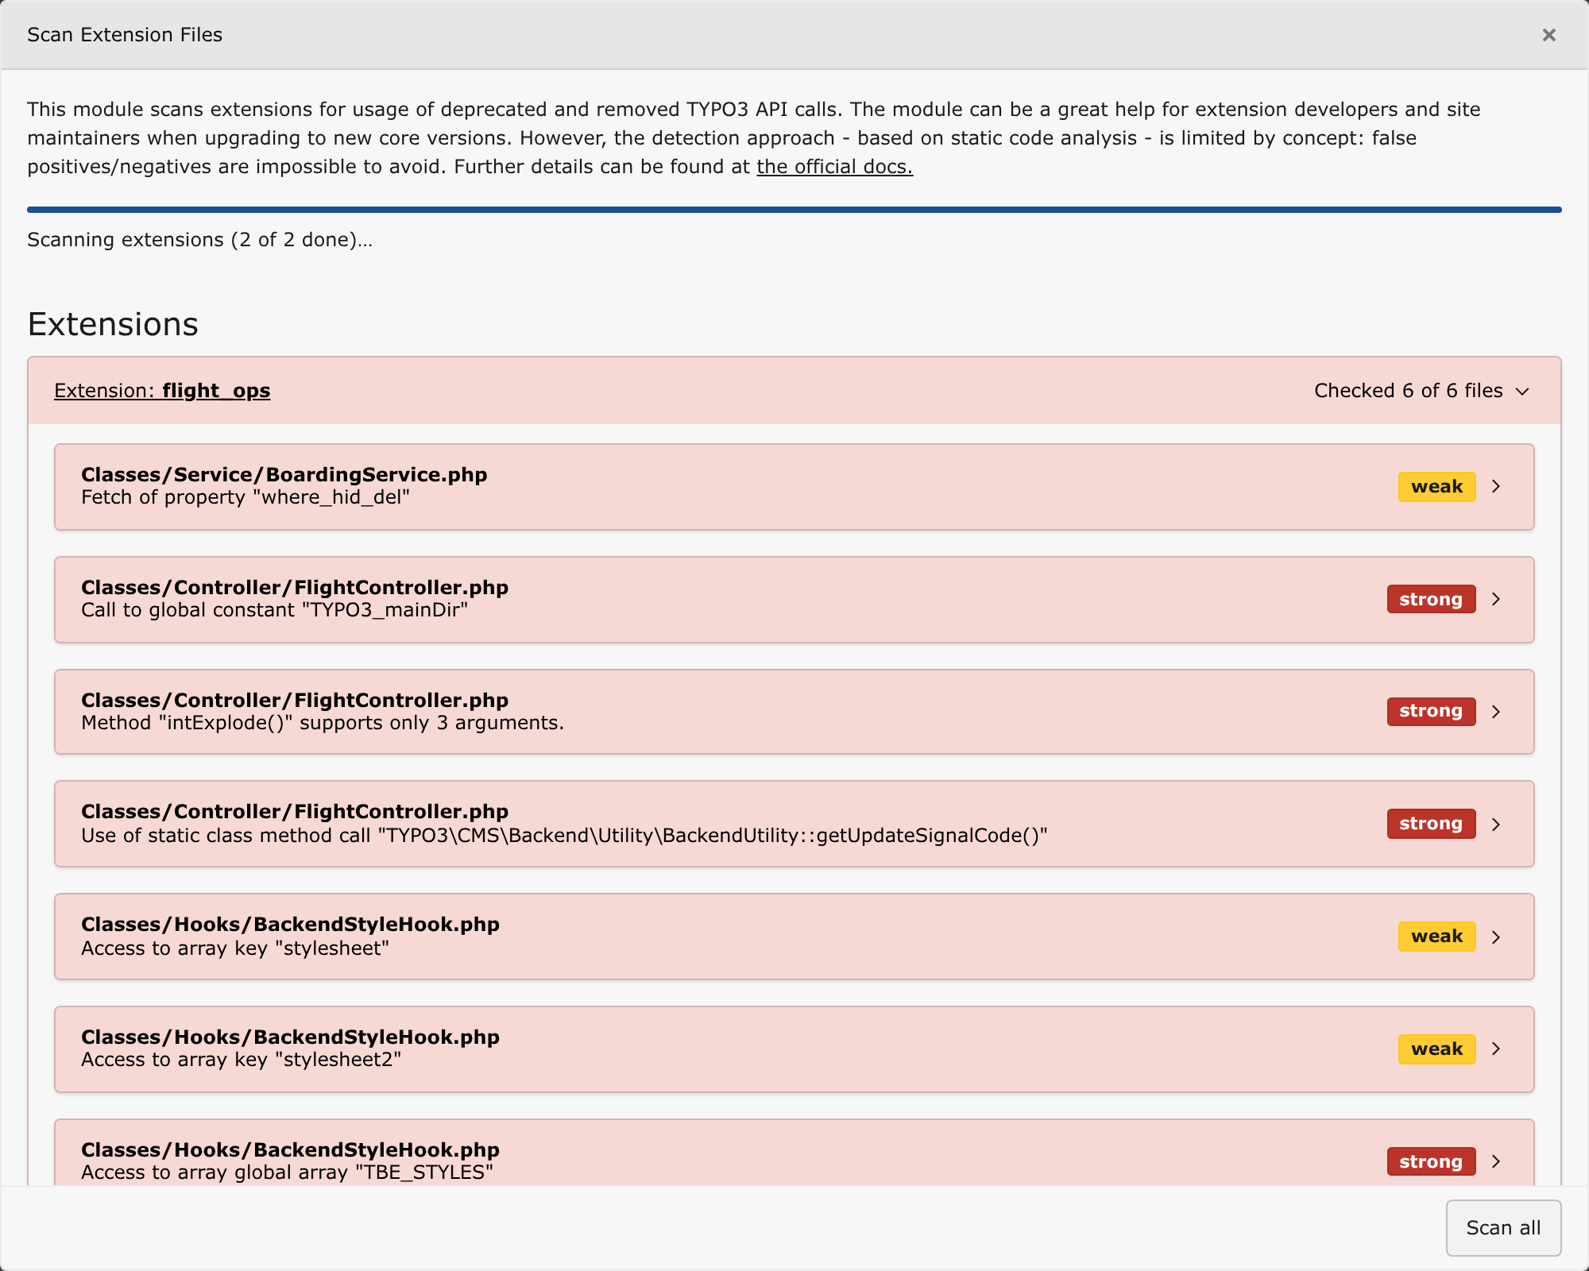
PHASE 2 · TOOLING
Scan again — same tool, new truth
◆ 13 findings before, 11 after — Rector cleared three, and the scanner found one that is new.
◆ New and strong: TypoScriptFrontendController itself, Deprecation #105230, a v13 entry the v12 scanner could not possibly have known.
◆ Same tool, same code, new truth — because the rule set ships with the core.
That new finding is not a phase-2 problem. It is the first line of your phase-3 backlog.
Scan Extension Files — the same extension, now on TYPO3 13.4.34
Fly the Upgrade — Stefan Bürk
69 / 88

Slide 70
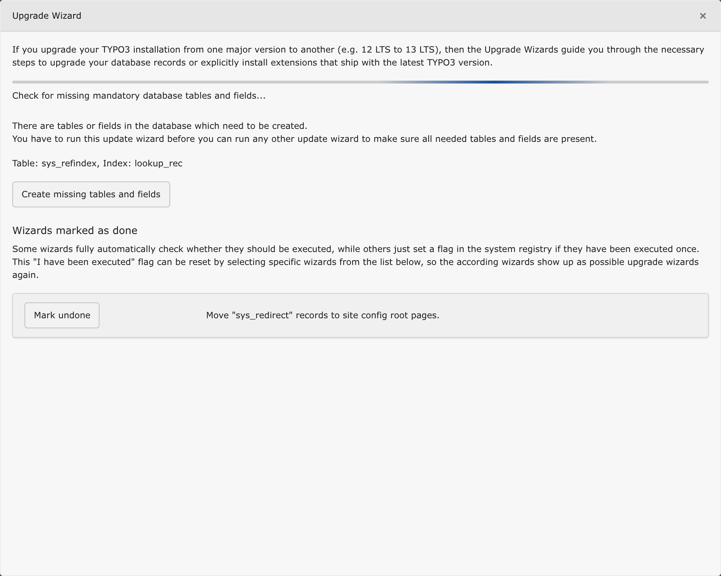
PHASE 2 · TOOLING
Upgrade wizards
◆ Wizards migrate DATA and CONFIGURATION — the part no refactoring tool can touch.
◆ Schema first: missing tables and fields must exist before any wizard may run.
◆ A wizard only appears when it actually has something to migrate — an empty list is an answer.
◆ “Mark undone” resets the flag, so a wizard can be re-run on the next environment.
This is also why you rehearse on a copy of production data. On an empty database every wizard looks finished.
Admin Tools › Upgrade › Upgrade Wizard — TYPO3 13.4.34
Fly the Upgrade — Stefan Bürk
70 / 88

Slide 71
PHASE 2 · TOOLING
Make it repeatable
Anything you do by hand once, you will do wrong the second time
# Schema first: creates and alters, never drops
./vendor/bin/typo3 extension:setup
./vendor/bin/typo3 cache:flush
# What is waiting, and what already ran?
./vendor/bin/typo3 upgrade:list
./vendor/bin/typo3 upgrade:list --all
# Run one, or run them all - scriptable, repeatable, reviewable
./vendor/bin/typo3 upgrade:run pagesRecyclerDoktypeMigration
./vendor/bin/typo3 upgrade:run
◆ The same script runs on your machine, on staging, and in production.
◆ That is how the production run stops being the first run.
◆ database:updateschema is TYPO3 Console, not core. Drops and renames: Analyze Database Structure.
Fly the Upgrade — Stefan Bürk
71 / 88

Slide 72
PHASE 2
When it breaks: Aviate · Navigate · Communicate
STEP 1
STEP 2
STEP 3
Aviate
Navigate
Communicate
Keep the system in a known state. Stop changing things. Do not panic-edit production. The aircraft is still flying.
Find out where you actually are. Which step? What does the log say? Is this in your QRH? Read the actual error, not the summary.
Team, community, Slack, documentation, the changelog. Asking for help early is a procedure, not a confession.
The order matters. People who communicate before they aviate crash while typing.
Fly the Upgrade — Stefan Bürk
72 / 88

Slide 73
PHASE 2
Two kinds of error
You predicted this one
You did not
◆ It is in your QRH with a prepared response
◆ The changelog entry is already open in a tab
◆ You apply the migration and continue
◆ Elapsed time: minutes. Stress: low.
◆ Stay calm — this is normal, not a failure
◆ Re-read the changelogs; you probably skipped one
◆ Check the extension's own upgrade instructions
◆ Ask. Then write it into the QRH for next time.
Preparation does not remove surprises. It shrinks the set of them, and it buys you the calm to handle what is left.
Fly the Upgrade — Stefan Bürk
73 / 88

Slide 74
PHASE 2
The go-around
◆ If the approach is not stable, you go around. Every time. It is not a failure — it is a manoeuvre.
◆ Pilots practise go-arounds. The decision is pre-briefed, so it costs nothing to make.
◆ Your rollback criteria were written in phase 1, when you were calm and nobody was watching.
◆ Execute them without ego. “We are already three hours in” is not a rollback criterion.
The reason to define abort criteria before departure is that you are the worst possible judge of them at 02:00 with a broken site.
Fly the Upgrade — Stefan Bürk
74 / 88

Slide 75
3
THE PHASE EVERYBODY SKIPS
Approach, Landing & Debrief
The flight does not end at touchdown. It ends at the gate, with the paperwork done.
Fly the Upgrade — Stefan Bürk
75 / 88

Slide 76
PHASE 3
Post-Flight checklist
Challenge — Response
FRONTEND
▸ smoke-tested by a human
BACKEND
▸ editors can do their actual daily work
SCHEDULER
▸ tasks registered and running
DEPRECATION LOG
▸ enabled and read
EXTENSION SCAN
▸ re-run — new deprecations recorded
TCA MIGRATIONS
▸ cleared, or in the backlog
FERRY EQUIPMENT
▸ shims and upgrade-only packages removed
CONSTRAINTS
▸ re-pinned to the new reality
DOCUMENTATION
▸ updated while you still remember
DEBRIEF
▸ held — predicted vs actual
NEXT FLIGHT
▸ planned from what you just learned
Fly the Upgrade — Stefan Bürk
76 / 88

Slide 77
Green again is not the end of the work. It is the end of the guessing.
A green pipeline on the new version means every path your tests cover behaves. It says nothing about the paths they do not cover — so the smoke test still happens, by a human, on purpose.
And the honest measurement for next time: which failures did your tests catch, and which did a person find afterwards? That gap is your coverage backlog.
Fly the Upgrade — Stefan Bürk
77 / 88

Slide 78
PHASE 3
Smoke-test the whole aircraft
◆ Frontend: every page type, every plugin, every language, images, forms, search.
◆ Backend: the tasks your editors actually perform — not the ones you find interesting.
◆ The boring infrastructure: mail, redirects, scheduler, indexing, caches, CDN.
◆ Have a person who did not do the upgrade click through it. They see what you cannot.
Your test suite proves the code runs. A human proves the site works.
Fly the Upgrade — Stefan Bürk
78 / 88

Slide 79
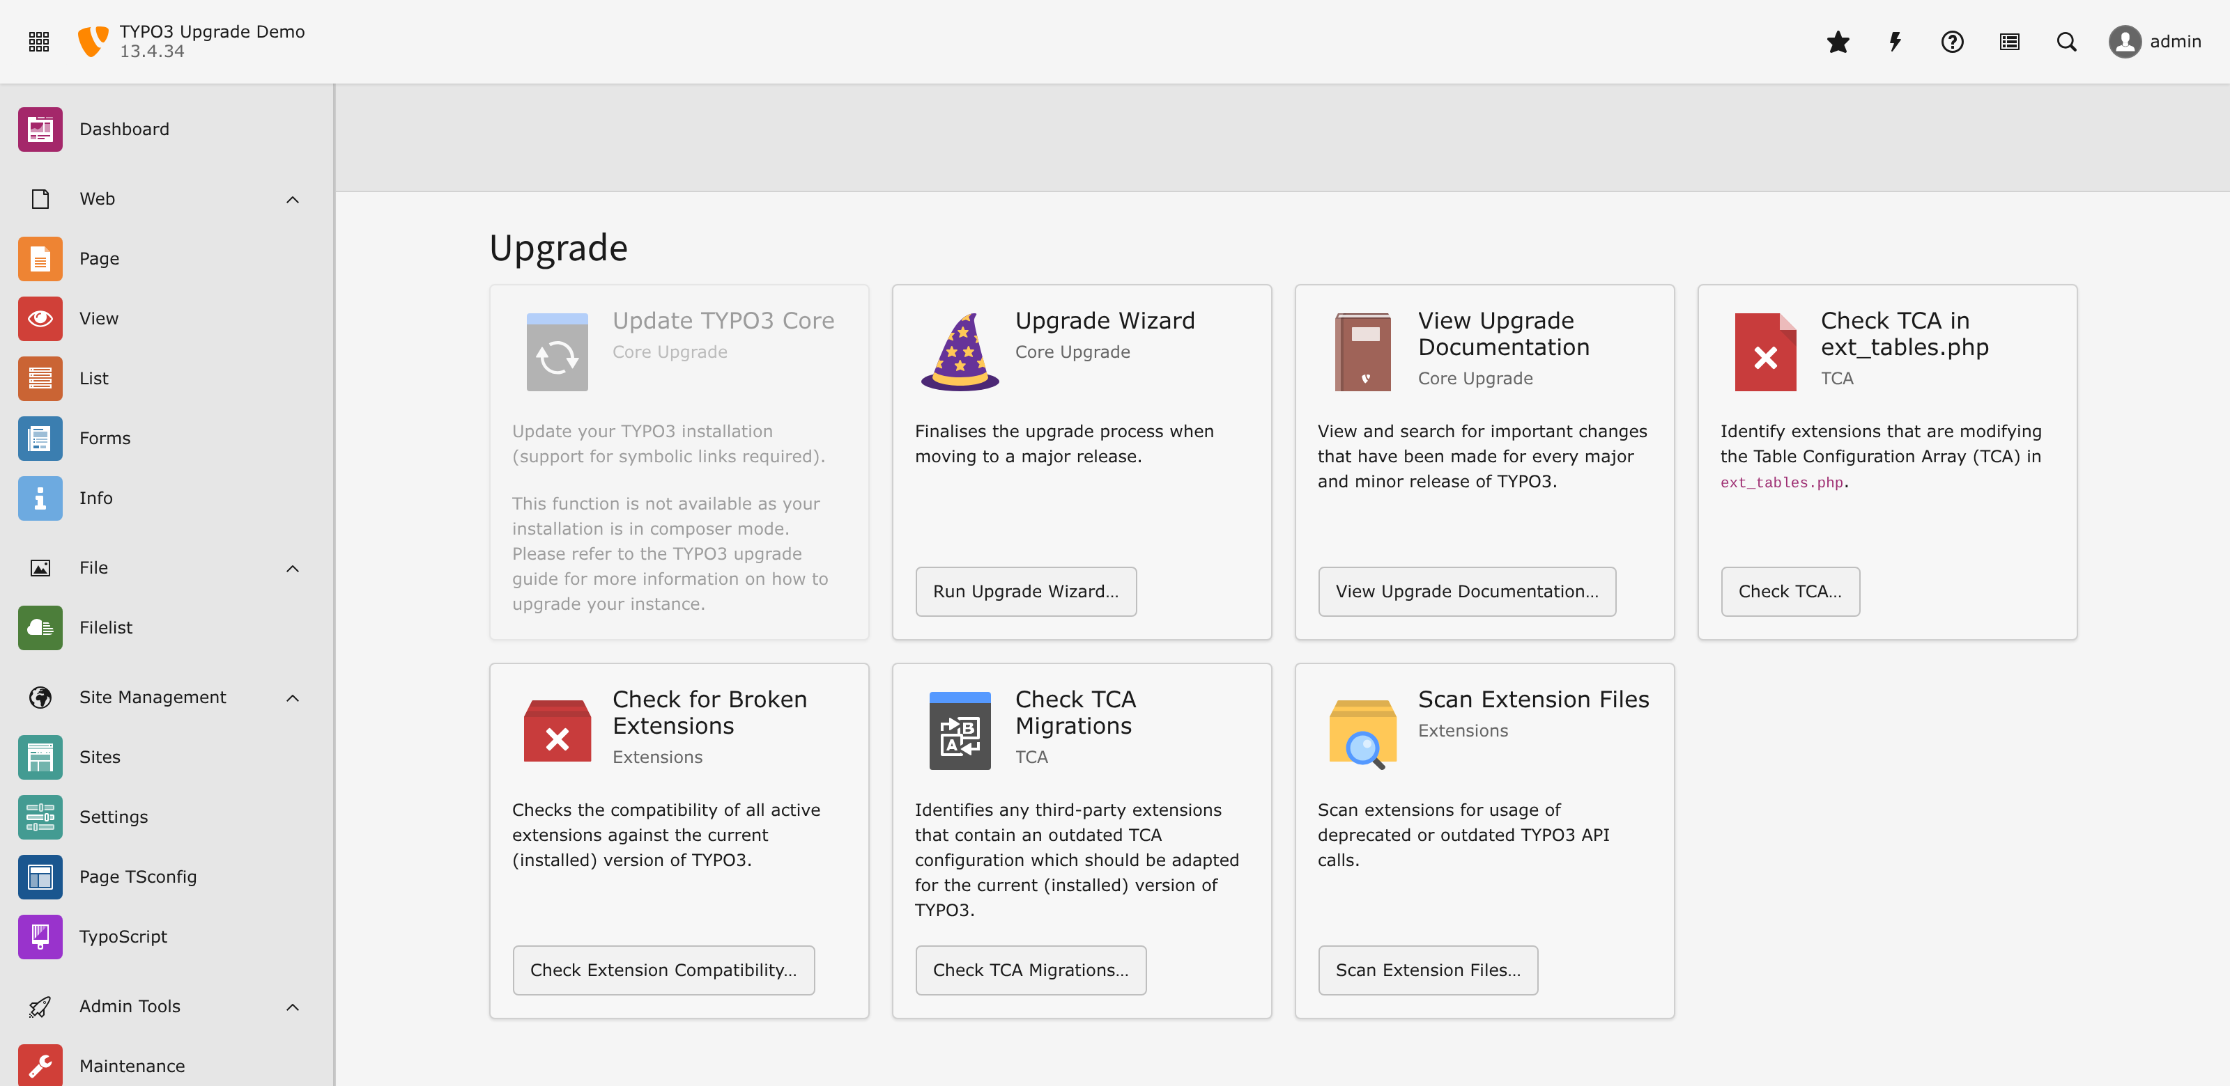
PHASE 3
First look after landing
◆ The version in the header is the only part of the upgrade that was ever guaranteed.
◆ Everything else on this checklist is what makes it true for your editors too.
The same instance, now TYPO3 13.4.34 — the demo for this talk, upgraded live
Fly the Upgrade — Stefan Bürk
79 / 88

Slide 80
PHASE 3 · TOOLING
TCA after landing
New migrations arrived
Old migrations left
◆ The new core added migrations your old core never had
◆ Run Check TCA Migrations again — the list is not the one you cleared
◆ Every new entry is a fresh deprecation you just inherited
◆ A migration you were silently relying on may be gone
◆ Then it is not a deprecation any more — the config is simply ignored
◆ Nothing errors. The field just renders wrong, or not at all
This is the half that bites without a stack trace: the autopilot was removed, and the aircraft is quietly out of trim. Only the checklist catches it.
Fly the Upgrade — Stefan Bürk
80 / 88

Slide 81
PHASE 3 · TOOLING
The deprecation log is your tech log
Pilots write up every defect after the flight, even the small ones
# config/system/additional.php - switch it on, then actually read it
$GLOBALS['TYPO3_CONF_VARS']['LOG']['TYPO3']['CMS']['deprecations']['writerConfiguration'] = [
\Psr\Log\LogLevel::NOTICE => [
\TYPO3\CMS\Core\Log\Writer\FileWriter::class => [
'disabled' => false,
],
],
];
# then, after a day of real traffic and real editing:
tail -f var/log/typo3_deprecations_*.log
◆ Static analysis reads code paths. The deprecation log reports the ones actually taken.
◆ It catches the dynamic calls the Extension Scanner structurally cannot see.
◆ Let it run under real editor traffic for a few days. That is where the rest hides.
Fly the Upgrade — Stefan Bürk
81 / 88

Slide 82
Scan again. You are not finished — you are at the start of the next one.
The version you just landed on deprecates things too. That list is not a leftover. It is the flight plan for the next upgrade, handed to you for free.
Run it now, while the context is still in your head, and put the findings in the backlog with the changelog links attached.
Fly the Upgrade — Stefan Bürk
82 / 88

Slide 83
PHASE 3
Remove the ferry equipment
◆ Compatibility shims and polyfills you added “just for the migration”.
◆ Upgrade-only dev packages — or move them into an isolated tools/ install.
◆ The @todo v13 comments you actually resolved. Delete them; do not let them rot.
◆ Version constraints still pointing at the old world in your own extensions.
An aircraft flies home with the ferry tank still fitted exactly once. After that it is just weight you pay for on every leg.
Fly the Upgrade — Stefan Bürk
83 / 88

Slide 84
PHASE 3
The debrief
◆ What did we predict correctly? Keep it in the checklist — it earned its place.
◆ What surprised us? That is a new QRH entry, written now, not “soon”.
◆ What took longest? That is where next time's preparation goes.
◆ What did we not need? Delete it. Checklists that grow forever stop being read.
Aviation improves because every incident is written down and shared, not because the next crew is more careful.
Fly the Upgrade — Stefan Bürk
84 / 88

Slide 85
PHASE 3
It is a cycle, not a project
Post-Flight
Pre-Flight
Flight
New deprecations recorded, debrief written
→
…which IS the preparation for the next version
→
…which is shorter, because you started early
↻
Teams for whom upgrades are painless are not luckier. They never left phase 3.
Fly the Upgrade — Stefan Bürk
85 / 88

Slide 86
DEBRIEF
Takeaways
1
Expect work
2
Expect errors — and prepare for them
An upgrade is a project with phases, not a ticket with an estimate.
You cannot prevent all of them. You can decide in advance how you will react.
3
Read the changelogs
4
Check deprecations in all three phases
They are your NOTAMs, and every entry already contains its own migration.
Today's deprecation is tomorrow's breaking change. Always.
5
Layer your tools
6
Write it down and share it
Scanner, Rector, Fractor, the TCA migration check, tests, the deprecation log. Every one has a blind spot the next one covers.
A plan in one person's head is not a plan. It is a single point of failure.
7
Stay calm
Aviate, navigate, communicate — in that order.
Fly the Upgrade — Stefan Bürk
86 / 88

Slide 87
DEBRIEF
Resources
CHANGELOGS
TOOLS
TYPO3 Core Changelog
Extension Scanner
docs.typo3.org/c/typo3/cms-core/main/en-us/Index.html
Admin Tools › Upgrade › Scan Extension Files
Shipped with your core
netresearch/extension-scanner-cli
vendor/typo3/cms-core/Documentation/Changelog/
github.com/netresearch/t3x-nr-extension-scanner-cli
Version support & ELTS
ssch/typo3-rector
get.typo3.org — and the ELTS pages on typo3.com
github.com/sabbelasichon/typo3-rector
a9f/typo3-fractor
github.com/andreaswolf/fractor
typo3/testing-framework
github.com/TYPO3/testing-framework
This talk's hands-on workshop
flight_ops on 12.4, labs for all three phases
Check TCA Migrations / Check TCA in ext_tables.php
Admin Tools › Upgrade — no CLI equivalent
Configuration › TCA backend module
EXT:lowlevel — shows the migrated values
Fly the Upgrade — Stefan Bürk
87 / 88

Slide 88
Thank you
Questions, war stories, and disagreements welcome.
Stefan Bürk stefan@buerk.tech · TYPO3 Core Team — Framework Maintainer
Fly the Upgrade — Stefan Bürk
88 / 88

