Slide 1
CHI411
Amna Irfan, Syed Bukhari, Geraldine Torres, Asma Rashid

Slide 2
Tasks
Data Discovery
Sources: Cook County Data Catalog, CMAP, SpotCrime, Illinois Data Portal
Data Extraction
Used BeautifulSoup4 to scrape yelp and get relevant author, restaurant, and review csvs
Manual Reference Datasets
Parse and clean Restaurants csv file to get relevant restaurants and join with Yelp, Business Licenses, Demographics datasets, etc. to produce manual references
Data Integration
Visualization
Used Plot.ly in Python and JS as well as ChartJS and Dash libraries to produce charts

Slide 3
Technologies Used
Python
Libraries: CSV, BeautifulSoup4, TextBlob, NLTK, Plot.ly
Javascript
Libraries: jQuery, ChartJS, Dash, Plotly.js
SQL (Athena)
Athena, AWS, S3

Slide 4
Query 1 : Crime Reports For Grocery Stores, Restaurants and Schools
Goal:
Report the type of crimes committed within 3 blocks of the following business types.
Schools
Grocery Stores
Restaurants
Datasets:
Crimes (Present to 2001) from Chicago City Portal
Yelp Data
Business Licenses from Chicago City Portal

Slide 5
Query 1 : Crime Reports For Grocery Stores, Restaurants and Schools
What Questions can this data answer?:
How many crimes were committed for a particular business?
What is the trend of the crime?
Crime distribution for some business type.
What type of business owner should I be?
Evaluate policies - Did a particular type of crime decrease after the policy went into effect?
And MANY MORE..

Slide 6
Query 4 : Food Inspection and Review Ratings
Goal:
Find out if there is a negative/positive correlation between the average yelp ratings of a restaurant and the number of times it fails/passes/conditionally passes a food inspection.
Datasets:
Food Inspections from Chicago City Portal
Yelp Data

Slide 7
Query 4 : Food Inspection and Review Ratings
What Questions can this data answer?:
How accurate are the yelp ratings?
As yelp ratings for restaurant increase, do they have more successful inspections than failed?
Result:
We found no such correlation between the number of passed inspections and yelp ratings as most of them fell between 3 and 4. However, the ones that were 1 and 5, did show some correlation but we don’t have enough data to form any correlation hypothesis.

Slide 8
Query 8 : Viability of a Business
What Questions can this data answer?:
How long is a business active after failing a food inspection?
Is there a certain number of months/years that most businesses go out of business after failing the inspection?
Result:
We found that most businesses went out of business between 6 months - 3 years after failing an inspection. There were some that lasted between 4 - 5 years. There was really no correlation between location or type of business (restaurant, grocery store, etc.) and the amount of time they stayed active.

Slide 9
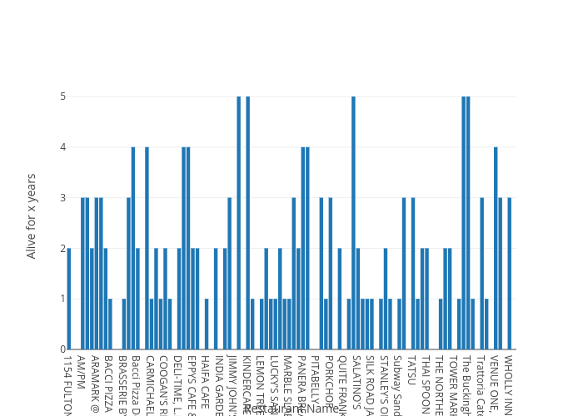

Slide 10
Query 9 : Crimes and Businesses with Liquor License for a block
Goal:
Find out if there is a positive correlation between the number of crimes committed in blocks that have more businesses with a liquor license.
Datasets:
Crimes (Present to 2001) from Chicago City Portal
Yelp Data
Business Licenses from Chicago City Portal

Slide 11
Query 9 : Crimes and Businesses with Liquor License for a block
What Questions can this data answer?:
Would it be useful to cancel liquor licenses to decrease crime rate?
If this is true, should we open a business near restaurants that have a liquor license?
Result:
We found no such correlation. We had a few blocks that had more than 50 businesses with a liquor license and their crime rate was the same as the blocks with less businesses licensed to sell liquor.

Slide 12
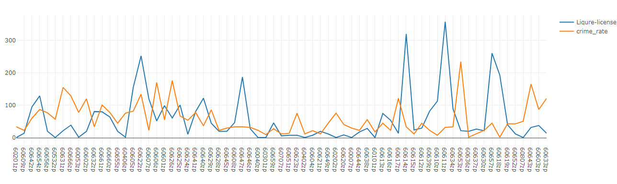
Supervised learning for Crime Prediction
•Generated a training model from multiple datasets
•Dataset consist of various databases e.t Crime statistic, business License, demographic (CityofChicago & Data.gov)
•Trained the Data on spatial features (consider classified attributes e.t Zip-code, Census Block )
•Couple extracted & parsed data, removed redundancy from dataset to built consistency
•Plot prediction illustrate no such correlation between neighborhood with Liquor Licenses and criminal activity to occur

Slide 13
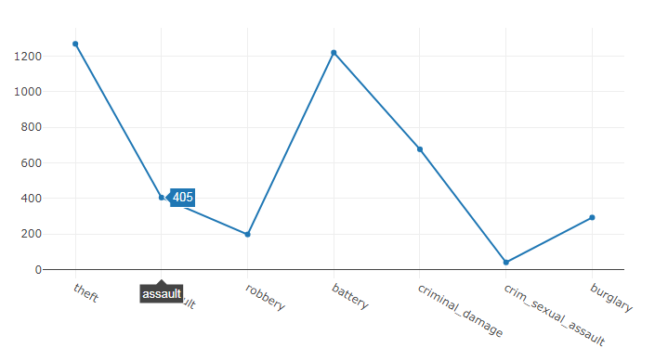
Crime Statistic: Crime-Type Rate/Year
Different Crime-Type Activities e.t (Theft, Robbery, Criminal Damage, Sexual Assault, Robbery) rate over the years in given Census Block
Crime Analysis represents inconsistency in yearly based reports, No such pattern observed

Slide 14
Query 5: Sentiment vs Rating for all reviews
Goal
Approach
For each restaurant, perform a sentiment analysis of its reviews. Produce a dataset with Restaurant Name, Sentiment Labels, and Review Rating for every analyzed review
Use Python’s TextBlob Library
Performs Naïve Bayes analysis on text
Produce Polarity and Subjectivity metrics of a sentiment
Use polarity to determine whether a sentiment is positive or negative
([-1.0,1.0], [0.0,1.0])

Slide 15
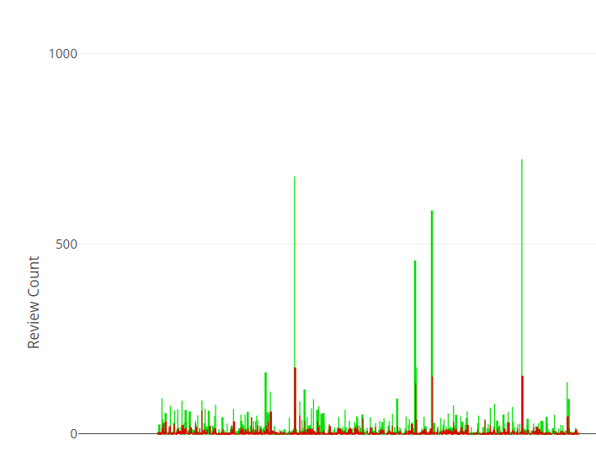
Query 5 (cont)
Ended up not using a bar graph as it was hard to read data

Slide 16
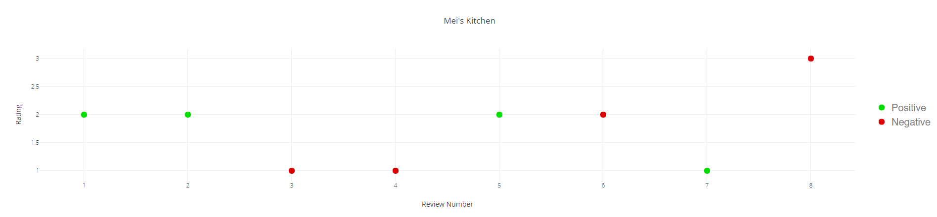
Query 5 (cont)

Slide 17
Query 6: Most Common Sentiment vs Average Rating for all restaurants
Goal
Approach
Identify how the sentiments relate to the review rating by plotting average ratings against most frequent overall sentiments.
Restaurant Name, Sentiment labels, Average Review Rating
Use dataset produced by Query 5
Map Restaurants to the counts of their sentiments and their average review ratings

Slide 18
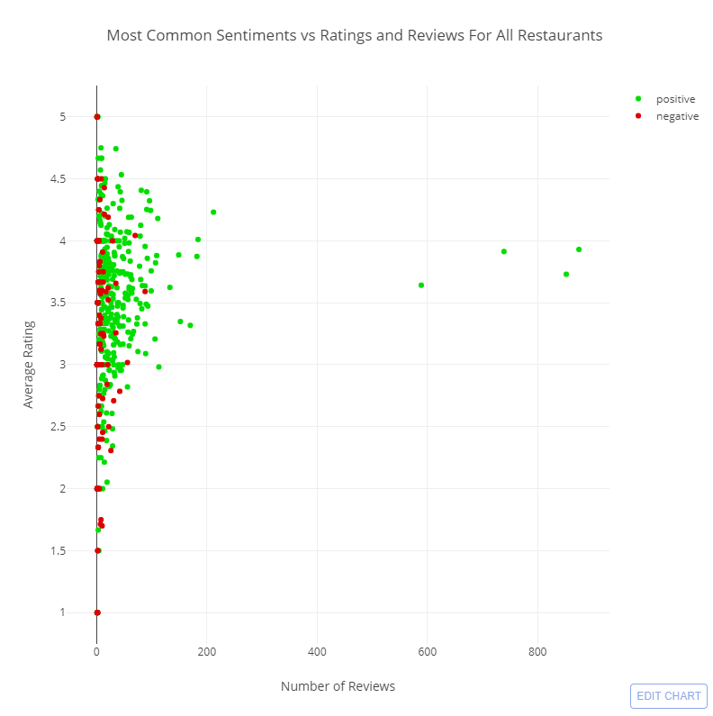
Query 6 (cont)

