Slide 1

DraftKings Weekly Drafts
Nic Brownrigg, Sean Bull, Alex Guenther, Taryn Syler, and Jabari Tucker
DU Data Analytics Boot Camp

Slide 2

The topic
Notes:
Selected topic: DraftKings Database
Reason topic was selected: general interest, practical to a large group of people (sports fans and fantasy drafts fans), fits needs of project and solving a problem, lots of data available
Image Source: https://milehighsports.com/understanding-prop-dd-qa-with-stanton-dodge-of-draft-kings/

Slide 3
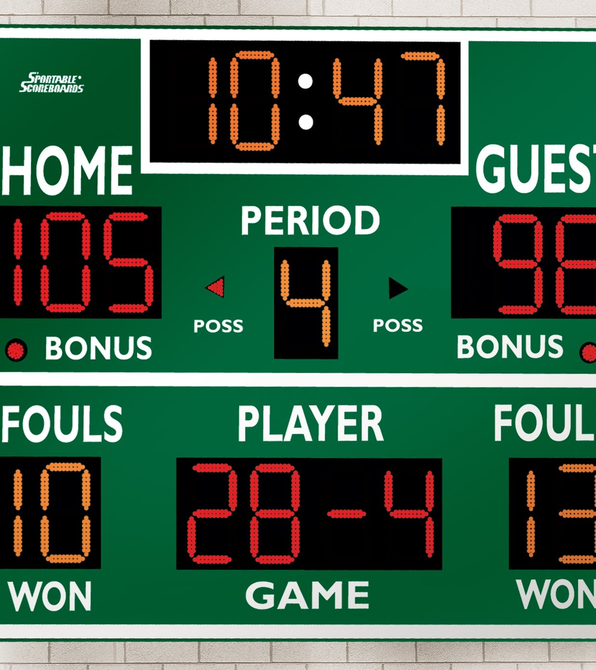
Data Source
Ideal Picks
Sportsipy
www.sports-reference.com
Notes:
Description of Source of Data: Data comes from sports-reference.com through a python API called sportsipy. Information about this API is available through GitHub. We will use this API to pull desired data and use to create ideal draft picks weekly.
Image source: https://www.gophersport.com/supplies/scoring/basketballvolleyballwrestling-15led-display-scoreboard

Slide 4
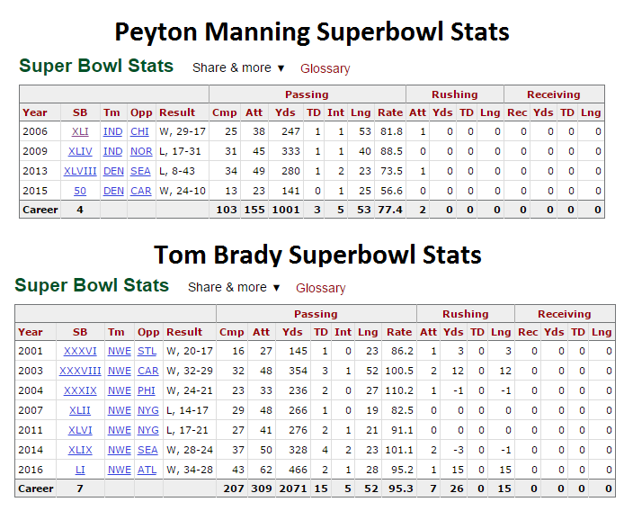
Placeholder
Notes:
Questions we hope to answer: Is it possible to create the ideal draft each week with the click of a button? No one wants to pore over statistics, large data sets, and various websites or go by blind luck trying to find the best draft for the week then do it all over again the next week. We want to make it possible to easily search all of that data and find the optimal team broken down by role. For example, a quarterback’s stats would pull from touchdowns and passing attempts.
Image source: https://www.reddit.com/r/Patriots/comments/6cxjlh/tom_brady_vs_peyton_manning_superbowl_stats/

Slide 5
Data exploration
Data of Interest: Week, Player, Position (NFL)
DraftKings
Issues-Web Scraping
Notes:
Description of the data exploration phase of the project: (Jabari) Data was divided into week, player, position. Machine learning used to predict player performance, allowing us to construct ideal draft picks. Data obtained from (DraftKings) and (Sportsipy). When obtaining data, issues came across with sportsipy and web scraping had to be involved to get appropriate info.

Slide 6
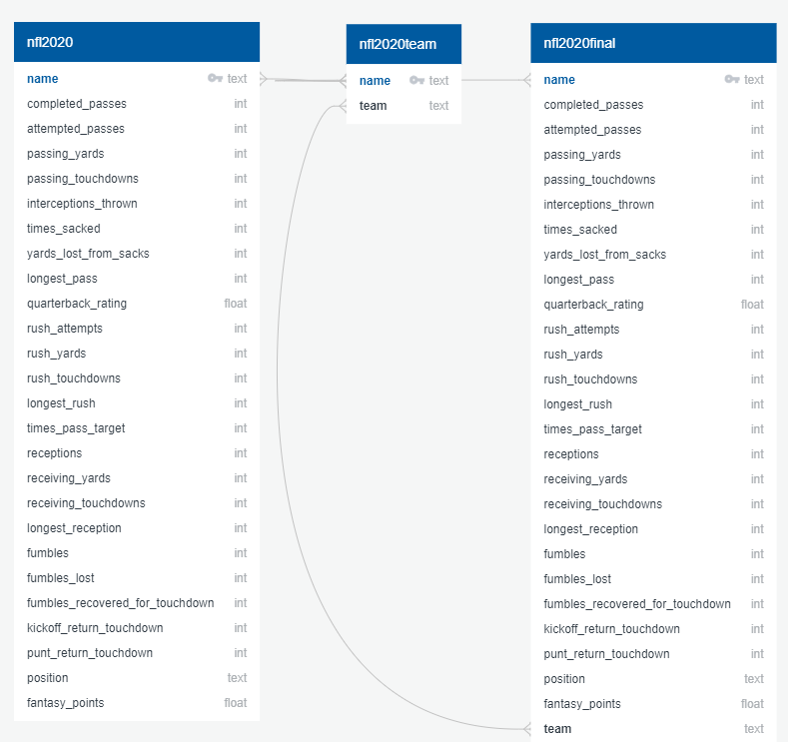
Notes:
Data exploration visual

Slide 7
Analysis phase
Multiple Linear Regression Model
Machine-Last Year’s Stats
Test effectiveness
Notes:
Description of the analysis phase of the project: (Sean) Use a multiple linear regression model to analyze data. Ideally, machine will analyze last year’s results to predict this year’s results in order to create ideal draft. However, for the purpose of the project we will test how well the machine makes a lineup for last year based on last year’s stats.

Slide 8
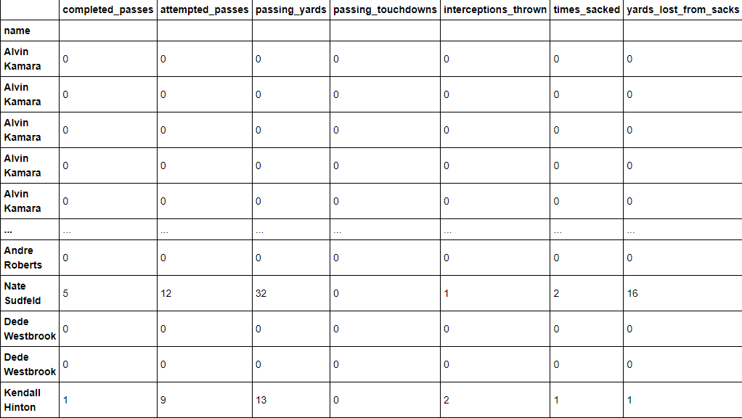
Placeholder for analysis
*Does this work for analysis? There is more data but it doesn’t fit
Notes:
Result of analysis:

Slide 9
Technologies, languages, tools
sportsipy
Website for web scraping
Web scraping tool
Websites for NFL data
DraftKings
Languages--
Notes:
Technologies, languages, tools, and algorithms used throughout the project:

Slide 10
Web app
Notes:
Web app: (Nic)

Slide 11
Recommendation for future analysis
Notes:
Recommendation for future analysis:

Slide 12
Done differently
Notes:
Anything the team would have done differently:

