Slide 1

DraftKings Weekly Drafts
Nic Brownrigg, Sean Bull, Alex Guenther, Taryn Syler, and Jabari Tucker
DU Data Analytics Boot Camp

Slide 2

Taryn-Intro

Slide 3

The topic
Notes:
Selected topic: DraftKings Database
Reason topic was selected: general interest, practical to a large group of people (sports fans and fantasy drafts fans), fits needs of project and solving a problem, lots of data available
Questions we hope to answer: Is it possible to create the ideal draft each week with the click of a button? No one wants to pore over statistics, large data sets, and various websites or go by blind luck trying to find the best draft for the week then do it all over again the next week. We want to make it possible to easily search all of that data and find the optimal team broken down by role. For example, a quarterback’s stats would pull from touchdowns and passing attempts.
Image Source: https://milehighsports.com/understanding-prop-dd-qa-with-stanton-dodge-of-draft-kings/

Slide 4
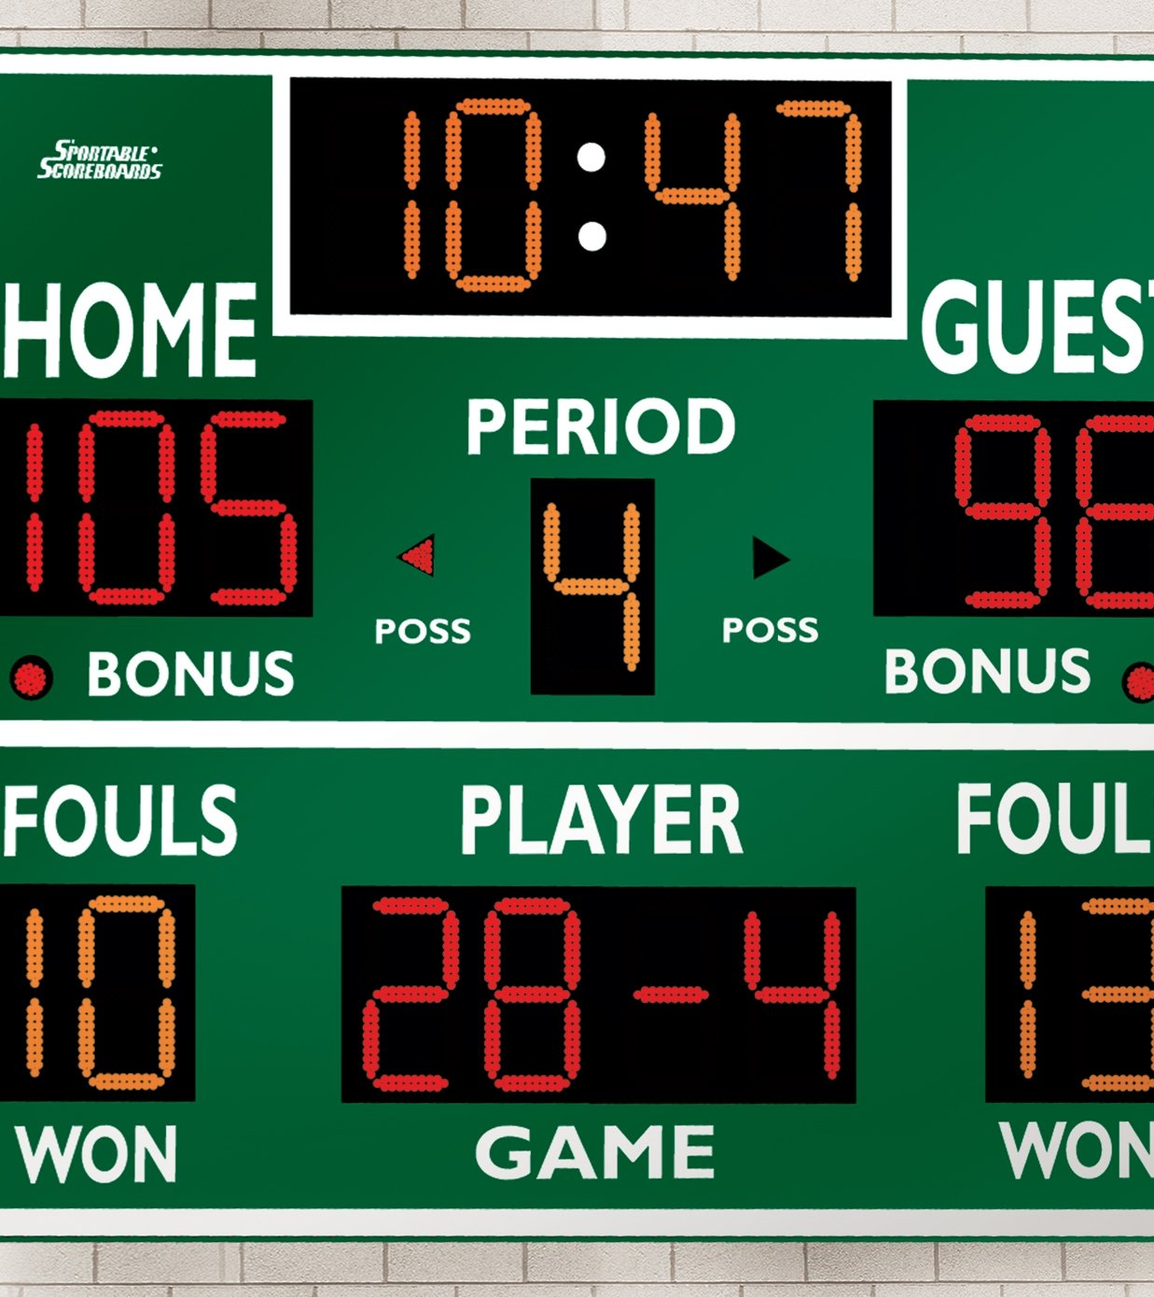
Data Source
Ideal Picks
Sportsipy
www.sports-reference.com
Notes:
Description of Source of Data: Data comes from sports-reference.com through a python API called sportsipy. Information about this API is available through GitHub. We will use this API to pull desired data and use to create ideal draft picks weekly.
Image source: https://www.gophersport.com/supplies/scoring/basketballvolleyballwrestling-15led-display-scoreboard

Slide 5

Jabari-Data exploration

Slide 6
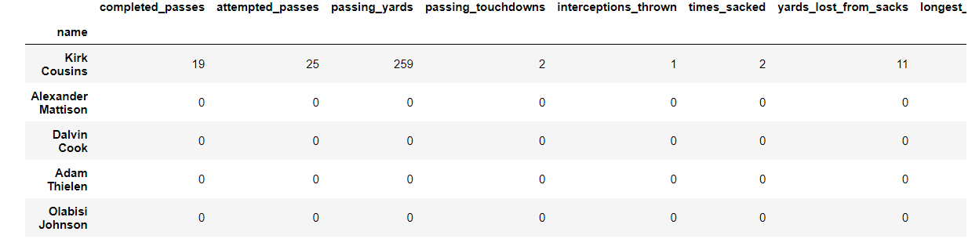
Data exploration
Utilized Sportsipy, a free python API, that pulls stats from www.sports-reference.com
Performed list comprehensions to iterate through box scores of every NFL game during the 2020 season
Appended box scores and created dataframe with features to be used in the machine learning model
Notes:
Description of the data exploration phase of the project: (Jabari) Data was divided into week, player, position. Machine learning used to predict player performance, allowing us to construct ideal draft picks. Data obtained from (DraftKings) and (Sportsipy). When obtaining data, issues came across with sportsipy and web scraping had to be involved to get appropriate info.

Slide 7
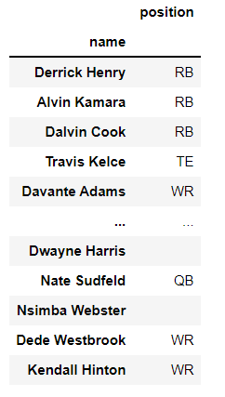
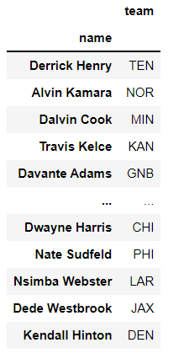
Data exploration
Due to the API being outdated, needed to web scrape player position and team from www.sports-reference.com directly
Appended player position to the dataframe in order to filter out defensive players
Calculated fantasy points (target variable) accrued, for each player each week in the 2020 season, and appended to the dataframe
Created ERD and imported box score dataframe and team dataframe into Postgresql. Performed a join between the two tables
Notes:
Description of the data exploration phase of the project: (Jabari) Data was divided into week, player, position. Machine learning used to predict player performance, allowing us to construct ideal draft picks. Data obtained from (DraftKings) and (Sportsipy). When obtaining data, issues came across with sportsipy and web scraping had to be involved to get appropriate info.

Slide 8

Sean-Analysis

Slide 9
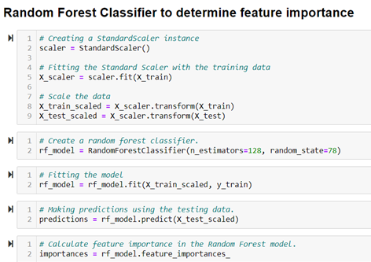
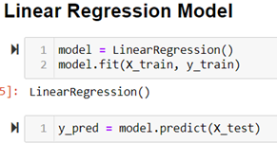
Model Selection
Multiple Linear Regression
Random Forest Classifier

Slide 10
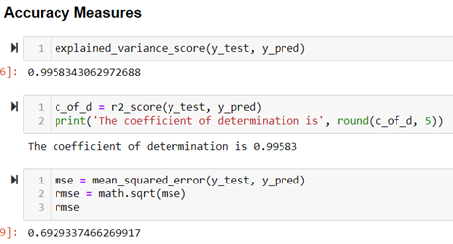
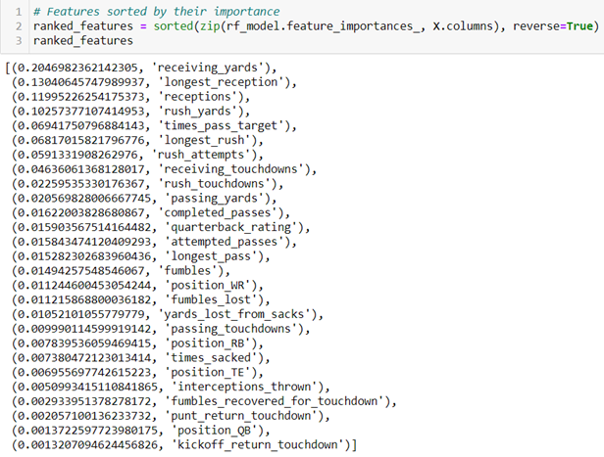
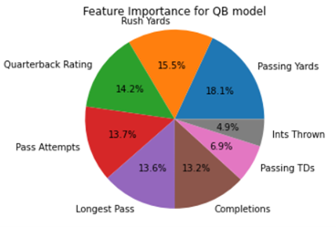
Model Results
Linear Regression
Random Forest Classifier
Ranked Features by Position

Slide 11
Model Limitations
Limited to accuracy scores for linear regression models (predicted points vs actual points)
Random forest classifier only helps to discern which past statistics actually assisted in predicting our model
Chose model features based on statistics which result in fantasy points and other basic stats we believed could be relevant
QB model was by far the most inaccurate of our positional models, showing that our model had much better success at predicting fantasy points accumulated for RBs, WRs, and TEs

Slide 12
Name | Completed_Passes | Passing_Yards | Interceptions_Thrown | Longest_Pass | Rush_Yards | Longest_Rush | Receptions | Receiving_Yards | Longest_Reception | Position | Fantasy_Points
Kirk Cousins | 19 | 259 | 1 | 37 | 34 | 16 | 0 | 0 | 0 | QB | 20.76
Alexander Mattison | 0 | 0 | 0 | 0 | 50 | 21 | 4 | 30 | 9 | RB | 12
Dalvin Cook | 0 | 0 | 0 | 0 | 50 | 12 | 1 | -2 | -2 | RB | 17.8
Adam Thielen | 0 | 0 | 0 | 0 | 0 | 0 | 6 | 110 | 37 | WR | 32
Olabisi Johnson | 0 | 0 | 0 | 0 | 0 | 0 | 3 | 56 | 29 | WR | 8.6
Kyle Rudolph | 0 | 0 | 0 | 0 | 0 | 0 | 2 | 28 | 22 | TE | 4.8
Justin Jefferson | 0 | 0 | 0 | 0 | 0 | 0 | 2 | 26 | 17 | WR | 4.6
Irv Smith Jr. | 0 | 0 | 0 | 0 | 0 | 0 | 1 | 11 | 11 | TE | 2.1
Mike Boone | 0 | 0 | 0 | 0 | 0 | 0 | 0 | 0 | 0 | RB | 0

Slide 13
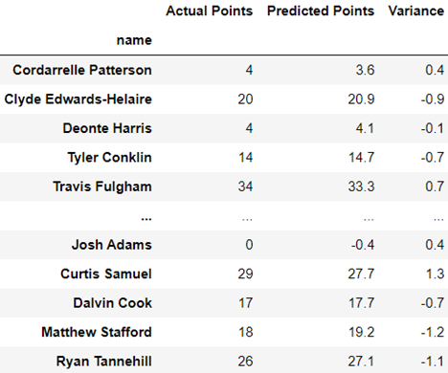
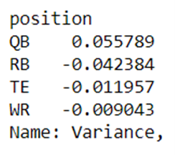
Stats

Slide 14

Nic-Web App

Slide 15
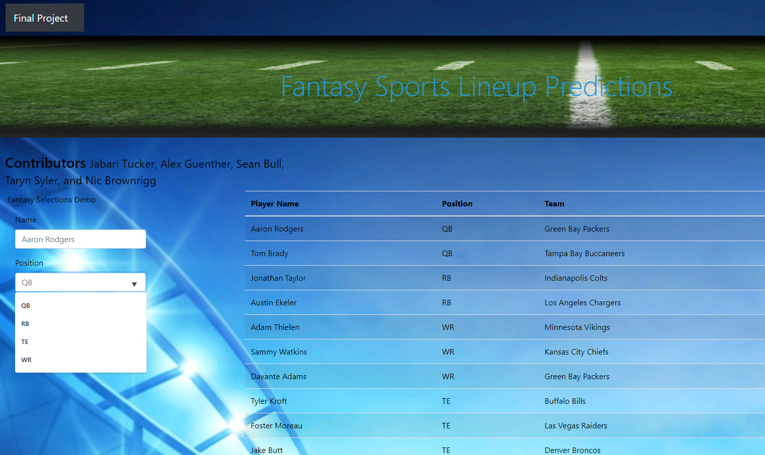
Web App
Original Premise:
Python Based App
Live Reference to SQL Database
Gauge Chart for Selection Viability
App Demo:
HTML Filterable Table
JavaScript Based App with Data.js Table
Utilizes similar interactivity as Original
Displays filterable info referenced from our API pull, not a live feed.
Table is a snapshot from one week

Slide 16

Alex-Conclusion

Slide 17
Conclusion
ETL (Extract, Transform, Load) Process
Data transformation
Data extraction from Sportsipy python API
Web Scraped directly from Sports reference for player positions and Teams
Calculated Fantasy points for each player per week for 2020 season.
Data Loading
Imported box score dataframe and Team dataframe and preformed a join between the two tables.
Machine learning model
We chose a multiple linear regression model due to the abundance of statistics available for training our model and the fact that we are attempting to predict a continuous variable (stats/fantasy points). In addition to the linear regression model we also ran a random forest classifier (logistic regression model) on the entire dataframe as well as for each of the different positions in order to determine which features used carried the most weight on the models predictions.
Trained our model on fantasy football points scored last year to try and predict 2021 fantasy points.
Web App
Created a simple web app using an index file that referenced simple JavaScript based data options showing data that we pulled from our API and predicted values.
The index utilizes three drop downs that allows you pick player name. position, and their team and show you predicted fantasy points

Slide 18
Future Analysis and Things we would have done differently
Update with easier to read visualizations to help view the data easier.
More in depth analysis in regards specific to positions.
Sportsipy API hadn't been updated so we had to web scrap some of the information.
Better methods for utilizing tools like SQLAlchemy to connect to our SQL to parse through live data.
Try to have the model predict future fantasy scores.
Work on getting a live reference from SQL Database.
For more accurate data it would have been better if we scraped from Sports Reference directly instead of the API.
Find more fixes to errors regarding security verification failures.

Slide 19
Recommendation for future analysis
Instead of using API, web scrape directly from sports-reference website
Better feature selection
Predict future performance
Streamline connection between SQL and Web App
Notes:
Recommendation for future analysis:

Slide 20

Questions?

